Slide 1
Using Smart Contracts for Digital Services:
A Feasibility Study based on Service Level Agreements
Stephan Zumkeller, 20th August 2018, Scientific advisors: Ulrich Gallersdörfer & Elena Scepankova

Slide 2
Outline
1 | Master’s Thesis in a nutshell
2 | Motivation and Research Questions
3 | Approach and Results
4 | Conclusion and Outlook

Slide 3
Using Smart Contracts for Digital Services:
A Feasibility Study based on Service Level Agreements
Initial position
  Smart contracts are on a quest for application
Guiding question
  Are service level agreements (SLA) of digital services
  a suitable application domain for smart contracts?
Research method
  Design Science Research
Key findings
  Smart contracts enable digitally executable SLAs
  Artifact is technically viable
  Impeded by user skepticism
  Blockchain technology requires improvements
1
2
3
4

Slide 4
The motivation of this thesis is to enrich smart contract’s scope of application
Blockchain technology was initially created to enable cryptocurrencies
Evolution with the introduction of smart contracts
Low adaption of the technology for practical applications despite its potential
SLAs of digital services appear as a possible application domain for smart contracts
Are SLA of digital services a suitable
application domain for smart contracts?
1
2
3
4
Notes:
SLAs could fit the potential of smart contracts to codify the legal agreement
Digital domain: possible good fit for blockchain as information on digital services is already digital
Blockchain has the potential to serve as an infrastructure for cross-organizational workflow management. [1] Fridgen 2018
[Smart Contracts] improve the efficiency, speed and performance of contracts. [10] Farrel 2016

Slide 5

We derived four research questions from our guiding question
RQ1:
How can smart contracts support SLAs of digital services?
RQ2:
How can required information about service performance be made available to smart contracts?
RQ3:
What are approaches for the design and development of a blockchain-based application which supports SLAs of digital services?
RQ4:
How feasible is the prototypical application for supporting SLA of digital services?
1
2
3
4

Slide 6
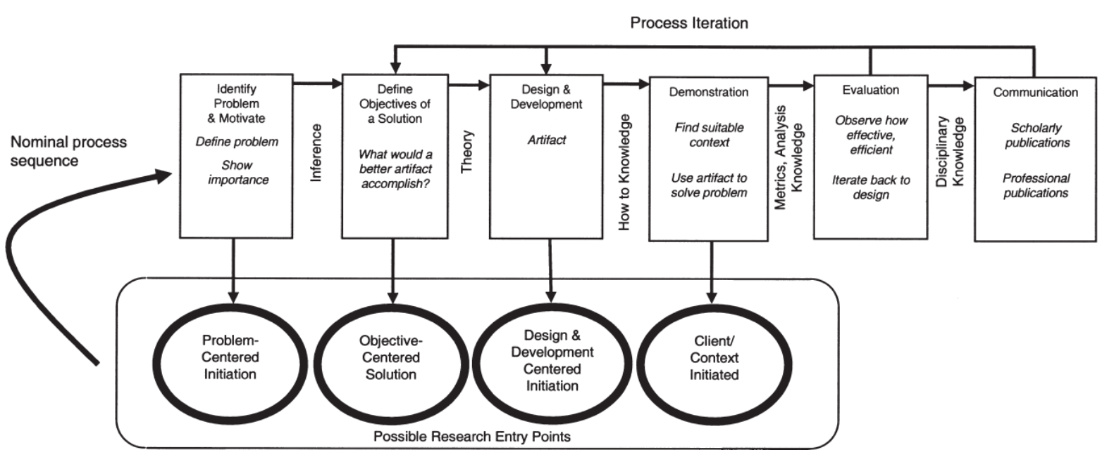
We generate problem domain-specific knowledge by employing design science research
3 iterations
RQ1
RQ1
RQ2/3
RQ2/3
RQ4
Peffers et al. (2007)
1
2
3
4

Slide 7
SLAs of digital services are costly, ineffective and lack support for modern technologies
Fulfillment of obligations depends on the good will of service partners
Enforcement of rights is not guaranteed
  Litigation might be unprofitable due to administrative efforts and legal costs
Missing features for cloud computing and the Internet of Things
Smart contracts provide new prospects of enforced fulfillment of programmed obligations and contractual interfaces to machines
1
2
3
4
Notes:
Enforcement of rights is not guaranteed
Performance data is not available -> therefore not possible to check if right exits
Legal process is too costly compared to its benefit (requires understanding of SLA, lawyers, litigation or arbitration process)
Missing features for technical innovation
SLA processes are too manual -> too high effort for dynamics of cloud computing
Effort for SLA processes growths with service growth -> impedes scalability
IoT / M2M lack capability to enter into service contracts with guaranteed, automated SLA
Potential of Smart Contracts:
Blockchain has the potential to serve as an infrastructure for cross-organizational workflow management. [1] Fridgen 2018
[Smart Contracts] improve the efficiency, speed and performance of contracts. [10] Farrel 2016

Slide 8
Our solution supports SLAs with enforced fulfillment of obligations, increased process efficiency, and enabling of technical innovation
Smart contracts represent SLAs and contain obligations
Smart contracts enforce the fulfillment of obligations
  reduce legal costs
Smart contract-based SLAs support scalability of cloud computing
IoT devices are able to buy digital services with SLAs
Smart contracts reduce manual effort to support scalability, enforce the fulfillment of obligations, and enable contractual interaction of IoT devices
1
2
3
4

Slide 9
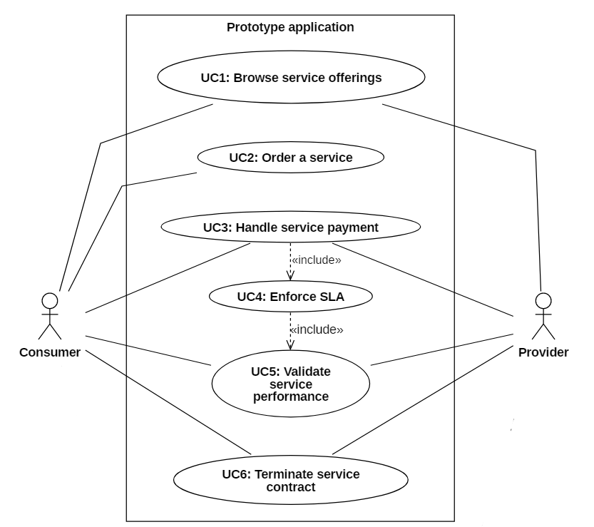



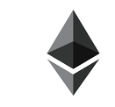
To enable the six use cases, we developed a distributed application based on Ethereum and React
Prototype Application
MetaMask
Ethereum
Provider smart contract
Service smart contracts
Use Cases
Architecture
1
2
3
4

Slide 10
Our prototype is a viable technical implementation and demonstrates feasibility of smart contracts for supporting SLAs of digital services
Provider
Customer
Provider
Customer
The prototype
    verifies service performance and enforces obligations
    reduces manual effort and enforcement costs
    improves scalability of digital services
Turn-by-turn service delivery reduces risks of digital services
The prototype
  reduces manual effort for SLA management
  supports scalability for cloud services
  independently proofs service performance to customers
  removes enforcement costs
  enables service offerings to IoT devices
The prototype
    verifies service performance and enforces obligations
    reduces manual effort and enforcement costs
    improves scalability of digital services
Turn-by-turn service delivery reduces risks of digital services
The prototype
  reduces manual effort for SLA management
  supports scalability for cloud services
  independently proofs service performance to customers
  removes enforcement costs
  opens service offerings to IoT devices
+
  Technical complexity hinders practical use
  Concerns regarding
      Reputation of cryptocurrencies
      Reliability
      Legality
  Implemented SLAs are not sufficiently functional
  Automated smart contract actions might violate laws
Concerns regarding
    Reputation of cryptocurrencies
    Data protection laws
    Fluctuations of cryptocurrencies
Prototype requires too many manual inputs (state channel)
-
1
2
3
4

Slide 11
Smart contracts are feasible for supporting SLAs of digital services, but require the resolution of practical issues
Problems
Solution
Findings
Outlook
Future work
Uncertain fulfillment and enforcement of obligations
High administrative and legal cost
Lacking support for modern technologies
Automated, enforced fulfillment of obligations to reduce uncertainty of contract performance and improve process efficiency
Equip SLAs with functionality to support cloud computing and IoT
Technically viable implementation
High cost and high latency
Feasible solutions impeded by practical concerns
Improve blockchain technology
Educate users
Reduce risks of legal uncertainty and cryptocurrency fluctuations
Design & Development
Evaluation
1
2
3
4

Slide 12
Stephan Zumkeller
17132
matthes@in.tum.de

Slide 13
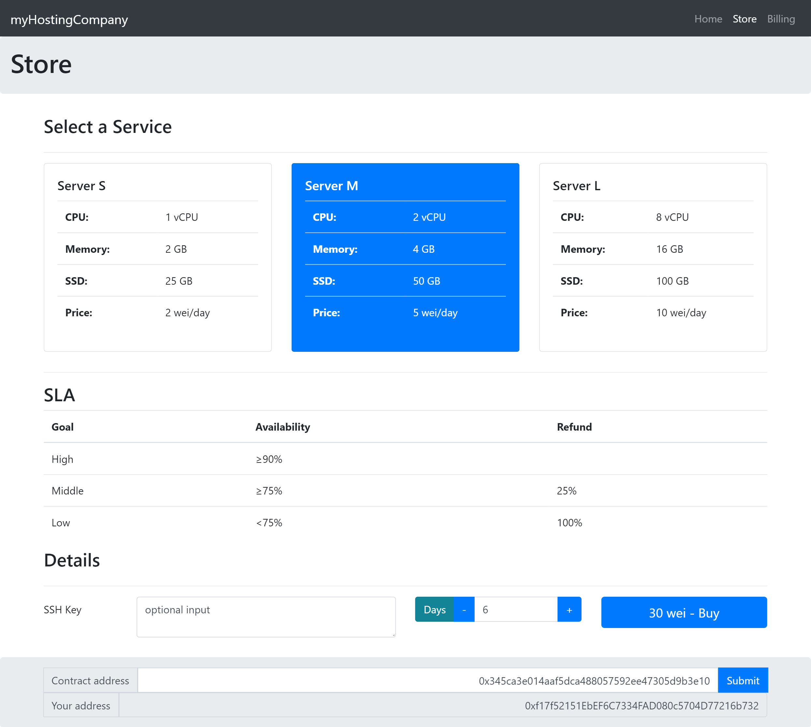
Store View

Slide 14
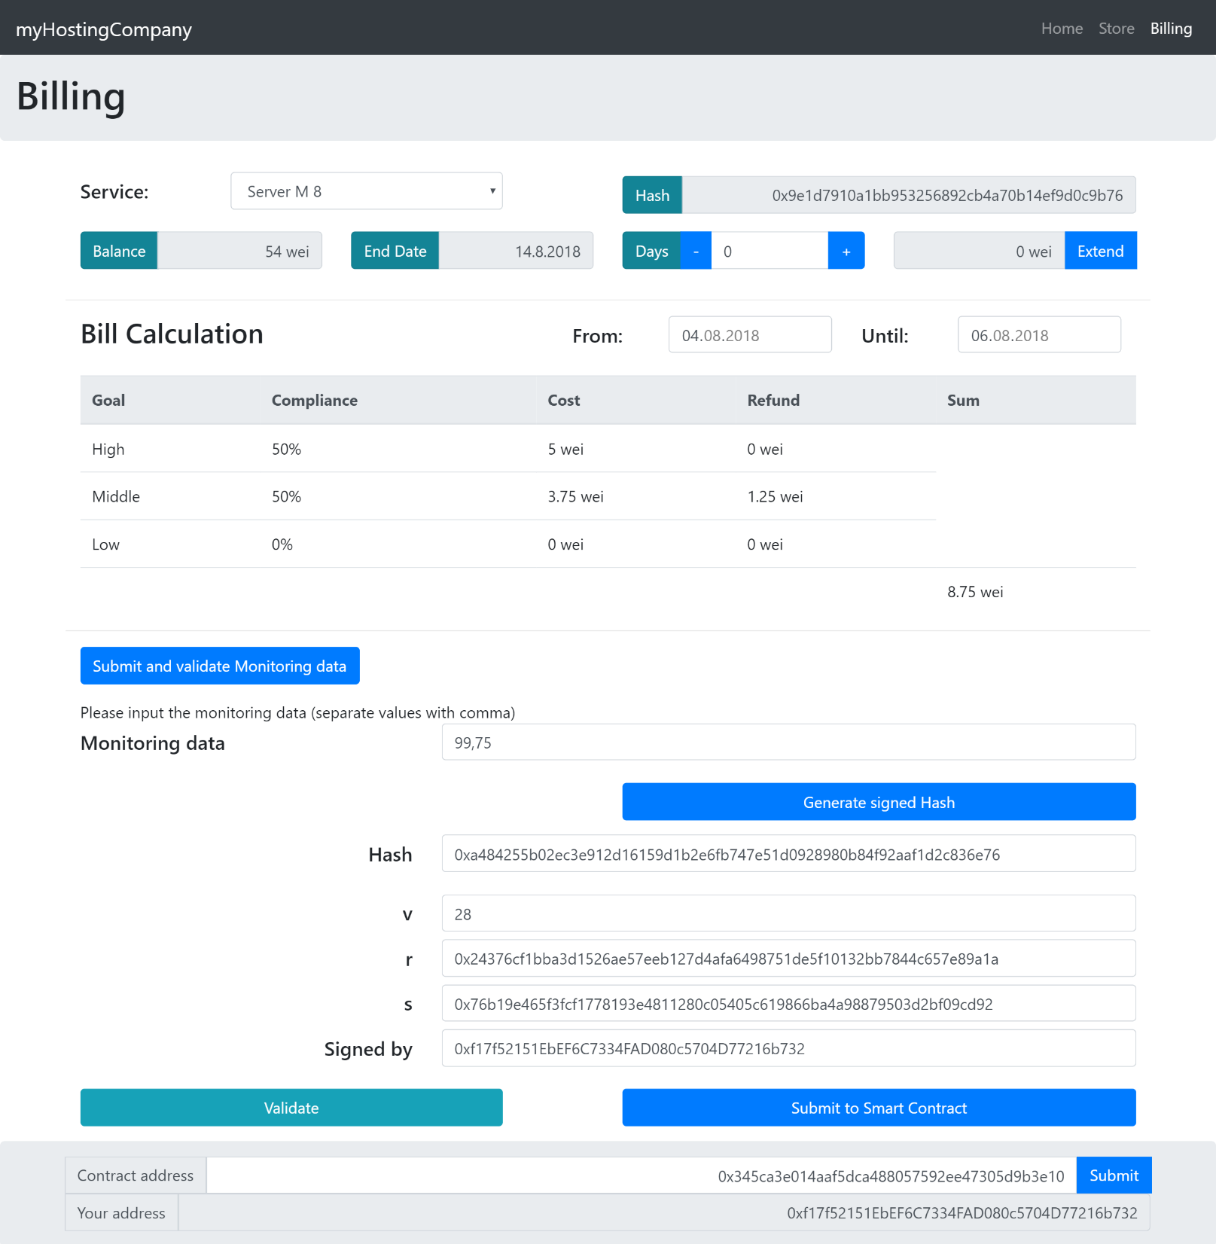
Billing View

Slide 15
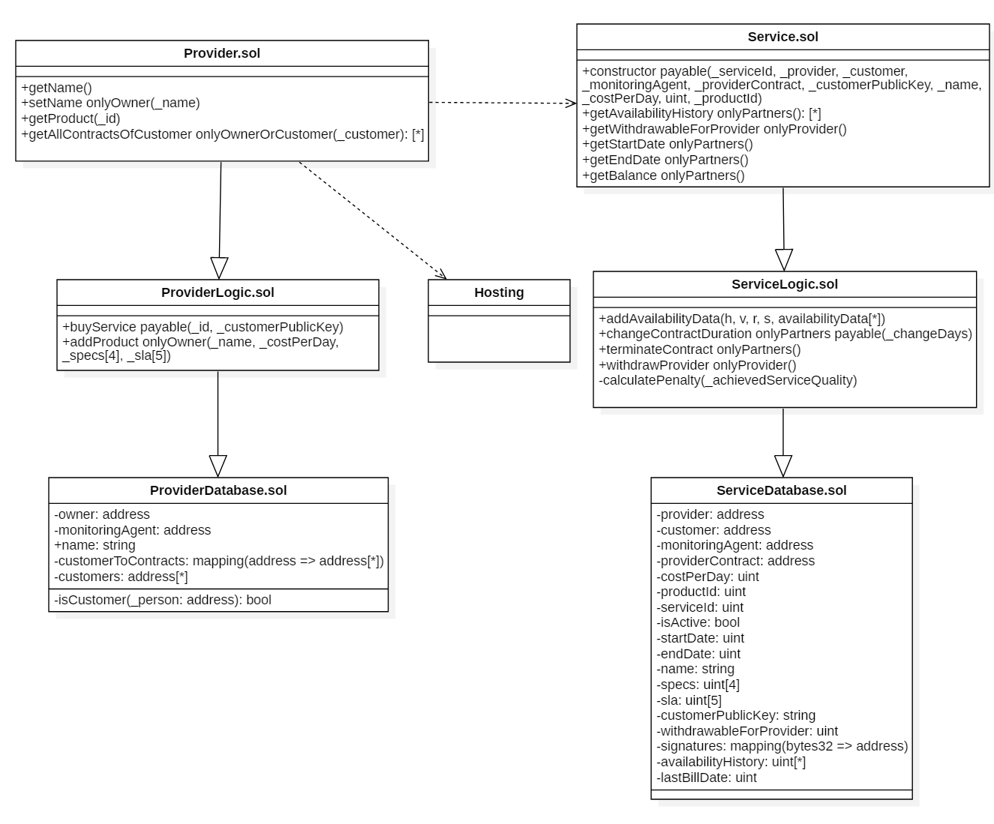
Smart Contracts

Slide 16
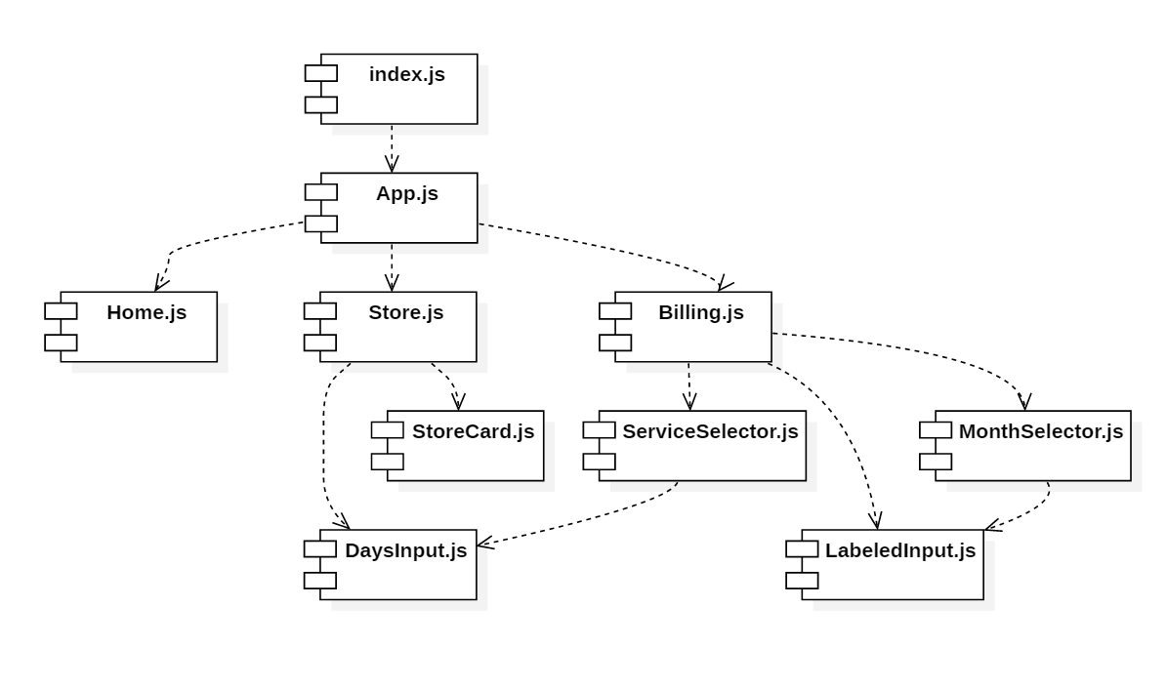
React components

Slide 17
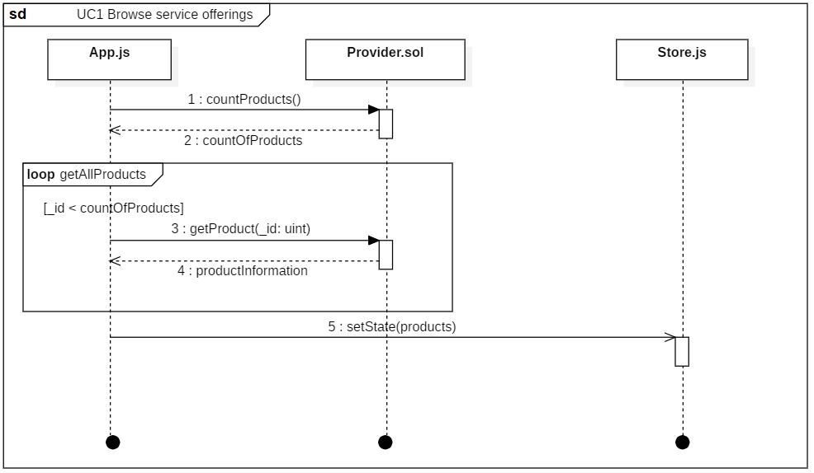
Sequence – Use Case 1: Browse service offerings

Slide 18
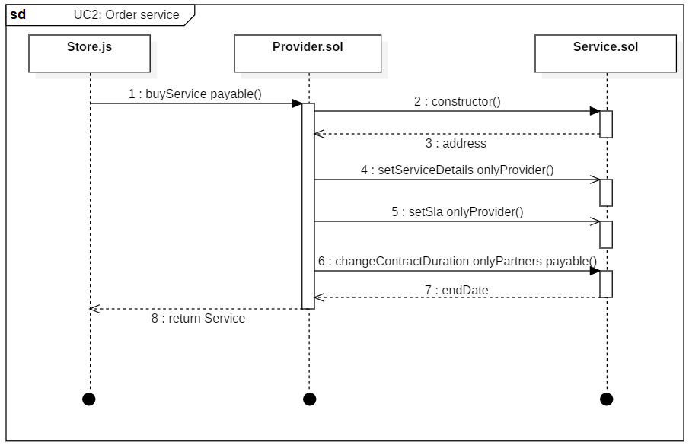
Sequence – Use Case 2: Order service

Slide 19
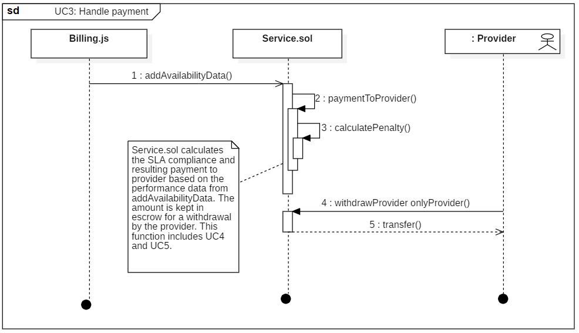
Sequence – Use Case 3: Handle payment

Slide 20
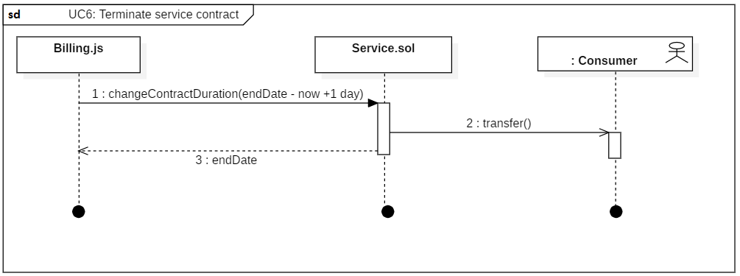
Sequence – Use Case 6: Terminate service contract

Slide 21
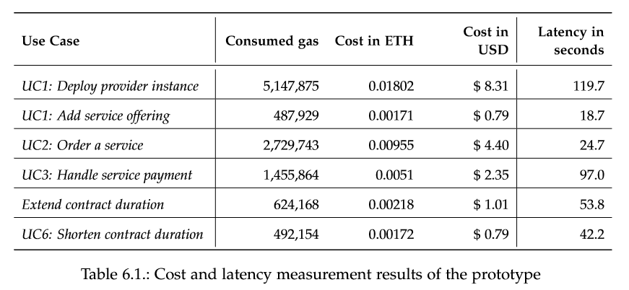

Slide 22
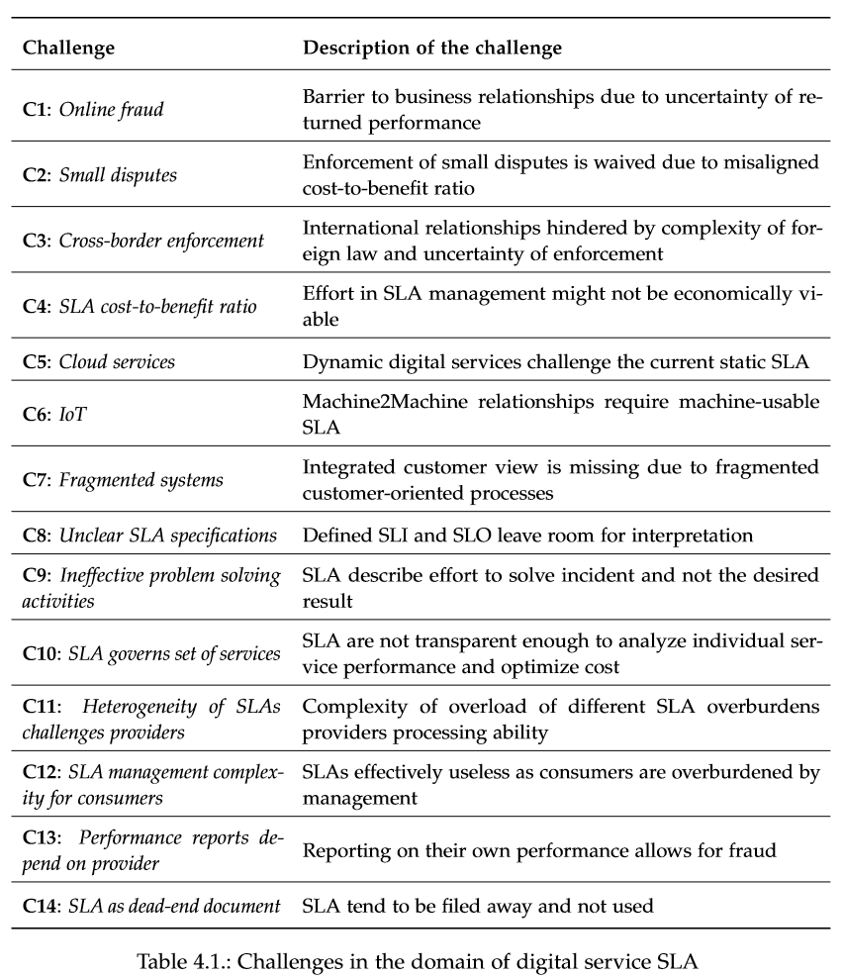

Slide 23
