Slide 1
Optimizing User-centered Design for CreateData4AI
26 May 2025
Mathis Hoffmann

Slide 2
Background | Manual Annotation of Text Data is Challenging
The Situation
Zettabytes of data are generated every day
80% of this data is unstructured text
→ How to make text useful for AI applications?
The Challenge
Training AI models requires annotated data
Annotation eats up most of the time – "80/20 Rule"
→ Manual annotations is costly, inefficient, not scalable!
CD4AI – The Solution?
What? – A web application implemented on a modern tech stack.
Goal? – Drastically reducing manual labor in the annotation process.
How? – Auto-annotation using a hybrid multi-step approach.
“Frontend“ application to interact with the workflow
“Backend“ NLP algorithms to generate annotations

Slide 3


Background | CD4AI’s Hybrid Human-Algorithm Approach
CD4AI is a task-oriented web app, with human-algorithm and human-human co-creation at its core.
Researcher (+ Collaborators)
Remote Algorithmic Processing
1. Keyword Definition
2. Keyword Extraction
3. Keyword Selection
4. Context Window Extraction
5. Context Window Selection
6. Extrapolation

Slide 4




Background | Open Issues with the CD4AI Prototype
Automation: Unclear if the system design‘s full potential of automation is exploited yet
Foundation: No validation against design science / human-computer interaction (HCI) theory
“So what?“: Open questions regarding future: Technical blueprint, deployment, documentation
Usability: No validation against real user requirements

Slide 5
Research Questions
RQ1: | What efforts can be taken to reduce human labor in the app while maintaining proper annotation performance?
RQ2: | How can the app be iteratively optimized for user experience?
RQ3: | What general technicalities must be considered to roll out CD4AI?

Slide 6




Methodology – The User-centered Design Process¹
Understand
Context of Use
Specify User
Requirements (UR)
Produce Design
Solutions to meet URs
Evaluate
against URs
CoU framework
Functional Req.’s
Heuristic Evaluation²
Thinking Aloud²
Persona(s)
NFRs
Cognitive Walkthrough²
Field Observation²
Action Analysis²
Questionnaires²
April – May
May - June
June - September
1) ISO 9241-210:2019 – Ergonomics of human-system interaction — Part 210: Human-centered design for interactive systems
2) Holzinger, Andreas. (2005). Usability Engineering Methods For Software Developers. Commun. ACM. 48. 71-74.

Slide 7
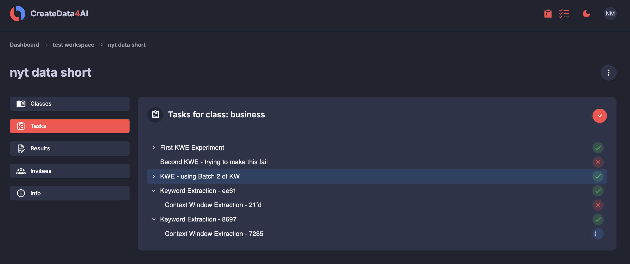
Initial Results – Heuristic Evaluation (Excerpt)
Feature: A project-level progress overview, allow the user to check every task status at once
Heuristic: Nielsen‘s 10 Usability Heuristics³ – Visibility of System Status
3) Nielsen, Jakob. (1994). Enhancing the explanatory power of usability heuristics. Proc. ACM CHI'94 Conf. (Boston, MA), 152-158.

Slide 8
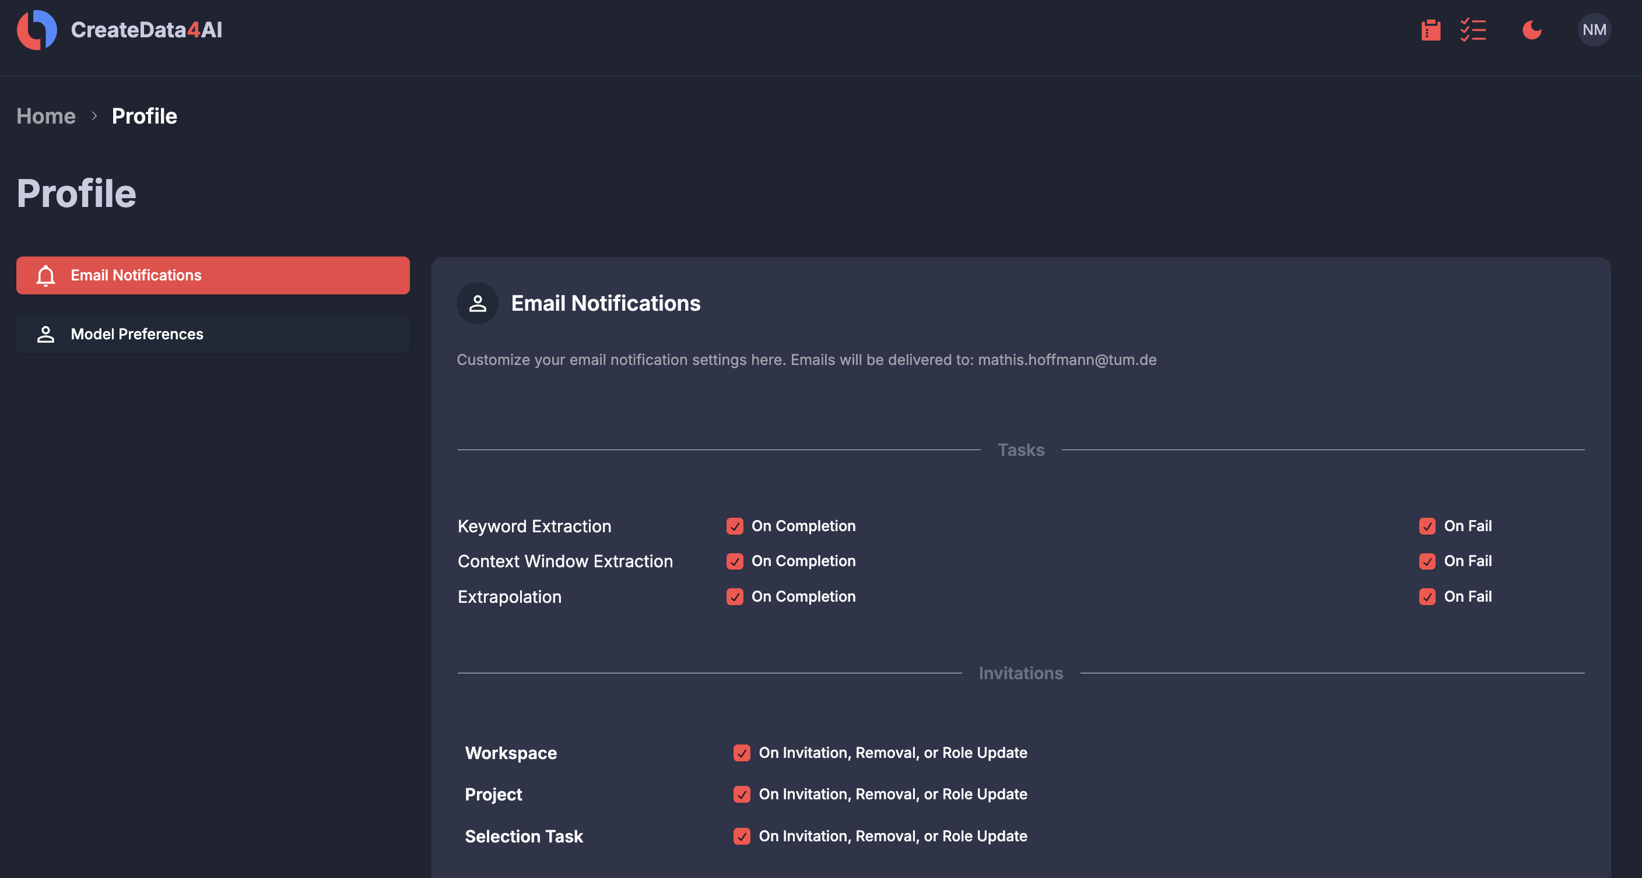
Initial Results – Heuristic Evaluation (Excerpt)
Feature: A customizable email notification system to keep track of task progress and collaboration
Heuristic: Horvitz‘ Principles of Mixed-Initiative User Interfaces⁴ – Timing & User Attention
4) Horvitz, Eric. (1999). Principles of mixed-initiative user interfaces. Proc. ACM CHI‘99 Conf. (New York, NY), 159–166.

Slide 9
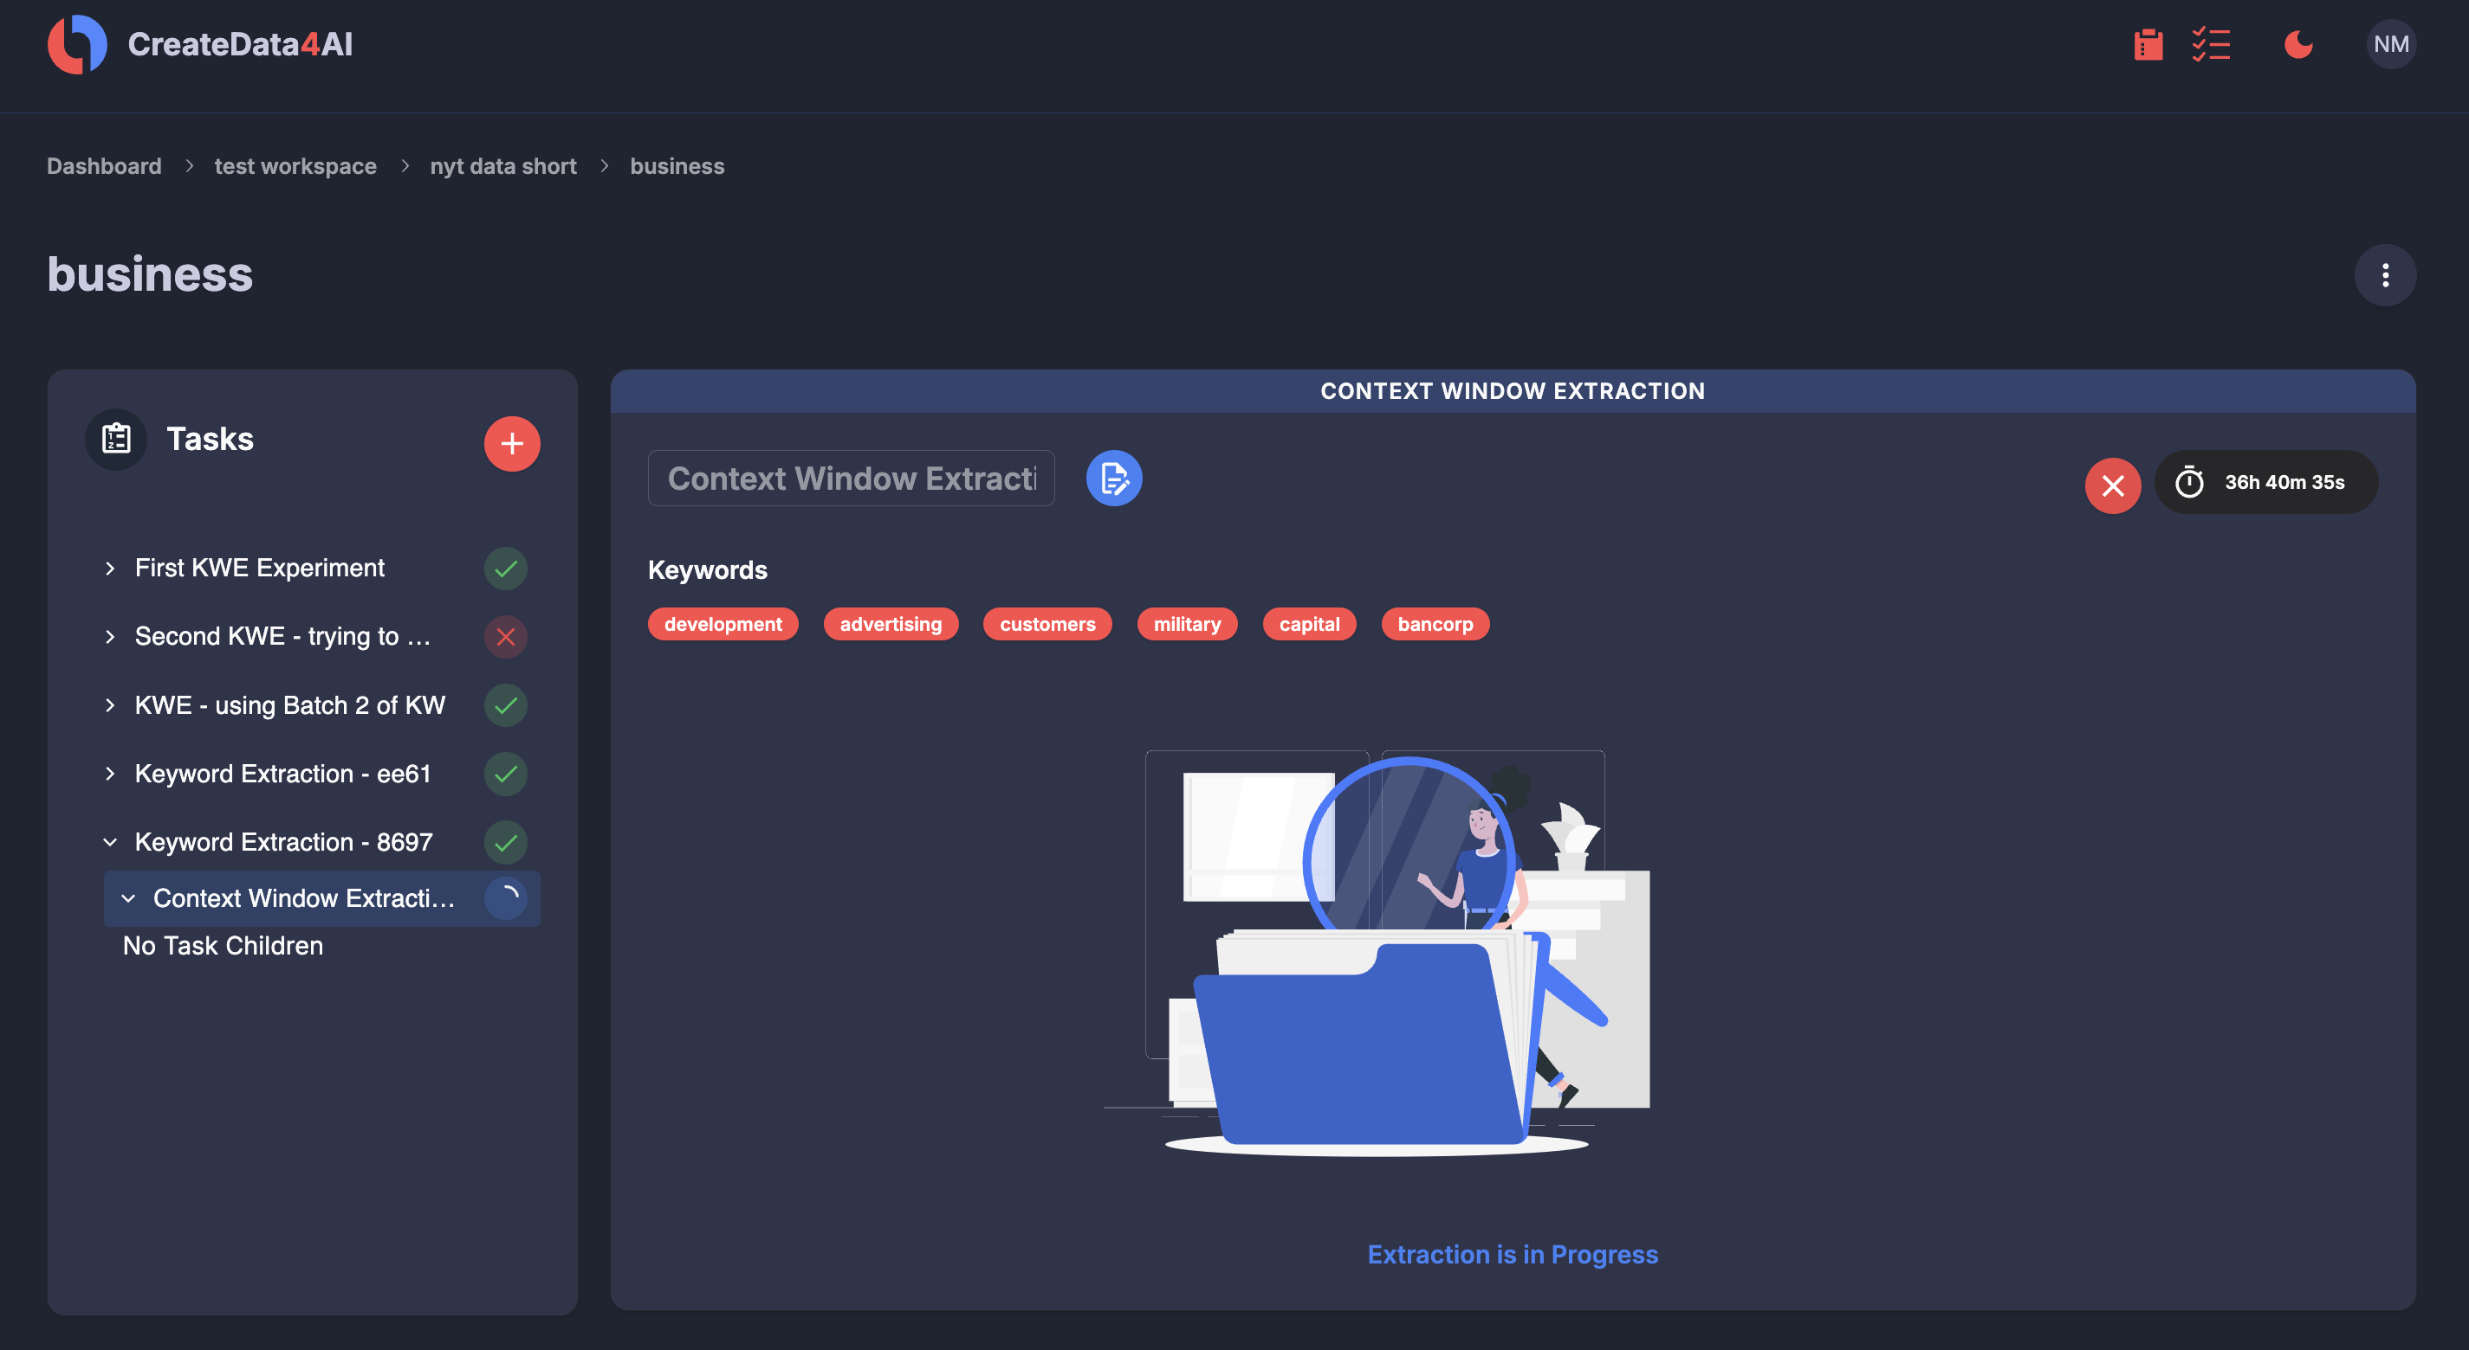
Initial Results – Heuristic Evaluation (Excerpt)
Feature: Hiding task interaction panels while algorithmic processing is in progress to avoid user overwhelmingness
Heuristic: Cognitive Load Theory – Progressive Disclosure⁵
5) Nielsen, Jakob. (2006). Progressive Disclosure. https://www.nngroup.com/articles/progressive-disclosure/ (last access: 25 May 2025)

Slide 10
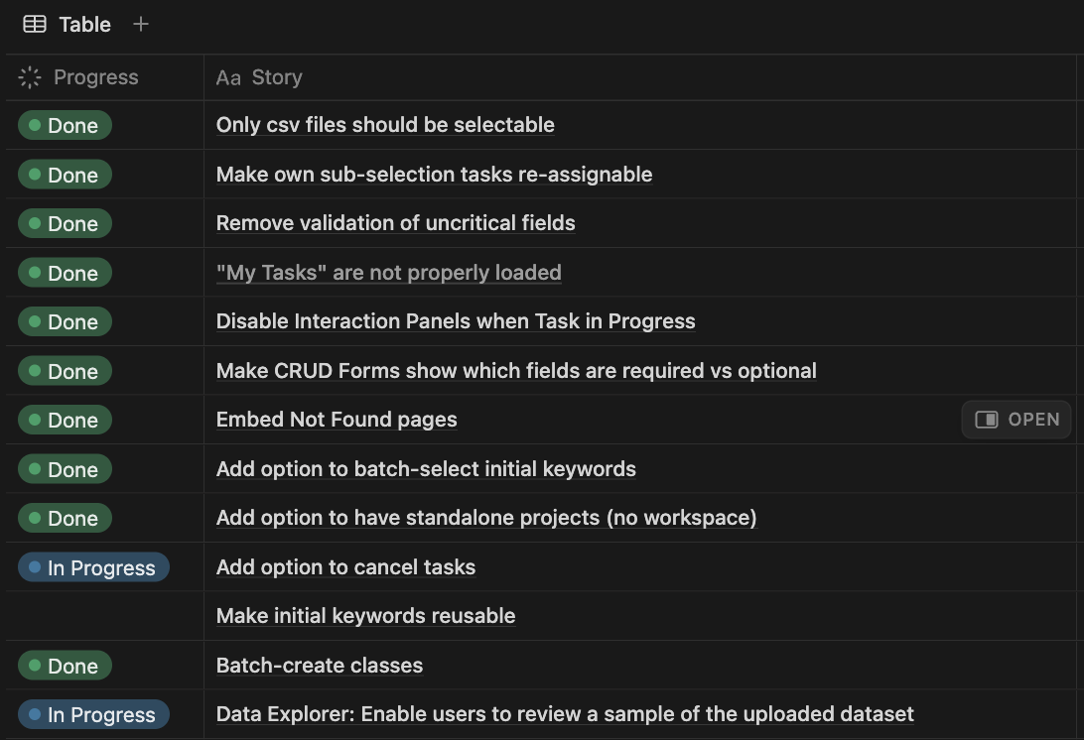
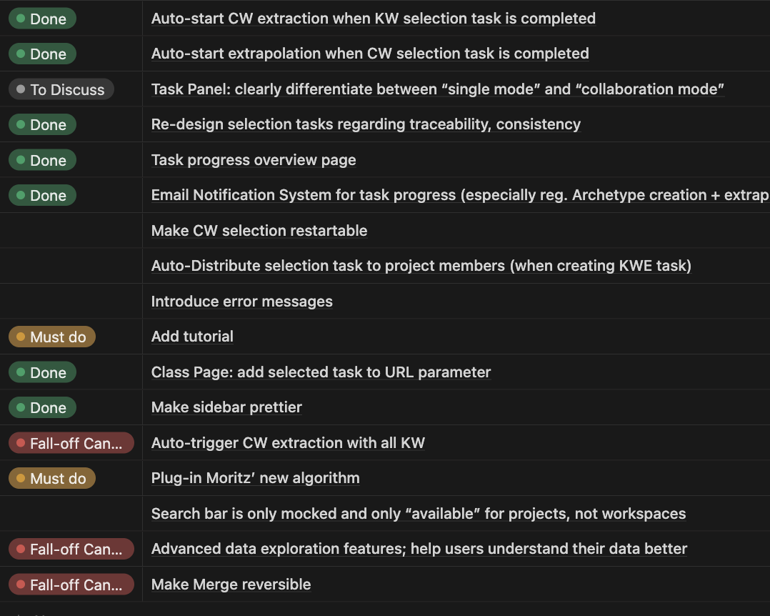
Initial Results – Heuristic Evaluation (Feature Backlog)
A backlog of 25+ features (17 completed) is under constant refinement and (re-)prioritization!

Slide 11

Next Steps – 4. Evaluate against User Requirements
Iterative Process
Evaluation Metrics
Identify Open Questions
Determine Target Users
Conduct Study
Analyse Feedback
Implement Findings
Quantitative Measures
System Usability Score
Task Success Rate
Task Completion Time
2-3 cycles
Qualitative Measures
Think-Aloud Comments
Field Observations
Questionnaires

Slide 12
Next Steps – Architecture & Roll-Out
RQ3: What general technicalities must be considered to roll out CD4AI?
Architecture
  What architectural considerations should be made in the future?
Deployment
  What aspects must be considered when deploying CD4AI?
Flexibility
How can we stay vendor- and platform-independent?
Cost
  What would it cost to host the app?
Other
  …

Slide 13


Expected Outcomes
CD4AI is proven to be intuitive, easy-to-use and functionally helpful
CD4AI is substantiated with HCI theory and UX patterns
User-Ready
Web App
CD4AI is deployed and available for use
CD4AI is open-source and ready to roll-out
A future plan and architectural blueprint is available
Future Plan

Slide 14
Timeline
 | 03/25 |  |  |  | 04/25 |  |  |  | 05/25 |  |  |  | 06/25 |  |  |  | 07/25 |  |  |  | 08/25 |  |  |  | 09/25 |  |  |  | 10/25
Abstract & Pitch
Literature Review
Inspection Phase
Feature Implementation
User Testing
User Feedback Implementation
Overall Feedback Anal.
Future Plan (RQ3)
Thesis Writing
Official Thesis Start
Now
Thesis Hand-In

Slide 15
B.Sc.
Mathis Hoffmann
mathis.hoffmann@tum.de

Slide 16
Backup

Slide 17




Personal Introduction
Education
Connection to the chair
M.Sc. Information Systems @ TU Munich
Study abroad Data Science @ UC San Diego
B.Sc. Information Systems @ TU Darmstadt
Blockchain-based Systems Engineering (SS23)
SEBA Master (SS23)
Strategic IT Management (WS23/24)
SEBA Lab Course NLP (SS24)
Practical Experience
Research Experience
Software Engineering @ BMW
IT Consulting @ Senacor, @ PwC
Strategy @ SAP
1st-authored research paper @ PACIS 2023
Master seminar @ SSE (Prof. Pretschner)
Research assistant @ TU Darmstadt

Slide 18
Initial Results – 1./2. Context of Use & User Requirements
Draft – Brief Overview over the Context of Use and Key NFRs

Slide 19
Methodology & Workflow
RQ1: What efforts can be taken to reduce human labor on the platform while maintaining proper annotation performance?
Analysis of Functional
Platform Design
Proposal of New
(Automation) Features
Feature
Implementation
Strengths
Features derived from free ideation
FE: Next.js / React
Challenges
BE: FastAPI
Features derived from HCI* theory & design patterns
Amount of required manual labor
Iterative re-evaluation of functional quality and performance regression!
* HCI = Human-Computer Interaction

Slide 20



Initial Results – 3. Producing Design Solutions to meet User Requirements
Holzinger (2005)² has identified the three most common so-called Inspection Methods.
These methods are intrinsic without real-world users contact.
Heuristic Evaluation
Judging to what degree the functional workflow and design elements of the app comply with established heuristics, patterns and best practices
Cognitive Walkthrough
Task-oriented method to explore system‘s functionalities with focus on cognitive issues.
Action Analysis
The process of breaking tasks down into actions and performing precise analytical inspection of action sequences intended to achieve a goal.
2) Holzinger, Andreas. (2005). Usability Engineering Methods For Software Developers. Commun. ACM. 48. 71-74.

Slide 21
Initial Results – Heuristic Evaluation (Excerpt)
Nielsen‘s 10 Usability Heuristics³
User Control & Freedom
Reduce friction to the main feature
“Fast-forward“ option: auto-proceed with certain steps in the workflow
Visibility of System Status
Global overview page to track progress of all experiments
Horvitz‘ Principles of Mixed-Initiative User Interfaces⁴
Timing & User Attention
→ Customizable notification system
Cognitive Load Theory
Progressive Disclosure⁵
→ Hide task interaction panels while there is nothing to do for the user
A backlog of 25+ features (18 completed) is under constant refinement and (re-)prioritization!
3) Nielsen, Jakob. (1994). Enhancing the explanatory power of usability heuristics. Proc. ACM CHI'94 Conf. (Boston, MA), 152-158.
4) Horvitz, Eric. (1999). Principles of mixed-initiative user interfaces. Proc. ACM CHI‘99 Conf. (New York, NY), 159–166.
5) Nielsen, Jakob. (2006). Progressive Disclosure. https://www.nngroup.com/articles/progressive-disclosure/ (last access: 25 May 2025)

Slide 22
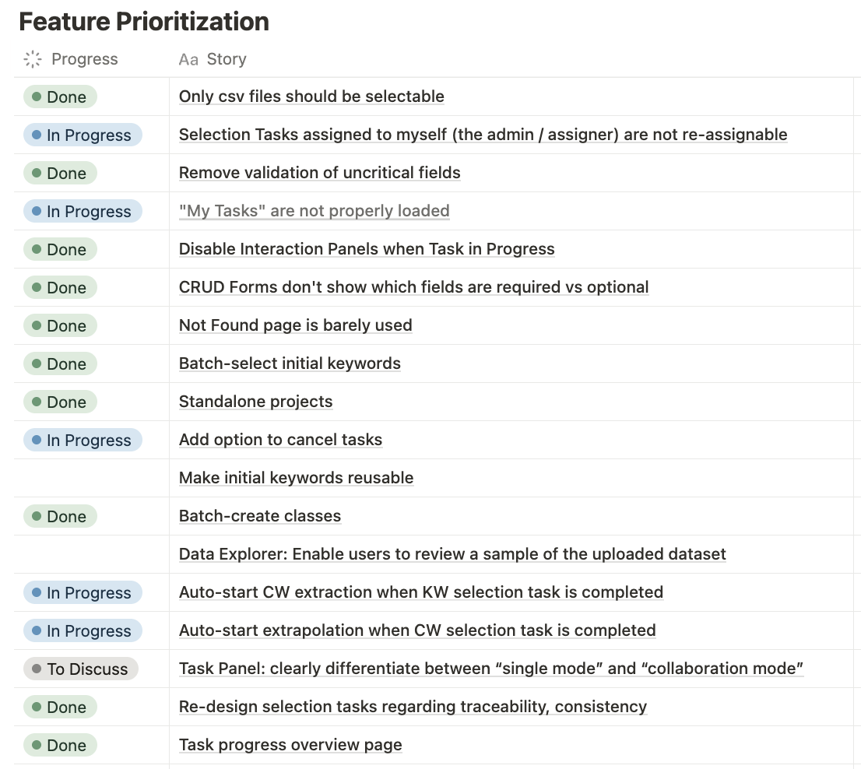
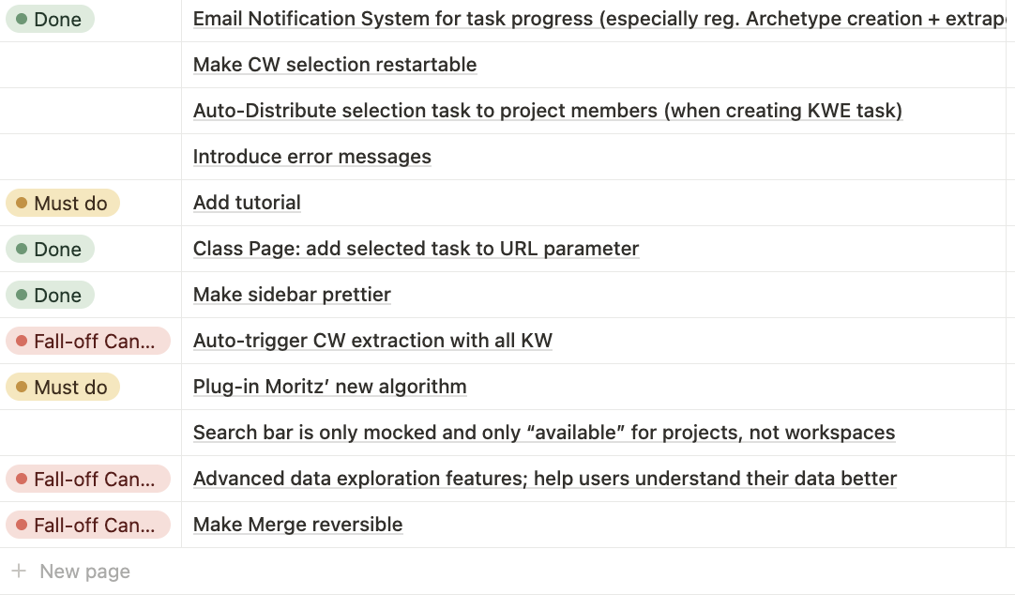
Feature Backlog

Slide 23
Methodology & Workflow
RQ2: How can the platform be iteratively optimized for user experience?
Transfer of HCI* Theory
User Study Iterations
Back-Transfer to Theory
Identify Open Questions
Determine Target Users
Conduct Study
Analyse Feedback
Implement Findings
Identification of HCI theory and UX patterns
Assessment of HCI theory and UX patterns
Implementation of relevant HCI theory and UX patterns
How did users respond to features from RQ1?
How did users respond to HCI theory?
How do these findings contribute to HCI theory?
2-3 cycles
* HCI = Human-Computer Interaction

Slide 24



Next Steps – 4. Evaluate against User Requirements
Holzinger (2005) also proposes the three most common so-called Test Methods.
These methods are extrinsic with contact to real-world users.
Thinking Aloud
Test users constantly verbalize their thoughts, commenting every action they take while using the system.
Field Observation
“Shadowing” test users during their system usage, without any kind of intervention.
Questionnaires
Questioning test users about their opinions regarding certain aspects of the system. No direct study of the actual interface.
Holzinger, Andreas. (2005). Usability Engineering Methods For Software Developers. Commun. ACM. 48. 71-74. 10.1145/1039539.1039541.

Slide 25

Expected Outcomes
CD4AI is proven to be intuitive, easy-to-use and functionally helpful
CD4AI is substantiated with HCI theory and UX patterns
User-Ready
Digital Platform
CD4AI is deployed and available for use
CD4AI is open-source and ready to roll-out
A future plan and architectural blueprint is available
Future Plan
HCI theory is validated in the context of a modern research platform
User responsiveness to UX patterns is assessed
Findings are discussed regarding their potential for generalizability to theory
Contribution to
HCI Theory

Slide 26
CD4AI – Hybrid Approach
Keyword Extraction: using classes or tags defined by a domain expert, unsupervised techniques for the extraction of keywords will be utilized to support the domain expert in defining the class. Moreover, related words and phrases are suggested to refine further the scope of the class.
Context Window Extraction: building around the keywords and keyphrases, windows encapsulating the context of these key units of information are extracted. Such windows should best embody the meaning of the selected keyword in context, so as to determine its function in text.
Context Rule Creation: using the extracted context windows, the domain expert is put into action, where he or she will determine which of the windows best describe the meaning of the predefined classes. The set of these selected rules will form the basis for automated dataset creation.
Extrapolation: for each class, the set of context rules are leveraged in conjunction with NLP techniques to "extrapolate" from the finite set of rules to a theoretically infinite number of unseen documents. With this step, the bridge between manually-defined rules and fully-unsupervised classification is crossed.

Slide 27
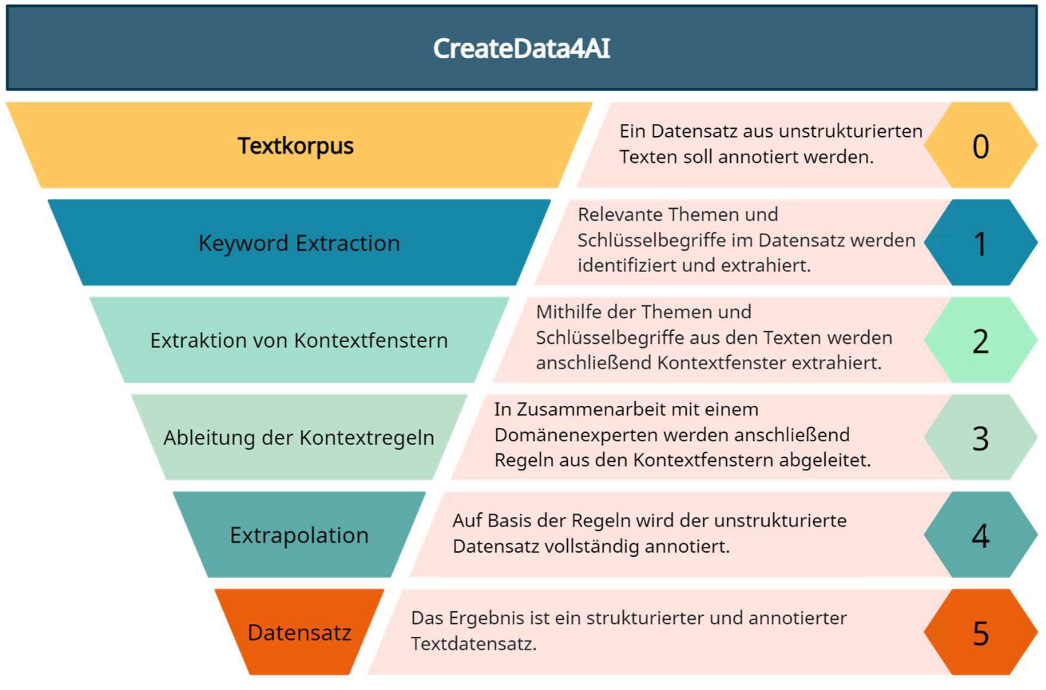
CD4AI – Hybrid Approach

Slide 28
Usability
Usability is defined by 5 quality components:
Learnability: How easy is it for users to accomplish basic tasks the first time they encounter the design?
Efficiency: Once users have learned the design, how quickly can they perform tasks?
Memorability: When users return to the design after a period of not using it, how easily can they reestablish proficiency?
Errors: How many errors do users make, how severe are these errors, and how easily can they recover from the errors?
Satisfaction: How pleasant is it to use the design?

Slide 29

UX Design Patterns
1. Visibility
The more visible functions are, the more likely users will be able to know what to do next. In contrast, when functions are out of sight, it makes them more difficult to find and know how to use.
2. Feedback
Feedback is about sending back information about what action has been done and what has been accomplished, allowing the person to continue with the activity. Various kinds of feedback are available for interaction design-audio, tactile, verbal, and combinations of these.
3. Constraints
The design concept of constraining refers to determining ways of restricting the kind of user interaction that can take place at a given moment. There are various ways this can be achieved.
4. Mapping
This refers to the relationship between controls and their effects in the world. Nearly all artifacts need some kind of mapping between controls and effects, whether it is a flashlight, car, power plant, or cockpit. An example of a good mapping between control and effect is the up and down arrows used to represent the up and down movement of the cursor, respectively, on a computer keyboard.
5. Consistency
This refers to designing interfaces to have similar operations and use similar elements for achieving similar tasks. In particular, a consistent interface is one that follows rules, such as using the same operation to select all objects. For example, a consistent operation is using the same input action to highlight any graphical object at the interface, such as always clicking the left mouse button. Inconsistent interfaces, on the other hand, allow exceptions to a rule.
6. Affordance
A term used to refer to an attribute of an object that allows people to know how to use it. For example, a mouse button invites pushing (in so doing acting clicking) by the way it is physically constrained in its plastic shell. At a very simple level, to afford means to give a clue (Norman, 1988). When the affordances of a physical object are perceptually obvious it is easy to know how to interact with it.
Source: https://www.designprinciplesftw.com/collections/don-normans-principles-of-design

Slide 30
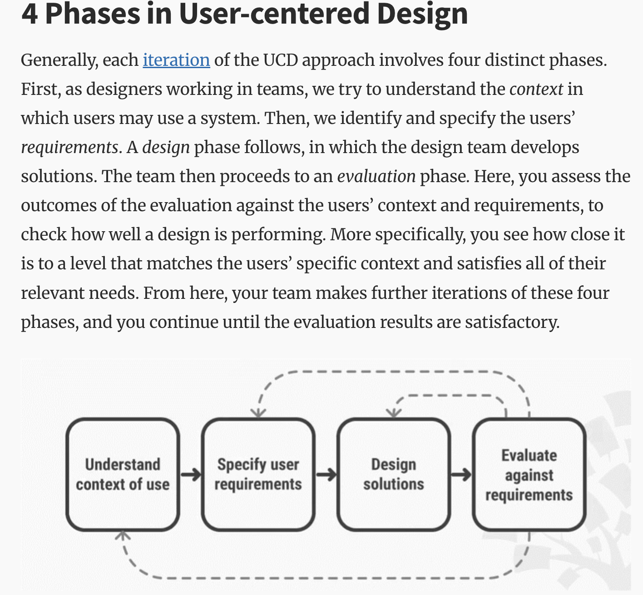
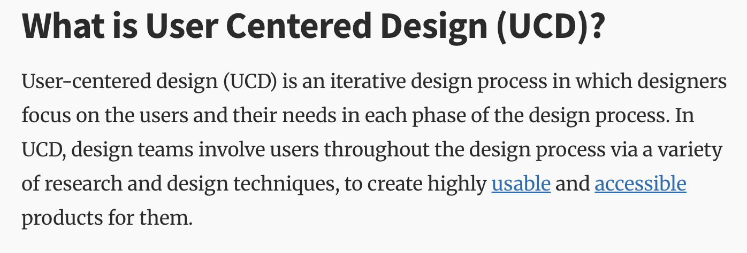
HCI Theory – User Centered Design
Source: https://www.interaction-design.org/literature/topics/user-centered-design?srsltid=AfmBOooBpJ2iopAtWrSb24gQslv-MEZqGM5xRa5WWlrS1e8bK6RkPVQR

Slide 31
HCI Theory – Hick‘s Law
The time it takes to make a decision increases with the number and complexity of choices.
Takeaways
Minimize choices when response times are critical to decrease decision time.
Break complex tasks into smaller steps in order to decrease cognitive load.
Avoid overwhelming users by highlighting recommended options.
Use progressive onboarding to minimize cognitive load for new users.
Be careful not to simplify to the point of abstraction.
Source: https://lawsofux.com/hicks-law/

Slide 32
HCI Theory – Others
Cognitive Load Theory
Fitt‘s Law
Ecological Interface Design
Gestalt Principles
…

Slide 33
Stick to the good sebis traditions
  Provide action links at the bottom of the slide to guide the audience to our web pages or publications (see below). (Select the text, press CTRL-K)
  Use a file name according to our sebis conventions which helps us and our audience to find the file of your presentation on our web site with Google search:
    YYMMDD Author Short Title
    Include this string in the footer (Einfügen -> Kopf- und Fusszeile -> Fusszeile)
    The unusual date format simplifies the search for the latest version of a slide in an alphabetical directory listing (Dropbox, Explorer, Tricia, Sky-Drive)
[Ha13g] Hauder, M., Roth, S., Matthes, F.: Current Tool support for Metrics in Enterprise Architecture Management
For more information visit BEAMS , EAM Pattern Catalog and EAM KPI Catalog (http://wwwmatthes.in.tum.de)

Slide 34
Use the sebis visual language
(shapes, fonts, colors, sizes)
Default
Line Style
Default Rectangle
Default
Rounded R.
Text
Default
Text
User
Store
Information
Arrow
Cloud
Process
Box
Explanation
Fast
Form 1
Fast
Form 2
Fast
Form 3
Fast
Form 4
Fast
Form 5
Fast
Form 6
Fast
Form 6
Fast
Form 1
Fast
Form 2
Fast
Form 3
Fast
Form 4
Fast
Form 5
Fast
Form 6
Fast
Form 6

