Slide 1
Trend Analysis of NLP Use Cases in the Legal Domain within the DACH Region
16/12/2024, Master’s Thesis Kick-Off meeting
Henrik Sergoyan

Slide 2
Problem Statement and Motivation
The Legal AI Use Case Radar Report serves as a dynamic resource, updated annually with insights from surveys, interviews, and literature reviews.
While the radar highlights current Legal AI use cases, it lacks a mechanism to track the evolution and shifting relevance of these use cases over time.
There is a need to capture trends in how Legal AI technologies are utilized and adapted within the legal sector.
Additionally, understanding the challenges that legal teams face when integrating these technologies is essential for refining the radar.
By addressing these gaps, the radar can evolve into a more valuable, practical tool for the legal industry, offering insights that reflect both current use and future potential.
241216 Henrik

Slide 3
Research Questions
What are the key trends of NLP technologies in Legal AI, as reflected in both the literature and their utilization by companies within the DACH region?
How can a structured methodology be developed and applied to track the evolution of Legal AI use cases over time?
What challenges do legal teams face when integrating NLP solutions into their workflows?
What are the Ethical, Legal, and Social Aspects (ELSA) concerns associated with the adoption of NLP in the legal domain?

Slide 4
Methodology
Systematic Literature Review
Conduct a comprehensive survey of recent Legal NLP literature, focusing on the latest trends then structure these findings by use case.
Semi-Structured Interviews
Review insights from previous interviews, followed by conducting additional semi-structured interviews with legal professionals and technology providers using a standardized set of questions.
Trend Mapping
Develop and apply a structured methodology to analyze the evolution of NLP use cases over time, using data from the literature review and semi-structured interviews. This approach will identify patterns in adoption, with timelines and trend graphs illustrating shifts in the relevance and priorities of use cases.
Challenges and ELSA Concerns
Extract and categorize common challenges from interview data and relevant literature, focusing on technical and operational aspects of NLP implementation in the legal sector. Specific Ethical, Legal, and Social Aspects (ELSA) concerns will be highlighted through thematic analysis.
Synthesis and Experience Reports
Summarize each interview into an Experience Report, capturing real-world applications, challenges, and insights from the interviewee’s perspective.

Slide 5
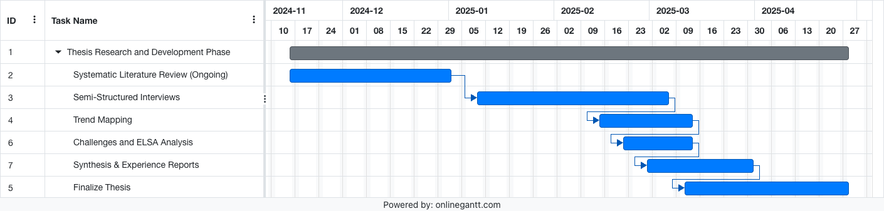
Timeline and Next Steps

Slide 6
1-Month Progress: Literature Review Approach and Insights From Manual Methods to Scalable Automation

Slide 7
Standard Approach for Literature Review
General Process
Challenges
Select Sources
Identify reliable academic sources (Scopus, IEEE, ACL, ACM, ICAIL)
Define Keywords
Choose keywords to filter relevant research articles
3. Manual Review
Review titles and abstracts for relevance.
Categorize articles by key themes (e.g., use cases, NLP technologies).
4. Dataset Creation
Compile a curated dataset of articles for further analysis.
Time-Intensive
Manual review requires significant effort.
Risk of Gaps
Important research may be missed due to limited keywords or manual oversight.
Scalability
Managing larger datasets is resource-intensive.
Current version of Legal AI radar covers around 50 papers!

Slide 8
Key Improvements and Revised Approach
Relaxed keyword filters: Broadened scope by including more comprehensive keyword variations, expanding the dataset from ~100 to ~3500 articles
Semi-automated processing with GPT
Paper Relevance: Evaluated abstracts for relevance to Legal NLP.
Legal Use Case Extraction: Classified papers into predefined use cases and flagged novel ones.
NLP Technology Extraction: Identified methods such as Named Entity Recognition, text Summarization .
( ( "NLP" OR "Natural Language Processing" OR "Computational Linguistics" OR "Language Models" OR "LLM" OR "Machine Learning" OR "Artificial Intelligence" OR "Deep Learning" ) AND ( "Law" OR "Legal" OR "Jurisprudence" OR "Judicial" OR "Attorney" OR "Contracts" OR "Case Law" OR "Regulations" OR "Statutes" ) ) OR ( ( "LegalTech" OR "Legal Tech" OR "Legal Technology" ) AND ( "Use Case" OR "Application" OR "Case Study" OR "Implementation" ) ) OR ( ( "Contract Analysis" OR "Legal Document Processing" OR "Legal Information Retrieval" OR "Legal Question Answering" ) )

Slide 9
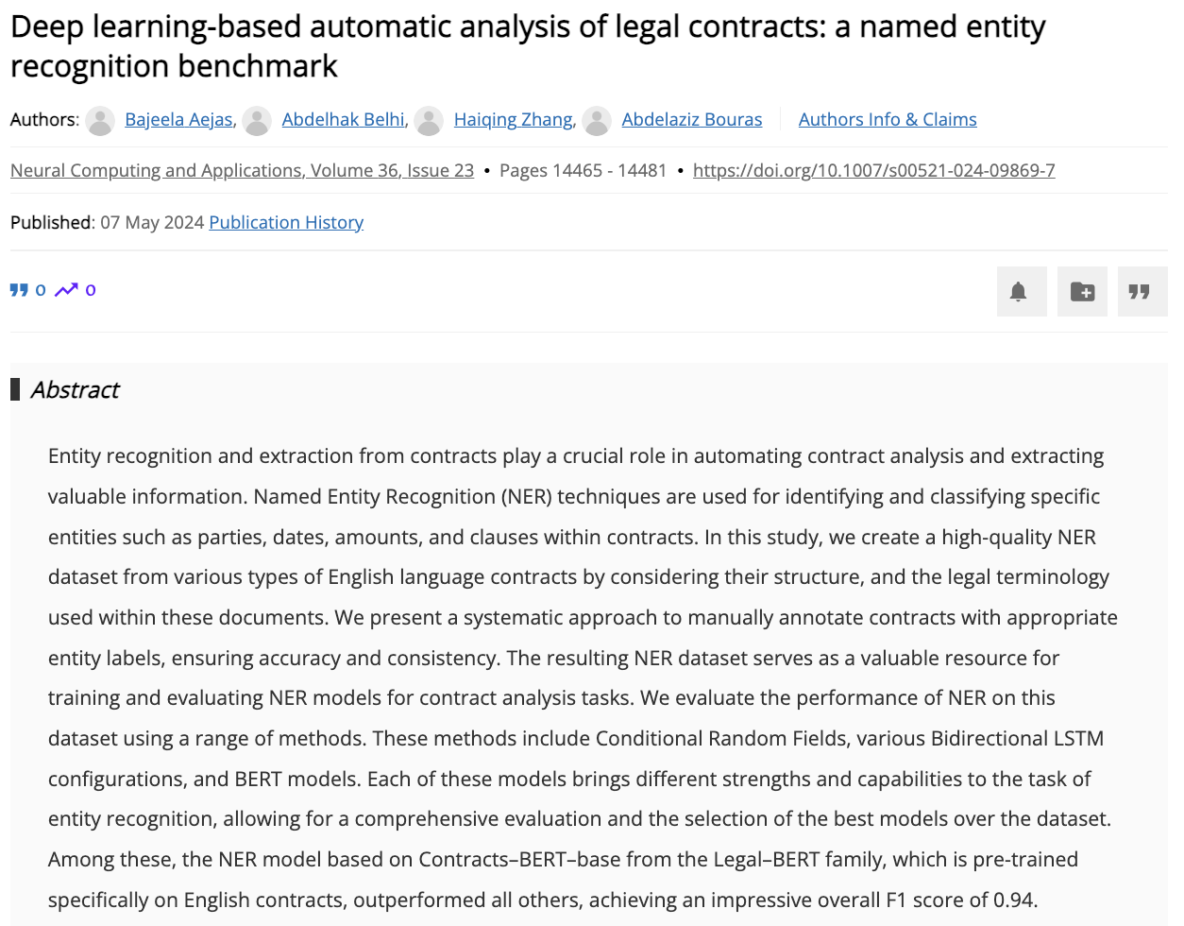
Legal NLP Use Case
Category: Information Processing and Extraction
Subcategory: Information Extraction
Confidence: 1.0
Novel Usecase: Legal dataset creation, evaluation and benchmarking
.
NLP Technology
Category: Text Extraction
Subcategory: Named Entity Recognition
Confidence: 1.0
Category: Text Representation
Subcategory: Language Modeling
Confidence: 0.9
.
.

Slide 10
Current Pipeline
Papers that have Legal NLP use case
ACL
Legal Use Case extraction
ACM
3578
candidate papers
Keyword Filtering
GPT filtering
1261
papers
Scopus
IEEE
New->
ICAIL
NLP-technologies extraction

Slide 11
Data Visualization
Demo to Streamlit Dashboard

Slide 12
Thank You

Slide 13
Prof. Dr.
Florian Matthes
17132
matthes@in.tum.de

