Slide 1
Trend Analysis of NLP Use Cases in the Legal Domain within the DACH Region
06/05/2025, Master Thesis Final Presentation
Henrik Sergoyan

Slide 2
Outline
Problem Statement and Motivation
Research Questions
Methodology
Results and Interesting Findings
Discussion

Slide 3
Problem Statement and Motivation
The Legal AI Use Case Radar Report serves as a dynamic resource, updated annually with insights from surveys, interviews, and literature reviews.
Yet the Radar lacks an automated, scalable literature-review pipeline and a repeatable interview-ranking exercise, so it cannot trace how the relevance of use-cases shifts over time.
To capture genuine trends, we need (i) an automated pipeline that continuously classifies new publications and (ii) a practitioner-ranking exercise that can be rerun on a regular basis.
Without longitudinal tracking, it is unclear whether the tasks most studied by scholars actually match the tasks most valued by practitioners
Closing these gaps will let the Radar evolve into a truly data-driven tool—one that reflects both current practice and emerging opportunities in the legal sector.

Slide 4
Research Questions
How can an automated, scalable pipeline effectively categorize academic literature into predefined legal AI use cases?
Which legal AI use cases have received the most attention in academic research, and how have these patterns evolved?
Which legal AI use cases do practitioners identify as most relevant to their professional practice, and what factors influence these perceptions?

Slide 5
Definitions
Legal AI Use-Cases
Compliance and Risk Management
Automation of Auditing
GDPR Compliance
Risk Assessment
Document Analysis and Management
File Difference Tracking
Document Classification
Content Lifecycle Management
Error Detection
Document Generation and Assistance
Contract Generation
Legal Document Enrichment
Summarization
Deadline Management
E-Mail
Class Action Lawsuits
Information Processing and Extraction
Anonymization
Information Extraction
Document Retrieval
Transcription
Legal Decision Making
Judge: Decision Making
Legal Reasoning
Strategy Recommendations
Dispute Resolution Mechanism
Legal Information Retrieval and Support
Chatbot
Question Answering
Ranking of Lawyers
Credibility of Witnesses
Translation
Legal Research and Information Management
Changes in Law
Court Rulings Indexing
Law Systems Divergence
Research Tool / Research Automation
e-Discovery

Slide 6
Definitions
Core NLP Techniques
Syntactic Analysis
Dependency Parsing
Tokenization
Lexical Normalization
Part-of-Speech Tagging
Text Extraction
Named Entity Recognition
Keyword Extraction
Document Analysis
Entity Linking
Document Similarity Analysis
Summarization
Text Representation
Word Embedding
Language Modelling
Text Generation
Text Summarization
Machine Translation
Conversational NLP
Chatbot Development
Question Answering
Text Classification
Topic Modelling
Concept Models
Text Classification

Slide 7
Methodology Systematic Literature Review

Slide 8
Standard Approach for Literature Review
General Process
Challenges
Select Sources
Identify reliable academic sources (Scopus, IEEE, ACL, ACM, ICAIL)
Define Keywords
Choose keywords to filter relevant research articles
3. Manual Review
Review titles and abstracts for relevance.
Categorize articles by key themes (e.g., use cases, NLP technologies).
4. Dataset Creation
Compile a curated dataset of articles for further analysis.
Time-Intensive
Manual review requires significant effort.
Risk of Gaps
Important research may be missed due to limited keywords or manual oversight.
Scalability
Managing larger datasets is resource-intensive.
Current version of Legal AI radar covers only 49 papers!

Slide 9
Current Pipeline
Source | # of Papers
Scopus | 2533
ICAIL | 632
ACL | 407
ACM | 119
IEEE | 59
Papers that has Legal NLP use case
ACL
Legal Use Case extraction
ACM
3578
candidate papers
Keyword Filtering
GPT filtering
988
papers
Scopus
IEEE
New->
ICAIL
NLP-technologies extraction

Slide 10
Key Improvements
Relaxed keyword filters: Broadened scope by including more comprehensive keyword variations, expanding the dataset from ~100 to ~3500 articles
( ( "NLP" OR "Natural Language Processing" OR "Computational Linguistics" OR "Language Models" OR "LLM" OR "Machine Learning" OR "Artificial Intelligence" OR "Deep Learning" ) AND ( "Law" OR "Legal" OR "Jurisprudence" OR "Judicial" OR "Attorney" OR "Contracts" OR "Case Law" OR "Regulations" OR "Statutes" ) ) OR ( ( "LegalTech" OR "Legal Tech" OR "Legal Technology" ) AND ( "Use Case" OR "Application" OR "Case Study" OR "Implementation" ) ) OR ( ( "Contract Analysis" OR "Legal Document Processing" OR "Legal Information Retrieval" OR "Legal Question Answering" ) )

Slide 11
Prompt Engineering: Objectives & Workflow
Goal: convert raw abstracts into reliable labels without manual screening
Two-step taxonomy-aligned classification
Step 1 – Legal NLP & Use-Case Detection Prompt A filters abstracts for explicit legal-NLP work and, when positive, tags every one of the 31 predefined sub-use-cases it explicitly addresses.
Step 2 – Technique Identification Prompt B then extracts each of the 17 NLP techniques the paper actually implements, anchoring every label to a quoted evidence sentence.
Draft
Test on dev subset
Analyse errors
Refine wording
Re-test
Figure 1: Prompt Refinement Loop

Slide 12
Prompt-Based Experiments — Executive Summary
Performance plateau Across all three metrics—Legal-NLP relevance, Use-Case labeling, Technique labeling—zero-shot GPT-4o levelled off after two refinement rounds on the 40-paper dev set.
Model benchmark GPT-4o topped GPT-4o mini, Claude 3.5 Sonnet, Llama 3.1, and DeepSeek-V3
Few-shot + Chain-of-Thought Adding 2-3 exemplars per class and enabling rationale generation increased token usage but delivered only marginal, non-significant gains; rare labels remained elusive.
Decision point Prompt engineering shows diminishing returns → proceed with manual annotation and fine-tuning to surpass the current ceiling.

Slide 13
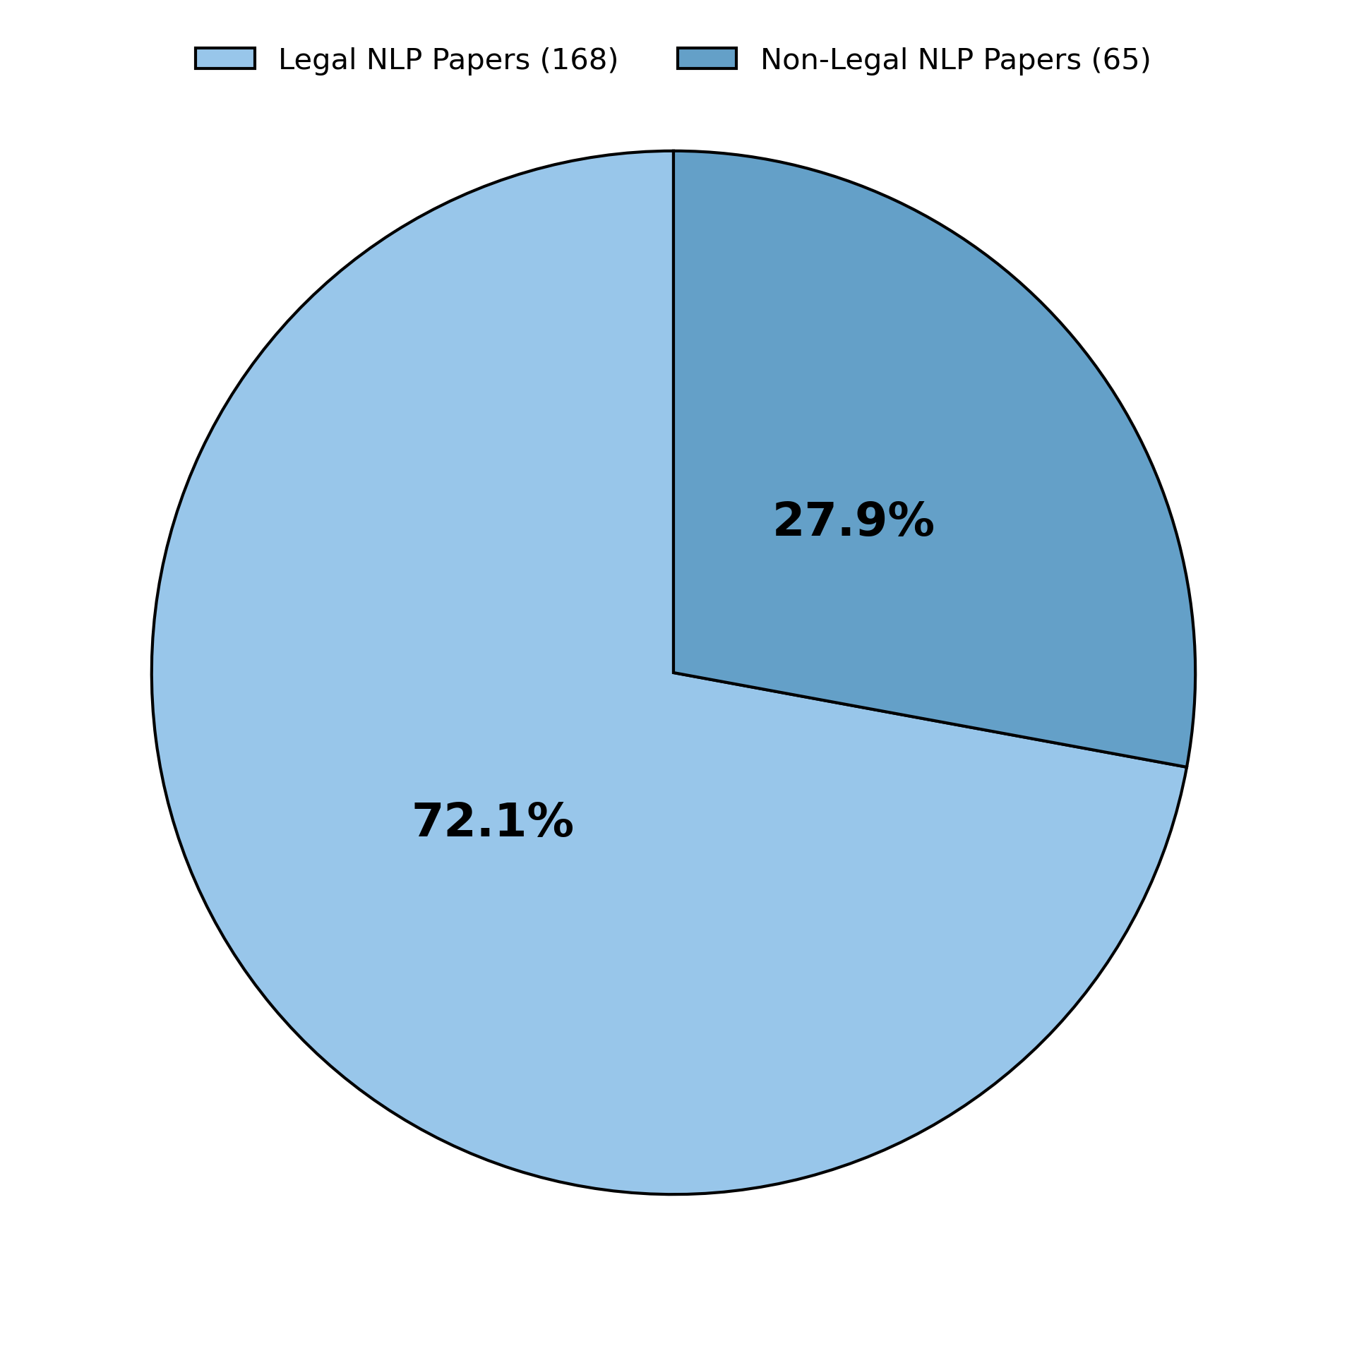
Manual-Labelled Dataset (Gold Set)
Sampling strategy
200 papers drawn at random from the candidate pool.
Gap analysis showed several rare use-cases / techniques were still missing.
Added 33 targeted papers via keyword search to boost those minorities.
Figure 2: Distribution of the 233 Manually Labelled Papers

Slide 14
Novel Use-Case Categories
Taxonomy expanded Manual labelling uncovered papers that fell outside the original framework; we bundled these “orphan” tasks into new buckets and appended them to the taxonomy, taking the total sub-use-case count from 31 to 34.
Main Category | Subcategory | Definition
Document Generation and Assistance | Legal Language Interpretation | Clarify complex provisions, simplify clauses, or explain terminology in legal documents.
Document Analysis and Management | Smart Contract Analysis | Examine blockchain-based contracts to identify obligations, risks, or compliance gaps.
Legal Research and Information Management | Legal Corpus Curation | Curate and enrich legal-text corpora as internal—or licensable—knowledge assets.
NLP Technique list remains unchanged !!!

Slide 15
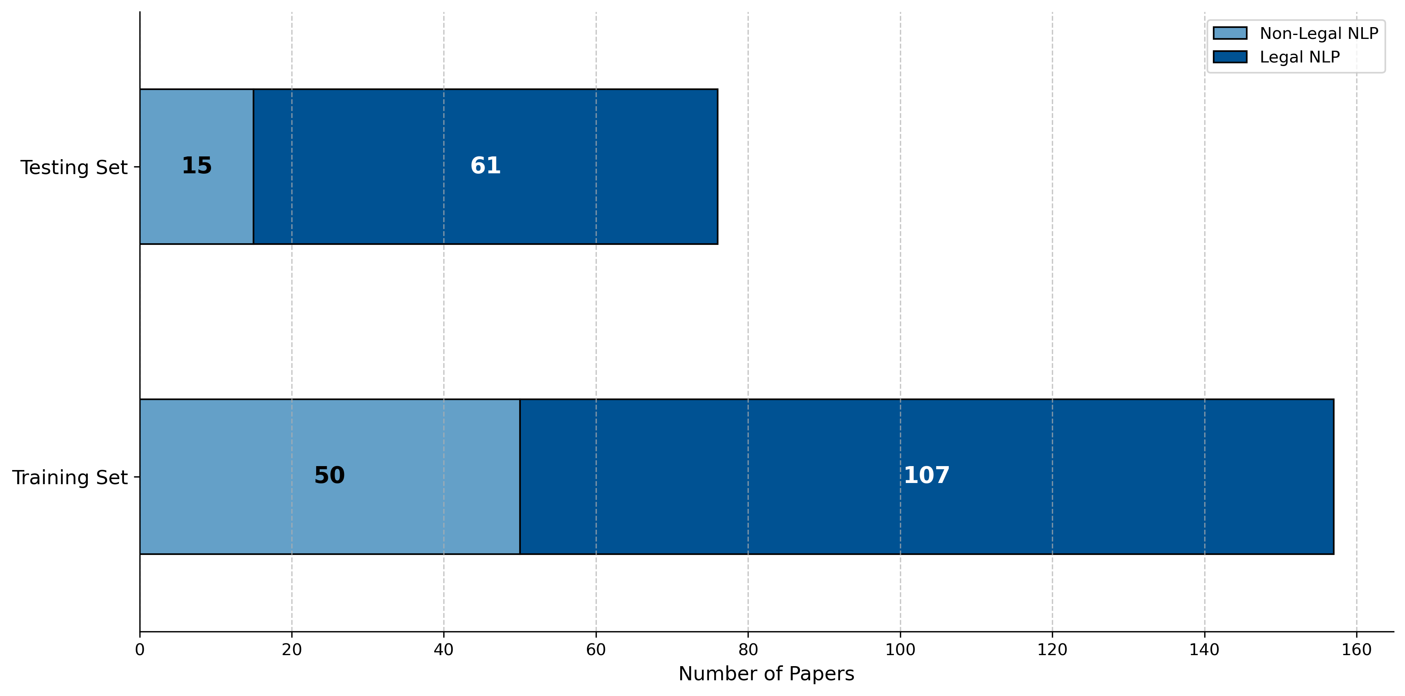
Fine-Tuning Workflow
Two specialised models First model fine-tunes Prompt A for relevance + use-case classification. Second model fine-tunes Prompt B for NLP-technique extraction.
Data split 233 gold-label papers → 157 train / 76 test. Rare use-cases and techniques were manually verified to appear in both sets.
Training routine • Base checkpoint: GPT-4o instruction-tuned model • Input: abstract + prompt template | Target: gold label string • 3 epochs • Checkpoint saved each epoch; best epoch chosen by macro-F₁ on a 10 % in-process validation slice.
Result Two task-specific GPT-4o based models ready for evaluation on the held-out 76-paper test set.
Figure 3: Distribution of Legal and Non-Legal Papers in Training and Test Sets

Slide 16
Methodology Semi-structured interviews

Slide 17
Interview setup
Objective Elicit practitioners’ priority order for the seven legal-NLP use-case categories and uncover the concrete sub-use-cases that shape those priorities.
What each participant does
Background – answer three quick questions (role, tenure, current NLP usage).
Ranking exercise – use an online PaperForm to rank the 7 main use-case categories.
Verbal follow-ups – for every category, explain why it scored high or low and name the specific use-case that influenced the decision.

Slide 18
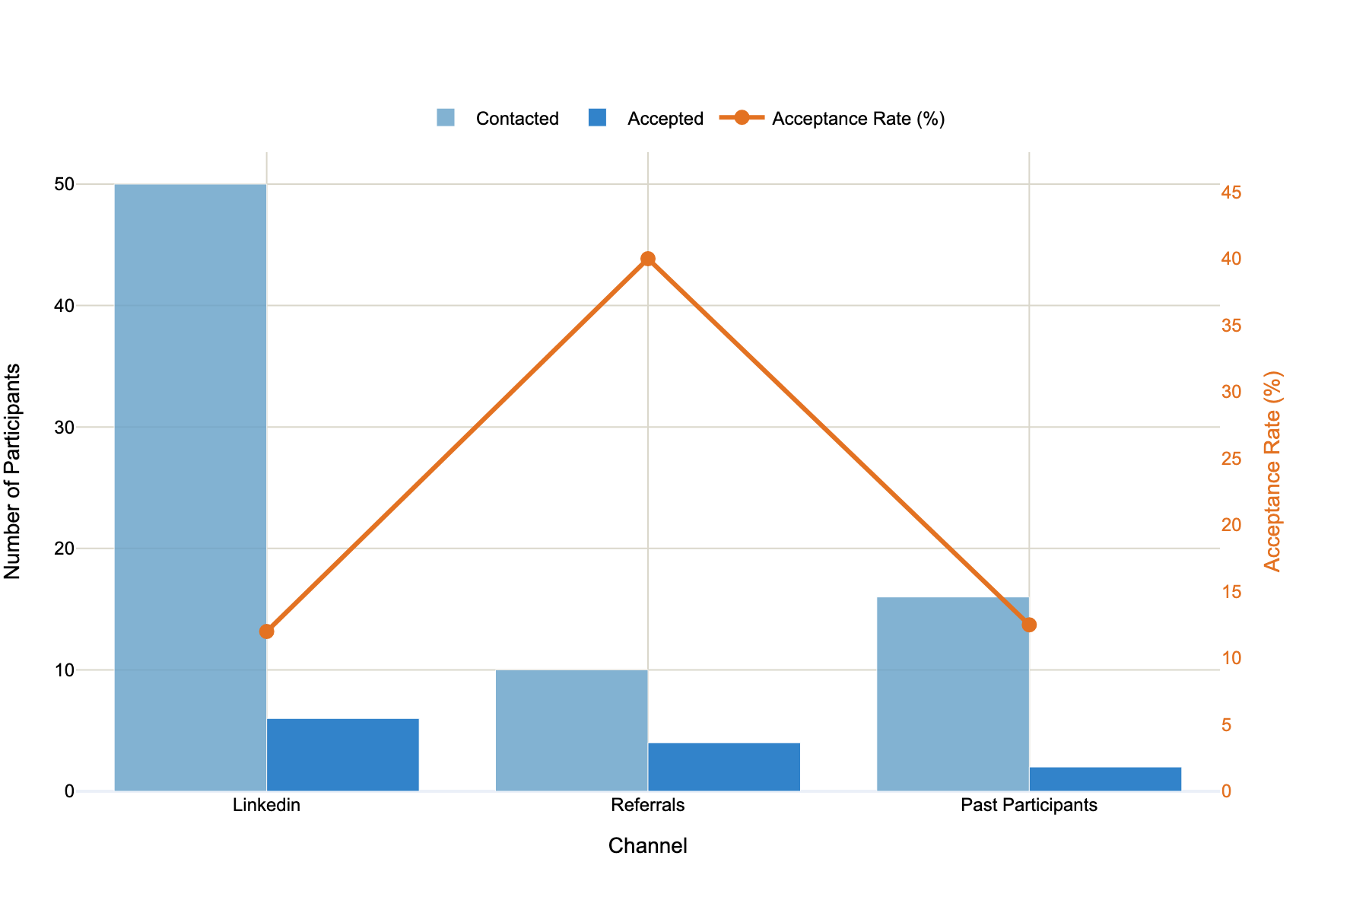
Participant Recruitment
Multi-channel outreach. Contacted ~75 professionals via LinkedIn, past-project alumni, and peer referrals; LinkedIn supplied the largest pool, but warm referrals delivered the highest yield.
Conversion rates. Referral invitations converted at ≈ 40 %, dwarfing LinkedIn’s ~12 % and past-participant outreach (~13 %), underscoring the value of personalised introductions.
Final sample. Secured 12 interviews spread across all three channels
Figure 3: Channel effectiveness in participant recruitment

Slide 19
Overview of Participants
ID | Position | Company Size | Gender | Experience | Duration
I-1 | Attorney | Small | Male | 20--25 | 37
I-2 | Attorney | Large | Male | 20--25 | 35
I-3 | Attorney | Medium | Male | 5--10 | 28
I-4 | Law Student | Student | Male | 0--5 | 25
I-5 | Prosecutor | State Institutions | Male | 5--10 | 32
I-6 | Attorney | Micro | Female | 5--10 | 27
I-7 | Attorney | Medium | Female | 10--15 | 30
I-8 | Attorney | Large | Female | 15--20 | 33
I-9 | Attorney | Large | Male | 10--15 | 25
I-10 | Attorney | Small | Male | 10--15 | 29
I-11 | Attorney | Large | Male | 20--25 | 23
I-12 | Attorney | Micro | Male | 20--25 | 25

Slide 20
Results Systematic Literature Review

Slide 21
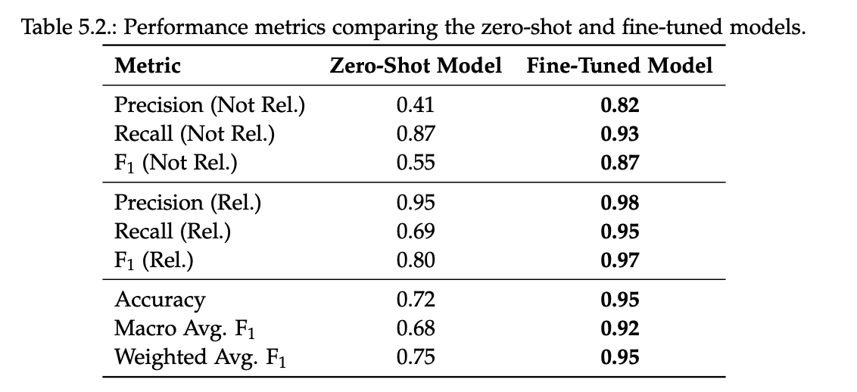
Model Performance Results
Legal NLP Relevance Classification
Performance jump: On a 76-paper test set, fine-tuned GPT-4o pushes accuracy 0.72 → 0.95 (Relevant F₁ 0.80 → 0.97, Not Relevant F₁ 0.55 → 0.87).
Fine-tuning learns domain-specific legal cues, leaving only a few interdisciplinary edge cases misclassified.

Slide 22
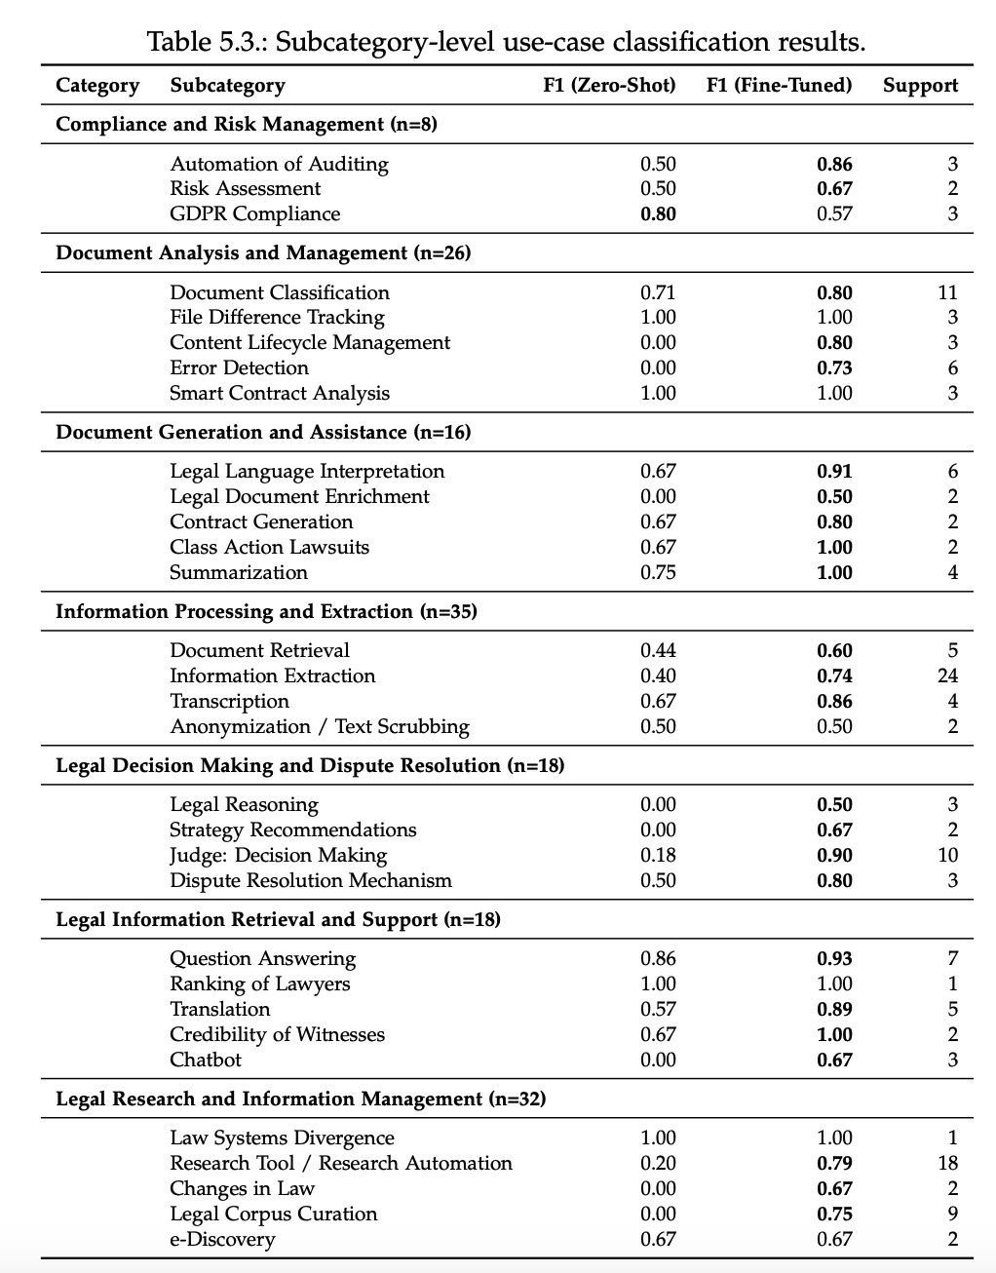
Model Performance Results
Legal AI Use-Case Extraction Performance
Biggest lifts: Judge Decision-Making +0.72 F₁, Audit Automation +0.36, Information Extraction +0.34.
Data matters: subcategories with ≥ 3 docs always jump > 0.25 F₁ after fine-tuning.
Still weak: GDPR Compliance and other ≤ 2-doc tasks stay ≤ 0.67 F₁ → require more samples or label consolidation

Slide 23
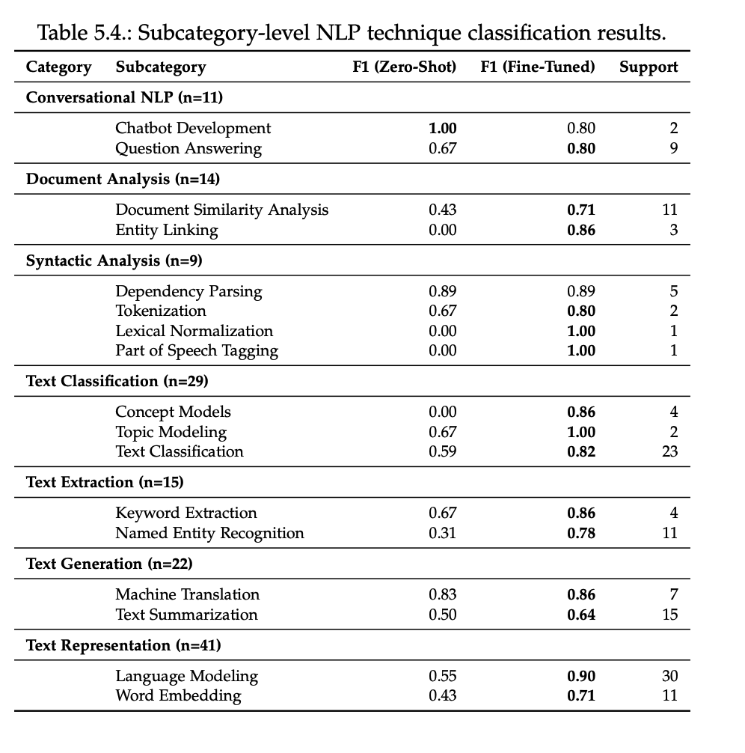
Model Performance Results
NLP Technique Extraction Performance
Dataset note: Results are computed on a 61-paper legally relevant test set
Biggest lifts: Language Modeling +0.35 → 0.90 F₁ Entity Linking +0.86; Lexical Norm./POS +1.00.
Broad uplift: 15 of 17 techniques improve (avg +0.31 F₁); most extraction & classification tasks now ≥ 0.78 F₁.
Still weak / volatile: Chatbot Dev −0.20 (n = 2) and Text Summarization +0.14—dialogue & abstractive tasks need richer data or tailored prompts.

Slide 24
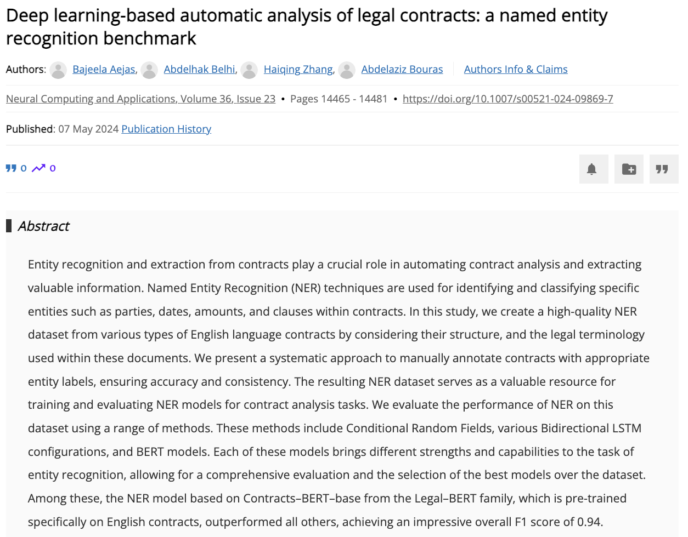
Legal NLP Use Case
Category: Information Processing and Extraction
Subcategory: Information Extraction
Confidence: 1.0
Novel Usecase: Legal dataset creation, evaluation and benchmarking
.
NLP Technology
Category: Text Extraction
Subcategory: Named Entity Recognition
Confidence: 1.0
Category: Text Representation
Subcategory: Language Modeling
Confidence: 0.9
.
.

Slide 25
Large-Scale Analysis

Slide 26
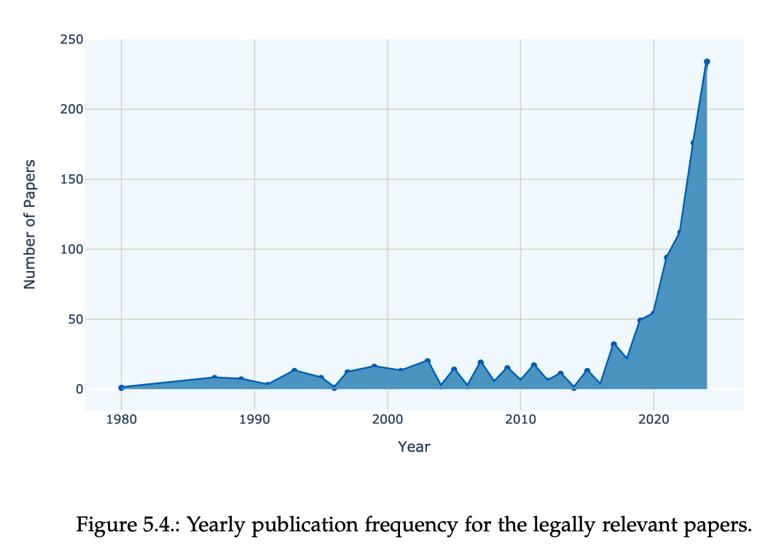
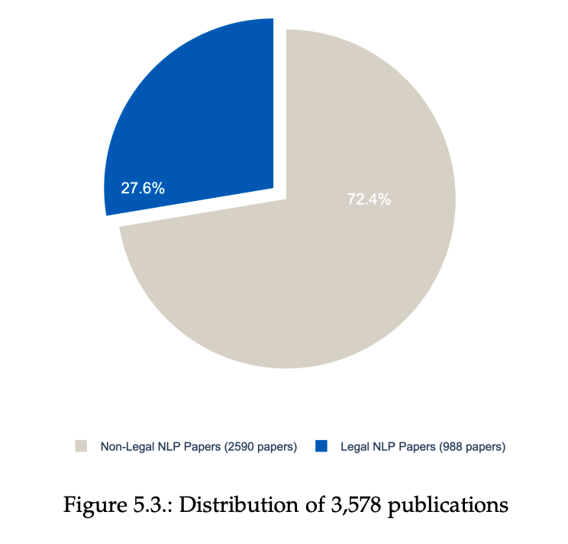
Overall Distribution of Papers
Legal NLP now makes up ≈28 % (988/3’578) of the full corpus.
Publication volume stayed almost flat (<15 papers / yr) for four decades, then takes off after 2015, mirroring the broader deep‑learning boom.
Roughly 75 % of all legal‑NLP papers were published in the last five years, signalling a rapid, still‑accelerating research wave

Slide 27
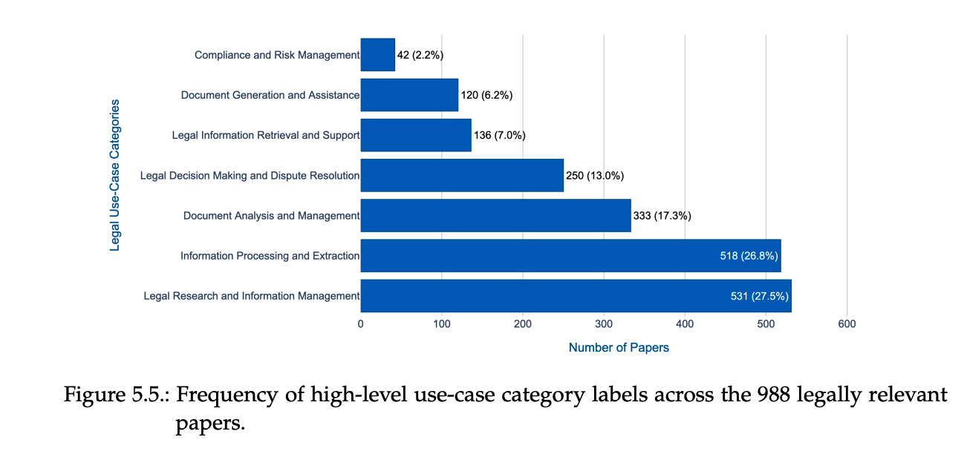
Legal Use-Case Category Distribution
Two knowledge-centric themes—Legal Research & Information Management and Information Processing & Extraction—together represent ≈54 % of all legal-NLP papers.
Practice-oriented areas such as Document Analysis & Management and Legal Decision & Dispute Resolution form a solid middle tier (≈30 % combined).
Compliance & Risk Management is notably scarce (2 %), pointing to a clear gap for future research and industry collaboration.

Slide 28
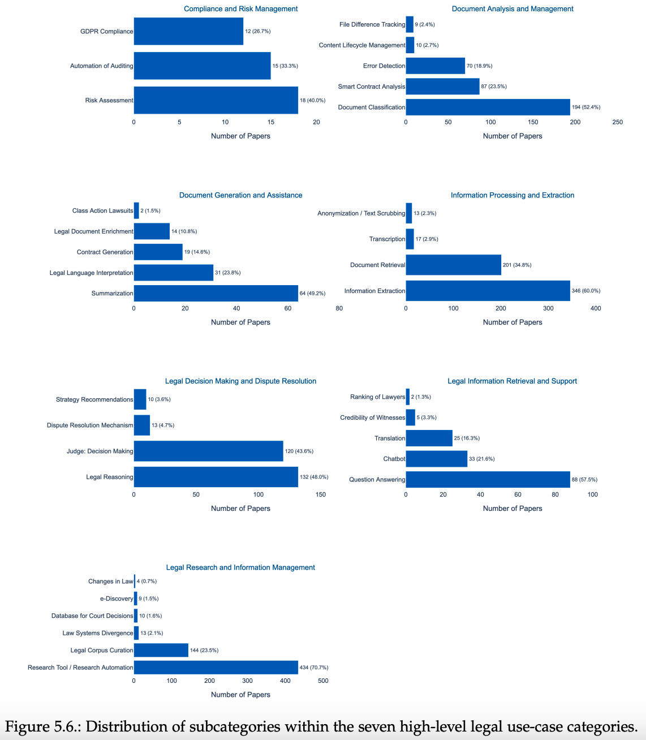
Legal Use-Case Subcategory Distribution
Just 5 subcategories—Research Automation, Information Extraction, Document Retrieval, Document Classification, Corpus Curation—cover ~75 % of all legal-NLP papers, showing research remains heavily data- and retrieval-centric.
Many practical workflow niches are scarcely studied: Ranking of Lawyers, Witness Credibility, Changes in Law, Strategy Recommendations and File-Diff Tracking each appear in ≤1 % of the corpus.
Emerging themes: Smart Contract Analysis (8.8 %) and Legal Language Interpretation (3.1 %) signal growing attention to blockchain agreements and semantic disambiguation.
No papers tackle E-mail or Deadline Management, underscoring a gap between academic focus and everyday legal-practice needs.

Slide 29
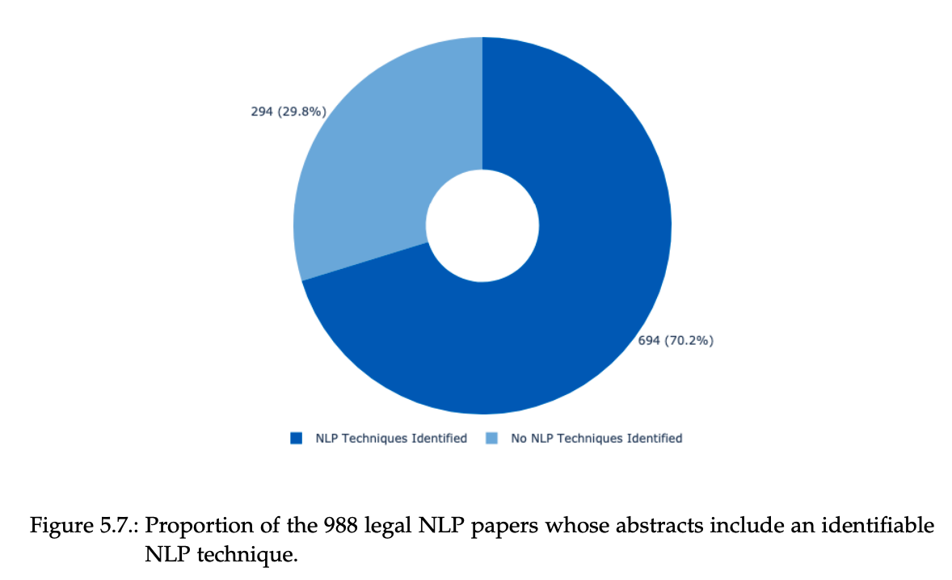
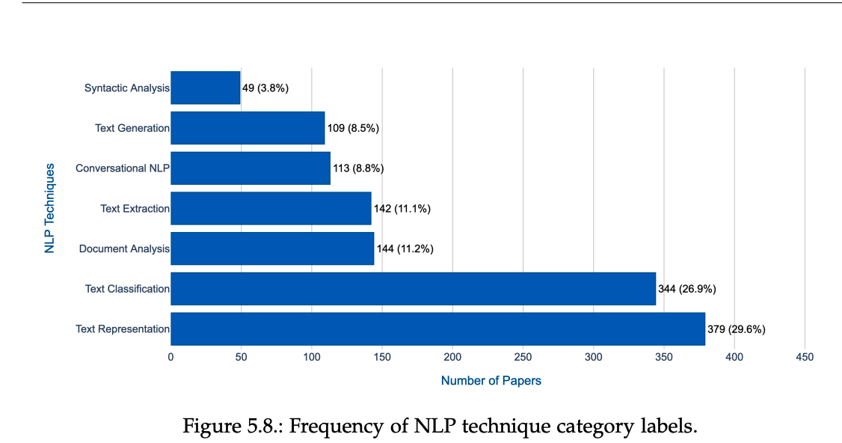
NLP Technique Extraction
Technique visibility: 70 % of abstracts cite at least one NLP method; 30 % omit technical details or focus on theory.
Dominant methods: Text Representation (~380 papers) and Text Classification (~345) account for > 50 % of all technique mentions.
Under-explored methods: Syntactic Analysis is discussed in just 49 papers, because dedicated parsers eclipsed by transformers’ built-in syntax handling.

Slide 30
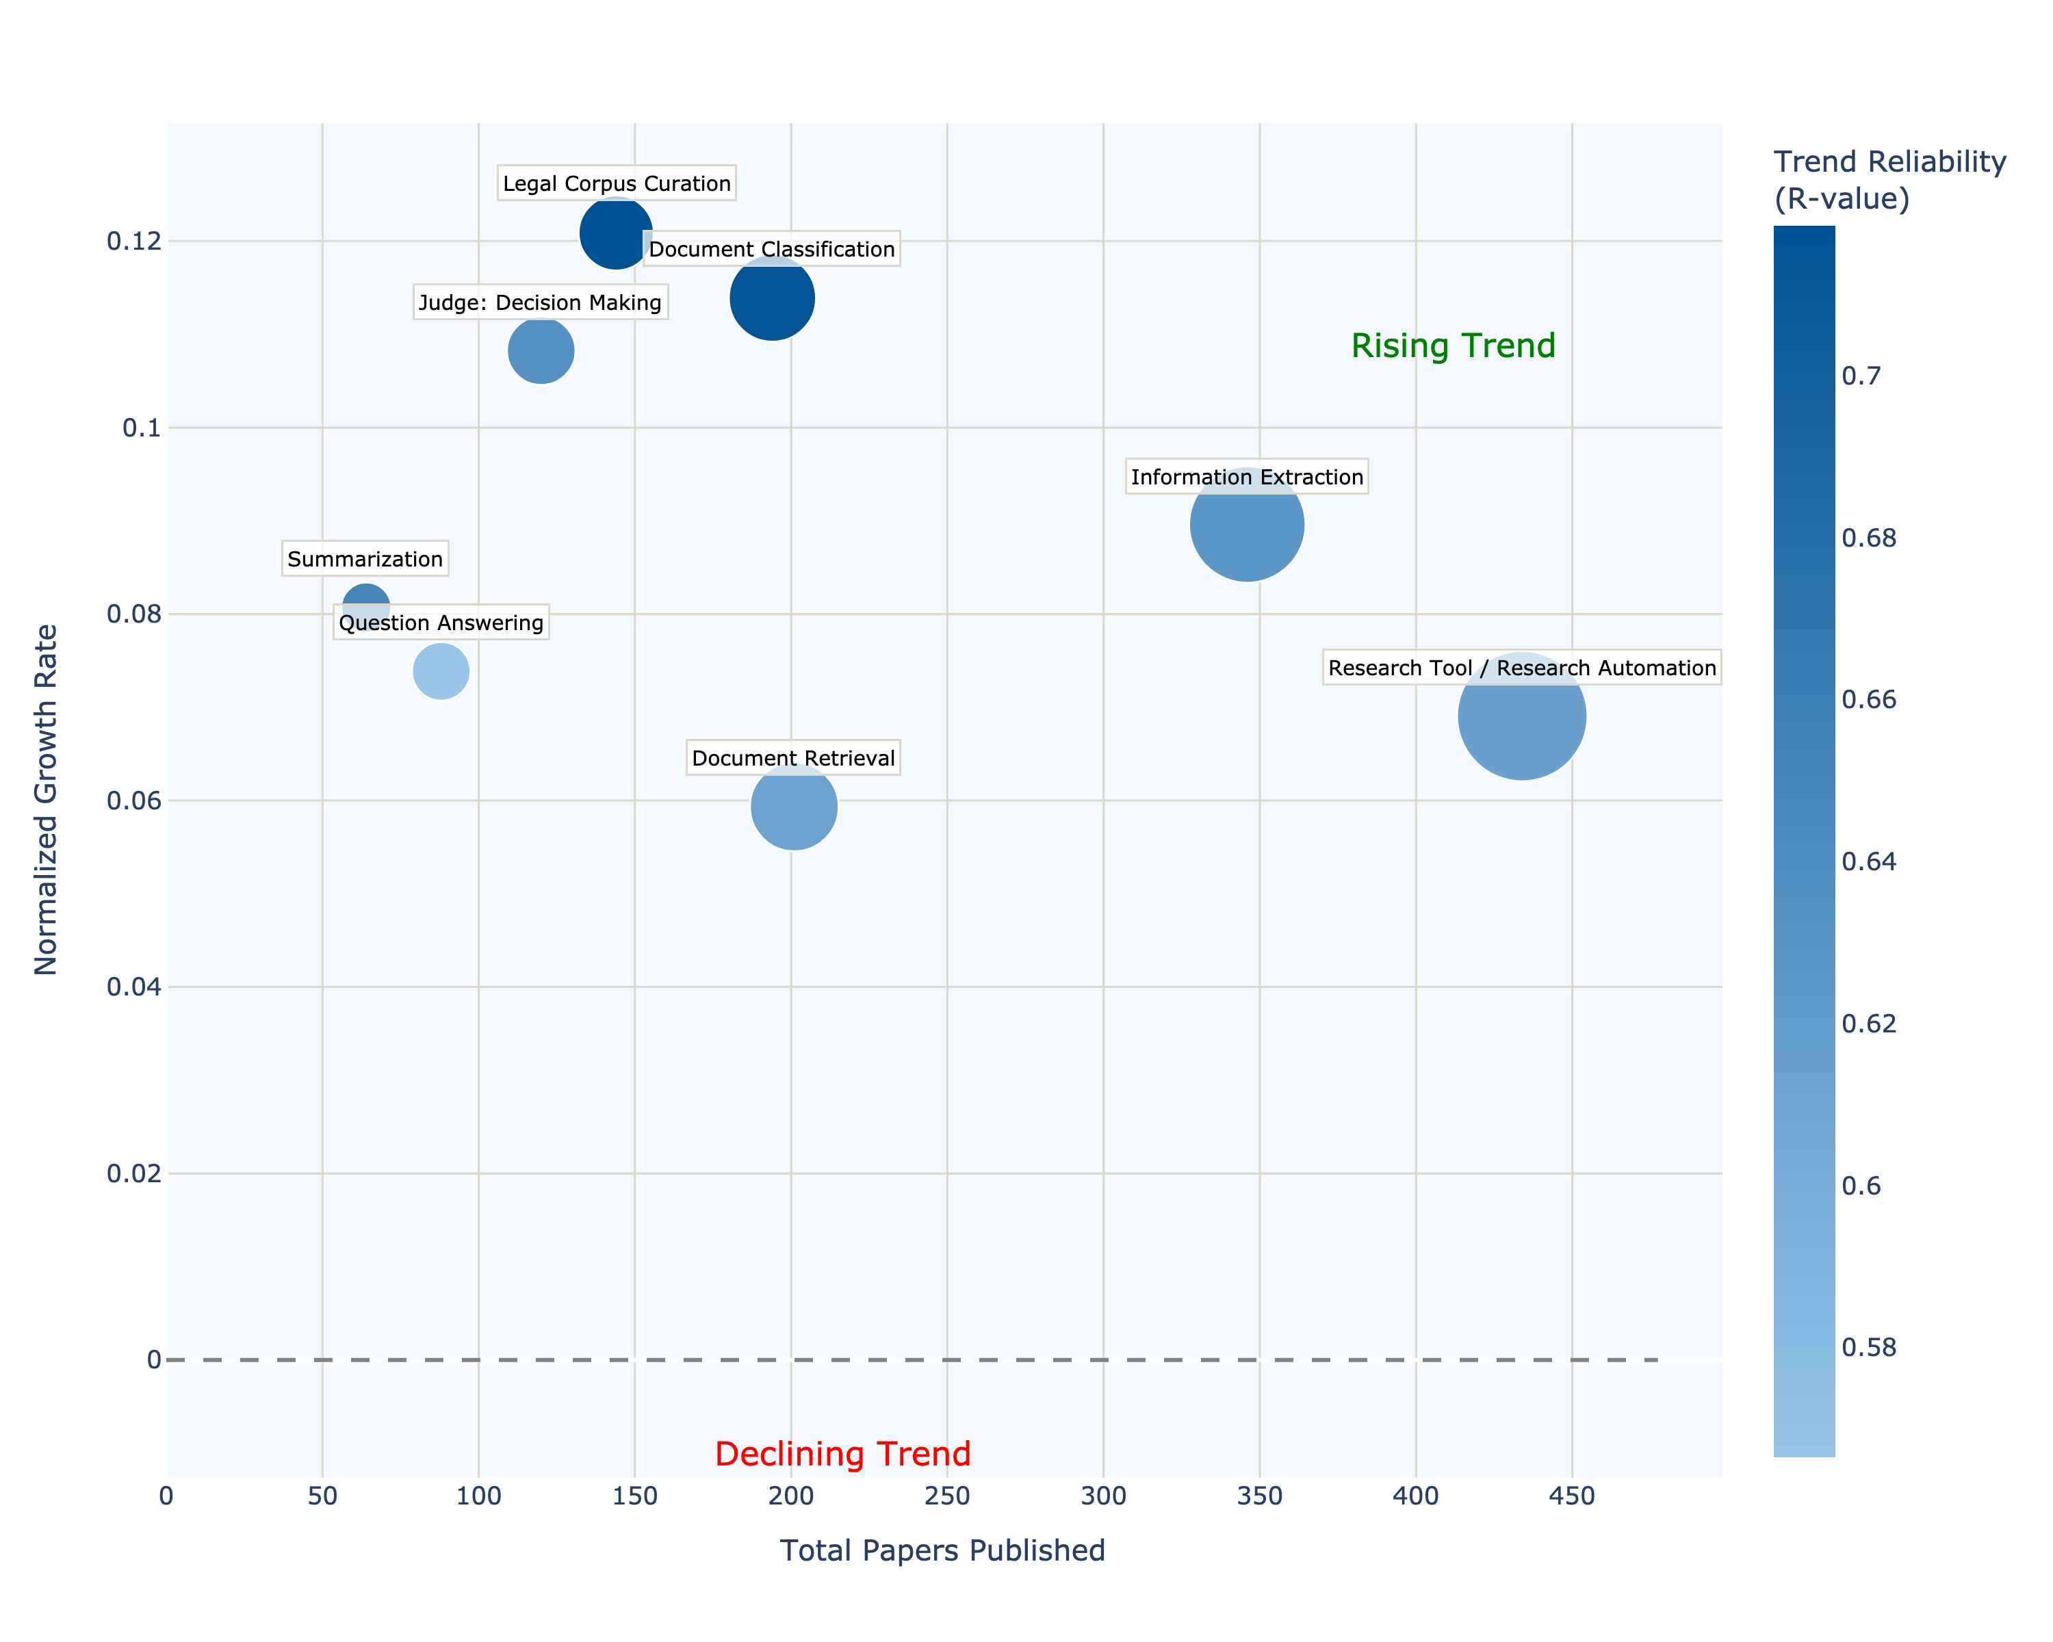
Use-Case Trend Analysis
Legal Corpus Curation (novel): fastest-growing subcategory (highest normalized growth & r-value) as the field pivots toward building large, domain-specific datasets to feed LLMs.
Document Classification & Judge Decision Making: both show robust, reliable upticks—transformer models now drive higher-accuracy document categorization and judicial-outcome prediction.
Steady climbers: Information Extraction, Summarization, Question Answering, Research Automation, and Document Retrieval all show statistically significant growth, signalling a shift from mere retrieval to richer semantic analytics.
No declines observed: every tracked subcategory rises, indicating legal-NLP research is broadening rather than consolidating its scope.

Slide 31
Results Semi-Structured Interviews

Slide 32
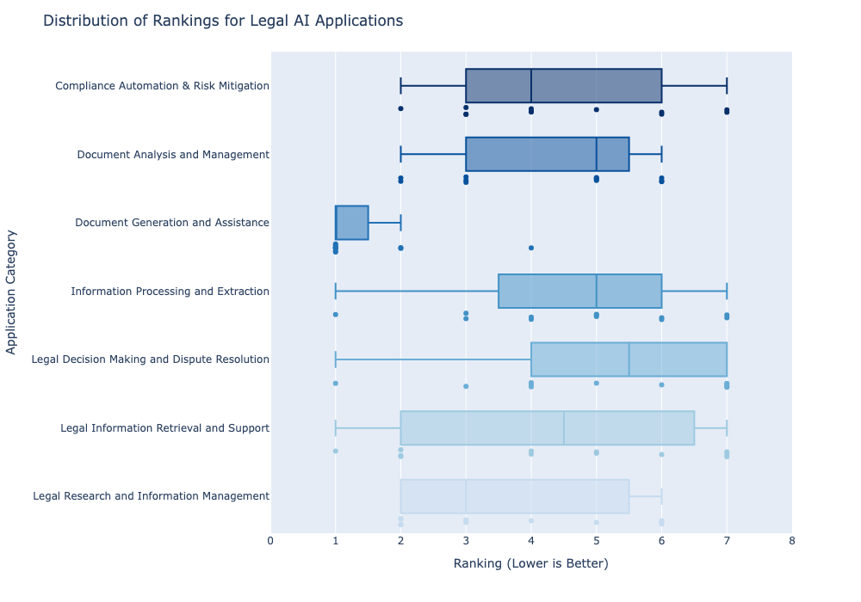
Ranking Outcomes from SSI
Clear #1: Document Generation & Assistance sits near rank 1 for almost everyone (avg 1.42) with a very tight IQR → strongest consensus.
Runner-up, wider spread: Legal Research & Information Management clusters lower than the rest (avg 3.67) but shows a broader IQR, signalling mixed emphasis across practices.
Middle cluster (avg ≈ 4–5): Document Analysis & Management (4.25), Legal Info Retrieval & Support (4.33), Compliance Automation & Risk (4.50), and Information Processing & Extraction (4.67) overlap substantially, indicating mid-level priority with varied views.
Lowest priority: Legal Decision Making & Dispute Resolution ranks last (avg 5.17) and has the widest range—only one outlier scores it highly, most place it at the bottom.

Slide 33
Qualitative Takeaways from 12 Expert Interviews
Document Generation & Assistance is the universal priority: nine of 12 interviewees praise contract-drafting and summarization tools for large time savings (e.g., I-10 sees ≥30 % overhead cut; I-11 values rapid regulation overviews).
Legal Research & Information Management ranks second but splits by practice area: multinational lawyers (I-2, I-8) emphasise monitoring law-system divergence, while e-Discovery is “indispensable” only for high-volume litigators (I-9).
Document Analysis & Management viewed as useful yet non-critical: classification speeds filing searches (I-7) but some (I-1) doubt benefits over existing rule-based systems.
Compliance Automation matters chiefly in tightly regulated fields—GDPR checks (I-8) and contract risk flags (I-11) are praised, but most others keep it secondary.
Legal Decision Making & Dispute Resolution sits last: one prosecutor (I-5) values resource-allocation predictions, yet most participants echo I-1’s concern that “complex judicial reasoning” is too sensitive to delegate to AI.

Slide 34
Discussion

Slide 35
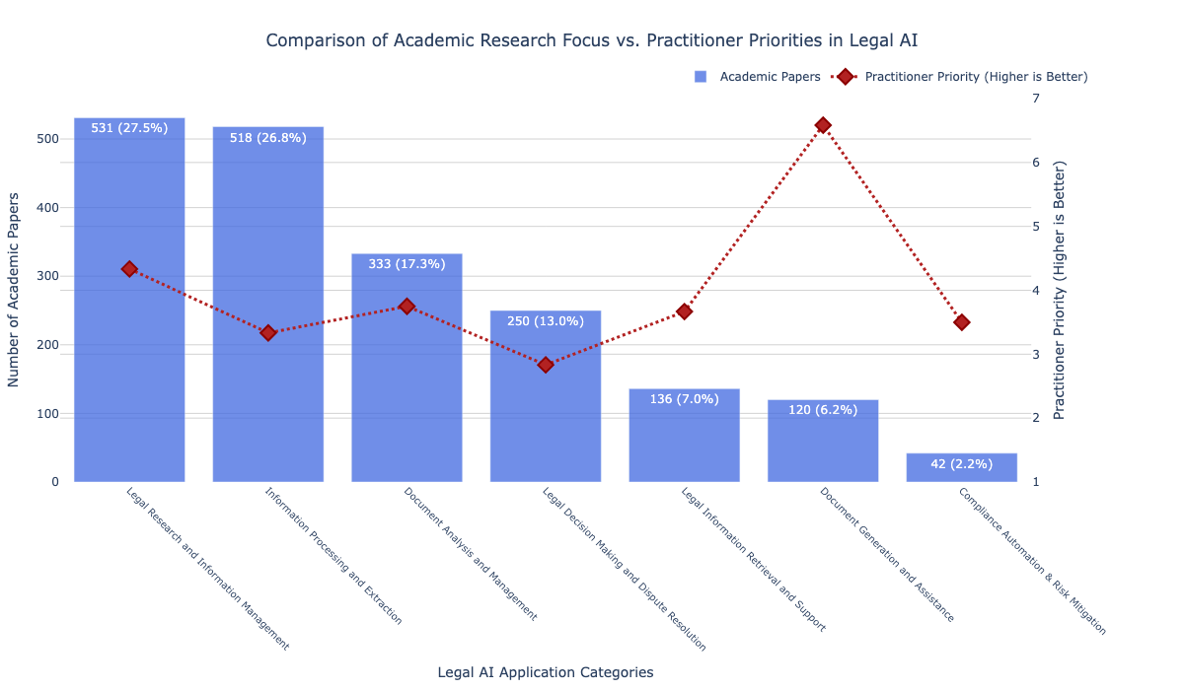
Alignment and Gaps between Academia and Industry
Alignment • Document Analysis & Mgmt (333 papers) – classification valued on both sides • Legal Research & Info Mgmt (531 papers) – shared focus on research automation; lawyers also want law-change, divergence, e-Discovery tools
Over-researched, low uptake • Info Processing & Extraction (518) – “not mature enough” for daily use • Decision Making & Dispute (250) – ethics / interpretability curb adoption
High practitioner demand, thin research • Document Generation & Assistance (< 130) – top-ranked for productivity, few contract-drafting studies • Compliance Automation & Risk (~ 40) – sought in regulated sectors, lacks datasets & domain work

Slide 36
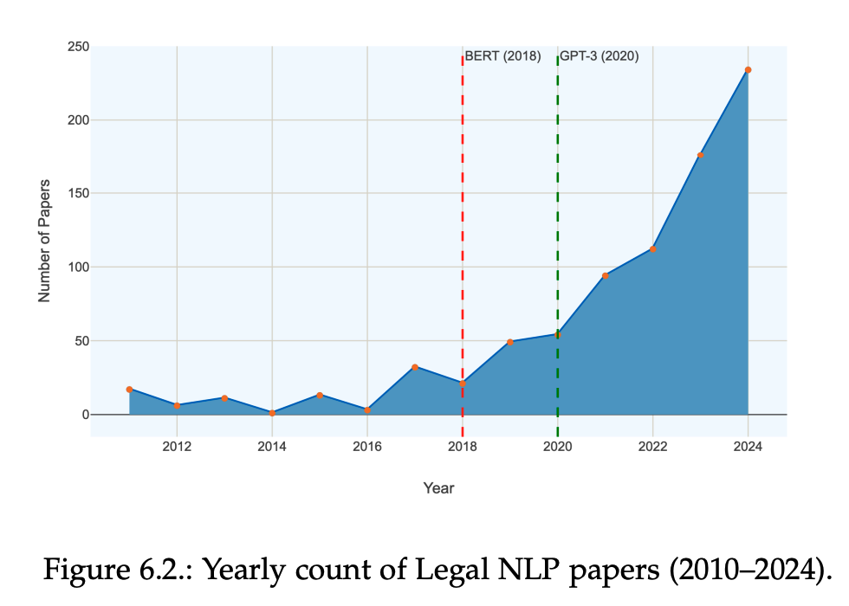
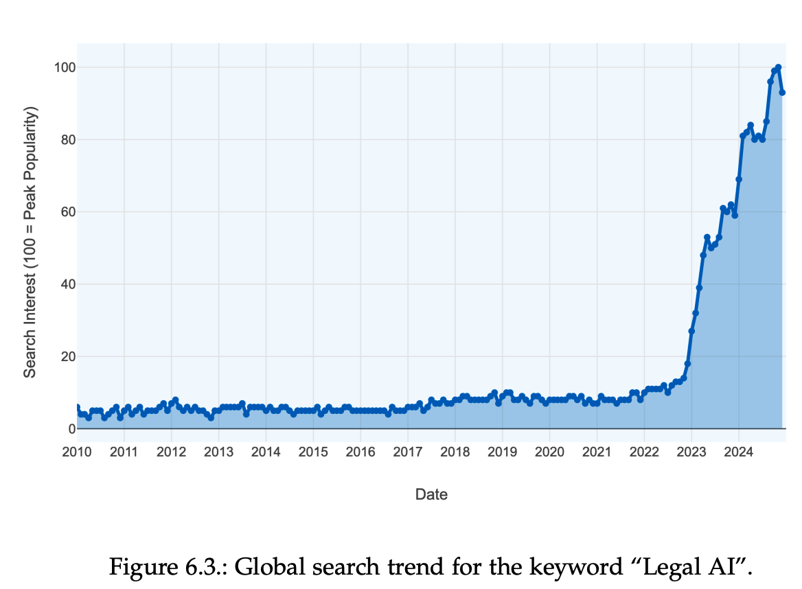
Interpreting the Rising Trend of Legal NLP Publications
Transformer milestones align with spike: BERT (2018) and GPT-3 (2020) mark inflection points in the curve, underscoring the field-wide impact of attention-based and LLM paradigms
Market visibility echoes the trend: Google searches for “Legal AI” stay modest until 2018, then climb steeply to a 2024 peak mirroring the publication uptick.
Capital follows momentum: global legal-tech funding accelerates post-2018, topping $5 B in 2024, injecting resources that fuel new data curation efforts and domain-adapted models.

Slide 37
Limitations and Future Work
Limitation | Future work
Keyword-based search may miss niche or older papers | Iteratively refine queries and add citation-snowball sampling
Abstract-only classification can overlook subtler methods | Parse introductions / selected full text to reduce mislabels
Small, imbalanced training set (233 abstracts; rare classes under-represented) | Expand and rebalance labeled corpus through collaborative annotation
Pipeline depends on proprietary, costly GPT-4-o | Experiment with open-source LLMs (e.g., Llama, DeepSeek) to match or exceed accuracy
Interview pool limited (12 participants) | Enlarge sample across jurisdictions, firm sizes, and roles
Missing practitioner roles (judges, paralegals, compliance officers) | Target broader professional diversity in future ranking exercises

Slide 38
Henrik Sergoyan
henrik.sergoyan@tum.de
17132
matthes@in.tum.de

Slide 39
Appendix

Slide 40
Prompt A: Boolean + Use-Case Classifier
You are an advanced classifier focusing EXCLUSIVELY on text, language, or NLP applications
within the legal domain.
USE CASE CATEGORIES TO EXPLICITLY SEARCH:
{legal_use_case_text}
TASK:
- The classification is MULTI-LABEL: the paper can match multiple sub-categories.
- Use EXACT sub-category names from the known set of legal NLP use-cases only.
- Do NOT create or use new sub-categories.
- If the text appears to be a literature survey, workshop summary, a book or book chapter
do NOT classify it.
- Only proceed with classification if the text is a research paper explicitly describing
NLP/text-based methods in legal contexts.
- If there is NO explicit mention or clear description of a text-based or language-based
or knowledge-based method in a legal context, output FALSE.
- Immediately exclude papers which discuss AI/automation in legal contexts **without
explicit text/language-based methods** (e.g., general AI ethics, governance, or policy debates).
IMPORTANT NOTE:
- NLP in this context includes any form of text analytics, text mining, text classification,
information extraction, summarization, or other language-based techniques specifically
applied to legal documents or legal data.
- Even if the terms "NLP" or "natural language processing" are not used, you should treat
references to analyzing, processing, comparing, extracting, curation or transforming text
within a legal context as an NLP use-case—provided the paper explicitly discusses
these text-based methods.
- "AI assisting judges" ≠ NLP unless it describes text analysis (e.g., extracting case facts,
summarizing precedents).
- "Chatbots" ≠ NLP unless they process legal text (e.g., parsing statutes, answering legal
questions from text corpora).
- Exclude papers that only mention automation, algorithms, or AI without **text-based workflows**.
CRITICAL INSTRUCTIONS:
- ONLY classify use cases DIRECTLY MENTIONED in the text. ZERO tolerance for inference.
- **Exclude** classifications with confidence < 0.8 from the final output
- ONLY classify use cases and concerns DIRECTLY MENTIONED or clearly described in the text
(e.g., mention of analyzing legal documents, extracting clauses, comparing legal text versions,
summarizing case files, etc.).
- If NO clear mention of text-based or language-based analysis for a legal purpose,
do NOT speculate—output FALSE.
- ZERO tolerance for inference without textual proof.
- No classification without explicit text/language + legal connection.
- Immediately EXCLUDE papers which mention terms like "black box," "transparency," or "fairness"
**without tying them to NLP techniques**.
- Immediately EXCLUDE papers which focus on societal/ethical implications of AI in law
rather than NLP applications.
- **ZERO IMPLICATION RULE**: NEVER use phrases like "can be interpreted as," "implies," "suggests,"
or "indirectly supports."
- **DIRECT EVIDENCE ONLY**: A sub-category is valid ONLY if the text **explicitly describes the task**
(e.g., "detect missing clauses," "analyze blockchain contracts").
- **Reject** classifications where the reasoning relies on assumptions or extrapolation.
CLASSIFICATION CRITERIA (confidence scores):
- 1.0 : Verbatim, direct use-case description in the text.
- 0.8–0.99 : Clear, specific application discussion.
- 0.6–0.79 : Implied but substantive discussion of a known use-case.
- 0.4–0.59 : Vague or peripheral mention (not well-defined).
- 0.0–0.39 : No meaningful mention or connection.
CRITICAL FINAL CHECK:
- No classification if no mention of text analytics or language-based processing in a
legal context.
- No speculation or invention of sub-categories.
- Maximum academic rigor and textual evidence.
- Preserve the exact sub-category names.
OUTPUT FORMAT (STRICT JSON):
A single string of comma-separated sub-categories (ONLY sub-categories with confidence >= 0.8).
If no valid classifications, output empty string.
Example: "Automation of Auditing, Risk Assessment"
If the paper does not discuss legal NLP use cases:
Return None
Objective Identify papers that explicitly apply text- or language-based methods to legal data and tag every matching sub-use-case from a fixed taxonomy of 31 predefined categories
Scope directive Searches only within those 31 categories; strictly ignores any topic outside this list.
Strict inclusion / exclusion rules
Accept research papers describing NLP/text workflows in a legal context.
Reject literature surveys, workshop summaries, books, policy/ethics papers, or generic “AI in law” work without text processing.
Zero-Implication & Evidence gate
Direct evidence only—no guessing, no “implies,” no extrapolation.
Confidence ≥ 0.80 required; otherwise the category is dropped.
Multi-label output Produces a comma-separated string of all sub-use-cases meeting the 0.80 threshold; returns None if none qualify.
// Output example
"Automation of Auditing, Risk Assessment"

Slide 41
Prompt B: NLP-Technique Extractor
You are an advanced classifier focusing EXCLUSIVELY on identifying specific Natural Language Processing (NLP) techniques used in research papers.
NLP TECHNIQUE CATEGORIES TO EXPLICITLY SEARCH:
{nlp_technique_text}
TASK:
- The classification is MULTI-LABEL: the paper can use multiple NLP techniques.
- Use EXACT technique names from the known set of NLP techniques only.
- Do NOT create or use new technique names.
- Only identify techniques that are EXPLICITLY mentioned or clearly demonstrated in the paper.
- Identify ONLY techniques that appear in the provided categories list above.
- If a technique is not explicitly mentioned or described, do NOT include it.
IMPORTANT GUIDELINES:
- Identify ONLY techniques that have DIRECT EVIDENCE in the text.
- A technique is valid ONLY if the text explicitly mentions or describes its use.
- Even if the exact name of the technique isn't used, include it if the description clearly matches.
- Exclude techniques with confidence < 0.8 from the final output.
- Maintain the original technique names exactly as listed above.
- Do NOT speculate on techniques that might be implied but not explicitly described.
CONFIDENCE CRITERIA:
- 1.0: Explicit mention by name with implementation details
- 0.8-0.99: Clear description of the technique even if not named explicitly
- 0.6-0.79: Strong indication of the technique's use
- 0.4-0.59: Possible but unclear reference to the technique
- 0.0-0.39: No substantive evidence of the technique
CRITICAL FINAL CHECK:
- Only include techniques with high confidence (>= 0.8)
- No speculation or invention of techniques
- Use exact technique names
- Maximum academic rigor and textual evidence
OUTPUT FORMAT:
A single string of comma-separated technique names (ONLY techniques with confidence >= 0.8).
If no techniques are identified with sufficient confidence, output an empty string.
Example: "Named Entity Recognition, Text Classification, Word Embedding"
If no valid techniques are identified:
Return an empty string
Objective From papers already flagged as Legal NLP, identify every NLP technique actually used, drawing only from a fixed list of 17 predefined categories.
Scope directive Searches only within those 17 techniques; ignores any method outside the list.
Strict inclusion / exclusion rules
Accept techniques explicitly named or clearly described in the text. • Zero speculation—a technique is valid only with direct mention or an unambiguous description of its application.
Zero-Implication & Evidence gate
Direct evidence only—no guessing, no “implies,” no extrapolation.
Confidence ≥ 0.80 required; otherwise the category is dropped.
Multi-label output Produces a comma-separated string of all sub-use-cases meeting the 0.80 threshold; returns None if none qualify.
// Output example
"Named Entity Recognition, Word Embedding"

Slide 42
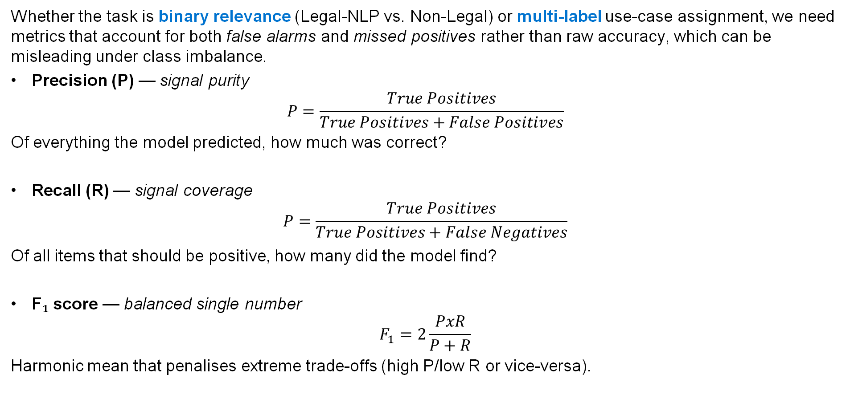
Evaluation Metrics
Whether the task is binary relevance (Legal-NLP vs. Non-Legal) or multi-label use-case assignment, we need metrics that account for both false alarms and missed positives rather than raw accuracy, which can be misleading under class imbalance.
Precision (P) — signal purity
$$P=\frac{True Positives}{True Positives+False Positives}$$
Of everything the model predicted, how much was correct?
Recall (R) — signal coverage
$$P=\frac{True Positives}{True Positives+False Negatives}$$
Of all items that should be positive, how many did the model find?
F₁ score — balanced single number
$$F_{1}=2\frac{PxR}{P+R}$$
Harmonic mean that penalises extreme trade-offs (high P/low R or vice-versa).

Slide 43
Trend-Analysis Method
Goal – As per our RQ2 we need to detect which of the 34 use-cases and 17 NLP techniques are genuinely rising or fading in the literature across 2010 - 2025.
Growth signal – Compute the Compound Annual Growth Rate (CAGR) of yearly paper counts for each label.
Trend significance – Measure the Pearson correlation (r) between year and count and test it with a p-value < 0.05 to confirm the pattern isn’t random noise.
Decision rule – Label is “trending” when CAGR > 0 and |r| is large and p < 0.05; otherwise classed as stable or unclear.

Slide 44
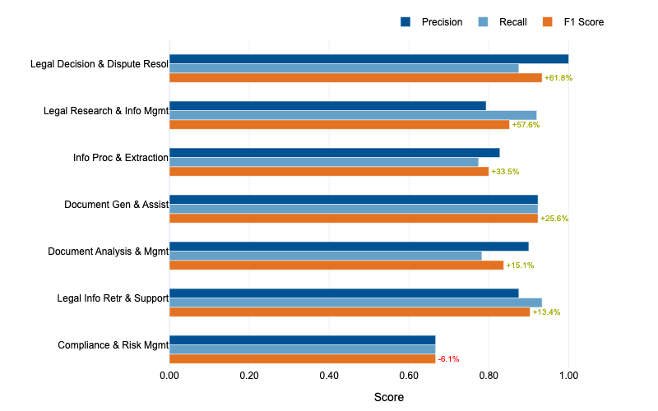
Model Performance Results
Use-Case Category Level Analysis
Headliner jump: Legal Decision Making & Dispute Resolution surges +62 pp, landing near 0.96 F₁.
Solid middle pack: Legal Research and Information Management and Information Processing and Extraction gain +34–58 pp, while three more categories now clear ~0.85 F₁.
Lone laggard: Compliance & Risk Management slips -6 pp (≈0.64 F₁) → signals need for extra samples or tighter label scope.

Slide 45
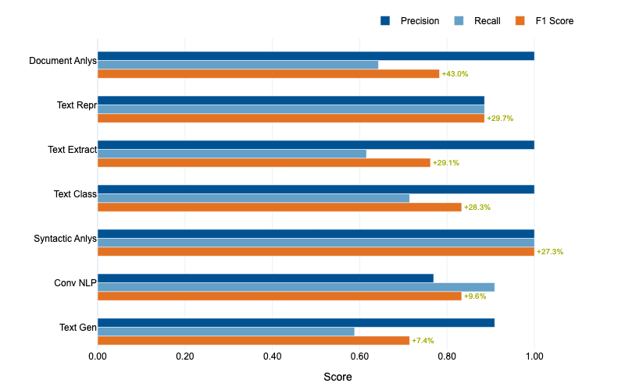
Model Performance Results
NLP Technique Category Level Performance
Stand-out gain: Document Analysis rockets +43 pp F₁, now flirting with 0.80 and near-perfect precision.
Wide boost band: Text Representation, Extraction & Classification each climb ~+28-30 pp, pushing four of seven categories past ~0.85 F₁.
Next focus: Conversational NLP (+9.6 pp) and Text Generation (+7.4 pp) still trail—suggests adding data or specialised prompts for dialogue-heavy tasks.

Slide 46
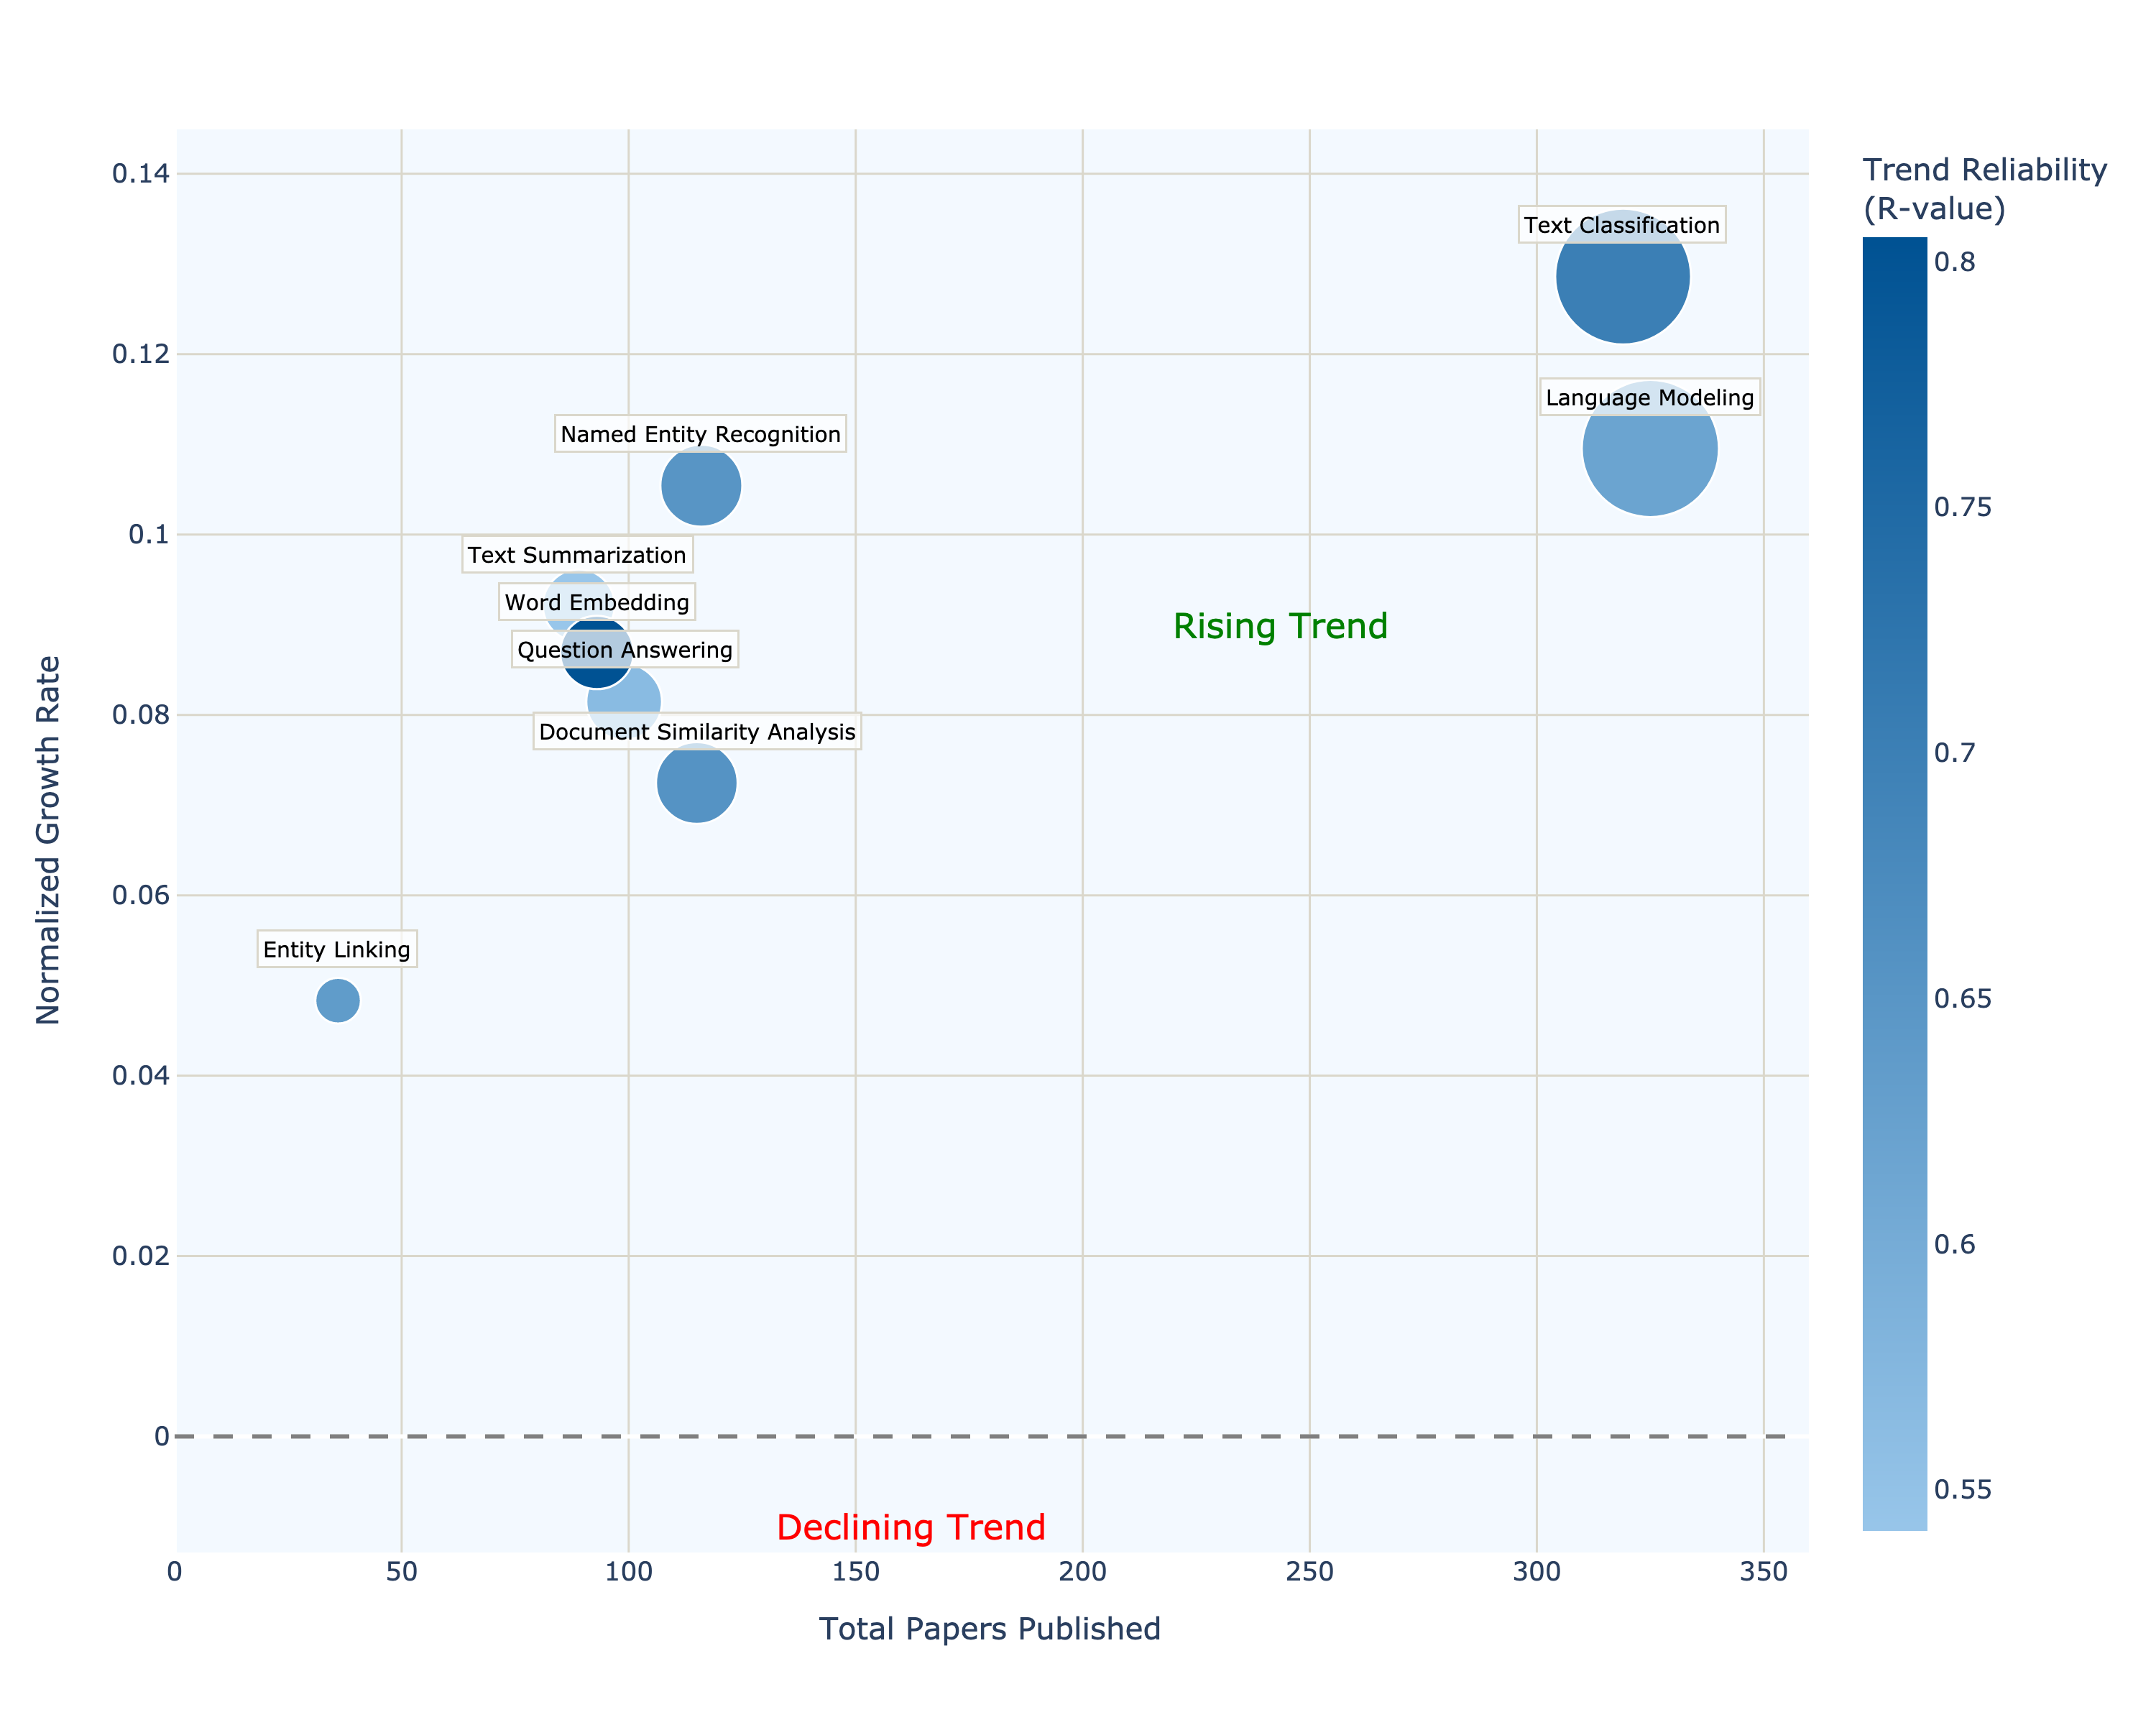
NLP Categories Trend Analysis
Clear front-runners: Text Classification and Language Modeling pair high volume with the steepest growth—evidence of transformer and LLM dominance across legal NLP tasks.
Strong runner-up: Named Entity Recognition is the fastest-growing mid-volume technique, mirroring demand for precise entity extraction in contracts and case law.
Steady climbers: Summarization, Word Embedding, Question Answering, and Document Similarity all rise at ~0.07–0.09 normalized rates, showing broadening adoption of semantic and retrieval-heavy methods.
Emerging niche: Entity Linking remains small (<50 papers) but trends upward, hinting at future integration between NLP and legal knowledge graphs.

Slide 47
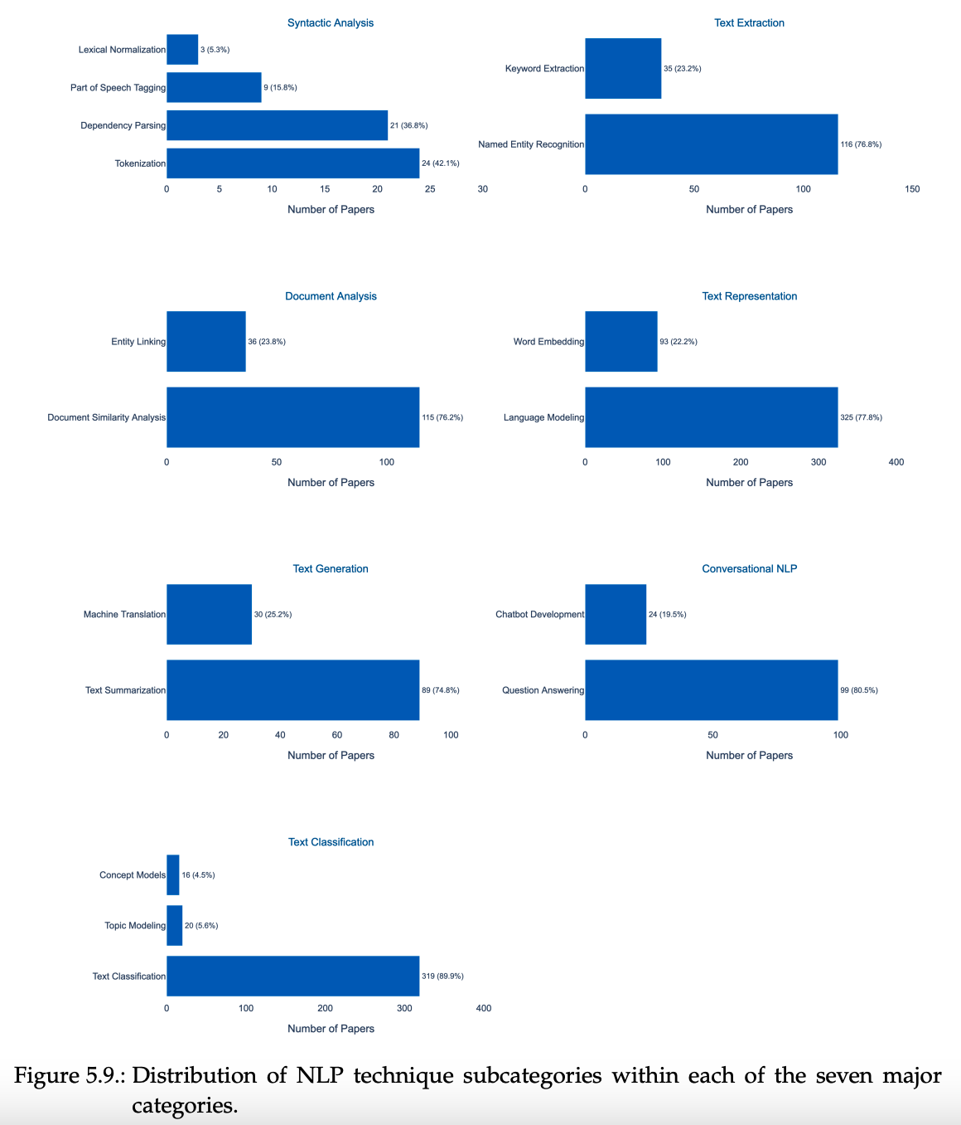
NLP Technique Subcategory Distribution
Language modeling and text classification dominate: together they account for roughly two-thirds of all technique mentions.
Mid-tier focus is on named-entity recognition and document similarity analysis (~12 % each), reflecting demand for entity-level analytics and case/contract matching.
Low-level syntactic work is rare—lexical normalisation (0.3 %), POS tagging (0.9 %)—likely handled by modern tokenisers or transformers’ built-in syntax.

Slide 48
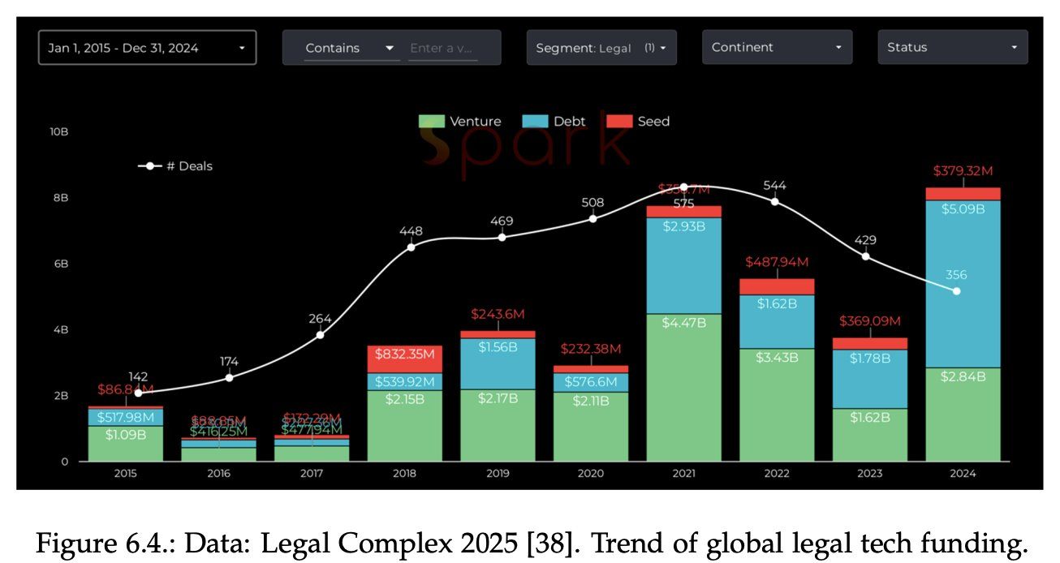
Legal Tech Funding

