Slide 1
Distillation of Semantically Similar Context Windows into Disjoint and Complete Class Archetypes Sets
Masters Thesis Kick-Off Presentation, 13.01.2025
Maria Nakhla

Slide 2

Outline
Introduction & Motivation
Research Questions
Methods & Results
Evaluation
Summary
Next Steps
Timeline

Slide 3

Introduction & Motivation (CD4AI)
Via
Archetypical Rule
or
Class Concept
Unstructured and Unlabelled Text
Classified and Annotated Data
"Today, we're seeing a massive shift in how organizations use data. From social media posts to video streams, the variety and volume of unstructured data are overwhelming. Yet, extracting value from it remains a challenge for many businesses."
Business

Slide 4

Introduction & Motivation
Goal
Many : 1/Few
:
Semantically Similar Context Windows
semantically similar context windows
coherent archetypes
fast food company was accused in federal court of serving adulterated food
Goal
Fast food industry controversies, food safety concerns, and legal disputes. Fast food companies accused of serving adulterated food in federal court. Food trucks and takeout/delivery food safety. Realization of food insecurity in schools, prisons, and senior centers. Discussion on food court and food fights.'
about the safety of your takeout and delivery food
Generate archetypical rule
way institutions like schools prisons and senior centers think about food
know about the food court
.
.
.

Slide 5
Research Questions
What are the most effective methods to accurately capture semantics from related text chunks and distill them into one coherent text?
What are the current prompt engineering techniques crucial for generating a well-defined, and coherent class archetypes which effectively incorporate domain expertise?
How can the quality and consistency of the generated class archetypes be evaluated, and ensured?
Does the downstream utility of generated archetypes achieve similar results to manually annotated datasets in domain-specific tasks?

Slide 6
Methods & Results - Pipeline Overview
Context Windows
Embedding Models
Clustering Methods
Clusters
Prompt Engineering
LLMs
Archetypical Rules

Slide 7
Methods & Results - Labelled Datasets
SetFit/20_newsgroups
SetFit/bbc-news
News_Category_Dataset_v3
20 News Groups
Fields:
  Text
  Label
5 News Categories
Fields:
  Text
  Label
42 news categories
Fields:
  Text
  Label
-Majority Paragraphs
-Single Sentences
-All Paragraphs
-Single Sentences
rec.sport.baseball,
rec.sport.hockey,..
business, entertain.., politics, sport or tech
business, sports, food & drink, politics, etc…

Slide 8
Methods & Results - Data Cleaning and Preprocessing
1- Filter Dataset
2- Generate seed keywords for each Category
Business
Politics
Politics
Food & Drinks
"Election campaigns", "Government policies", "Political debates", "Voting rights", "International relations", "Legislative reforms"
3- Pass the seed keywords & text paragraphs to CD4AI pipeline to generate more keywords
4- Use the generated keywords to extract context windows
['campaigning', 'campaigns', 'political', 'policies', "Election campaigns", "Government policies", 'campaigned', "Political debates", 'campaigners', 'campaign', 'elections', 'election', 'campaigner', 'electioneering', 'debates', 'politics', 'reforms', "Voting rights", "International relations", "Legislative reforms"]
['attacked his policies', 'said the plans were based on policies already in', 'said conservative policies would cause', 'support of political parties', 'said the move would be political suicide', 'election candidates should be entitled to a free mailshot for campaign leaflets says', 'launched its campaign for the local elections', 'has a chance in the election', 'repaid 500 000 to former tory treasurer lord ashcroft after he said the party could not win the election', 'called in the run up to the general election', 'a lid can be put on the speculation over the rivalry it may even threaten to undermine the election campaign', 'election slogan will be', etc…]

Slide 9
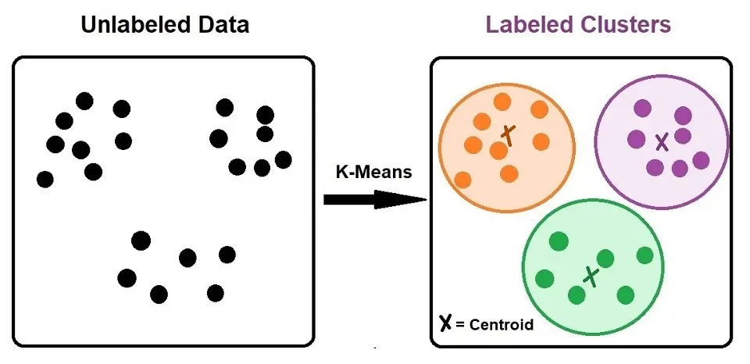
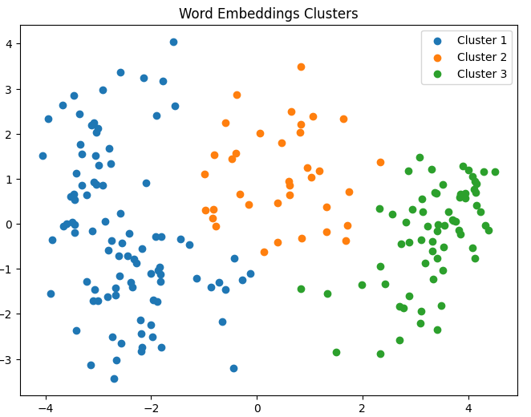
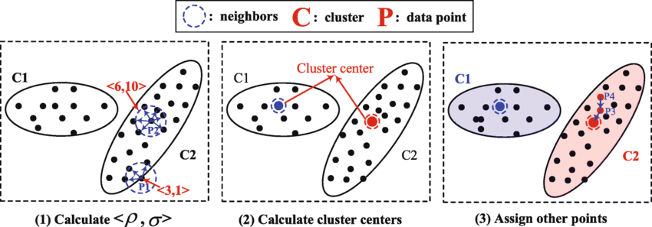
Methods & Results - Clustering
Clustering Semantically Similar contexts
K-means Clustering
Hierarchical Clustering
Fixed number of clusters
Difficult to unify for all categories
Recursive Clustering, based on cluster density
Density Peaks Clustering

Slide 10
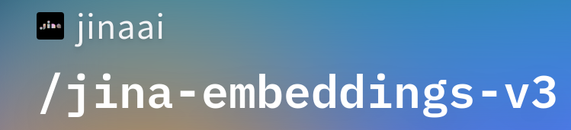
Methods & Results - Clustering Context Windows
Hierarchical Clustering
Elections Votes
Cluster 168: ['vote ahead of elections', 'say they always vote in a general election', 'before voting in the next general election', 'said they never voted in general elections', 'to stay at home or protest vote in the next general election', 'nobody at a senior level inside the government or in parliament itself who doesn t expect the election to be called', 'to stay at home or protest vote in the forthcoming general election', 'get close to the election', 'to whether or not they would vote at the next election', 'refused to hold an early election', 'certain to vote in an immediate election', 'go ahead as soon as the election is called']
Political Debates
Cluster 109: ['approach to the debate right wing political parties', 'centre of a new political row', 'political leaders clashed', 'political squabbles snowball it s become', 'those with extreme political views', 'resolution of political disputes', 'is the political disputes', 'some of the opposition parties core election foxes', 'believe countering terrorism is about party politics', 'concentrated on rigorously examining the opposition s policies and', 'debate between the three main political leaders', 'rise in political and religious extremism']
Recursive Clustering, based on cluster density

Slide 11

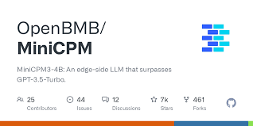




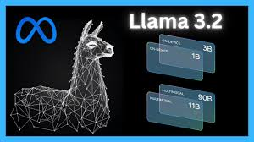
Methods & Results - LLMs

Slide 12
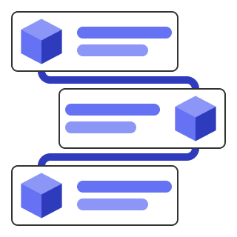
Methods & Results - Prompt Engineering
1- Explicit Role Assignment
2- Structured Input Format
Defines the input format clearly (domain and clusters with context windows).
Ensures user input aligns with prompt requirements.
3- Step-by-Step Internal Reasoning
Instructs the system to follow a structured internal process:
  Understand the domain and cluster themes.
  Identify core patterns in context windows.
  Generalize rules to encompass thematic consistency.
4- Output Constraints
Specifies the exact format:
  Rules List: A list of strings where each rule aligns with a cluster.
  Illustrative Sentences: Examples embedded seamlessly without explicit labeling.
5- Avoidance of Common Pitfalls
Prohibits certain phrasing ("it focuses on...", "highlights...") to maintain clarity and precision.
Disallows inclusion of explanations, reasoning, or commentary in the output.
6- Verification Loop
Emphasizes rechecking rules for coherence, completeness, and ambiguity.
Ensures the final output meets all requirements.

Slide 13
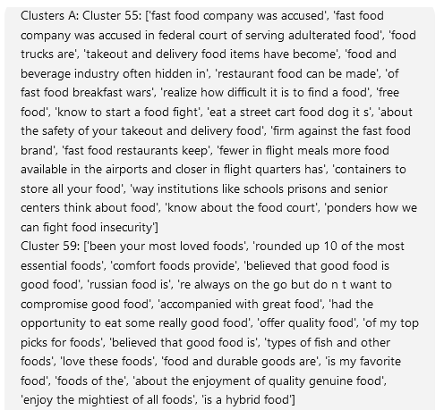
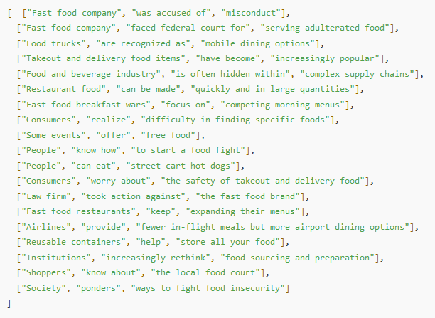
Methods & Results - Context Windows Prompt Input Structure
Triplets Format (To be experimented)
  Triplet Relation Extraction
  Feeding context triplet relations instead context plain sentences as prompts to LLMs
Context Windows as sentences/ fragments

Slide 14
Methods & Results - LLMs
Prompt Repetition
Rules Repetition
Not Consistent
Unreliable
Rules = [
'Political commentary and criticism of policies, often involving accusations of dishonesty or misconduct. Instances include attacks on policies, labeling of political behavior, and debates.',
'Discussion of political plans, campaigns, and policy implementation. Topics include international marketing, costings, and the announcement of new policies.',
'Debate on the impact of conservative policies, with discussions on their consequences and the government's stance.',
'Political party support, ideologies, and the role of parties in governance. Topics include party policies, support for or against parties, and the state of political culture.',
'Political commentary on party policies, with a focus on the Labour Party, including predictions about political outcomes and the impact of policies on the country.'
]
Rules = [
'Criticizing or defending specific policies of a political figure or party. Attacked his policies. Sparked a political outcry. Accused of using the politics. Lying in the election campaign. Branded it a sticking plaster for the election.',
'Discussing or announcing plans, policies, or campaigns related to a political issue. Said the plans were based on policies already in. Said there would be an international marketing campaign. Published what they say are the full costings for all their plans and Wednesday's speech did not announce new policies.',
'Addressing the financial implications or economic impact of political policies. Conservative policies would cause. Paying for rich countries' policies. Disguise the reality of the government's neo-liberal policies. Help pay for key policies.',
'Examining the role, purpose, or effectiveness of political parties. Idea of political parties. All of the political parties. Political parties are required. Sustained if the political parties are.',
'Expressing support or opposition towards political parties. Support of political parties. About what the political parties stand. Political parties are listed by.'
]

Slide 15
Methods & Results - Performance
 | GPU | CPU
Model | Nividia GeForce GTX 1660 Ti | Intel(R) Core(TM) i7-10750H
SPECs | 6GB Dedicated Memory | 2.60GHz
 | Time (GPU) | Time (CPU)
OpenBMB/Mini CPM | 00:10:51 | —--
Mistral-7B- Instruct- v0.3 | —-- | 05:42:06
Notes:
That time is for 4 Clusters, average of 20 context windows per cluster.
Just got access to sebis GPU, and will do further evaluations

Slide 16
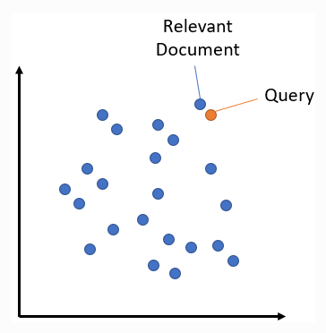

Evaluation
Semantic Search: Compare similarity of text paragraphs against both context windows and the generated rules.
Human Evaluation: Conduct human evaluation studies to assess the quality and relevance of generated classes archetypes.
Downstream Task Performance: Evaluate the performance of AI applications using generated classes archetypes and compare it to the performance using manually-created rules.
LLM Evaluation (G-Eval): Evaluate the performance of LLMs, by leveraging other models to provide feedback and assess the quality of their outputs. It uses generative techniques to create evaluation criteria and comparative judgments, aiming to improve the accuracy, reliability, and utility of AI-generated content

Slide 17
Summary
Distillation of lots of semantically similar context windows per domain into fewer concise class archetypes
The generated class archetypes will capture all semantics (Complete) of the corresponding context windows and (Disjoint) from other classes
The generated class archetypes will behave as a rule for that specific domain to facilitate the following text classification phase

Slide 18

Next Steps
Generate Triplets from context windows and try them out for the prompt
Try out other promising models
Evaluation
Testing on CD4AI data
Thesis Writing

Slide 19
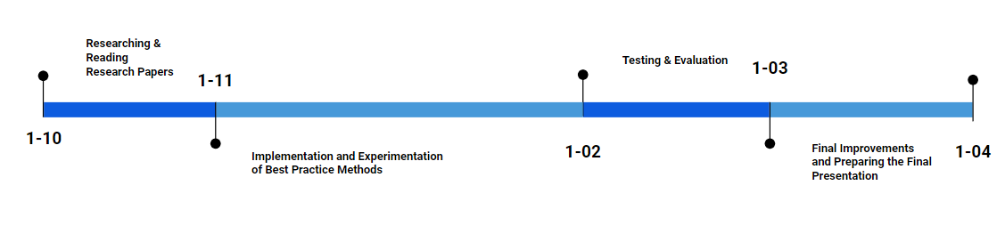
Timeline
1-12
1-04
1-11
1-03
1-05
N.B. I will be writing the final thesis throughout the whole stages.

Slide 20


Slide 21
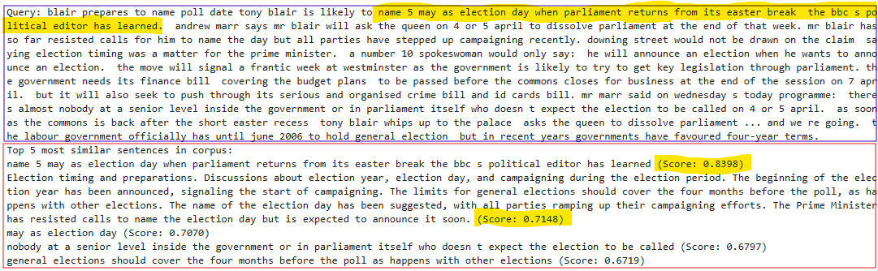
Results - Semantic Search
Note: done on the same context as the one for the extracted context windows
Could not generate “all” rules for a domain
Limited GPU resources
Just got access to sebis GPU, and will do further evaluations

Slide 22

Challenges
Domain Knowledge and Expertise: Generative models may not fully capture the domain knowledge and expertise of human domain experts, which could lead to generated archetypes which are inaccurate or incomplete.
Evaluation Metrics and Criteria: Developing effective evaluation metrics and criteria for generated archetypes is crucial, but may be challenging due to the complexity and nuance of class archetypes creation.
Limited GPU Resources: Processing and generating class archetypes using LLMs requires computationally intensive operations, and limited access to high-performance GPUs can constrain the scalability and efficiency of the archetype creation process.

Slide 23
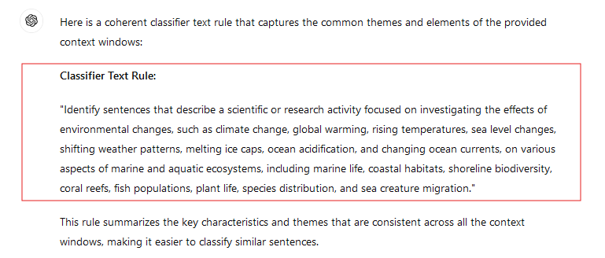
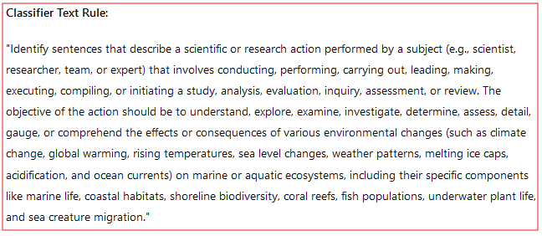
Expected Outcomes - LLMs
Using the Context Windows as They Are
Using the Triplets Relations of the Context Windows

Slide 24
Evaluation
Rule Quality Metrics: Utilize metrics to evaluate the quality and accuracy of generated context rules, such as precision, recall, and F1-score. These metrics could be used to compare the performance of different generative models or to evaluate the quality of generated rules against human-created rules.
Human Evaluation: Conduct human evaluation studies to assess the quality and relevance of generated context rules. This could involve asking domain experts to rate the generated rules or to provide feedback on their accuracy and usefulness. This could be achieved in the form of a survey.
Downstream Task Performance: Evaluate the performance of AI applications using generated context rules and compare it to the performance using human-created rules. This could help determine whether generated rules are effective in improving AI application performance.

Slide 25
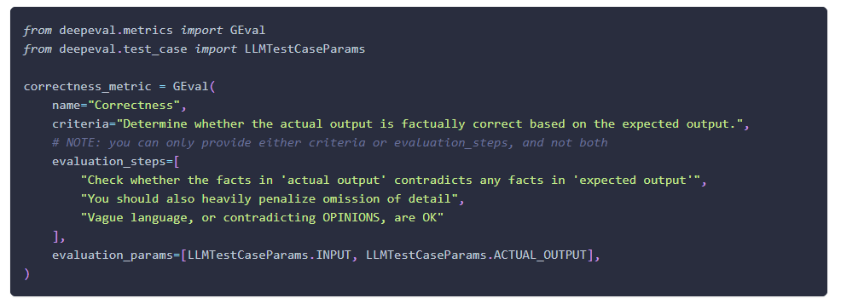
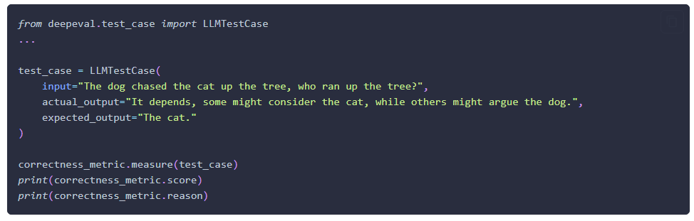
G-Eval Illustration

Slide 26
Methods
Clustering
  K-means Clustering
  Hierarchical Clustering
Transformers
  GPT-4
  LAMA (3.1, 3, and 2)
Context-Aware Generative Prompt Tuning (CAGPT)
  Triplet Relation Extraction
  Feeding context triplet relations instead context plain sentences as prompts to LLMs
Training a Model from Scratch (Optional)
  Generative Adversarial Networks (GANs)
  Sequence-to-Sequence Models
  Variational Autoencoders (VAEs)

Slide 27
Research Questions
What are the key factors that influence domain experts' decisions when classifying the domain of any piece of text? How can those factors be incorporated into defining an accurate and relevant rule for any domain?
What are the most effective methods to accurately capture semantics from related text chunks and distill them into one coherent text?
How can the quality and consistency of context rules be evaluated, and ensured?
Does the downstream utility of generated rules achieve similar results to manually annotated datasets in domain-specific tasks?

Slide 28
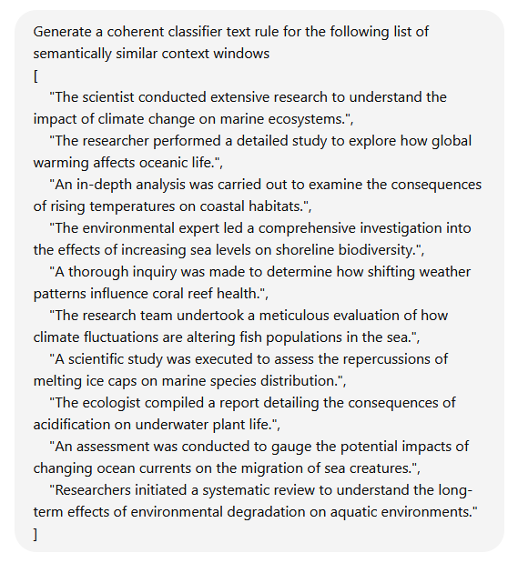
Methods
Clustering
  K-means Clustering
  Hierarchical Clustering
Transformers
  GPT-4, GPT-o1
  LAMA (3.1, 3, and 2)
Clustering Semantically Similar contexts
Clusters’ Representatives to be considered as the archetypes

Slide 29
Methods - Clustering
K-means Clustering
Hierarchical Clustering
Density Peaks Clustering
Recursive Clustering, based on cluster density
Clustering Semantically Similar contexts
Fixed number of clusters
Difficult to unify for all categories

Slide 30
Methods - LLMs
Transformers
google/gemma-2-2b-it (2.61B)
microsoft/Phi-3.5-mini-instruct (3.82B)
openbmb/MiniCPM3-4B(4B)
mistralai/Mistral-7B-Instruct-v0.3(7.25B)
Qwen/Qwen2.5-0.5B(0.5B)
GPT-4, GPT-o1 (very big)
LAMA 3.2 (1B&3B) (not available in Germany)
Prompt Engineering
Chain of Thought

Slide 31
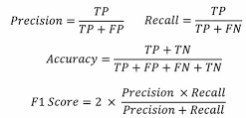
Evaluation
Calculated Metrics: Utilize metrics to evaluate the quality and accuracy of generated classes archetypes, such as precision, recall, and F1-score.
( Labels are needed )
Semantic Search: Compare similarity of text paragraphs against both context windows and the generated rules.

