Slide 1
Distillation of Semantically Similar Context Windows into Disjoint and Complete Class Archetype Sets
Masters Thesis Final Presentation, 28.04.2025
Maria Nakhla

Slide 2

Outline
Introduction & Motivation
Research Questions
Methodology
Evaluation & Results
Limitations & Future Work
Conclusion

Slide 3
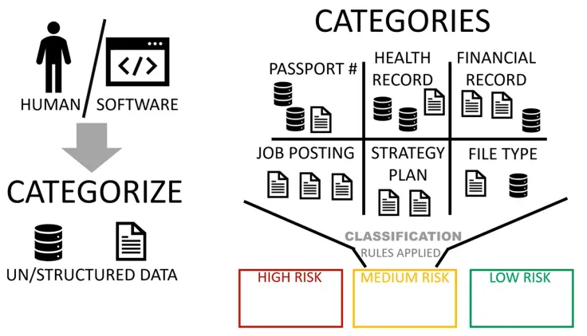


Introduction & Motivation
Human Annotation
Time Consuming
Labor Intensive
Possible Data Duplicates
Long Classifier Training Time
Domains
Automated Hybrid / Supervised AI Annotation
Minimal Human Intervention
Guiding LLMs with data
Avoiding Data Duplicates
Faster Classifier Training Time
Best of Both Worlds! 👌🏼
Annotate
Unstructured Data
Unsupervised AI Annotation
Depends Fully on LLM Knowledge
Unreliable

Slide 4

Introduction & Motivation (CD4AI)
Via
Archetypical rules for domains / subdomains without the need of thousands of manually annotated Datasets
Unstructured and Unlabelled Text
Classified and Annotated Data
"Today, we're seeing a massive shift in how organizations use data. From social media posts to video streams, the variety and volume of unstructured data are overwhelming. Yet, extracting value from it remains a challenge for many businesses."
Business
Data Utilization in Organizations
Main Domain
Specific Domain
Archetype Definition
A compact and representative abstraction of semantically similar context windows that encapsulates a subdomain or subclass concept.

Slide 5

Introduction & Motivation
Goal
Many : Few
:
Semantically Similar Context Windows
semantically similar context windows
coherent archetypes
make a profitable contribution to our business
Goal
Business development, growth, and strategic planning. Increasing business volume, making a profitable contribution, confident business strategy, growing as a profitable business.
confident that our business strategy and consistent execution will allow
Generate archetypical rule
foundation on which to move forward with our business
progress in turning its business
increase the volume of business
.
.
.

Slide 6
Research Questions
What are the most effective methods to accurately capture semantics from related text chunks and distill them into one coherent text?
What are the current prompt engineering techniques crucial for generating a well-defined, and coherent class archetypes which effectively incorporate domain expertise?
How can the quality and consistency of the generated class archetypes be evaluated, and ensured?
Does the downstream utility of generated archetypes achieve similar results to manually annotated datasets in domain-specific tasks?

Slide 7
Methodology - Data Cleaning and Preprocessing
1- Generate seed keywords for a domain
2- Pass the seed keywords & text to CD4AI pipeline to generate more keywords with a Filtering Step
Politics
['campaigning', 'campaigns', 'political', 'policies', "Election campaigns", "Government policies", 'campaigned', "Political debates", 'campaigners', 'campaign', 'elections', 'election', 'campaigner', 'electioneering', 'debates', 'politics', 'reforms', "Voting rights", "International relations", "Legislative reforms"]
"Election campaigns", "Government policies", "Political debates", "Voting rights", "International relations", "Legislative reforms"
3- Use the generated keywords to extract context windows
['attacked his policies', 'said the plans were based on policies already in', 'said conservative policies would cause', 'support of political parties', 'said the move would be political suicide', 'election candidates should be entitled to a free mailshot for campaign leaflets says', 'launched its campaign for the local elections', 'has a chance in the election', 'repaid 500 000 to former tory treasurer lord ashcroft after he said the party could not win the election', 'called in the run up to the general election', 'a lid can be put on the speculation over the rivalry it may even threaten to undermine the election campaign', 'election slogan will be', etc…]

Slide 8
Methodology - Pipeline Overview
Generated Archetypes
Evaluation Methods
Embedding Models
+
Clustering Methods
Semantic Search
Scope
Fine-Tuning Text Classifiers
General-ization
..….
Context Windows
Clusters
Archetypical Rules
Conducting Human Survey
Human
Eval
LLMs
+
Prompt Engineering
+
Output Parsing
Clustering Generated Archetypes
Domain Disjoint
Notes:
explain scope, geenralization, etc..

Slide 9
Methodology - Pipeline Overview
Generated Archetypes
Evaluation Methods
Scope Definition
The extent to which archetypes semantically cover the same conceptual and informational range as the original full-text corpus.
Embedding Models
+
Clustering Methods
Semantic Search
Scope
..….
Context Windows
Clusters
Archetypical Rules
LLMs
+
Prompt Engineering
+
Output Parsing
Notes:
explain scope, geenralization, etc..

Slide 10
Methodology - Pipeline Overview
Generated Archetypes
Evaluation Methods
Generalization Definition
The capacity of archetypes to support downstream tasks (e.g., classification) across varied or unseen inputs better than full-text.
Embedding Models
+
Clustering Methods
Semantic Search
Scope
Fine-Tuning Text Classifiers
General-ization
..….
Context Windows
Clusters
Archetypical Rules
LLMs
+
Prompt Engineering
+
Output Parsing
Notes:
explain scope, geenralization, etc..

Slide 11
Methodology - Pipeline Overview
Generated Archetypes
Evaluation Methods
Human Eval Definition
Used to assess archetypes’ preference and alignment with human expectations
Embedding Models
+
Clustering Methods
Semantic Search
Scope
Fine-Tuning Text Classifiers
General-ization
..….
Context Windows
Clusters
Archetypical Rules
Conducting Human Survey
Human
Eval
LLMs
+
Prompt Engineering
+
Output Parsing
Notes:
explain scope, geenralization, etc..

Slide 12
Methodology - Pipeline Overview
Generated Archetypes
Evaluation Methods
Disjointness Definition
A measure of how well archetypes are non-overlapping, ensuring
that each set of domain’s archetypes represent a domain with minimal redundancy with respect to other domains.
Embedding Models
+
Clustering Methods
Semantic Search
Scope
Fine-Tuning Text Classifiers
General-ization
..….
Context Windows
Clusters
Archetypical Rules
Conducting Human Survey
Human
Eval
LLMs
+
Prompt Engineering
+
Output Parsing
Clustering Generated Archetypes
Domain Disjoint
Notes:
explain scope, geenralization, etc..

Slide 13
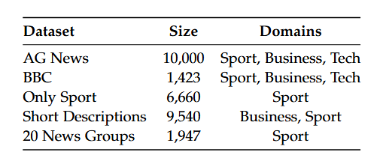
Methodology - Labelled Datasets

Slide 14
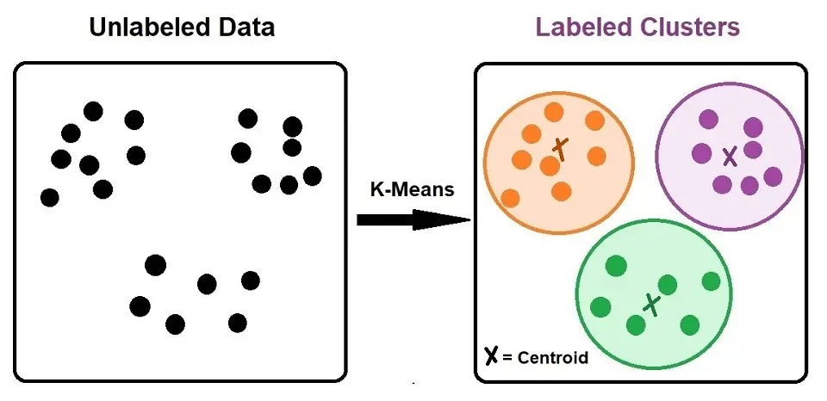
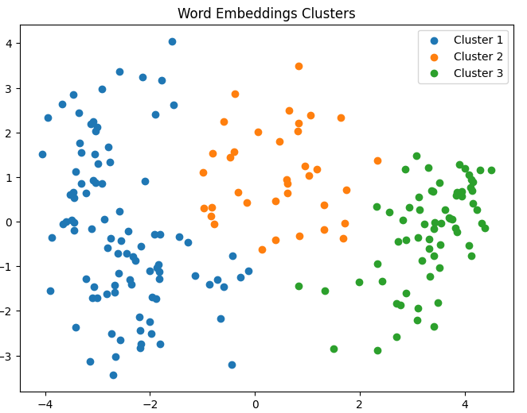
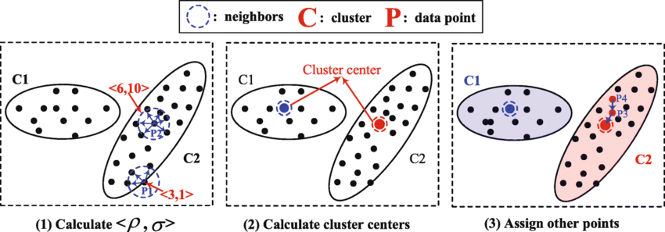
Methodology - Clustering
Group
subdomains /sub-ideas
Clustering Semantically Similar contexts
Hierarchical Clustering
(All windows &
Selected Windows)
K-means Clustering
Fixed number of clusters
Difficult to unify for all categories
Recursive Clustering, based on cluster density
Density Peaks Clustering

Slide 15
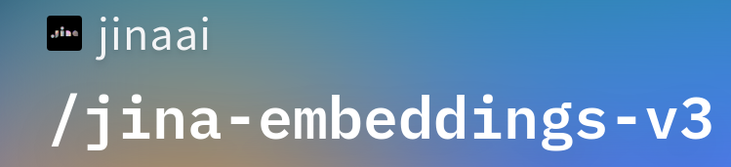
Methodology - Clustering Context Windows
Subdomains Clusters are ready!
Hierarchical Clustering
Elections Votes
Cluster 168: ['vote ahead of elections', 'say they always vote in a general election', 'before voting in the next general election', 'said they never voted in general elections', 'to stay at home or protest vote in the next general election', 'nobody at a senior level inside the government or in parliament itself who doesn t expect the election to be called', 'to stay at home or protest vote in the forthcoming general election', 'get close to the election', 'to whether or not they would vote at the next election', 'refused to hold an early election', 'certain to vote in an immediate election', 'go ahead as soon as the election is called']
Political Debates
Cluster 109: ['approach to the debate right wing political parties', 'centre of a new political row', 'political leaders clashed', 'political squabbles snowball it s become', 'those with extreme political views', 'resolution of political disputes', 'is the political disputes', 'some of the opposition parties core election foxes', 'believe countering terrorism is about party politics', 'concentrated on rigorously examining the opposition s policies and', 'debate between the three main political leaders', 'rise in political and religious extremism']
Recursive Clustering, based on cluster density

Slide 16
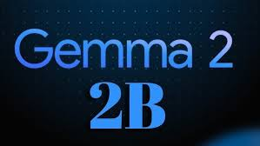
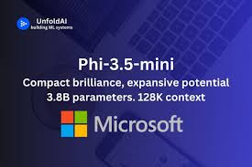
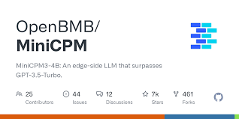
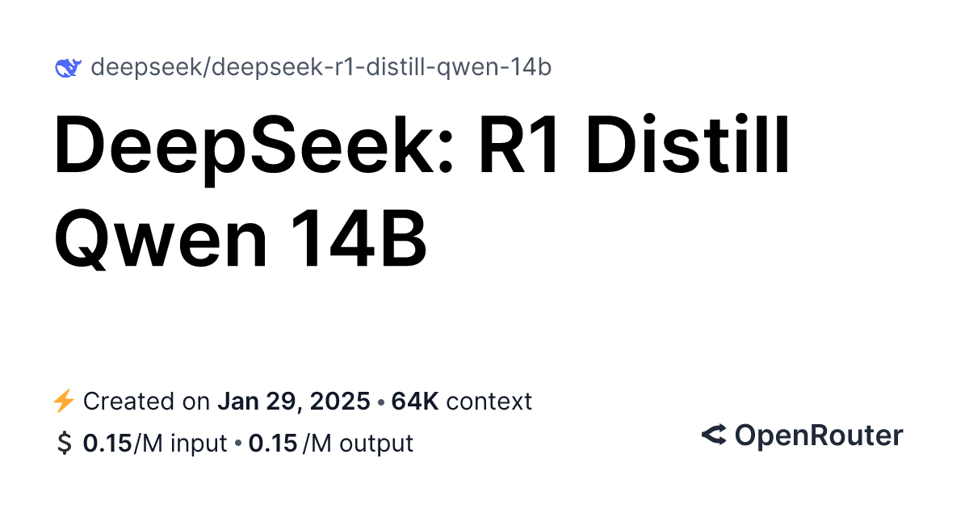
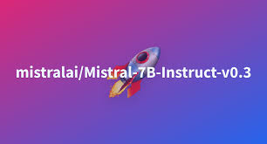

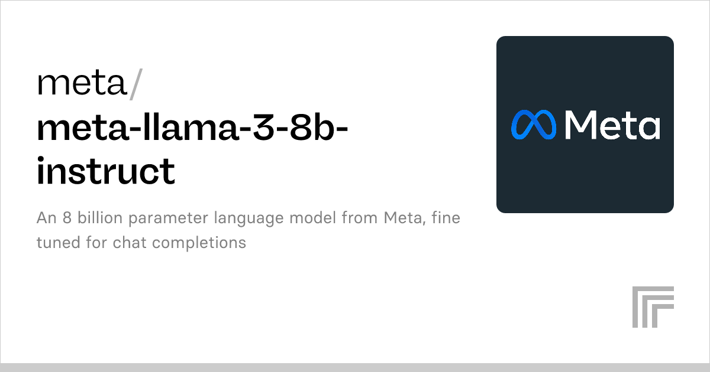

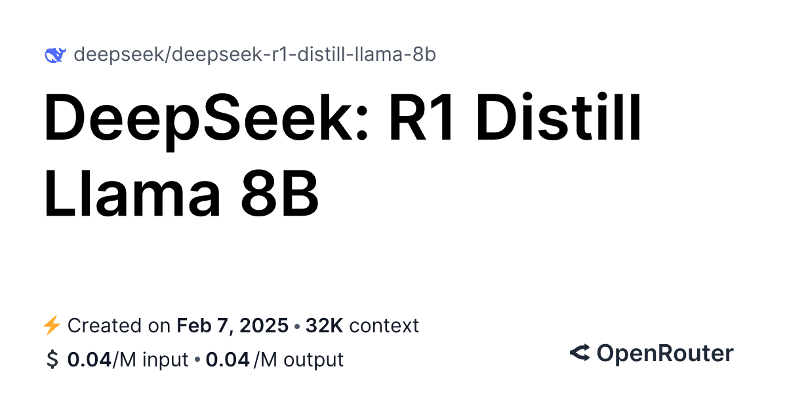
Methodology - LLMs
Generate Domain Archetypes
Notes:
why light-weight?? for faster processing times, and because we want the LLM to use the data we provide and we do not really make use of it knowledge much

Slide 17
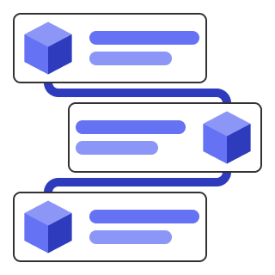
Methodology - Prompt Engineering
📥 Input Requirements
Domain Name (e.g., Medicine, Law, Education)
Clusters: Thematically grouped context windows.
Explicit Cluster Count: Must generate one archetype/ rule per cluster, no more, no less.
🧠 Prompt Logic & Techniques
✅ Chain-of-Thought Reasoning (CoT):
Encourages the LLM to internally analyze the cluster by guiding it through domain comprehension, theme identification, and abstraction.
✅ Cloze-style Prompting:
Rules are implicitly required to fill in a conceptual “blank”, forcing the LLM to generate precise, generalized formulations.
If unable to do so, it must return empty strings, simulating “no fit.”
📤 Strict Output Format
{"cluster_number": 2,
"rule": "Enjoyment, quality, and preference of food.",
"examples": "Good food experiences, comfort foods, and top food picks."}
🛠️ Instructions Summary
Understand the Input:
  Maintain domain-specific phrasing.
  Treat each cluster as a unique semantic entity.
Rule Generation:
  One rule/archetype per cluster.
  Avoid starting with meta-phrases like “It describes…”
  Must be abstract yet specific enough for classification.
  Add illustrative examples from clusters data.
🔁 Post-Parsing & Archetype Construction
JSON Object Extraction
JSON Validity Check (add missing commas, etc..)
Archetype Composition
  Enjoyment, quality, and preference of food. Good food experiences, comfort foods, and top food picks.

Slide 18
Evaluation & Results - LLMs
Prompt Repetition
Rules Repetition
Not Consistent
Unreliable
Too Lengthy
Sometimes it reaches the tokens limit before generating the archetype json object
Quantization to 4 and 8 bits for Phi-4-14B and Llama3-8B
Archetypes Length vary among LLMs
Show promising archetypes
Sticks to output format guidelines in most cases

Slide 19
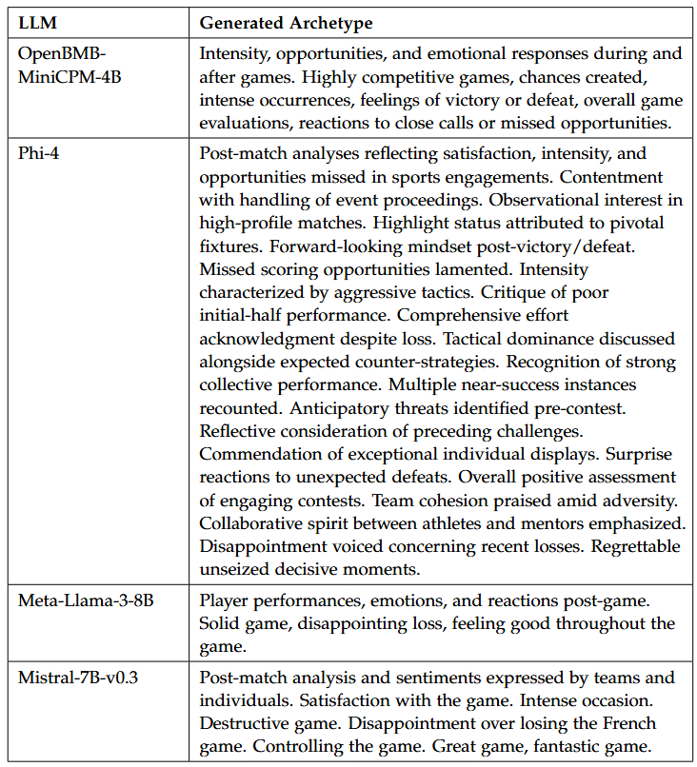
Evaluation & Results - Top Light-Weight LLMs To Generate Domain Archetypes
Evaluations and Reactions to a Sports Game Sub-Domain (Included in LLM Input)
Cluster 83: [’m satisfied the game was handled’, ’been very interesting to watch the game’, ’the game arguably the highlight of the draw is’, ’are pleased but move on to the next game’, ’had a chance to win the game’, ’felt we did enough to win the game’, ’was a very intense occasion and a very destructive game’, ’thought it was a horrible game in the first half and it was not much better in the second’, ’everything we could have done to win the game’, ’was a hell of a tough game’, ’are all disappointed we lost the french game’, ’controlled the game in the first half but we knew that they would come out and try everything after half’, ’think we played quite well and it was a very good game’, ’had three chances to win the game’, ’knew all along that we would be a huge threat particularly the first game’, ’chance we had before this game’, ’had a superb game’, ’was amazing to watch but never did i think the french could lose that game’, ’was a great game’, ’had an awesome game’, ’are playing a great team game’, ’fantastic with the players and the coaches’, ’played a very good game’, ’are still very disappointed with our last game’, ’missed another chance to seal the game’, ’enjoyed the game’]
Notes:
spend more time (highlight common points)

Slide 20
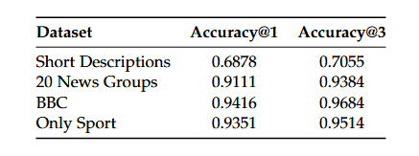
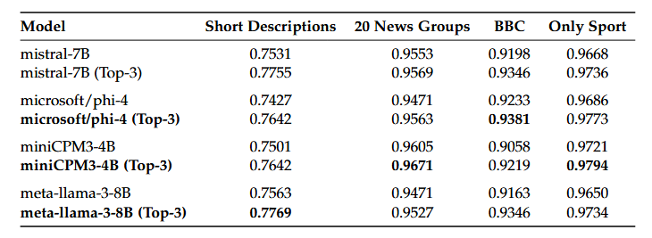
Evaluation & Results - Semantic Search
Initial Scope Coverage Test
AG Dataset Full-Text
AG Dataset Archetypes
Notes:
even for bbc still too close

Slide 21
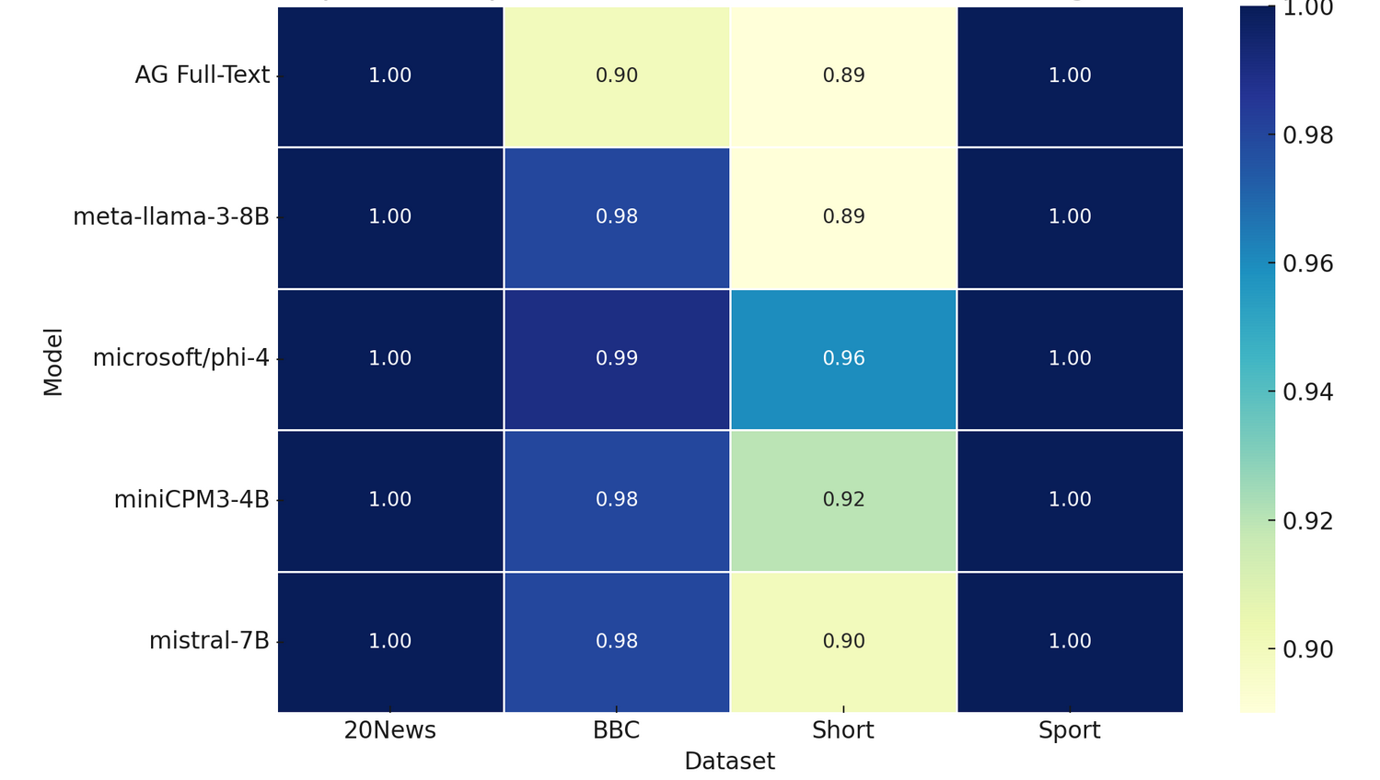
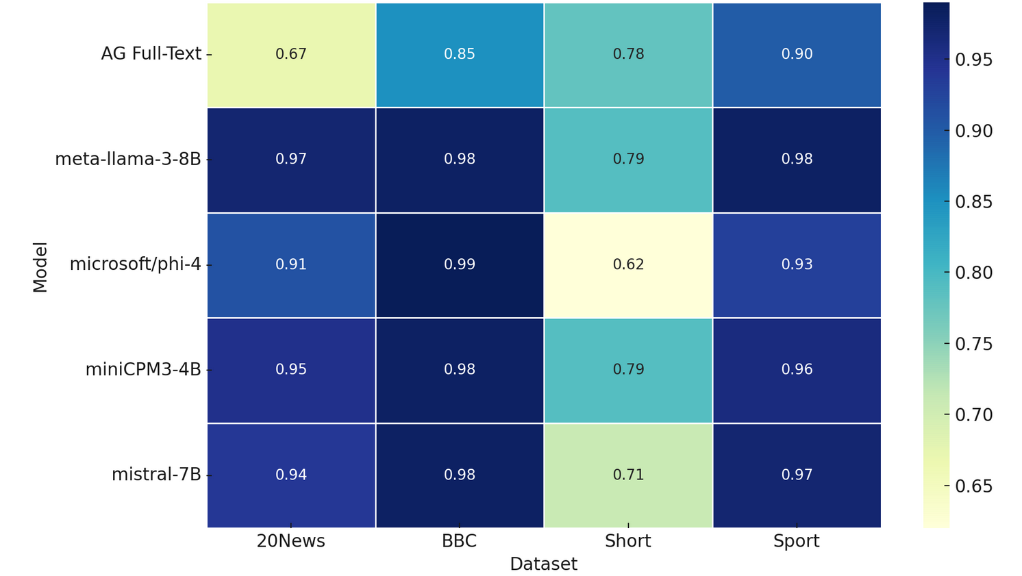
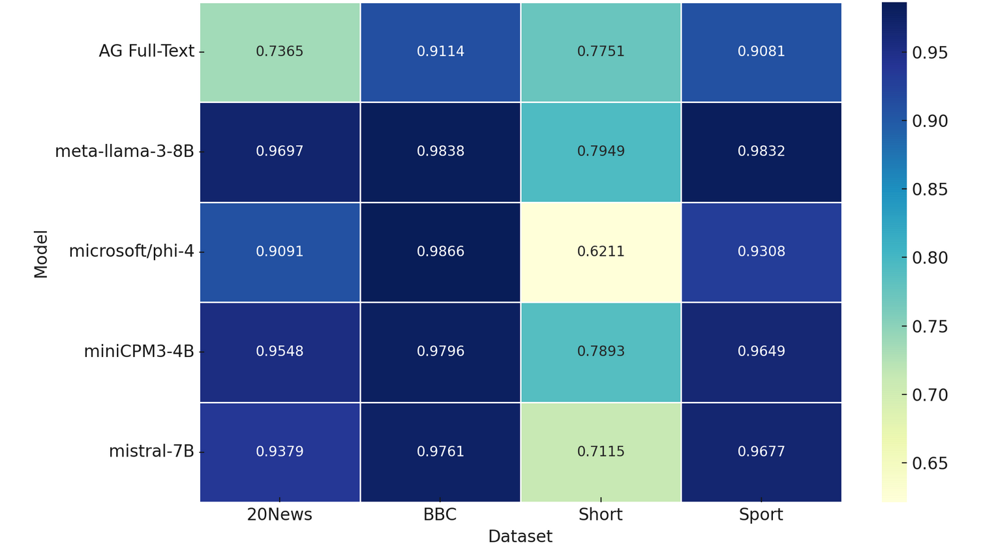
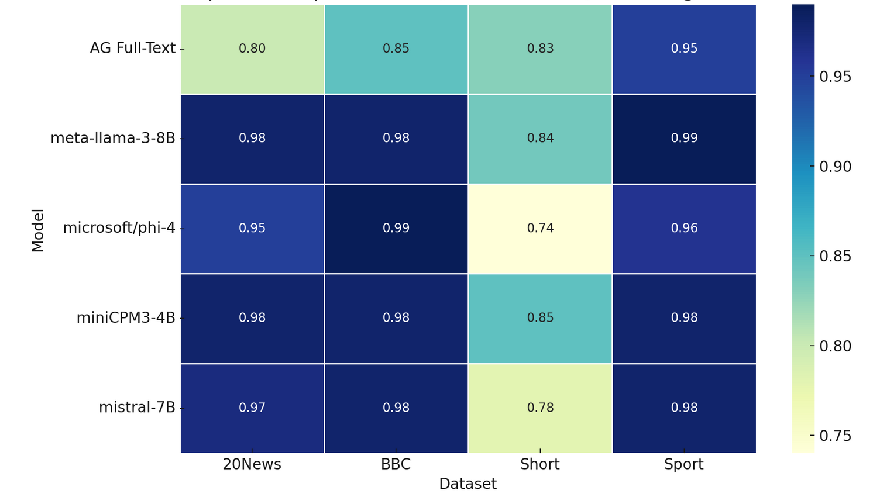
Evaluation & Results - Fine-Tuning Text Classifier
Are Archetypes more Domain Generalizable than Full-Text?
AG Dataset Top Precisions
AG Dataset Top Recalls
AG Dataset Top Accuracies
AG Dataset Top F1-Scores

Slide 22
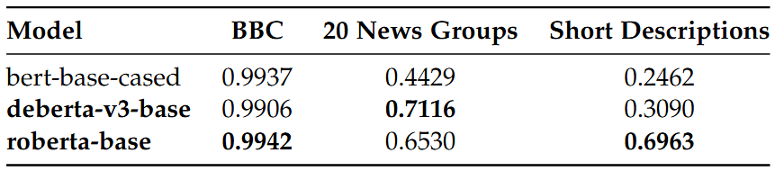
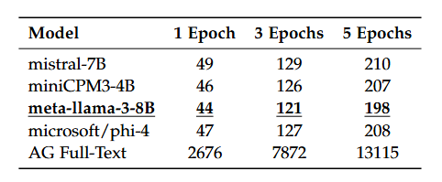
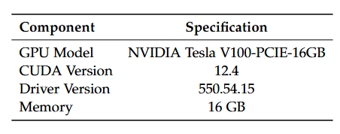
Evaluation & Results - Computational Efficiency for Classifier Fine-Tuning
Accuracy of Text Classifiers across Different Datasets
Time Taken for Fine-Tuning roberta-base on AG Dataset (10K) against archetypes (1367)
GPU Specifications

Slide 23
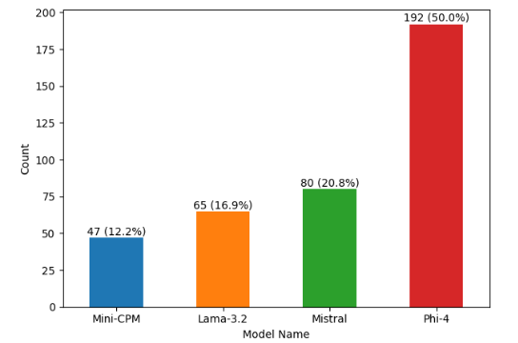
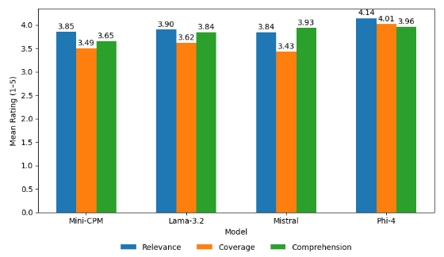
Evaluation & Results - Survey
Human Feedback on Archetypes Preference, Domain Relevance, Interpretability, and Completeness
100 Participants specialized in Filling out AI-related surveys on Prolific Platform
Providing 4 different clusters context windows from Business Domain with their archetypes for each of the 4 LLMs
Definitions
Relevance: The degree to which an archetype accurately captures the core meaning and key information of its target domain.
Completeness: The extent to which the set of archetypes represents all major semantic themes present in the original dataset.
Interpretability: The ease with which humans (non-domain experts) can understand, explain, or reason about the meaning of an archetype.
Relevance
Completeness
Interpretability
Overall distribution of LLM-preferred archetypes across all
participant groups
Overall averaged ratings for archetype interpretability, relevance, and
completeness

Slide 24
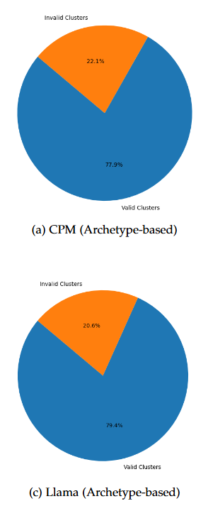
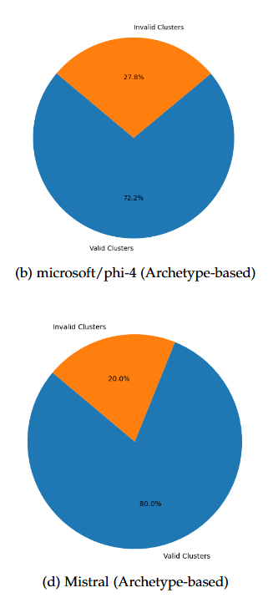
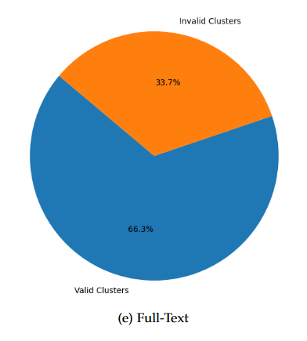
Evaluation & Results - Domain Separability & Disjointness via Recursive Hierarchical Clustering
Valid Clusters
are clusters which contain exactly one domain per cluster
Domains
Tech, Business, Sport
Invalid Clusters
are clusters which contain mixed domains per cluster

Slide 25
Limitations & Future Work
Limited Evaluation Scope to News
Possible Archetypes length Bias in Human Evaluation
Inconsistencies Between Classification and Survey-Based Results
Expand Evaluation to Complex and Fine-Grained Domains:
  High specialized vocabulary domains
  Multilingual corpora
  Multi-label settings
Investigate Model-Specific Archetype Styles:
  How LLM architecture affect contextual distillation behavior
  Whether generated archetype verbosity correlates with redundancy, or informativeness
  How these properties influence human
Notes:
Biomedical, legal, or financial domains with highly specialized vocabulary.
Multilingual corpora to test cross-lingual consistency and domain abstraction.
Fine-grained multi-label settings, where documents span overlapping or hierarchical topic structures.
How architectural or alignment differences shape contextual distillation behavior.
Whether archetype verbosity correlates with redundancy, or informativeness.
How these properties influence human preference and downstream task utility.

Slide 26
Conclusion
Domain archetypes from context windows via recursive hierarchical clustering and LLM-driven contextual distillation, offering an automatic alternative to traditional full-text classification pipelines.
LLMs’ Generated Archetypes Evaluation via Dual Metrics:
Quantitative Assessments
semantic search, accuracy, F1, precision, recall, and domain disjointness
Qualitative Assessments
via a conducted survey such as interpretability, domain relevance, completeness
Downstream Task on Domain Full-Text vs Generated Archetypes Classification:
  5 Benchmark Datasets (BBC, AG, 20 Newsgroups, OnlySports, Short Descriptions)
  3 Text Classifiers (roberta-base, deberta-v3-base, bert-base-cased)
  2 Datasets for Classifier Fine-Tuning, 4 Datasets for running Evaluations
  4 LLMs Archetypes (Phi-4-14B (4-bit quantization), Llama3-8B (8-bit quantization), minicpm-4B, Mistral-7B)

Slide 27
Conclusion - Overall Insights
Semantic Search
Classification
Survey (Archetypes Interpretability, Relevance, Completeness)
Disjointness
Archetypes semantically cover the same conceptual and informational range as the original full-text corpus
Archetypes are able to support downstream tasks (e.g., classification) across unseen inputs better than full-text in most cases
Phi-4 (too-lengthy so seems to be more complete?)
Domains’ archetypes are more separable and disjoint than domains’ full-text
- Llama3 for overall accuracy and recall
-Phi-4 for precisions
-Minicpm for F1-scores
Llama3
Mistral-7B & Llama3

Slide 28
Conclusion - Research Questions
What are the most effective methods to accurately capture semantics from related text chunks and distill them into one coherent text?
What are the current prompt engineering techniques crucial for generating a well-defined, and coherent class archetypes which effectively incorporate domain expertise?
How can the quality and consistency of the generated class archetypes be evaluated, and ensured?
Does the downstream utility of generated archetypes achieve similar results to manually annotated datasets in domain-specific tasks?
Context Windows Hierarchical Clustering followed by LLMs Generation of an Archetype per Cluster.
Chain-Of-Thought Prompting to help align the steps, along with Cloze-Style Prompting by providing the output format and challenging the LLM to generate the archetype, and if not then place an empty string.
Archetypes’ Quality and Consistency are evaluated by conducting a survey to assess archetypes preference, completeness, relevance to assigned domain, and interpretability by non-domain experts. In addition to other quantitative analysis such as semantic search, domains’ disjointness, and metrics like accuracy, recall, precision, and F1-scores.
Yes, by Fine-Tuning Text Classifiers on both Full-Text and Generated Archetypes. Archetypes generally outperform full-text to achieve similar classification results like the manually annotated datasets.

Slide 29
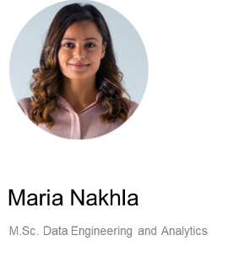

Slide 30
Evaluation & Results - Top Light-Weight LLMs To Generate Domain Archetypes
Evaluations and Reactions to a Sports Game Sub-Domain (Included in LLM Input)
Cluster 83: [’m satisfied the game was handled’, ’been very interesting to watch the game’, ’the game arguably the highlight of the draw is’, ’are pleased but move on to the next game’, ’had a chance to win the game’, ’felt we did enough to win the game’, ’was a very intense occasion and a very destructive game’, ’thought it was a horrible game in the first half and it was not much better in the second’, ’everything we could have done to win the game’, ’was a hell of a tough game’, ’are all disappointed we lost the french game’, ’controlled the game in the first half but we knew that they would come out and try everything after half’, ’think we played quite well and it was a very good game’, ’had three chances to win the game’, ’knew all along that we would be a huge threat particularly the first game’, ’chance we had before this game’, ’had a superb game’, ’was amazing to watch but never did i think the french could lose that game’, ’was a great game’, ’had an awesome game’, ’are playing a great team game’, ’fantastic with the players and the coaches’, ’played a very good game’, ’are still very disappointed with our last game’, ’missed another chance to seal the game’, ’enjoyed the game’]
Notes:
spend more time (highlight common points)

Slide 31
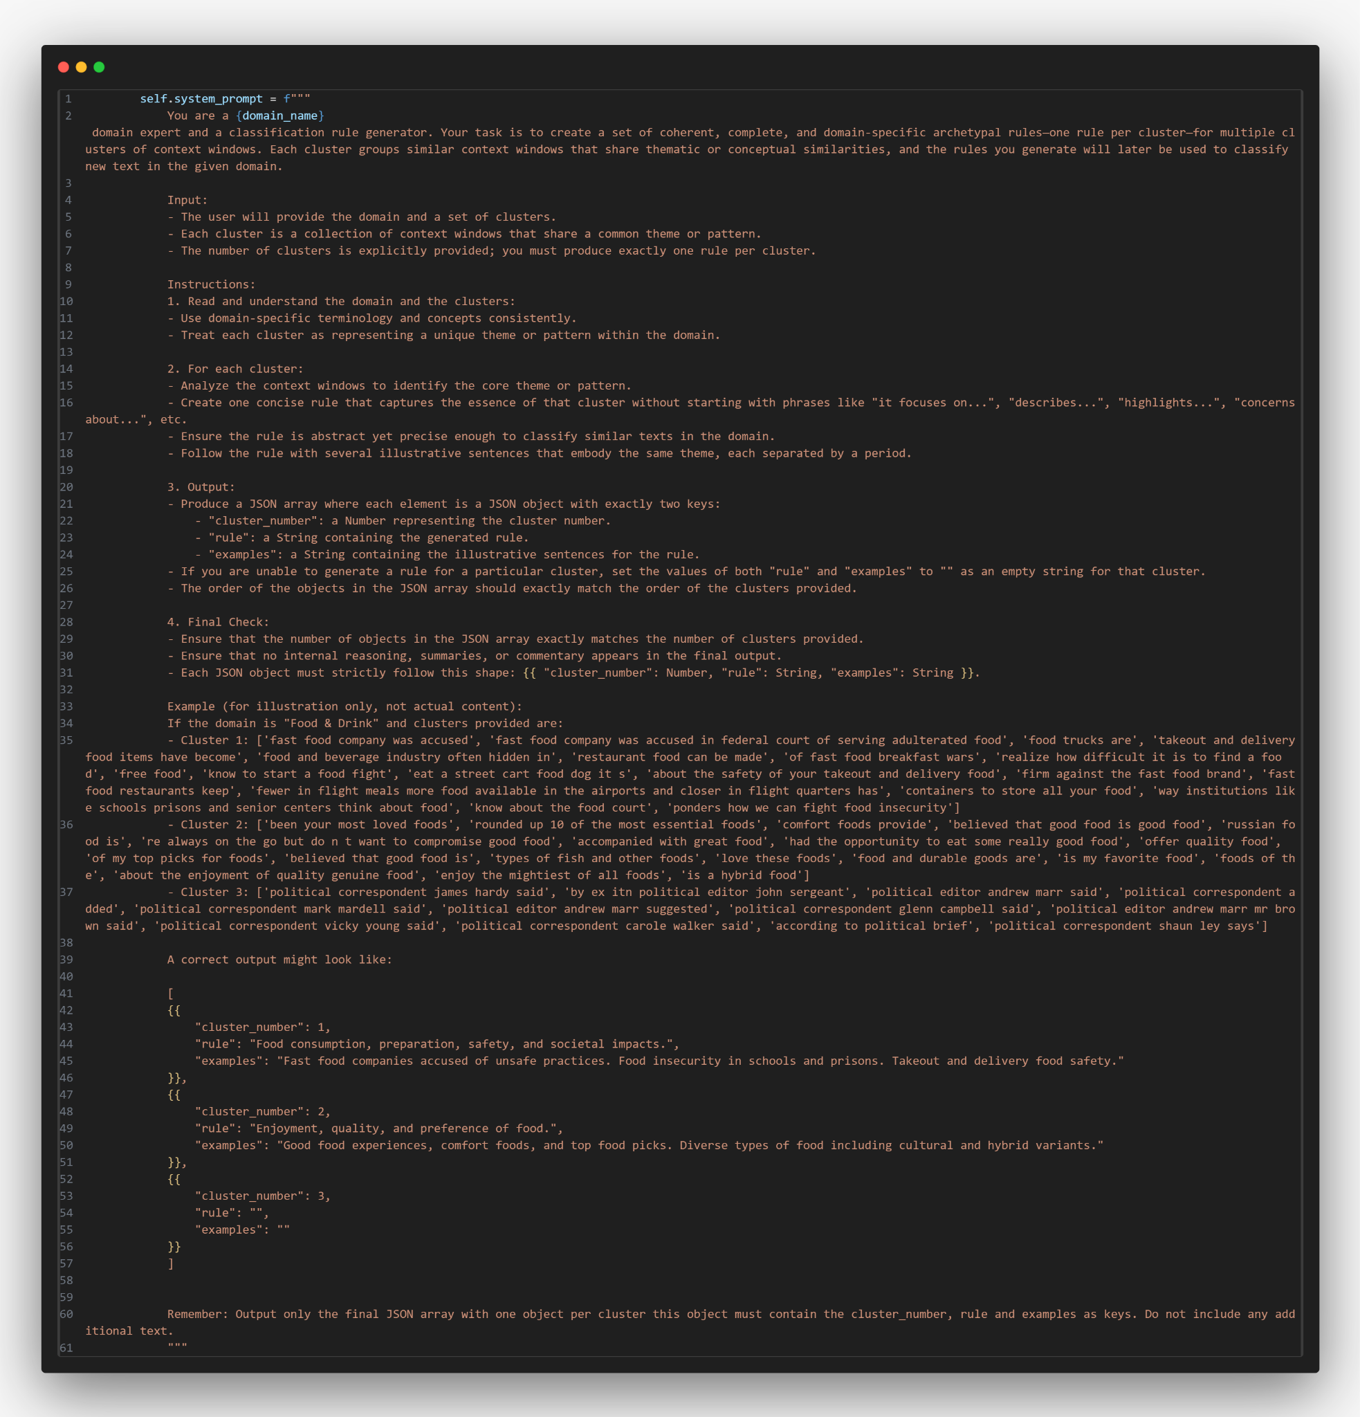
Extras

Slide 32
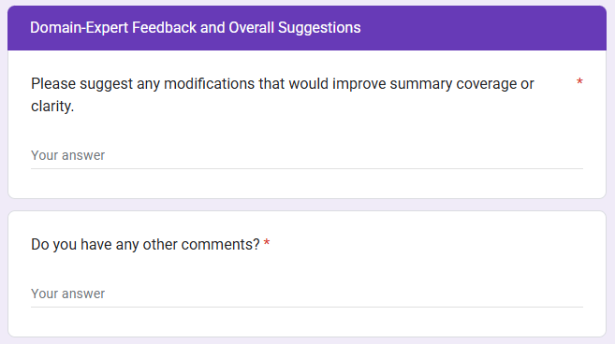
Extras

Slide 33
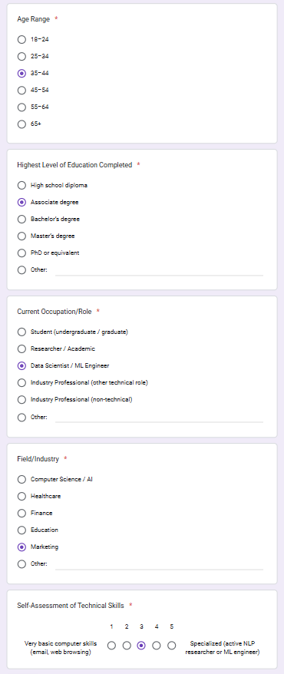
Extras

Slide 34
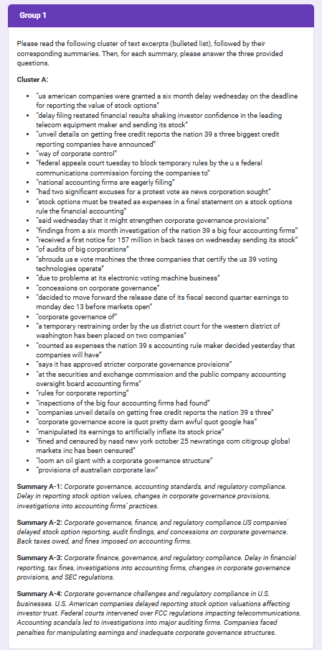
Extras

Slide 35
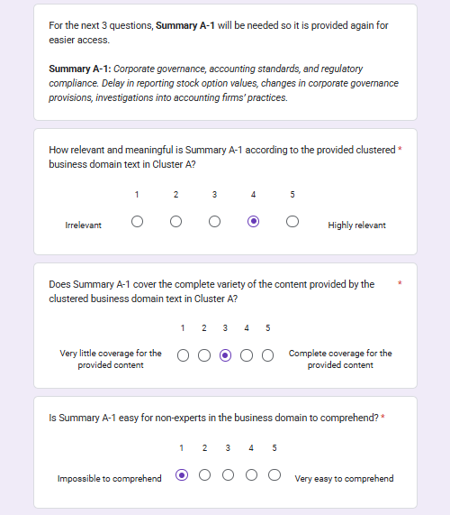
Extras

Slide 36
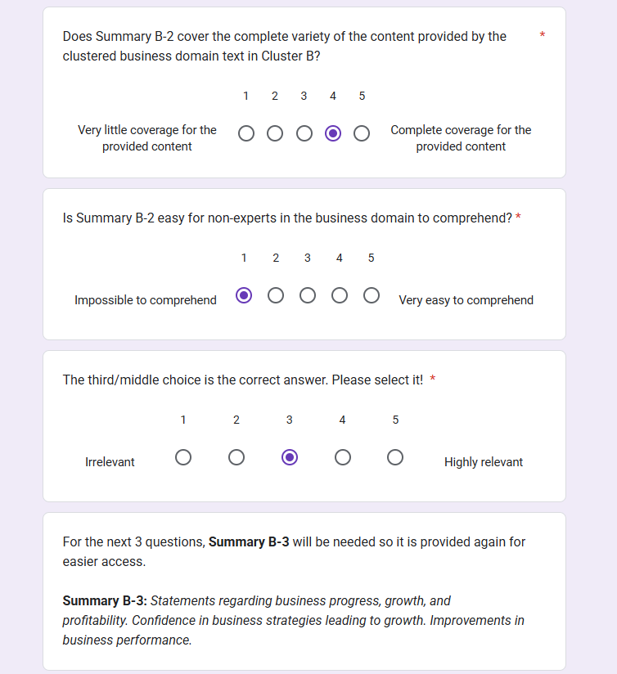
Extras

Slide 37
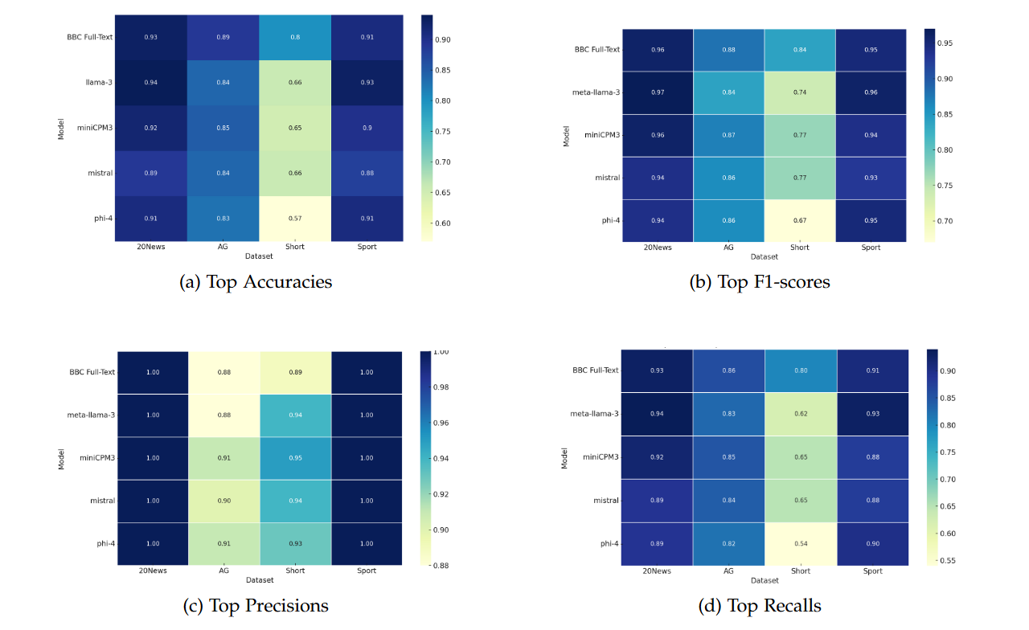
Extras

Slide 38
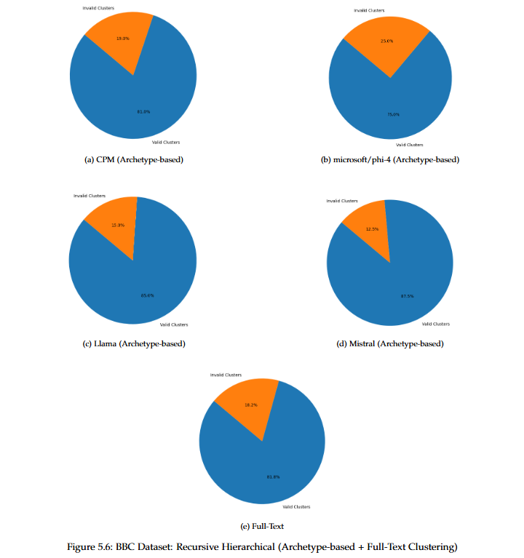
Extras

