Slide 1
Evaluating Legal AI Use Cases based on Experience Reports from the DACH Region
14.04.2025
Jan Rothweiler

Slide 2
Objective and Motivation
Objective:
Determine the AI use cases in legal domain through contact with legal professionals
Find out which challenges are encountered and they are overcome
Obtain a perspective on future Legal AI development
Overarching project → Legal AI Use Case Radar
Motivation:
Literature must be validated through real-world applications
Bridge the gap between academia and legal professionals

Slide 3
Research Questions
RQ1: What are the AI use cases in the legal domain?
RQ2: What are the contextual factors and challenges that affect the adoption and usage of Legal AI tools?
RQ3: How do legal professionals perceive the future of AI usage in the legal domain?

Slide 4
Methodology
Developed interview guide
Themes:
AI use cases and tools employed
Challenges faced and other contextual factors affecting adoption and usage of AI
View on future developments
Sample Questions:
[SSI Interviewguide] H. Kallio, A. -M. Pietilä, M. Johnson, and M. Kangasniemi. “Systematic methodological
review: developing a framework for a qualitative semi-structured interview guide”

Slide 5
Methodology
Participant Recruitment
Interviews
45 min to 1 hour
Semi-structured interviews → set of questions with flexible format
Analysis
Transcribe interviews
Derive Themes
[Gounded Theory Method] D. F. Birks, F. Walter, L. Natalia, and S. Nasirin. “Grounded theory method in in-
formation systems research: its nature, diversity and opportunities

Slide 6
Results

Slide 7
Demographic Results
ID | Position | Experience | Organisation Type | Company Size
1 | Lawyer | 16+ | Law Firm | Large Law Firm
2 | Lawyer, Associate | 0 - 5 years | Law Firm | Large Law Firm
3 | Lawyer, Partner | 16+ | Law Firm | Medium Law Firm
4 | Lawyer, Associate | 0 - 5 years | Law Firm | Medium Law Firm
5 | Lawyer, Associated Partner | 11 - 15 years | Law Firm | Large Law Firm
6 | Lawyer, Managing Partner | 16+ | Law Firm | Large Law Firm
7 | Lawyer, Legal Tech Manager | 6 - 10 years | Law Firm | Large Law Firm
8 | Manager, Legal Tech | 6 - 10 years | Corporation | Large Corporation
9 | Lawyer, Start-Up Founder | 0 - 5 years | Legal Tech Start-Up | Small Start-Up
10 | Lawyer, Legal Tech Manager | 6 - 10 years | Law Firm | Large Law Firm
11 | Lawyer, Partner | 16+ | Law Firm | Large Law Firm
12 | Project Manager | 0 - 5 years | Corporation | Large Corporation
13 | Lawyer, Partner | 11 - 15 years | Law Firm | Medium Law Firm
14 | Lawyer, Director of Legal Tech | 16+ | Law Firm | Large Law Firm
15 | Lawyer | 16+ | Law Firm | Large Law Firm
16 | Corporate Counsel | 16+ | Corporation | Medium Corporation
17 | Corporate Counsel | 6 - 10 years | Corporation | Medium Corporation
18 | Lawyer | 11 - 15 years | Law Firm | Large Law Firm
19 | Lawyer | 0 - 5 years | Law Firm | Medium Law Firm
20 | Lawyer | 0 - 5 years | Law Firm | Large Law Firm
21 | Lawyer | 6 - 10 years | Law Firm | Medium Law Firm
22 | Corporate Counsel | 11 - 15 years | Corporation | Large Corporation
23 | Corporate Counsel, Managing Director | 6 - 10 years | Corporation | Small Corporation
24 | Lawyer, External Consultant | 16+ | Corporation | Medium Corporation
25 | Corporate Counsel | 0 - 5 years | Corporation | Large Corporation
26 | Corporate Counsel | 6 - 10 years | Corporation | Large Corporation
27 | Consultant | 0 - 5 years | Government
28 | Lawyer | 0 - 5 years | Self-employed Lawyer | Solo-practitioner
29 | Lawyer, Partner | 11 - 15 years | Law Firm | Small Law Firm
30 | Lawyer, Research Assistant | 0 - 5 years | University

Slide 8
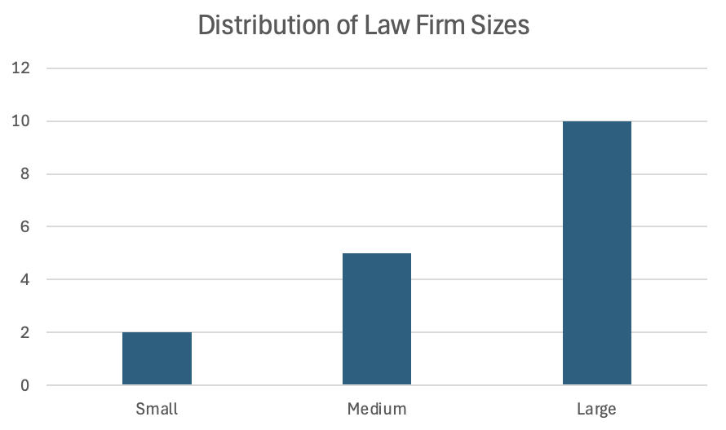
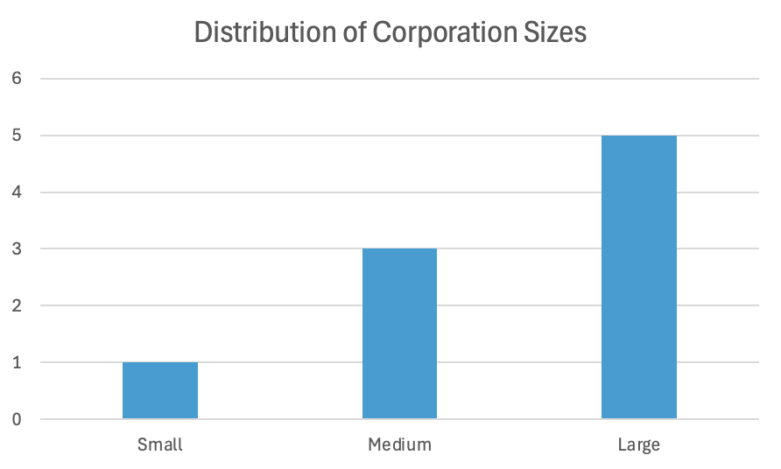
Demographic Results
30 Participants in 27 interviews

Slide 9
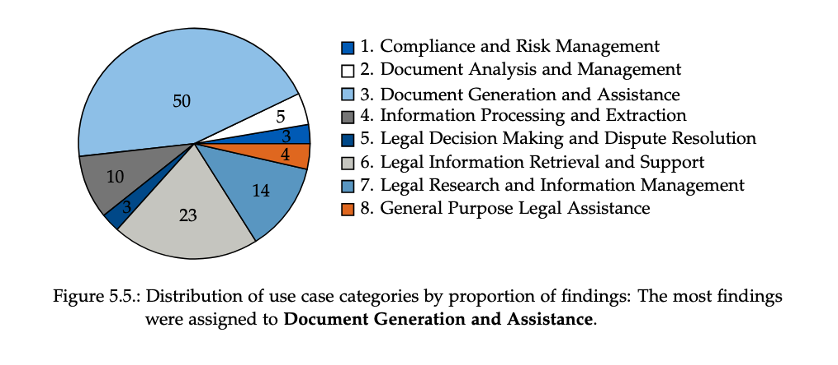
Use Case Category (UCC) Distribution – RQ1

Slide 10
Compliance and Risk Assessment (UCC-1)
Legal professionals employ specialized AI solutions to support auditing processes.
By observing reliable results, legal professionals recognize the value in specialized tools.
Due to the extensive detail required, compliance checks continue to be primarily performed by humans.
Tools employed:
Legalian
Data Snipper
In-house development

Slide 11
Document Analysis and Management (UCC-2)
Current AI solutions fail to accurately analyse long and complex documents.
Therefore, legal professionals can not employ AI tools for this UCC in their productive workflow.
Tools employed:
Harvey AI
In-house development
P-26: "The tool actually works quite reliably up to six to eight pages. If it goes beyond that, it fails.”

Slide 12
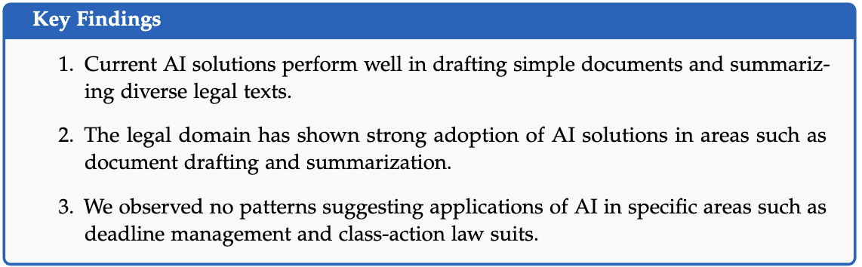
Document Generation and Assistance (UCC-3)
17 participants reported on AI usage for summarization:
Contracts
Long documents
Laws and regulations
Tools employed:
ChatGPT, Copilot
Harvey AI
Henchman, Lawlift, Westlaw

Slide 13
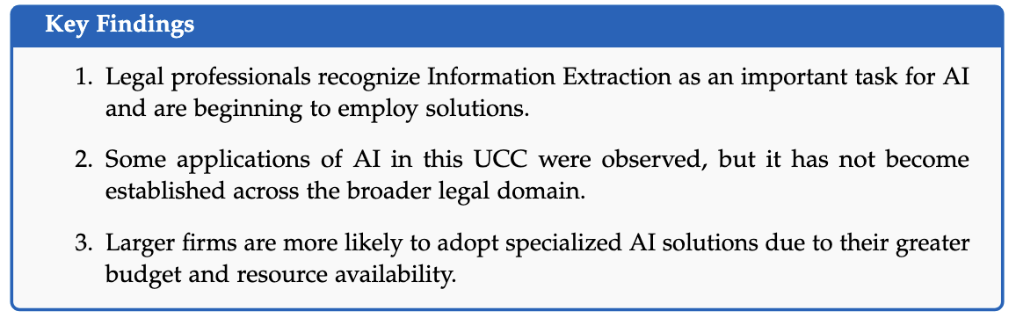
Information Processing and Extraction (UCC-4)
P-2: "Check a COC or a non-compete clause in these 100,000 documents, and then display the results in a table."
P-7: "We always try to use it in our client work, but it is probably not necessary that often."
Tools employed:
Leah
Legisway Analyzer
In-house development
→ Specialized tools

Slide 14
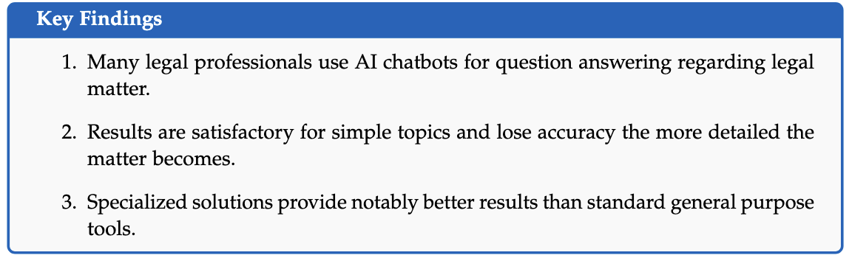
Information Retrieval and Legal Research (UCC-6, UCC-7)
P-21: "Its [Copilot] available to everyone in the firm so that they can familiarize themselves with the
topics."
Tools employed:
ChatGPT, Copilot
AI Chatbot in BeckOnline

Slide 15
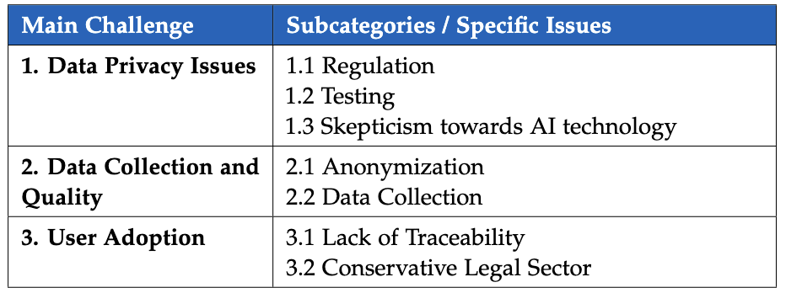
Challenges – RQ2

Slide 16
Data Privacy
P-9: "We can’t take the risk that it will go wrong in the end.”
No transparency
Regulation
Solutions:
Hosting in the EU
Regular contact with Provider
Data Privacy Issues
Testing
Anonymization tool

Slide 17
User Adoption
P-3: "We offered it to everyone. But no one really took it upon themselves to get it off the ground with an implementation project.”
Problems:
Expect traceability and reliability
No willingness to use AI
Solutions:
Workshops
Competitions
Conservative Legal Sector

Slide 18
Contextual Factors – RQ2
How did the participants’ context affect how they integrate Legal AI?
Regulation in the EU
→ stricter than international counterparts
Budget and Resources
→ Large firms have more
Conservative attitude
→ Risk losing competitiveness
Different Application Areas
→ ex. self-employed or high-end area
Buy vs Build Strategy
→ Trend towards Buy

Slide 19
Future Outlook of Participants – RQ3
P-29: "It will certainly also lead to law firms having
to think about what their remuneration structure can or should look like in the future."
Various views on future:
Uncertainty → unease and resistance
Cautious and tend to observe
‘AI is in full swing’
AI will not replace humans, due to oversight and person element required
→ Legal professionals are developing realistic views on the usage of AI

Slide 20
Discussion

Slide 21
Discussion
Use Cases and Tool Types
Contextual Factors and Firm Dynamics
Navigating Challenges and Adoption Barriers

Slide 22
Use Cases and Tool types
General-purpose tools like ChatGPT lack legal depth
Specialized tools show promise, but adoption is slow due to market complexity and high implementation effort
General Purpose AI Tools
Specialized Tools

Slide 23
Contextual Factors and Firm Dynamics
Large firms adopt Legal AI more actively due to greater financial resources, dedicated tech teams, and broader use cases.
AI offers efficiency gains for high-volume routine tasks, which are more common in large firms than in smaller ones.
Smaller firms face structural limitations, not a lack of interest, and can learn from the experiences of larger firms.
Large Firms
Small Firms
VS.
Who requires Legal AI more urgently?
Large firms have a high-volume of routine tasks → can be automated
Small firms propose value in close client relationships → less applicability of AI

Slide 24
Navigating Challenges and Adoption Barriers
Data privacy is a major barrier to Legal AI adoption, as firms lack trust in how providers handle their data; hosting tools on European servers is a common workaround
Strict regulations protect data but may hinder competitiveness
long-term solutions that balance security and innovation
User adoption remains difficult, but hands-on workshops have proven effective
though mostly feasible for larger firms due to resource demands

Slide 25
Conclusion

Slide 26
Conclusion
Legal AI is becoming increasingly more integral in legal processes
Will not replace humans
Oversight and Personal element
Limitations
Relatively small sample set
All interviews conducted by one person
For robust data collection, multiple researchers should conduct the interviews to avoid Interviewer Bias
Future Research
More accessible, transparent AI solutions
Anonymization software
Longitudinal approach → longer timeline allows to observe change
More collaboration between academia and legal professionals → more tailored solutions.

Slide 27
Jan Rothweiler
jan.rothweiler@tum.de
17132
matthes@in.tum.de

