Slide 1
An LLM-based Method to Generate Instructions for Users How to Navigate Web-based User Interfaces
24th March 2025, Master Thesis Final Presentation
Doruk Gercel

Slide 2
Outline
Background & Motivation
Research Questions
Methodology
Results
Conclusion

Slide 3
Background & Motivation
Modern Technology Company has a Web-based UI Application:
With lots of Components, Options and Configurations
Accessible from Standard Web Browser
They want to Design and (Partially) Implement LLM Chatbot for their Web UI Application:
Make Web UI Setup Easier with Virtual Assistance
Guide User in the UI according to the User’s Prompt
Integration of LLM to the Product

Slide 4
Outline
Background & Motivation
Research Questions
Methodology
Results
Conclusion

Slide 5
Research Questions
RQ1) How to model UI components to feed LLM to generate the required steps to perform UI actions? | Literature Review Identify Attributes Construct the Grammar
RQ2) How to generate UI instructions from the textual output generated from the LLM? | Construct UI Instruction Format Prepare a Prompt for the LLM Generate Method to Extract UI Instructions Develop the ‘User Guidance Algorithm’
RQ3) How to integrate this chatbot into the product by following and considering software engineering principles? | Collect the Chatbot Application Requirements Design a Mock Prototype Design and Define Subcomponents Develop and Implement the Subcomponents

Slide 6
Outline
Background & Motivation
Research Questions
Methodology
Results
Conclusion

Slide 7
Requirements of the Chatbot Application
UI like a Messaging Application
Leverage the LLM
Guide the User until the Last Instruction or the User Turns-Off the Guidance Mode
Continue to Guide the User even if the User makes an Error
The Design Elements shall be Compatible with the Other Design Elements of the Web Application
The OpenAI’s GPT-4o mini shall be Used as the LLM

Slide 8
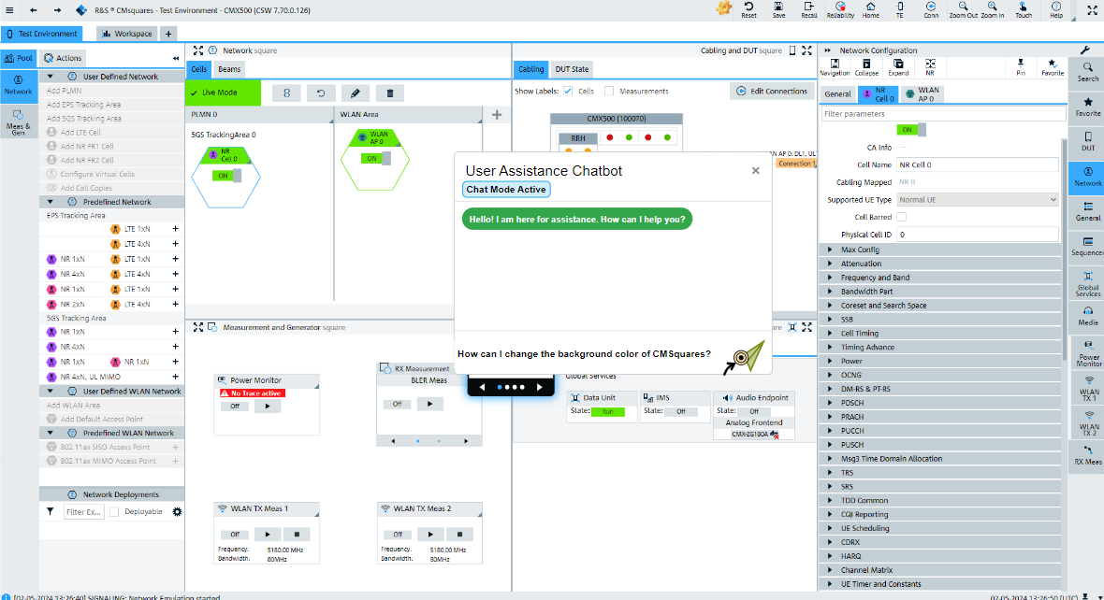
Prototype Proposal
Chat Mode Send Prompt

Slide 9
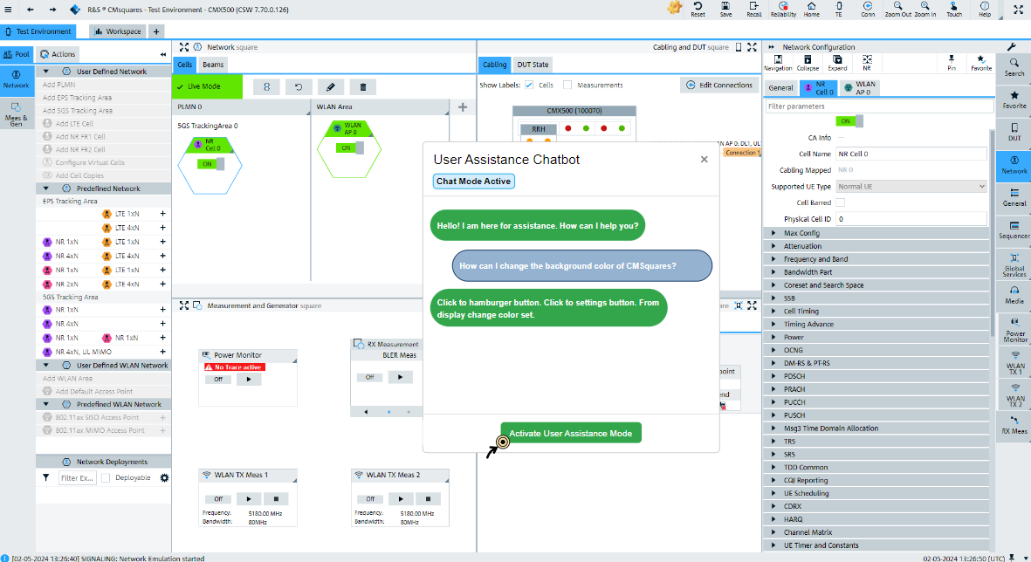
Prototype Proposal
Display List of Instructions

Slide 10
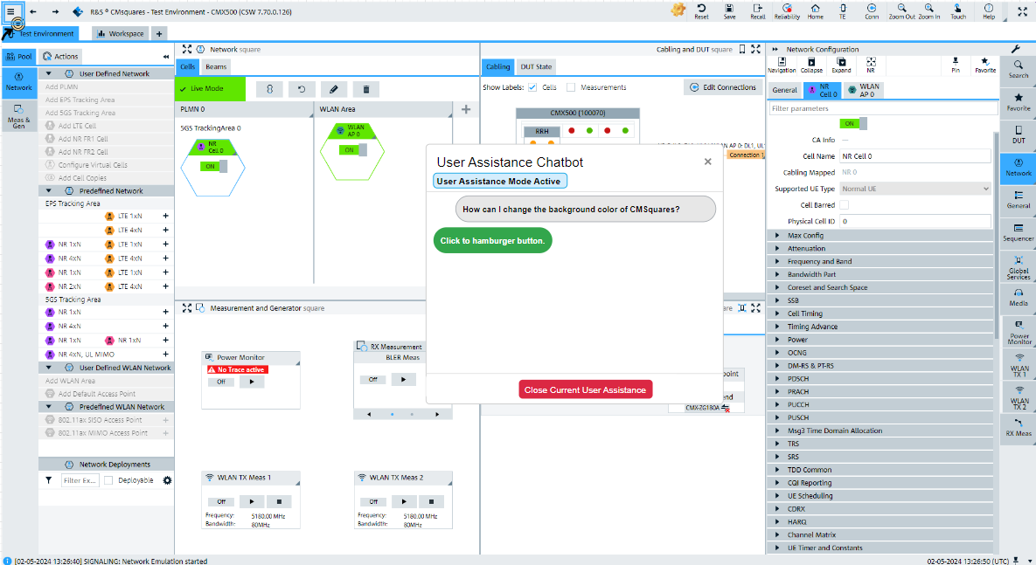
Prototype Proposal
Highlight Hamburger Button

Slide 11
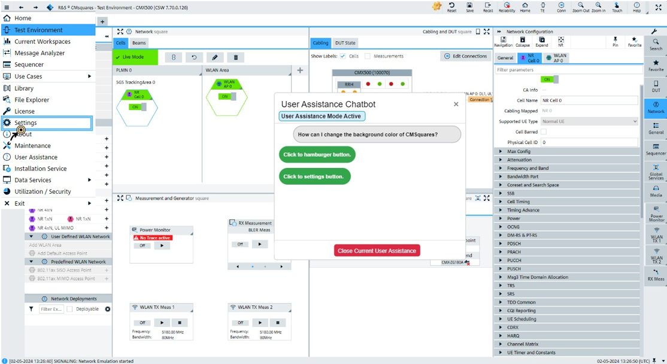
Prototype Proposal
Highlight Settings Button

Slide 12
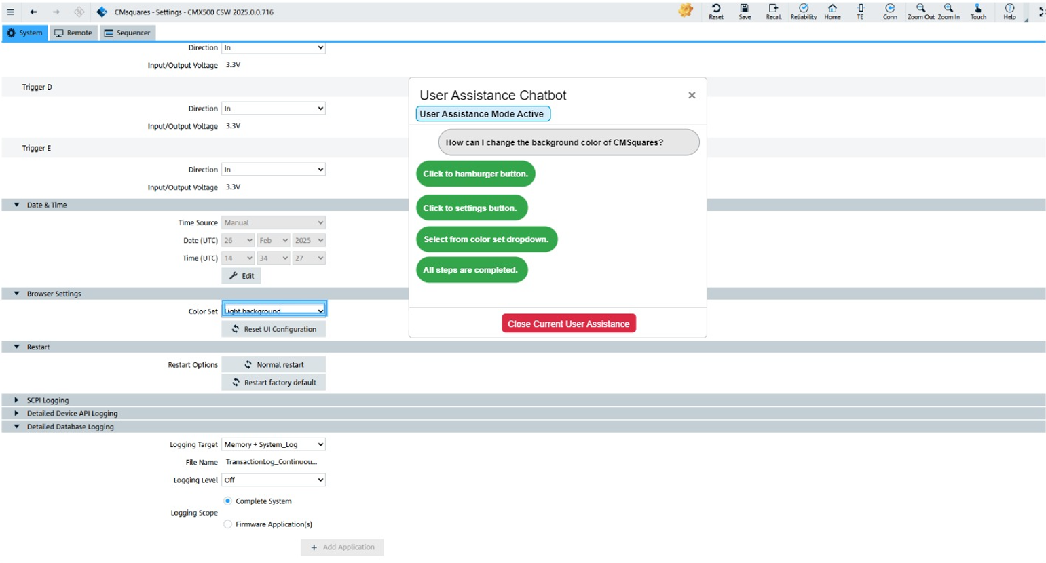
Prototype Proposal
Display that All Steps are Completed

Slide 13
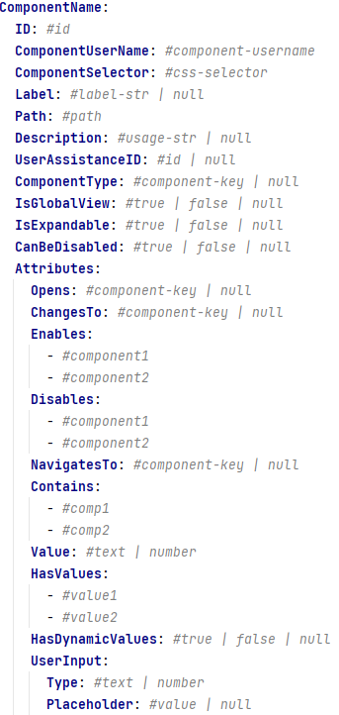
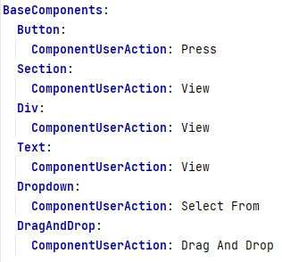
Grammar Definition for UI Components
Unique Identifiers for Components &
CSS Selectors
Use Case Description of the Component &
User Assistance Document ID
Type of Parent Component
(e.g., Button, Dropdown, Menu)
Base Grammar Definition
Attributes Specific to the
Component Type
(e.g., Dropdown Contains HasValues,
Button Contains Opens)
Proposed Grammar Definition

Slide 14
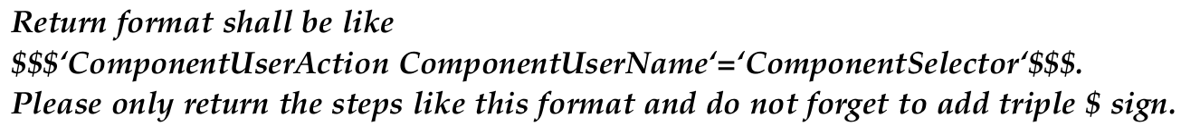
Generating UI Instructions from the LLM
UI Instructions Format
UI Instructions Format Example
Prompt for UI Instructions Format
UI Instructions Extractor Regex

Slide 15
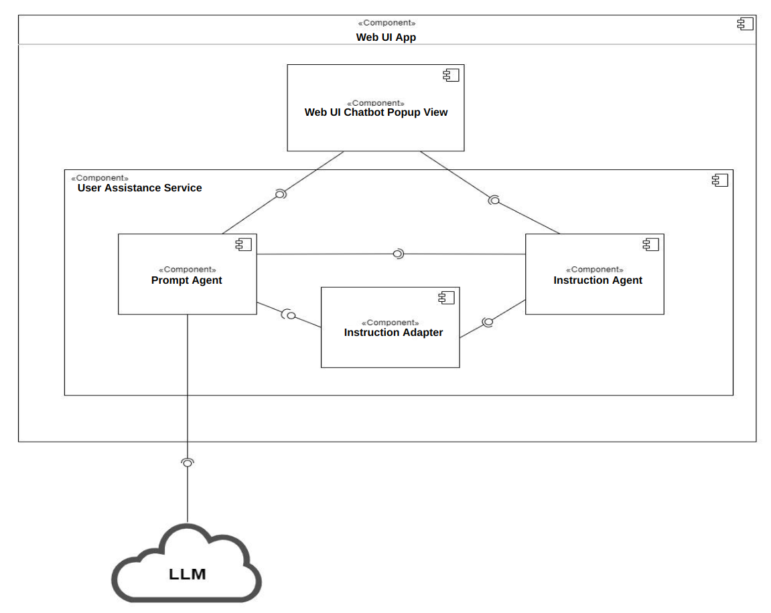
Architecture Overview
Chatbot Application Component Diagram

Slide 16
Architecture Overview
Chatbot that the Client
Interacts
Structures the Prompt from the User and Interacts with the LLM
Detects the Current Page View and Executes the List of Steps Received from the Adapter
Converts Textual UI Instructions from LLM to User Instructions and Selectors
Chatbot Application Component Diagram

Slide 17
Architecture Overview
Highlight
Components
Textual
Instructions
to User
Text
UI
Instructions
User Instructions and Selectors
Structured
Prompt
UI
Instructions
Chatbot Application Component Diagram

Slide 18
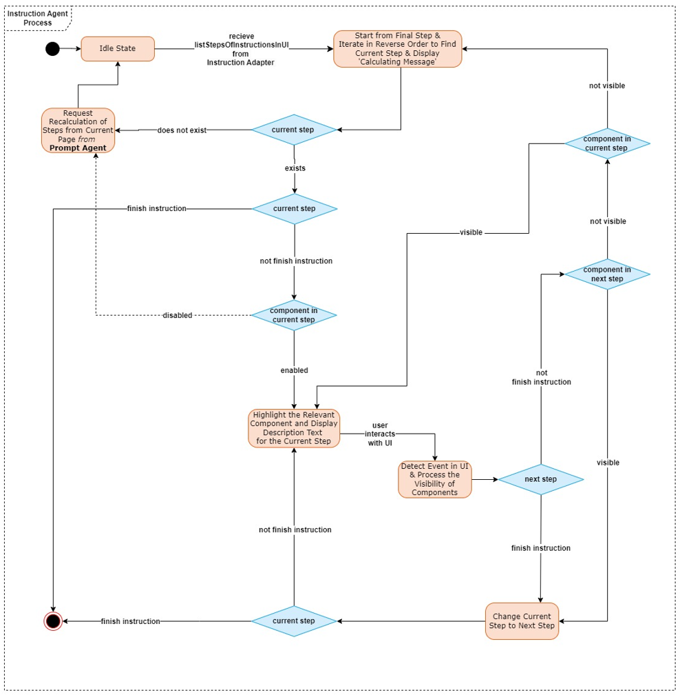
Algorithm for User Guidance
User Guidance Algorithm FSM Diagram

Slide 19
Algorithm for User Guidance
Initial Steps
User Guidance Algorithm FSM Diagram

Slide 20
Algorithm for User Guidance
Provide User Guidance Step by Step
User Guidance Algorithm FSM Diagram

Slide 21
Algorithm for User Guidance
Client did not Perform the Correct Action and Completely Changed the View
User Guidance Algorithm FSM Diagram

Slide 22
Algorithm for User Guidance
A Configuration is Missing and Must be Configured with Guidance from the LLM
User Guidance Algorithm FSM Diagram

Slide 23
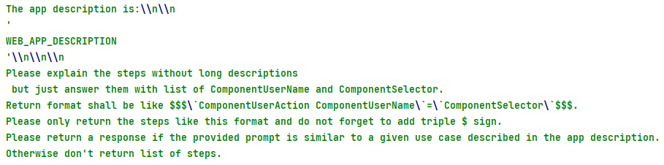

Implementation of the Prototype
Init Prompt
Web UI Description Prompt
Current Page Prompt

Slide 24
Implementation of the Prototype
System Prompt
User Prompt

Slide 25
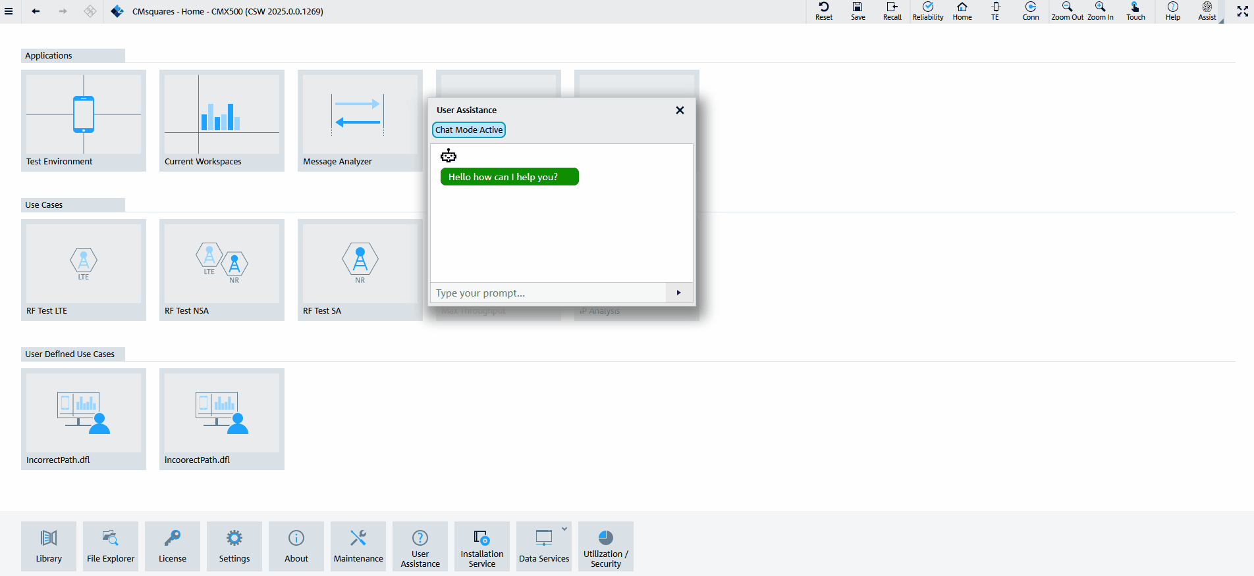
Chatbot Application Screen Capture
View Power Dynamics Measurement

Slide 26
Evaluation Methods - Measuring the Understandability of the Grammar
Direct Questions:
1. What is the possible user action for component X?
2. What elements are visible on web page Y?
3. Which component is web component X’s parent component?
4. Is use case Z achievable with component X?
Navigational Questions:
1. If component X1 is visible from the current page, is component X2 visible?
2. From page Y, what are the necessary steps to reach component X?
3. If component X1 is visible from the current page, what are the necessary steps to reach
component X2?
4. If component X can be disabled or enabled, which component can enable or disable it?

Slide 27
Evaluation Methods - Measuring the Generation of UI Instructions
Easy | Change Background Color | Requires navigation between web components and pages. 1-10 steps of instructions to complete the task.
Medium | Change IPv4 Method | Requires the configuration of a web component, navigation between web components and pages. 1-10 steps of instructions to complete the task.
Hard | Create Measurement and View Test Results | Requires the configuration of a web component, navigation between web components and pages. 1-25 steps of instructions to complete the task.
Error | Order a Hamburger, Create an IP Router/ a New Color/ a Movie | Cannot be achieved by the web application. An empty list of instructions shall be obtained.

Slide 28
Evaluation Methods - Conducting Interviews about the Chatbot Application
Target Groups:
Participants Unfamiliar with the Web Application
Participants Familiar with the Web Application
Participants Familiar with the Web Application and Chatbot Application
Use Cases:
Easy: Change Background Color
Medium: Change IPv4 Method
Hard: Create Measurement and View Test Results
Questions:
Design
Navigation and Flow
Feedback and Improvement
Software Packages and Integration

Slide 29
Outline
Background & Motivation
Research Questions
Methodology
Results
Conclusion

Slide 30
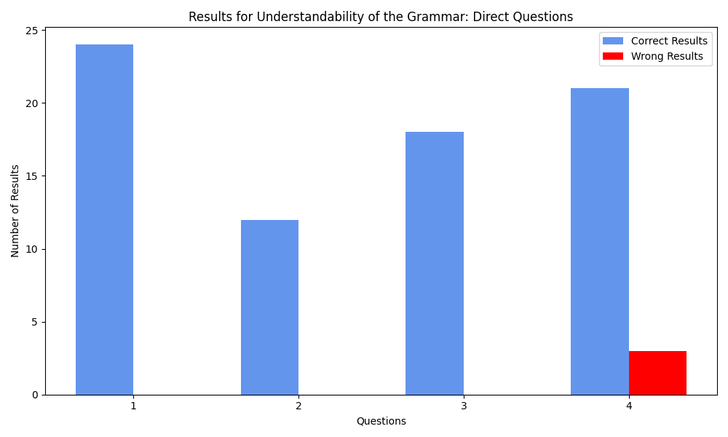
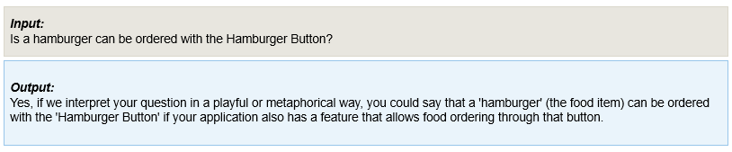
Results - Measuring the Understandability of the Grammar
Direct Question Results
Polysemy Confusion Example

Slide 31
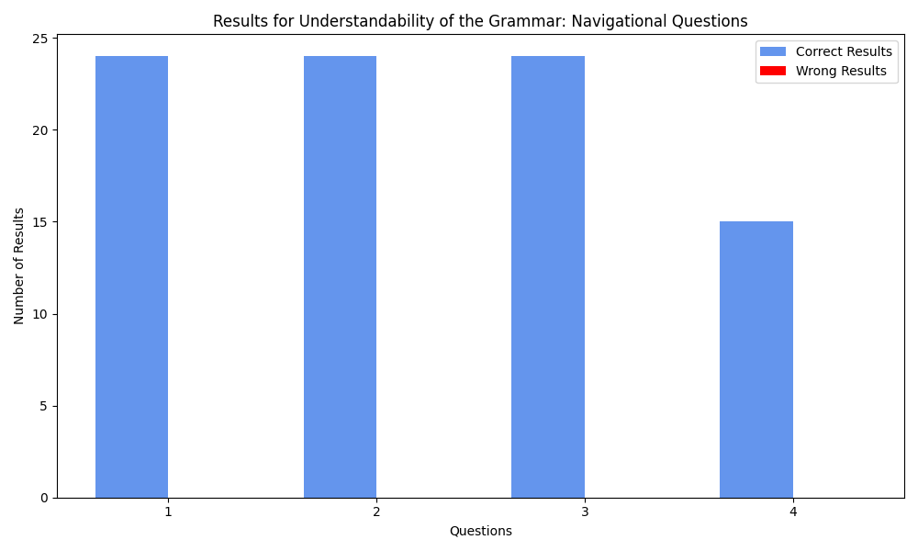
Results - Measuring the Understandability of the Grammar
Navigational Question Results

Slide 32
Results - Measuring the Generation of UI Instructions
Results:
Correct
Wrong:
The List of Instructions Obtained is Correct but Not the Shortest from the Current Page
The Use Case is Achievable, but No Instruction is Obtained
The Use Case is Achievable, but Missing Steps in the Execution Path
The Use Case is not Achievable, but a List of Instructions is Obtained

Slide 33
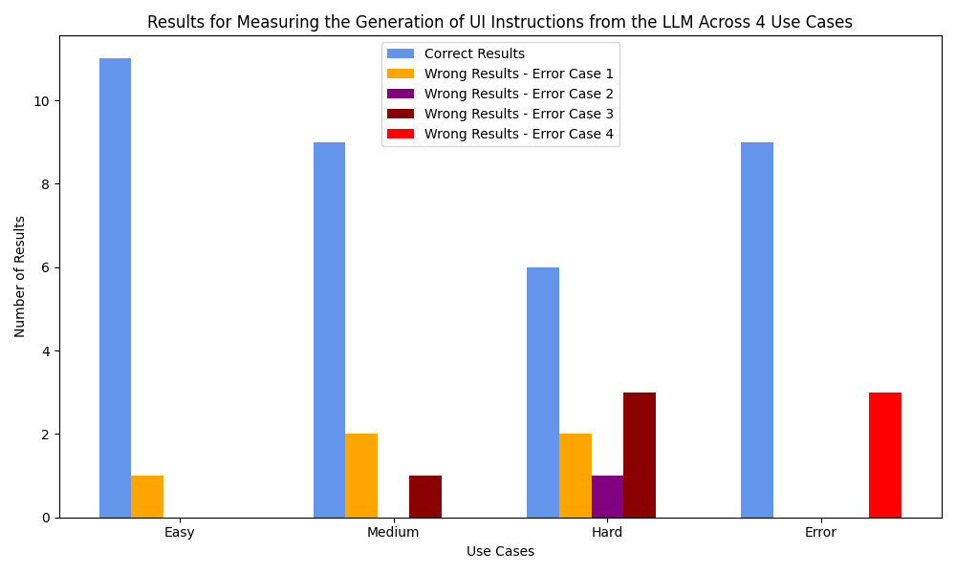
Results - Measuring the Generation of UI Instructions
Generation of UI Instructions Results

Slide 34
Results - Conducting Interviews about the Chatbot Application
Design
Helpful for user guidance
Not confusing
Step-by-step highlighting, textual instructions and error handling are well designed
Divide steps to substeps, display error behavior
Navigation and Flow
Helpful and Straightforward for Completing the Task
Clear, Easy to Understand, and Straightforward
Feedback and Improvement
More Interactive and Visually Engaging than Traditional Documentation
Onboarding the Use Cases for the Web Application and Troubleshooting
More Customization Options and a Quick-Search Function
Receiving all Instructions at the Beginning may be Optional
Textually Interacting with the Chatbot Application is much easier
Software Packages and Integration
The Package Structure Fits the Main Application’s Structure
Design Principles and Patterns are Used
Application Logic and Design is Integrated to the Main Application

Slide 35
Outline
Background & Motivation
Research Questions
Methodology
Results
Conclusion

Slide 36
Conclusion
Key Results
An approach to model the web UI components is investigated by searching the related work and extending this work by proposing a grammar to define the components.
A format to represent UI instructions is designed, a method to extract these instructions from the textual output is implemented, and the proposed format is added to the prompt to explain the format specification to the LLM. Afterward, the user guidance algorithm is implemented so that the extracted UI instructions can be followed step-by-step by the developed chatbot application.
A chatbot application is developed considering the software development principles and the user experience.
Limitations
Token and Prompt Text Size
Applicability to the All Project
Infrastructure
Sample Size

Slide 37
BSc.
Doruk Gercel
17132
matthes@in.tum.de

Slide 38
Backup Slides - Outline
Screen Captures
Sequence Diagram
Algorithms
Interview

Slide 39
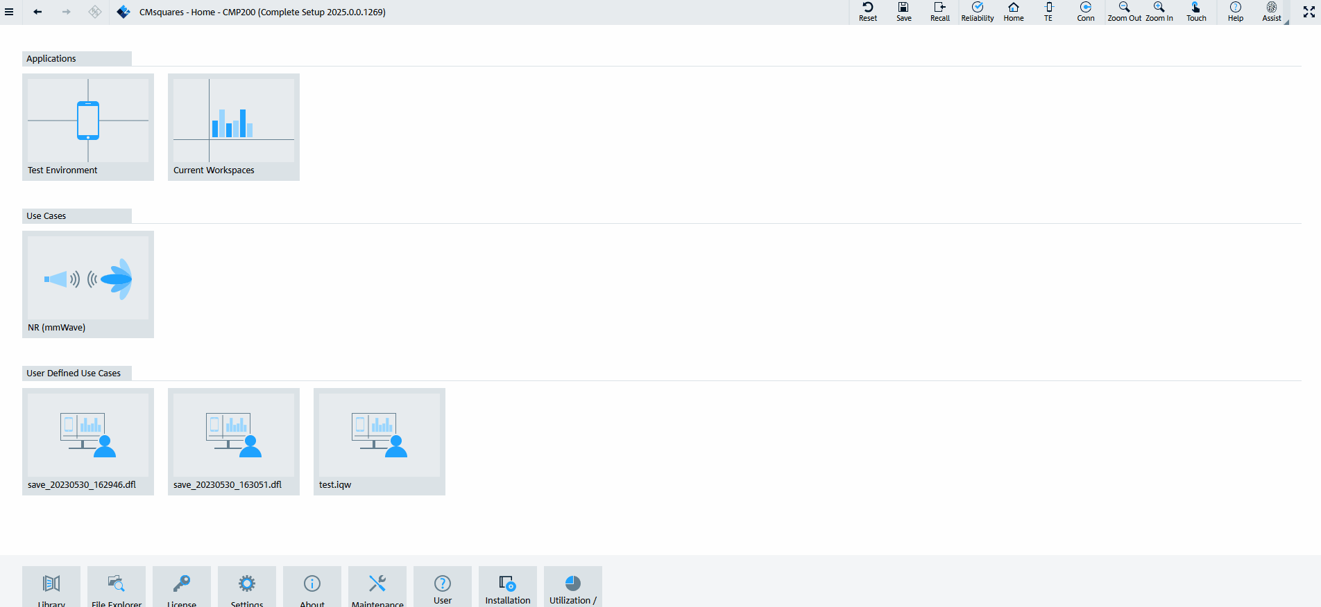
Chatbot Application Screen Capture
Change Background Color - Standard

Slide 40
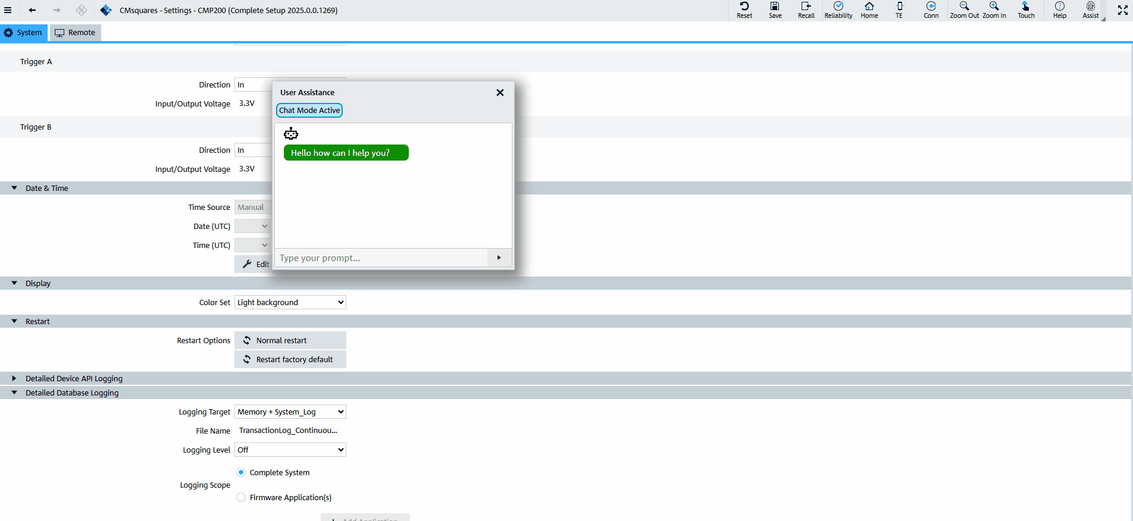
Chatbot Application Screen Capture
Change Background Color - Current Page: Settings Page

Slide 41
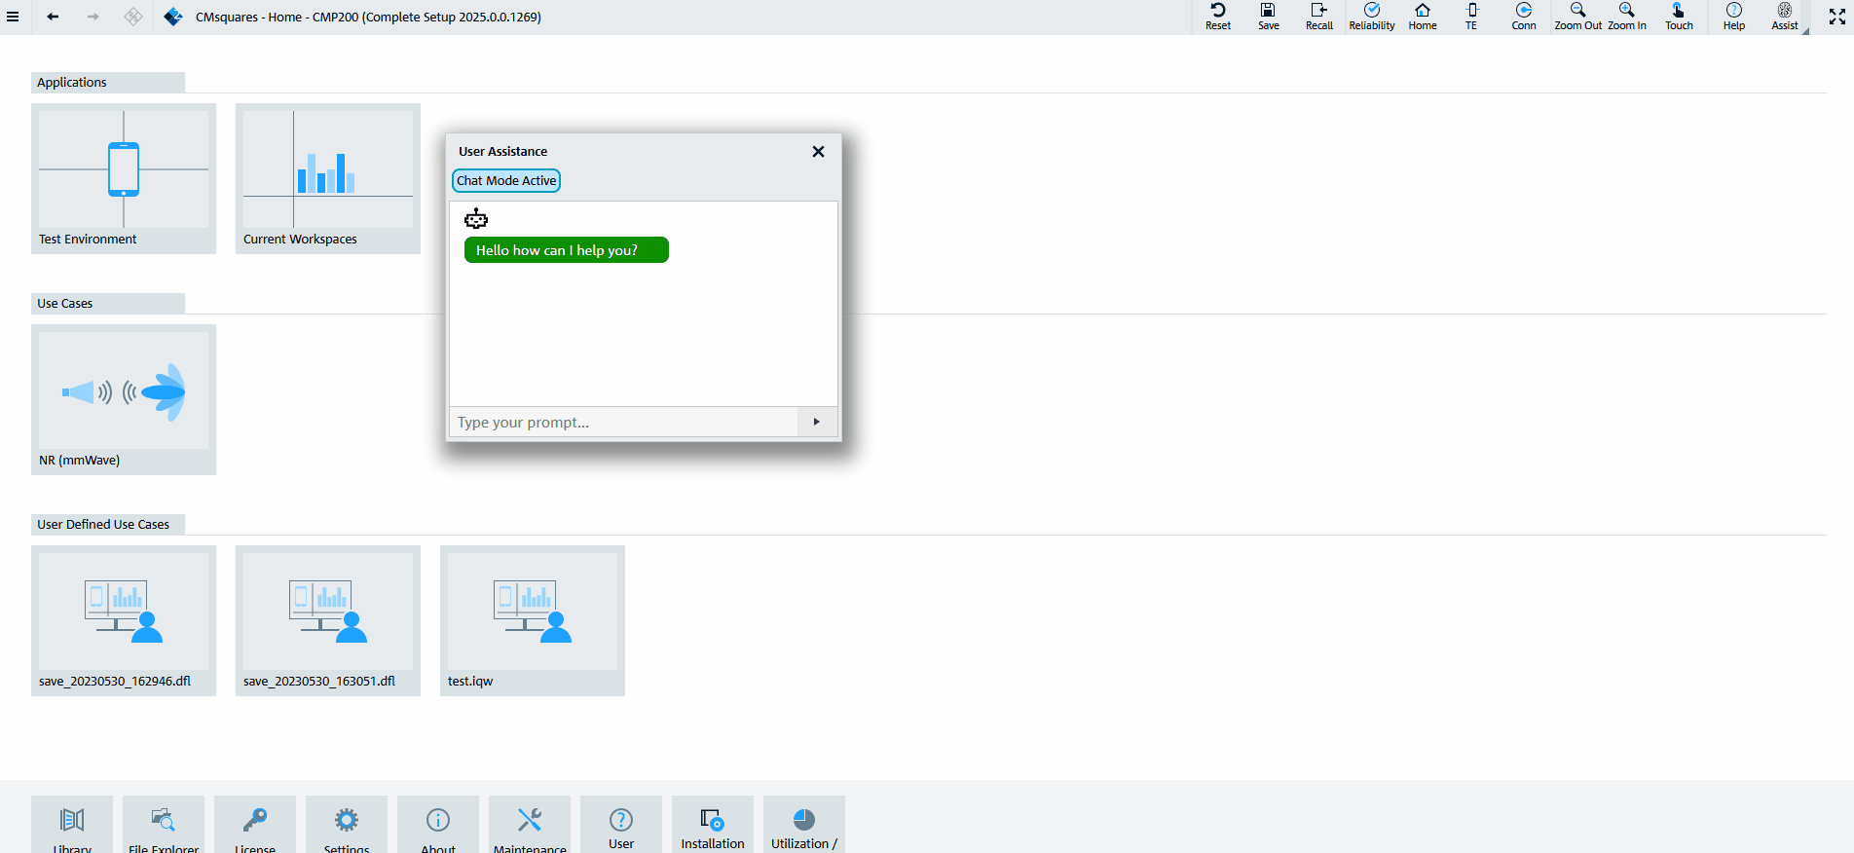
Chatbot Application Screen Capture
Change Background Color - Long Prompt

Slide 42
Chatbot Application Screen Capture
Unachievable Prompt

Slide 43
Chatbot Application Screen Capture
View Power Dynamics Measurement

Slide 44
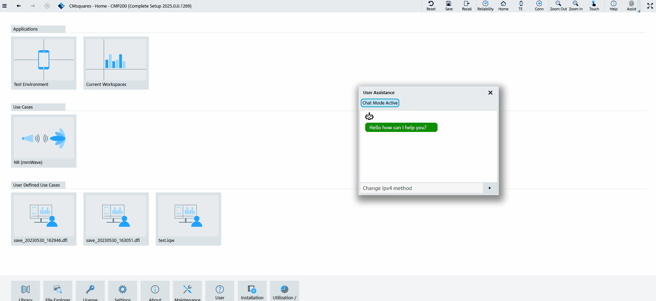
Chatbot Application Screen Capture
Change IPv4 Method

Slide 45
Backup Slides - Outline
Screen Captures
Sequence Diagram
Algorithms
Interview

Slide 46
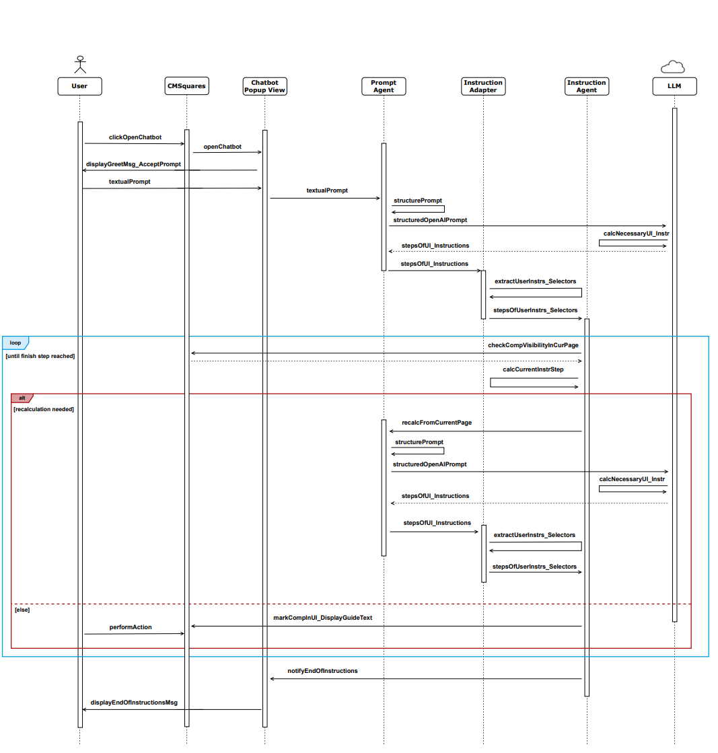
Sequence Diagram
User Interaction Sequence Diagram

Slide 47
Backup Slides - Outline
Screen Captures
Sequence Diagram
Algorithms
Interview

Slide 48
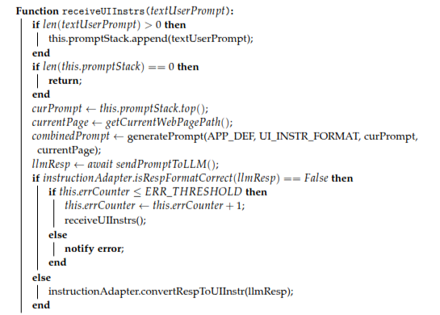
Prompt Agent Routine
Prompt Agent Routine

Slide 49
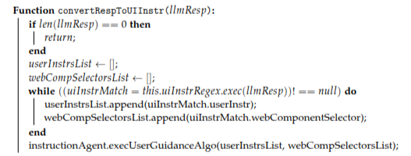
Backup Slide - Instruction Adapter Routine
Instruction Adapter Routine

Slide 50
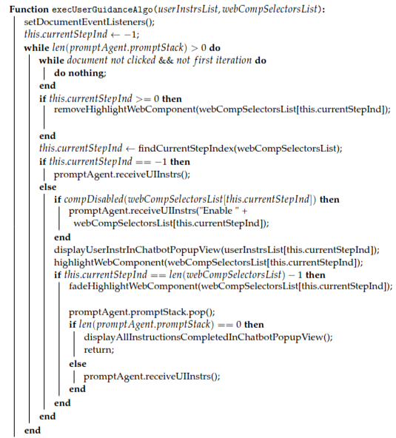
Backup Slide - Instruction Agent Routine
Instruction Agent Routine

Slide 51
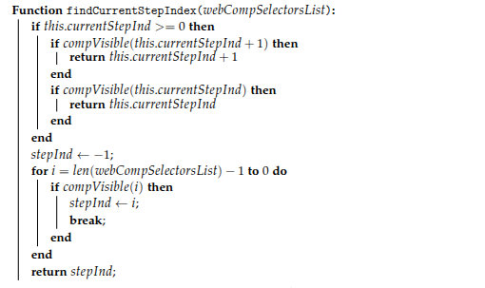
Backup Slide - Instruction Agent Routine
Instruction Agent Routine

Slide 52
Backup Slides - Outline
Screen Captures
Sequence Diagram
Algorithms
Interview

Slide 53
Backup Slide - Conducting Interviews about the Chatbot Application
Design
Are the design (color, highlights, etc.) elements helpful to complete the task?
Do you find any design element feel confusing?
What is good about the user guidance and design elements?
Would you have preferred it a different way, and if so, how?
Navigation and Flow
Is the user guidance helpful to complete the task?
Are the instructions clear and easy to understand/follow?
Feedback and Improvement
Would you prefer using the tool over traditional help/manual/documentation, etc.?
What kind of tasks/use cases would you use it for?
What could be improved? What features are missing?
If you could redesign one part of this user guidance, what would you change and why?
Would voice assistance (input/output) be helpful?

