Slide 1
Improving The Algorithmic Efficiency And Expert Collaboration
Of A Data Annotation Web Application
23.09.2024
Majd Alkayyal - Application Project Final Presentation

Slide 2
Outline
CreateData4AI Background
Dataset Summary
Efficiency Problem
Information Overload Problem
Demo
System Usability Scale Results
Future Improvements

Slide 3

CD4AI Background
It bridges the gap between unstructured datasets and annotated datasets by allowing users to annotate their own textual data using user-defined classes.
How does it work?
Text
Text
upload
Text
Keyword Extraction
Context Window Extraction
Extrapolation
Text 1
Text 0
Text 1
Text 1
Text 0
Text 1
Text 1
Text 0
Text 1
define
Classes
Job Descriptions
IT

Slide 4
CD4AI Background
It bridges the gap between unstructured datasets and annotated datasets by allowing users to annotate their own textual data using user-defined classes.
How does it work?
Text
Text
upload
Text
Keyword Extraction
Context Window Extraction
Extrapolation
Text 1
Text 0
Text 1
Text 1
Text 0
Text 1
Text 1
Text 0
Text 1
define
Classes
software
hardware
systems
Job Descriptions
IT
technology
database
machinery

Slide 5
CD4AI Background
It bridges the gap between unstructured datasets and annotated datasets by allowing users to annotate their own textual data using user-defined classes.
How does it work?
Text
Text
upload
Text
Keyword Extraction
Context Window Extraction
Extrapolation
Text 1
Text 0
Text 1
Text 1
Text 0
Text 1
Text 1
Text 0
Text 1
define
Classes
software
hardware
systems
Job Descriptions
IT
technology
database
machinery

Slide 6
CD4AI Background
It bridges the gap between unstructured datasets and annotated datasets by allowing users to annotate their own textual data using user-defined classes.
How does it work?
Text
Text
upload
Text
Keyword Extraction
Context Window Extraction
Extrapolation
Text 1
Text 0
Text 1
Text 1
Text 0
Text 1
Text 1
Text 0
Text 1
define
Classes
software
database
systems
Job Descriptions
extensive experience in managing relational databases
As a software engineer you will be responsible
implementation of efficient systems in the assembly line
IT

Slide 7
CD4AI Background
It bridges the gap between unstructured datasets and annotated datasets by allowing users to annotate their own textual data using user-defined classes.
How does it work?
Text
Text
upload
Text
Keyword Extraction
Context Window Extraction
Extrapolation
Text 1
Text 0
Text 1
Text 1
Text 0
Text 1
Text 1
Text 0
Text 1
define
Classes
IT
extensive experience in managing relational databases
As a software engineer you will be responsible
Job Desc 1
Job Desc 2
Job Desc 3
Healthcare
administering medications, monitoring vital signs
conducting clinical trials, analyzing data
Job Descriptions
Construction
overseeing daily construction activities, ensuring safety
designs and plans infrastructure projects

Slide 8
Dataset Summary
Content | Job Descriptions for multiple Industries
Language | English
File format | .csv
Number of docs | 100k
Size | 453.1 MB
Average number of words per doc | 642.20 words
Example | “JOB REQUIREMENTS: Your journey to building a better world starts here! WHO WE ARE We help create products that build a better world across a variety of industries: Healthcare and Life Sciences Aerospace and Defense Industrial Some examples…”

Slide 9
Efficiency Issues (Keyword / Context Window) Extraction
Processing times are not optimal, significantly impacting productivity.
Goal:
Identifying and fixing implementation (code) inefficiencies to improve the processing time on a single machine.
20 Classes | Time per class * 20
T_CPU | 13.8 days
T_GPU | 4.8 days
RQ1.
How can tasks requiring high computational resources be optimized to enhance the scalability and efficiency of processing large datasets on a single machine?

Slide 10
Analysis of Keyword Extraction Issues
Same Algorithm, Different Implementation
 | Old Implementation (Sequential) | New Implementation (Parallel)
🔄 Data Passes | Multiple | Single
📊 Embedding Calculations | Repeated | Single
🔍 Similarity Calculations | Repeated | Single
⚙️ Code Efficiency | Redundent Checks and manipulation | Unnecessary overhead removed
🗂️ Execution Scope | One class per run | Multiple classes per run
💻 Hardware Utilization | No parallel + No GPU support | GPU (if aval) + parallel execution

Slide 11
Execution Time Comparison
= 16.6 hr
20 Classes | Old Implementation | New Implementation
T_CPU | 13.8 days | 13.4 mins
T_GPU | 4.8 days | 11.4 mins
= 5.8 hr

Slide 12
Context Window Extraction Analysis
software
systems
database
… [ extensive experience in managing relational databases ]…
… [ As a software engineer you will be responsible…
… [ implementation of efficient systems in the assembly line ] …
Dataset
Same Algorithm, Different Implementation
 | Old Implementation | New Implementation
💻 Hardware Utilization | Sequential | Parallel

Slide 13
Execution Time Comparison
= 5.8 hr

Slide 14
Information Overload
cd4ai
user
Keyword Extraction
Context Window Extraction
Keywords
Context Windows
Relevant Keywords
Context Windows Rules
per class
cd4ai
user
Dataset | 1% of Original = 1k docs
Class 1. Technology | 4079 context windows
Class 2. Healthcare | 3408 context windows
Class 3. Retail | 4869 context windows
RQ2.
How can collaborative features and automation tools enhance the efficiency and speed of the data selection process for domain experts?

Slide 15




Solutions’ Overview
Collaboration Feature
Workspaces Management
Invitees / Roles Management
Selection Tasks
Context Window Selection
New UI/UX
Auto Assigning
Keywords Re-Ranking
Re-ranks based on the domain expert selections
Gamification

Slide 16
CD4AI Tour
(Demo)

Slide 17
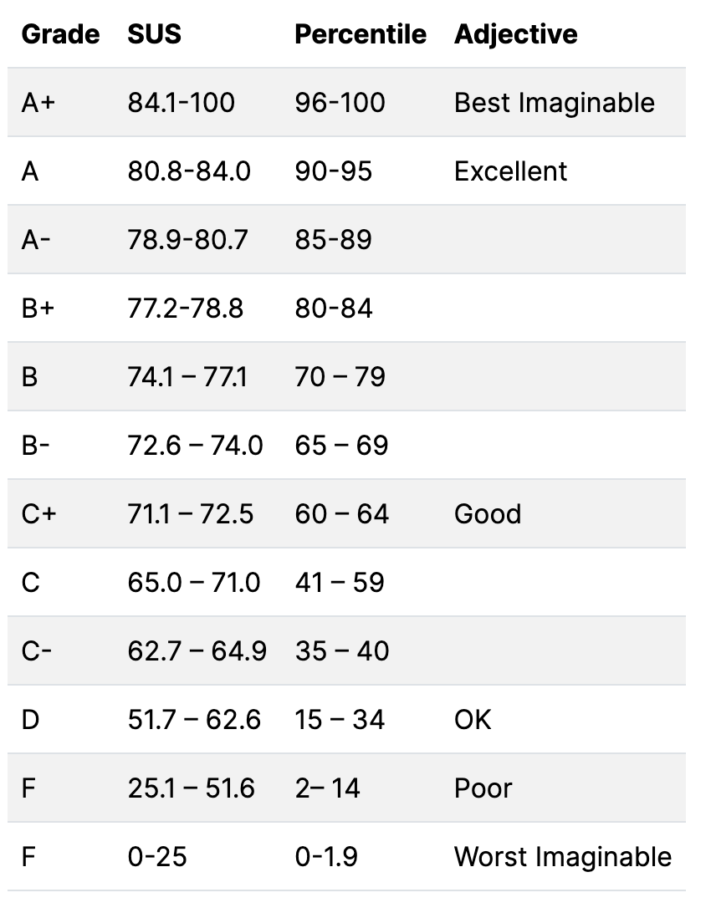

System Usability Scale
SEBIS & Fusionbase
6 people
Main Objective
Gathering opinions on the usability of the new UI/UX of context window selection process
CD4AI SUS | 75.4 (B)

Slide 18





Future Improvements
Multi-class context window extraction
GPU cluster support
Context Window Expanding
Task notification
Explainations/Guided Navigation

Slide 19
Majd Alkayyal
17132
matthes@in.tum.de

Slide 21


Time Complexities
$$Keyword Extraction Upper Bound: O(n.V+V.d +V.s.d)$$
$$n:number of docs \\ V:vocabulary size \\ s:number of seed keywords \\ d:embedding dimension$$
$$Context Window Extraction Upper Bound: O(n . m . k)$$
$$n:number of docs \\ m:avg number of tokens per doc \\ k:number of keywords$$

Slide 22
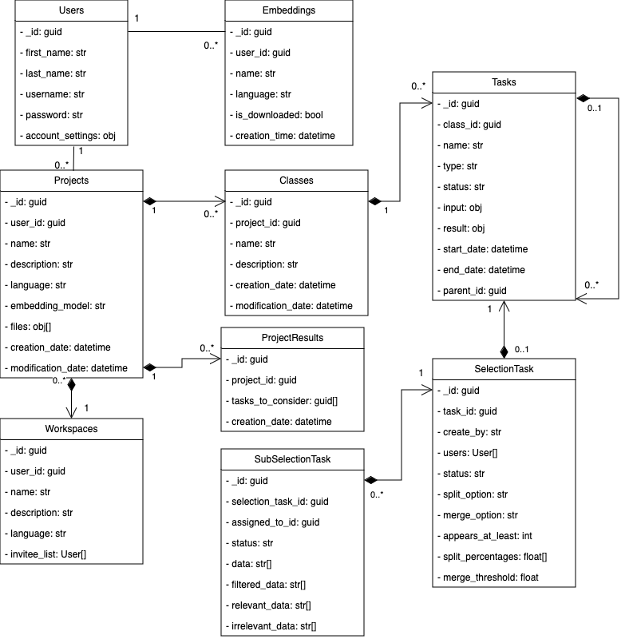
DB Model

