Slide 1
Expanding and Refining a Knowledgebase of Legal AI Use Cases
Benedikt Thiess
04.03.2024, Kick-Off Presentation
Notes:
Introduce myself
1

Slide 2
Outline
Motivation
Legal AI Use Case Radar
Research Questions
Methodology
Timeline
Benedikt Thiess, 04.03.2024, Kick-Off Presentation
© sebis
2
Notes:
(maybe say this at the corresponding slide:)
Since I started the thesis just half a month ago, there are not that many results I can already share with you.
What I can share are the results of a first information retrieval on the internet
2

Slide 3
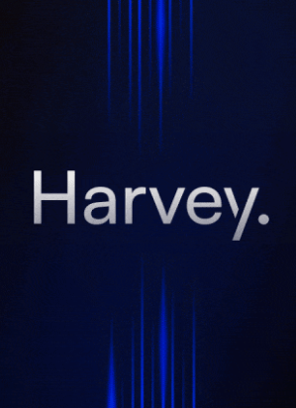

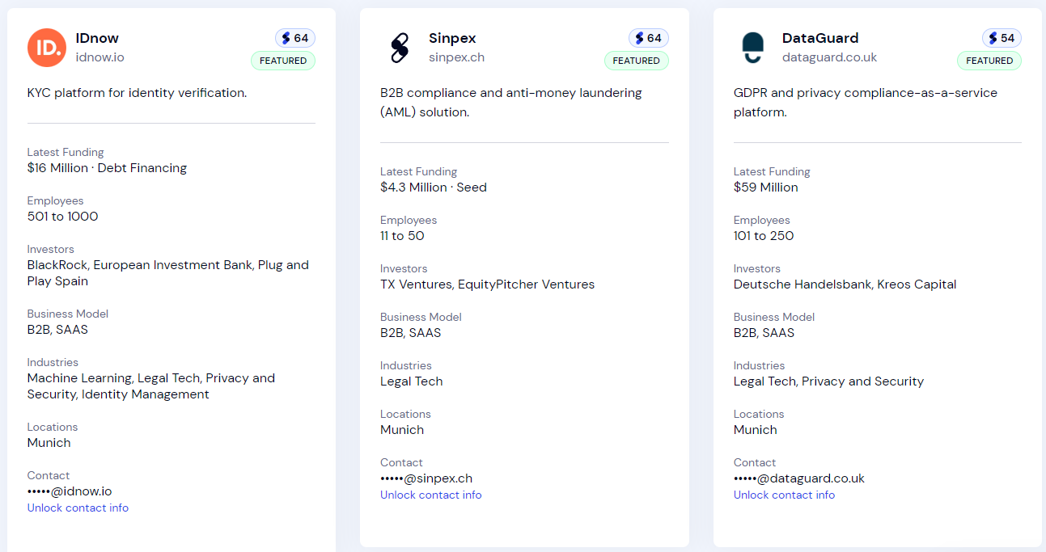


Motivation
Series B […] participation from OpenAI Startup Fund and Sequoia. The $80 million investment brings Harvey’s total funding to over $100 million and values Harvey at $715 million.
https://www.harvey.ai/blog
Number of Legal Tech Startups in Europe
Top 3 (out of 15,000)
UK (2774)
Germany (1946)
France (1941)
EY announces alliance with Reveal to offer clients AI-powered solutions to advance data discovery and compliance needs
Location in Germany
Top 3 (out of 1946)
Berlin (656)
Munich (358)
Hamburg (184)
https://www.ey.com/en_gl/news
https://www.seedtable.com/legal-tech-startups-germany
Benedikt Thiess, 07.02.2024, Proposal Meeting
© sebis
3
Notes:
A lot on a first glance…I know… but there is a lot going on in the LegalTech market.
Startups appearing and vanishing every week. Legislation trying to stay up to date. And a lot of money involved.
Take Harvey for example: a LLM built upon OpenAI‘s GPT AI but tailored to law firms
And as you can read, they have a total funding of over 100 mil. dollars
Big players in the market are increasingly interested
Harvey is already being used by Allen&Overy and Pwc
EY is partnering with the e-Discovery platform Reveal
What you can see on the bottom is an extraction of the database seedtable which keeps track of LegalTech startups in Europe
As you can see the LegalTech market in Europe is huge
It shows that in Europe, Germany is right at the forefront of LegalTech innovation
The problem at hand is that there is a lot of information about startups and their technologies but too little information about the use cases. That is how the clients of the startups actually use the technology
The research project NLawP is trying to declutter this by getting into contact with users.
3

Slide 4
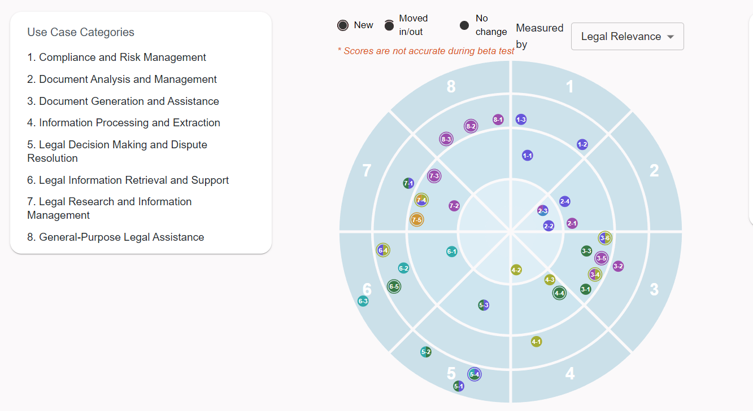
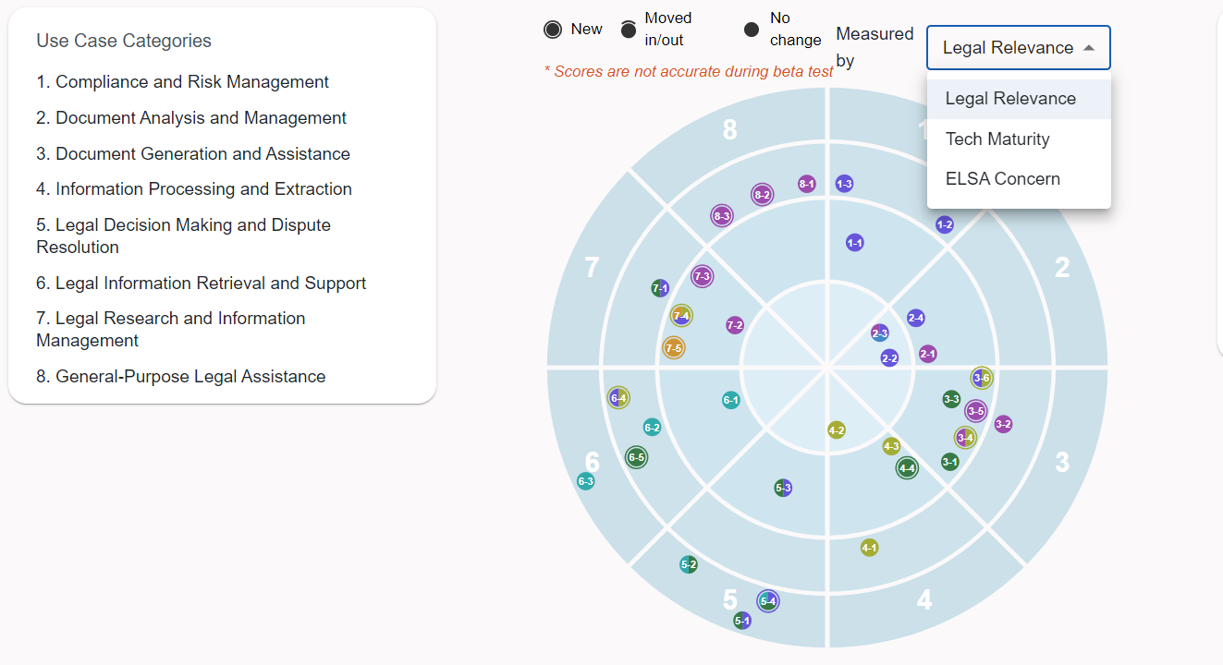
Use Case Radar
Existing set of use cases for NLP tools and their mapping
There is a need to validate it with more data from the economy
Benedikt Thiess, 04.03.2024, Kick-Off Presentation
© sebis
4
Notes:
Previous work has left us with a knowledge base – the Legal AI Use Case Radar – where technologies are mapped to their respective use cases
My thesis will add upon this. We propose a new approach in getting to the users, namely by going through the vendors of the technologies.
But more on that later, when we come to the methodology
34 Ucs identified in interviews are depicted by the blips on the radar and were summarized in 8 different categories that you can see on the left
They are visualized by the sectors of the radar
Warning message -> this thesis is trying to improve that by getting more data from the Legal Tech industry and compare it with what we have
This will result in changes of the radar: more detailed use cases identified and different evaluations of the metrics
4

Slide 5
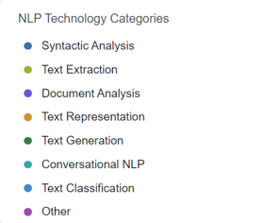
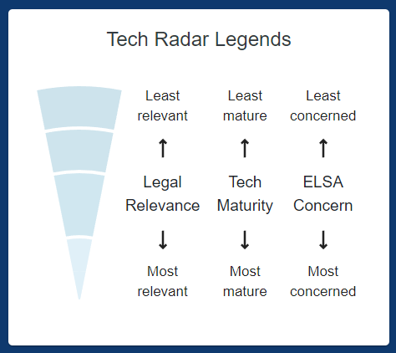
Use Case Radar
Blips colour depends on this
Blips position depends on this
Benedikt Thiess, 04.03.2024, Kick-Off Presentation
© sebis
5
Notes:
The metrics I was just talking about is what you selected in the drop-down menu and the blips position depends on it
If you have already wondered what the colours are all about
That is an additional categorization into NLP technologies
5

Slide 6
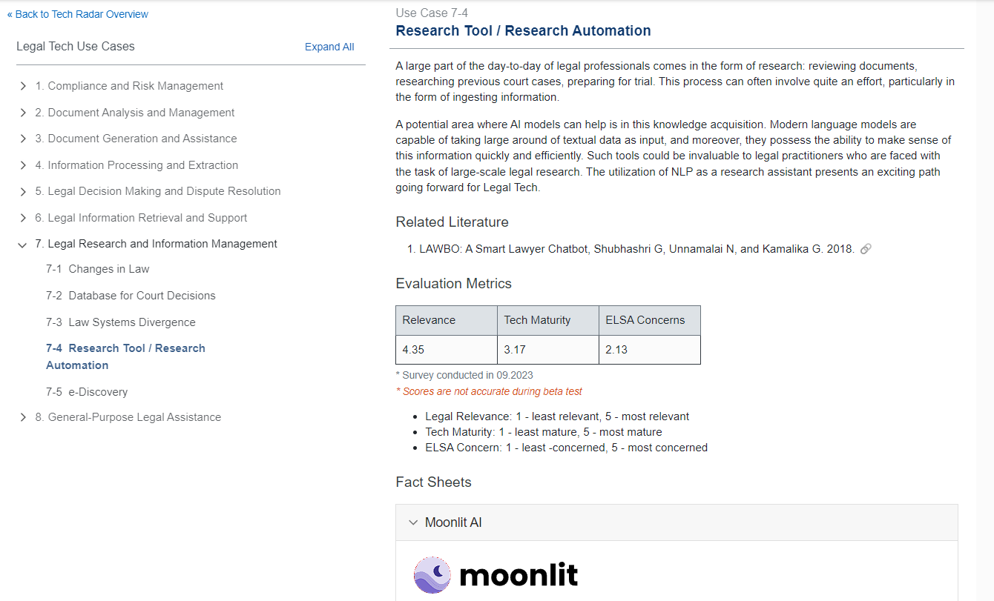
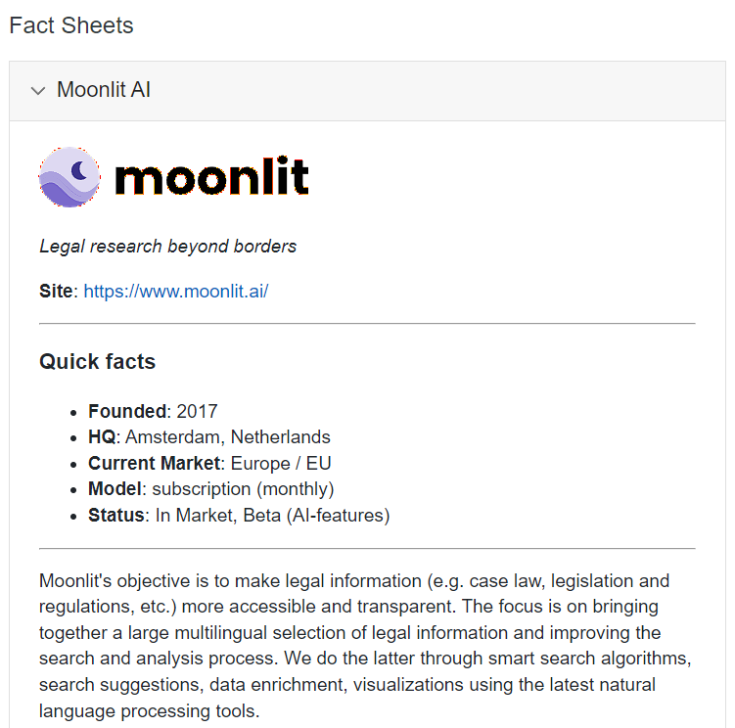
Wiki Page
Benedikt Thiess, 04.03.2024, Kick-Off Presentation
© sebis
6
Notes:
Clicking on a blip takes you to its wiki page
It consists of
- a short description
- related literature
- a detailed evaluation of the metrics
Specific to this use case is the fact sheet which relates the use case with a startup that fits into it
(-> After my thesis we want to be able to include more of these fact sheets)
Before I already spoke about our intended approach to go through the vendors to get to the users

Slide 7
Research Questions
Methodology
RQ1:
What do startups reveal about which use cases they are developing NLP tools for?
Information Retrieval from Online Resources
Semi-Structured Interviews
RQ2:
How does that compare to the use cases of their clients, practitioners of the field Legal Tech?
Benedikt Thiess, 04.03.2024, Kick-Off Presentation
© sebis
7
Notes:
We designed the research questions correspondingly
RQ1: Here we want to get a set of use cases that companies think their tools provoke
RQ2: validate this set of use cases by scheduling interviews with their clients and see what they are using their tools for
Also, I already teaser the methodology a bit here
(First, we want to get information from company’s websites, blog posts, LinkedIn, and so on)
Secondly, we will do SSI, meaning some questions are predetermined, but the order and phrasing of them are not
And, we leave room for exploration of the interviewee's responses
7
7
7

Slide 8
Methodology – Information Retrieval from Online Resources
Sources of Information
Communities
Legal Tech Verband Members
German Legal Tech Hub
Databases
SeedTable
Startups Incubators/ Accelerators
Venture Capital Merantix
Legal Tech Colab
XPRENEURS
TechFounders
Berlin Startup Incubator
(Networking) Forums
LinkedIn search with terms like “LegalTech NLP”
AI Startups
Legal Tech Verzeichnis
Startupill
LegalTech Blog
Conferences and Events
Legal Tech Berlin,
Legal Tech Forum, or
Legal AI Summit.
Legal Revolution
Denk Fabrik Legal Tech
University (Research Groups, Research Papers)
Paper: Law and Word Order: NLP in Legal Tech of Cambridge University
Paper: Natural Language Processing in the Legal Domain
Project: Lynx
Use the sources to find Legal AI startups with clients in D/A/CH - region
Visit their websites and LinkedIn profiles to see if they still exist and what they offer
Find somebody to contact (LinkedIn Premium)
Compare findings with the set of use cases of the radar and see where they fit into
set of companies to contact
idea of technologies and their use cases
a first categorization
Benedikt Thiess, 04.03.2024, Kick-Off Presentation
© sebis
8
Notes:
This slide gets into detail on how I want to carry out the respective methodology
8

Slide 9


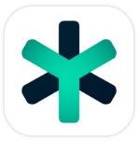






Methodology – Information Retrieval from Online Resources
Company | Aleph Alpha | Blaubach AI | Certivity | Judict | June | Libra | Luminance | Ocos | Rfrnz
gen. information | their AI technologies can be used to automate legal processes, such as document review, contract analysis, and legal research | Tailored AI solutions for document processing and the creation of individual AI pipelines | AI-driven Technical Compliance | Database for EU Law using NLP to scan through documents | use AI and LLM for an intelligent project-based case management system | leverage LLMs for legal drafting tasks to augment legal decision-making and produce claims automatically | uses NLP and machine learning to analyze legal documents, identify patterns, and assist lawyers in due diligence and contract review | Developing what they call Hybrid AI (i.e. AI models that can reason about decisions made) | Automated contract analysis based on AI
Location | Heidelberg | Cologne | Munich | Berlin | Munich | Berlin | Cambridge | Munich | Munich
Size (in employees) | 97 | 4 | 31 | 4 | 23 | 4 | 158 | 4 | 15
Source | Legal Tech Blog | LinkedIn | Legal Tech Colab | LinkedIn | Denkfabrik | LinkedIn | AI Startups | Legal Tech Colab | Tech Founders
Benedikt Thiess, 04.03.2024, Kick-Off Presentation
© sebis
9
Notes:
To contact these companies, I will make use of the free month of LinkedIn premium
9

Slide 10
Methodology – Semi-Structured Interviews
Interviewee Sources
personal contacts, referrals, LinkedIn, email, …
Develop an interview guide
Contact interviewees (LinkedIn Prem. + Sales Nav.)
Interview startups
Interview clients
Record interviews and transcribe using Whisper/ Otter
Analyse interviews afterwards
Interview Guide - Categories
“Personal” questions
To understand what the person knows about NLP and about the tool they are developing/ using
e.g.: “What position do you have in your company?”
Technology and Methodology
To understand which technology is developed/ used and how.
e.g.: “What NLP techniques (e.g., rule-based, machine learning, deep learning) are you using, and why?”
ELSA Concerns
To understand if they are aware of these implications
e.g.: “What happens with the data of the client?”
Group specific questions
Questions that I cannot ask both startups and clients
e.g.: “What data sources do you use to train your NLP models?”
set of use cases derived from startups
set of use cases derived from clients
further insights (ELSA concerns, referrals, future outlook, …)
Benedikt Thiess, 04.03.2024, Kick-Off Presentation
© sebis
10
Notes:
First we will contact Legal AI startups with clients in the D/A/CH - region
This will tell us what use cases they envision and
Then we want to ask their clients what use cases they actually have
Analysis can be done with Thematic Pattern Analysis
10

Slide 11
Timeline
Information Retrieval
Interview Guide
SSI Startups
SSI Clients
Data Analysis
Writing thesis
February | March | April | May | June | July
Start
15.02.2024
Kick-Off 04.03.2024
End
15.07.2024
Benedikt Thiess, 04.03.2024, Kick-Off Presentation
© sebis
11
Notes:
Because LegalTech landscape is changing rapidly, researching startups will be an ongoing task throughout the thesis
Next Steps:
Think of questionnaire
Structure the questionnaire sensibly
Start researching startups and possible interviewees
Think of the most appealing way to contact them
11

Slide 12
Benedikt Thiess
17132
matthes@in.tum.de
Notes:
12

