Slide 1
Expanding and Refining a Knowledge Base of Legal AI Use Cases
Benedikt Thiess
22.07.2024, Bachelor Thesis Final Presentation
Notes:
Introduce myself
Dissect title: We expanded and refined a pre-existing Knowledgebase that I will show you shortly
Legal AI is Legal Tech, so technology that changes the way legal professionals work, which leverages AI
1

Slide 2
Outline
Motivation
Related Work
Research Questions
Methodology
Findings
Limitations and Future Work
© sebis
2
Notes:
I want to highlight an important related work that provided the knowledge base which the title referenced
2

Slide 3
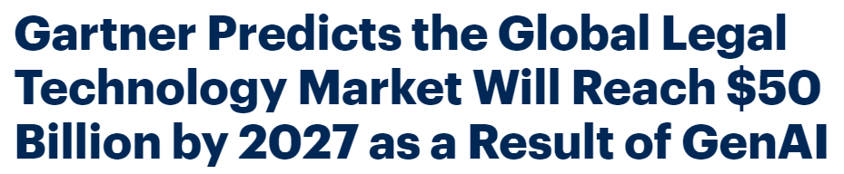




Motivation
https://www.gartner.com/en/newsroom/press-releases/2024-04-25-gartner-predicts-global-legal-technology-market-will-reach-50-billion-by-2027-as-a-result-of-genai
Series B […] participation from OpenAI Startup Fund and Sequoia. The $80 million investment brings Harvey’s total funding to over $100 million and values Harvey at $715 million.
EY announces alliance with reveal to offer clients AI-powered solutions to advance data discovery and compliance needs
https://www.harvey.ai/blog
https://www.ey.com/en_gl/news
© sebis
3
Notes:
A lot on a first glance…I know… but there is a lot going on in the LegalTech market.
Startups appearing and vanishing every week. Legislation trying to stay up to date. And a lot of money involved.
Take Harvey for example: a LLM built upon OpenAI‘s GPT AI but tailored to law firms with a total funding of over 100 mil. dollars
Big players in the market are increasingly interested; Harvey is already being used by Allen&Overy and Pwc; EY is partnering with the e-Discovery platform Reveal
The problem at hand is that there is a lot of information about startups and their technologies but too little information and research about the practical applications.
This has already motivated research at this chair prior to my thesis
3

Slide 4
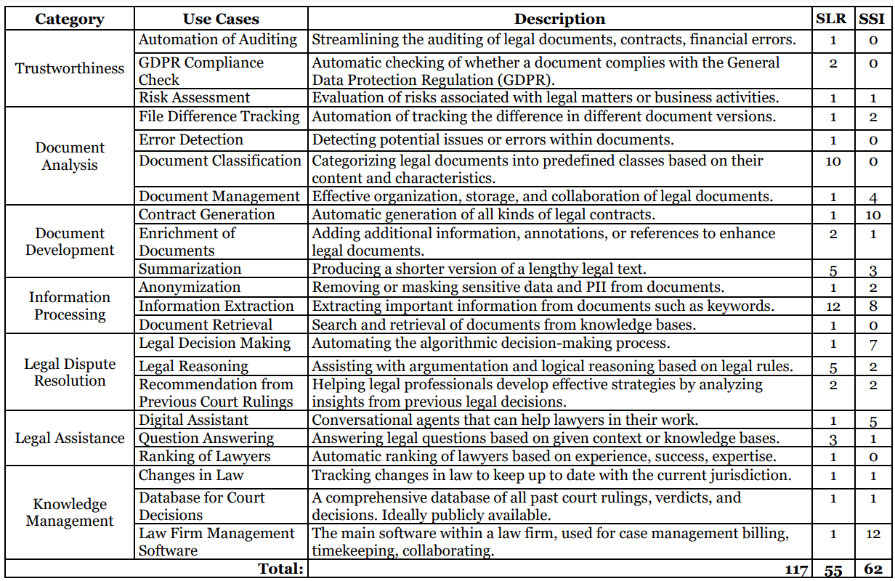
Related Work
Table from a paper by Juraj, Stephen, Alexandra, Prof. Matthes, and master student Martina Preis
Basis of the knowledge base
We wanted to validate the use cases with more insights from legal practitioners
© sebis
4
Notes:
[names] wrote a paper summarizing the findings of a Systematic Literature Review and Semi-structured interviews of Legal AI use cases shown in this table
This is the basis of the knowledge base that my thesis expanded and refined
Later on when I present the use cases we identified in this thesis I will refer back to this table
Our approach differed from the related work, because we decided to first interview providers and then appliers of legal AI tools.
We did this to include a broader range of perspectives but also because we thought it would facilitate the contact to appliers. However, this was more difficult than expected because providers were reluctant to give out information about their clients

Slide 5
Research Questions
RQ1
Methodology
What do startups reveal about the use cases they are developing NLP tools for?
Semi-Structured Interviews (SSIs)
RQ2
How does that compare to the use cases of their clients and practitioners in the legal field?
© sebis
5
Notes:
We designed the research questions corresponding to our new approach
Through RQ1 we want to get a set of use cases that companies say their tools provoke
RQ2 validate this set of use cases
We did SSI, meaning some questions are predetermined, but the order and phrasing of them are not
This leaves room for the exploration of the interviewee's responses
In the following I will go more into detail about the methodology
5
5
5

Slide 6
SSIs – Identifying Interview Participants
Interview Process
Filters for Selecting Participants
Calendly Invite
Located or has clients in DACH countries
Provided / applied solution leverages AI
Provided / applied solution affects work processes of legal professionals
Zoom call
Channels for Reaching Participants
Whisper Transcription
Channel | Contacted | Accepted | Acceptance Rate
Personal Introduction | 2 | 2 | 100%
Referrals | 11 | 5 | 45.45%
Search Results | 167 | 17 | 10.18%
Total | 180 | 24 | 13.33%
Manual Verification
MAXQDA24 Coding
© sebis
6
Notes:
Now coming to the process of [title]
Filters:
Filter: with DACH standing for Germany, Austria and Switzerland. This filter refers more to providers than appliers
Channels:
Individuals in Search Results were contacted through LinkedIn InMails
Total and acceptance
Process: The Calendly Invite that I sent with every message was the first step of the Interview process

Slide 7
SSIs – Overview of Participants
ID | Position | Experience (years) | Duration (min)
P-1 | CEO | 10-15 | 60
P-2 | CTO | 5-10 | 58
P-3 | CEO | 10-15 | 50
P-4 | CEO | 20-25 | 39
P-5 | CPO | 5-10 | 42
P-6 | CTO | 0-5 | 29
P-7 | CTO | 5-10 | 37
P-8 | Head of Legal Engineering | 0-5 | 49
P-9 | CTO | 25-30 | 45
P-10 | CTO | 5-10 | 29
P-11 | CEO | 10-15 | 35
P-12 | CTO | 15-20 | 30
P-13 | Account Executive | 5-10 | 40
P-14 | COO | 5-10 | 32
P-15 | CEO | 10-15 | 29
A-1 | Attorney | 15-20 | 47
A-2 | Attorney | 5-10 | 17
A-3 | Head of Legal Tech | 5-10 | 43
A-4 | Administrator | 0-5 | 29
A-5 | Head of Legal Tech | 0-5 | 35
A-6 | Attorney | 0-5 | 43
A-7 | Head of Legal Tech | 0-5 | 27
A-8 | Test Manager | 0-5 | 30
A-9 | Attorney | 10-15 | 28
Average |  | 9.88 | 38.04
© sebis
7
Notes:
Here you can see an overview of the 24 interview participants
ID column you can see Ids leading with a P for providers and an A for appliers
providers mostly worked in upper management
Appliers were mainly attorneys which sometimes had the additionaly role Head of Legal Tech
Experience is given in ranges of 5 years, average is 9.88
Duration of the interviews is given in min, average is 38.04

Slide 8
SSIs - Demographics
Interview Groups
Gender Distribution
Company Size
Category | Company (#) | Company (%) | Interviewee
Micro-sized | 12 | 50.00% | A-4, P-1 to P-3, P-6 to P-12, P-14
Small-sized | 4 | 16.67% | P-4, P-5, P-13, P-15
Medium-sized | 4 | 16.67% | A-1, A-2, A-5, A-9
Large-sized | 4 | 16.67% | A-3, A-6, A-7, A-8
* Company Size according to European Union Recommendation 2003/361
© sebis
8
Notes:
-
-
Company Size was determined based on a EU recommendation which classifies enterprises as
Micro enterprises (employ less than 10 people*
Small enterprises (employ less than 50 people*
Medium-sized enterprises (employ less than 250 people*

Slide 9
Findings – Overview
Identified Use Cases
Tool Specifications
Category | Use Case | ID | Mentions (#)
Trustworthiness | GDPR Compliance for Websites | UC-01 | 2
Document Analysis | File Difference Tracking | UC-02 | 3
 | Document Classification | UC-03 | 4
 | Legal Argument Extraction | UC-04 | 1
 | Contract Review | UC-05 | 2
Document Development | Legal Document Generation | UC-06 | 7
 |  | UC-09 | 1
 |  | UC-10 | 1
 |  | UC-11 | 1
 | Enrichment of Documents | UC-07 | 2
 | Summarization | UC-08 | 5
Information Processing | Anonymization | UC-12 | 3
 | Information Extraction | UC-13 | 12
 | Document Retrieval | UC-14 | 3
Legal Assistance | Digital Assistant | UC-15 | 12
 | Question Answering | UC-16 | 9
 | Translation | UC-17 | 3
Licensing of Models
User-Tool Interaction
Preferences
Prepared Prompts
Specific vs. Comprehensive Tool
Main Benefits
Accessibility of Documents
Efficiency
Main Challenges
Resource Strain
Missing Training Data
© sebis
9
Notes:
In the table you can see the 17 use cases we identified with the amount of times they were mentioned, structured by the same categories as the pre-existing knowledge base. We also assigned an ID to each uc to uniquely identify it.
Use Cases: We identified ten existing use cases and seven new uc that we will explore in more detail in the following slides
Additional findings include…

Slide 10
Existing Use Cases
Category | Use Case | UC-ID | P-ID | A-ID | #
Document Analysis | File Difference Tracking | UC-02 | P-4, P-13 | A-6 | 3
 | Document Classification | UC-03 | P-5, P-6, P-11 | A-3 | 4
Document Development | Legal Document Generation | UC-06 | P-2, P-4, P-5, P-13, P-15 | A-2, A-7 | 7
 | Enrichment of Documents | UC-07 | P-6, P-9 | - | 2
 | Summarization | UC-08 | P-3, P-9 | A-6, A-7, A-9 | 5
Information Processing | Anonymization | UC-12 | P-7, P-13 | A-8 | 3
 | Information Extraction | UC-13 | P-2 to P-4, P-6, P-8, P-10, P-11, P-13 | A-1, A-3, A-5, A-9 | 12
 | Document Retrieval | UC-14 | P-13, P-15 | A-9 | 3
Legal Assistance | Digital Assistant | UC-15 | P-2 to P-5, P-9, P-12, P-13, P-15 | A-4, A-6, A-7, A-9 | 12
 | Question Answering | UC-16 | P-2, P-4, P-5, P-9, P-10, P-1 | A-6, A-7, A-9 | 9
© sebis
10
Notes:
Here you can see the identified use cases that already existed in the knowledge base, grouped by category shown in orange on the previous slide
In the column P-ID …
In the column A-ID …
The last column is the sum of the total mentions of this use case by interviewees.
Now, I will go into more detail about the use cases, split by category.

Slide 11
Existing Use Cases
Category | Use Case | UC-ID | P-ID | A-ID | #
Document Analysis | File Difference Tracking | UC-02 | P-4, P-13 | A-6 | 3
 | Document Classification | UC-03 | P-5, P-6, P-11 | A-3 | 4
File Difference Tracking
Document Classification
Comparing documents to see changes that have been made.
Categorizing documents based on their content and characteristics.
“Normally, old school, you go through it and look at all the changes and write them in parallel in an excel spreadsheet [...]. In [the tool] you can simply upload both documents and then you will be given a nice table, showing you which topic has been changed.” (A-6)
© sebis
11
Notes:
File dif: This is interesting in mergers and acquisitions. There comparing documents is common during redline summaries.
[now click quote]
He explains that before you had to write changes manually into a spreadsheet. Now, the tool does that for him.

Slide 12
Existing Use Cases
Category | Use Case | UC-ID | P-ID | A-ID | #
Document Development | Contract Generation | UC-06 | P-2, P-4, P-5, P-13, P-15 | A-2, A-7 | 7
 | Enrichment of Documents | UC-07 | P-6, P-9 | - | 2
 | Summarization | UC-08 | P-3, P-9 | A-6, A-7, A-9 | 5
Contract Generation
Enrichment of Documents
Summarization
Creating legal contracts, often out of existing ones.
Adding additional information to legal documents.
Summarizing legal documents to retrieve the key points.
“[...] assign further labels or tags to the document. So, for example, there's a court hearing now, do you have to appear in person, or does it take place digitally?" (P-6)
© sebis
12
Notes:
-
Enrich. o. Doc.: example of P-6

Slide 13
Existing Use Cases
Category | Use Case | UC-ID | P-ID | A-ID | #
Information Processing | Anonymization | UC-12 | P-7, P-13 | A-8 | 3
 | Information Extraction | UC-13 | P-2 to P-4, P-6, P-8, P-10, P-11, P-13 | A-1, A-3, A-5, A-9 | 12
 | Document Retrieval | UC-14 | P-13, P-15 | A-9 | 3
Anonymization
Information Extraction
Document Retrieval
Anonymizing sensitive data in legal documents. This is important, for example, when court verdicts need to be published.
Extracting important information from legal documents like clauses or file numbers.
Speeding up the process of retrieving legal documents from knowledge bases. Enables to search through the entire company’s data.
© sebis
13
Notes:
Anonymization: all mentions used anonymization for this reason

Slide 14
Existing Use Cases
Category | Use Case | UC-ID | P-ID | A-ID | #
Legal Assistance | Digital Assistant | UC-15 | P-2 to P-5, P-9, P-12, P-13, P-15 | A-4, A-6, A-7, A-9 | 12
 | Question Answering | UC-16 | P-2, P-4, P-5, P-9, P-10, P-1 | A-6, A-7, A-9 | 9
Digital Assistant
Question Answering
Conversational agents that assist lawyers in some task.
Functionality like ChatGPT, offering an interface where users can interact with the system.
Answering legal questions based on provided context or knowledge bases.
"[...] answering complex legal questions, compliance questions, [and] data protection questions.” (P-4)
© sebis
14
Notes:
-
Question Answ.: P-4 called this e-Lawyer and gave the examples [quote]

Slide 15
Newly Identified Use Cases
Category | Use Case | UC-ID | P-ID | A-ID | #
Trustworthiness | GDPR Compliance for Websites | UC-01 | P-12 | A-4 | 2
Document Analysis | Legal Argument Extraction | UC-04 | P-10 | - | 1
 | Contract Review | UC-05 | P-4 | A-3 | 2
Document Development | Letter Generation | UC-09 | P-10 | - | 1
 | Statement of Defense Generation | UC-10 | P-4 | - | 1
 | Lawsuit Generation | UC-11 | P-4 | - | 1
Legal Assistance | Translation | UC-17 | P-14 | A-1, A-6 | 3
© sebis
15
Notes:
We identified new use cases that were shown in green in the overview
Although some of them could not be validated by appliers we do not question their practical applications as all provider had active clients and they collaborated closely with them when developing their solution

Slide 16
Newly Identified Use Cases
Category | Use Case | UC-ID | P-ID | A-ID | #
Trustworthiness | GDPR Compliance for Websites | UC-01 | P-12 | A-4 | 2
GDPR Compliance for Websites
Ensuring GDPR compliance for websites by assisting users in creating data privacy policies.
© sebis
16
Notes:
[text] it can [quote]

Slide 17
Newly Identified Use Cases
Category | Use Case | UC-ID | P-ID | A-ID | #
Document Analysis | Legal Argument Extraction | UC-04 | P-10 | - | 1
 | Contract Review | UC-05 | P-4 | A-3 | 2
Legal Argument Extraction
Contract Review
Automatic identification and classification of legal arguments.
Examining a contract's terms, conditions, clauses and overall structure.
© sebis
17
Notes:
We expanded the category Document Analysis by two new use cases.

Slide 18
Newly Identified Use Cases
Category | Use Case | UC-ID | P-ID | A-ID | #
Document Development | Letter Generation | UC-09 | P-10 | - | 1
 | Statement of Defense Generation | UC-10 | P-4 | - | 1
 | Lawsuit Generation | UC-11 | P-4 | - | 1
Letter Generation
Statement of Defense Generation
Lawsuit Generation
Creating statement of defense if a lawsuit has been filed against the user.
Creating lawsuits if the user wants to sue somebody.
“[...] drafting of letters to counter parties.“ (P-10)
Legal Document Generation
© sebis
18
Notes:
As all of these use cases generate a legal document we consolidated them together with the pre-existing use case contract generation into a new use case called Legal Document Generation

Slide 19
Newly Identified Use Cases
Category | Use Case | UC-ID | P-ID | A-ID | #
Legal Assistance | Translation | UC-17 | P-14 | A-1, A-6 | 3
Translation
Translating text from one language to another. Particularly interesting for legal professionals working in an international context.
"We do have access to DeepL. However, if you create a nice prompt and you have more text, or you can give it a better context, I would argue that the GPT can translate it better.“ (A-1)
© sebis
19
Notes:
Appliers argue that they prefer ChatGPT over DeepL, translating legal documents because you can give it more context

Slide 20
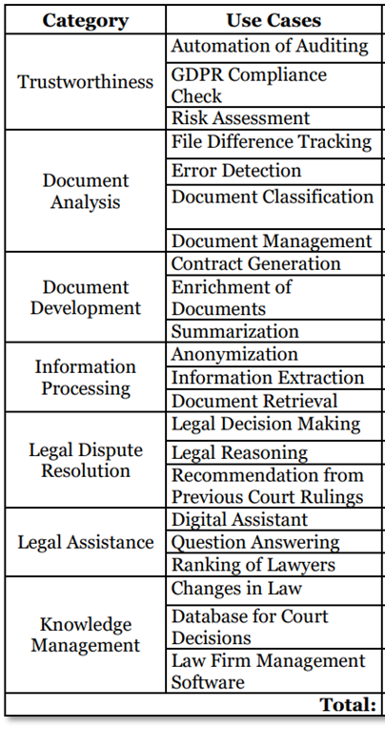
Use Cases – Inferences
Refuted Use Cases
Main Use Cases
Automation of Auditing
GDPR Compliance Check
Error Detection
Ranking of Lawyers
Contract Generation, mentioned 7 times
Question Answering, mentioned 9 times
Information Extraction, mentioned 12 times
Digital Assistant, mentioned 12 times
© sebis
20
Notes:
UC … This demonstrates that lawyers value tools the most that automate routine tasks and provide easy access to relevant legal information and documents.
-
We refuted the practical application of use cases that did not surface in neither our nor the previous interviews

Slide 21
Tool Specifications
Licensing of AI Models
Trend goes towards third-party models, especially commercial ones. Azure Open AI‘s ChatGPT is the favorite.
Why?
Licensing | #
Commercial | 9
Open-source | 4
Proprietary | 4
"It was really very easy for us to connect [our system] to ChatGPT, so that the law firms [can work] in a data protection-compliant, and extremely simple way with AI.“ (P-3)
User-Tool Interaction
Interface | #
Web-app | 12
Word add-in | 3
Web-applications are the clear winner in this race.
Identified preference of appliers to work in their trusted word-environment stands in contrast to that.
© sebis
21
Notes:
When it comes to the licensing of AI models
We think that the Word add-in is an under-recognized choice and should be considered more often

Slide 22
Preferences
Prepared Prompts
Specific vs. Comprehensive Tool
Out-of-the-box use cases through prompts for less tech-savvy users who are unfamiliar with prompting
Identified as a preference by four appliers and four providers
Dissonance among providers whether users prefer
a specific tool that just focuses on one use case (four mentions),
or
a comprehensive tool that unites many use cases (three mentions)
"[...] the solution has to specialize or focus specifically on the right use case." (P-2)
“[The users] say, ’No, so either you can do everything, or I won’t use it’" (P-3).
© sebis
22
Notes:
We identified the preference of appliers to have
The quotes below illustrate this dissonance with P-2 arguing for…

Slide 23
Main Benefits
Accessibility of Documents
Efficiency
Mentioned by three providers and two appliers
Company’s entire knowledge base is made accessible
Users can quickly find their own but also colleagues’ documents
Highlighted by five providers and eight appliers
Time savings and familiarizing oneself with documents faster were mentioned the most
© sebis
23
Notes:
The main benefits are …
Here interviewees

Slide 24
Main Challenges
Resource Strain
Missing Training Data
Five providers mentioned appliers‘ resource strains
Five appliers support this, emphasizing their need to improve efficiency and handle large amounts of data
Mentioned by seven providers as a major challenge
Highly sensitive data → not openly available non-anonymized
Solution:
Collaborating with a law firm
Using synthetic data
© sebis
24
Notes:
For appliers the main challenge in their day-to-day work is some kind of ressource strain
For providers developing tools the main challenge is …
Synthetic data is currently being explored by two provider but none of them are using it yet

Slide 25
Findings – Summary
Identified Use Cases
Refuted Use Cases
Category | Use Case | ID | Mentions (#)
Trustworthiness | GDPR Compliance for Websites | UC-01 | 2
Document Analysis | File Difference Tracking | UC-02 | 3
 | Document Classification | UC-03 | 4
 | Legal Argument Extraction | UC-04 | 1
 | Contract Review | UC-05 | 2
Document Development | Legal Document Generation | UC-06 | 7
 |  | UC-09 | 1
 |  | UC-10 | 1
 |  | UC-11 | 1
 | Enrichment of Documents | UC-07 | 2
 | Summarization | UC-08 | 5
Information Processing | Anonymization | UC-12 | 3
 | Information Extraction | UC-13 | 12
 | Document Retrieval | UC-14 | 3
Legal Assistance | Digital Assistant | UC-15 | 12
 | Question Answering | UC-16 | 9
 | Translation | UC-17 | 3
Automation of Auditing
GDPR Compliance Check
Error Detection
Ranking of Lawyers
Tool Specifications
Third-party models
Web-application
Preferences
Prepared Prompts
Specific vs. Comprehensive Tool
Main Benefits
Accessibility of Documents
Efficiency
Main Challenges
Resource Strain
Missing Training Data
© sebis
25
Notes:
In summary

Slide 26
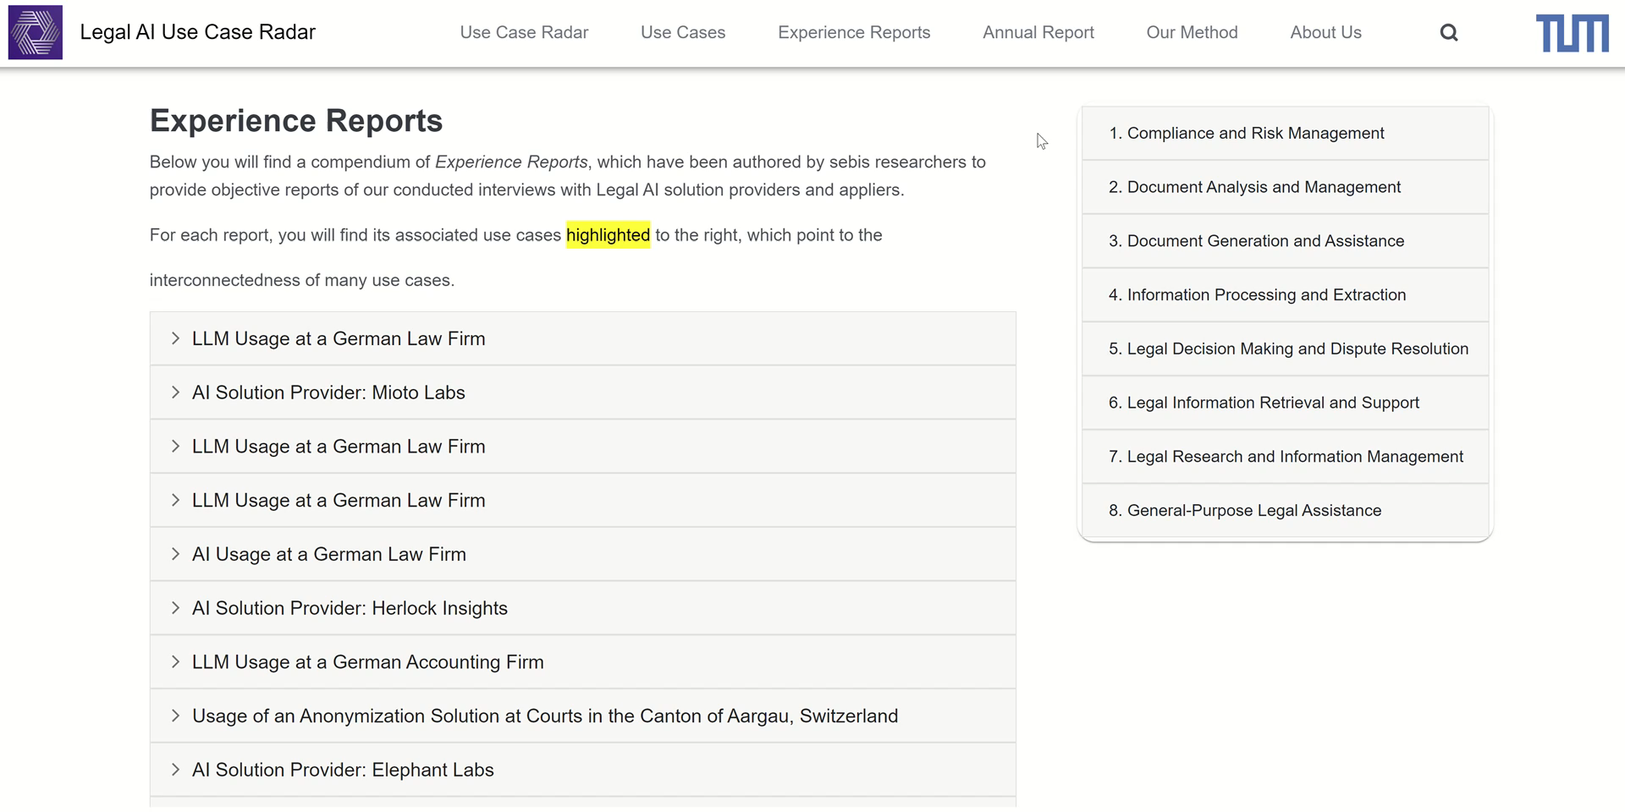
Experience Reports
https://legal-ai-radar.de/findings
© sebis
26
Notes:
A tangible result of my thesis can be found under the link on the bottom of this slide
It take you to a website maintained by this chair which keeps track on the information we have about the legal ai use cases
Here you can also find experience reports summarizing the interviews that were conducted by sebis researchers shown in this short video clip
The majority of these reports are based on this thesis work

Slide 27
Limitations and Future Work
Limitations
Future Work
Generalizability
24 interviews with 15 providers and 9 appliers
5 out of 24 participants identify as female
Tracking development of the tools and their use cases over time.
Participant Recruitment
Focusing heavily on LinkedIn
Contacted 167 out of 189 individuals (92.78%)
17 accepted interviews out of 24 (70.83%)
Synthetic legal data for AI model training and testing.
Biases
Researcher Bias
Desirability Bias
© sebis
27
Notes:
-
This reliance on a digital tool favors companies with a strong online presence and overlooks those without one.

Slide 28
Benedikt Thiess
17132
matthes@in.tum.de
Notes:
28

Slide 29
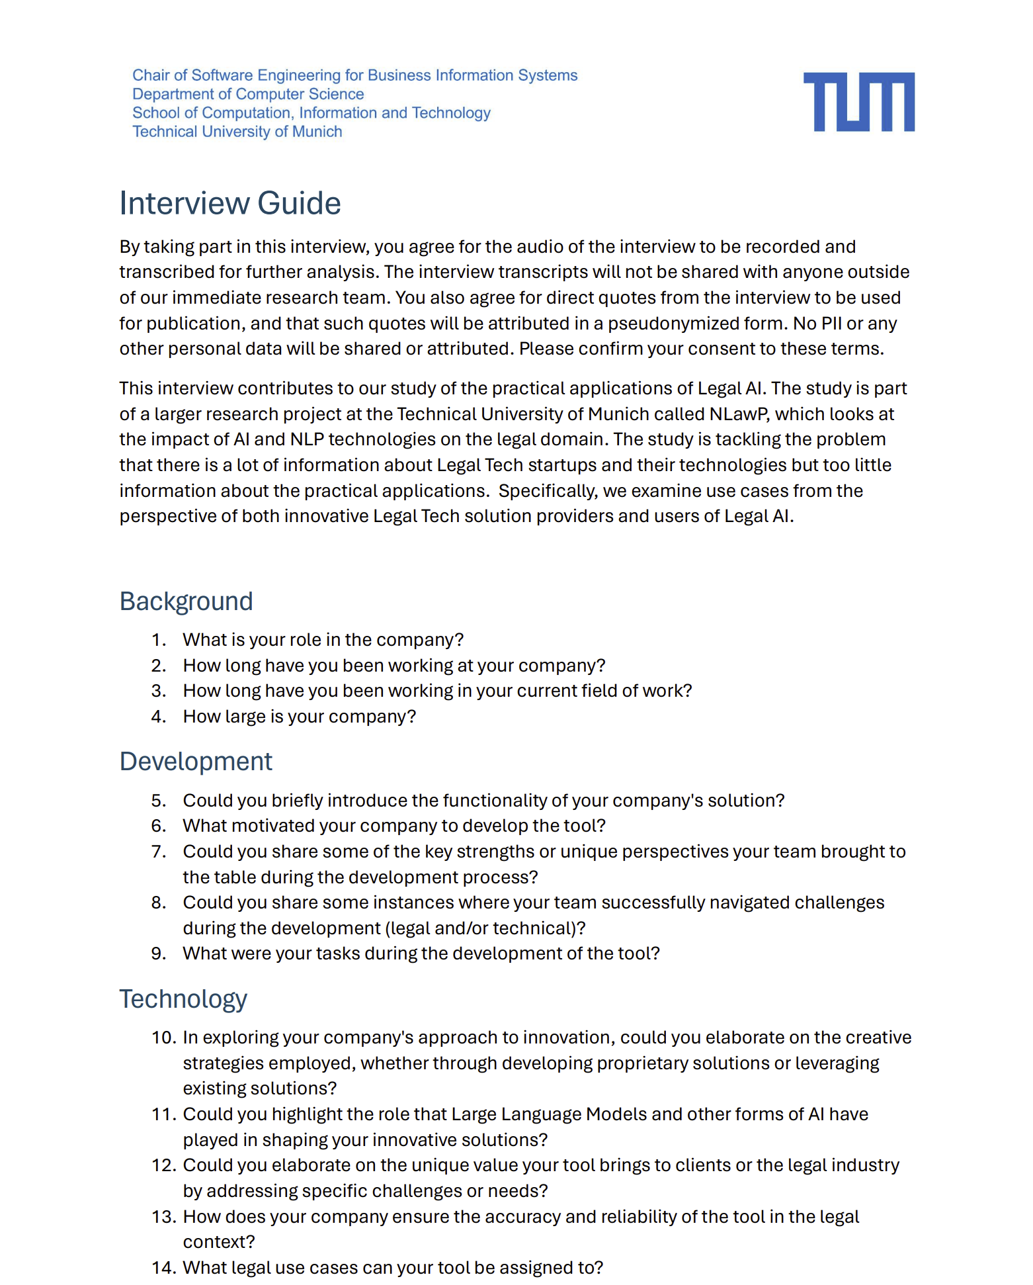
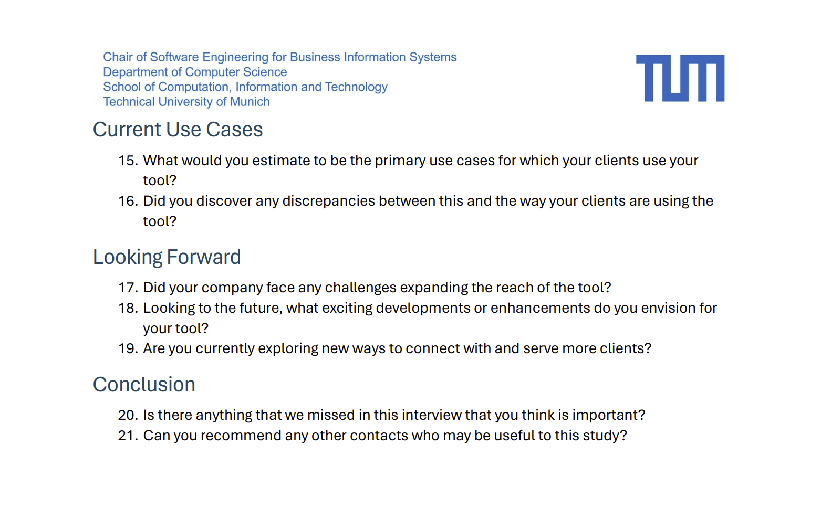
Appendix – Interview Guide Provider

Slide 30
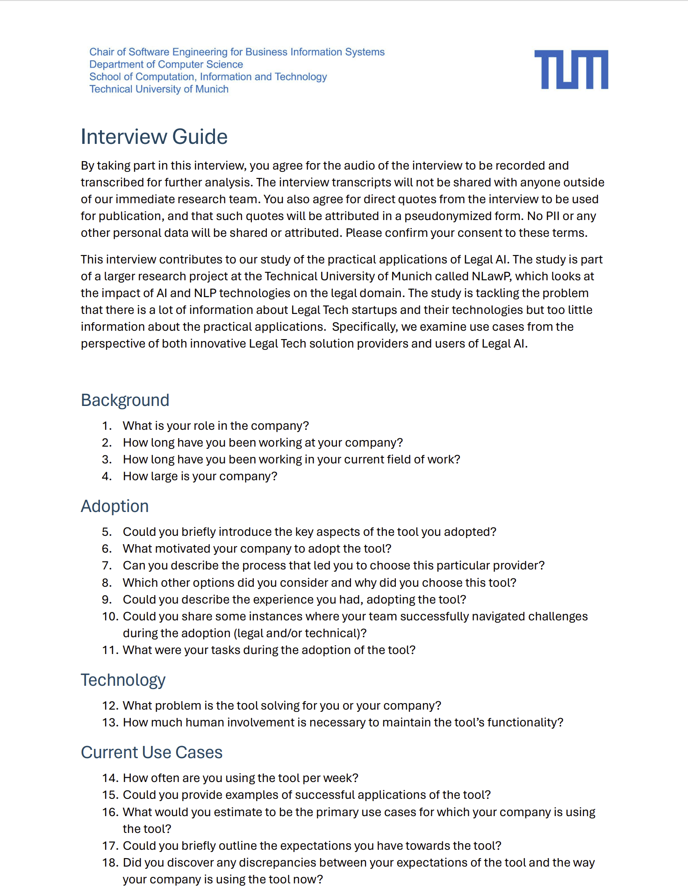
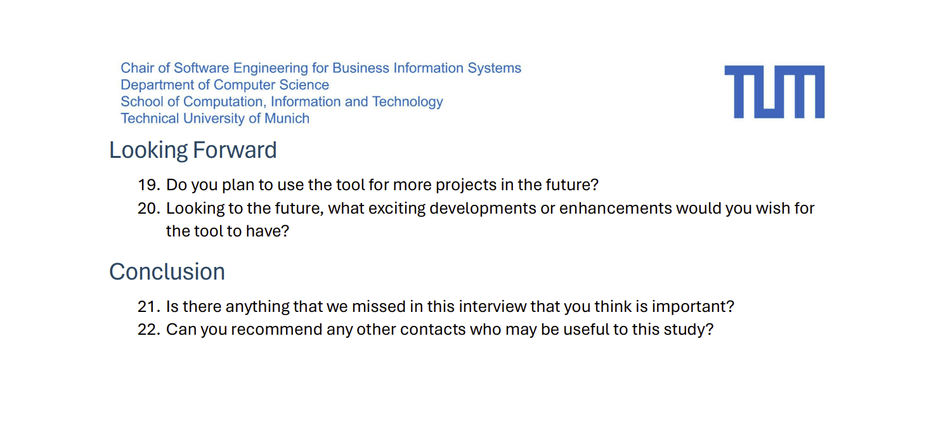
Appendix – Interview Guide Applier

Slide 31
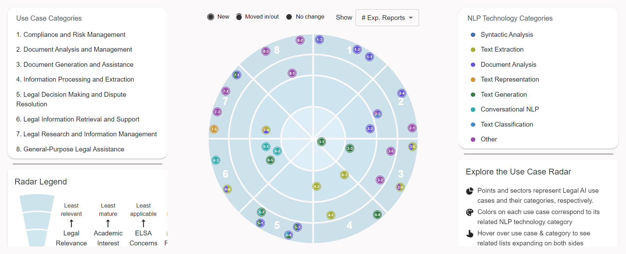
Appendix – Legal AI Use Case Radar
https://legal-ai-radar.de/radar
Existing set of use cases for Legal AI tools and their visualization
© sebis
31
Notes:
A more visually appealing form of displaying this information is the Use Case Radar
Ucs identified in interviews are depicted by the blips on the radar and were summarized in 8 different categories that you can see on the left
They are visualized by the sectors of the radar
More data… so we decided to interview more experts of that domain. Our approach differed from the related work, because we decided to first interview providers and then appliers of legal AI tools.
We did this to include a broader range of perspectives but also because we thought it would facilitate the contact to appliers. However, this was more difficult than expected.
31

Slide 32
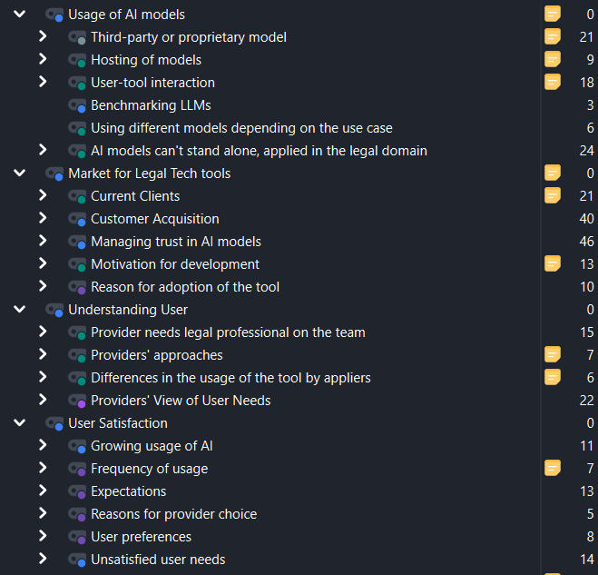
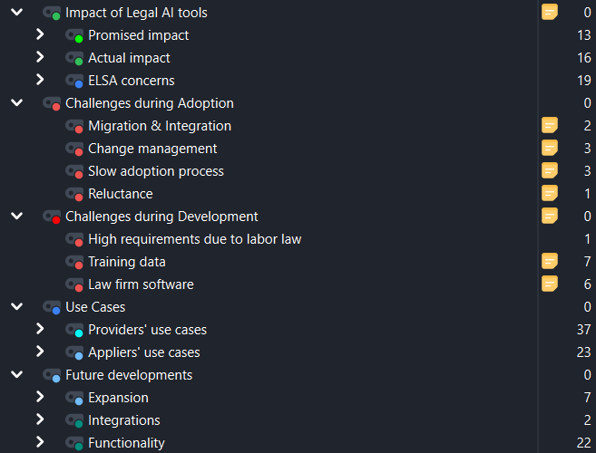
Appendix – Code Book

Slide 33
SSIs – Structure of the Interview Guides
Background
Development / Adoption
Technology
Getting familiar with the interviewee:
Experience
Company
Information about the development / adoption process:
Motivation
Challenges
Focusing on the technology provided / applied:
Usage of AI
USP
Accuracy & Reliability
Current Use Cases
Looking Forward
Conclusion
Discovering use cases and current usage of the tool:
Primary use cases
Expectations vs. reality
Frequency
Discussing the future development / usage of the tool.
Concluding the interview and asking for referrals.
© sebis
33
Notes:
Now, I’ll briefly go through the general structure of the interview guides
-
-
Tech: Usage of AI for providers refers to the technical aspects, for appliers the question was how much human involvement is still necessary

