Slide 1
Cluster-Based Corrective Filtering for Class Specific Keyword Sets
Guided Research Final Presentation, 15.04.2024
Maria Nakhla

Slide 2
Outline
Introduction & Motivation
Research Questions
Methods
Results
Challenges and Future Work
Conclusion

Slide 3

Introduction & Motivation
CD4AI Recap
['Agriculture', 'forestry', 'Crop production', 'Animal breeding',.....]
Keywords set getting
bigger and bigger!!
And maybe somehow irrelevant?!
Use of plant and animal natural resources
Business Class
Description
Seed Keywords
for a Business class
Keyword Extraction Methods
Seed Keywords
+
Extracted Keywords
['Agriculture', 'forestry', 'Crop production', 'Animal breeding', 'Crop plant','Silver', 'cultivated plants', 'grains', 'Agriculture', 'Land', 'country', 'agricultural trade products' ,'Countryman', ….]
Proposed Solution
Keyword Clustering
Detect and Remove Outliers

Slide 4
Research Questions
Which clustering approaches currently exist that can be utilized to cluster keywords based on relevance to a class?
What are possible outlier detection methods that could also help to achieve a more class-specific keyword set?
Could different methods be combined for better results?
In which ways can the resulting filtered keywords set be evaluated?

Slide 5



Methods
A general approach to remove outliers from a large set of keywords
Keywords
Translation
Keywords
Embeddings
JinaAI Bert Model
All mpnet Transformers Model ✅
paraphrase-multilingual-MiniLM-L12-v2
gbert-large-paraphrase-cosine
Clustering Methods
Hierarchical ✅
K-means
DBSCAN
Latent semantic
Outlier Detection Methods
Local Outlier ✅
Isolation Forest ✅
Dataheroes Coresets ✅ (then faced a technical problem)
Z-score
DeepL
Google by (deep trans & translators libs)
Lingvanex

Slide 6
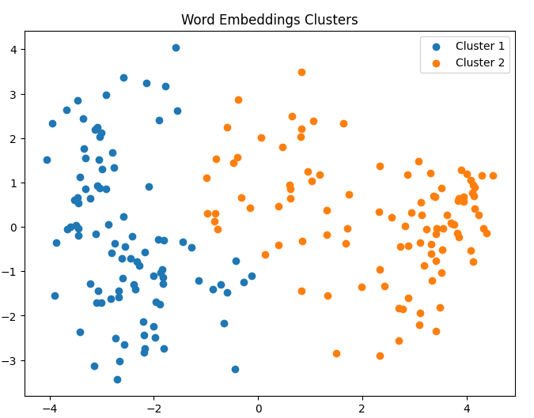
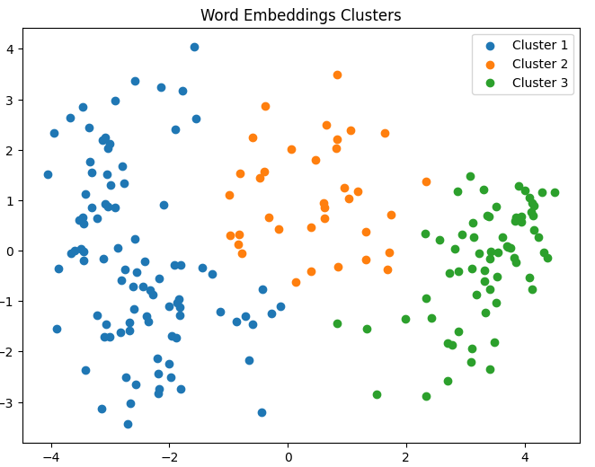
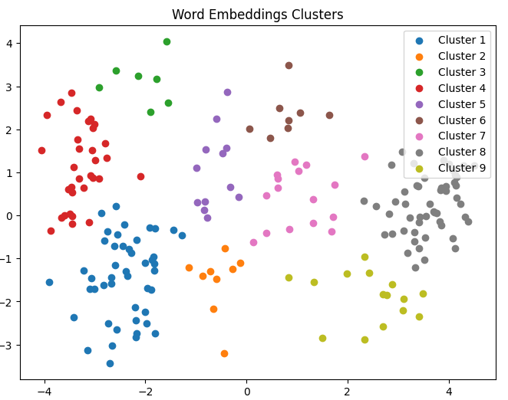
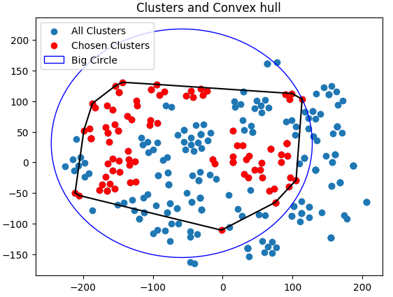
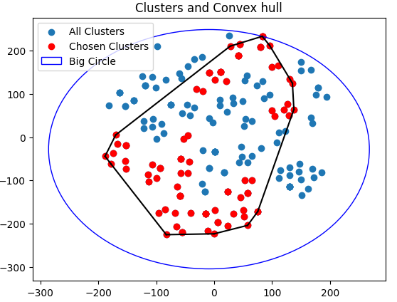
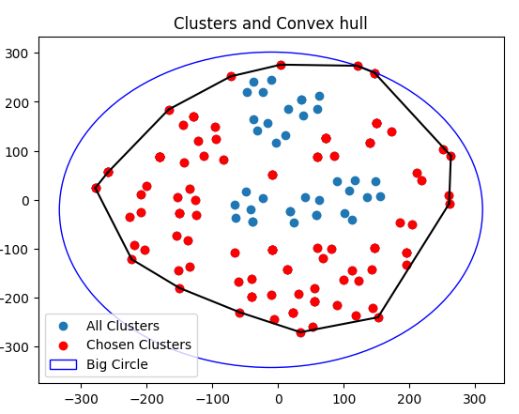
Main Ideas Recap
Recursive
Clustering
Circle / Convex Hull

Slide 7
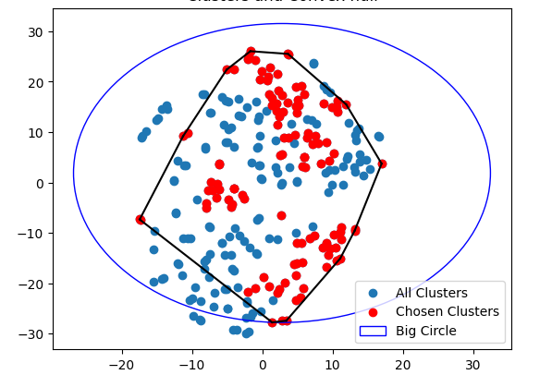
Methods - Convex Hull Illustration
Class Keywords
Recursive Hierarchical Clustering based on cluster density
Class Seed Keywords
Class Seed Keywords
Synonyms (WordNet/ ConceptNet)
LOF
ISO
Seeds + Synonyms
ISO U LOF
Outliers
All Combined Outliers
Hierarchical Clustering
Outliers
Cos
Sim
Threshold
Filtered Outliers

Slide 8
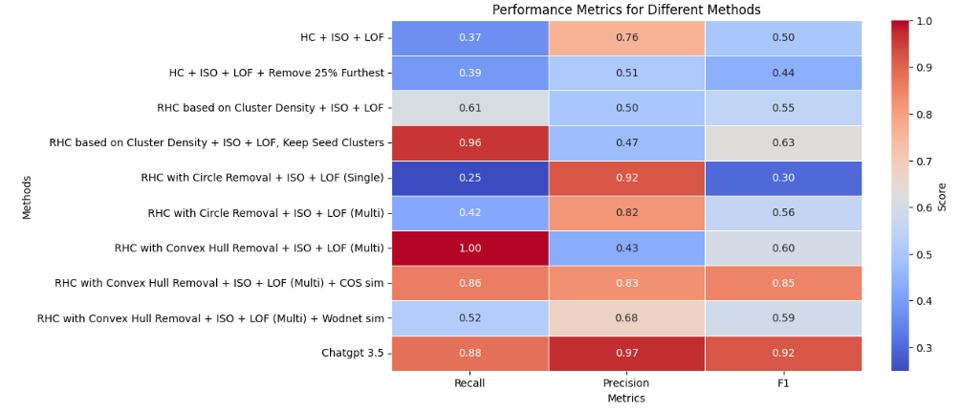
Recap- Results - Class A (Translated English Keywords)
Agriculture, forestry, fishing. This section covers the use of plant and animal natural resources. This includes activities such as plant cultivation, animal breeding and animal husbandry, wood extraction and the extraction of other plant and animal products on agricultural or forestry farms or in the wild. These include: agriculture, forestry, crop production, animal breeding, animal husbandry.

Slide 9
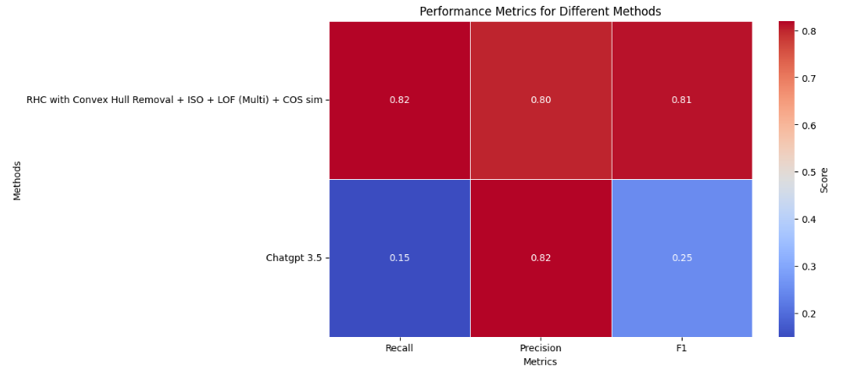
Recap - Results - Class B (Translated English Keywords)
Mining and extraction of stones and earth. This section includes the extraction of naturally occurring solid (coal and ores), liquid (petroleum) and gaseous (natural gas) mineral raw materials. It also includes additional activities for the preparation of raw materials for sale, e.g. B. Crushing, grinding, washing, sorting, concentration of ores, liquefaction of earth These include: mining, quarrying, coal mining, ore mining, natural gas.

Slide 10
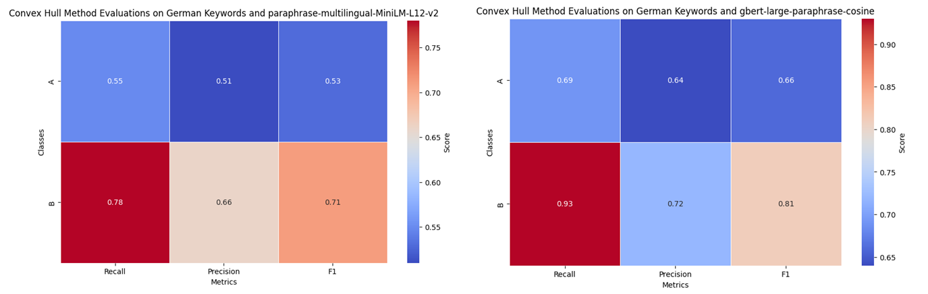
Further Results on German Keywords
Gbert-large-paraphrase-cosine model showed better results than Paraphrase-multilingual-MiniLM
Gbert-large-paraphrase-cosine model took noticeably more time to generate the embeddings

Slide 11
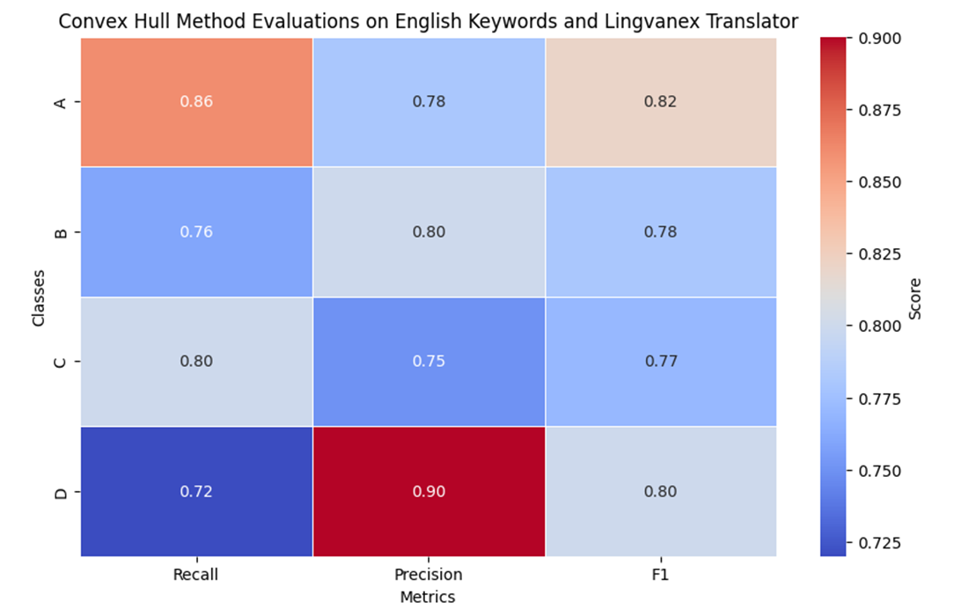
Further Results on English Keywords and Lingvanex Translator

Slide 12
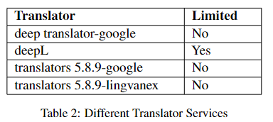
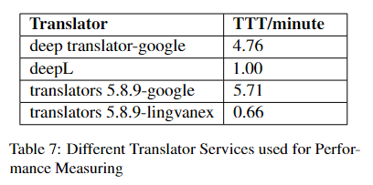
Further Results on Performance
Time To Translate one class Keywords
Note: The whole process takes about 3 minutes/class to remove outliers

Slide 13
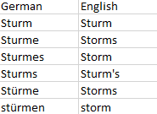
Challenges & Future Work
Translations:
The quality of translations showed significant effect on the results
Some of the keywords fail to be translated
Neural Machine Translation Model
Hyperparameters Tuning:
Many hyperparameters are needed to be set
Example: density threshold, hierarchical clustering threshold, cosine similarity threshold, and LOF & ISO Contamination rate, etc..
Automated Hyperparameters Tuning

Slide 14
Conclusion and Key Points Takeaway
Hybrid Methods work best when it comes to removing semantic text outliers
Convex Hull approach proved outstanding, stable, and reliable results across different tests
German Text Embedding Models still need further improvements to be used reliably
Translators affect results in a highly noticeable way
Google Translator takes a lot of time to translate and not highly accurate
DeepL Translator is highly accurate, but has limited free text translations
Lingvanex is not so well known, however it has fast, accurate, and unlimited translations
ConceptNet is a very useful source to output related keywords and synonyms
ChatGPT did not show stable results for outlier detection across different classes

Slide 15


Slide 16



Prof. Dr.
Florian Matthes
17132
matthes@in.tum.de

Slide 17
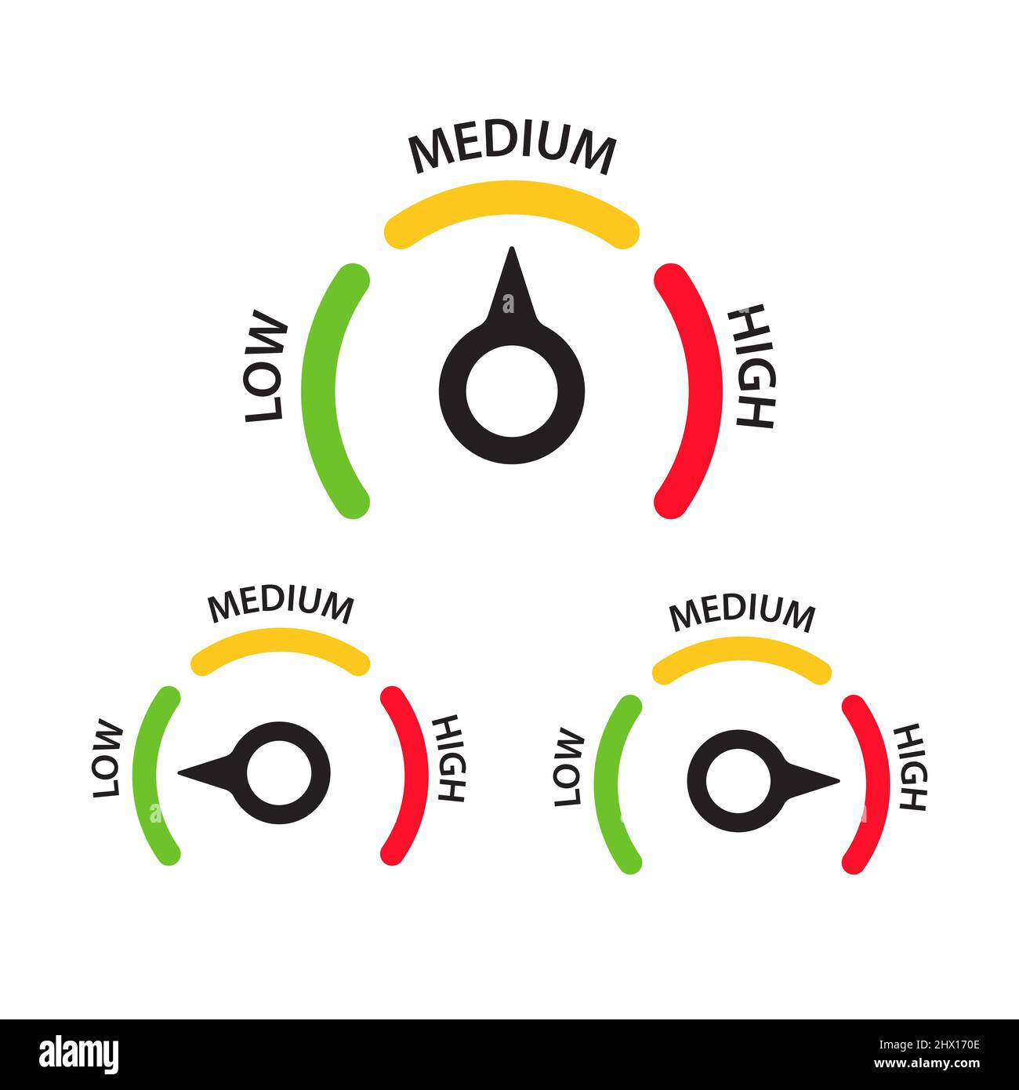
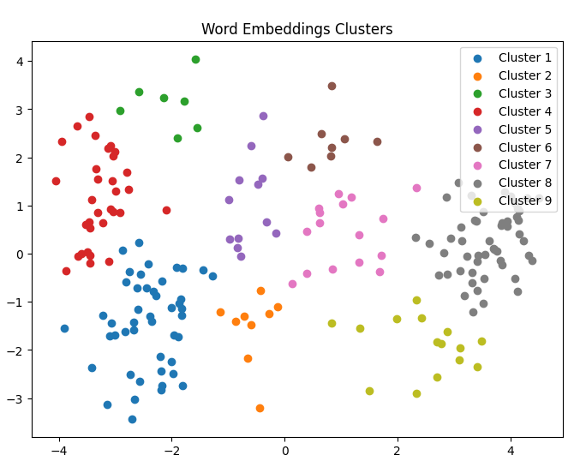
Methods - Low Complexity Approaches
Hierarchical Clustering followed by ISO and LOF
Same as above + remove furthest 25% members of each cluster
Complexity
LOF & ISO
Challenges:
Max number of clusters is limited across all classes
If a cluster contains less members, then consider members as outlier
Fixed Contamination percentage for Local Outlier Factor and Isolation Forest
Challenges:
Max number of clusters is limited across all classes
If a cluster contains less members, then consider members as outlier

Slide 18
Methods - Medium Complexity Approaches
Recursive Hierarchical Clustering based on Cluster Density followed by ISO and LOF
Same as 1 + keeping only clusters which contain any class seed keywords
Same as 1 + taking the mean embeddings per cluster comparing it to mean embeddings of all Class seed keywords ( mean threshold?? )
Complexity

Slide 19
Methods - High Complexity Approaches
Recursive Hierarchical clustering with removing keywords outside a circle enclosing all clusters which contain seed keywords followed by ISO and LOF (single/ multi recursive)
Recursive Hierarchical clustering with removing keywords outside a convex hull enclosing all clusters which contain seed keywords followed by ISO and LOF (single/ multi recursive)
Complexity

