Slide 1
Investigating data to text approaches to achieve diversity of generated marketing text in the music industry
28. June 2023, Master thesis Kickoff
Alexandre Mercier
Notes:
Uniqueness in text generation
Alternative ideas for titles:
"Empowering User-Facing Applications in Startups through Advanced NLG Technology"
"Exploring the Potential of State-of-the-Art NLG Techniques in Enhancing User-Facing Applications for Startups"
"Maximizing User Engagement in Startup Ventures with Cutting-Edge NLG Technology"
"Unlocking the Power of Advanced NLG Technology for Seamless User Experiences in Startups"
"Driving Innovation in Startups: Harnessing State-of-the-Art NLG Techniques for User-Facing Applications“
Improving language diversity with state-of-the-art language generation for business use-cases

Slide 2
Outline
Motivation
Methodology
Problem Statement and Goal
Approach
Timeline

Slide 3
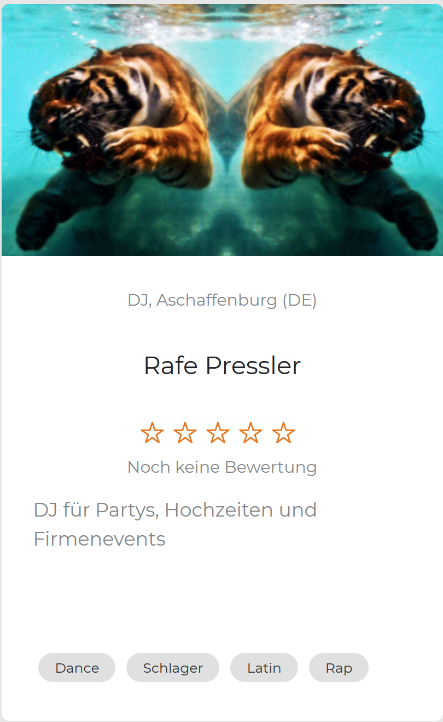
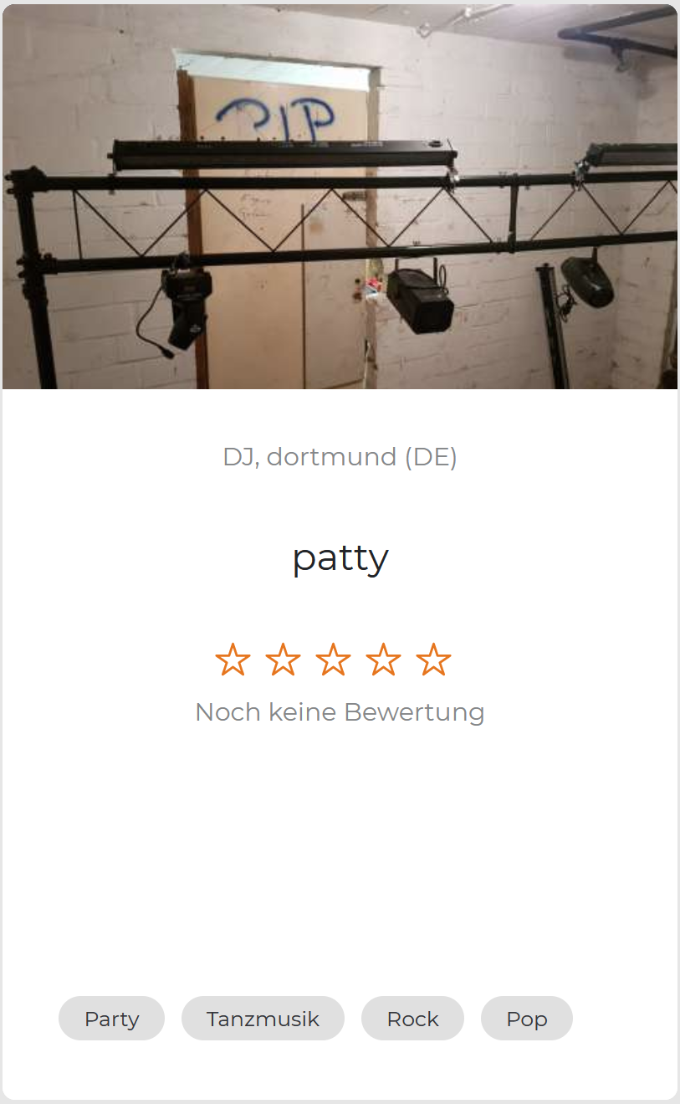
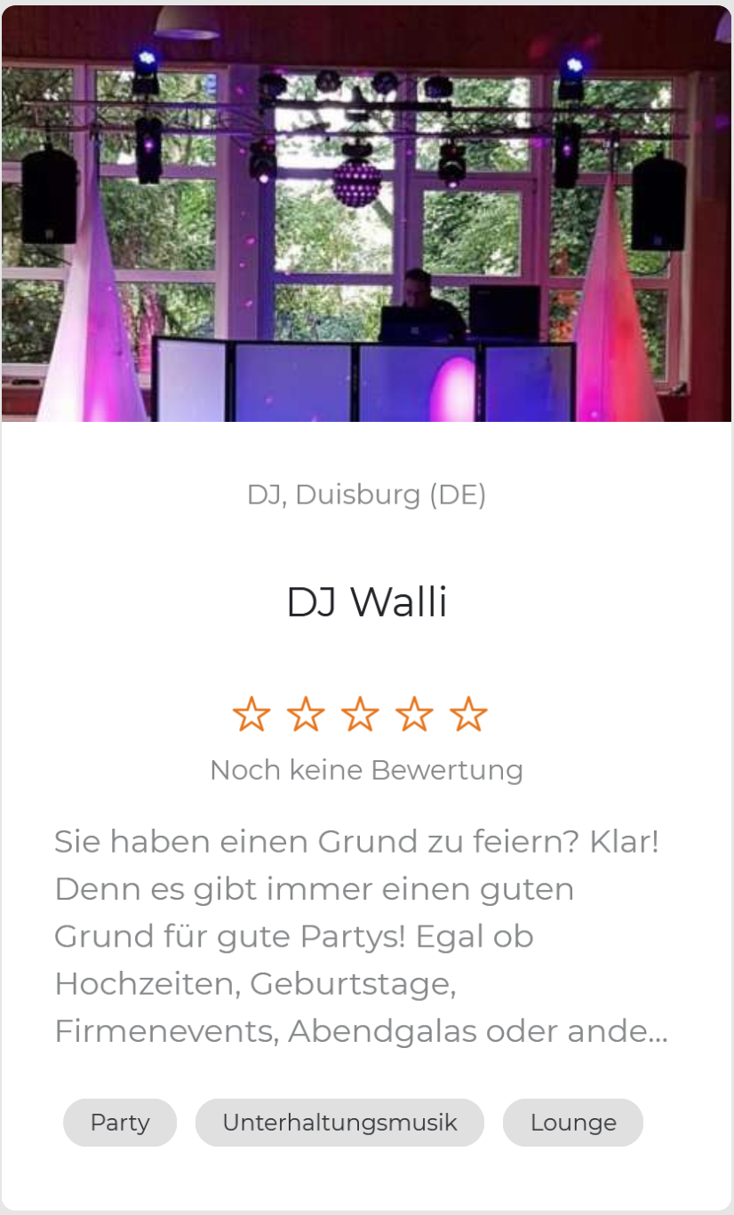
Motivation
Notes:
Quick example: 3 DJs competing for my next party.
Which Dj would you choose here?
After quick inspection, DJ Walli is the only one that I get to know.
Highlights a problem: Users do not want to spend time setting up their account.
Less opportunities for me, competition and quality of service for platform

Slide 4
Motivation
Companies and platforms are scrambling to leverage the newest Natural Language Generation (NLG) technologies:
→ Assist time-intensive tasks (specifically: requiring effort from users)
→ Automate writing similar texts
Notes:
Companies and platforms lack time and personel for many repetitive tasks and want to leverage AI‘s power to improve their products and services.
Users dislike spending the required time for setting up a high-quality profile

Slide 5
Motivation
Companies and platforms are scrambling to leverage the newest Natural Language Generation (NLG) technologies:
→ Assist time-intensive tasks (specifically: requiring effort from users)
→ Automate writing similar texts
Templates
Welcome to the energetic world of ________! This __________ hails from the town of _________ and is ready to conquer the clubs in their region. With an impressive radius of _____ km, they are prepared to spread their unique blend of _____________ and ______ far and wide. _______ consists of ____ talented musicians who captivate audiences with their creative arrangements and dynamic live performances. Immerse yourself in the world of ______ and let their compelling sound sweep you away!
Until now
Notes:
Companies and platforms lack time and personel for many repetitive tasks and want to leverage AI‘s power to improve their products and services.
Can be helped or filled with a template when missing
Users dislike spending the required time for setting up a high-quality profile

Slide 6
Motivation
Lasst euch von Rafe Pressler, dem Schlager-DJ aus Aschaffenburg, in eine unvergessliche musikalische Welt entführen! In einem Umkreis von 300 km steht Rafe Pressler bereit, die Clubs der Region mit mitreißenden Schlagerklän…
Lasst euch von patty, dem Rock-DJ aus Dortmund, in eine unvergessliche musikalische Welt entführen! In einem Umkreis von 300 km steht patty bereit, die Clubs der Region mit mitreißenden Partyklängen zu erobern.
Notes:
Templates are a way of helping users but they get boring really fast

Slide 7
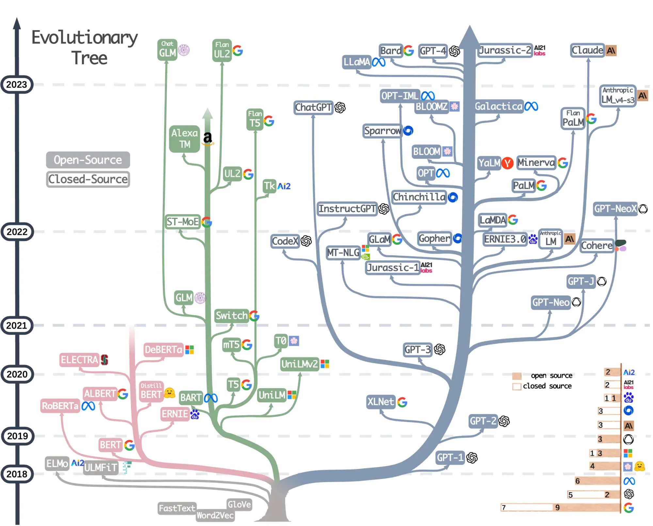
Motivation
https://github.com/Mooler0410/LLMsPracticalGuide/blob/main/imgs/models-colorgrey.jpg
Notes:
NLG technology has advanced in great strides the last few years, expanding from single sentence generation to now entire essays without any required training.

Slide 8
Motivation
Zu jedem Fest gehört Musik. Ob Hochzeit, Firmenevent oder Party, meine Künste bringen selbst den faulsten Tiger zum tanzen.
Ich komme zu euren Events in Aschaffenburg und Umgebung …
Hier DJ Patty, fresh aus Dortmund mit den besten underground tunes für euch. Tanzt ihr lieber zu Rock und Pop? Dann steht auch da mein Repertoire für euch zur Verfügung …
Notes:
Great texts and diverse, but…

Slide 9
Motivation
LLMs still suffer from repetitions:
“Over 90% of 1008 generated jokes were the same 25 Jokes.”
S. Jentzsch and K. Kersting, “ChatGPT is fun, but it is not funny! Humor is still challenging Large Language Models,” Jun. 2023. [Online]. Available: http://arxiv.org/pdf/2306.04563v1
Notes:
Chatgpt learns a pattern of jokes, not actual humour.
Investigate whether current state-of-the-art models are sophisticated enough for deployment and contact with users.

Slide 10
Industry partner
Startup aiming to simplify how artists/bands connect with event organizers and locations.
They provide
Access to their database
Their website as a testing ground
The Thesis
Implement 3 different use-cases
Evaluate their impact on service quality and user interaction
Notes:
Teamed up with an Industry partner Connactz
Whether these tasks can be automated in a production env.

Slide 11
Impact
For university:
Research on text diversity with llms
(extrapolating from limited data to generate text)
Can be adapted to many data-to-text tasks (email generation, other types of reports, some creative writing,…)
For Connactz:
Improve service
simplify setup of new accounts

Slide 12
Outline
Motivation
Methodology
Problem Statement and Goal
Approach
Timeline

Slide 13
Methodology
Data-to-Text generation
Name | Age | Profession
Alex | 25 | Student
Alex is a 25 year old student.
Notes:
Subtask of NLG specializing in usage of structured data to create full sentence text.
Topic of ongoing research because difficult to create something with just a few key datapoints
→ Expect a great benefit from models able to reproduce human-like language

Slide 14
Methodology
Data-to-Text generation
Name | Age | Profession
Alex | 25 | Student
Alex is a 25 year old student.
Common applications: Reports and personalized communication
- Journalism (sport or stock reports)
- Descriptions (products, movies, artists…)
- Tasks with similar underlying datastructures
Notes:
Better chance when it is a repetitive task

Slide 15
Solution
Data-to-Text generation
Name | Age | Profession
Alex | 25 | Student
Alex is a 25 year old student.
Common applications: Reports and personalized communication
- Journalism (sport or stock reports)
- Descriptions (products, movies, artists…)
- Tasks with similar underlying datastructures
Notes:
Better chance when it is a repetitive task

Slide 16
Existing Solutions
Templates: learned through neural models, most rigid generation. [9]
Plan-then-Generate: 2-step process of ordering the data then generating a text. (PlanGen) [2][4][8][10]
Large language models: impressive results but hard to evaluate. (T5, GPT, …) [3][5][7]
Current limitations
Controllability: How can one orient a model’s training or generate the output they require.
Creativity: Variety of content is limited compared to human content.
Lack of input data: The model relies on structured data but a text will often have additional context, analysis or details.
Evaluation: of generated content is complicated and often manual.
Notes:
Templates: good results since interpretable/controllable but no creativity. Templates can be learned by machine learning models
PlanThenGen: Planning phase can be about what data to use but also more finegrained
LLMS: very little control on quality but usually creative and good enough for simple applications or drafts.
Controllability:
Variety: usually because of the training or the data
Lack of input data: model can’t mention my favourite pizza if its not in the dataset.
Evaluation: No established standard (for unsupervised)

Slide 17
Outline
Motivation
Methodology
Problem Statement and Goal
Approach
Timeline

Slide 18
Problem statement and goal
Goal: Build and deploy data-to-text generation pipelines for business uses and evaluate their user impact.
Three pipelines are currently planned:
1) Descriptive Texts of bands | 2) Press kit for bands | 3) Regional summary
We are The Letters, bringing the trendiest songs to your festival. | The Letters are an inspiring duo from Regensburg. They last played at the Puch Open Air … | In Bavaria you will encounter a wide a variety of traditional wind orchestra as well as …
Notes:
We wish to investigate the viability of new methods in a production environment.
Ad | Conversation or Article | Numbers to text
Press kit includes recent gigs
Regional summary is about recent/upcoming gigs, popular bands/styles/eventtypes

Slide 19
Problem statement and goal
Which generative data-to-text approach yields the best overall results?
How can creativity/variety of generative models be controlled and evaluated? How unique is the generated content?
How can we compare and rank similar generated text?
Are generated texts as fluent and coherent as human written text?
Are current NLG techniques accurate enough for a production environment and in contact with users?
Notes:
Are we able to measure the impact on users?
Does the „popularity“ of our users change because of it?

Slide 20
Outline
Motivation
Methodology
Problem Statement and Goal
Approach
Timeline

Slide 21

Approach
Dataset preview
Gig
Location Date …
Artist
Name Location Description
Formation
Name Description (target) Location Range Contact information Event types Prices Genres Requirements Song list …
. . .
. . .
The descriptions are in German
Notes:
TODO: Make nicer, maybe add another table

Slide 22
Approach
How can the data be used?
As RDF triples:
Subject | Predicate | Object
Abba | Artist_name | Agnetha_Fältskog
Abba | Artist_name | Björn Ulvaeus
Abba | Artist_name | Benny Andersson
Abba | Artist_name | Anni-Frid Lyngstad
Abba | Genre | Pop
Abba | Genre | Disco
Abba | Genre | Pop_Rock
Agnetha_Fältskog | Role | singer
Agnetha_Fältskog | Role | songwriter
Notes:
Resource Description Framework data model → Linearize data

Slide 23
Approach
Building the pipelines
Data augmentation
Models
Dataset
Output
Output
RDF
Output
Output Text
Prepare and linearize
Evaluate
. . .
Additional Datasets
Iterate
Notes:
Additional data → examples of good descriptions as an example

Slide 24
Approach
How can we control the uniqueness of the output?
Study possible repetitions/word schemas in-between texts
Adapt parameters where necessary: Temperature: values between 0 and 1 with lower values making the model more focused and deterministic and higher values more random
Prompts: Modifying prompts will also modify the output and can nudge the model in the required direction
Penalty terms in loss function: When accessible, the loss function can add a diversity reward or an N-gram repetition penalty to modify the output.
→ More diversity might come at the cost of lesser quality

Slide 25
Approach
Descriptive texts of bands | Press-kit for bands | Regional summary
Using data from a band we want to generate a description of the band | Using data from a band, especially their latest gigs, generate interview texts for the band. | Aggregate data about bands in an area and write a summary about it.
Easier
Harder
Notes:
2) Some personal information/backstory is not known
TODO: add clarification (add, conversation, resume…)

Slide 26
Evaluation metrics
How do we check the quality of the models?
Human evaluation:
Faithfulness: Is the sentence consistent with the input data?
Fluency: Is the sentence fluent and easy to understand?
Creativity: Is the sentence engaging/interesting?
Turing-style test: Guess if machine generated or human written
Uniqueness: How similar are the samples overall?
→ Implement a survey with our industry partner
Automated evaluation:
Rouge/BLEU: similarity metrics compared to a “golden truth”
Learned functions:
Turing-style test
Rank generated sentences
Judge uniqueness of models
And others, specific for each task
Notes:
BLEU: Bilingual Evaluation Understudy Score → Precision
Rouge: Recall Oriented Understudy for Gisting Evaluation → Recall
What did I mean by learned functions?
The most popular evaluation metrics for NLG

Slide 27
Evaluation metrics
Evaluating the usability of generated band descriptions
Present a generated description to the band as a baseline
Band description chosen/modified by the user
Analyze/compare

Slide 28
Proof of concept
Data augmentation
Models
Template-based
Dataset
Plan-then-generate
Output
Output
RDF
Output
Output Text
Prepare and linearize
End-to-end
Evaluate
. . .
Additional Datasets
Iterate
Notes:
Simplified query, cleaning and simple training of a T5 model with adafactor optimizer (recommended for T5)
Results aren’t good yet → little training data, german

Slide 29

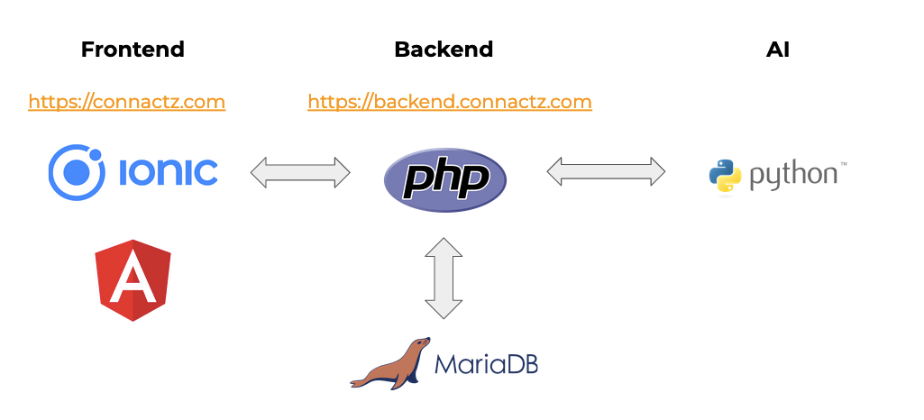


Tech stack
Frontend
Backend

Slide 30
Outline
Motivation
Methodology
Problem Statement and Goal
Approach
Timeline

Slide 31
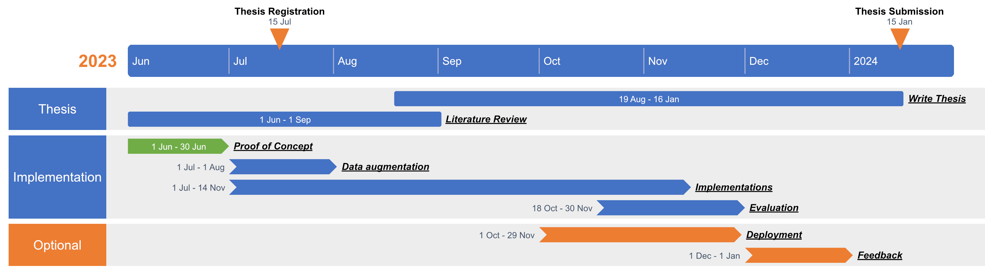
Timeline
Notes:
Note: Data augmentation should probably start later and implementation earlier

Slide 32
Timeline
Is this style better?
May
Jun
Jul
Aug
Sep
Oct
Nov
Dec
Thesis
Literature Review
Write Thesis
Implementation
Optional
15/06/2023 Thesis registration
15/12/2023 Thesis submission
Notes:
Note: Data augmentation should probably start later and implementation earlier

Slide 33
References
[1] an Chenxin, J. Feng, K. Lv, L. Kong, X. Qiu, and X. Huang, “CoNT: Contrastive Neural Text Generation,” May. 2022. [Online]. Available: http://arxiv.org/pdf/2205.14690v4
[2] R. Eisenstadt and M. Elhadad, Neural Micro-Planning for Data to Text Generation Produces more Cohesive Text, Proceedings of the Workshop on Discourse Theories for Text Planning. Dublin, Ireland: Association for Computational Linguistics. [Online]. Available: https://aclanthology.org/2020.dt4tp-1.2
[3] M. Freitag and S. Roy, “Unsupervised Natural Language Generation with Denoising Autoencoders,” Apr. 2018. [Online]. Available: http://arxiv.org/pdf/1804.07899v2
[4] R. Puduppully, Y. Fu, and M. Lapata, “Data-to-text Generation with Variational Sequential Planning,” Feb. 2022. [Online]. Available: http://arxiv.org/pdf/2202.13756v1
[5] L. F. R. Ribeiro, M. Schmitt, H. Schütze, and I. Gurevych, “Investigating Pretrained Language Models for Graph-to-Text Generation,” Jul. 2020. [Online]. Available: http://arxiv.org/pdf/2007.08426v3
[6] E. Riloff, D. Chiang, J. Hockenmaier, and J. Tsujii, Eds., Proceedings of the 2018 Conference on Empirical Methods in Natural Language Processing. Stroudsburg, PA, USA: Association for Computational Linguistics, 2018.
[7] Y. Su, Z. Meng, S. Baker, and N. Collier, “Few-Shot Table-to-Text Generation with Prototype Memory,” 2021.
[8] Y. Su, D. Vandyke, S. Wang, Y. Fang, and N. Collier, “Plan-then-Generate: Controlled Data-to-Text Generation via Planning,” Aug. 2021. [Online]. Available: http://arxiv.org/pdf/2108.13740v1
[9] S. Wiseman, S. Shieber, and A. Rush, “Learning Neural Templates for Text Generation,” in Proceedings of the 2018 Conference on Empirical Methods in Natural Language Processing, Brussels, Belgium, 2018, pp. 3174–3187.
[10] S. Yang and Y. Liu, “Data-to-text Generation via Planning,” J. Phys.: Conf. Ser., vol. 1827, no. 1, p. 12190, 2021, doi: 10.1088/1742-6596/1827/1/012190.

Slide 34
Stick to the good sebis traditions
Provide action links at the bottom of the slide to guide the audience to our web pages or publications (see below). (Select the text, press CTRL-K)
Use a file name according to our sebis conventions which helps us and our audience to find the file of your presentation on our web site with Google search:
YYMMDD Author Short Title
Include this string in the footer (Einfügen -> Kopf- und Fusszeile -> Fusszeile)
The unusual date format simplifies the search for the latest version of a slide in an alphabetical directory listing (Dropbox, Explorer, Tricia, Sky-Drive)
[Ha13g] Hauder, M., Roth, S., Matthes, F.: Current Tool support for Metrics in Enterprise Architecture Management
For more information visit BEAMS , EAM Pattern Catalog and EAM KPI Catalog (http://wwwmatthes.in.tum.de)

Slide 35
Use the sebis visual language (shapes, fonts, colors, sizes)
Default
Line Style
Default Rectangle
Default
Rounded R.
Text
Default
Text
User
Store
Information
Arrow
Cloud
Process
Box
Explanation
Fast Form 1
Fast Form 2
Fast Form 3
Fast Form 4
Fast Form 5
Fast Form 6
Fast Form 6
Fast Form 1
Fast Form 2
Fast Form 3
Fast Form 4
Fast Form 5
Fast Form 6
Fast Form 6

