Slide 1
Extracting Semantically Meaningful Context Windows around Class-Specific Keywords
21.09.2023, Master Thesis Kick-Off
Alexandra Seibicke

Slide 2
Outline
Introduction
Method
Motivation
Initial Results
Research Questions
Dataset and Technologies
Approaches
Baseline Approach
Naïve Approach
Dependency Approach
Some Statistics
Next Steps
Timeline

Slide 3


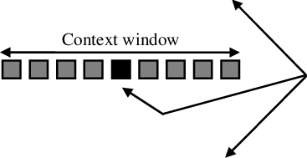



Method
k classes
per class
n
Chunk size
2n+1
Keywords
1
…
n
Word Sense Disambiguation
<2n+1
Output

Slide 4

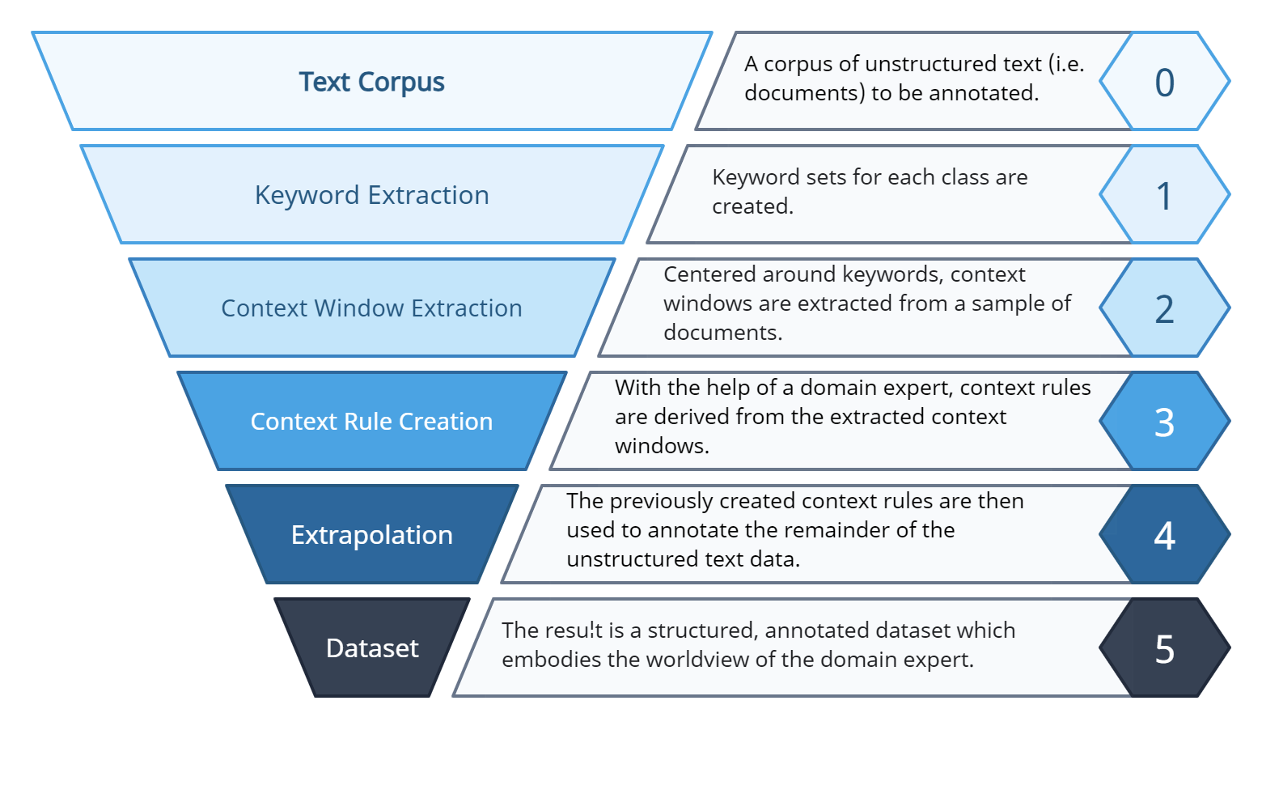
Motivation
CreateData4AI project

Slide 5


Motivation
“I deposited my money in the bank.”
“bank“ financial institution or edge of river??
Word Sense Disambiguation: use context clues like “money“ and “deposited“ to determine context
Get context windows around all relevant class-specific keywords from previous step of the pipeline
“After withdrawing money from the bank, I went for a walk by this beautiful river.”
Context window:
“After withdrawing money from the bank, I went for a walk by this beautiful river.”
“After withdrawing money from the bank, I went for a walk by this beautiful river.”
“After withdrawing money from the bank, I went for a walk by this beautiful river.”
“After withdrawing money from the bank, I went for a walk by this beautiful river.”

Slide 6
Research Questions
1
2
3
4
What are the current state-of-the-art approaches for Word Sense Disambiguation?
How can these approaches be combined with clustering techniques for class-based context filtering?
What methods can be leveraged to trim meaningful context windows from text chunks containing keywords?
Which evaluation approaches are most appropriate to assess the effectiveness of the filtering step and the cohesiveness of the window extraction?
Literature Research:
Machine-Learning Based approach
Knowledge Based approach
Literature Research Clustering techniques
Flat vs hierarchical clustering
Soft vs hard clustering, ….
Evaluate techniques on current use case
- Brainstorm and Research meaningful trimming
- Implement trims and evaluate the context windows
- Literature Research on some evaluation metrics
- Apply evaluation metrics and draw conclusion

Slide 7




Dataset and Technologies
Business Registry of Business Purposes
(Handelsregister) → purpose
extracted Keywords per Class
Class name | Seed keywords
G | Handel, Großhandel, Einzelhandel, Verpacken, Umverpacken, Abfüllen von Erzeugnissen wie Spirituosen oder Chemikalien, Abfallsortieren, ..
A | Landwirtschaft, Forstwirtschaft, Aquakultur, …
~ 3 million entries
Legal Name | Purpose
PMB Präzision Maschinenbau GmbH | Lieferung, Handel, Planung und Fertigung von Maschinenkomponenten sowie Stahlkonstruktionen.
MVA Neu Schönau GmbH & Co. KG | Erzeugung und Vermarktung landwirtschaftlicher Produkte, insbesondere die Erzeugung und Vermarktung von Milch.
21 classes

Slide 8

Baseline Approach
Lieferung, Handel, Planung und Fertigung von Maschinenkomponenten sowie Stahlkonstruktionen.
Keyword: Handel
2 words left, 2 words right:
Lieferung, Handel, Planung und Fertigung von Maschinenkomponenten sowie Stahlkonstruktionen.
Context Window:
Lieferung, Handel, Planung und
Problem: Words directly next to the keyword are often punctuation, words like “and” etc. (→ Stop words)
Critical clues and context to the keyword may be very far-off → not flexible sizes for different sentences
Solution: Use dependencies that spacy calculates for each sentence!

Slide 9
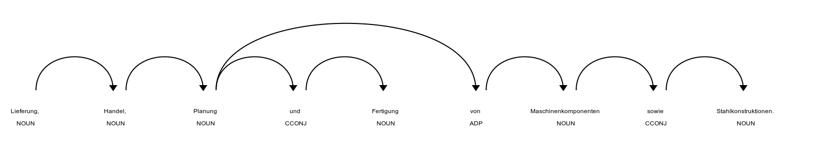
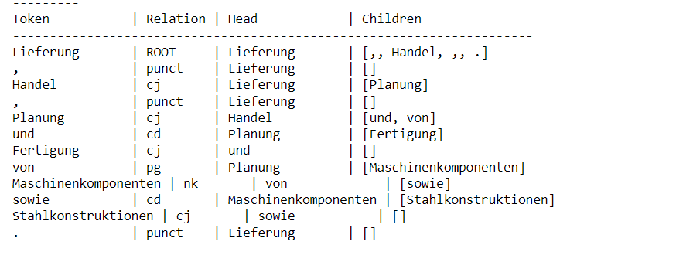
What are Dependencies?
1.) Find the keyword
2.) check relations of keyword (e.g. “Handel”)
3.) check the head (“Lieferung”) and the children (“Handel”)
4.) check the relation of the words (e.g. conjunction, punctuation, …) → maybe jump again if not a meaningful word (e.g. “,”)

Slide 10


Naïve Approach
Now use these dependencies!
1.) Fix windows size (e.g. 3 left, 3 right)
2.) Check all heads and children and select the rightmost and leftmost word within window and resize window
Variations: different windows size

Slide 11
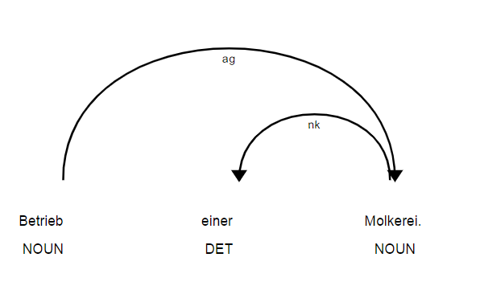
Problem: Very variable sizes of sentences! How to set optimal window size?
→ either whole coverage of sentence or very small part
→ in long sentences, important clues can be overlooked with small coverage
Solution: Maybe set number of jumps fix instead of window size?

Slide 12
Dependency Approach
Fix number of jumps (e.g. 1 jump), do more jumps if a stop word occurs
Stop words: .,””, aus, gegen, einer, zum, man, ganz, …
Variations: different number of jumps

Slide 13
Compare Approaches
Keyword: Handel
Window of naïve approach with windows size 13 | Window of dependency approach with 1 additional jump if stop word encounters | Window of dependency approach with 1000 jumps if stop word encounters
und Handel mit diesen | und Handel mit diesen | Herstellung und der Einbau von Heizungs-, Lüftungs- und Klimaanlagen in Gebäuden und Handel mit diesen
same window as naïve approach
Jump at “mit” → no jump at “und”
→ “und” is stop word: jump again
→ “diesen” has no children

Slide 14
Some Statistics
Key takeaways:
Root suitable for detecting start of window
After punctuation occurs, no need to look further
Noun kernel element suitable for detecting windows
Most common dependencies | Most common dependencies at the start of the context window | Most common dependencies at the end of the context window
Noun kernel element | Root | Noun kernel element
Conjunction | Noun kernel element | Conjunction
Coordinating conjunction | Coordinating conjunction | Punctuation
 | Conjunction

Slide 15




Next Step: Machine-learning Based Approach
Machine-learning based approach:
Build meaningful dataset, features and model
Automatically detect windows start and end and ideally keyword
Lieferung, Handel, Planung und Fertigung von Maschinenkomponenten sowie Stahlkonstruktionen.
Data
Features
Model

Slide 16
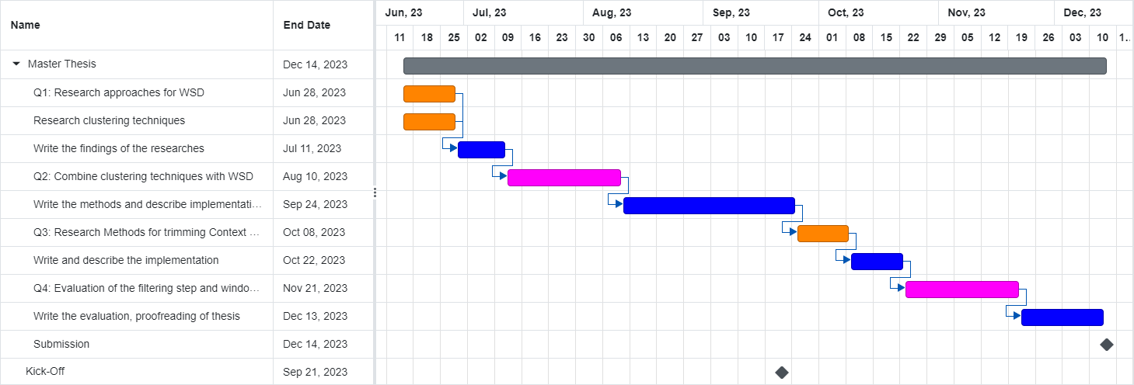
Timeline

Slide 17
Alexandra Seibicke
17132
matthes@in.tum.de

