Slide 1
Extracting Semantically Meaningful Context Windows around Class-Specific Keywords
15.01.2024, Master Thesis Final Presentation
Alexandra Seibicke

Slide 2
Outline
Motivation
Methodology
  Research Questions
  Dataset and Technologies
  Clustering
  Approaches
    Manual Approaches
    Machine Learning Approaches
Results
  Statistics
  Expert Evaluation
  Challenges
  Conclusion
  Future Work

Slide 3

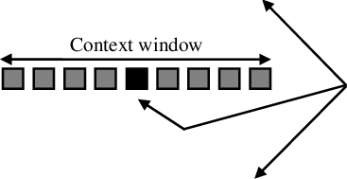
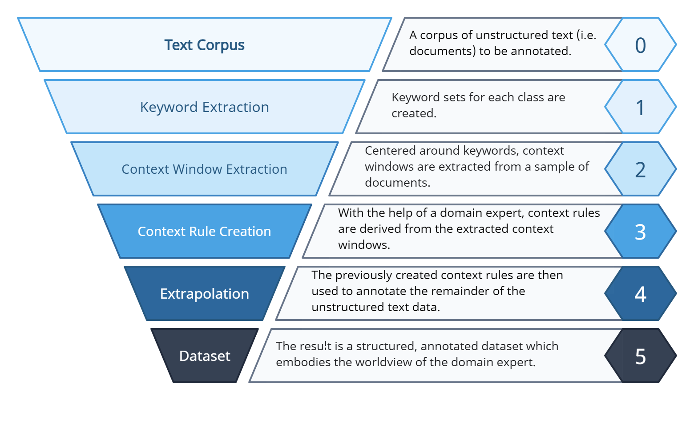
Motivation
  CreateData4AI project

Slide 4


Motivation
“I deposited my money in the bank.”
  “bank“ financial institution or edge of river??
  Word Sense Disambiguation: use context clues like “money“ and “deposited“ to determine context
  Get context windows around all relevant class-specific keywords from previous step of the pipeline
“After withdrawing money from the bank, I went for a walk by this beautiful river.”
Context window:
“After withdrawing money from the bank, I went for a walk by this beautiful river.”
  “After withdrawing money from the bank, I went for a walk by this beautiful river.”
“After withdrawing money from the bank, I went for a walk by this beautiful river.”
“After withdrawing money from the bank, I went for a walk by this beautiful river.”

Slide 5
Research Questions
1
2
3
4
What are the current state-of-the-art approaches for Word Sense Disambiguation?
How can these approaches be combined with clustering techniques for class-based context filtering?
What methods can be leveraged to trim meaningful context windows from text chunks containing keywords?
Which evaluation approaches are most appropriate to assess the effectiveness of the filtering step and the cohesiveness of the window extraction?
Literature Research:
Machine-Learning Based approach
Knowledge Based approach
Literature Research Clustering techniques
Flat vs hierarchical clustering
Soft vs hard clustering, ….
Evaluate techniques on current use case
- Brainstorm and Research meaningful trimming
- Implement trims and evaluate the context windows
- Literature Research on some evaluation metrics
- Apply evaluation metrics and draw conclusion

Slide 6





Dataset and Technologies
Business Registry of Business Purposes
(Handelsregister) → purpose
extracted Keywords per Class
Class name | Seed keywords
G | Handel, Großhandel, Einzelhandel, Verpacken, Umverpacken, Abfüllen von Erzeugnissen wie Spirituosen oder Chemikalien, Abfallsortieren, ..
A | Landwirtschaft, Forstwirtschaft, Aquakultur, …
~ 3 million entries
Legal Name | Purpose
PMB Präzision Maschinenbau GmbH | Lieferung, Handel, Planung und Fertigung von Maschinenkomponenten sowie Stahlkonstruktionen.
MVA Neu Schönau GmbH & Co. KG | Erzeugung und Vermarktung landwirtschaftlicher Produkte, insbesondere die Erzeugung und Vermarktung von Milch.
21 classes

Slide 7
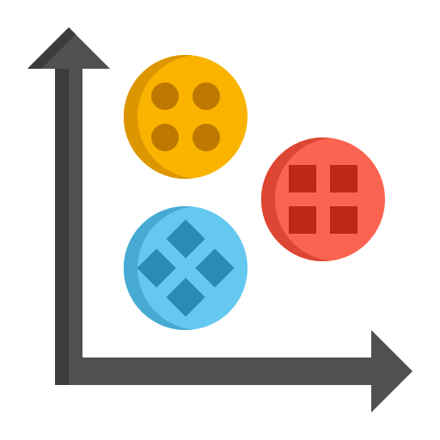
Clustering
Some keywords may belong to two or more classes for the newest keyword version
→ Clustering needed
K-Means
Suitable for big data and predefined number of clusters (21)

Slide 8

Baseline Approach
Lieferung, Handel, Planung und Fertigung von Maschinenkomponenten sowie Stahlkonstruktionen.
Keyword: Handel
2 words left, 2 words right:
Lieferung, Handel, Planung und Fertigung von Maschinenkomponenten sowie Stahlkonstruktionen.
Context Window:
Lieferung, Handel, Planung und
Problem: Words directly next to the keyword are often punctuation, words like “and” etc. (→ Stop words)
Critical clues and context to the keyword may be very far-off → not flexible sizes for different sentences
Solution: Use dependencies that spacy calculates for each sentence!

Slide 9
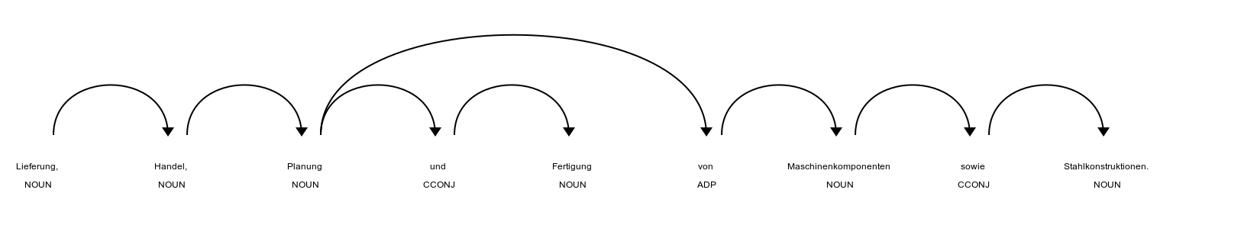
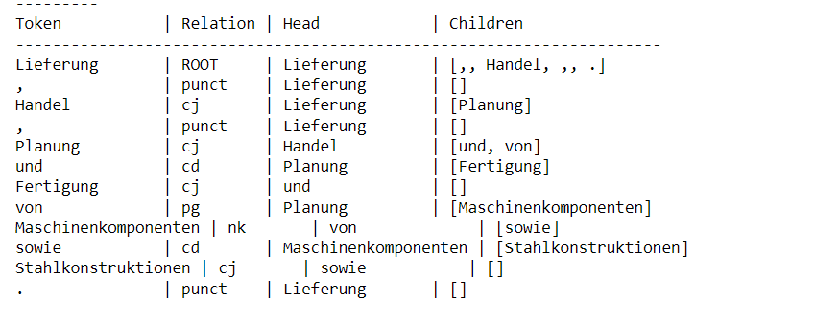
What are Dependencies?
1.) Find the keyword
2.) check relations of keyword (e.g. “Handel”)
3.) check the head (“Lieferung”) and the children (“Handel”)
4.) check the relation of the words (e.g. conjunction, punctuation, …) → maybe jump again if not a meaningful word (e.g. “,”)

Slide 10


Naïve Approach
Now use these dependencies!
1.) Fix windows size (e.g. 4 left, 4 right)
2.) Check all heads and children and select the rightmost and leftmost word within window and resize window
Variations: different windows size

Slide 11
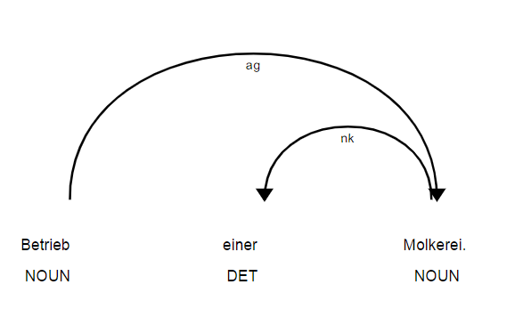
Problem: Very variable sizes of sentences! How to set optimal window size?
→ either whole coverage of sentence or very small part
→ in long sentences, important clues can be overlooked with small coverage
Solution: Maybe set number of jumps fix instead of window size?

Slide 12
Dependency Approach
Fix number of jumps (e.g. 1 jump), do more jumps if a stop word occurs
Stop words: .,””, aus, gegen, einer, zum, man, ganz, …
Variations: different number of jumps

Slide 13
Compare Manual Approaches
Keyword: Handel
Window of Naïve Approach with windows size 8 | Window of Dependency Approach with 1 additional jump if stop word encounters | Window of Dependency Approach with 1000 jumps if stop word encounters
und Handel mit diesen | und Handel mit diesen | Herstellung und der Einbau von Heizungs-, Lüftungs- und Klimaanlagen in Gebäuden und Handel mit diesen
same window as naïve approach
Jump at “mit” → no jump at “und”
→ “und” is stop word: jump again
→ “diesen” has no children

Slide 14

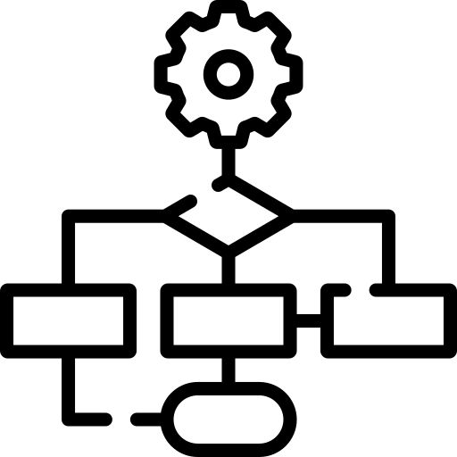




Machine Learning Approaches
Pre-Processing
Data
Feature Extraction
Feature Selection
Train Model
A, B, C, D, G
(150 each)
and 50 of Class K
part of speech tag,
distance to keyword,
is child to keyword, is in same sentence, ….
Predict

Slide 15
Machine Learning Approaches
RandomForest | XGBoost | Gaussian
Decision Trees | Decision Trees with optimizing worst performing tree | Using Bayes Theorem
5-fold cross-validation: → 700 estimators Max depth 10 mean cross-validated accuracy score of 0.932 on the validation set | 5-fold cross-validation: Subsample 0.7 → 100 estimators Max depth 80 learning rate of 0.01 mean cross-validated accuracy score of 0.934 on the validation set | Different kernels: → 1.0 * RBF(1.0) default RationalQuadratic Kernel → mean cross-validated accuracy score of 0.968 on the validation set
Higher Recall (+0.9) Higher Precision (+8.32) Higher F1 score (+5.64) than manual approaches | Higher Recall (+5.66) Lower Precision (-0.21) Higher F1 score (+2.08) than RandomForest approach | Sometimes empty predictions Low Precision (-27.81), Recall (-3.2) and F1 score (-14.41) on test data → High Precision (+3.6), Recall (-0.22) and F1 score (+20.65) on training data set

Slide 16
Machine Learning Approaches
RandomForest | XGBoost | Gaussian
Decision Trees | Decision Trees with optimizing worst performing tree | Using Bayes Theorem
5-fold cross-validation: → 700 estimators Max depth 10 mean cross-validated accuracy score of 0.932 on the validation set | 5-fold cross-validation: Subsample 0.7 → 100 estimators Max depth 80 learning rate of 0.01 mean cross-validated accuracy score of 0.934 on the validation set | Different kernels: → 1.0 * RBF(1.0) default RationalQuadratic Kernel → mean cross-validated accuracy score of 0.968 on the validation set
Higher Recall (+0.9) Higher Precision (+8.32) Higher F1 score (+5.64) than manual approaches | Higher Recall (+5.66) Lower Precision (-0.21) Higher F1 score (+2.08) than RandomForest approach | Sometimes empty predictions Low Precision (-27.81), Recall (-3.2) and F1 score (-14.41) on test data → High Precision (+3.6), Recall (-0.22) and F1 score (+20.65) on training data set

Slide 17
Machine Learning Approaches
RandomForest | XGBoost | Gaussian
Decision Trees | Decision Trees with optimizing worst performing tree | Using Bayes Theorem
5-fold cross-validation: → 700 estimators Max depth 10 mean cross-validated accuracy score of 0.932 on the validation set | 5-fold cross-validation: Subsample 0.7 → 100 estimators Max depth 80 learning rate of 0.01 mean cross-validated accuracy score of 0.934 on the validation set | Different kernels: → 1.0 * RBF(1.0) default RationalQuadratic Kernel → mean cross-validated accuracy score of 0.968 on the validation set
Higher Recall (+0.9) Higher Precision (+8.32) Higher F1 score (+5.64) than manual approaches | Higher Recall (+5.66) Lower Precision (-0.21) Higher F1 score (+2.08) than RandomForest approach | Sometimes empty predictions Low Precision (-27.81), Recall (-3.2) and F1 score (-14.41) on test data → High Precision (+3.6), Recall (-0.22) and F1 score (+20.65) on training data set

Slide 18
Feature Importance of Machine Learning Approaches
RandomForest | XGBoost | Gaussian
Distance to Keyword | Distance to Keyword | Sentence Length
Sentence Length | punctuation | Child
Index of Keyword | Index of Keyword | Head
Is Child | Is Child | Index of Keyword
Child | In Sentence | Distance to Keyword
Is Head | … | Number of tokens to the right
In Sentence |  | Number of tokens to the left
…

Slide 19




Post Processing
1. If the model did not predict anything, the context window includes just the keyword.
2. If the model did not include the keyword in the context window, extend the context
window to include the keyword.
3. If there are holes in the predicted context window, find the largest chains and merge
them.
4. If the context window does not start and end with a NOUN, then search the 3 tokens
beneath to find the nearest NOUN and include it in the context window.
NOUN

Slide 20
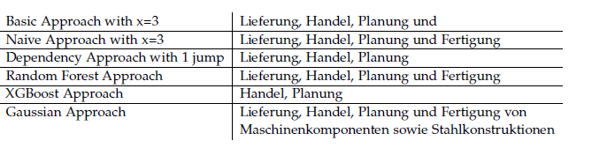
Overview of all Approaches

Slide 21
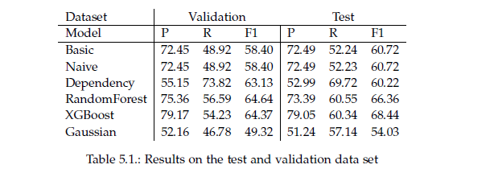
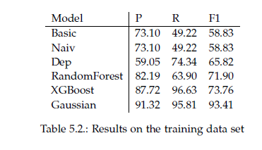
Results

Slide 22
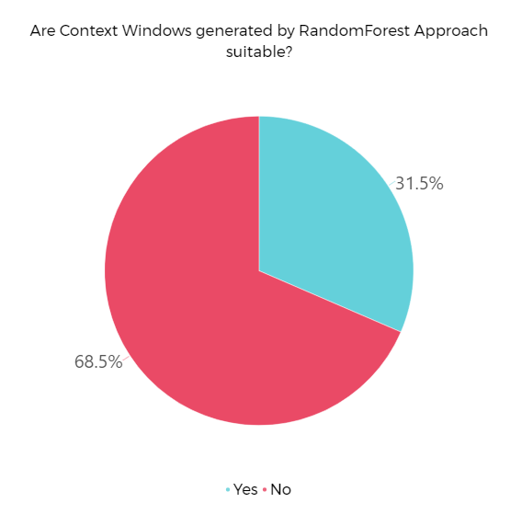
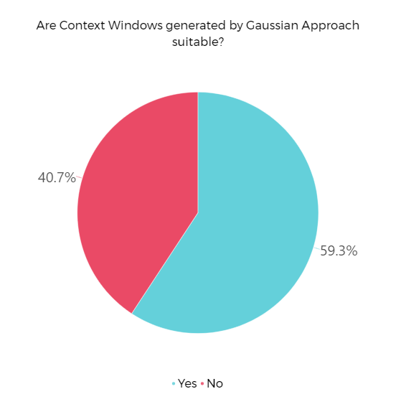
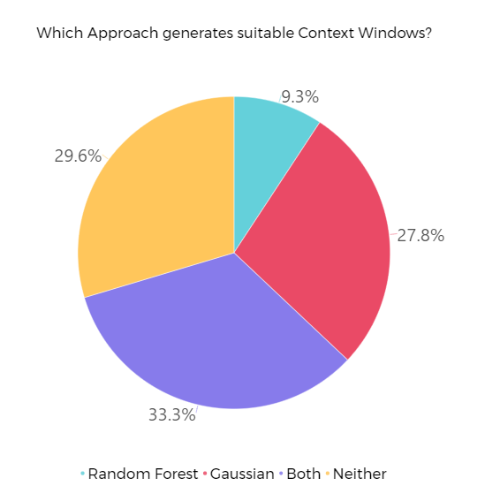
Expert Evaluation

Slide 23
Expert Evaluation
Gaussian Approach often generates longer Context Windows
→ Experts prefer longer windows
PROBLEM:
Keywords of different classes may be included in one context window
Each example description does only contain one keyword in our evaluation
Enhance evaluation with keywords of different classes in a sentence
More feedback needed (only 3 responses so far)

Slide 24


Challenges
Varying data
different sentence lengths, keywords can be beginning, middle or end of a sentence
Long sentences with many enumerations
→ keywords of different classes are near each other

Slide 25



Conclusion
Machine Learning approaches are superior to manual approaches
Gaussian Approach leads to very high scores in the training set and is preferred by experts
Preliminary since we need to enhance evaluation and collect more feedback
XGBoost Approach leads to overall consistent results with high scores

Slide 26
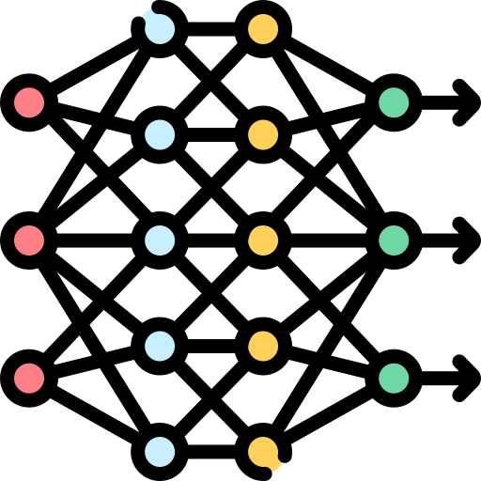


Future Work
Develop Deep Learning models like LSTMs
Labeling subset of all 21 classes and compare results
Improve post- and preprocess steps and Evaluation

Slide 27
Alexandra Seibicke
17132
matthes@in.tum.de

