Slide 1
Studying the Privacy-Utility Trade-off of Word Embedding Perturbations with a Focus on Sensitivity Analysis and Vector Mapping
18th December 2023, Master Thesis Final Presentation
Alisha Riecker

Slide 2
Outline
1. Motivation
2. Research Questions
3. Methodology
4. Results
5. Discussion

Slide 3



Motivation – Differential Privacy for Word Embedding Vectors (1)
Privacy gain
Using differential privacy to perturb word embedding vectors
How can we design the perturbation to get a favorable trade-off between privacy and utility?
Utility loss

Slide 4





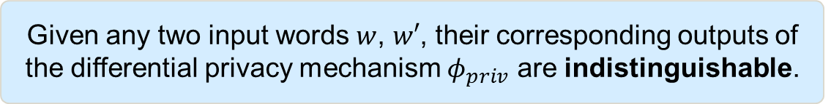
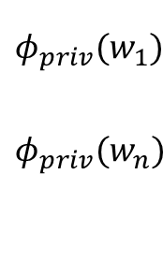




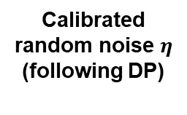
Motivation – Differential Privacy for Word Embedding Vectors (2)
Given any two input words $w$, $w′$, their corresponding outputs of the differential privacy mechanism $φ_{priv}$ are indistinguishable.
User 1
Text 1
NLP Application
Privatized word embedding vectors
User 2
Text 2
Data Collector
(untrusted)
User 3
Text 3
…..
Calibrated random noise $η$
(following DP)
Embedding
function $Φ$
Privatized word embedding vectors
User m
Text m
$$w_{1}$$
$$w_{n}$$
$$φ(w_{1})$$
$$φ(w_{n})$$
+
$$η$$
$$η$$
$$φ_{priv}(w_{1})$$
$${φ_{priv}(w}_{n})$$
=
Text i
….
…
….
...
+
=

Slide 5
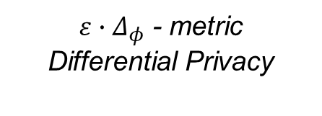
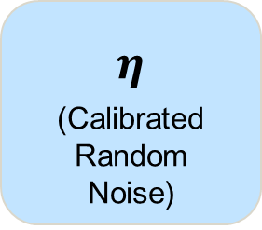
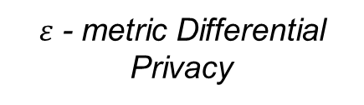
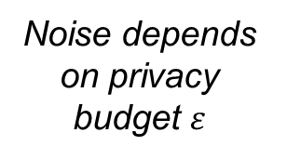
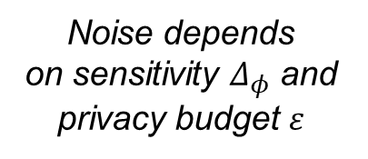
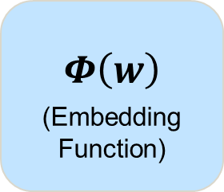
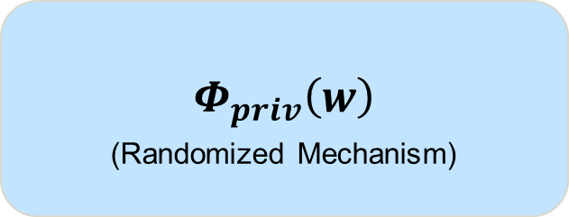
Motivation - Differential Privacy for Word Embedding Vectors (3)
$$Φ\left(w\right)$$
(Embedding Function)
$$η$$
(Calibrated Random Noise)
$$Φ_{priv}\left(w\right)$$
(Randomized Mechanism)
+
=
Noise depends
on sensitivity $Δ_{φ}$ and privacy budget $ε$
Noise depends on privacy budget $ε$
$ε$ - metric Differential Privacy
$ε∙Δ_{φ}$ - metric Differential Privacy
Smaller sensitivity yields smaller noise or stronger privacy guarantees

Slide 6

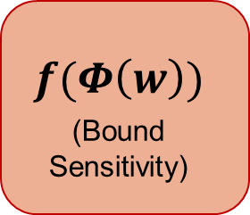
Motivation - Differential Privacy for Word Embedding Vectors (3)
$$Φ\left(w\right)$$
(Embedding Function)
$$f(Φ\left(w\right))$$
(Bound Sensitivity)
$$η$$
(Calibrated Random Noise)
$$Φ_{priv}\left(w\right)$$
(Randomized Mechanism)
+
=
Smaller amount of noise
Stronger privacy guarantees
How can sensitivity be bounded?
How does the bounding affect the Privacy-Utility Trade-off?

Slide 7
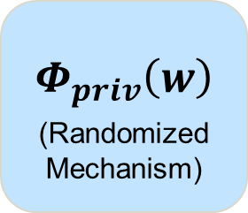
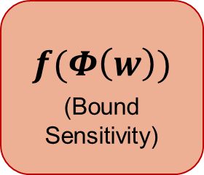
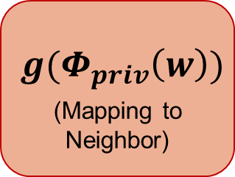
Motivation - Differential Privacy for Word Embedding Vectors (3)
$$Φ\left(w\right)$$
(Embedding Function)
$$f(Φ\left(w\right))$$
(Bound Sensitivity)
$$η$$
(Calibrated Random Noise)
$$Φ_{priv}\left(w\right)$$
(Randomized Mechanism)
$$g(Φ_{priv}\left(w\right))$$
(Mapping to Neighbor)
+
=
Targeted calibration of noise
Adapted privacy guarantees
Output is a „real“ word
→ better interpretability
How can sensitivity be bounded?
What can the mapping look like?
How does the bounding affect the Privacy-Utility Trade-off?
How does this mapping affect the Privacy-Utility Trade-off?

Slide 8
Outline
1. Motivation
2. Research Questions
3. Methodology
4. Results
5. Discussion

Slide 9
Research Questions
RQ1
What approaches are there to privatize word embeddings by perturbing word vector representations?
RQ2
How can we make these privatized word embeddings more effective?
RQ3
What is the effect of different approaches to estimating sensitivity on privacy and utility for downstream NLP tasks?
RQ4
What are the implications on privacy and utility resulting from mapping noisy word embeddings to similar embedding vectors which are associated with real words?

Slide 10
Outline
1. Motivation
2. Research Questions
3. Methodology
4. Results
5. Discussion

Slide 11
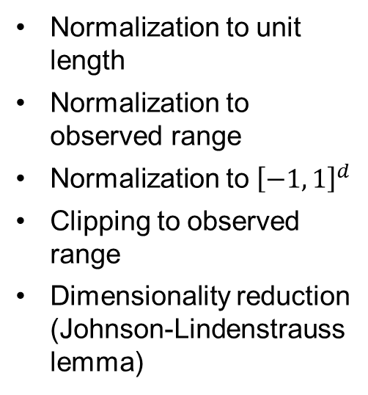
Methodology – Privatized Word Embedding Vectors
$$Φ\left(w\right)$$
(Embedding Function)
$$f(Φ\left(w\right))$$
(Bound Sensitivity)
$$η$$
(Calibrated Random Noise)
$$Φ_{priv}\left(w\right)$$
(Randomized Mechanism)
$$g(Φ_{priv}\left(w\right))$$
(Mapping to Neighbor)
+
=
RQ2
RQ1
RQ2
Normalization to unit length
Normalization to observed range
Normalization to ${\left[−1, 1\right]}^{d}$
Clipping to observed range
Dimensionality reduction (Johnson-Lindenstrauss lemma)
Multivariate Laplace Mechanism
Truncated Gumbel Mechanism
Mapping to nearest neighbor embedding
Randomly mapping to first or second nearest neighbor
© sebis
11

Slide 12





Methodology – Experiment Setup (RQ 3 & 4) (1)
Utility Evaluation
Sentiment Analysis (TP)
Topic Classification (AG)
Metrics
Empirical Utility:
F1 Score
Privacy-Utility Trade-off (Heuristic):
$∆_{util}$ + $∆_{priv}$
Empiricallycompare privatized embedding vectors
Change in
Utility: $∆_{util}$∗
$∆_{priv}$
Privacy Evaluation
Identification of authors‘ gender (TP)
Identification of named entities (AG)
Empirical Privacy:
1 – F1 Score
Change in
Privacy: $∆_{priv}$∗
$$∆_{util}$$
TP: Trustpilot Dataset
AG: AG News Corpus
∗$∆_{priv}$ and $∆_{util}$ with respect to baselines

Slide 13

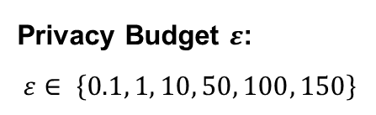
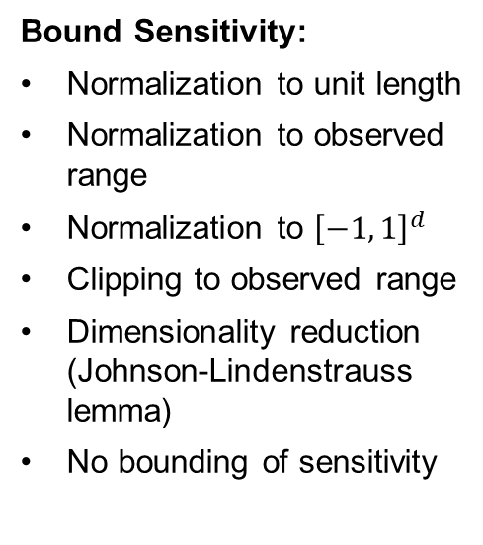
Methodology – Experiment Setup (RQ 3 & 4) (2)
DP Mechanism
Dataset:
Trustpilot Dataset
AG News Corpus
Dataset
Bound Sensitivity:
Normalization to unit length
Normalization to observed range
Normalization to ${\left[−1, 1\right]}^{d}$
Clipping to observed range
Dimensionality reduction (Johnson-Lindenstrauss lemma)
No bounding of sensitivity
Model
Privacy
Budget $ε$
Model:
LSTM
BERT
Bound Sensitivity
Vector Mapping
DP Mechanism:
Multivariate Laplace
Truncated Gumbel
Vector Mapping:
Mappping to nearest neighbor embedding
Randomly mapping to first or second nearest neighbor
No vector mapping
Privacy Budget $ε$:
$$ε∈ \left\{0.1, 1, 10, 50, 100, 150\right\}$$
684 Experiments
Notes:
In the exps., I compared the privatized emb. Vects. In diff. Exp. Setups where several exp. Dimensions have been varied.
As mentioned, I used two diff. Datasets to see if the results would persist across diff. Datasets.

Slide 14
Outline
1. Motivation
2. Research Questions
3. Methodology
4. Results
5. Discussion

Slide 15
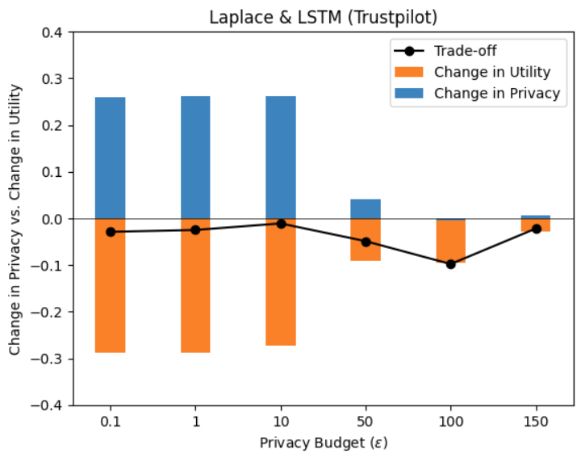
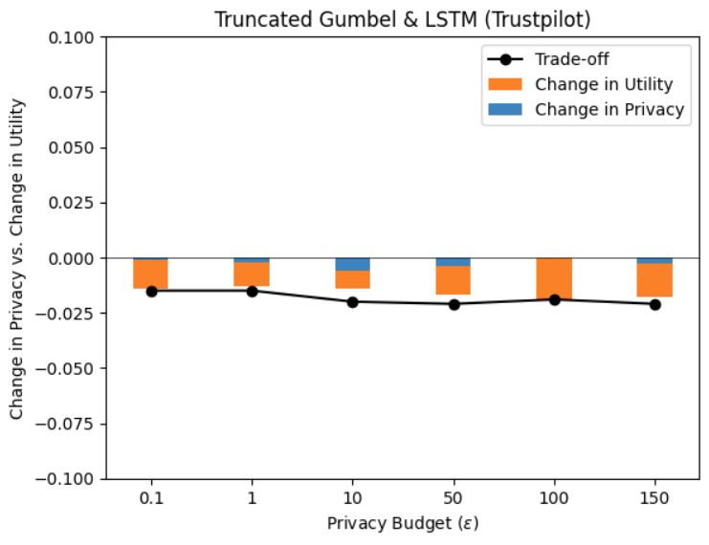


Results - Multivariate Laplace vs. Truncated Gumbel mechanism
For $ε=150$:
$∆_{util}=−0.029$
$∆_{priv}=+0.007$
For $ε=0.1$:
$∆_{util}=−0.014$
$∆_{priv}=−0.001$
Strong dependency on 𝜖 for Multivariate Laplace
Truncated Gumbel performs more similar to the (unperturbed) baseline also for small 𝜖 values

Slide 16
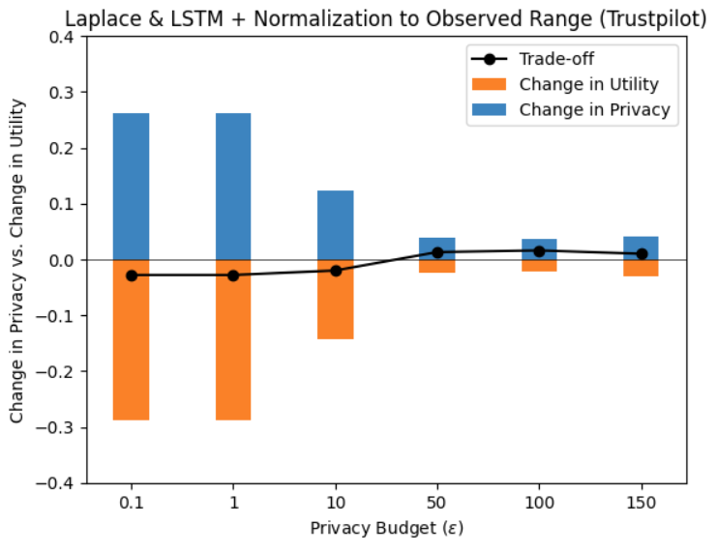
Results – Approaches to Bounding Sensitivity
Results varied largely depending on different experiment setups
All approaches achieved a favorable trade-off in at least one experiment setup

Slide 17
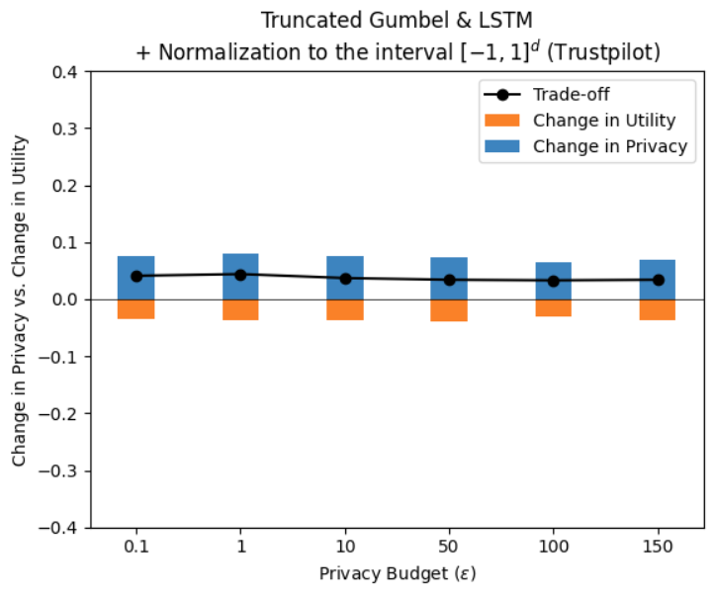
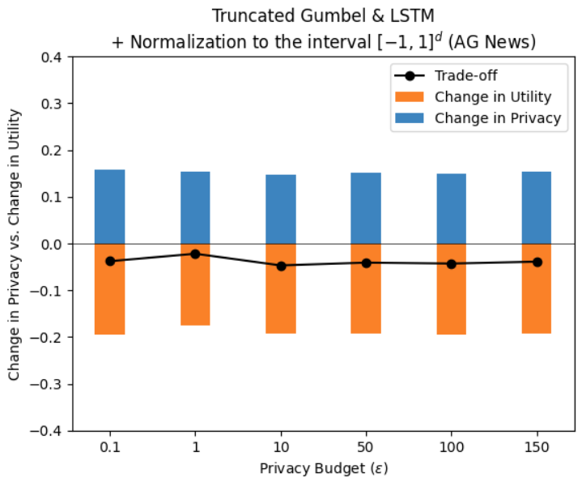
Results – Trustpilot Dataset vs. AG News Corpus
Same experiment setup can yield very different results for different datasets
We assume different suitability of the datasets and tasks

Slide 18
Outline
1. Motivation
2. Research Questions
3. Methodology
4. Results
5. Discussion

Slide 19

Discussion - Key Takeaways & Limitations
Results vary for different datasets
Suitability of privacy tasks
→ questionable influence of perturbing individual words on gender identification
Strong dependency on dataset and tasks

Slide 20
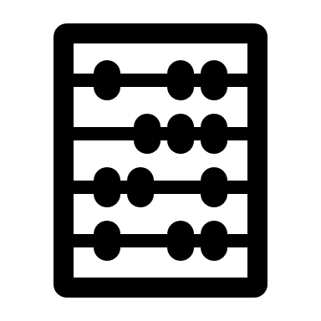




Discussion - Key Takeaways & Limitations
Weighting privacy vs. utility
Interdependence between privacy and utility
Strong dependency on dataset and tasks
$$∆_{priv}$$
$$∆_{util}$$
Lack of a quantitative metric for the privacy-utility trade-off
$$∆_{util}$$
$$∆_{priv}$$
→ pos. trade-off
→ pos. trade-off
Empirical Utility:
F1 Score
Empirical Privacy:
1 – F1 Score

Slide 21

Discussion - Key Takeaways & Limitations
We used two mechanisms
→ Multivariate Laplace
→ Truncated Gumbel
Some parameters chosen based on existing research
→ for random vector mapping, we follow parameter selection by Xu et al.¹ (favor second nearest neighbor)
Strong dependency on dataset and tasks
Lack of a quantitative metric for the privacy-utility trade-off
Selection of mechanisms and parameters
¹ Z. Xu et al. “On a Utilitarian Approach to Privacy Preserving Text Generation”. In: PrivateNLP 2021 11 (2021).

Slide 22

Discussion - Key Takeaways & Limitations
Same amount of noise for every word
Added noise on word-level
→ length of output sequence equals length of input sequence
Strong dependency on dataset and tasks
Lack of a quantitative metric for the privacy-utility trade-off
Selection of mechanisms and parameters
Same amount of noise for every word

Slide 23

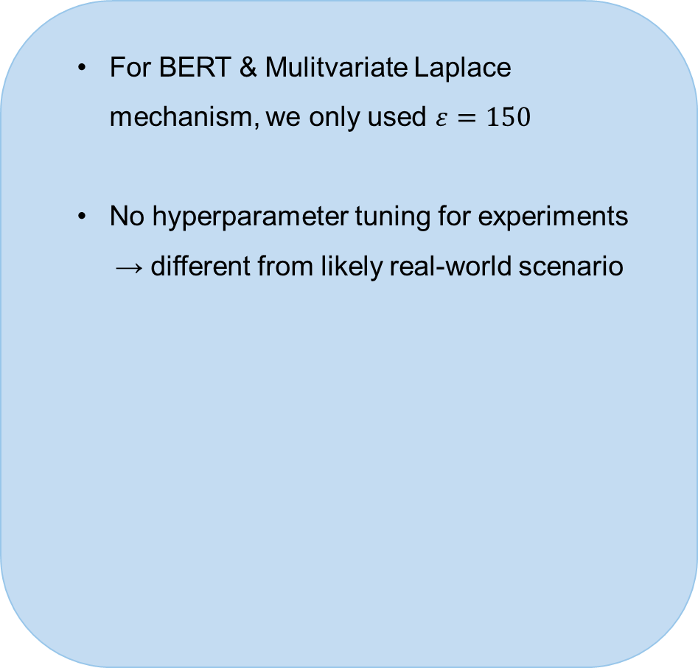
Discussion - Key Takeaways & Limitations
For BERT & Mulitvariate Laplace mechanism, we only used $ε=150$
No hyperparameter tuning for experiments
→ different from likely real-world scenario
Strong dependency on dataset and tasks
Lack of a quantitative metric for the privacy-utility trade-off
Selection of mechanisms and parameters
Same amount of noise for every word
Computational limitations

Slide 24
Discussion - Future Research
Investigate how datasets and tasks influence privacy and utility
Set of DP evaluation datasets and tasks
Strong dependency on dataset and tasks

Slide 25
Discussion - Future Research
Investigate how datasets and tasks influence privacy and utility
Set of DP evaluation datasets and tasks
Strong dependency on dataset and tasks
Lack of a quantitative metric for the privacy-utility trade-off
Quantitative metric for the privacy-utility trade-off

Slide 26
Discussion - Future Research
Investigate how datasets and tasks influence privacy and utility
Set of DP evaluation datasets and tasks
Strong dependency on dataset and tasks
Lack of a quantitative metric for the privacy-utility trade-off
Quantitative metric for the privacy-utility trade-off
Selection of mechanisms and parameters
Testing further mechanisms and parameters
Same amount of noise for every word
Computational limitations

Slide 27
Discussion - Future Research
Investigate how datasets and tasks influence privacy and utility
Set of DP evaluation datasets and tasks
Strong dependency on dataset and tasks
Lack of a quantitative metric for the privacy-utility trade-off
Quantitative metric for the privacy-utility trade-off
Selection of mechanisms and parameters
Testing further mechanisms and parameters
Same amount of noise for every word
Investigate targeted noise addition
Word- vs. Document- vs. User-Level DP
Computational limitations

Slide 28
Alisha Riecker
alisha.riecker@tum.de

Slide 29
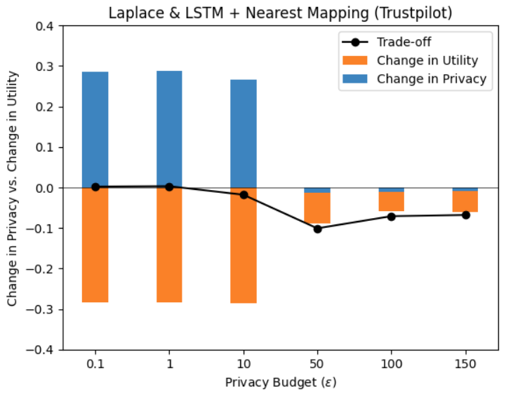
Results – Vector Mapping Approaches
Results varied largely depending on different experiment setups
Approaches often reduced utility losses and privacy gains (better performance w.r.t F1 score on both tasks)

Slide 30
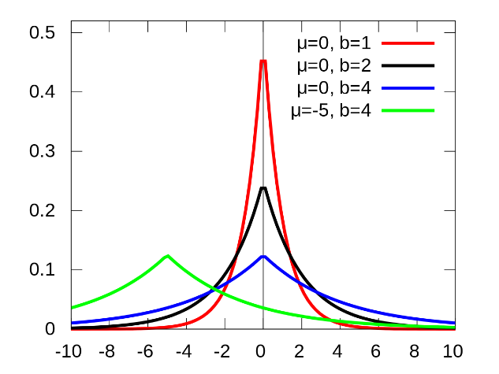
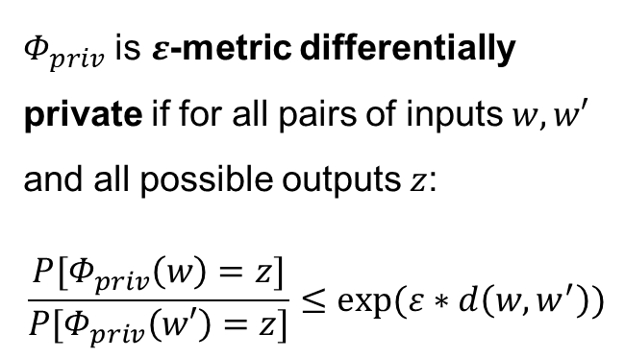
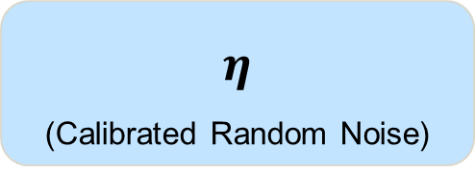
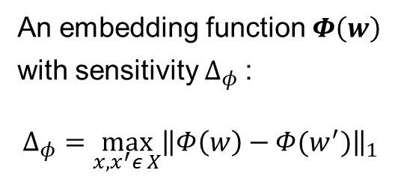
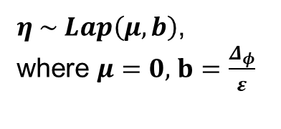
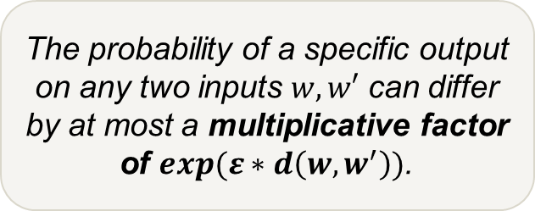
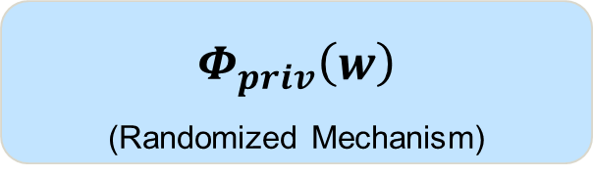
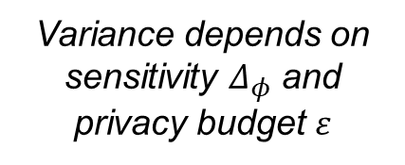
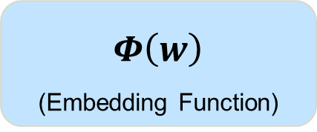
Motivation - Differential Privacy for Word Embedding Vectors
$$Φ\left(w\right)$$
(Embedding Function)
+
$$η$$
(Calibrated Random Noise)
=
$$Φ_{priv}\left(w\right)$$
(Randomized Mechanism)
Example: Laplace Mechanism
$Φ_{priv}$ is $ε$-metric differentially private if for all pairs of inputs $w, w′$ and all possible outputs $z$:
$$\frac{P[Φ_{priv}\left(w\right)=z]}{P[Φ_{priv}\left(w′\right)=z]}≤exp⁡(ε∗d\left(w,w^{′}\right))$$
An embedding function $Φ\left(w\right)$
with sensitivity $Δ_{φ}$:
$$Δ_{φ}=\max_{x, x^{′}ε X}{{\left\|Φ\left(w\right)−Φ(w^{′})\right\|}_{1}}$$
$η \sim Lap\left(μ,b\right)$,
where $μ=0$, $b=\frac{Δ_{φ}}{ε}$
Sensitivity describes the maximum possible change in a function‘s output, when the input is changed.
The probability of a specific output on any two inputs $w, w′$ can differ by at most a multiplicative factor of $exp⁡(ε∗d\left(w,w^{′}\right))$.
https://en.wikipedia.org/wiki/Laplace_distribution
Variance depends on sensitivity $Δ_{φ}$ and privacy budget $ε$
© sebis
30

Slide 31




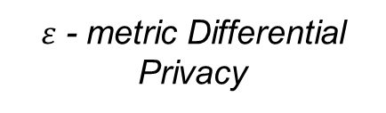
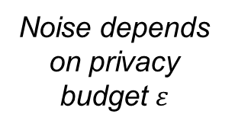
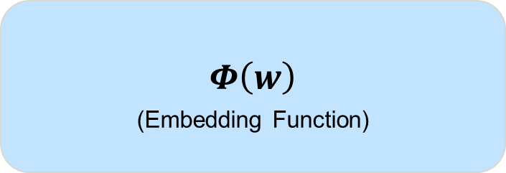
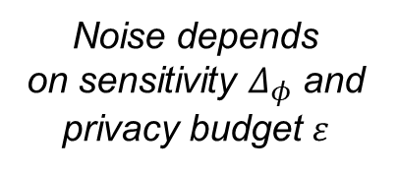
Motivation - Differential Privacy for Word Embedding Vectors (3)
$$Φ\left(w\right)$$
(Embedding Function)
$$η$$
(Calibrated Random Noise)
$$Φ_{priv}\left(w\right)$$
(Randomized Mechanism)
+
=
Example: Multivariate Laplace Mechanism
$Φ_{priv}$ satisfies
Metric Differential Privacy
An embedding function $Φ\left(w\right)$
$$η \sim Lap$$
Sensitivity describes the maximum possible change in a function‘s output when the input is changed.
Noise depends
on sensitivity $Δ_{φ}$ and privacy budget $ε$
$ε$ - metric Differential Privacy
Noise depends on privacy budget $ε$
$ε∙Δ_{φ}$ - metric Differential Privacy

