Slide 1
Differential Privacy in Transformer Architectures
10. 7. 2023, Master Thesis Kick-off
Jakob Zmrzlikar

Slide 2
Outline
1. Motivation
2. Research Questions
3. Methodology
4. Initial Findings
5. Timeline

Slide 3
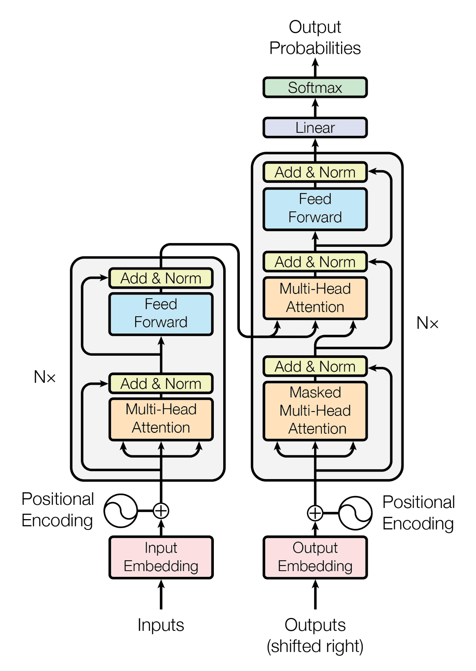
Motivation
DP ensures the privacy of individuals in datasets by adding random noise to the data before releasing it for analysis.
We want to add enough noise to mask the sensitivity of our function.
  DP is easy to formulate for simple functions (like the mean and median) but gets significantly more complicated with the use of more complicated functions like transformers.
A. Vaswani et al. Attention Is All You Need. 2017.

Slide 4
Motivation
DP ensures the privacy of individuals in datasets by adding random noise to the data before releasing it for analysis.
We want to add enough noise to mask the sensitivity of our function.
  DP is easy to formulate for simple functions (like the mean and median) but gets significantly more complicated with the use of more complicated functions like transformers.
A. Vaswani et al. Attention Is All You Need. 2017.

Slide 5
Motivation
We want to try out different ways to make transformers DP and benchmark them.
Specifically, we want to try adding noise to inputs and individual layers of the transformer.

Slide 6
Outline
1. Motivation
2. Research Questions
3. Methodology
4. Initial Findings
5. Timeline

Slide 7
Research Questions
1.
In what ways has DP been applied to transformer-based models in existing literature?
How can DP be achieved via input perturbations for transformer-based NLP models and how does that compare to DP-SGD in terms of privacy guarantees they provide?
2.
How can DP be achieved via layer perturbations for transformer-based NLP models and how does that compare to DP-SGD in terms of privacy guarantees they provide?
3.
4.
How do input and layer perturbations impact model accuracy on downstream tasks?

Slide 8
Outline
1. Motivation
2. Research Questions
3. Methodology
4. Initial Findings
5. Timeline

Slide 9
Methodology
1.
In what ways has DP been applied to transformer-based models in existing literature?
Literature review of DP techniques used with transformer architectures
How can DP be achieved via input perturbations for transformer-based NLP models and how does that compare to DP-SGD in terms of privacy guarantees they provide?
2.
Proving mathematically that the differential privacy property holds for each of the chosen techniques.
How can DP be achieved via layer perturbations for transformer-based NLP models and how does that compare to DP-SGD in terms of privacy guarantees they provide?
3.
Implementing our own methods and benchmarking their performance on downstream tasks.
4.
How do input and layer perturbations impact model accuracy on downstream tasks?

Slide 10
Outline
1. Motivation
2. Research Questions
3. Methodology
4. Initial Findings
5. Timeline

Slide 11
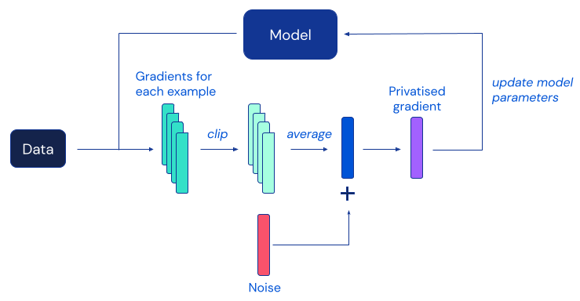
Initial findings
Previous DP work on transformers has focused primarily on adding noise to the gradients during training (DP-SGD) [Abadi et al., 2016]
DP-SGD uses a slightly different version of gradient descent (gradient clipping) to control sensitivity and make DP attainable.
DP-SGD ensures differential privacy for training data, but not for inference data.
https://www.deepmind.com/blog/unlocking-high-accuracy-differentially-private-image-classification-through-scale

Slide 12
Initial findings
We can tackle differentially private inference via input and layer perturbations.
However, standard self-attention has a very high sensitivity and makes DP infeasible.
We can either use clipping or a modified version of self-attention to bring sensitivity under control and make inference DP.

Slide 13
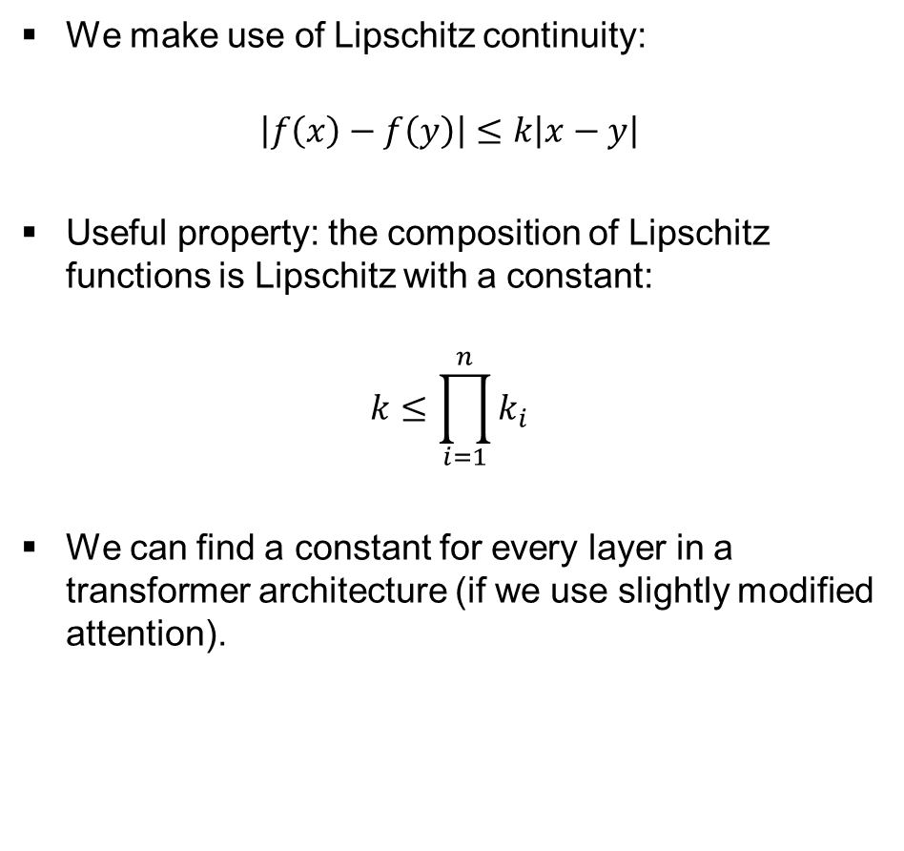
Idea of the proof: bounding the sensitivity via Lipshitz constants
We make use of Lipschitz continuity:
$$\left|f\left(x\right)−f\left(y\right)\right|≤k\left|x−y\right|$$
Useful property: the composition of Lipschitz functions is Lipschitz with a constant:
$$k≤\prod_{i=1}^{n}{k_{i}}$$
We can find a constant for every layer in a transformer architecture (if we use slightly modified attention).
Vaswani et al. Attention Is All You Need. 2017

Slide 14



Idea of the proof: bounding the sensitivity via Lipshitz constants
We make use of Lipschitz continuity:
$$\left|f\left(x\right)−f\left(y\right)\right|≤k\left|x−y\right|$$
Useful property: the composition of Lipschitz functions is Lipschitz with a constant:
$$k≤\prod_{i=1}^{n}{k_{i}}$$
We can find a constant for every layer in a transformer architecture (if we use slightly modified attention).
$$k_{3}$$
$$k_{2}$$
$$k_{1}$$
Vaswani et al. Attention Is All You Need. 2017

Slide 15
Next steps
Identifying datasets and downstream tasks for benchmarking
Implementing our methods in Python
Benchmarking the methods on chosen tasks

Slide 16
Outline
1. Motivation
2. Research Questions
3. Methodology
4. Initial Findings
5. Timeline

Slide 17
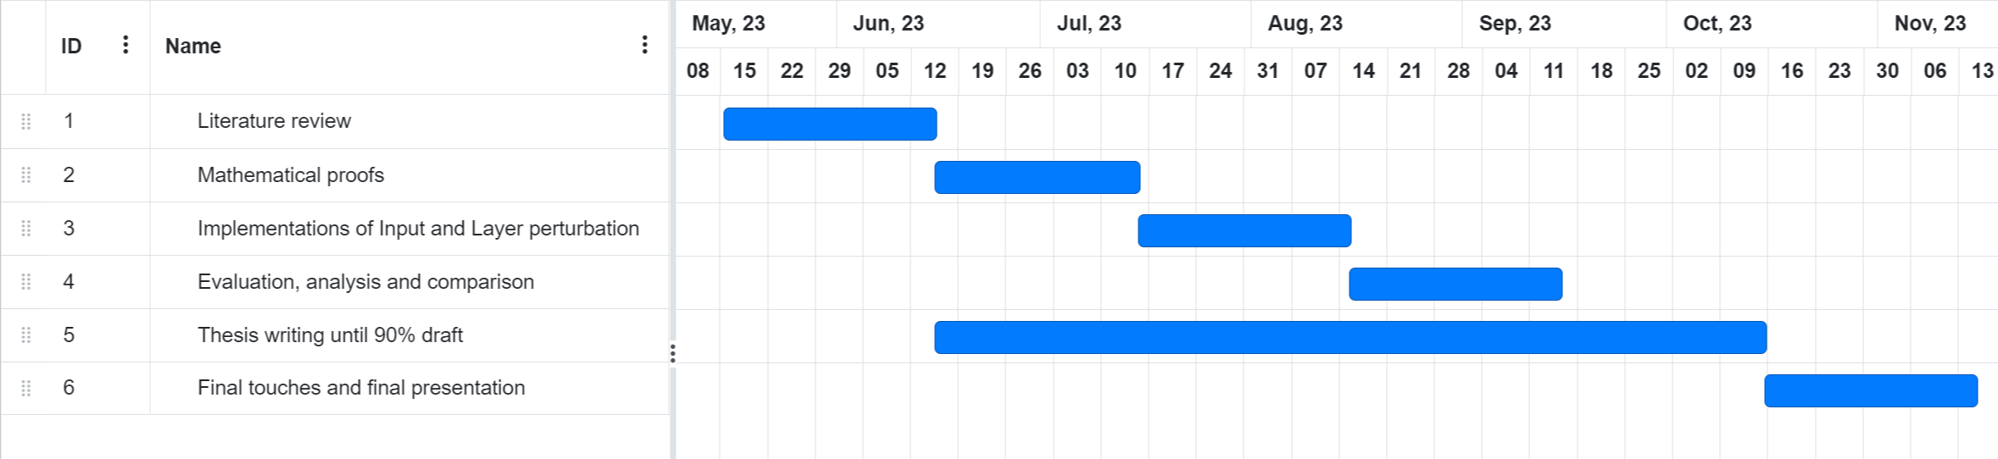
Timeline

Slide 18
BSc.
Jakob Zmrzlikar
17132
matthes@in.tum.de

Slide 19
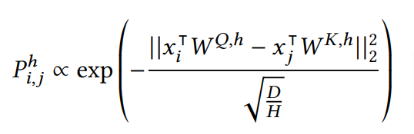
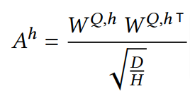
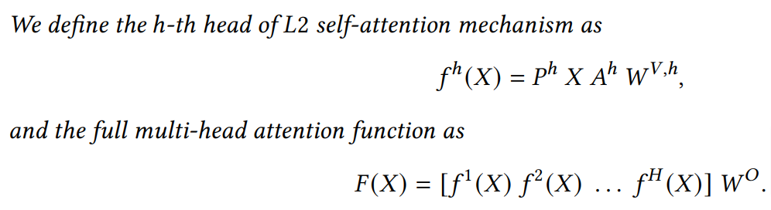
L2-Multihead Attention formulation

Slide 20
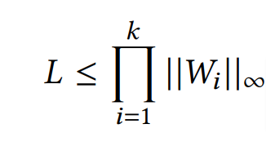
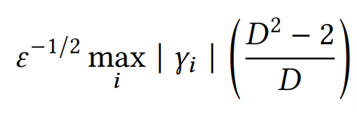
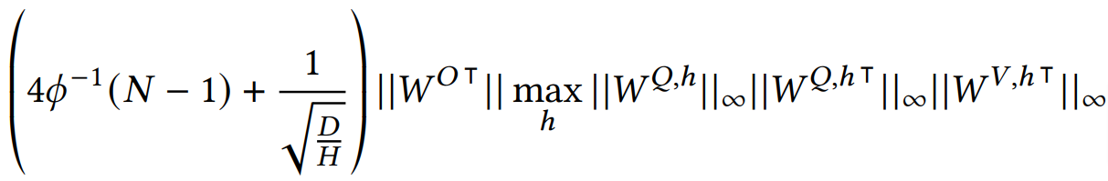

Lipschitz constant upper bounds for different layers
Fully-connected layer:
Normalization layer:
L2-Multihead Attention layer:
where
Vaswani et al. Attention Is All You Need. 2017

