Slide 1
Differential Privacy in Transformer Architectures
30. 10. 2023, Master Thesis Final Presentation
Jakob Zmrzlikar

Slide 2
Outline
1. Motivation
2. Research Questions
3. Methodology
4. Results
5. Conclusion

Slide 3
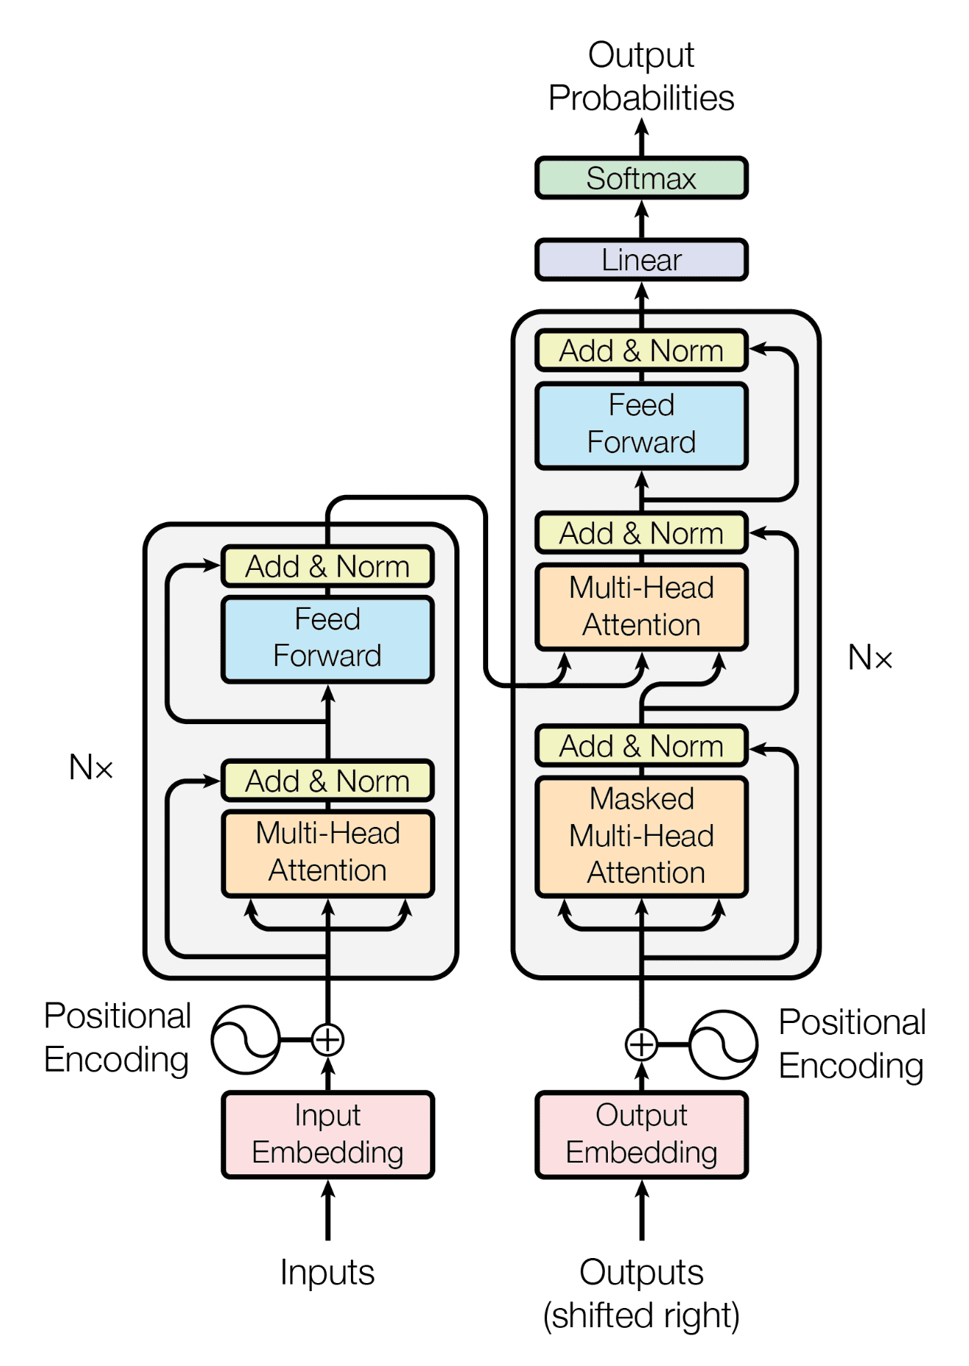
Motivation
DP ensures the privacy of individuals in datasets by adding random noise to the data before releasing it for analysis.
We want to add enough noise to mask the sensitivity of our function.
DP is easy to formulate for simple functions (like the mean and median) but gets significantly more complicated with the use of more complicated functions like transformers.
A. Vaswani et al. Attention Is All You Need. 2017.

Slide 4
Motivation
DP ensures the privacy of individuals in datasets by adding random noise to the data before releasing it for analysis.
We want to add enough noise to mask the sensitivity of our function.
DP is easy to formulate for simple functions (like the mean and median) but gets significantly more complicated with the use of more complicated functions like transformers.
A. Vaswani et al. Attention Is All You Need. 2017.

Slide 5
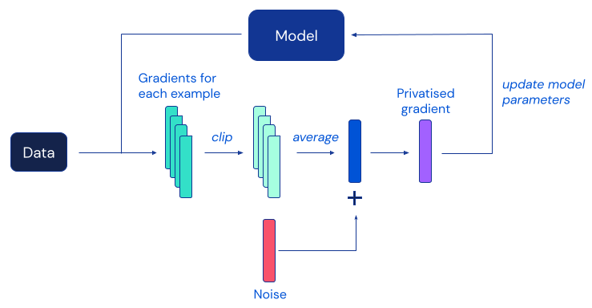
Existing methods
Previous DP work on transformers has focused primarily on adding noise to the gradients during training (DP-SGD) [Abadi et al., 2016]
DP-SGD uses a slightly different version of gradient descent (gradient clipping) to control sensitivity and make DP attainable.
DP-SGD ensures differential privacy for training data, but not for inference data.
https://www.deepmind.com/blog/unlocking-high-accuracy-differentially-private-image-classification-through-scale

Slide 6
Outline
1. Motivation
2. Research Questions
3. Methodology
4. Results
5. Conclusion

Slide 7
Research Questions
1.
In what ways has DP been applied to transformer-based models in existing literature?
How can DP be achieved via input perturbations for transformer-based NLP models and how does that compare to DP-SGD in terms of privacy guarantees they provide?
2.
How can DP be achieved via layer perturbations for transformer-based NLP models and how does that compare to DP-SGD in terms of privacy guarantees they provide?
3.
4.
How do input and layer perturbations impact model accuracy on downstream tasks?

Slide 8
Outline
1. Motivation
2. Research Questions
3. Methodology
4. Results
5. Conclusion

Slide 9
Methodology
1.
In what ways has DP been applied to transformer-based models in existing literature?
Literature review of DP techniques used with transformer architectures
How can DP be achieved via input perturbations for transformer-based NLP models and how does that compare to DP-SGD in terms of privacy guarantees they provide?
2.
Proving mathematically that the differential privacy property holds for each of the chosen techniques.
How can DP be achieved via layer perturbations for transformer-based NLP models and how does that compare to DP-SGD in terms of privacy guarantees they provide?
3.
Implementing our own methods and evaluating their performance on downstream tasks.
4.
How do input and layer perturbations impact model accuracy on downstream tasks?

Slide 10
Perturbation methods and proofs
Input perturbation
We project word embeddings into a one-dimensional equidistant space.
If we add Geometric noise, equidistance ensures DP guarantees hold.
Layer perturbation
We require all encoder layers to be Lipschitz continuous with a small constant.
We can bound the sensitivity with the product of Lipschitz constants and use the regular Gaussian mechanism.

Slide 11
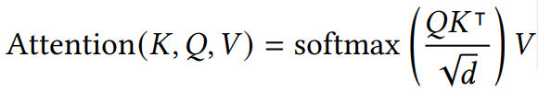

Architectural modifications for layer perturbation
To ensure Lipschitz continuity, we require the use of L2-multihead attention.
Although standard LayerNorm is Lipschitz continuous, the constant is too large, so we use CenterNorm instead.

Slide 12
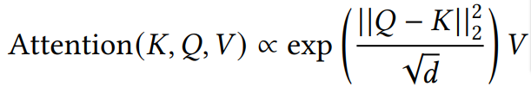

Architectural modifications for layer perturbation
To ensure Lipschitz continuity, we require the use of L2-multihead attention.
Although standard LayerNorm is Lipschitz continuous, the constant is too large, so we use CenterNorm instead.

Slide 13
Evaluation of input perturbation
Select binary text classification dataset
Select BERT model trained on same dataset
Perturb the test split of the dataset
Evaluate model on perturbed test set
Select multi-label text classification dataset
Select BERT model trained on same or similar dataset
Perturb the train and test splits of the dataset
Finetune model on the perturbed train set
In the first case, we measure the performance impact of zero-shot private classification.
In the second case, the finetuning data is also privatized. Therefore, we are measuring the performance impact of few-shot private classification.
Evaluate model on the perturbed test set

Slide 14
Evaluation of layer perturbation
Implement Lipschitz variant of the BERT model from scratch
Pretrain this model on the English Wikipedia
Evaluate noisy model predictions on test splits of datasets
Finetune model on train splits of preselected text classification datasets

Slide 15
Outline
1. Motivation
2. Research Questions
3. Methodology
4. Results
5. Conclusion

Slide 16
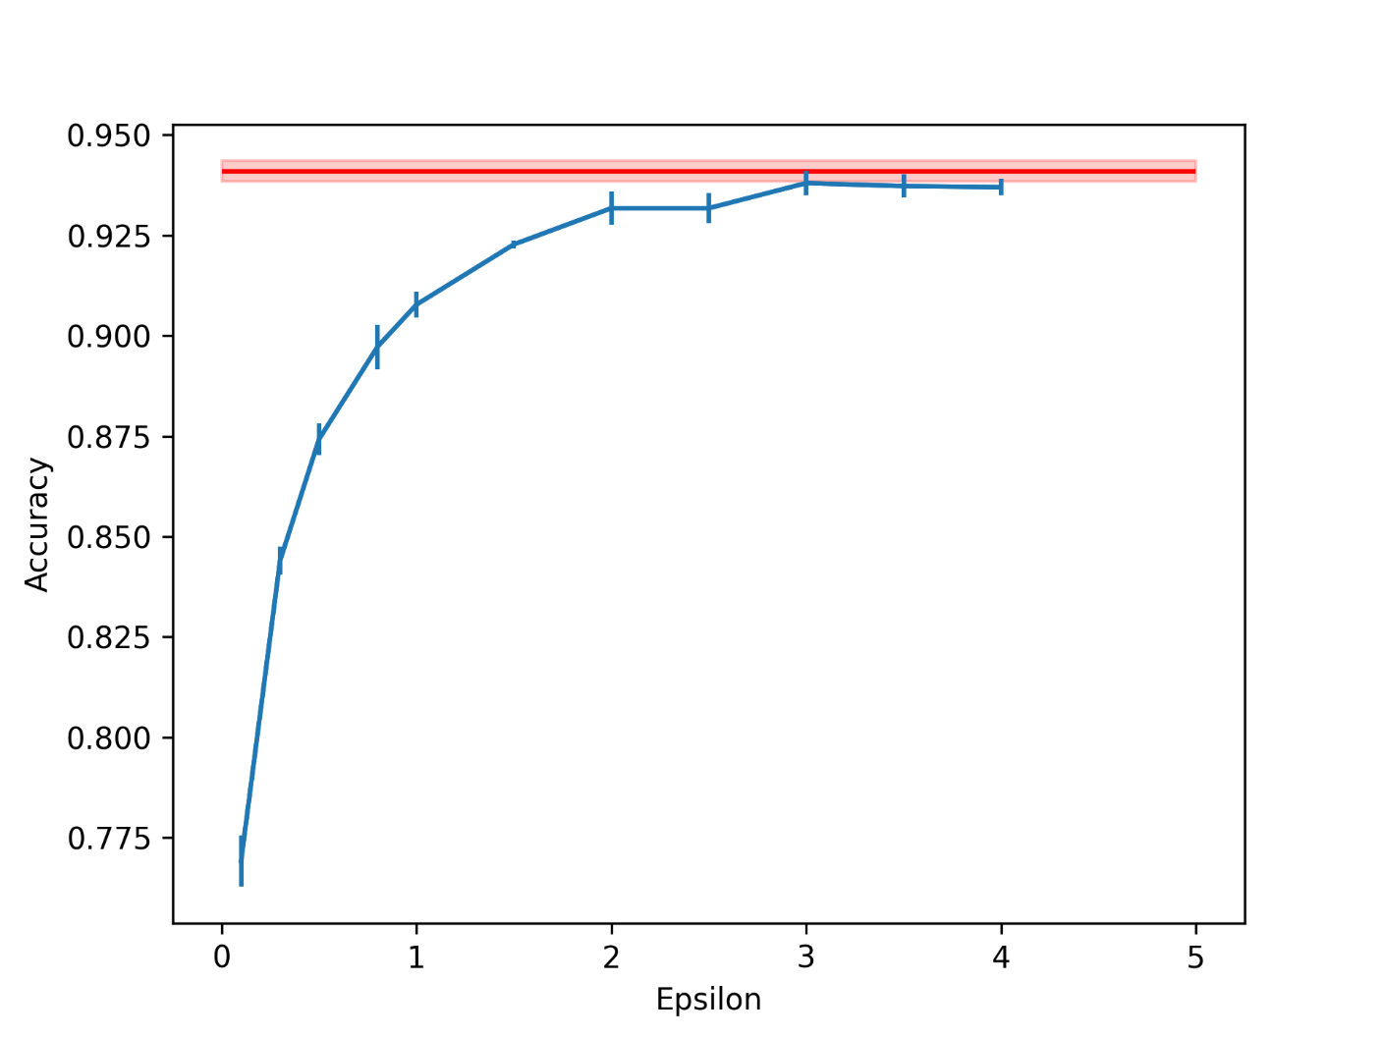
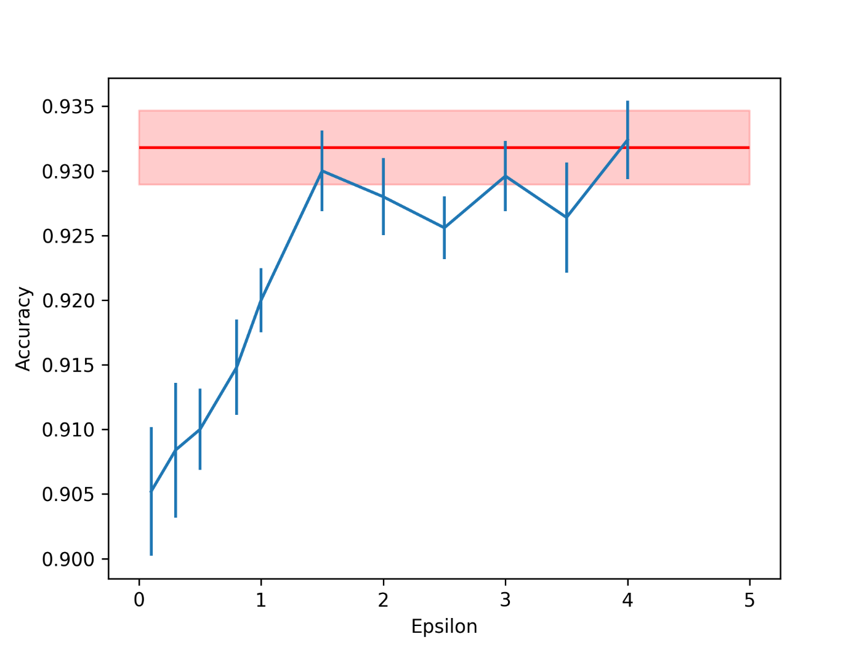
Input perturbation: binary text classification
Amazon Review Polarity
IMDB

Slide 17
Input perturbation: binary text classification
Amazon Review Polarity
IMDB

Slide 18
Input perturbation: binary text classification
On the Amazon dataset, the accuracy of the most privacy preserving technique is ~17% below the benchmark.
However, on the similar IMDB dataset, the accuracy of the most privacy preserving technique is less than 3% below the benchmark!

Slide 19
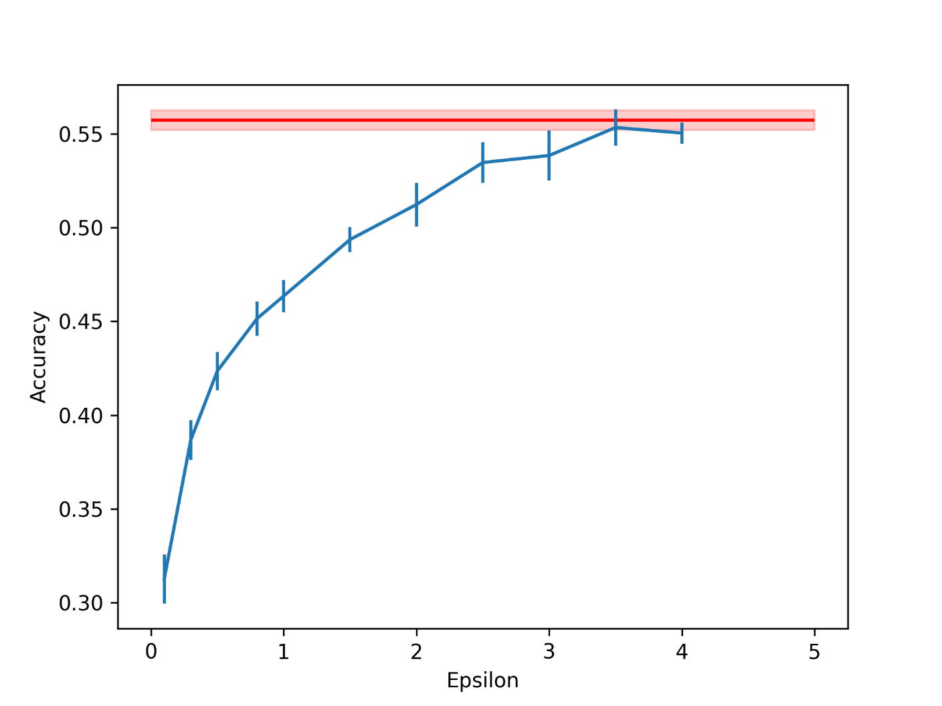
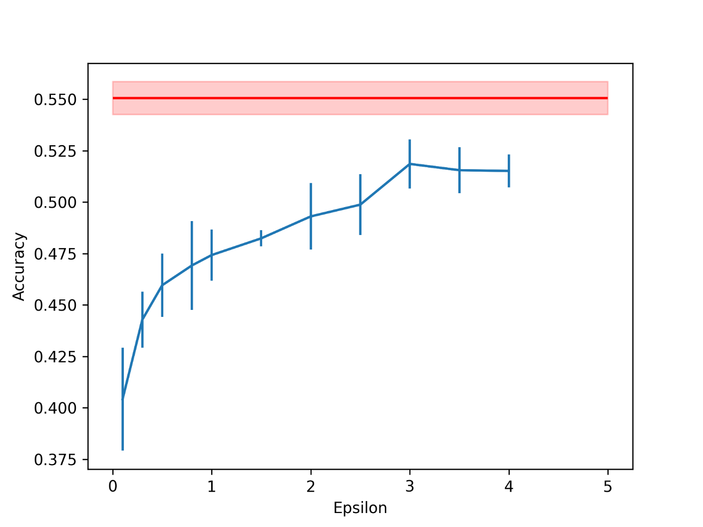
Input perturbation: multi-label text classification
Clinical Trials Reason to stop
Go Emotions

Slide 20
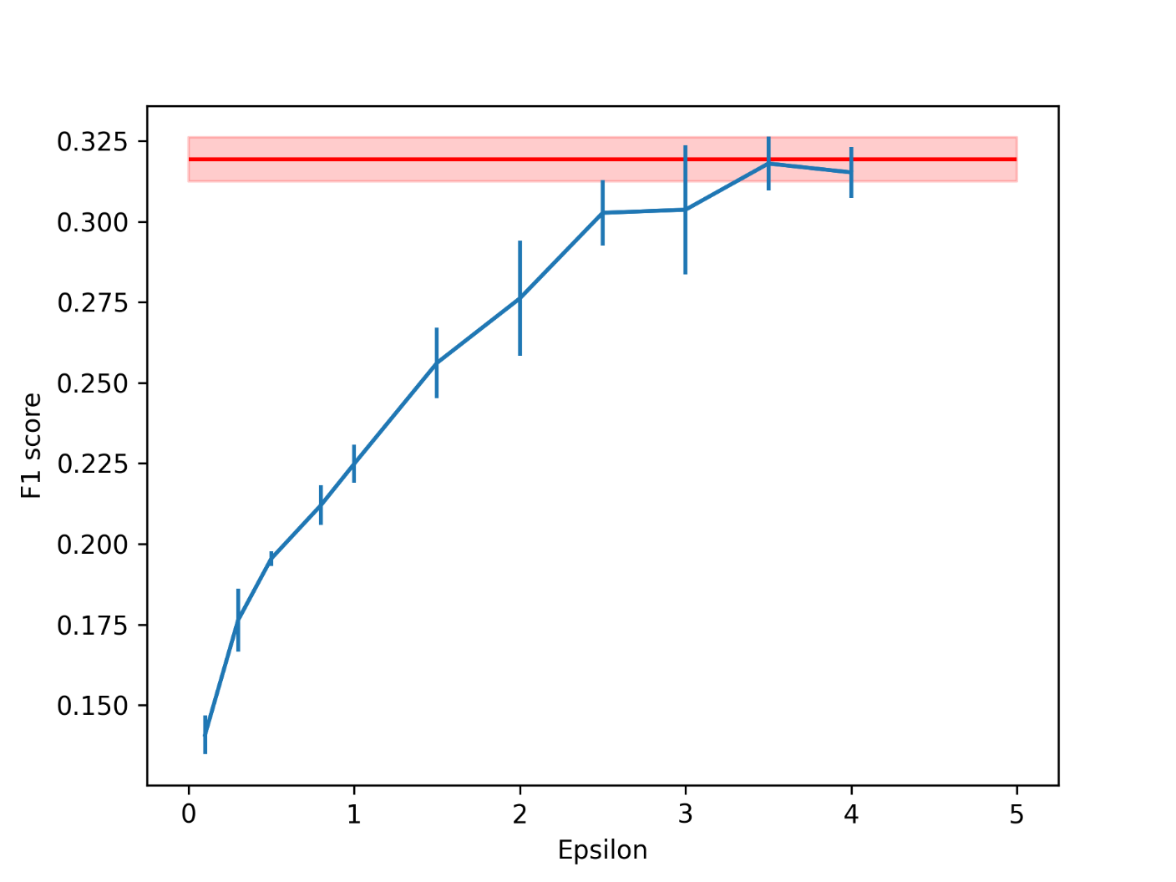
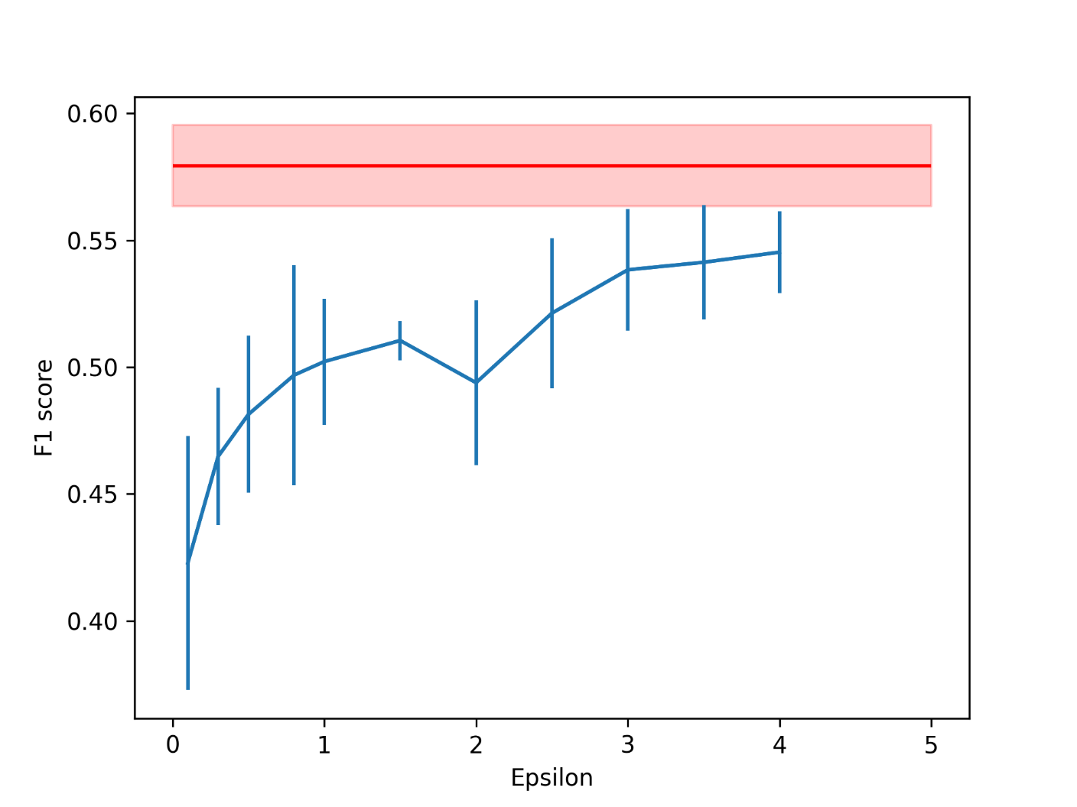
Input perturbation: multi-label text classification
Clinical Trials Reason to stop
Go Emotions

Slide 21
Layer perturbation: model pretraining
Very time and resource consuming.
Problems with convergence once reaching the loss plateau.
These problems seem to be endemic to our modified Lipschitz continuous architecture.
Changing model size, batch size or learning rate does not help.
The classical transformer architecture does not exhibit the same problems during pretraining.
Initializing some layers to pretrained weights also does not help.

Slide 22
Layer perturbation: Lipschitz constants of an encoder block
Weight initialization method | Sequence length = 512 | Sequence length = 128
Fully random | 1.02 | 1.01
Pretrained Feedforward weights | 1.55 | 1.54
Pretrained Attention Weights | 48.34 | 9.54
Pretrained Feedforward and Attention weights | 73.91 | 14.59
High Lipschitz constant implies worse privacy-utility tradeoff.
Constants close to 1 are ideal, as they also scale well with multiple layers.
Large constants are only sensible for models with very few layers.

Slide 23
Outline
1. Motivation
2. Research Questions
3. Methodology
4. Results
5. Conclusion

Slide 24
Conclusion
1.
DP-SGD only preserves privacy of training data, but not of the inference data.
2&3.
Input and layer perturbation methods are proven to ensure DP for inference data.
The performance after input perturbation depends a lot on the underlying dataset, and it is unclear what about the dataset matters.
Lipschitz continuous transformer architectures are much harder to pretrain than the classical ones.
Performance after layer perturbation depends a lot on the model weights but looks very promising in some cases.
If you are training a Foundation model from scratch and have ample resources, you can try augmenting it to be Lipschitz continuous and use layer perturbation.
If you don’t have the resources, input perturbation is much easier to implement, but gives potentially worse results.
4.

Slide 25
Future work
Further investigations into how datasets impact the performance after input perturbation.
How to effectively pretrain Lipschitz continuous models?
How large are the Lipschitz constants of effectively pretrained models? How can we further lower them?
Evaluations of layer perturbation for trained models.

Slide 26
BSc.
Jakob Zmrzlikar
17132
matthes@in.tum.de

Slide 27
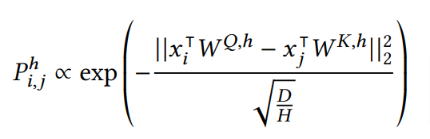
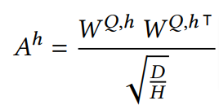
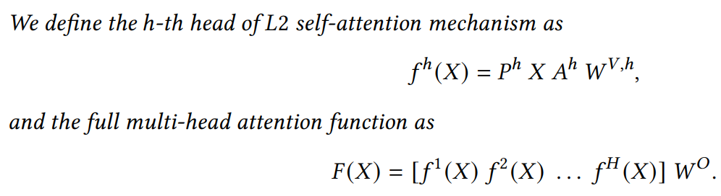
L2-Multihead Attention formulation

Slide 28
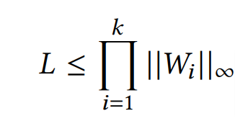
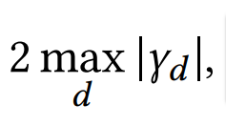
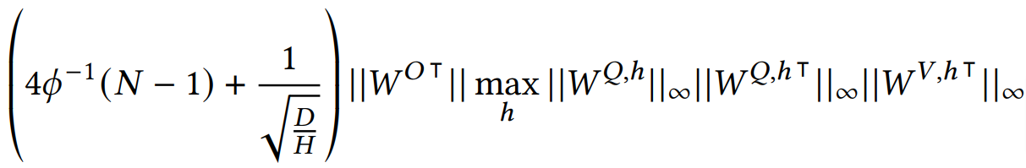

Lipschitz constant upper bounds for different layers
Fully-connected layer:
CenterNorm:
L2-Multihead Attention layer:
where
Vaswani et al. Attention Is All You Need. 2017

