Slide 1
Analyzing and Measuring Censorship and its Effects on the Ethereum Blockchain
08/05/2023, Kick-Off
Cristian Neufuss
Notes:
Welcome everybody to the kick-off presentation of my master thesis: “Analyzing and measuring censorship and its effects on the Ethereum Blockchain”

Slide 2
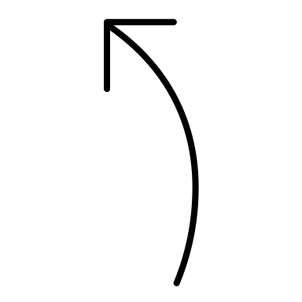
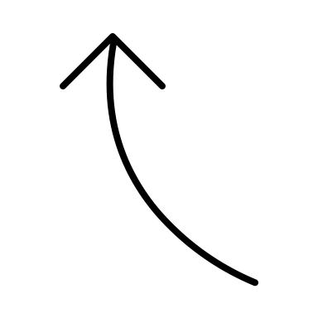
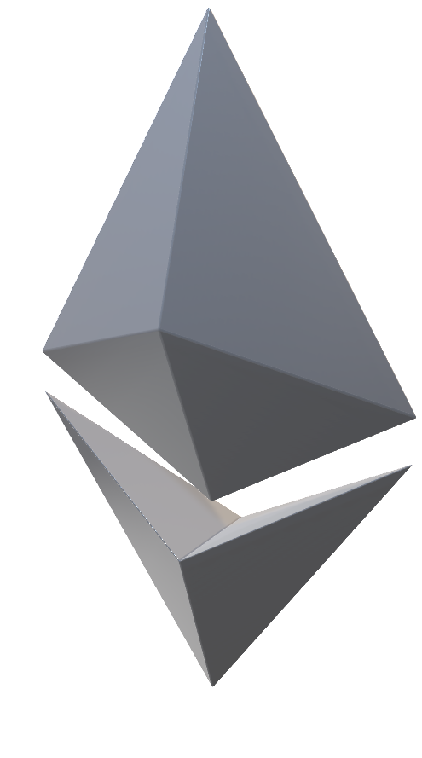
Outline
Introduction
Motivation
Research Questions
Methodology
Timeline
Notes:
I’ll start by introducing core concepts so you get a better idea what the work will be about as well as what motivated this topic THEN
Go over the research questions I defined
TALK about the methodology I planned to employ
AND FINALLY lay out the timeline I’m orienting myself on to successfully complete the thesis

Slide 3
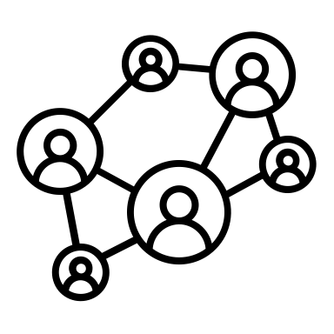
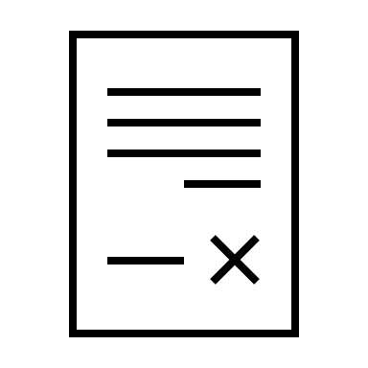




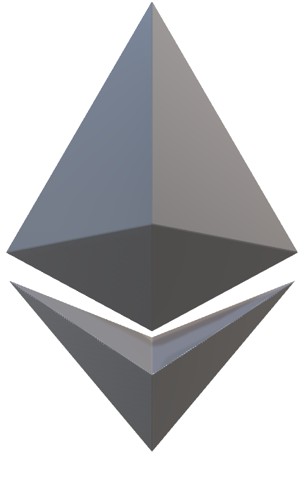
1. Introduction
Open-Source, Public, Decentralized and Permissionless
Blockchain Network with Smart Contract Capabilities
Turing Complete Programming Language
DeFi, NFTs, DAOs
FLOW DIAGRAM
Notes:
As you could guess from the title, my thesis revolves around the Ethereum Blockchain.
But what is a blockchain? In short, it’s a form of Distributed Ledger Technology that enables P2P record keeping. They come in numerous variations, the Ethereum Blockchain for one is OPEN-SOURCE, PUBLIC, DECENTRALIZED AND PERMISSIONLESS meaning that the transactions are publicly visible and anyone is free to join the network and transact, and there is no central authority governing the network.
UNLIKE the bitcoin blockchain, Ethereum is Turing-Complete which gave rise to a lot of program, so called “Smart Contracts” being deployed on it.
Most of those programs fall under the category of FINANCIAL applications called “Decentralized Finance” or “DeFi”, “Non-Fungible Tokens” or NFTS which represent collectibles and DAOs which stands for decentralized autonomous organizations which are communities that organize themselves using the Ethereum blockchain.

Slide 4
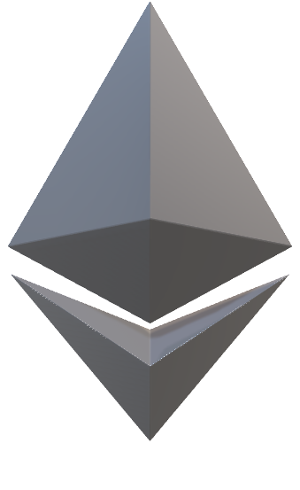
1. Introduction
$250+ Billion Market Cap [1]
228,600,000+ Unique Addresses [4]
~84% Validators Distributed among 10 countries [6]
Economic Metrics
Network Metrics
$31+ Billion Total Value Locked [2]
$8+ Billion Weekly Volume [3]
561,655 Active Validator Nodes [5]
~49% in the US alone [6]
[1] https://www.coingecko.com/en/coins/Ethereum, 18/04/2023
[2] https://defillama.com/chains, 18/04/2023
[3] https://defillama.com/dexs/chains, 18/04/2023
[4] https://etherscan.io/chart/address, 18/04/2023
[5] https://beaconcha.in/, 18/04/2023
[6] https://etherscan.io/nodetracker, 18/04/2023
Notes:
Some interesting metrics
It has grown significantly in recent years, with more than $8 billion dollars of weekly transaction volume and over 228 million address which can represent both users or smart contracts
There are more than half a million validator nodes that make up the network of which 84% are spread across 10 countries with a strong concentration in the US
About 49% nodes are located in the United States which is a number that should be reduced if you want to be more decentralized but yeah, that’s the state of the network as of April this year.
Now you’ve heard about Ethereum but how does transacting on it work and how can it be censored?

Slide 5



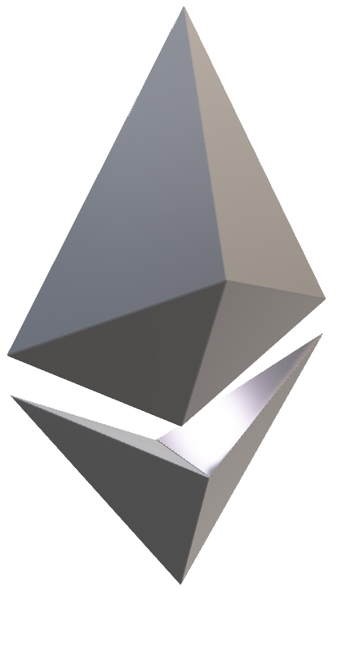
1. Introduction
Node
Node
Tx 1
Tx 2
.
.
Tx 1
Tx 2
.
.
Mempool
Mempool
Tx Broadcast
Tx Broadcast
Transaction Lifecycle:
A High Level Overview
Notes:
I’ll give you the high level overview, but if you want a more indepth analysis I recommend you visit the lecture ”Blockchain-based System Engineering” by Prof. Matthes
In Ethereum, Users can transact with another user or with a smart contract.
In both cases, they create a transaction that is broadcasted to the rest of the network

Slide 6

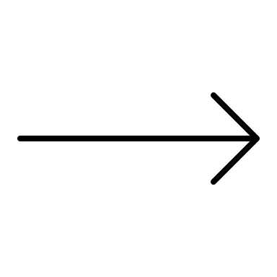
1. Introduction
Tx Broadcast
Tx Broadcast
Node
Node
Tx 1
Tx 2
.
.
Tx 1
Tx 2
.
.
Mempool
Mempool
Transaction Lifecycle:
A High Level Overview
Tx 1
Tx 2
.
.
Block Proposer
Mempool
Proposes Block
Ethereum Blockchain
Selects txs to include
Notes:
This lands in a pool of pending transactions, the so called “Mempool”.

Slide 7
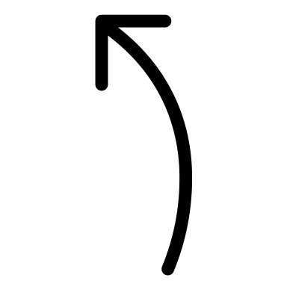
1. Introduction
Economic Metrics
Network Metrics
Tx Broadcast
Tx Broadcast
Node
Node
Tx 1
Tx 2
.
.
Tx 1
Tx 2
.
.
Mempool
Mempool
Transaction Lifecycle:
A High Level Overview
Block Proposer
Tx 1
Tx 2
.
.
Mempool
Selects Txs to include
Proposes Block
Ethereum Blockchain
Notes:
Out of all the nodes, the Ethereum protocol randomly selects one node to propose the next block
The block proposer then has the power to choose which transactions to include and which not to include in its block and it’s exactly here that censoring is made possible

Slide 8

1. Introduction
Economic Metrics
Network Metrics
Tx Broadcast
Tx Broadcast
Node
Node
Tx 1
Tx 2
.
.
Tx 1
Tx 2
.
.
Mempool
Mempool
Transaction Lifecycle:
A High Level Overview
Block Proposer
Tx 1
Tx 2
.
.
Mempool
Proposes Block
Ethereum Blockchain
Selects Txs to include
Notes:
They publish the block to the network and all other nodes add it on top of the previous chain of blocks which represent the world state of the network.
Once a transaction was included in a block it has “officially” been executed.
Again this is very simplified description and if you want a more detailed explanation I highly recommend the lecture.

Slide 9
Outline
Introduction
Motivation
Research Questions
Methodology
Timeline
Notes:
Okay so what motivated this topic?

Slide 10


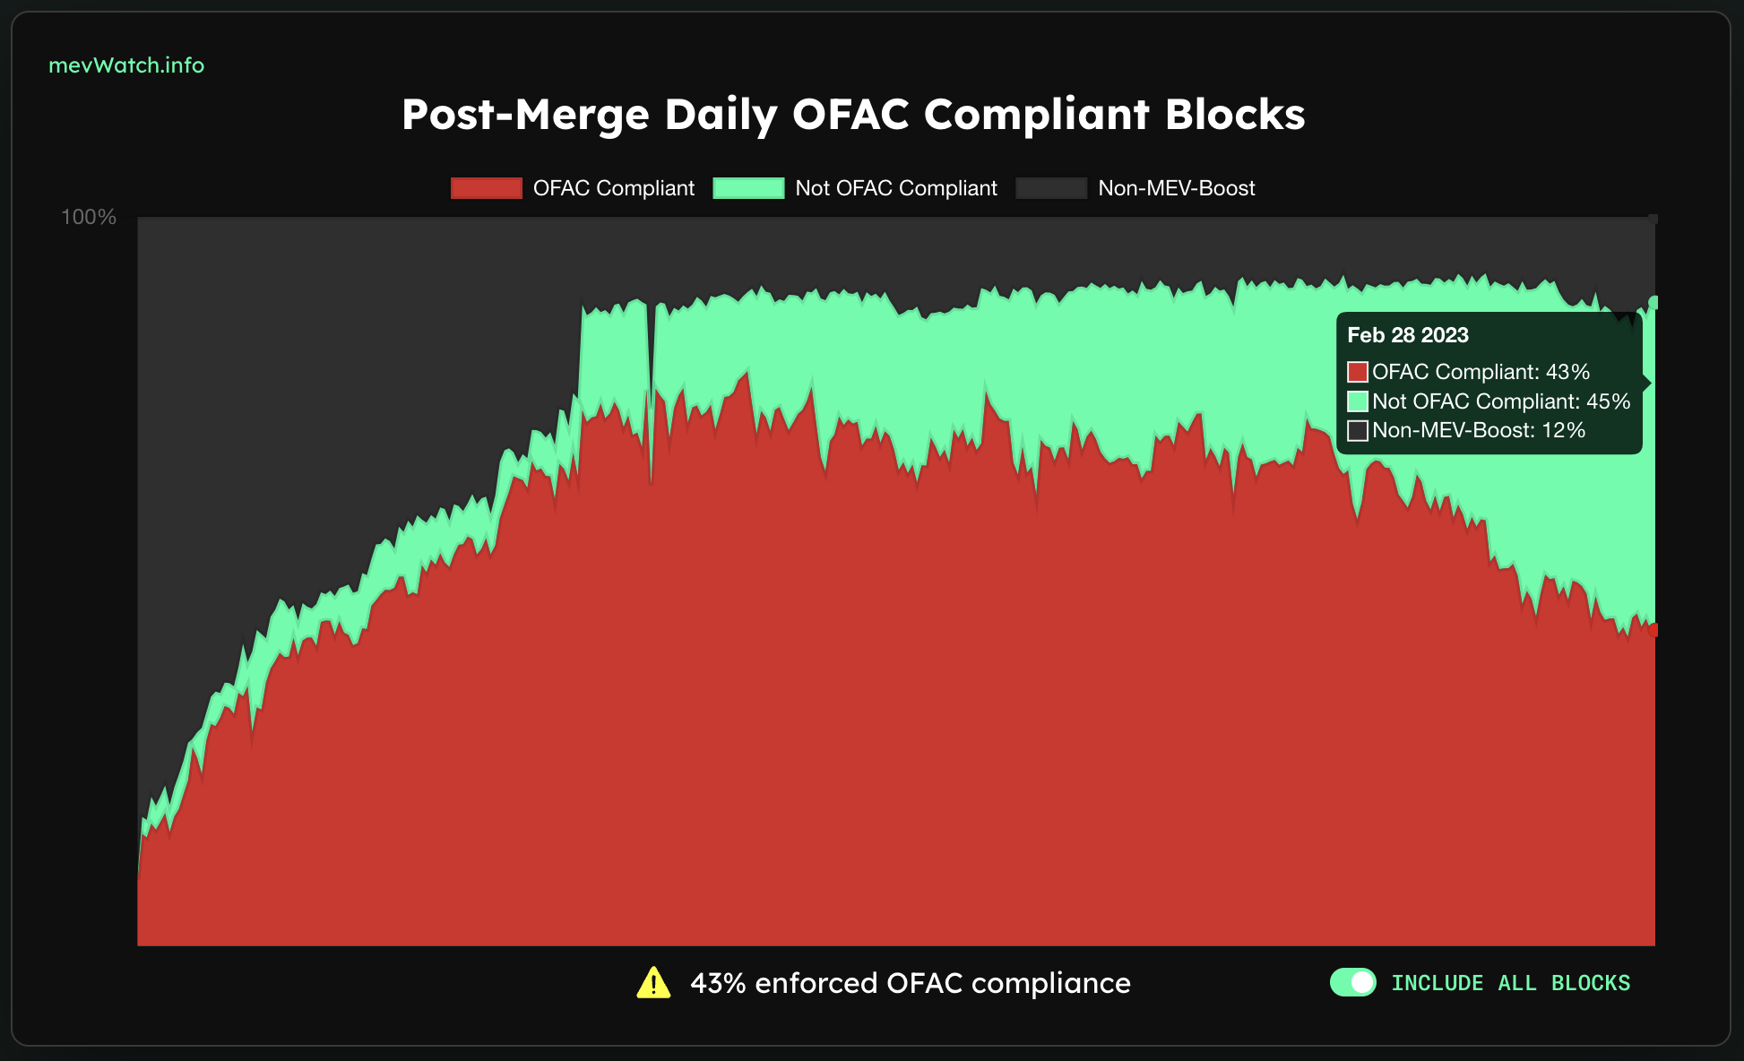
2. Motivation
8th August 2022: Office of Foreign Asset Control (OFAC) sanctions Tornado Cash
Tornado Cash is a mixer service on Ethereum, which severs the connection between sender & receiver of funds, enabling transaction privacy.
Ethereum infrastructure providers residing in the US had to comply with OFAC sanctions. Transaction to Tornado Cash were hence filtered out by them.
→ Access to Tornado Cash became more difficult for technically inexperienced users
[2]
[1]
Non-censoring
Censoring
[1] https://de.wikipedia.org/wiki/Office_of_Foreign_Assets_Control
[2] https://logowik.com/tornado-cash-torn-logo-vector-8481.html
Notes:
The motivation for this thesis came from an event that took place in August of 2022: The Office of Foreign Asset Control or OFAC for short, which is an agency of the U.S. Department of the Treasury sanctioned Tornado Cash.
Tornado Cash is a so called “mixer service” on Ethereum. I won’t go into detail but in essence, Tornado Cash allows users to deposit their assets into a pool with other users' funds, and then receive an equivalent amount of "anonymized" assets from the pool. This makes it difficult for outside observers to trace the flow of funds through the blockchain, which can help protect users' privacy and security.
As a consequence of the sanction, many Ethereum infrastructure providers residing in the US had to comply and filter out txs associated with Tornado Cash. Remember that number of 49% nodes residing in the US? Yes, this became a big attack vector for the network.
Tornado Cash is still operating just fine, but for users in the US it became a bit trickier to accss it.
In the diagram to the right we can see a statistic of blocks produced since then.
I need to explain that in reality, the majority of blocks are built in an external market by dedicated block builders. The block proposer just picks a block from it to propose. Only a minority of block proposers actually build their own blocks. Why this is the case is not of importance for this presentation.
So the colored areas represent those blocks built by the external market of which the red area are OFAC compliant, so censoring blocks and green non-censoring blocks. Black represents the blocks built by block proposers themselves.
As you can notice, non OFAC compliant blocks have increased in the past months which could be a result of more nodes outside of the US coming online or the communities effort to use non-censoring nodes

Slide 11

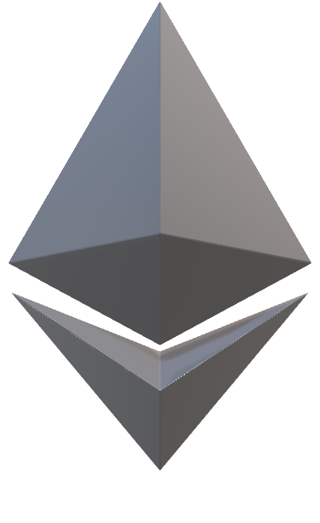
2. Motivation
Core Values
Problem
How Censorship Resistant is Ethereum?
Def: Ability of the network to operate without being subject to censorship by a central authority
Permissionlessness and Decentralization are core values and the premise of Ethereum
No Censorship Resistance
→ No freedom of transaction
→ Credible Neutrality compromised
→ Failed its goal?
Permissionless
Decentralized
Transparent
Neutral
Notes:
So why was this incident problematic for Etherum?
Well its core values have always been to be this permissionless, decentralized, transparent and neutral network that isn’t controlled by any one entity.
This incident with OFAC however has raised doubts about the decentralization and neutrality property of Ethereum and raised the question How censorship resistant Ethereum really is?
Because WITHOUT censorship resistance, there is no guarantee of freedom of transactions which in turns means that its credibility of being neutral has been compromised and failed its goal
With Censorship Resistant in the context of Ethereum I mean the ability of the network to operate without being subject to censorship by a central authority.

Slide 12
Outline
Introduction
Motivation
Research Questions
Methodology
Timeline
Notes:
- This is the topic that I will analyze which brings me to the defined Research Questions for this thesis

Slide 13
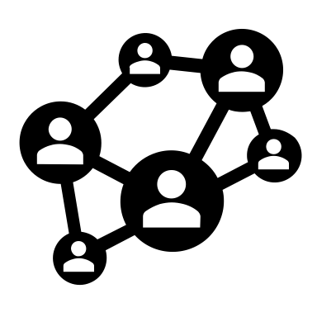





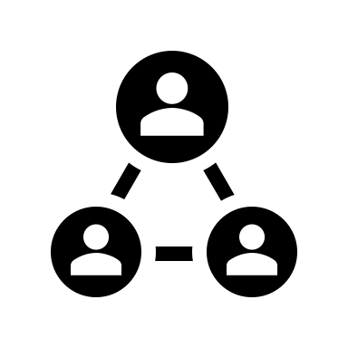
RQ1: How Much Censorship Occurs On Ethereum?
Motivation
Research Goals
Core value of Ethereum: permissionless, decentralized network
What and who is getting censored?
Failure of values if high degree of censorship exists
Measure amount of transactions being censored
Community interest in amount of censoring and by whom?
How much do the different participants in the network censor?
Notes:
Dictionary of proposed blocks where we inc count if censored or not censored as we can see each role involved (builders/relayers/validators)
-
The first research question is “How much censorship occurs on Ethereum?”
The motivation for this was just mentioned: censorship goes against the core values of Ethereum and of course there is general interest to know how severe the problem is.
The concrete goals are to find out:
What and who is getting censored?
The amount of transactions being censored?
How much do the different participants in the network censor?

Slide 14



RQ2: How Effective Is Censorship On Ethereum?
Motivation
Research Goals
Understand transaction censorship by network participants
Measure expected delay based on total percentage of censoring nodes
Gain insights on degree and means of censoring sanctioned transactions
Notes:
The second research question is “ How EFFECTIVE is censorship on Ethereum?”
There are different roles in the block building process. The motivation for this is to understand how much each one of them, CAN censor.
It’s important to make the distinction between hard censorship, which comes in the form of all out denial of service for the censored party or soft censorship that occurs when a block proposer doesn’t include your transaction but eventually some other block proposer will, resulting in a worsened UX because of the delay.
So, the goals are to explore the different network participants ability to delay or deny transactions to understand the degree of possible censorship, and measure expected delay based on total percentage of censoring to understand the UX implications of censorship.

Slide 15

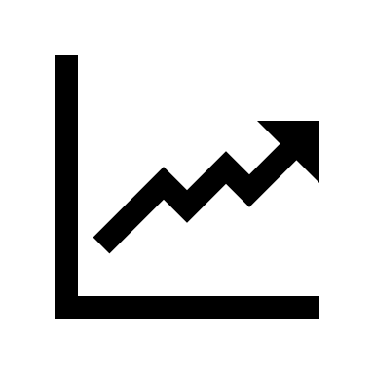




RQ3: What Is The Profit Difference Between Non-Censoring And Censoring Network Participants On Ethereum?
Motivation
Research Goals
Encourage adoption of profitable strategies and discourage unprofitable ones
Determine most profitable approach
Results will benefit the wider community and block builders
Determine whether joining a MEV marketplace makes a difference
Estimate costs of free and censored transaction flow
Notes:
The first motivation point is just interesting for MEV-Boost participants, the listener won’t understand why this should be interesting from a network/user perspective
→ I’d have to explain the MEV scene in some way
Not sure if results will benefit the wider community: case Profit(censoring) > Profit(non-censoring) -> more censoring = bad ?
The second research goal again requires presenting MEV
Explain it: talk about block building
--------------------------------------------------------------
The third Research Question is “What is the profit difference between non-censoring and censoring network participants on Ethereum?”
This RQ looks at the economic side of this issue.
The aforementioned block builders, those that operate in the external market, are economically driven when they build blocks.
They are dependent on the block proposer to accept their block to earn rewards.
So when you have a group of censoring and non-censoring block proposers of which one is randolmy chosen to be the next proposer, what is the optimal strategy for the block builder becomes a game theoretic problem.
The Results of this RQ would benefit block builders as they could adopt the more profitable one and the wider community because:
Assuming non-censoring is more profitable: Then the community could rely that over longer period of time the nodes would switch to the more profitable one to stay competitive
And in the case that censoring is more profitable: the community would understand why it is more profitable and what can be done to change that.

Slide 16




RQ4: Can Censorship Be Mitigated?
Motivation
Research Goals
Many design solutions exists to combat censorship on Ethereum but which are not yet implemented
What solutions are currently available to prevent transaction censorship?
Assess the effectiveness of solutions in preventing different degrees of censorship
Unclear to users that want/require transactional freedom whether Ethereum can provide this
Notes:
Present this as a future work: because the goal isnt to develop a solution but understand the current state and understand the core problems.
----------
After we have analyzed and understood the dynamics of censorship, we can then investigate how effective present design solutions are to combat these challenges.
This will take the form of more of a theoretic analysis rather than empirical as many solutions are still work in progress.
In present time it is still unclear for a person that wants transactional freedom whether
Ethereum can guarantee that there isn’t a censorship risk and with the results of this RQ I hope to give at the very least an outlook on this matter.

Slide 17
Outline
Introduction
Motivation
Research Questions
Methodology
Timeline
Notes:
And how do I plan to work on these research questions?

Slide 18





Methodology
+
Blockchain Monitoring
&
Data Analysis
Montior known censored addresses
Monitor mempool for tx staying longer than usual
Gather data of blocks proposed by censoring and non-censoring parties
Literature Review
Research methods to identify censoring entities
Research solutions to combat censorship
Empirical Testing
Measure inclusion time of transactions to censored addresses
Evaluate data based on various metrics
RQ 1
RQ 4
RQ 1
RQ 2
RQ 3
RQ 2
Notes:
The methodology I will employ are
Literature Review: I will research methods to identitfy censoring entities, and research solutions to combat censorship
Second: Blockchain monitoring and Data Analysis. As all transactions are public, I can easily monitor known censored addresses to estimate their average waiting time, which validators don’t include their txs and so on..
I can monitor the mempool to observe txs that stay longer there than usual. This could lead me to discover more censored addresses. And furthermore I will conduct a proposed block study of both censoring and non-censoring block proposers to gather data on profitability
Lastly, through means of empirical testing I will measure inclusion time of txs to censored addresses and evaluate the data based on metrics that accounts for various factors that goes into including a transaction or not
(Think fees, latency of a tx etc.)
Which RQs are addressed by which methodology

Slide 19
Outline
Introduction
Motivation
Research Questions
Methodology
Timeline
Notes:
For the 6 months of working time, I broke the tasks up in the following way

Slide 20
Timeline
March | April | May | June | July | August | Sept. | October
Literature Review
RQ1: Amount Of Censorship
RQ2: Effectiveness of Censorship
RQ3: Which practice is more profitable
RQ4: Can Censorship Be Prevented
Finish writing Background
Revision of thesis
Create Presentation
Registration
15/04/2023
Kick-Off
08/05/2023
Submission
15/10/2023
Notes:
The Literature Review I already started in the months leading up to deciding on the topic of this thesis. Whenever there is the need to research something more deeply during these 6 monts I will make use of this.
RQ1 which most likely will require the most work, I will start first and try to both complete AND finish writing about it by the end of June.
RQ1 is a good transition to RQ2 as I will already be monitoring blockchain data and conducting a Data Analysis so that reseraching the effectiveness of censorship shouldn’t require a lot of setting up. I plan to complete this mid July.
I follow this up with RQ3 and RQ4 which I want to finish by end of July and August respectively.
By end of August I will also start writing the Background chapters of my thesis and I estimate that this will require about a month as there is a lot of material to cover.
In the first two weeks of October I will revise the thesis and create my presentation to submit on the 15th of October.

Slide 21
B.Sc.
Cristian Neufuss
Master‘s Student Informatics
cristian.neufuss@tum.de
17132
Notes:
And that was my kickoff presentation. If you have any questions, I’d be happy to answer them.

