Slide 1
Analyzing and Measuring Censorship and its Effects on the Ethereum Blockchain
27.11.2023, Final Master’s Presentation
Cristian Neufuss
Notes:
Welcome everybody to the final presentation of my master thesis: “Analyzing and measuring censorship and its effects on the Ethereum Blockchain”

Slide 2



Outline
Introduction
Research Questions
Methodology
Results
Conclusion
Limitations & Future Work

Slide 3




Introduction
[1]
Neutral?
8th August 2022: Office of Foreign Asset Control (OFAC) sanctions Tornado Cash
Ethereum infrastructure providers residing in the US had to comply with OFAC sanctions. Transaction to Tornado Cash were hence filtered out by them.
→ Access to Tornado Cash became more difficult for technically inexperienced users
Decentralized?
Censorship-Free?
Public Blockchain with Smart Contract capabilities
Permissionless
Transparent
Decentralized
Neutral
Censoring
[1] https://de.wikipedia.org/wiki/Office_of_Foreign_Assets_Control

Slide 4
Research Questions
Research Question 1
Research Question 2
Research Question 3
Research Question 4
Is there a profit difference between non-censoring and censoring network participants?
How much Censorship occurs on Ethereum?
How effectivte is Censorship on Ethereum?
Can Censorship be mitigated?

Slide 5
Methodology
Novel Censorship Classification Framework
Transaction Traffic Monitoring
Novel Inclusion Delay Metric
Literature Review
RQ 1
RQ 1
RQ 3
RQ 2
RQ 4
Notes:
Four our methodology, we came up with a novel censorship classification framework to identify and measure the amount of censorship.
We build a transaction traffic monitoring system to help measure both the amount and profitability of censoring.
We derived a novel inclusion delay metric to measure how effective censorship is.
And conducted a literature review to investigate if censorship can be mitigated.

Slide 6
Methodology
Defining Censorship
Network Level?
Block Proposal Level?
Smart Contract Level?
Excluding Transactions from Blocks
Denial-Of-Service
Attacks on Nodes
Blacklisting Addresses
Notes:
- As a first step we had to first define what censorship in the context of Ethereum actually looks like
- It turns out that censorship can occur on various levels:
- On the network level
- On the Block Proposal level
- or on the smart contract level

Slide 7
Methodology
Defining Censorship
Network Level
Block Proposal Level
Smart Contract Level
We focused on the block proposal level as it’s measurable by us and better reflects the censorship transactions might face

Slide 8




Methodology
Defining Censorship
Censorship in the Block Proposal Process
Def: “The intentional exclusion of any valid transaction t from a block b for reasons other than economic ones.”
Block Proposer
Tx 1
Tx 2
Tx t .
Tx t Broadcast
Selects Txs to include
Mempool
Ethereum Blockchain
Block b
Tx t
Notes:
- Illustrated is the typical lifecycle of a transaction and the block proposal process
- explain

Slide 9


Methodology
Defining Censorship
Censorship in the Block Proposal Process
Def: “The intentional exclusion of any valid transaction t from a block b for reasons other than economic ones.”
Block Proposer
Tx 1
Tx 2
Tx t .
Tx t Broadcast
Selects Txs to include
Mempool
Ethereum Blockchain
Block b
Tx t
Notes:
- On the level of the block proposal process, we define censorship as..

Slide 10
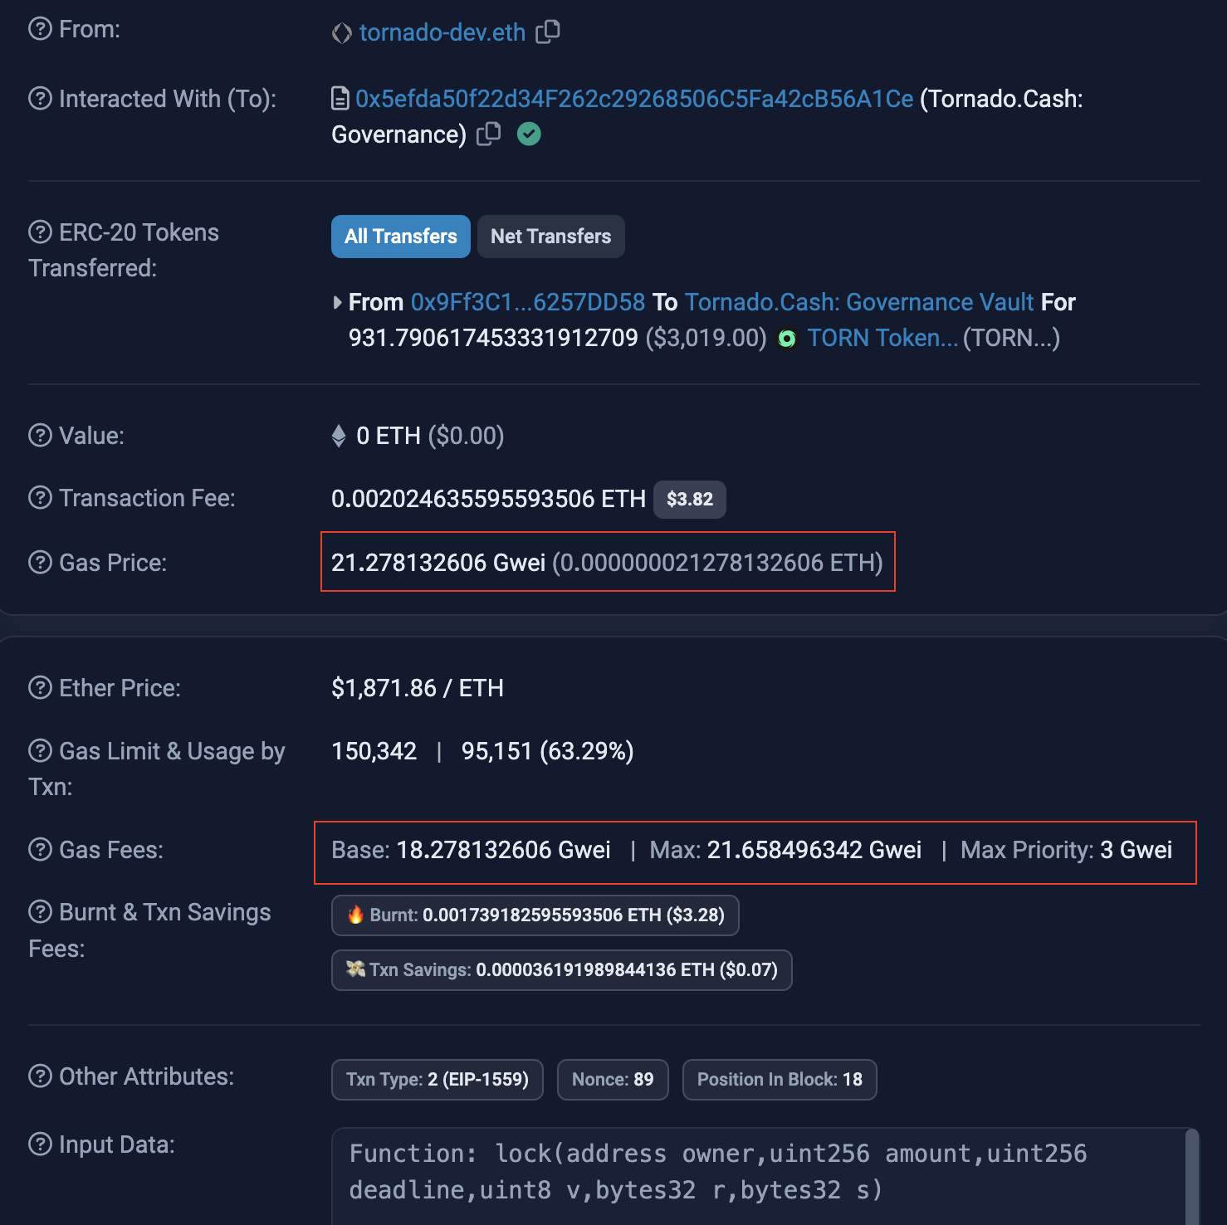
Methodology
Defining Censorship
Economic rational block builders include transactions based on the reward they receive
Prioritize transactions based on priority fee
Excluding a transaction with a higher priority fee than the included transactions is economically irrational → Possibly a case of censorship
Example of the data contained in a transaction. Block proposers receive the priority fee as reward for including a transaction.
Source: https://etherscan.io/tx/0x51ca2da5cd7c98474d1043343b49e49186564efa341443a8f0aee89fcce81c0f
Notes:
- To understand the economical rational angle, you need to know that every transacions has to pay a minimum fee, called the "base fee" to be included in a block
- But optionally they can pay a priority fee which will go directly to the block proposer if they include them
- So naturally, an economically rational block proposer would include transactions based on their priority fee
- Censorship however can cause them to act in a economic irrational way and this is the core idea our framework revolves around: - we try to reason if the exclusion of a transaction can be economically justified or if it really was an instance of intentional exclusion i.e. censorship.

Slide 11
Methodology
Censorship Classification Framework: Transaction Rank
We rank an excluded sanctioned transaction based on their priority fee rank within a block. One of the following scenarios can occur:
Block
[ 0 ]:
[ 1 ]:
.
.
.
.
.
.
.
.
[n-1]:
[ n ]:
Transaction 0
Transaction i + 1
.
.
.
.
.
.
Transaction n - 1
Priority Fee
Transaction n
Notes:
To help us reason better, we compare the priority fee of an excluded transaction with those of the included transactions and assign it a rank class.

Slide 12
Methodology
Censorship Classification Framework: Transaction Rank
We categorize a transaction based on their priority fee rank within a block. One of the following scenarios can occur:
Scenario 1 (S1): Transaction has the highest priority fee within the block
Block
[ 0 ]:
[ 1 ]:
.
.
.
.
.
.
.
.
[n-1]:
[ n ]:
Transaction 0
Transaction i + 1
.
.
.
.
.
.
Transaction n - 1
Priority Fee
Transaction n

Slide 13
Methodology
Censorship Classification Framework: Transaction Rank
We categorize a transaction based on their priority fee rank within a block. One of the following scenarios can occur:
Scenario 1 (S1)
Scenario 2 (S2): Transaction offers neither the highest, nor the lowest priority fee.
Block
[ 0 ]:
[ 1 ]:
.
.
.
.
.
.
.
.
[n-1]:
[ n ]:
Transaction 0
Transaction i + 1
.
.
.
.
.
.
Transaction n - 1
Priority Fee
Transaction n

Slide 14
Methodology
Censorship Classification Framework: Transaction Rank
We categorize a transaction based on their priority fee rank within a block. One of the following scenarios can occur:
Scenario 1 (S1)
Scenario 2 (S2)
Scenario 3 (S3): Transaction offers the lowest priority fee.
Block
[ 0 ]:
[ 1 ]:
.
.
.
.
.
.
.
.
[n-1]:
[ n ]:
Transaction 0
Transaction i + 1
.
.
.
.
.
.
Transaction n - 1
Priority Fee
Transaction n

Slide 15
Methodology
Censorship Classification Framework: Transaction Rank
We categorize a transaction based on their priority fee rank within a block. One of the following scenarios can occur:
Scenario 1 (S1)
Scenario 2 (S2)
Scenario 3 (S3)
Scenario 4 (S4): Transaction is invalid because it failed to pay the base fee for inclusion.
Block
[ 0 ]:
[ 1 ]:
.
.
.
.
.
.
.
.
[n-1]:
[ n ]:
Transaction 0
Transaction i + 1
.
.
.
.
.
.
Transaction n - 1
Priority Fee
Transaction n

Slide 16
Methodology
Censorship Classification Framework: Transaction Rank
We categorize a transaction based on their priority fee rank within a block. One of the following scenarios can occur:
Scenario 1 (S1)
Scenario 2 (S2) → break apart into:
Scenario S2 + Top Transaction is ranked among the upper third
Scenario 3 (S3)
Scenario 4(S4)
Block
[ 0 ]:
[ 1 ]:
.
.
.
.
.
.
.
.
[n-1]:
[ n ]:
Transaction 0
Transaction i +1
.
.
.
.
.
.
Transaction n - 1
Transaction i + 1
Priority Fee
Transaction n
Notes:
S2 as it is is too broad, so we break it further apart into

Slide 17
Methodology
Censorship Classification Framework: Transaction Rank
We categorize a transaction based on their priority fee rank within a block. One of the following scenarios can occur:
Scenario 1 (S1)
Scenario 2 (S2) → break apart into:
Scenario S2 + Top
Scenario S2 + Mid Transaction is ranked among the middle third
Scenario 3 (S3)
Scenario 4 (S4)
Block
[ 0 ]:
[ 1 ]:
.
.
.
.
.
.
.
.
[n-1]:
[ n ]:
Transaction 0
Transaction i + 1
.
.
.
.
.
.
Transaction n - 1
.
.
.
.
Priority Fee
Transaction n

Slide 18
Methodology
Censorship Classification Framework: Transaction Rank
We categorize a transaction based on their priority fee rank within a block. One of the following scenarios can occur:
Scenario 1 (S1)
Scenario 2 (S2) → break apart into:
Scenario S2 + Top
Scenario S2 + Mid
Scenario S2 + Bot Transaction is ranked among the bottom third
Scenario 3 (S3)
Scenario 4 (S4)
Block
[ 0 ]:
[ 1 ]:
.
.
.
.
.
.
.
.
[n-1]:
[ n ]:
Transaction 0
Transaction i + 1
.
.
.
.
.
.
Transaction n - 1
Priority Fee
Transaction n - 1
Transaction n

Slide 19
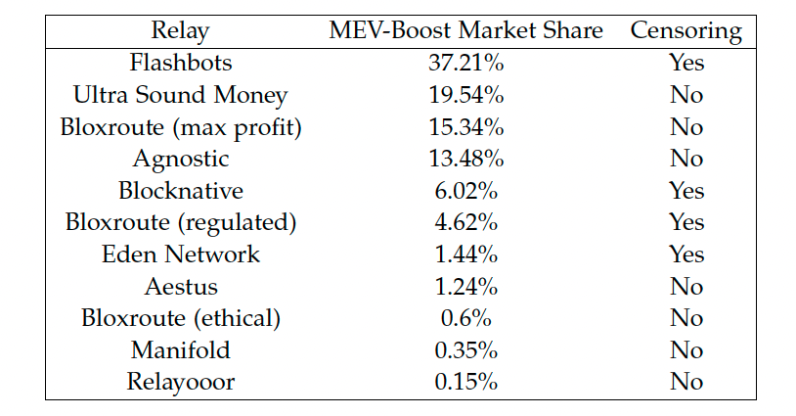

Methodology
Censorship Classification Framework: Block Production Method
Standard way of producing blocks: Validators build blocks themselves (”Vanilla”)
More popular: third-party auctioning market “MEV-Boost”
Builders sent block payloads together with a bid to Relays, which forward it to Validators who includes the highest bidding payload in their block
Every Relay has its own censorship policy
We leverage a community maintained dashboard¹ on GitHub for the censoring policy of the different Relays → Use censoring policy information for more accurate censorship classification
Overview of the different relays and their censoring policy.
Marketshare data was taken from Rated Network², 14.09.2023
¹ https://github.com/eth-educators/ethstaker-guides/blob/main/MEV-relay-list.md
² https://www.rated.network/relays?network=mainnet&timeWindow=all
Notes:
- Next factor we have to consider is the block production method
- Standard way of producing
- But, as it turns out the majority of blocks is produced through a third-party auctioning market called “MEV-Boost”
- We already heard some presentations on MEV, but to quickly recap, MEV is an additional form of revenue block builders can earn by exploiting the ordering of transactions in a specific way
- In MEV-Boost the content of the blocks are built by so called Builders, while the actual block proposer just chooses the block of the highest bidding Builder to propose.
- Central to MEV-Boost are the relays who connect Builders and Block proposers.
- Those relays are operated by different organizations, some of which reside in the US and each has their own policy regarding OFAC compliance and will filter out blocks by builders containing sanctioned transactions
- We leverage this information to more accurately classify instances of censorship

Slide 20
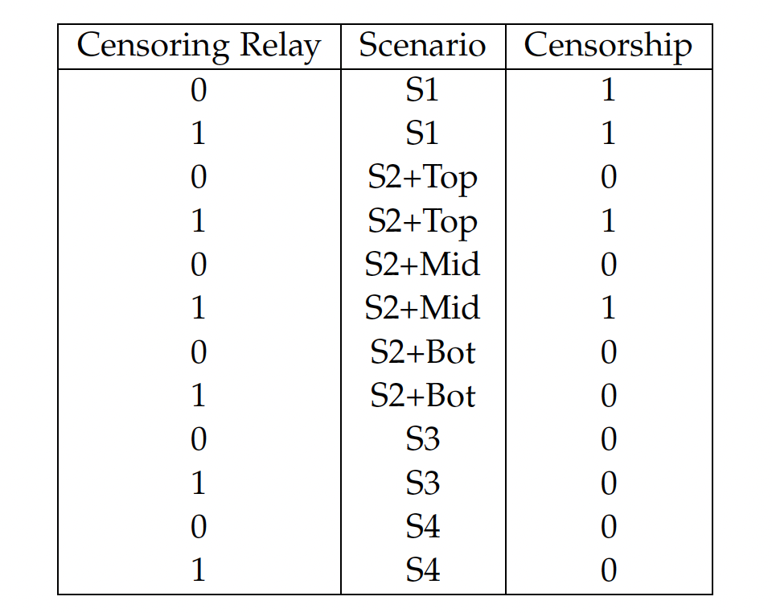
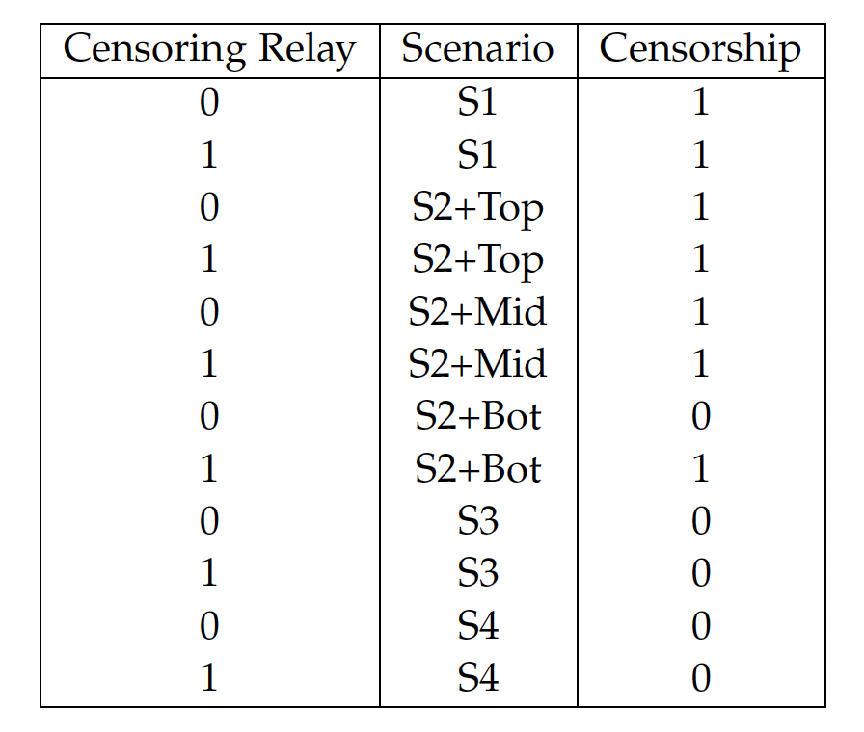
Methodology
Censorship Classification Framework: Classification Criteria
Censorship Strict
Censorship Non-Strict
Notes:
- This brings us to our censorship classification criteria itself with which we reason on a case-by-case basis whether the exclusion of a transaction was economically justified or censorship which differentiates us from other approaches
- We come up with two metrics, Censorship Strict where we classify something as censorship only if we have high confidence
- and Censorship Non-Strict for instances of possible censorship but where we have less confidence compared to the strict version
- What you see in the tables are the criteria for MEV-Boost blocks

Slide 21
Methodology
Censorship Classification Framework: Classification Criteria
Censorship Strict
Censorship Non-Strict
Notes:
- For instance, if a transaction would have paid the highest priority fee, so it’s ranked S1, it is obviously economically irrational to exclude it and we classify it as censorship
-the highlighted rows are where censorship strict and non-strict differ
- for example when a transaction is ranked S2+Top, so it’s in the top 33% we do not classify it as censorship if the relay involved is not censoring because the builder that submitted the payload to this relay would have no reason to censor so we give it the benefit of the doubt while in the non-strict version we count it as censorship regardless

Slide 22
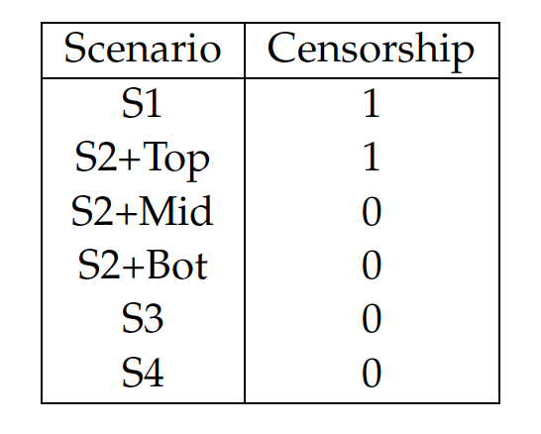
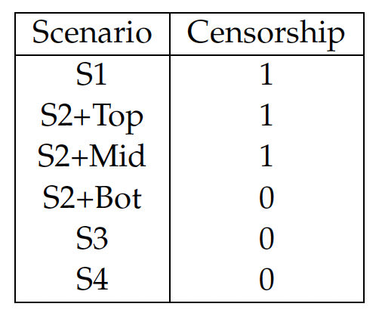
Methodology
Censorship Classification Framework: Classification Criteria
Censorship Strict
Censorship Non-Strict
Notes:
- For vanilla blocks we don’t have the additional relay information but the criteria nearly identical

Slide 23


Methodology
Monitoring System Set-Up
Monitoring Component
Tracks transaction activity of addresses on OFAC’s SDN list ¹
Leverages Alchemy’s ² RPC endpoint for Blockchain monitoring
Storage Component
We use a locally running MongoDB ³ server for our Database
Store logs created by the monitoring component for later data analysis
Data Analysis Component
Processes logs and applies our censorship classification framework
Measures the impact censorship has on inclusion time
Investigates network participant behavior
Python libraries such as NumPy and Matplotlib
¹
³
¹ https://github.com/ultrasoundmoney/ofac-ethereum-addresses
² https://www.alchemy.com/
³ https://www.mongodb.com/
Notes:
- For getting those excluding blocks and transactions in the first place, we created a monitoring system comprised of a monitoring, storage and data analysis component.
- the monitoring component leverages Alchemy’s RPC endpoint to monitor the blockchain activity
-

Slide 24



Methodology
Monitoring System Flow Illustration
Transaction
Mempool
Notes:
- To illustrate we monitor the mempool for any incoming transactions

Slide 25



Methodology
Monitoring System Flow Illustration
Transaction
Sanctioned Addresses
Mempool
Sanctioned?
Notes:
- when one arrives we check if any of the sanctioned addresses was involved in the transaction

Slide 26



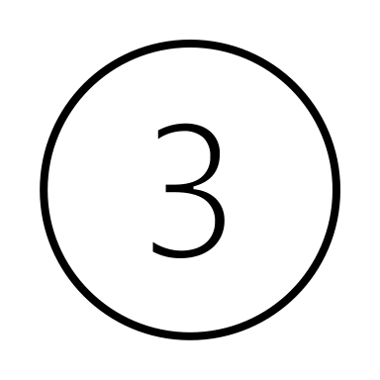
Methodology
Monitoring System Flow Illustration
Transaction
Sanctioned Addresses
Tracking List
Mempool
Sanctioned?
Yes
Notes:
If yes, we add the transaction to our tracking list

Slide 27

Methodology
Monitoring System Flow Illustration
Transaction
Sanctioned Addresses
Tracking List
Mempool
Sanctioned?
Yes
New Block
Notes:
- Whenever a new block is published

Slide 28

Methodology
Monitoring System Flow Illustration
Transaction
Sanctioned Addresses
Tracking List
Mempool
Sanctioned?
Yes
Block Transactions
New Block
Notes:
- we check the transactions included

Slide 29

Methodology
Monitoring System Flow Illustration
Transaction
Sanctioned Addresses
Tracking List
Mempool
Sanctioned?
Yes
Block Transactions
New Block
Tracking List
contains?
Notes:
And see if any of our tracked transaction were included

Slide 30


Methodology
Monitoring System Flow Illustration
Transaction
Sanctioned Addresses
Tracking List
Mempool
Sanctioned?
Yes
Block Transactions
Database
New Block
Tracking List
contains?
Yes
Notes:
If yes, we store a log of the transaction, at what time it first arrived in the mempool and when it got included, in our database. With that information we know which blocks excluded the transaction and that we need to investigate.

Slide 31



Methodology
Normal Inclusion Time Metric
Transaction
Inclusion Time:
(1+BlocksPending) * BlockTime
Mempool
Mempool
Mempool
…
Transaction
(1+k) * 12s
Block
i
Block i+1
Block i+1+k
Notes:
- For investigating how effective censorship is on etherum, we focused on the impact on their inclusion time.
- Inclusion Time describes the time passed since a transaction first arrived in a mempool until its inclusion in a block. So in the example here:

Slide 32
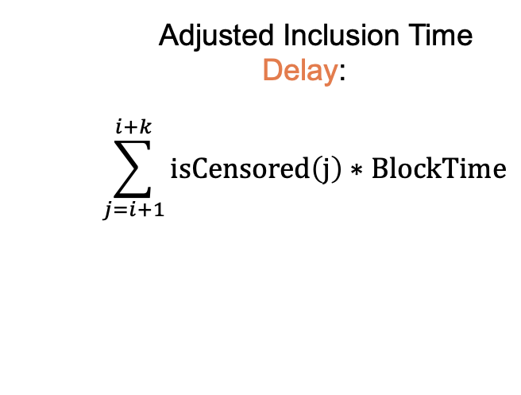
Methodology
Novel Inclusion Delay Metric
Adjusted Inclusion Time Delay:
$$\sum_{j=i+1}^{i+k}{isCensored\left(j\right)∗BlockTime}$$
Transaction
Mempool
Mempool
Mempool
…
Transaction
censored * BlockTime
Block
i
Block i+1
Block i+1+k
Is Censored?
Yes
censored += 1
Notes:
- A straight-forward way to estimate the impact censorship has on inclusion time, is to attribute the delay caused by all excluding blocks to censorship
- A more accurate way to measure the time penalty caused by censorship, is to check for each excluding block if it was censored and if yes, add the time that elapsed between this and the previous block to the delay, which is our metric.

Slide 33
Results
Collected Data
Mempool Monitor ran from 12th July to 28th August
Recorded 3733 transasctions associated with addresses on OFAC’s SDN list
Recorded transaction span across a total of 21,438 blocks either being in the mempool or being included
The overwhelming majority of blocks was produced through MEV-Boost
Notes:
This was the methodology, now to our results.

Slide 34
Results
RQ1: Censorship Amount
We measured a 29% censorship rate (Strict) for sanctioned transactions
Additionally, in 18% of the exclusion it could have been censored as well (Non-Strict)
Almost a third is excluded for economic reasons

Slide 35
Results
RQ1: Censorship Amount Comparison between MEV-Boost and Vanilla
Notes:
- We measured a statistically significant difference of the rates of censorship and inclusion between MEV-Boost blocks and Vanilla blocks which underlines the weakness Relays pose for the MEV-Boost market in terms of censorship
(chi squared test)

Slide 36
Results
RQ1: Censorship Amount Comparison
MEV-Watch flags a MEV-Boost block as OFAC compliant, if it was forwarded by a compliant Relay
It serves as an upper bound estimation of censorship
The amount of strictly censored blocks lies below MEV-Watch estimation
When considering non-strictly censored (excl.) blocks, we exceed MEV-Watch upper bound estimation however
Notes:
We compared our framework to MEV-Watch
MEV-Watch flags.

Slide 37






Results
RQ1: Censorship Behavior by different Participants
Category | Builder | Relay | Proposer
OFAC-Compliant | 44,87% | 0% | 49,66%
Max-Profit | 39,74% | 100% | 0,51%
Economic | 7,69% | 0% | 29,76%
Including | 7,69% | 0% | 20,07%
→ No Relay has been 100% OFAC compliant
Notes:
MEV-Watch assumption is wrong

Slide 38
Results
RQ2: Impact of Censorship on Inclusion Time
The average inclusion time of sanctioned transactions is 51,63s
The adjusted delay due to strictly censoring blocks is 13,34s
The adjusted delay due to non-strictly censoring blocks is 21,53s
→ 25,8% - 41,7% of the waiting time of a sanctioned transaction is due to censoring blocks
Notes:
- we see that attributing the whole inclusion time to be due to censorship largely overestimates the penalty caused by censorship
- in reality every sanctioned transaction experienced 1-2 block time worth of penalty

Slide 39
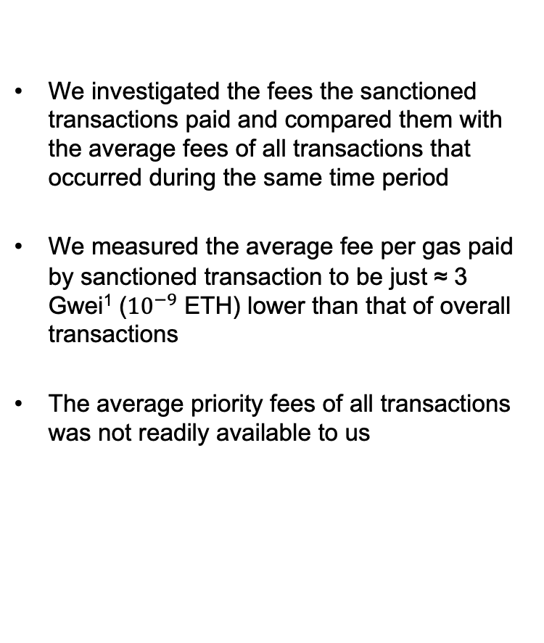
Results
RQ3: Profitability of Censorship
We investigated the fees the sanctioned transactions paid and compared them with the average fees of all transactions that occurred during the same time period
We measured the average fee per gas paid by sanctioned transaction to be just ≈ 3 Gwei¹ (${10}^{−9}$ ETH) lower than that of overall transactions
The average priority fees of all transactions was not readily available to us
¹ $0,0000063 at an ETH price of $2100

Slide 40
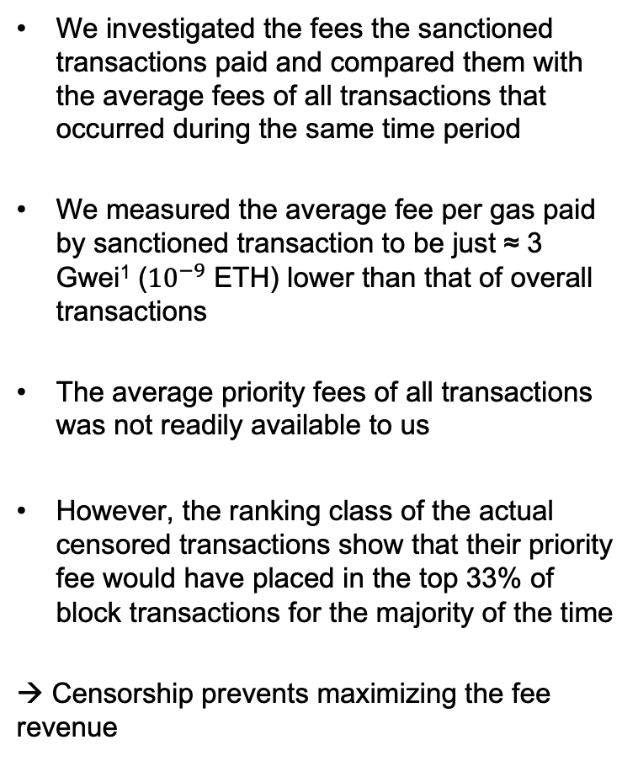
Results
RQ3: Profitability of Censorship
We investigated the fees the sanctioned transactions paid and compared them with the average fees of all transactions that occurred during the same time period
We measured the average fee per gas paid by sanctioned transaction to be just ≈ 3 Gwei¹ (${10}^{−9}$ ETH) lower than that of overall transactions
The average priority fees of all transactions was not readily available to us
However, the ranking class of the actual censored transactions show that their priority fee would have placed in the top 33% of block transactions for the majority of the time
→ Censorship prevents maximizing the fee revenue
¹ $0,0000063 at an ETH price of $2100

Slide 41

Results
RQ4: Can Censorship be mitigated
Core Problem
As the majority of blocks are produced through MEV-Boost, validators no longer have control over the content of their blocks.
Solutions
Solutions design exist where third-party builders only provide part of a block and the validator remains in control over the rest (PBA)
In other design solutions, the block proposer can define a list of observed transactions in the mempool they wish third-party builders to include if there is still space in the block (crLists)
No live solution as of yet
Examples
Partial Block Auctions (PBA)
Forward Inclusion Lists / Censorship Resistant Lists (crLists)
Notes:
- mention how we’ve seen this materialize in the inclusion and censorship rate

Slide 42
Conclusion
RQ1: How much Censorship occurs on Ethereum?
RQ2: How effective is Censorship on Ethereum?
RQ3: Is there a profit difference between non-censoring and censoring network participants?
RQ4: Can censorship be mitigated?

Slide 43
Conclusion
Key Findings
In 33% of exclusion instances, sanctioned transactions were excluded for economically rational reasons
Censorship rate of 29% (high-confidence) for sanctioned transactions
Significantly higher rate of censorship with MEV-Boost blocks than Vanilla blocks
RQ1: How much Censorship occurs on Ethereum?
RQ2: How effective is Censorship on Ethereum?
RQ3: Is there a profit difference between non-censoring and censoring network participants?
RQ4: Can censorship be mitigated?
Notes:
With our new classification framework we found that 33% of exclusions were economically justified which emphasizes the point that you can’t flag every block that excluded a sanctioned transaction as censoring. In 29% of

Slide 44
Conclusion
Key Findings
Despite censoring actors, it doesn’t stop transactions from eventually being included
We measured the time penalty caused by censorship to make up 25,8% to possibly 41,7% of the inclusion time
Attributing the entire inclusion time to censorship would be a large overestimation
RQ1: How much Censorship occurs on Ethereum?
RQ2: How effective is Censorship on Ethereum?
RQ3: Is there a profit difference between non-censoring and censoring network participants?
RQ4: Can censorship be mitigated?
Notes:
- Despite censorship of some actors it doesn’t stop transactions from eventually being included
- We measured the penalty caused for inclusion time to be around 25,8% to possibly 41.7%
- This also shows that attributing the entire IT to censorship is a large overestimation.

Slide 45
Conclusion
Key Findings
Censorship practise causes economically irrational behaviour
This prevents a block proposer from maximizing their fee revenue and can negatively impact their profitability
RQ1: How much Censorship occurs on Ethereum?
RQ2: How effective is Censorship on Ethereum?
RQ3: Is there a profit difference between non-censoring and censoring network participants?
RQ4: Can censorship be mitigated?

Slide 46
Conclusion
Key Findings
There exists some design solutions that enable block proposers to retain some control over their blocks content
However, there is no live solution as of this moment
RQ1: How much Censorship occurs on Ethereum?
RQ2: How effective is Censorship on Ethereum?
RQ3: Is there a profit difference between non-censoring and censoring network participants?
RQ4: Can censorship be mitigated?

Slide 47



Limitations & Future Work
Sanctioned Addresses
Limited to predefined list
Discover other addresses that might be subject to censorship
MEV-Reward
MEV-Reward plays a role for transaction rank
Ideally, include it in the ranking process
Transaction Ranking Granularity
For ease of arguing, we bundle transactions into ranking classes
Ideally, you look at a case-by-case basis
Latency
Latency of transactions propagation is a factor to consider
We could be producing false positives

Slide 48
B.Sc.
Cristian Neufuss
Master‘s Student Informatics
cristian.neufuss@tum.de
17132

