Slide 1
Leveraging Domain Knowledge for Class-Specific Keyword Extraction
Bachelor’s Thesis Kickoff Presentation
Weixin Yan, 26 June 2023

Slide 2
Outline
Introduction
  Motivation
  Goals
  Dataset
Research Approach
  Research Questions
  Methodology
Initial Results
Challenges & Next Steps
Timeline

Slide 3



Motivation
  Around 80% of generated data are unannotated and unstructured text
  Many AI applications require structured input data with clear labels
  → Annotation needed
  Naïve approach: manual classification and annotation by domain experts
  Precise, incorporate domain-specific knowledge
  Costly, inefficient, not scalable
  Need for a hybrid approach
  Combine Natural Language Processing techniques with domain expertise

Slide 4
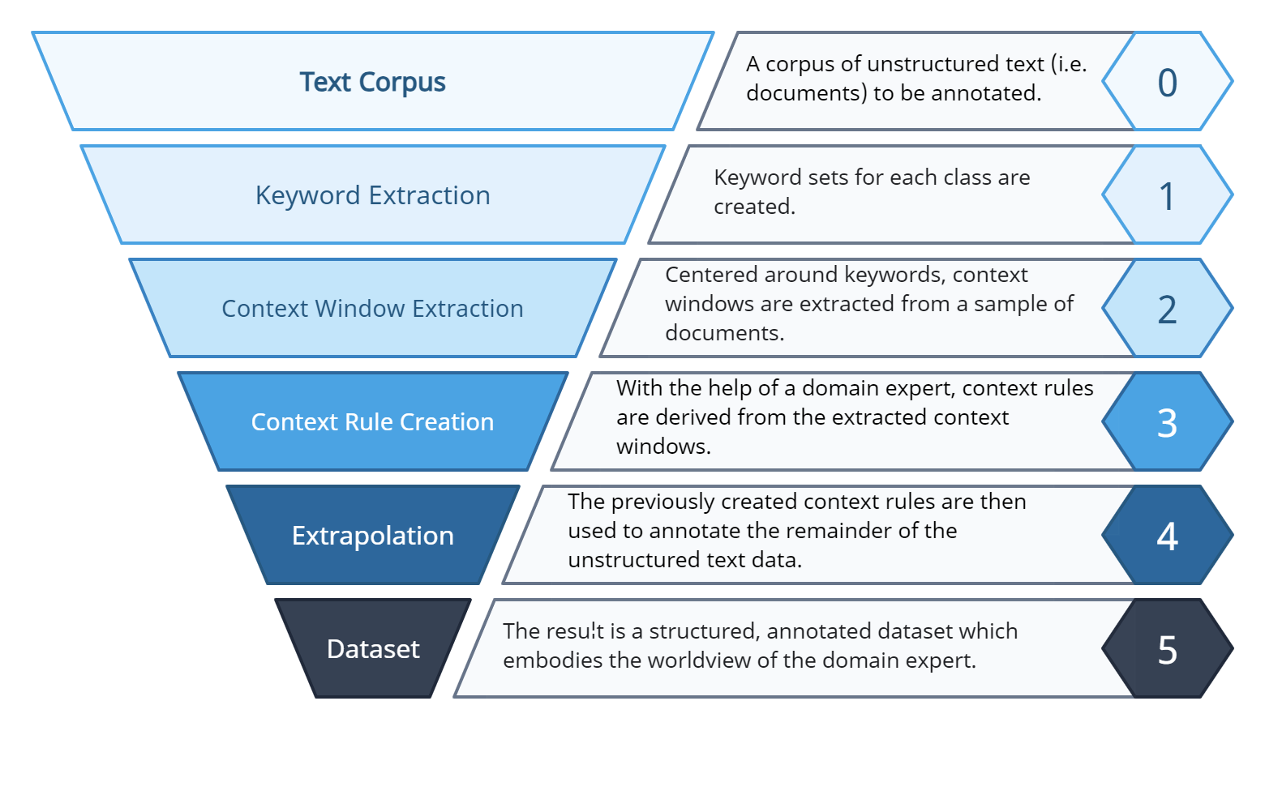
Goals
  Part of the CreateData4AI Project
    Ultimate goal: structured and annotated datasets, classified according to defined features
  Step 1: Keyword extraction
    Outcome/deliverable: (reasonably)
    complete set of keywords per class
    → basis for the rest of the project
https://wwwmatthes.in.tum.de/pages/nqpi6qljq0x9/CreateData4AI-CD4AI

Slide 5


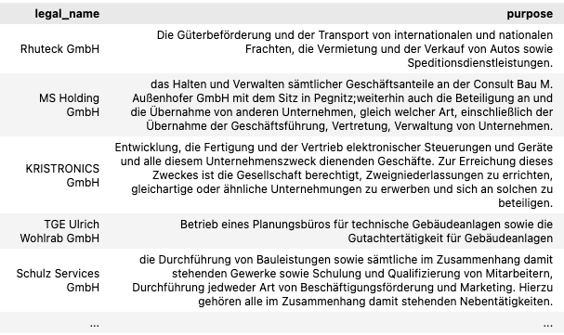
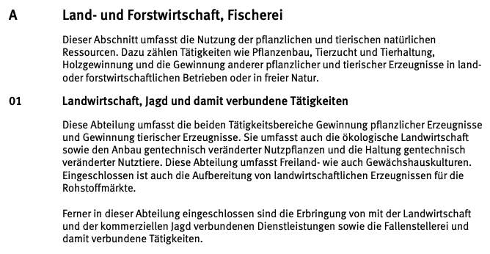
Dataset
Business Registry of Business Purposes
(Handelsregister)
Classification of Business Sectors
(Klassifikation der Wirtschaftszweige 2008)
This thesis:
keyword extraction with help of WZ2008
WZ2008
Ultimate goal of the project:
Annotation & classification of each business registry according to WZ2008
Dataset to extract keywords from
(~3 million entries)
Definitions, explanation and seed keywords of the 21 classes

Slide 6
Outline
Introduction
  Motivation
  Goals
  Dataset
Research Approach
  Research Questions
  Methodology
Initial Results
Challenges & Next Steps
Timeline

Slide 7
Research Questions
1
What approaches currently exist that can be utilized to extract keywords and keyphrases from large unstructured text corpora?
How can short textual class descriptions and class-specific seed keywords from the WZ2008 classification, validated by domain experts, be leveraged to adapt the identified keyword extraction approaches for class-specific keyword extraction?
2
3
Without the use of external knowledge bases, how can the extracted class-specific keywords be used as a basis for the generation of further class-specific keywords?
4
In what way can the modified approach be evaluated by domain experts to validate the representativeness of the resulting keyword sets?

Slide 8
Methodology
1
What approaches currently exist that can be utilized to extract keywords and keyphrases from large unstructured text corpora?
Literature review on existing keyword extraction algorithms
Select the best one to work with
How can short textual class descriptions and class-specific seed keywords from the WZ2008 classification, validated by domain experts, be leveraged to adapt the identified keyword extraction approaches for class-specific keyword extraction?
Adapted keyword extraction
Given: class descriptions and seed keywords
Extract related keywords in the data based on the given information
2
(Further) keyword generation given previous results
Ideas: wordnets, transformer-based lexical substitutions, etc.
Desired outcome: (reasonably) comprehensive set of keywords for each class
3
Without the use of external knowledge bases, how can the extracted class-specific keywords be used as a basis for the generation of further class-specific keywords?
4
In what way can the modified approach be evaluated by domain experts to validate the representativeness of the resulting keyword sets?
Result validation and evaluation by domain experts
Desired outcome: validated set of keywords

Slide 9
Outline
Introduction
  Motivation
  Goals
  Dataset
Research Approach
  Research Questions
  Methodology
Initial Results
Challenges & Next Steps
Timeline

Slide 10




Initial Results
}
Illustrated workflow
for each class
List of generated keywords
Keyword generation (RQ3)
Guided keyword extraction (RQ2)
Subset data (~10k)
Seed keywords
discarded
List of extracted keywords
Filtering for all classes
(e.g. deduplication, clustering etc.)
(Reasonably) complete keyword set per class

Slide 11
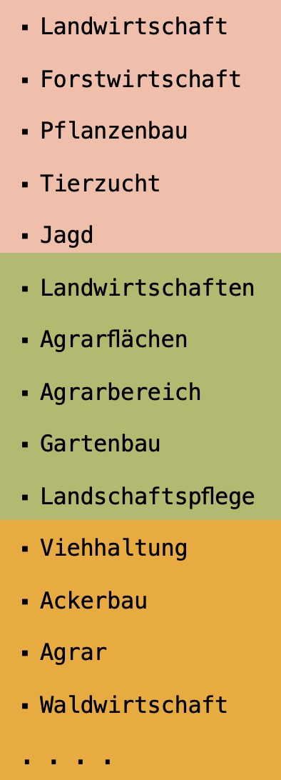
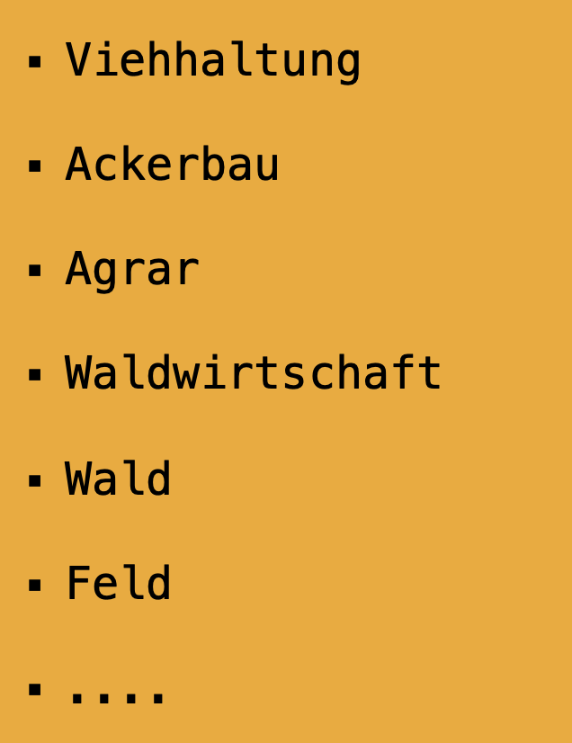
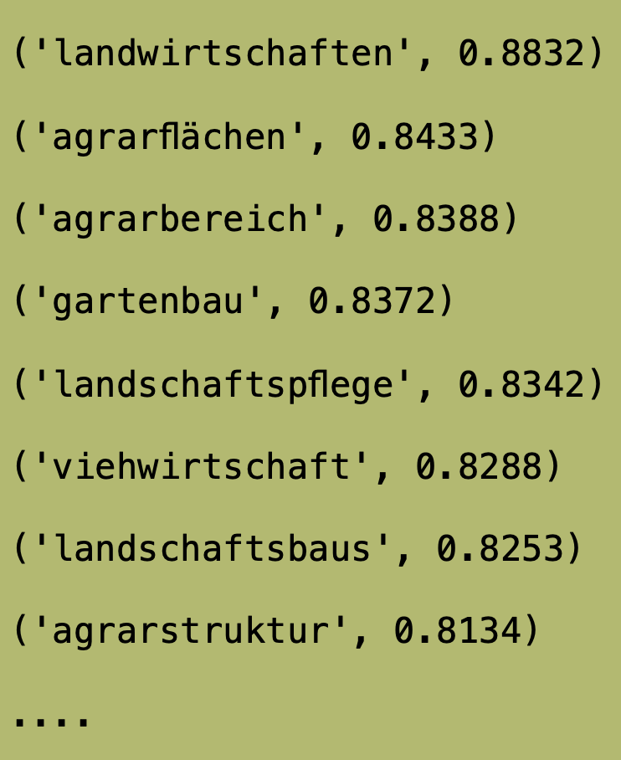
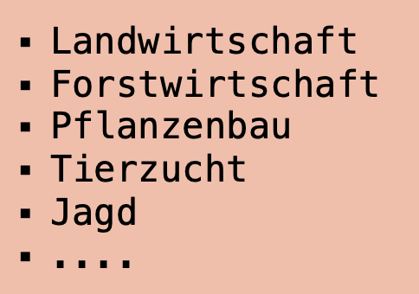
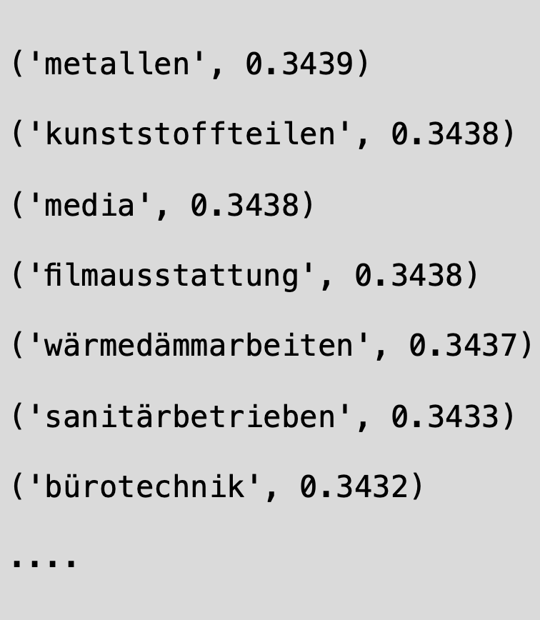
Initial Results: Example
}
Class A: Land- und Forstwirtschaft, Fischerei
List of Generated keywords
Keyword generation (RQ3)
Guided keyword extraction (RQ2)
Subset data (~10k)
Seed keywords (taken from WZ2008)
discarded
List of extracted keywords
Filtering for all classes
(e.g. deduplication, clustering etc.)
(Reasonably) complete keyword set per class

Slide 12
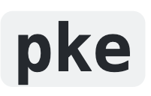


Initial Results
RQ1
Literature review on existing keyword extraction methods
Selection of the most suitable one to work with
  Transformer-based
  Captures semantics
  Dataset is mainly short texts
  Feature: seed keywords as inputs
  Relatively easy adaptation

Slide 13
Initial Results
RQ2 – What to extract?
Nouns Only
Unigrams Only
Only extract noun(s) as keywords
Keywords are commonly nouns
Special vectorizer (KeyphraseVectorizer) needed for part-of-speech tagging
Results:
Mostly single-words
✖️ Slow: 2.5h for one class (GPU), >8h (CPU)
✖️ Somewhat repetitive: same word, different forms (numbers, cases etc.)
  → post processing needed
❌ → extract unigrams instead
Only extract unigrams (single words) as keywords, no phrases
Not just limited to nouns
Phrases can be identified later in context window extraction
Results:
Mostly nouns and adjectives
✔︎ Fast: 15 min for one class (GPU)
✖️ Somewhat repetitive: same word, different forms (declensions, cases etc.)
  → post processing needed
✅

Slide 14
Initial Results
RQ2 – How to use the seed?
Mean Seed
Max Seed
Default for KeyBERT
Results:
✖️Might be steered into certain directions
  Highly dependent on how the seed keywords are defined
→ Modification needed
Attempt to mitigate the issues of using mean seed
Results:
“Irregular” performance
  Depends on the class
  ✖️ Unrelated words may have high scores
→ Modification needed
embeddings of seeds
{
0.1 | 0.5 | 0.3 | …
“Jagd”
embeddings of seeds
similarity scores
candidate keyword
(“Agrar”)
mean seed embedding
0.7 | -0.5 | 0.9 | …
“Tierzucht”
0.1 | 0.5 | 0.3 | …
0.6589
0.9 | -0.3 | 0.7 | …
0.4 | 0.3 | 0.3 | …
candidate keyword
(“Agrar”)
“Jagd”
-0.8 | 0.1 | -0.2 | …
“Landwirtschaft”
0.7 | -0.5 | 0.9 | …
0.7098
… | … | … | …
0.9 | -0.3 | 0.7 | …
Compute similarity
“Tierzucht”
resulting score
resulting similarity score
-0.8 | 0.1 | -0.2 | …
0.8649
(“Agrar”,0.8649)
(“Agrar”,0.7578)
“Landwirtschaft”
take max
… | … | … | …
Idea: TAKE AVERAGE

Slide 15
Initial Results
RQ2 – Preprocessing?
Compare Sentence Similarity First
❌
Attempt to save time and computing power
Results/Challenges:
Smaller keyword lists
Difficulty in threshold determination
✖️ Similarity score highly dependent on other factors
  Model used
  Quality of class description
  Text length
business purposes
similarity scores
0.1 | 0.5 | 0.3 | …
0.2043
Business 1: “Betrieb eines Restaurants”
class description embedding
0.7 | -0.5 | 0.9 | …
0.6508
Only consider these entries for keyword extraction
Compute similarity
Business 2: …
0.9 | -0.3 | 0.7 | …
“Dieser Abschnitt umfasst die Nutzung der pflanzlichen natürlichen Ressourcen…”
-0.8 | 0.1 | -0.2 | …
0.7580
Business 3: …
… | … | … | …
define threshold t = 0.6

Slide 16
Initial Results
RQ2 - Overview
Method | Explanation | Justification | Results | Takeaway
Extract nouns only | Only consider noun phrases Special vectorizer needed | Seeds are mostly nouns | Mostly single-words ✖️ Slow, somewhat repetitive | ❌ → unigram
Extract unigrams (single words) | Only consider single words | Not just limited to nouns Phrases can be identified later (context window extraction) | Mostly nouns and adjectives ✔ Fast ✖️ repetitive adjectives | ✅
Mean Seed | Score of an extracted keyword = its similarity with the average embedding of the seed keywords | Default | ✖️ Extraction might be steered into certain directions | 🔨 combine with max seed
Max Seed | Calculate similarity scores between each candidate and all seed keywords, take the maximum | Mean seed might favor the extraction in certain directions | “Irregular” performance ✖️ Unrelated keywords with high scores | 🔨 combine with mean seed
Sentence Similarity first | Only consider business descriptions whose similarity score with the class description are above a threshold | Save time & computing power | ✖️ Fewer keywords extracted ✖️ Quality dependent on other factors | ❌

Slide 17
Initial Results
RQ2 – Current Approach
Method | Explanation | Justification | Results | Takeaway
Extract unigrams (single words) | Only consider single words | Not just limited to nouns Phrases can be identified later (context window extraction) | Mostly nouns and adjectives ✔ Fast ✖️ repetitive adjectives | ✅
Mean Seed | Score of an extracted keyword = its similarity with the average embedding of the seed keywords | Default | ✖️ Extraction might be steered into certain directions | ✅ Take
Max Seed | Calculate similarity scores between each candidate and all seed keywords, take the maximum | Mean seed might favor the extraction in certain directions | “Irregular” performance ✖️ Unrelated keywords with high scores | average
Extract unigrams
Mean Seed
average
Max Seed
Notes:
Transition slide only

Slide 18
Initial Results
RQ2 – Current Approach
Extract unigrams only, score of a keyword = average from Mean Seed and Max Seed approach
mean seed embedding
mean seed: score
0.4 | 0.3 | 0.3 | …
(“Agrar”,0.7578)
Guided keyword extraction
Mean Seed
0.9 | -0.3 | 0.7 | …
averaged result
candidate keyword
(“Agrar”)
(“Agrar”,
0.8114)
Subset data (~10k)
seed embeddings
similarity scores
Max Seed
0.1 | 0.5 | 0.3 | …
0.6589
“Jagd”
Seed keywords
max seed: score
Extracted unigrams
0.7 | -0.5 | 0.9 | …
0.7098
(“Agrar”,0.8649)
“Tierzucht”
-0.8 | 0.1 | -0.2 | …
0.8649
“Landwirtschaft”
take max
… | … | … | …

Slide 19
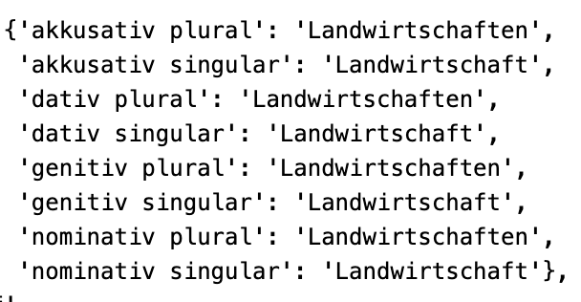
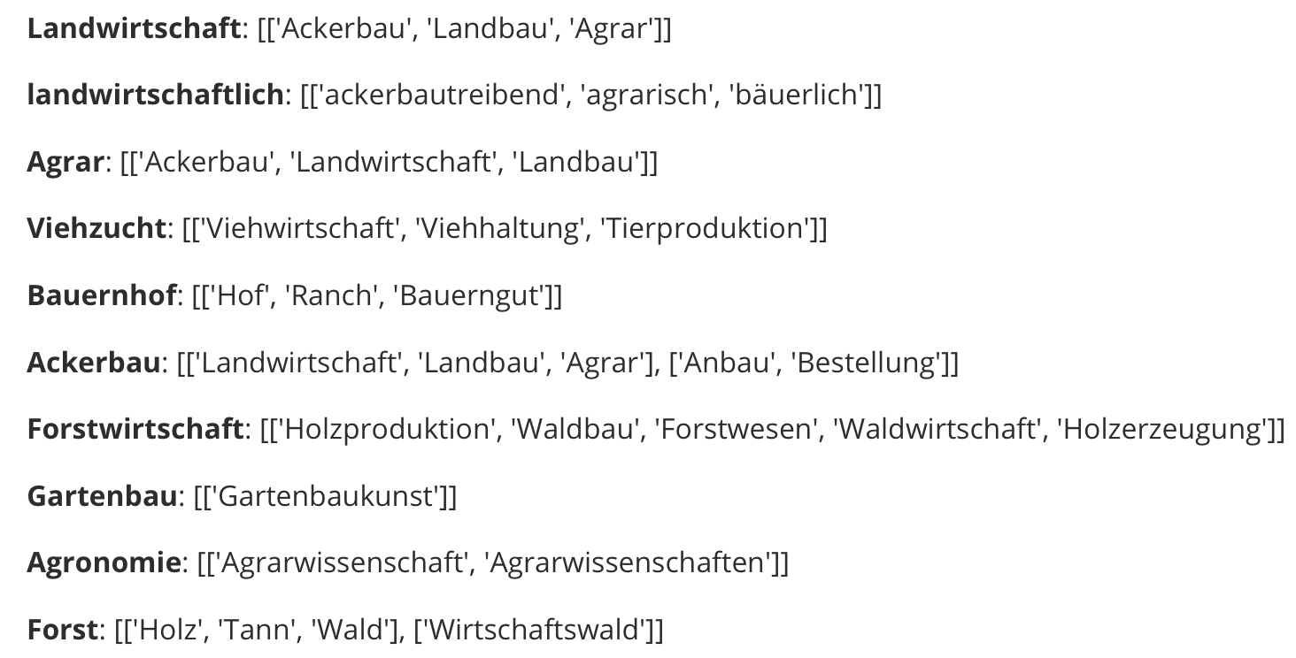
Initial Results
RQ3 – Keyword Generation
Word forms & inflections
Synonym generation using wordnets
german-nouns [1]
Open German Wordnet (OdeNet) [2]
Word forms of “Landwirtschaft”
Partial results of computing synonyms for extracted keywords
[1] gambolputty. german-nouns. GitHub. https://github.com/gambolputty/german-nouns
[2] Siegel, M., & Bond, F. (2021). OdeNet: Compiling a German Wordnet from other Resources. GitHub repository: https://github.com/hdaSprachtechnologie/odenet
Notes:
OdeNet: no guarantee that a synonym is found

Slide 20
Outline
Introduction
  Motivation
  Goals
  Dataset
Research Approach
  Research Questions
  Methodology
Initial Results
Challenges & Next Steps
Timeline

Slide 21
Challenges & Next Steps
How to determine a cut-off point for accepting/discarding the extracted keywords?
  → Try damping function
Continue code adaptation & improvement
  Using the average of mean & max seed
Search for & test further keyword generation techniques
  Other wordnets
  Lexical substitution
Validation by the domain experts
Start writing!

Slide 22
Outline
Introduction
  Motivation
  Goals
  Dataset
Research Approach
  Research Questions
  Methodology
Initial Results
Challenges & Next Steps
Timeline

Slide 23
Timeline
 | MAR | APR | MAY | JUN | JUL | AUG | SEP
RQ1 Literature review
RQ2 incorporating domain-specific knowledge
RQ3 keyword generation
RQ4 evaluation by domain experts
Drafting & Writing
Submission Deadline
15.09.23
Registration
15.04.23
Kickoff
26.06.23

Slide 24
Weixin Yan
17132
matthes@in.tum.de

