Slide 1
Exploring the Legal Perspective on the Use of Privacy-Enhancing Technologies for Data Privacy Compliance
Hannah Kiel
26.06.2023, Bachelor Thesis Kick-Off

Slide 2
Outline
Motivation and Background
Methodology
Initial Results
Expected Outcome
Next Steps
Timeline

Slide 3
Outline
Motivation and Background
Methodology
Initial Results
Expected Outcome
Next Steps
Timeline

Slide 4
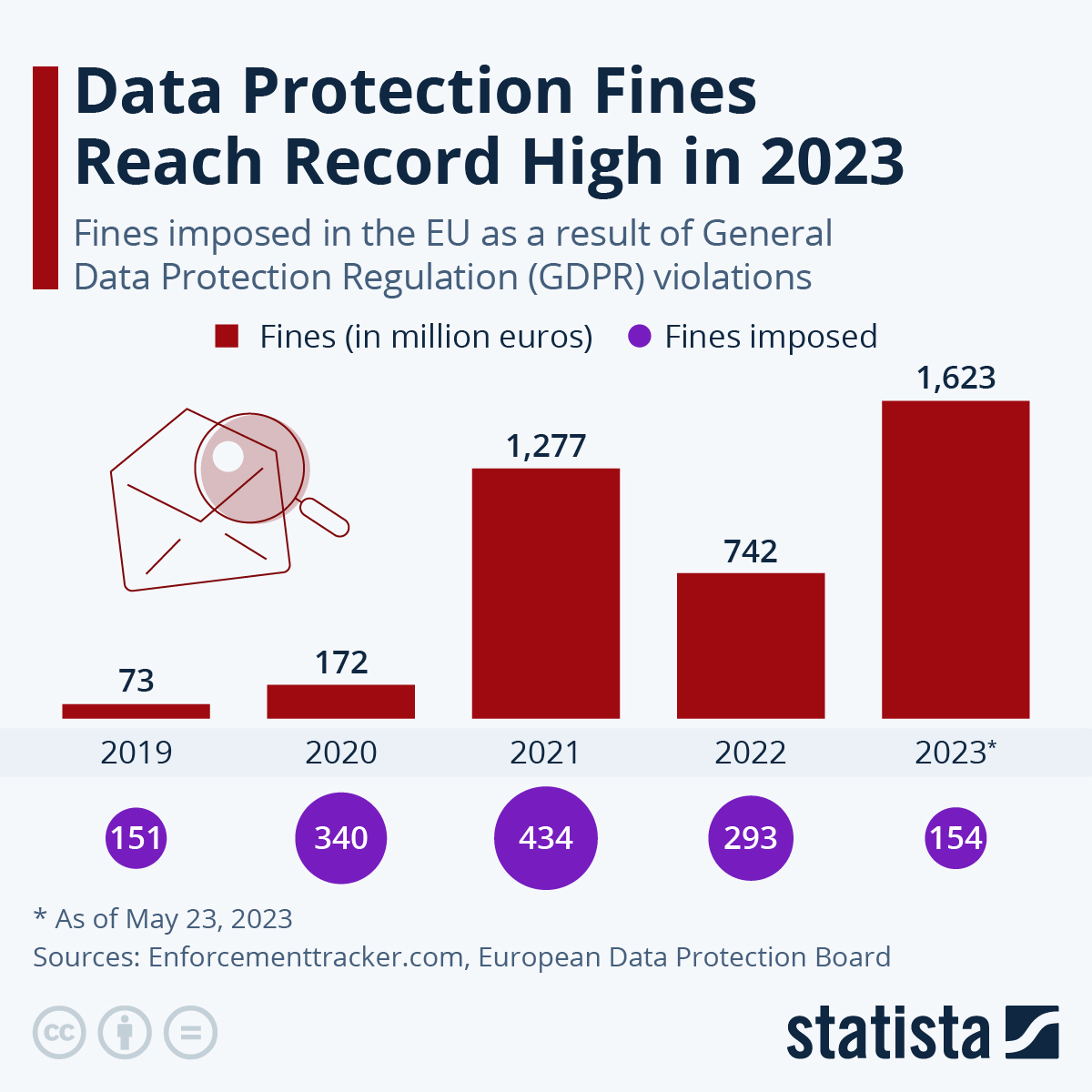
Data Protection and GDPR
GDPR is considered the strongest data protection regulation in the world
Numerous fines were issued for non compliance
In this new complex legal and regulatory landscape, legal input is essential for a successful data privacy compliance

Slide 5
Data Protection Law and Privacy-Enhancing Technologies
Privacy-Enhancing Technologies
„embody fundamental data protection principles by minimizing personal data use, maximizing data security, and empowering individuals“¹
Art. 25, GDPR mandates Privacy by Design
„appropriate technical and organisational measures“

Slide 6
Legal Experts and Privacy-Enhancing Technologies
IT Security
this complexity in data privacy compliance also brings new challenges and obstacles for the legal sector
Usage of PETs by Companies
Regulatory Compliance
Data Privacy

Slide 7
Outline
Motivation and Background
Methodology
Initial Results
Expected Outcome
Next Steps
Timeline

Slide 8
Research Methodology
What is the role of legal experts in supporting the use of Privacy-Enhancing Technologies in the Process of data privacy compliance?
What are the obstacles and challenges faced by legal professionals in the process of data privacy compliance when Privacy-Enhancing Technologies are used?
What strategies can be implemented to increase the ability of legal experts to support data privacy compliance when Privacy-Enhancing Technologies are used?

Slide 9
Research Methodology
What is the role of legal experts in supporting the use of Privacy-Enhancing Technologies in the Process of data privacy compliance?
What are the obstacles and challenges faced by legal professionals in the process of data privacy compliance when Privacy-Enhancing Technologies are used?
What strategies can be implemented to increase the ability of legal experts to support data privacy compliance when Privacy-Enhancing Technologies are used?

Slide 10
Research Methodology
What is the role of legal experts in supporting the use of Privacy-Enhancing Technologies in the Process of data privacy compliance?
Systematic Literature Review
Definition of data privacy compliance
Insights on the legal perspective on the use of Privacy-Enhancing Technologies in the process of data privacy Compliance
Semi-Structured Interviews
Understand the role of legal experts in the process of data privacy compliance
Identify challenges and obstacles in practice
Identify possible solution strategies for the identified challenges
What are the obstacles and challenges faced by legal professionals in the process of data privacy compliance when Privacy-Enhancing Technologies are used?
What strategies can be implemented to increase the ability of legal experts to support data privacy compliance when Privacy-Enhancing Technologies are used?

Slide 11
Systematic Literature Review
Search Methodology
Databases: Google Scholar IEEE Explore ACM Digital Library Search strategy: Automated searches using search strings derived from the research questions („Lawyers“ OR „Legal“ OR „Law“) AND („PETs“ OR Privacy-Enhancing Technologies“) OR („Privacy Compliance“) „Data Privacy Compliance“ „Technology“ AND („Lawyers“ OR „Legal“ OR „Law“)
Inclusion / Exclusion Criteria
Inclusion criteria: Has to be published within the last 30 years Papers that talk about data privacy compliance when technical measures are used and that adress the technichal / legal collaboration Grey Literature regarding IT-Security and data privacy standards Exclusion criteria: Papers focused on technical requirements of PETs for data privacy compliance Papers that do not mention legal and regulatory aspects of the implementation of PETs

Slide 12
Systematic Literature Review – Findings
Lack of literature on the operational legal perspective on the use of Privacy-Enhancing Technologies in the process of data privacy compliance
Lack of literature on the applicability of Privacy-Enhancing Technologies for data privacy compliance
Need for research on the interdisciplinary communication and collaboration between legal and technical domains when Privacy-Enhancing Technologies are used by companies for data privacy compliance
Literature mainly focuses on:
Data privacy laws and principles
Technical-legal gap
Standards, supporting materials, guidance, advice and templates for data protection
databases search
selected papers
63
20
selection
forward and backward search
15
Notes:
Focus on data privacy compliance from a technical point of view when PETs are used
E.g. approaches for privacy and data protection engineering
Literature on privacy laws and principles
E.g. explanation of law terminology for a technical audience
Standards, supporting materials, guidance, advice and templates
E.g. ISO/IEC 27001 Information technology - Security techniques - Information security management systems - Requirements

Slide 13
Semi-Structured Interviews
Candidate Selection
Legal experts in the field of data protection and cybersecurity
Contact
LinkedIn Email Personal contacts Referred contacts
Statistics
70 contacted 15 accepted 13 done
Interview Structure
4 sections: data privacy compliance, data privacy compliance sources, privacy, technology and law, strategies Duration ~ 1 hour

Slide 14
Semi Structured Interviews – Statistics
Count | Role | Industry Domain | Organization Size | Experience | Duration
1 | External Counsel | Law Firm | Large-sized | 5-10 | 50'
2 | Founder, External Counsel | Law Firm | Large-sized | 20+ | 40'
3 | External Counsel | Law Firm | Large-sized | 5-10 | 85'
4 | External Counsel | Law Firm | Large-sized | 20+ | 60'
5 | Head of Data Privacy | Media Group | Large-sized | 5-10 | 79'
6 | Legal Counsel | Health | Large-sized | 5-10 | 77'
7 | DPO, Legal Counsel, Founder | Finance | Small-sized | 5-10 | 60'
8 | Legal Counsel | Payment | Large-sized | 5-10 | 50'
9 | Legal Counsel | Manufacturing | Large-sized |  | 60'
10 | General Deputy Manager | Telecommunications | Large-sized | 5-10 | 45'
11 | Law Student | Academia | - | 1-3 | 77'
12 | Researcher, Lawyer | Law Firm, Academia | Medium-sized | 1-3 | 30'
13 | Researcher, Lawyer | Academia | - | 1-3 | 30'

Slide 15
Outline
Motivation and Background
Methodology
Initial Results
Expected Outcome
Next Steps
Timeline

Slide 16
Initial Results
Q1
What is the role of legal experts in supporting the use of Privacy-Enhancing Technologies in the Process of Data Privacy Compliance?
Legal experts…
… help the companies to meet the regulatory and legal requirements for the collection, processing, and maintenance of personal information
… measure PETs according to data protection principles which are set out in data protection law and regulations (e.g. data minimisation, state of the art or storage limitation) by developing a „Data Protection Impact Assessment“
Legal and technical expertise is urgently needed
Notes:
Data protection assesment
exakte Beschreibung der geplanten Verarbeitungsvorgänge und der jeweiligen Verarbeitungszwecke sowie etwaiger berechtigter Interessen des Verantwortlichen.
Privacy by design mandates
.. PETs can help to fulfill this requirement s

Slide 17
Initial Results
Q2
What are the obstacles and challenges faced by legal professionals in the process of data privacy compliance when Privacy-Enhancing Technologies are used?
“language” barriers
cooperation between IT and Law
lack of guidance from authorities
challenges
rare legal cases so far
lack of technical knowledge
no regulatory standard

Slide 18
Initial Results
Q3
What strategies can be implemented to increase the ability of legal experts to support data privacy compliance when Privacy-Enhancing Technologies are used?
checklists for legal experts
guidance from regulators
IT education
better collaboration
solutions and strategies
industry standards
IT-Tools
common definitions
certification

Slide 19
Initial Results
Q3
What strategies can be implemented to increase the ability of legal experts to support data privacy compliance when Privacy-Enhancing Technologies are used?
checklists for legal experts
guidance from regulators
IT education
better collaboration
solutions and strategies
industry standards
IT-Tools
common definitions
certification

Slide 20
Outlook - Checklists Methodology
„So, checklists are absolutely helpful and good. I would like to have them too, they just don't really exist.“
Systematic Literature Review
Analyze data protection laws on existing regulatory requirements for Privacy by Design
Analyze selected PETs on existing legal aspects of data privacy compliance
Collect and analyze already existing checklists for data privacy compliance
→ Create checklists for selected PETs
Checklists for legal experts for the use of PETs in the process of data privacy compliance
(Survey)
Feedback on checklists
Notes:
Privacy-Enhancing Technologies must be measured according to data protection principles
Difficulties in assessing this, especially in the case of new technologies
Checklists help to meet the regulatory requirements of data privacy compliance

Slide 21
Initial Results
Q3
What strategies can be implemented to increase the ability of legal experts to support data privacy compliance when Privacy-Enhancing Technologies are used?
checklists for legal experts
guidance from regulators
IT education
better collaboration
solutions and strategies
industry standards
IT-Tools
common definitions
certification

Slide 22
Outlook – Common Definitions Methodology
“They don’t listen to each other, and even when they talk to each other, they use different words for the same thing “
Systematic Literature Review
Identify vague legal definitions regarding data privacy compliance when PETs are used
Determine associated technical definitions
Semi-Structured Interviews
Identify further unclear definitions between legal and technical experts
Create an overview of unclear definitions
Find common definitions for legal and technical experts
Common legal and technical definitions for data privacy compliance when PETs are used
Notes:
Difficult assessment if Privacy-Enahncing Technologies always are sufficient to satisfy the regulatory compliance
Huge challenge in this process are not uniformly defined privacy terms
→ need for common terminology
Is Homomorphic encryption anonymizing or pseudonymizing personal data
Huge impact GDPR not applicable if data is anonymized

Slide 23
Outline
Motivation and Background
Methodology
Initial Results
Expected Outcome
Next Steps
Timeline

Slide 24
Challenges-Solutions Mapping
academic
curriculum
lack of industry standards
continuous
Learning
enhancing Education
“language”barriers between IT and Law
regarding PETs
guidance from authorites
checklists
cooperation between IT and Law
Legal Perspective on the Use of PETs in the Data Privacy Compliance Process
challenges
cross-Functional Teams
more collaboration
lack of guidance from authorities
certification
lack of technical knowledge
automated data privacy compliance checks
IT tools
rare legal cases so far
common definitions

Slide 25
Artefacts
Academic
Curriculum
lack of industry standards
continuous
learning
enhancing Education
“language” barriers between IT and Law
regarding PETs
guidance from authorites
create checklists for legal experts
checklists
cooperation between IT and Law
Legal Perspective on the Use of PETs in the Data Privacy Compliance Process
Challenges
cross-functional teams
more collaboration
lack of guidance from authorities
certification
Lack of Technical Knowledge
automated data compliancecchecks
IT tools
Rare legal cases so far
common definitions
list of inconsistent definitions and bridge the gap

Slide 26
Outline
Motivation and Background
Methodology
Initial Results
Expected Outcome
Next Steps
Timeline

Slide 27
Next Steps
Interviews
Conduct further interviews
Find more interview partners: small- and medium-sized companies, international data privacy experts
Thematic Concept Analysis
Transcribing
Coding
Solution Concepts
Systematic literature review on solution ideas
Developing of possible solution concepts
Conducting a survey to evaluate artefacts
Writing the Thesis

Slide 28
Outline
Motivation and Background
Methodology
Initial Results
Expected Outcome
Next Steps
Timeline

Slide 29
Timeline
Literature Review
Semi-Structured Interviews
Data Analysis
Solution Concepts
Writing thesis
April | Mai | Juni | Juli | August | September

Slide 30
Hannah Kiel
17132
matthes@in.tum.de

Slide 31
Initial Results – „Language“ Barriers (PET definition)
Q2
What are the obstacles and challenges faced by legal professionals in the process of data privacy compliance when Privacy-Enhancing Technologies are used?
„Your question was also about how far the term (PETs) plays a role in my daily work, it is practically non-existent."
„I actually had to do a bit of Googling first to find out what all actually falls under it.“
no common definition
legal Perspective on the Use of PETs in the Data Privacy Compliance Process
challenges
“language” barriers
technical-legal gap

