Slide 1
Exploring the Legal Perspective on the Use of Privacy-Enhancing Technologies for Data Privacy Compliance
Hannah Kiel
25.09.2023, Bachelor Thesis Final Presentation

Slide 2
Outline
Motivation and Background
Methodology
Findings
Discussion

Slide 3
Outline
Motivation and Background
Methodology
Findings
Discussion

Slide 4
Data Protection Law and Privacy-Enhancing Technologies
Art. 25, GDPR mandates Privacy by Design
Privacy-Enhancing Technologies
„embody fundamental data protection principles by minimizing personal data use, maximizing data security, and empowering individuals“¹
„appropriate technical and organisational measures“

Slide 5
Legal Experts and Privacy-Enhancing Technologies
Usage of PETs by Organizations
IT Security
Regulatory Compliance
Data Privacy
This complexity in data privacy compliance also brings new challenges and obstacles for the legal sector

Slide 6
Outline
Motivation and Background
Methodology
Findings
Discussion

Slide 7
Research Methodology
RQ1
What is the role of legal experts in supporting the use of Privacy-Enhancing Technologies in the Process of data privacy compliance?
RQ2
What are the obstacles and challenges faced by legal professionals in the process of data privacy compliance when Privacy-Enhancing Technologies are used?
RQ3
What strategies can be implemented to increase the ability of legal experts to support data privacy compliance when Privacy-Enhancing Technologies are used?

Slide 8
Research Methodology
RQ1
What is the role of legal experts in supporting the use of Privacy-Enhancing Technologies in the Process of data privacy compliance?
Systematic Literature Review
Definition of data privacy compliance
Insights on the legal perspective on the use of Privacy-Enhancing Technologies in the process of data privacy Compliance
Semi-Structured Interviews
Understand the role of legal experts in the process of data privacy compliance
Identify challenges and obstacles in practice
Identify possible solution strategies for the identified challenges
RQ2
What are the obstacles and challenges faced by legal professionals in the process of data privacy compliance when Privacy-Enhancing Technologies are used?
RQ3
What strategies can be implemented to increase the ability of legal experts to support data privacy compliance when Privacy-Enhancing Technologies are used?

Slide 9
Systematic Literature Review
Search Methodology
Databases: Google Scholar IEEE Explore ACM Digital Library Search strategy: Automated searches using search strings derived from the research questions Query 1: ("lawyers" OR "law" OR "legal") and ("Privacy-Enhancing Technologies" OR PET) AND ("privacy compliance") Query 2: "data privacy compliance" Query 3: ("technology" OR "IT" or "Privacy-Enhancing Technologies") AND ("law" OR "lawyers" OR "privacy compliance")
Inclusion / Exclusion Criteria
Inclusion criteria: They must have been published within the last 40 years Papers that address data privacy compliance with technical measures Papers that address the technical-legal collaboration Exclusion criteria: Papers that only focus on the technical requirements of Privacy-Enhancing Technologies Papers that do not mention legal and regulatory aspects of Privacy-Enhancing Technologies
Databases search
Selected papers
63
22
Selection
Forward and backward search
15

Slide 10
Semi-Structured Interviews
Candidate Selection
Legal experts in the field of data protection and cybersecurity
Contact
LinkedIn Email Personal contacts Referred contacts
Interview Structure
4 sections: data privacy compliance, data privacy compliance sources, privacy, technology and law, strategies 35 questions
Statistics
70 contacted 17 accepted 20 done (3 follow up)
Facts:
~18 hours
external and in-house counsels, DPO, regulators
4 different countries (USA, Brazil, Germany, India)
Processing:
Transcription
Coding
Thematic Concept Analysis

Slide 11
Semi Structured Interviews – Demographics
 | Role | Industry Domain | Organizational Size | Experience | Duration
1 | Head of Legal | Payments | Large-sized | 5-10 | 50’
2 | External Counsel | Law Firm, Academia | Medium-sized | 1-3 | 30’
3 | External Counsel | Law Firm | Medium-sized | 20+ | 60’
4 | External Counsel | Law Firm | Large-sized | 20+ | 40’
5 | Legal Counsel | Health | Large-sized | 5-10 | 77’
6 | Legal Counsel | Law Firm | Large-sized | 5-10 | 85’
7 | Regulator | Supervisory authority | - | 5-10 | 60’
8 | Head of Data Privacy | Media Group | Large-sized | 5-10 | 79’
9 | Law Student | - | - | - | 60’
10 | DPO, Founder | Finance | Medium-sized | 5-10 | 60’
11 | Legal Counsel | Manufacturing | Large-sized | 5-10 | 60’
12 | Regulator | Supervisory authority | - | 1-3 | 50’
13 | General Deputy Manager | Telecommunications | Large-sized | 5-10 | 30’
14 | External Counsel | Law Firm | Medium-sized | 5-10 | 40’
15 | External Counsel | Law Firm | Large-sized | 5-10 | 40’
16 | Lawyer | Academia | Medium-sized | - | 30’
17 | Legal Counsel | Manufacturing | Medium-sized | 5-10 | 45’

Slide 12
Outline
Motivation and Background
Methodology
Findings
Discussion

Slide 13
RQ1
What is the role of legal experts in supporting the use of Privacy-Enhancing Technologies in the process of data privacy compliance?
Notes:
Data protection assesment
exakte Beschreibung der geplanten Verarbeitungsvorgänge und der jeweiligen Verarbeitungszwecke sowie etwaiger berechtigter Interessen des Verantwortlichen.
Privacy by design mandates
.. PETs can help to fulfill this requirement s

Slide 14
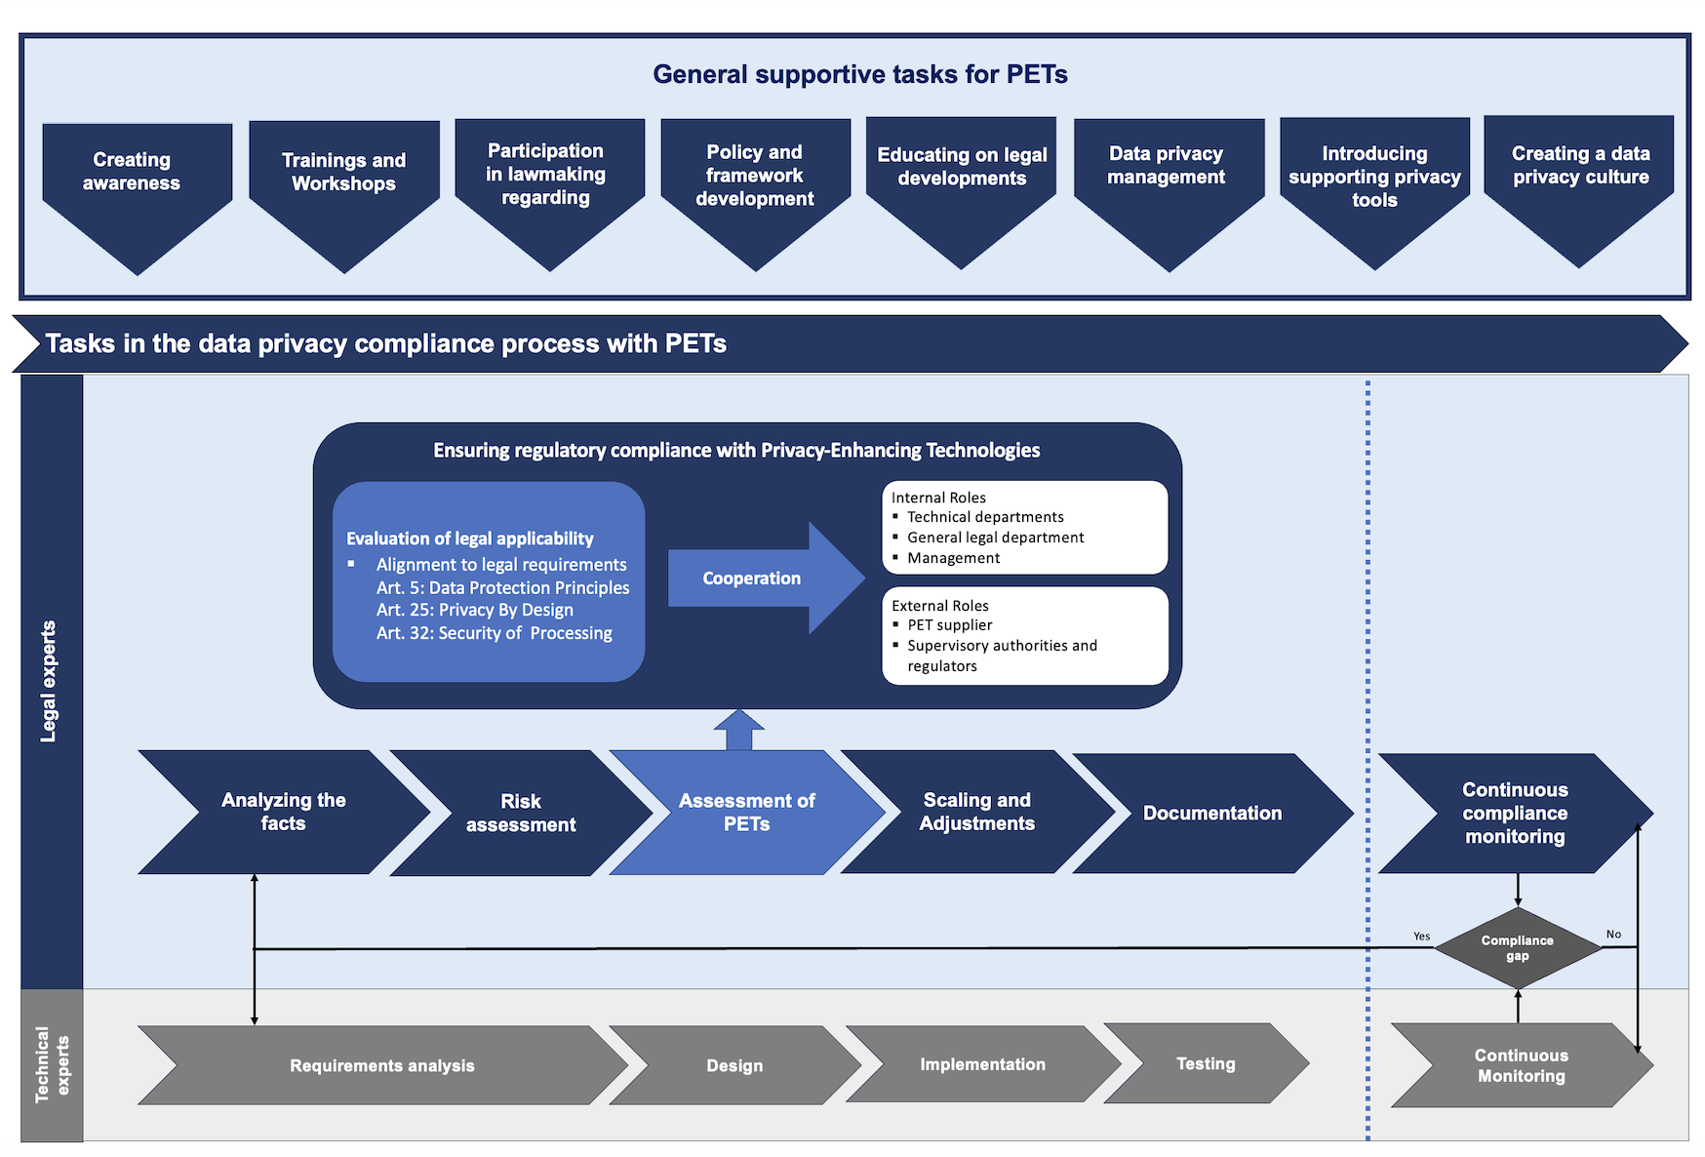
Procedure:
Insights from interviews as basis
Three additional follow-up meetings for validation
General supportive tasks as part of solution strategies
Notes:
Rhomb: Exclusive conditional gateway
Unidirectional Arrow: Links activities, events, and gateways within the process

Slide 15
RQ2
What are the obstacles and challenges faced by legal professionals in the process of data privacy compliance when Privacy-Enhancing Technologies are used?
Notes:
Data protection assesment
exakte Beschreibung der geplanten Verarbeitungsvorgänge und der jeweiligen Verarbeitungszwecke sowie etwaiger berechtigter Interessen des Verantwortlichen.
Privacy by design mandates
.. PETs can help to fulfill this requirement s

Slide 16
Challenges and Obstacles
Regulatory-legal
6 challenges
Technical-legal
5 challenges
Organizational
4 challenges
15 challenges were identified

Slide 17
Regulatory – Legal Challenges
C | Challenge | Mentions
C1 | Regulatory and legal vagueness | 13
C2 | PETs mostly not state-of-the art | 5
C3 | Applicability of PETs to existing law | 7
C4 | Case-by-Case Asessment | 10
C5 | Liability issues | 4
C6 | Massive amount of laws | 7
Regulatory ambiguities in privacy regulations like the GDPR, which can pose challenges in selecting and implementing PETs
Difficult alignment of Privacy-Enhancing Technologies to the laws and regulations
Challenging to ensure that PETs align with evolving technology standards while balancing innovation with compliance
Challenging integration of PETs into current legal frameworks, conducting case-specific assessments, managing liability, and addressing diverse data privacy regulations
„The whole article 25 […] It’s all undetermined. There are no limits, there are no thresholds.“ (I-7)
„What is it, what is the consequence of using such a technology?.“ (I-4)
„Just because what you write today may be obsolete the day after tomorrow.” (I-12)
„But it always depends on the individual case, on the specific processing, and then you have to see if it works or not.“ (I-7)

Slide 18
Technical – Legal Challenges
C | Challenge | Mentions
C1 | Difficulties in interdisciplinary collaboration | 8
C2 | Lack of awareness for PETs | 9
C3 | IT-security vs. data privacy | 4
C4 | Insufficient Technical Expertise | 10
C5 | Different Dynamics of Law and Technology | 7
Communication problems in collaboration due to different expertise and “language“
Limited awareness and understanding of Privacy-Enhancing Technologies among legal professionals
Potential conflicts between IT security practices and data privacy requirements
Law evolves slowly and endures over time, technology rapidly advances, driven by constant innovation
„This is a challenge for me as a lawyer, of course, because it requires that I can do it and that I understand it. So, it’s not the English language, but the technical language.“ (I-3)
“Lawyers know they (PETs) exist but they are often not well-versed in their implications.” (I-12)
“This kind of technological revolution, if you want to call it that, just takes forever in the legal world.” (I-9)

Slide 19
Organizational Challenges
C | Challenge | Mentions
C1 | Lack of resources | 4
C2 | Late involvement of legal experts | 7
C3 | Demanding collaboration with regulators | 8
C4 | Limited Expertise in Small- and Medium-Sized Organizations | 7
Coping with constrained budgets, personnel, and technical resources, particularly in smaller organizations
Legal experts are often engaged late in compliance processes, potentially leading to data privacy compliance gaps
Collaboration with regulators to ensure alignment of PETs with evolving data privacy regulations and standards is often challenging
„The perception is likely to be that it slows down development. And that it always costs a lot of money.” (I-6)
„It is a big problem that the project is developed and then legal advice is sought.“ (I-2)
„Regulators usually tell you what not to do. But they don’t tell you how to do it.“ (I-8)

Slide 20
RQ3
What strategies can be implemented to increase the ability of legal experts to support data privacy compliance when Privacy-Enhancing Technologies are used?
Notes:
Data protection assesment
exakte Beschreibung der geplanten Verarbeitungsvorgänge und der jeweiligen Verarbeitungszwecke sowie etwaiger berechtigter Interessen des Verantwortlichen.
Privacy by design mandates
.. PETs can help to fulfill this requirement s

Slide 21
Solution Strategies
Solution | Mentions
Interdisciplinary research and collaboration | 6
Increasing awareness | 6
Fostering collaboration of technical and legal experts | 9
Standardizing data privacy compliance | 12
Improving education | 13
Enhancing guidance | 15

Slide 22
Solution Strategies
Solution | Mentions
Interdisciplinary research and collaboration | 6
Increasing awareness | 6
Fostering collaboration of technical and legal experts | 9
Standardizing data privacy compliance | 12
Improving education | 13
Enhancing guidance | 15

Slide 23
Fostering Collaboration of Technical and Legal Experts
Solution | Mentions
Cross-functional teams | 7
Cross-functional training | 5
Supporting tools | 8
Cross-functional teams can foster early and open collaboration between technical and legal departments, clear communication and defined roles
Cross-functional training bridges the knowledge gap between legal and technical teams, optimizing the implementation and understanding of PETs
Visualization, a shared glossary, and PET-specific checklists improve collaboration between legal and technical teams
Improved collaboration fosters mutual understanding and trust, bridging the technical-legal gap and enhancing legal experts‘ ability to support PETs for data privacy compliance
“Both teams need to have a minimum understanding of each other’s function.” (I-15)
„I really think that the closer you get to the technical side, the better advice you can give because it really comes down to the details and really understanding both the purpose of whatever the technology is and how it works.“ (I-15)
„But our goal is always to get involved in things like that as early as possible.“ (I-8)

Slide 24
Improving Education
Solution | Mentions
Law curriculum | 7
Training | 8
Continuous learning | 7
Integrating seminars on PETs into the law curriculum, coupled with interdisciplinary courses and hands-on training, equips legal professionals with foundational technical understanding
Specialized training, hackathons, and continuous learning sessions like Tech Talks equip legal professionals with a broader understanding of PETs
Legal experts must continuously adapt and educate themselves on emerging technologies, there is a need for more PET-focused educational resources
Equips legal professionals with foundational technical understanding, facilitating effective collaboration with tech experts.
„It may be that tomorrow a new project comes along and I have to completely familiarize myself with it. Then I really work my way in until I understand the product.“ (I-6)
„At that time, we were offered a course and paid for a course, so these are, as I say, already such points that help a lot. Yes, and that is something, you just have a huge advantage over someone who only had the legal training and nothing else.“ (I-5)
„You need a better symbiosis or cooperation between law and technology. The head of the unit has always said that we need a mixed degree, or privacy, or even privacy as a major.“ (I-7)

Slide 25
Enhancing Guidance
Solution | Mentions
Legal applicability | 12
Improving collaboration | 11
Advocate for comprehensive regulatory guidance on PETs, including e.g. clear definitions, risk assessment methodologies, and an updated list of state-of-the-art PETs
Promoting technical expertise within supervisory authorities and integrating PETs into national data and AI strategies
Strengthen cooperation with supervisory authorities, fostering dialogue and utilizing regulatory sandbox systems
Legal experts are equipped with guidance required to effectively support the usage of Privacy-Enhancing Technologies in data privacy compliance.
„Yes, so it would be nice to have some consolidation and not have it all solved at the state level. So that makes it very difficult.“ (I-5)
„If the regulator says this is the way it fits, then it gives me the authority to tell my clients, there has to be something better first” (I-3).
„And the only thing I’ve really seen so far are these sandbox systems.“ (I-7)

Slide 26
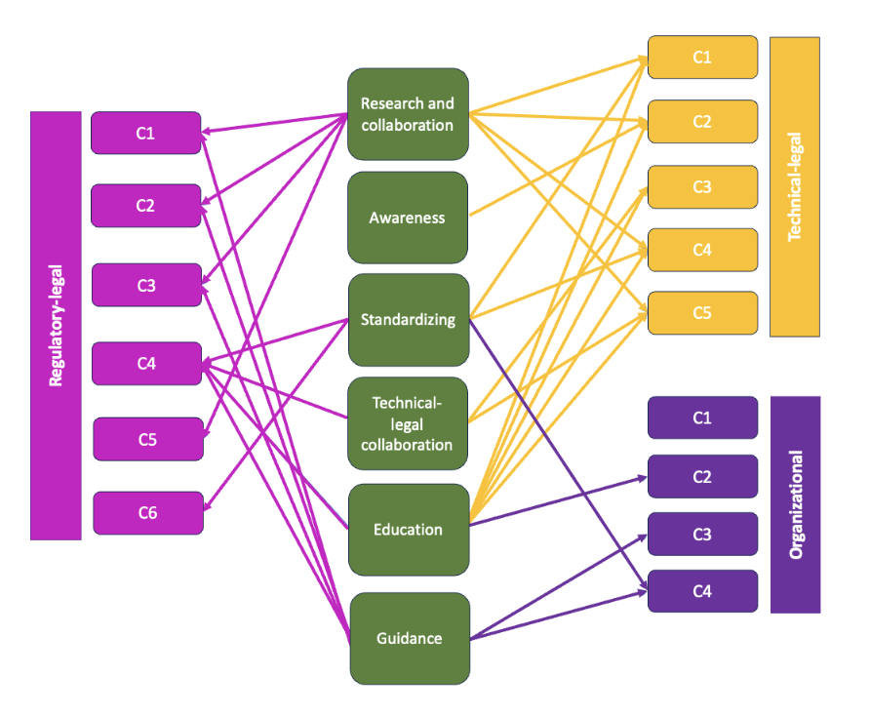
Challenges-Solutions Mapping

Slide 27
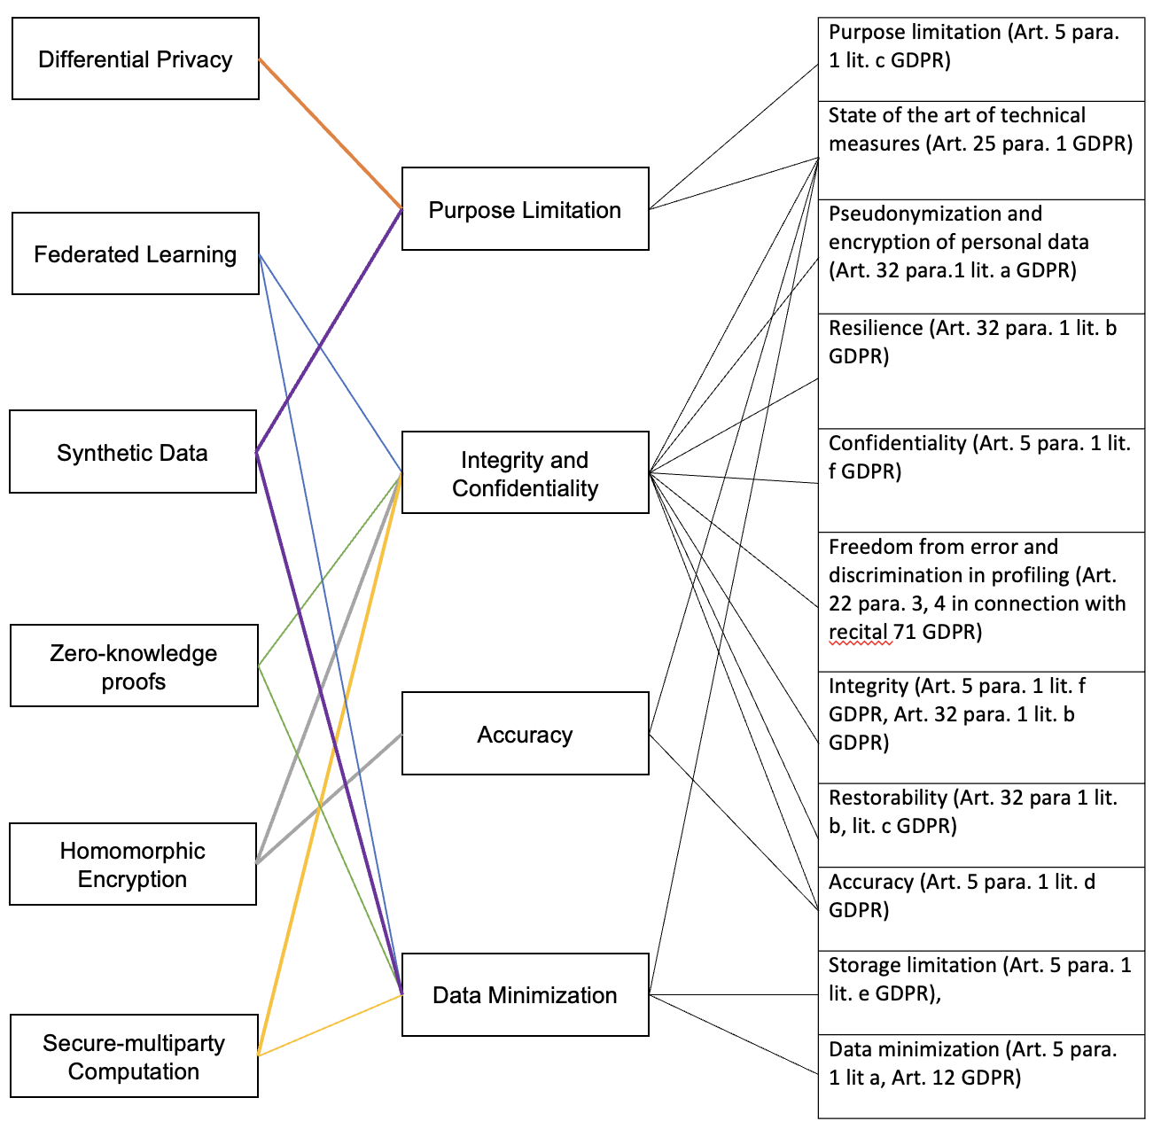
Mapping Privacy-Enhancing Technologies and Data Protection Principles
Procedure:
Based on existing literature (ICO´s PETs guide, Standard Data Protection Model) and interview insights
One hour interview with regulator from the technical department for validation
Feedback from two legal experts
„Because in risk analysis, for example, it can sometimes come out that, […] we are processing far too much data. […] Which mitigating measure, which PET could I use? And then you can say, okay, Secure multi-party computation.“ (I-8)
„I just want to use the data, as much as I need and as little as possible, then I look what technologies I can use to do that.“ (I-5)
Notes:
Methodology: rechts oben → highlight

Slide 28
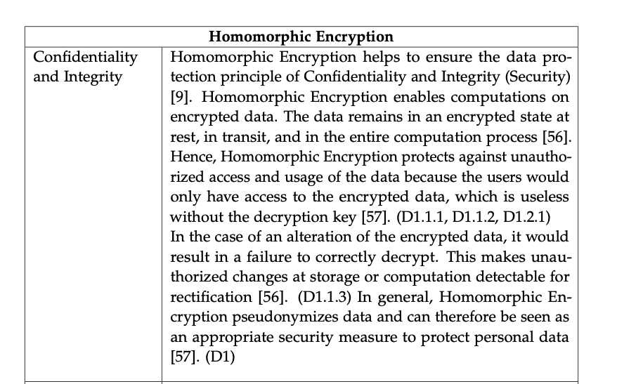
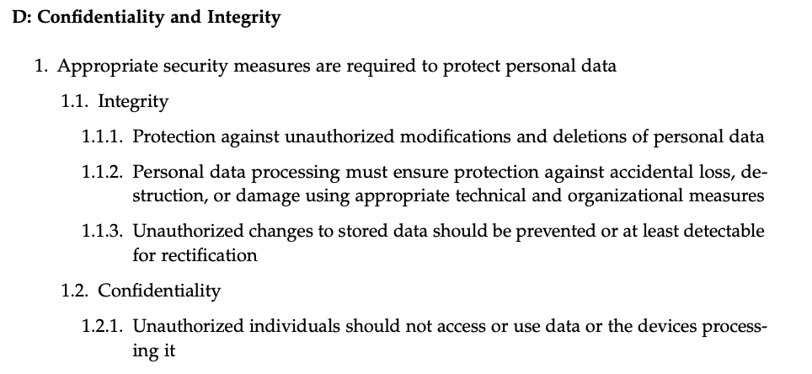
Mapping Privacy-Enhancing Technologies and Data Protection Principles
„And if a PET or a technical mechanism is suitable to achieve these protection goals […]then it is also intended for compliance, so to speak. […] I just have to be able to somehow prove that the technical mechanism that I have will help to achieve a legal objective. And that proof is necessary.“ (I-12)

Slide 29
Outline
Motivation and Background
Methodology
Findings
Discussion

Slide 30
Discussion
Limitations
Interviews
More participants
More medium- and small-sized organizations
Different regions
Different roles
Future Research
Legal Applicability of PETs
Education and Training
Technical-legal cooperation
Organizational factors

Slide 31
Hannah Kiel
17132
matthes@in.tum.de

