Slide 1
Exploring Domain Adaptation Techniques for Abstractive Text Summarization
Aditi Arora, 28.11.2022, Guided Research Kick-off presentation

Slide 2
Outline
Problem Statement
Proposed Solution
Approaches of Text Summarization
Models
Domain Adaption
Basics
DA in NLP
DA in Text Summarization
Research Questions
References

Slide 3
Text Summarization of domain specific documents : Problem Statement
Text summarization is the process of generating short, fluent, and most importantly accurate summary of a respectively longer text documents. While manual processing is possible, it has following drawbacks.
Time Consuming
Erroneous
Requires Domain Expertise.
Costly
Biased

Slide 4
Proposed Solution: Automatic Text Summarization
Automatic text summarization is a subfield of NLP which aims at automatically shortening the content of a textual information source in a way that retains its most important information. Some of the key features of Automatic Text summarization are:
Produces a concise and fluent summary
Preserves the meaning of the original text document
Does not contain repetition of the same information
Does not require domain expertise

Slide 5

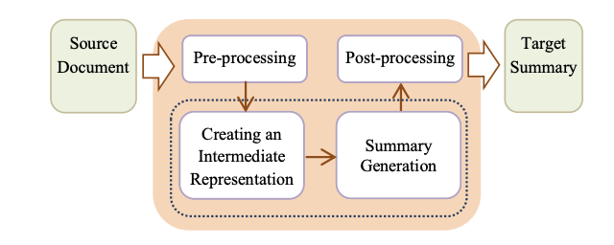
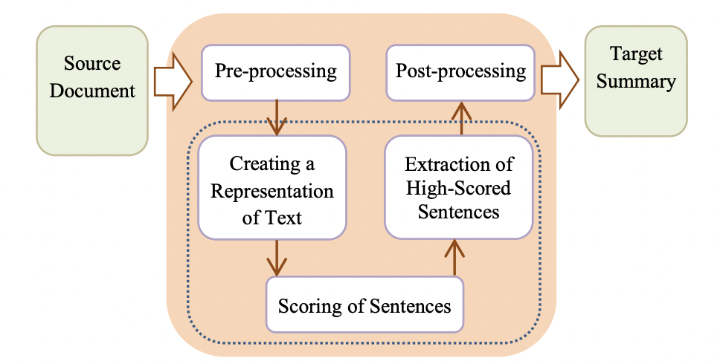
Automatic Text Summarization : Approaches
Abstractive Text Summarization
Uses advanced NLP (i.e., word embeddings) to understand the semantics of the text and generate a meaningful summary.
Image: Abstractive Text Summarization Architecture (Wafaa et al.)
Extractive Text Summarization
Selects the most important sentences within a text (without necessarily understanding the meaning), therefore the result summary is just a subset of the full text.
Image: Extractive Text Summarization Architecture (Wafaa et al.)
Image: Abstractive Text Summarization Architecture (Wafaa et al.)

Slide 6
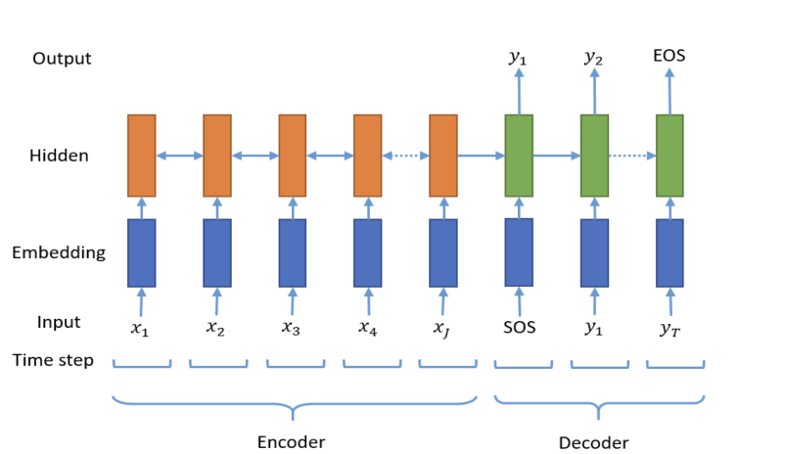
Automatic Text Summarization : Models
Sequence-to-Sequence Modeling (Seq2Seq)
Seq2Seq model use encoder decoder architecture to generate summary of text provided as input.
Encoder: Reads the input and generates a context vector which is passed on the decoder.
Decoder: The decoder unit generates an output sequence based on the context vector.
Research Focus: State-of-the-art Transformer-based Models
Neural Abstractive Text Summarization with Sequence-to-Sequence Models

Slide 7
Automatic Text Summarization: Transformer-based Models
Why transformer-based models?
Transformer encoder-decoder models are more effective at modelling the dependencies present in the long sequences encountered in summarization.
Transformer models combined with self-supervised pre-training have shown to be a powerful framework for producing general language learning, achieving state-of-the-art performance when fine-tuned on a wide array of language tasks.
GPT-2
BERT
RoBERTa
BigBird
Pegasus
BART

Slide 8
Domain Adaptation : Basics
Domains
Financial Text
Scientific Paper
Patent Data
Medical Data
Legal Documents
HR Data
Text data can be classified into different domains depending on the context.
One of the key features of domain specific text data is the presence of domain specific cue terms and phrases.

Slide 9
Why do we need domain adaptation techniques in NLP?
Evolving test data is a common problem in NLP.
Changes in this data leads to a shift in training and test set distributions.
Domain adaptation helps in building models that are robust to shift in distributions.
Transformer Based Multi-Source Domain Adaptation

Slide 10
Why do we need domain adaptation techniques in text summarization?
Training a model to generate meaningful and coherent summaries requires large amount of labelled data.
Acquiring large amount of labelled data for different domains is expensive .
Lack of labelled data in new domains affects the quality of generated summaries.
Domain adaptation techniques allow a summarization system to learn content selection from out-of-domain data while acquiring language generating behaviour with in-domain(target) data.

Slide 11
Research Questions
Question 1:
What are the state-of-art transformer-based models for abstractive text summarization?
Question 2:
Which techniques are used for domain adaptation in NLP?
Question 3:
Which domain adaptation techniques are suitable for abstractive text summarization?

Slide 12
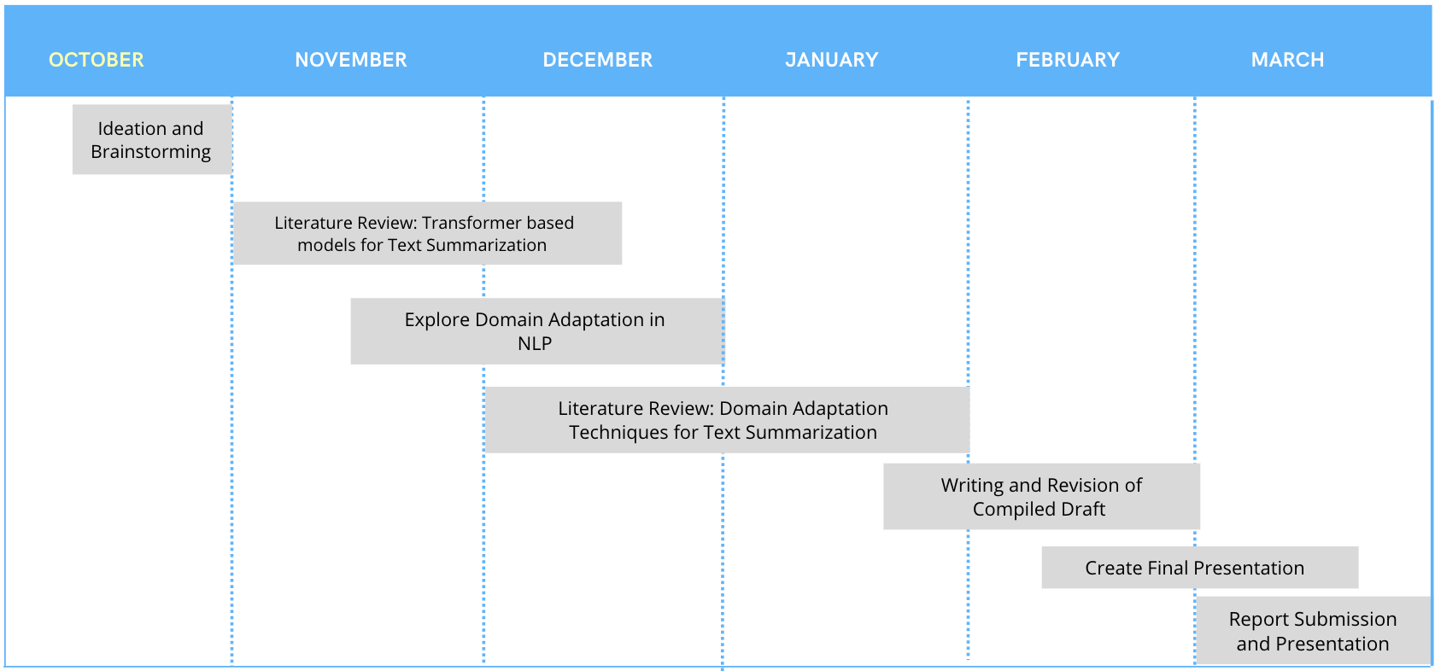
Timeline

Slide 13
References
Hua, X. and Wang, L., 2017. A pilot study of domain adaptation effect for neural abstractive summarization. arXiv preprint arXiv:1707.07062.
Klymenko, O., Braun, D. and Matthes, F., 2020. Automatic Text Summarization: A State-of-the-Art Review. ICEIS (1), pp.648-655.
Sarkar, K., 2009. Using domain knowledge for text summarization in medical domain. International Journal of Recent Trends in Engineering, 1(1), p.200.
El-Kassas, W.S., Salama, C.R., Rafea, A.A. and Mohamed, H.K., 2021. Automatic text summarization: A comprehensive survey. Expert Systems with Applications, 165, p.113679
https://ai.googleblog.com/2020/06/pegasus-state-of-art-model-for.html

Slide 14
Aditi Arora
M.Sc. Student Data Engineering and Analytics
17132
aditi.arora@tum.de

Slide 15
Automatic Text Summarization: Transformer-based Models
Why open-sourced datasets?
Datasets are easily accessible and can be used for benchmarking.
Results are reproducible.
Results can be easily published.
ALBERT
BART

Slide 16
Automatic Text Summarization: Datasets???????
Some of the available open-source datasets:
English-language dataset containing just over 300k unique news articles as written by journalists at CNN and the Daily Mail along with the highlights.
Bigpatent consists of 1.3 million records of U.S. patent documents along with human written abstractive summaries.
CNN Daily Mail
BIGPATENT
BillSum
NewsRoom
NEWSROOM is a large dataset for training and evaluating summarization systems. It contains 1.3 million articles and summaries written by authors and editors in the newsrooms of 38 major publications.
BillSum, summarization
of US Congressional and California state bills. It contains bill text along with the summaries.

