Slide 1
Generative Question Answering for a Chatbot in the Human Resources Domain
Tao Xiang, 14.10.2022, Kick-Off Presentation

Slide 2
Outline
1 Motivation
2 Problem Statement and Goal of the Guided Research
3 Research Questions
4 Approaches
5 Timeline
221013 Tao Xiang Guided Research Kick-off

Slide 3
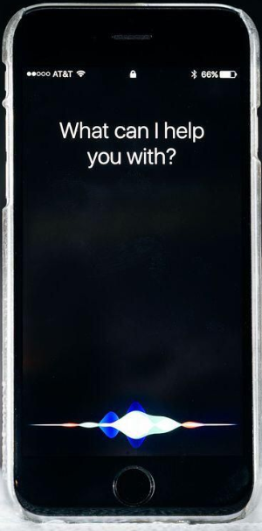

What is a chatbot?
A chatbot is a type of software that helps user by automating conversations and interact with them through messaging platforms.
221013 Tao Xiang Guided Research Kick-off

Slide 4

Example: HR Chatbot
Functionality
Provide Information
Conversation
Benefits
Easy Accessibility
source
Efficient
221013 Tao Xiang Guided Research Kick-off
Notes:
slide3

Slide 5
Motivation
currently >330.000 HR tickets per year in SAP
the target is to cover about 30% of the ticket volume via bot functionality
current solution: retrieval-based model
60% retrieval accuracy
221013 Tao Xiang Guided Research Kick-off
Notes:
slide4

Slide 6
Motivation
currently >330.000 HR tickets per year
the target is to cover about 30% of the ticket volume via bot functionality
current solution: retrieval-based model
60% retrieval accuracy
We want a better solution (DL-based)!
221013 Tao Xiang Guided Research Kick-off
Notes:
slide4

Slide 7
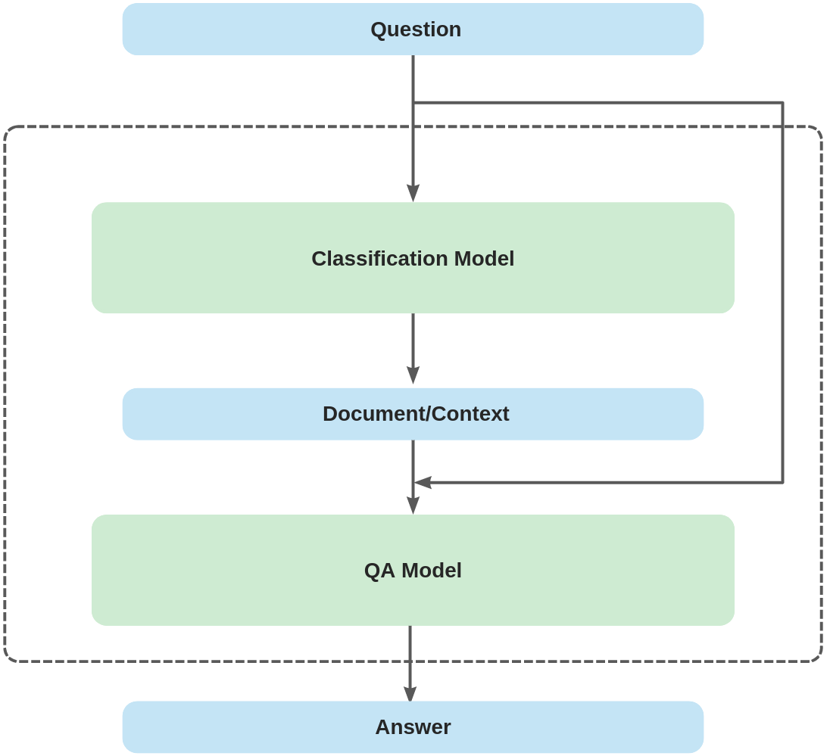
Aside: Framework Structure
221013 Tao Xiang Guided Research Kick-off

Slide 8
Outline
1 Motivation
2 Problem Statement and Goal of the Guided Research
3 Research Questions
4 Approaches
5 Timeline
221013 Tao Xiang Guided Research Kick-off

Slide 9
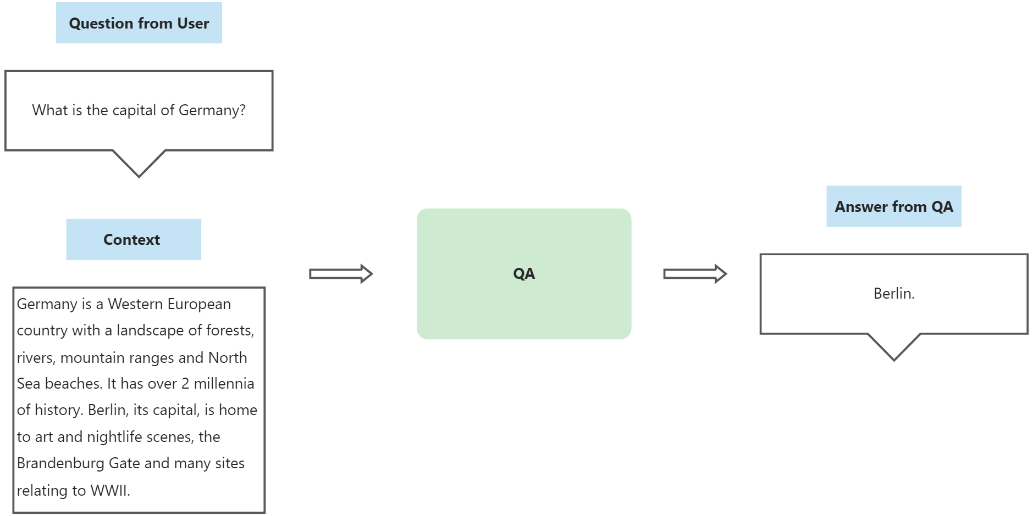
Problem Statement and Goal of the Guided Research
We need to train a domain-specific generative QA system
221013 Tao Xiang Guided Research Kick-off

Slide 10
Domain-Specific vs Open-Domain
Geography
Media
History
“Everything”
(e.g. ChatGPT)
Sports
domain-specifc
open-domain
221013 Tao Xiang Guided Research Kick-off
Notes:
our domain: HR

Slide 11
Domain-Specific vs Open-Domain
Geography
Media
History
HR
Sports
Our specific domain
221013 Tao Xiang Guided Research Kick-off
Notes:
our domain: HR

Slide 12
Generative vs Rule-Based
Generative
no templates
“open-ended”
“I think the captical of Germany is Berlin”
Rule-Based
with templates
manually designed
“The captical of $Country$ is $City$”.
221013 Tao Xiang Guided Research Kick-off
Notes:
focus on generative

Slide 13
Generative vs Rule-Based
Generative
no templates
“open-ended”
“I think the captical of Germany is Berlin”
Rule-Based
with templates
manually designed
“The captical of $Country$ is $City$”.
221013 Tao Xiang Guided Research Kick-off
Notes:
focus on generative

Slide 14


Aside: Dialogflow and Rasa
Two conversational AI frameworks:
user intent identification
intents: manually designed
response generation
rule-based
221013 Tao Xiang Guided Research Kick-off
Notes:
other approaches; red font(transition)

Slide 15
Aside: Dialogflow and Rasa
Two conversational AI frameworks:
user intent identification
intents: manually designed
response generation
rule-based
Downside: not scalable and manageable
221013 Tao Xiang Guided Research Kick-off
Notes:
other approaches; red font(transition)

Slide 16
Outline
1 Motivation
2 Problem Statement and Goal of the Guided Research
3 Research Questions
4 Approaches
5 Timeline
221013 Tao Xiang Guided Research Kick-off

Slide 17



Research Question
Would efficient Transformers be able to effectively encode longer sequences to support GQA?
Would semi-supervised learning framework with human in the loop provide quality data to improve the model performance?
Which analytical scores would be ideal to evaluate the performance of the models?
221013 Tao Xiang Guided Research Kick-off

Slide 18
Outline
1 Motivation
2 Problem Statement and Goal of the Guided Research
3 Research Questions
4 Approaches
5 Timeline
221013 Tao Xiang Guided Research Kick-off

Slide 19
Approach
Literature Review
Prepare Dataset
Train Efficient Transformers
Experiments
221013 Tao Xiang Guided Research Kick-off
Notes:
literature review; arrow

Slide 20
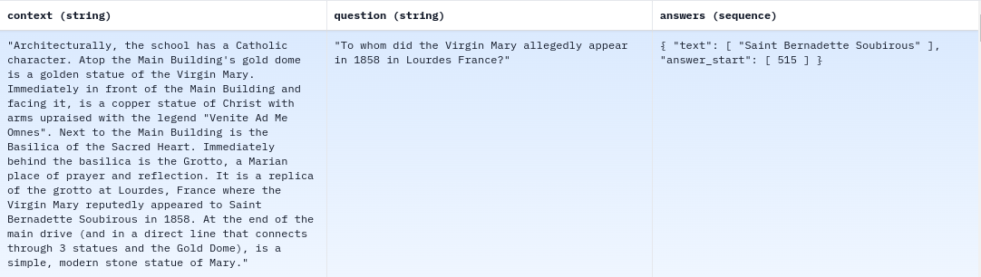
Approach - SQuAD Dataset
Stanford Question Answering Dataset (SQuAD):
a reading comprehension dataset
questions posed by crowdworkers on Wikipedia articles
open-domain
source
221013 Tao Xiang Guided Research Kick-off

Slide 21
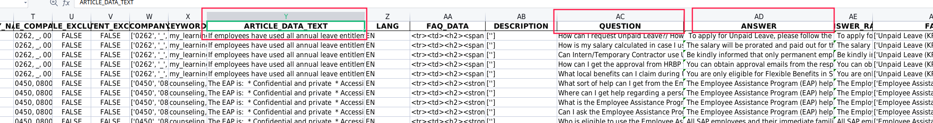
Approach - SAP Dataset: Similarity_df.csv

Slide 22
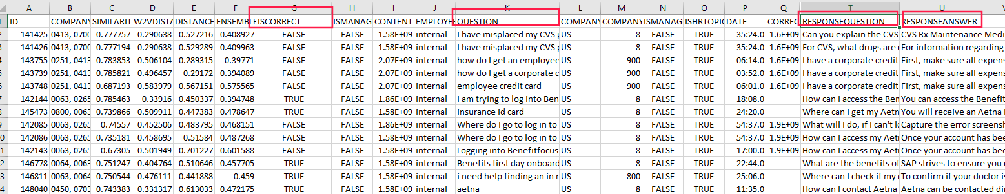
Approach - SAP Dataset: HIL.csv
221013 Tao Xiang Guided Research Kick-off
Notes:
a few samples?

Slide 23
Approach - SAP Dataset: HIL.csv
Some selected columns:
QUESTION: raw user input
RESPONSEQUESTION: retrieved quesiton by current bot
RESPONSEANSWER: the corresponding answer of the retrieved question
ISCORRECT: whether the retrieving is correct
221013 Tao Xiang Guided Research Kick-off
Notes:
a few samples?

Slide 24
Approach - Models
Efficient
Transformer
e.g. “LongT5”
GPT
T5
BART
Models
221013 Tao Xiang Guided Research Kick-off
Notes:
efficient transformers

Slide 25
Approach - Training
Pre-train on Open-Source Dataset
Fine-tune on SAP training set
Training Procedure
221013 Tao Xiang Guided Research Kick-off

Slide 26
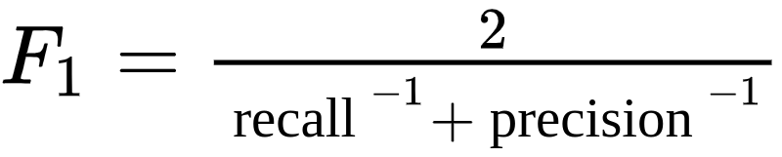
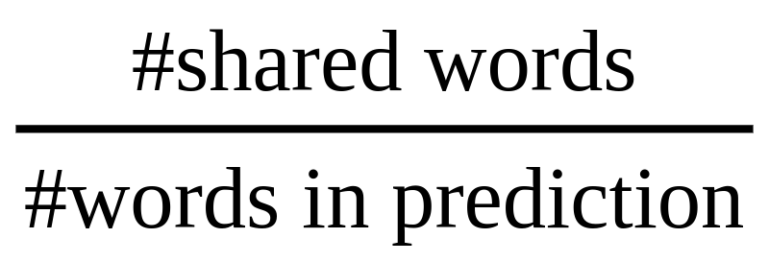
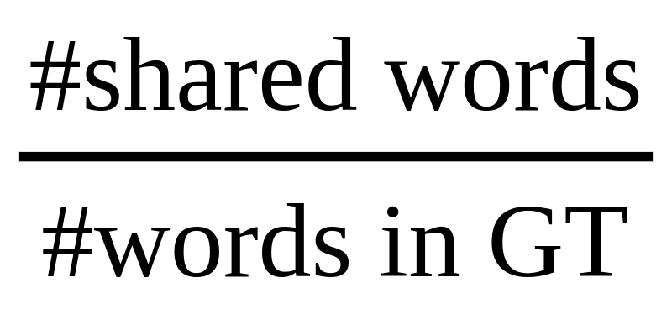
Approach - Evaluation
Exact Match (EM)
EM = 1 if the prediction exacly matches one of the true answers, otherwise 0
F1-Score
precision:
recall:
BLEU
ROUGE
…
221013 Tao Xiang Guided Research Kick-off
Notes:
bert score; more details

Slide 27
Approach - Experiments
We compare the performance of different efficient transformers.
Baseline: current retrieval model
Experimental Dataset: the test sets of the two SAP datasets
(question, context, answer) tuples
Metric 1: sentence similarity metrics
token-level metrics: BLEU, ROUGE, etc
neural metrics: BERTScore, other models for sentence similarity
human evaluation
Metric 2: Efficiency (computation time & memory requirement)
221013 Tao Xiang Guided Research Kick-off
Notes:
bert score; more details

Slide 28
Outline
1 Motivation
2 Problem Statement and Goal of the Guided Research
3 Research Questions
4 Approaches
5 Timeline
221013 Tao Xiang Guided Research Kick-off

Slide 29
Timeline
Literature Review
Data Cleaning
Experimentation
Report
15.11.2022
15.12.2022
01.01.2023
01.04.2023
15.04.2023
221013 Tao Xiang Guided Research Kick-off

Slide 30
Thank you!
221013 Tao Xiang Guided Research Kick-off

Slide 31
Aside: Structure
221013 Tao Xiang Guided Research Kick-off

Slide 32
Prof. Dr.
Florian Matthes
Inhaber des Lehrstuhls
17132
matthes@in.tum.de

