Slide 1
Formalizing and automating regulatory document versioning
Thien-An Huynh, Master Thesis Kick-Off Presentation

Slide 2
Keeping track of different regulatory document versions is messy and difficult!
1. Motivation
2. Automatic Consolidation
2.1. Research Questions
2.2. Existing Solutions
2.3. Thesis Contribution
3. Timeline
4. Recap & Questions

Slide 3
Keeping track of different regulatory document versions is messy and difficult!
1. Motivation
2. Automatic Consolidation
2.1. Research Questions
2.2. Existing Solutions
2.3. Thesis Contribution
3. Timeline
4. Recap & Questions

Slide 4
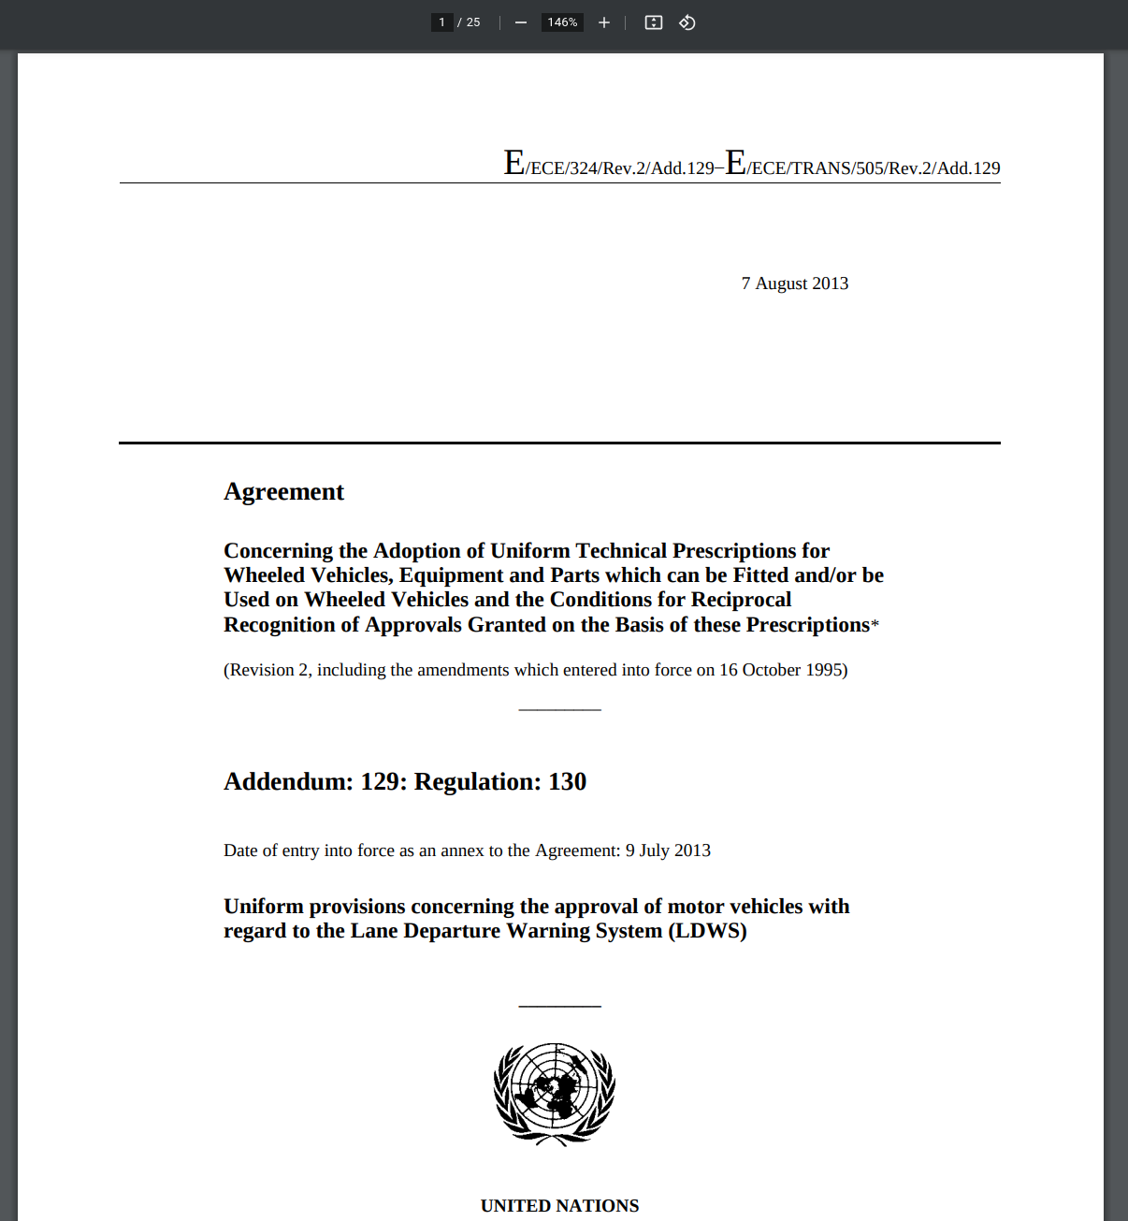
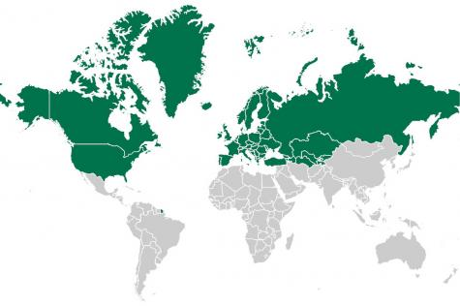
Terminology
UNECE
United Nations Economic Commission for Europe
56 member states
1.0 enforced

Slide 5
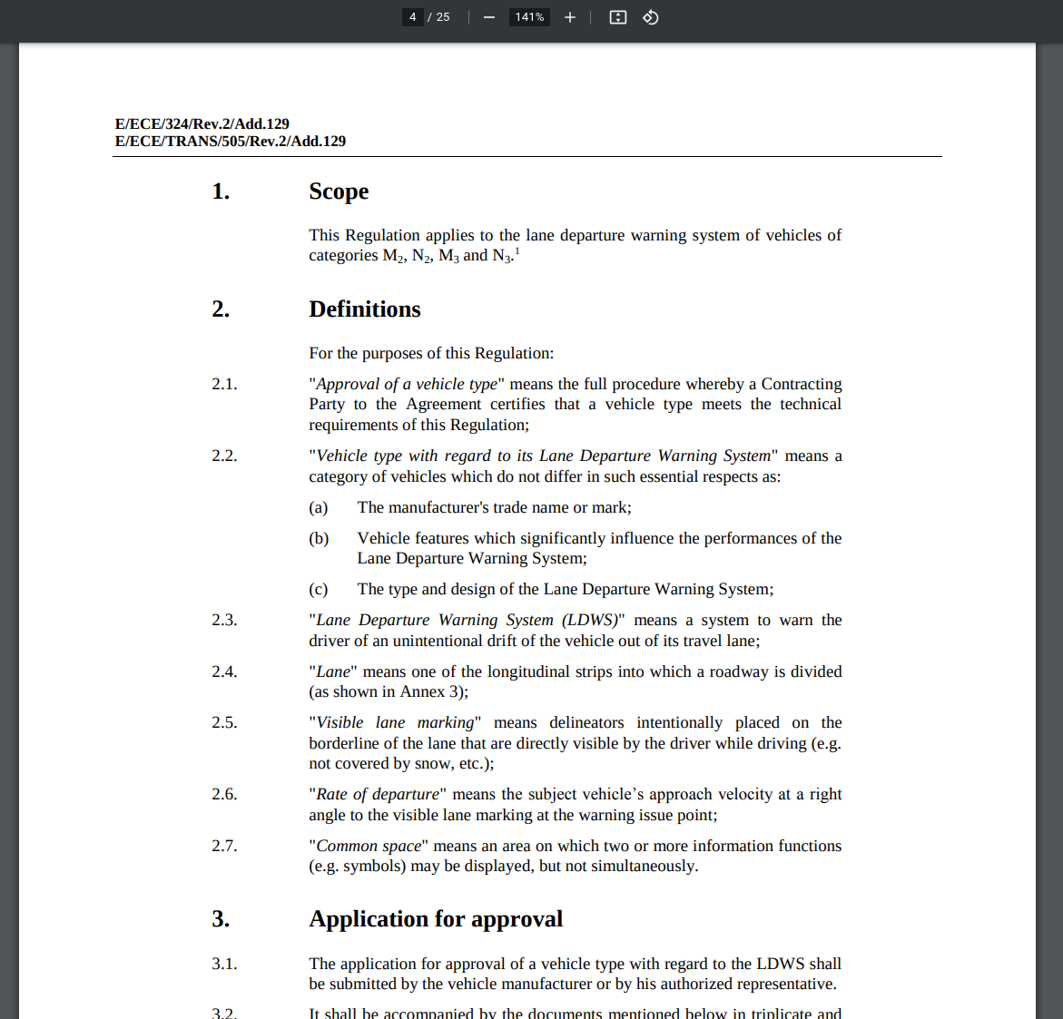
Terminology
1.0 enforced
Base Document
Contains every element of the regulation according to its current version
Example: UNR-130 regarding Lane departure warning systems

Slide 6
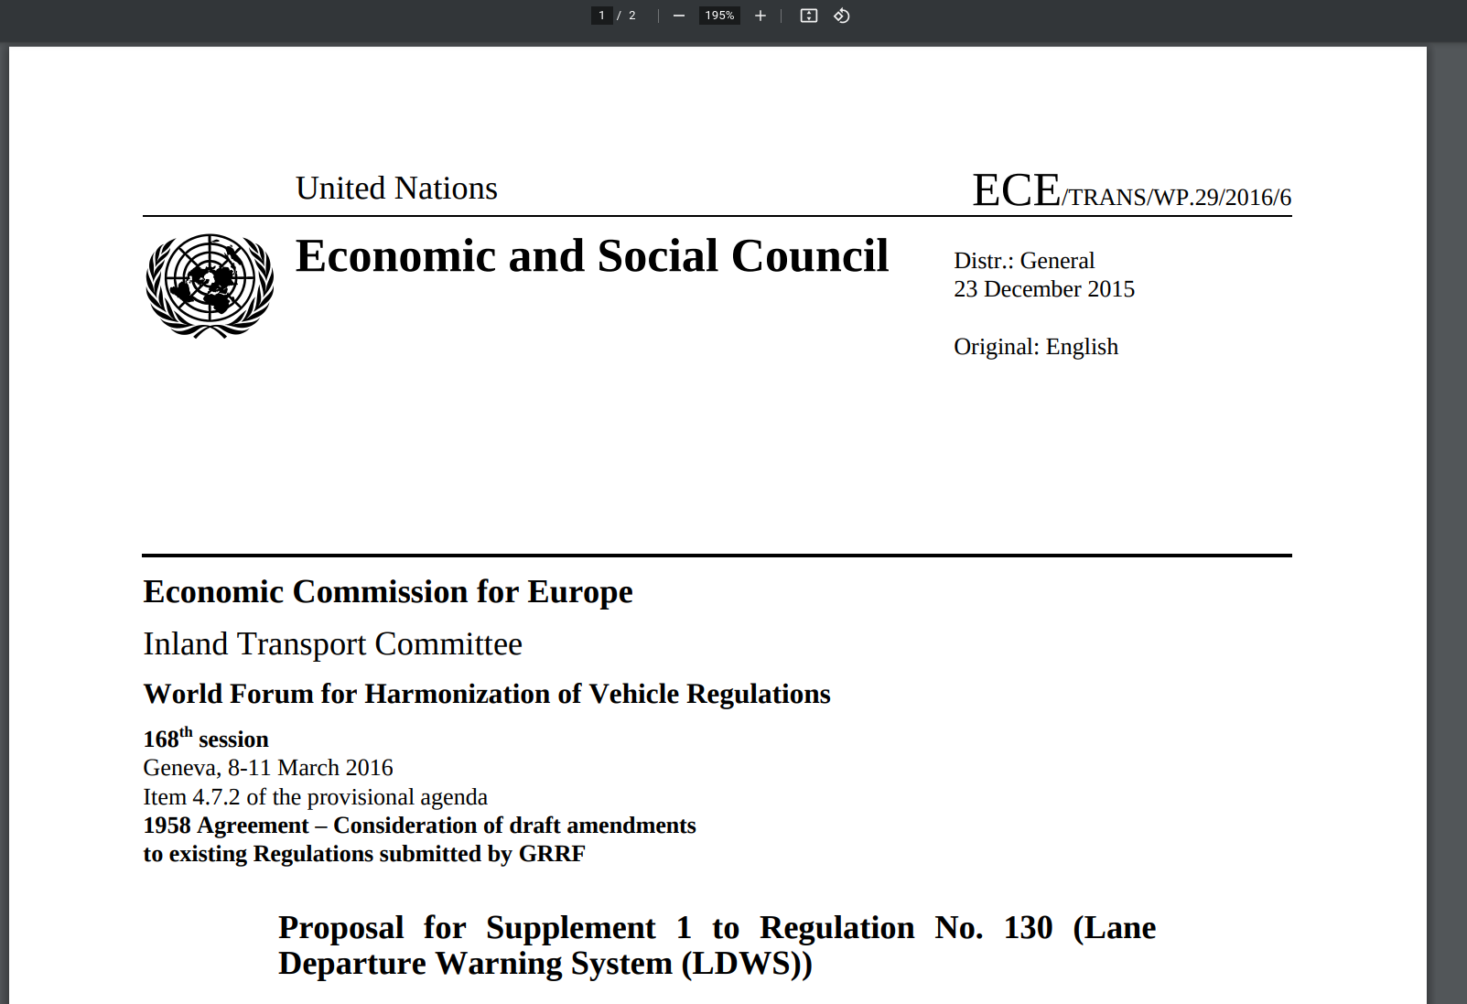
Terminology
Delta Document
Merely contains instructions how to amend base document in order to create new version
1.1 proposed

Slide 7
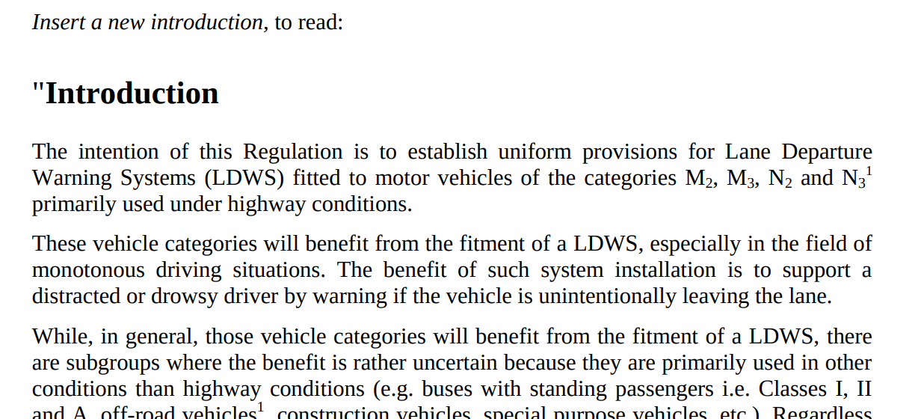
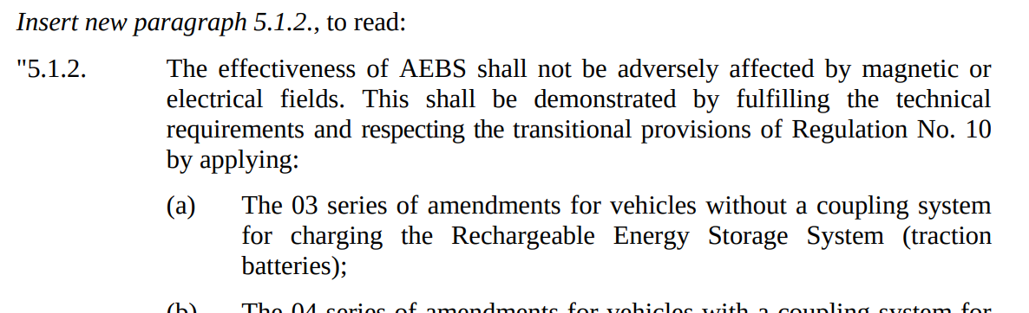
Terminology
Delta Document
Merely contains instructions how to amend base document in order to create new version
1.1 proposed

Slide 8
Terminology
How to get the full document for proposed version 1.1?
Consolidation
Delta
Document
Consolidated
Document
Consolidated
Document
Base
Document
Consolidation

Slide 9




Example: Regulation Updates
1.0 enforced
1.1 proposed/p1
1.1 proposed/p2
1.1 proposed/p3
Vote
1.1 adopted
After ~6 Months
1.1 enforced
1.2 proposed
2.0 proposed
1.2 adopted
2.0 adopted
Base Document
Delta Documents
Consolidated
1.2 enforced
2.0 enforced

Slide 10
Example: Consolidation
1.0 enforced
1.1 proposed
1.1 adopted
1.1 enforced
1.2 proposed
1.2 adopted
1.2 enforced
1.1 proposed
=
1.0 enforced
+
1.1 proposed
1.1 enforced
=
1.0 enforced
+
1.1 enforced
1.2 enforced
=
1.0 enforced
+
1.1 enforced
+
1.2 enforced
=
=
1.1 enforced
+
1.2 enforced

Slide 11
Terminology
Base Document
Delta Document
Contains every element of the regulation according to its current version
Merely contains instructions how to amend base document in order to create new version
Consolidation
Delta
Document
Base
Document
Consolidated
Document
Consolidation

Slide 12

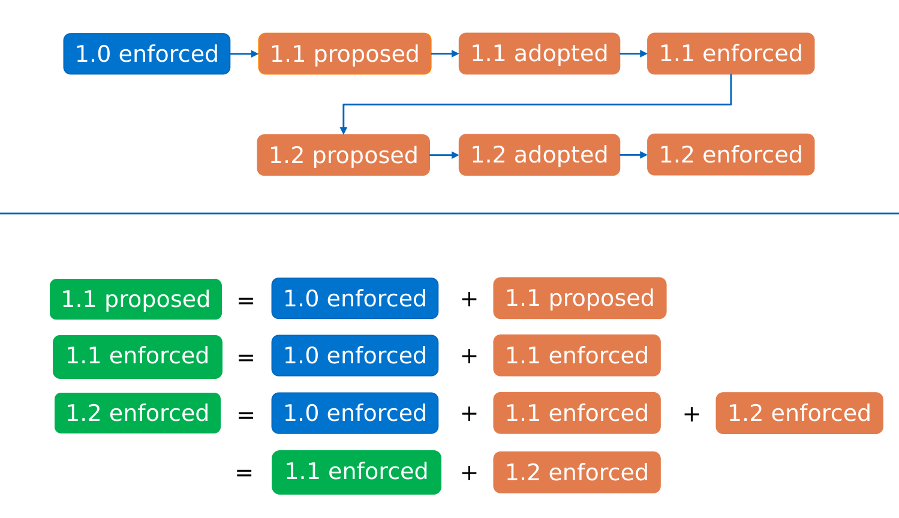

Slide 13
What is currently being done in the industry?
1. Motivation
2. Automatic Consolidation
2.1. Research Questions
2.2. Existing Solutions
2.3. Thesis Contribution
3. Timeline
4. Recap & Questions

Slide 14




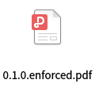



Current Practice in Industry
Issues with manual consolidation: - slow - non-repeatable actions, mistakes are hard to trace - only input / output, little information about amendment logic
human-readable
Manual Consolidation
Issues with PDF format: - not machine readable - cannot be enriched with further information - no easy comparison between versions - not easily searchable / analysable across documents
human-readable

Slide 15
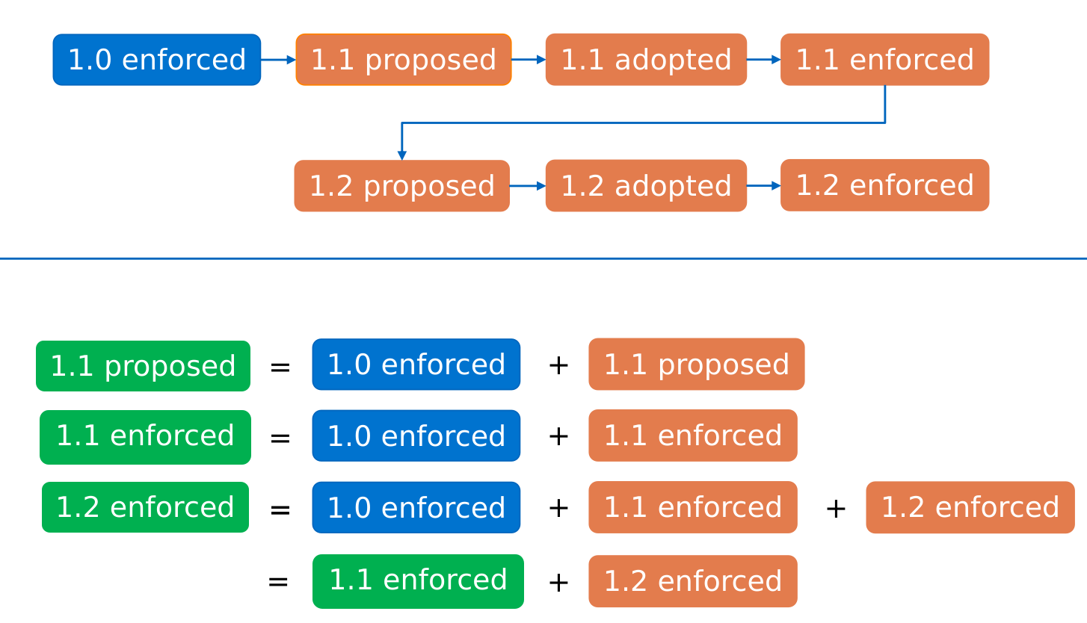
Manual task that is often repeated?

Slide 16
Ultimate Goal: Automatic Consolidation
1. Motivation
2. Automatic Consolidation
2.1. Research Questions
2.2. Existing Solutions
2.3. Thesis Contribution
3. Timeline
4. Recap & Questions

Slide 17
Automatic Consolidation
Happy Path
Parse / Translate
human-readable
Consolidated
Documents
Base Document
+
Amending
Instructions
Engine
machine-readable
machine-readable
Renderer
human-readable

Slide 18
Research Questions:
What are the existing approaches to deal with (automatic) legal consolidation?
How to automatically apply amending instructions to regulations?
How effective is this approach in producing correctly consolidated documents?
1. Motivation
2. Automatic Consolidation
2.1. Research Questions
2.2. Existing Solutions
2.3. Thesis Contribution
3. Timeline
4. Recap & Questions

Slide 19
What is currently being done in research?
1. Motivation
2. Automatic Consolidation
2.1. Research Questions
2.2. Existing Solutions
2.3. Thesis Contribution
3. Timeline
4. Recap & Questions

Slide 20
Systematic Literature Review
Define Query String
Search
590
Filter
("consolidat*" OR "amend*" OR "modific*" OR "change" OR "version control" OR "version*")
("legal" OR "law" OR "norm" OR "regulat*" OR "legisl*")
("formaliz*" OR "automati*" OR "NLP*" OR "natural language processing" OR "machine learning")
Title only in:
Scopus
Web of Science
ACM Digital Library
Google Scholar
IEEExplore
Apply exclusion- and inclusion criteria
17
Backwards and Forwards Reference Search
Repeat Filtering
Summarize and Aggregate Results
21

Slide 21


Literature Review - Results
21 papers after filtering
5 papers:
no special focus on consolidation, general legal formalization
2 papers:
pre-consolidation
14 papers with direct connection to legal consolidation
8 Italian papers
3 Greek papers
1 of each:
- Japanese
- Spanish
- Polish

Slide 22
Automatic Consolidation Pipeline
Parse / Translate
human-readable
Consolidated
Documents
Base Document
+
Amending
Instructions
Engine
machine-readable
machine-readable
Renderer
human-readable

Slide 23
Automatic Consolidation Pipeline
Parse / Translate
human-readable
Consolidated
Documents
Base Document
+
Amending
Instructions
Engine
machine-readable
machine-readable
Renderer
human-readable

Slide 24
Automatic Consolidation Pipeline
Parse / Translate
human-readable
Consolidated
Documents
Base Document
+
Amending
Instructions
Engine
machine-readable
machine-readable
Renderer
human-readable

Slide 25
Research Questions:
What are the existing approaches to deal with (automatic) legal consolidation?
Define Query String
Search
590
Filter
("consolidat*" OR "amend*" OR "modific*" OR "change" OR "version control" OR "version*")
("legal" OR "law" OR "norm" OR "regulat*" OR "legisl*")
("formaliz*" OR "automati*" OR "NLP*" OR "natural language processing" OR "machine learning")
Title only in:
Scopus
Web of Science
ACM Digital Library
Google Scholar
IEEExplore
Apply exclusion- and inclusion criteria
17
Backwards and Forwards Reference Search
Repeat Filtering
Summarize and Aggregate Results
21

Slide 26
Thesis Contribution: 1. Formalize Regulatory Documents into DSL 2. Automate Change Application 3. Verify Results
1. Motivation
2. Automatic Consolidation
2.1. Research Questions
2.2. Existing Solutions
2.3. Thesis Contribution
3. Timeline
4. Recap & Questions

Slide 27
Automatic Consolidation Pipeline
Parse / Translate
human-readable
Consolidated
Documents
Base Document
+
Amending
Instructions
Engine
machine-readable
machine-readable
Renderer
human-readable

Slide 28
Automatic Consolidation Pipeline
Parse / Translate
human-readable
Consolidated
Documents
Base Document
+
Amending
Instructions
Engine
machine-readable
machine-readable
Renderer
human-readable

Slide 29
Automatic Consolidation Pipeline
Parse / Translate
human-readable
Consolidated
Documents
Base Document
+
Amending
Instructions
Engine
machine-readable
machine-readable
Renderer
human-readable

Slide 30

Thesis Contribution - Architecture
Certivity Data Set
Delta Documents in PDF
.json format containing html + corresponding metadata
Contains regulations from at least DE, EU, UN, US regions
Contains consolidated documents, which can be used as ground truth
Translated
by hand
Parse
DSL Base Documents
DSL Delta Documents
Consolidation Engine
Compare
correctness
against
PDF
Consolidated Documents

Slide 31
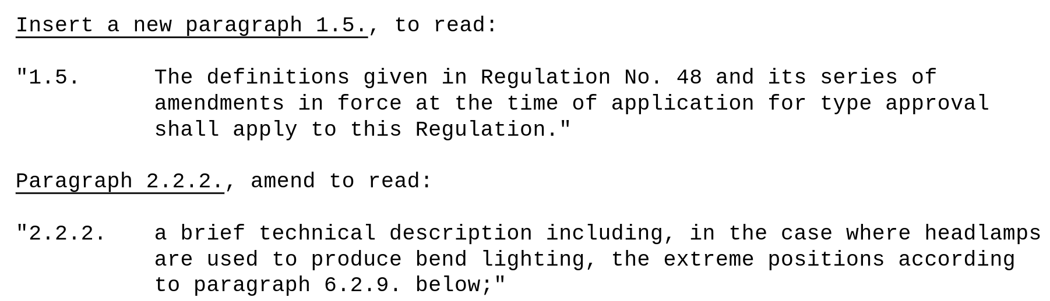
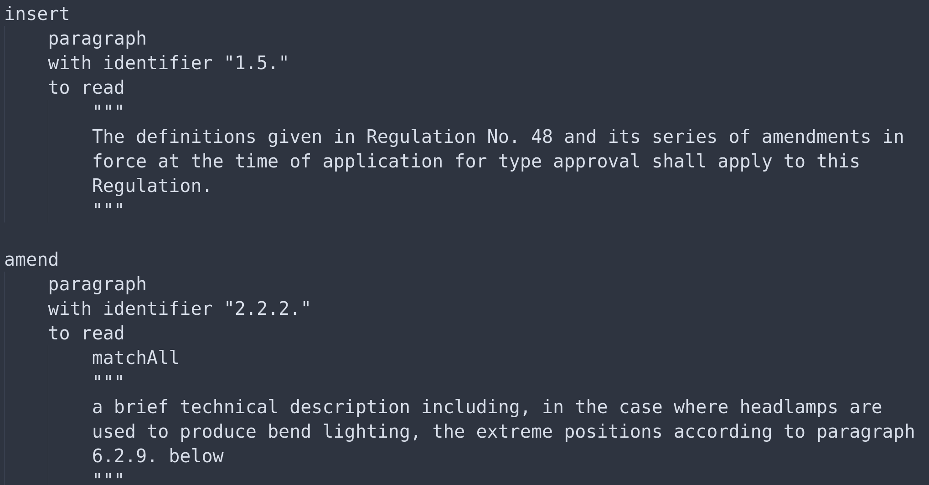
DSL Example - Amendment Modelling
Human readable
&
writable syntax
Markdown for text representation
good html compatibility
intuitive style encoding

Slide 32
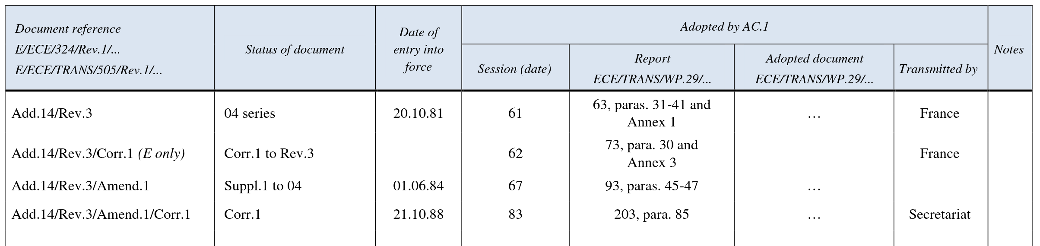
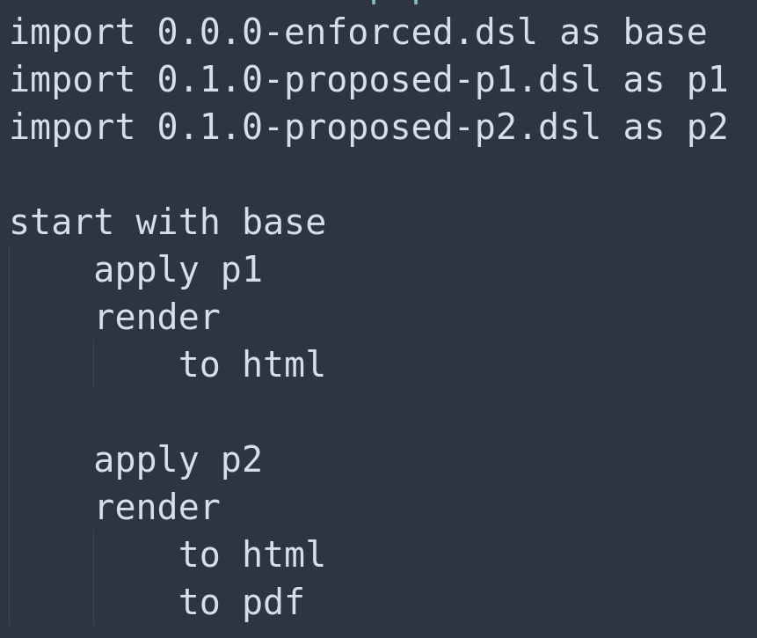
DSL - Automatic Change Application

Slide 33
Research Questions:
How to automatically apply amending instructions to regulations?
Certivity Data Set
Delta Documents in PDF
.json format containing html + corresponding metadata
Contains regulations from at least DE, EU, UN, US regions
Contains consolidated documents, which can be used as ground truth
Translated
by hand
Parse
DSL Base Documents
DSL Delta Documents
Consolidation Engine
Compare
correctness
against
PDF
Consolidated Documents

Slide 34
Research Questions:
How effective is this approach in producing correctly consolidated documents?
Certivity Data Set
Delta Documents in PDF
.json format containing html + corresponding metadata
Contains regulations from at least DE, EU, UN, US regions
Contains consolidated documents, which can be used as ground truth
Write
by hand
Parse
DSL Base Documents
DSL Delta Documents
Consolidation Engine
Compare
correctness
against
PDF
Consolidated Documents

Slide 35
Timeline
1. Motivation
2. Automatic Consolidation
2.1. Research Questions
2.2. Existing Solutions
2.3. Thesis Contribution
3. Timeline
4. Recap & Questions

Slide 36
Timeline
Writing Thesis
Conducting Experiment
Interpret results
Literature Review
DSL Design
15.10.22
15.11.22
15.12.22
15.01.23
15.02.23
15.03.23
15.04.23
DSL Implementation
Data Collection & Sanitization
Last fixes
Final presentation preparation

Slide 37
Recap
1. Motivation
2. Automatic Consolidation
2.1. Research Questions
2.2. Existing Solutions
2.3. Thesis Contribution
3. Timeline
4. Recap & Questions

Slide 38
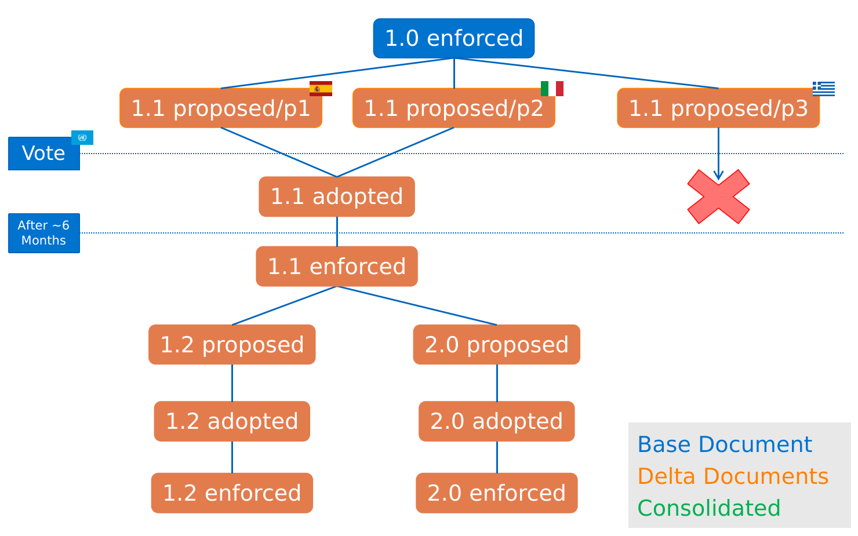
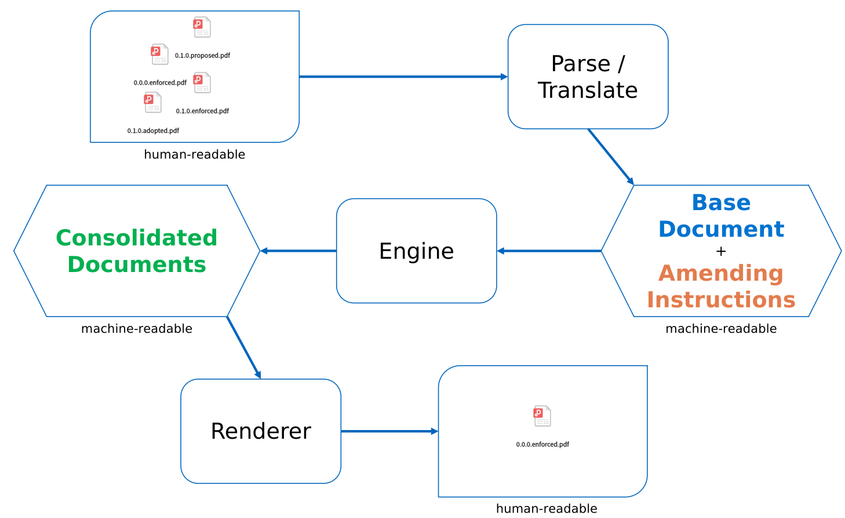
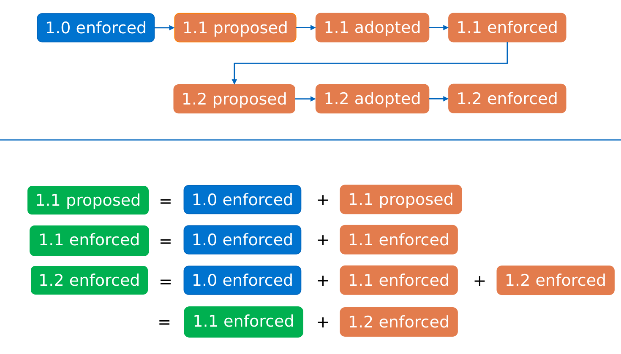
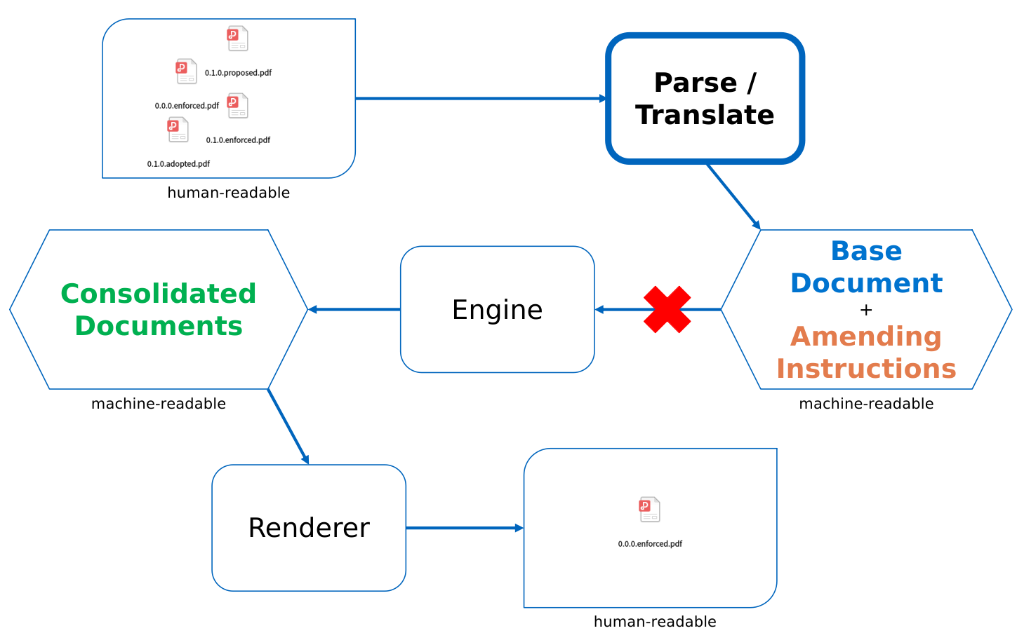
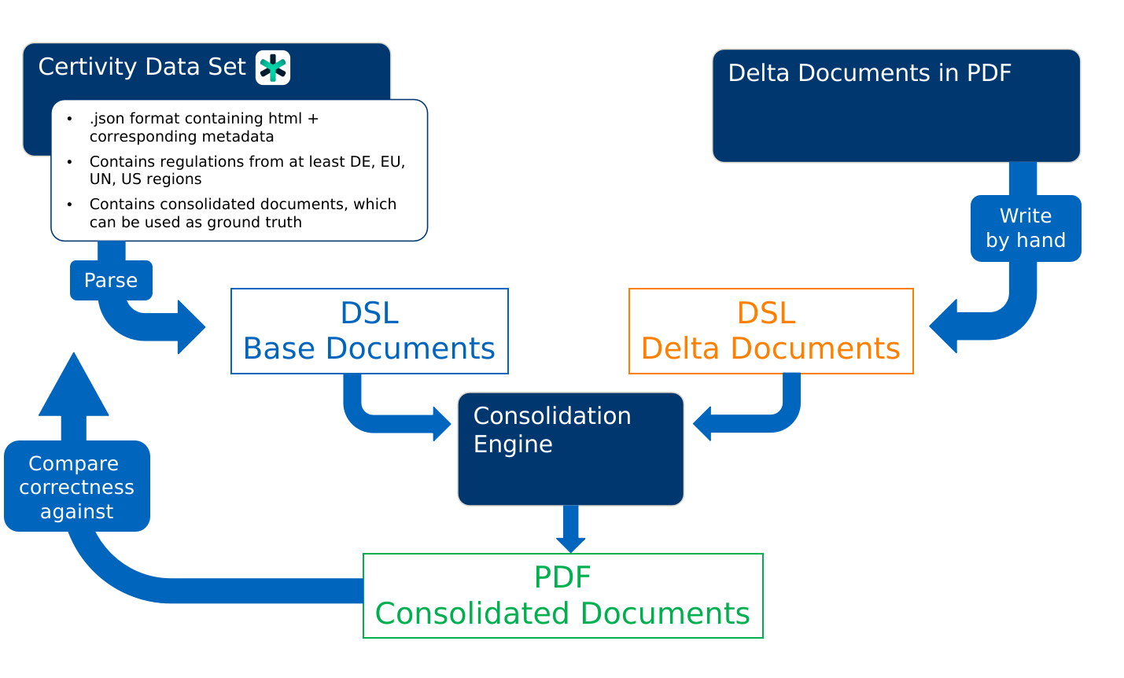
Recap

Slide 39
Questions?
1. Motivation
2. Automatic Consolidation
2.1. Research Questions
2.2. Existing Solutions
2.3. Thesis Contribution
3. Timeline
4. Recap & Questions

Slide 40
Prof. Dr.
Florian Matthes
17132
matthes@in.tum.de

Slide 41
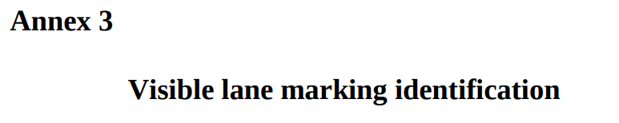
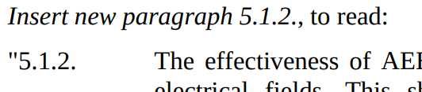
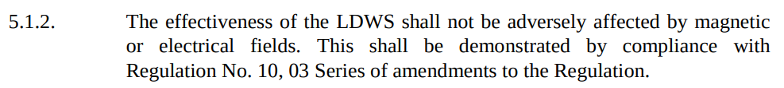
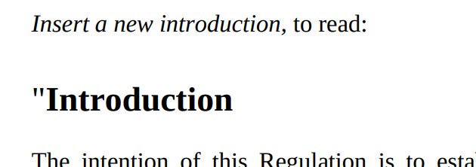
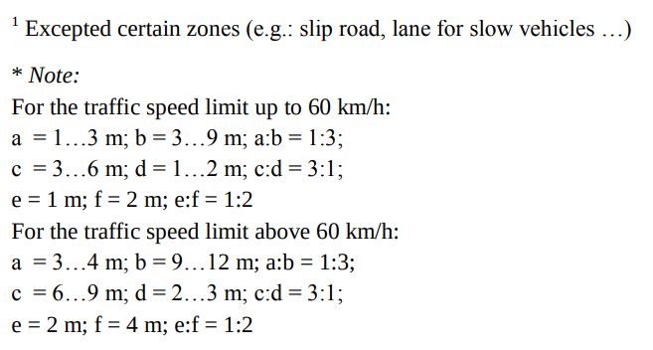
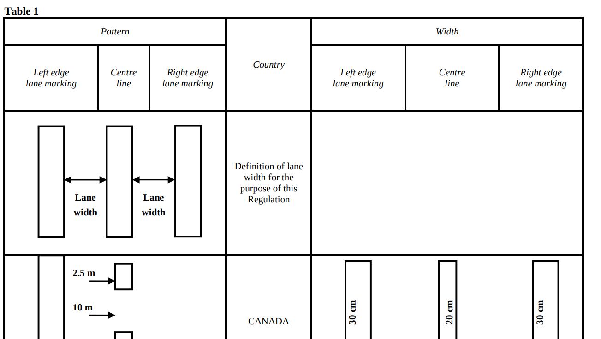
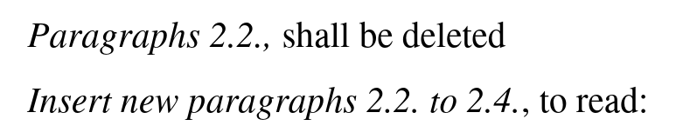
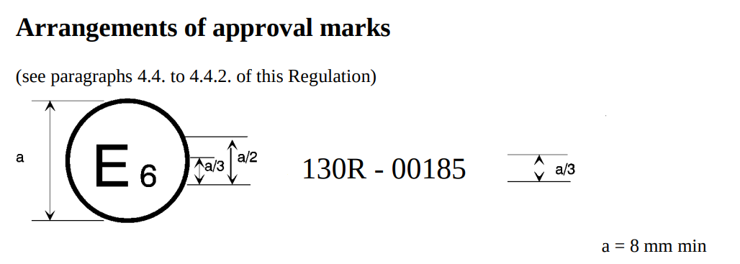
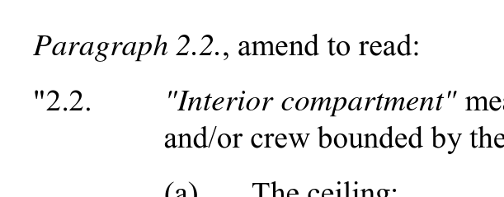
Building Blocks of a Regulation
Entities
Operations

