Slide 1
Formalizing and automating regulatory document versioning
26.05.2023, Master‘s Thesis Final Presentation
Thien-An Huynh

Slide 2
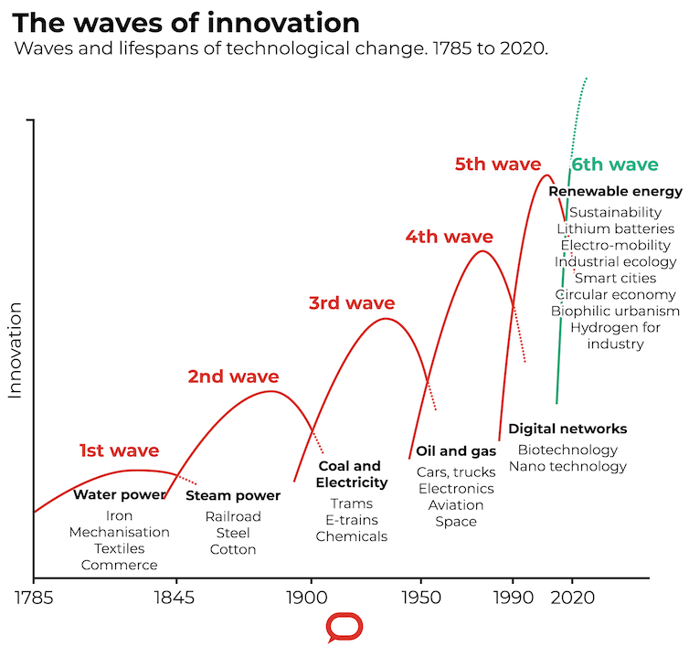

Slide 3
We are developing new technologies at an increasingly faster rate

Slide 4
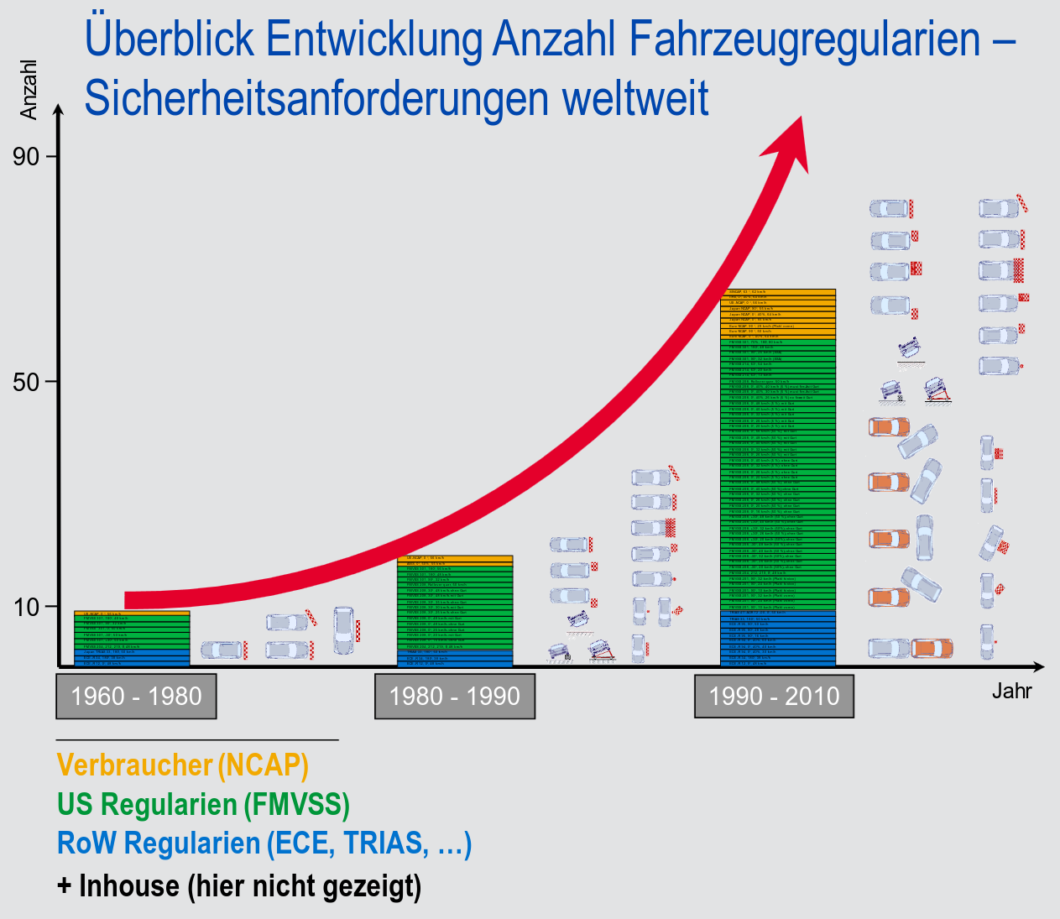

Slide 5
Staying compliant is becoming increasingly more complicated and expensive

Slide 6

Example: Regulation Updates
1.0 enforced
1.1 proposed p1
1.1 proposed p2
1.1 proposed p3
Vote
1.1 adopted
After ~6 Months
1.1 enforced
1.2 proposed
2.0 proposed
1.2 adopted
2.0 adopted
1.2 enforced
2.0 enforced

Slide 7
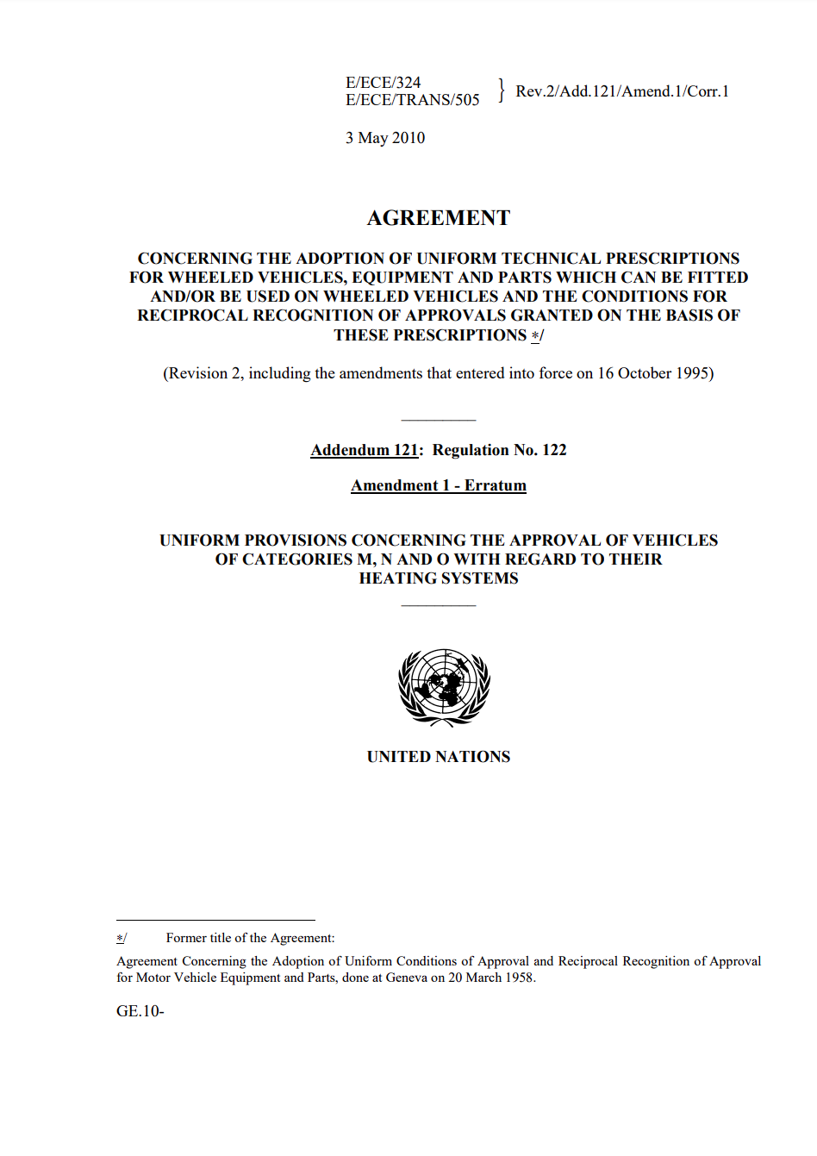
Example: Regulation Updates

Slide 8
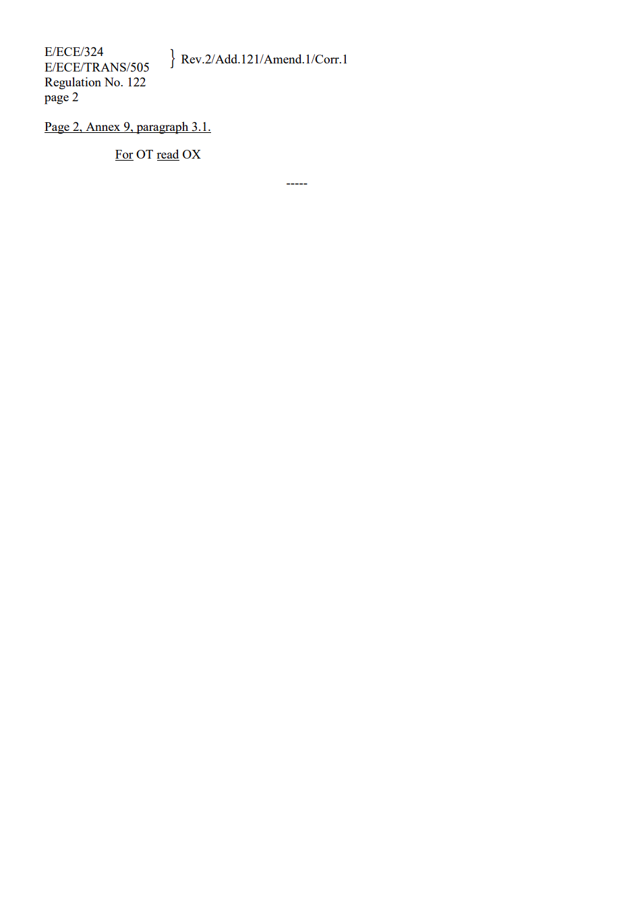
Example: Regulation Updates

Slide 9
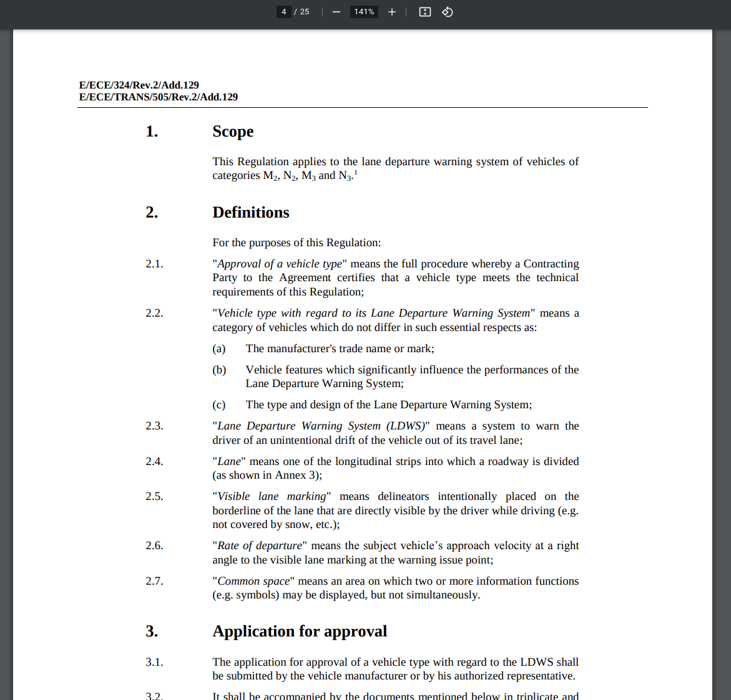
Terminology
Base Document
Contains provision of the regulation according to its current version.
Example:
UNR-130 regarding Lane departure warning systems

Slide 10
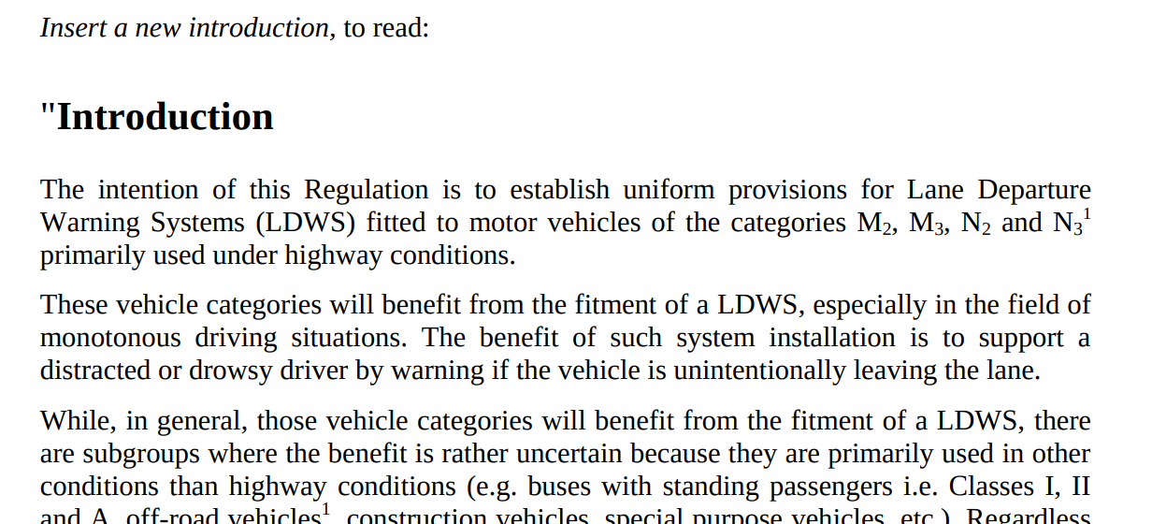
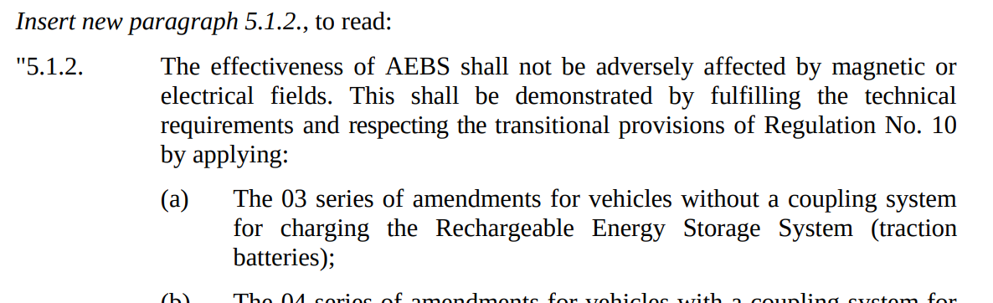
Terminology
Amending Document
Contains instructions (aka modificatory provisions) on how to amend base document in order to create new version
Modificatory Provision
Distinct instruction on how to amend a particular set of document entities.

Slide 11
Terminology
Version 1.0
Legal Consolidation
Base Document
Process of applying modificatory provisions to a base document version, combining multiple legal entities into one.
Consolidated Document
Apply
Version 1.1
Result of consolidation, contains all legal provisions of its current version, similar to base document versions.
Amending Document
Creates
Consolidated Document

Slide 12










Example: Regulation Updates
Regulatory Bodies
Automotive Companies
non-consolidated
documents
Consolidation Companies
hand-consolidated
documents

Slide 13
Example: Regulation Updates
1.0 enforced
1.0 enforced
1.1 proposed p1
1.1 proposed p2
1.1 proposed p3
Vote
1.1 adopted
1.1 enforced
After ~6 Months
1.1 enforced
2.0 enforced
1.2 proposed
2.0 proposed
1.2 adopted
2.0 adopted
2.0 enforced
1.2 enforced
2.0 enforced

Slide 14
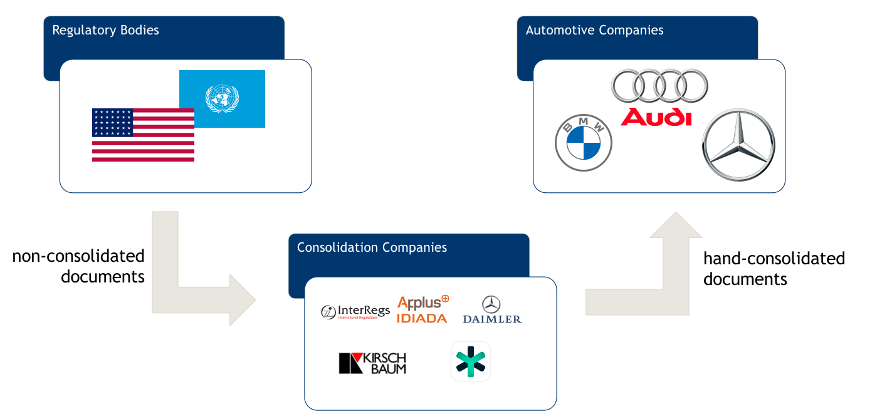
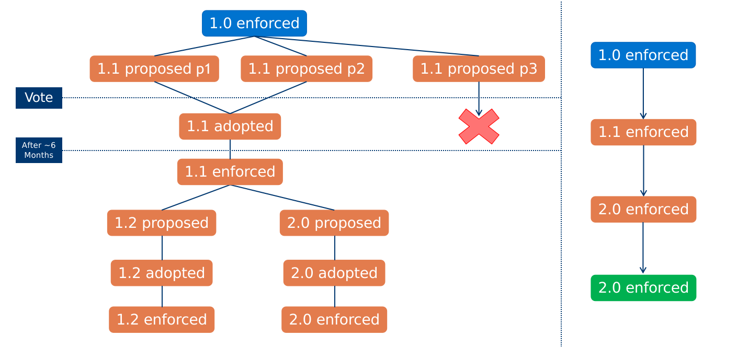
Legal Consolidation: Unhappy Path
Automate everything!

Slide 15
ULTIMATE GOAL & MOTIVATION:
Fully automated legal consolidation system to assist and boost innovation
Kickoff Recap
  Motivation
  Research Gap
  Research Questions
Approach & Results
  Data Set Description
  RQ1: Functionality Requirements
  RQ2: Data Requirements
  RQ3: Reference Implementation Performance

Slide 16
Automated Legal Consolidation:
Happy Path
Regulatory Bodies
Automotive Companies
Consolidation Companies
faster consolidation

Slide 17
Automated Legal Consolidation:
Happy Path
Base Document
Representations
Base Documents*
+
Amending
Documents*
Parse & Annotate
machine-readable
Amending Document Representations
*human-readable
machine-readable
Consolidated
Documents
Consolidation Engine
machine-readable

Slide 18
RESEARCH GAP:
How close are we to developing such a system?
Kickoff Recap
  Motivation
  Research Gap
  Research Questions
Approach & Results
  Data Set Description
  RQ1: Functionality Requirements
  RQ2: Data Requirements
  RQ3: Reference Implementation Performance

Slide 19
Research Gap
Base Document
Representations
Base Documents*
+
Amending
Documents*
Parse & Annotate
machine-readable
Amending Document Representations
*human-readable
machine-readable
Consolidated
Documents
Consolidation Engine
machine-readable

Slide 20
Research Gap
⚠
Base Document
Representations
Base Documents*
+
Amending
Documents*
✔
Parse & Annotate
machine-readable
⚠
Amending Document Representations
*human-readable
machine-readable
Consolidated
Documents
❌
Consolidation Engine
machine-readable

Slide 21
RESEARCH QUESTIONS
Kickoff Recap
  Motivation
  Research Gap
  Research Questions
Approach & Results
  Data Set Description
  RQ1: Functionality Requirements
  RQ2: Data Requirements
  RQ3: Reference Implementation Performance

Slide 22
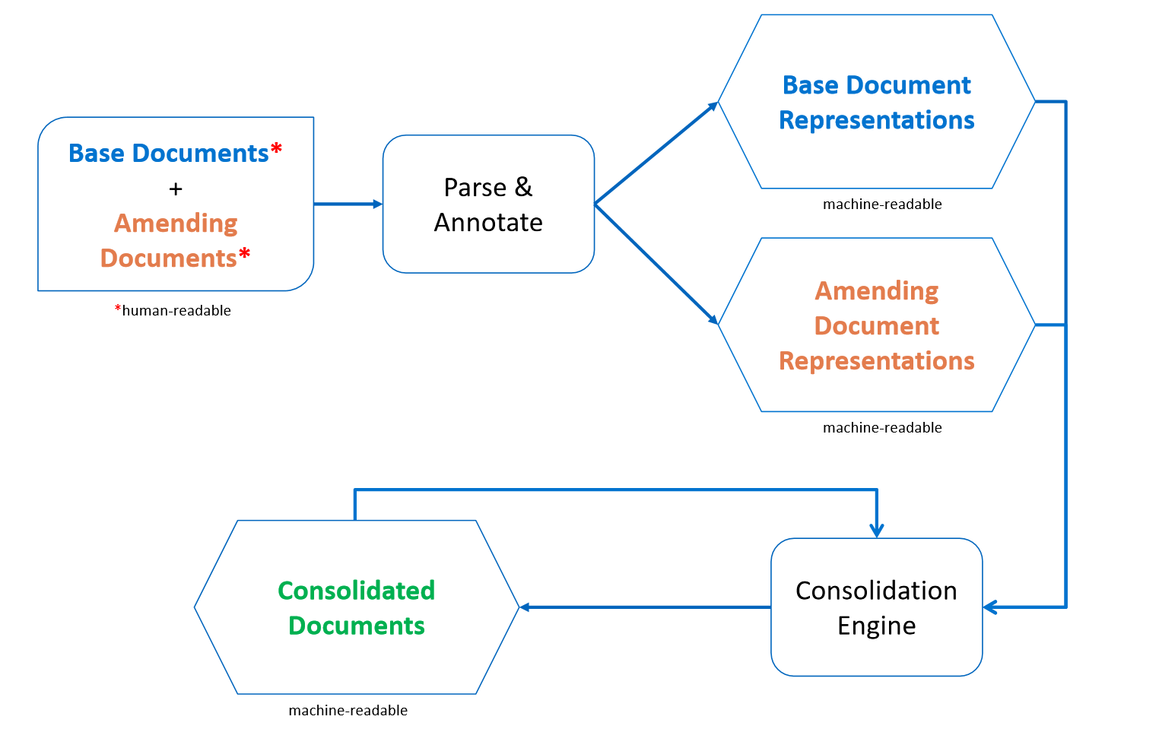
Research Questions
RQ1: What is the minimum set of consolidation engine operations needed to model all modificatory provisions in the data set?
What functions should a consolidation engine expose?

Slide 23
Research Questions
RQ2: What is the minimum set of metadata fields needed in the representation formats of base documents and modificatory provisions in order to perform automatic consolidation?
What information would a consolidation engine require to reliably perform automatic consolidation?

Slide 24
Research Questions
RQ2: What is the minimum set of metadata fields needed in the representation formats of base documents and modificatory provisions in order to perform automatic consolidation?
What information would a consolidation engine require to reliably perform automatic consolidation?

Slide 25
Research Questions
RQ3: How accurate are the automatic change applications performed by the consolidation engine reference implementation?
How reliable does a reference implementation based on the specifications of RQ1 and RQ2 perform automatic consolidation?

Slide 26
Out-of-Scope Topics
Non-regulatory legal documents
  Contracts, criminal law, etc.
Automatic parsing / annotation of human-readable data
Operations targetting non-chapter entities, e.g.
  Tables
  Figures
  Footnotes

Slide 27
DATA SET DESCRIPTION
Kickoff Recap
  Motivation
  Research Gap
  Research Questions
Approach & Results
  Data Set Description
  RQ1: Functionality Requirements
  RQ2: Data Requirements
  RQ3: Reference Implementation Performance

Slide 28
Data Set Description
All Regulatory Documents
Automotive
Regulations

Slide 29
Data Set Description
 | Unstructured Data | Structured Data
File Formats | Human-readable (pdf, docx, etc.) | Machine-readable (html)
Author
Consolidated Documents | Very rare outside of base versions (~1/50 versions) | Manually consolidated by regulatory experts
Metadata Annotation | None | Chapter Identifier Annotation, Tree Structure
❌
✔
❌
✔

Slide 30
APPROACH - RQ1:
What functions should a consolidation engine support?
Kickoff Recap
  Motivation
  Research Gap
  Research Questions
Approach & Results
  Data Set Description
  RQ1: Functionality Requirements
  RQ2: Data Requirements
  RQ3: Reference Implementation Performance

Slide 31

RQ1: What functions are necessary?
Keyword Extraction
amend, delete, remove, renumber / re-number, introduce, insert, add, correct, replace, to read, redesignate, revise
Categorization
DELETE: delete, remove
RENUMBER: redesignate, renumber / re-number
INSERT: introduce, insert, add
AMEND: amend, correct, replace, to read, revise

Slide 32
RQ1: What functions are necessary?
Basic Operations
INSERT
DELETE
RENUMBER
AMEND, REPLACE

Slide 33
RQ1: What functions are necessary?
Basic Operations
INSERT
DELETE
RENUMBER
Renumber single chapter
Renumber Multiple
AMEND, REPLACE
Replace full chapter
Replace partly
Replace Keyword

Slide 34
APPROACH - RQ2:
What data is needed to perform these operations?
Kickoff Recap
  Motivation
  Research Gap
  Research Questions
Approach & Results
  Data Set Description
  RQ1: Functionality Requirements
  RQ2: Data Requirements
  RQ3: Reference Implementation Performance

Slide 35
RQ2: What data is needed in the
document representation formats?

Slide 36
RQ2: What data is needed in the
document representation formats?

Slide 37
RQ2: What data is needed in the
document representation formats?
Amending Documents
Input Parameters
INSERT
  New chapter key
  New content
RENUMBER single chapter
  Target chapter key
  New chapter key
RENUMBER multiple
  Original chapter keys
    from
    to
  New chapter keys
    from
    to
DELETE
  Target chapter key
AMEND full chapter
  Target chapter key
  New content
AMEND partly
  Target chapter key
  ( New Content | ... ) [ ]
AMEND keyword
  Target chapter key
  Keyword
  Replacement
  Recursive (y/n)

Slide 38
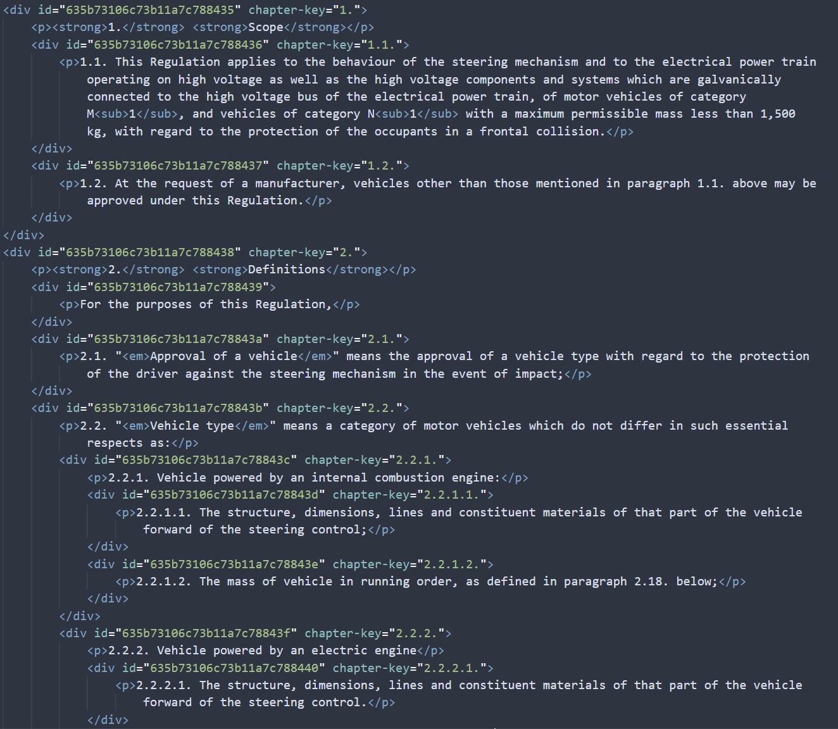
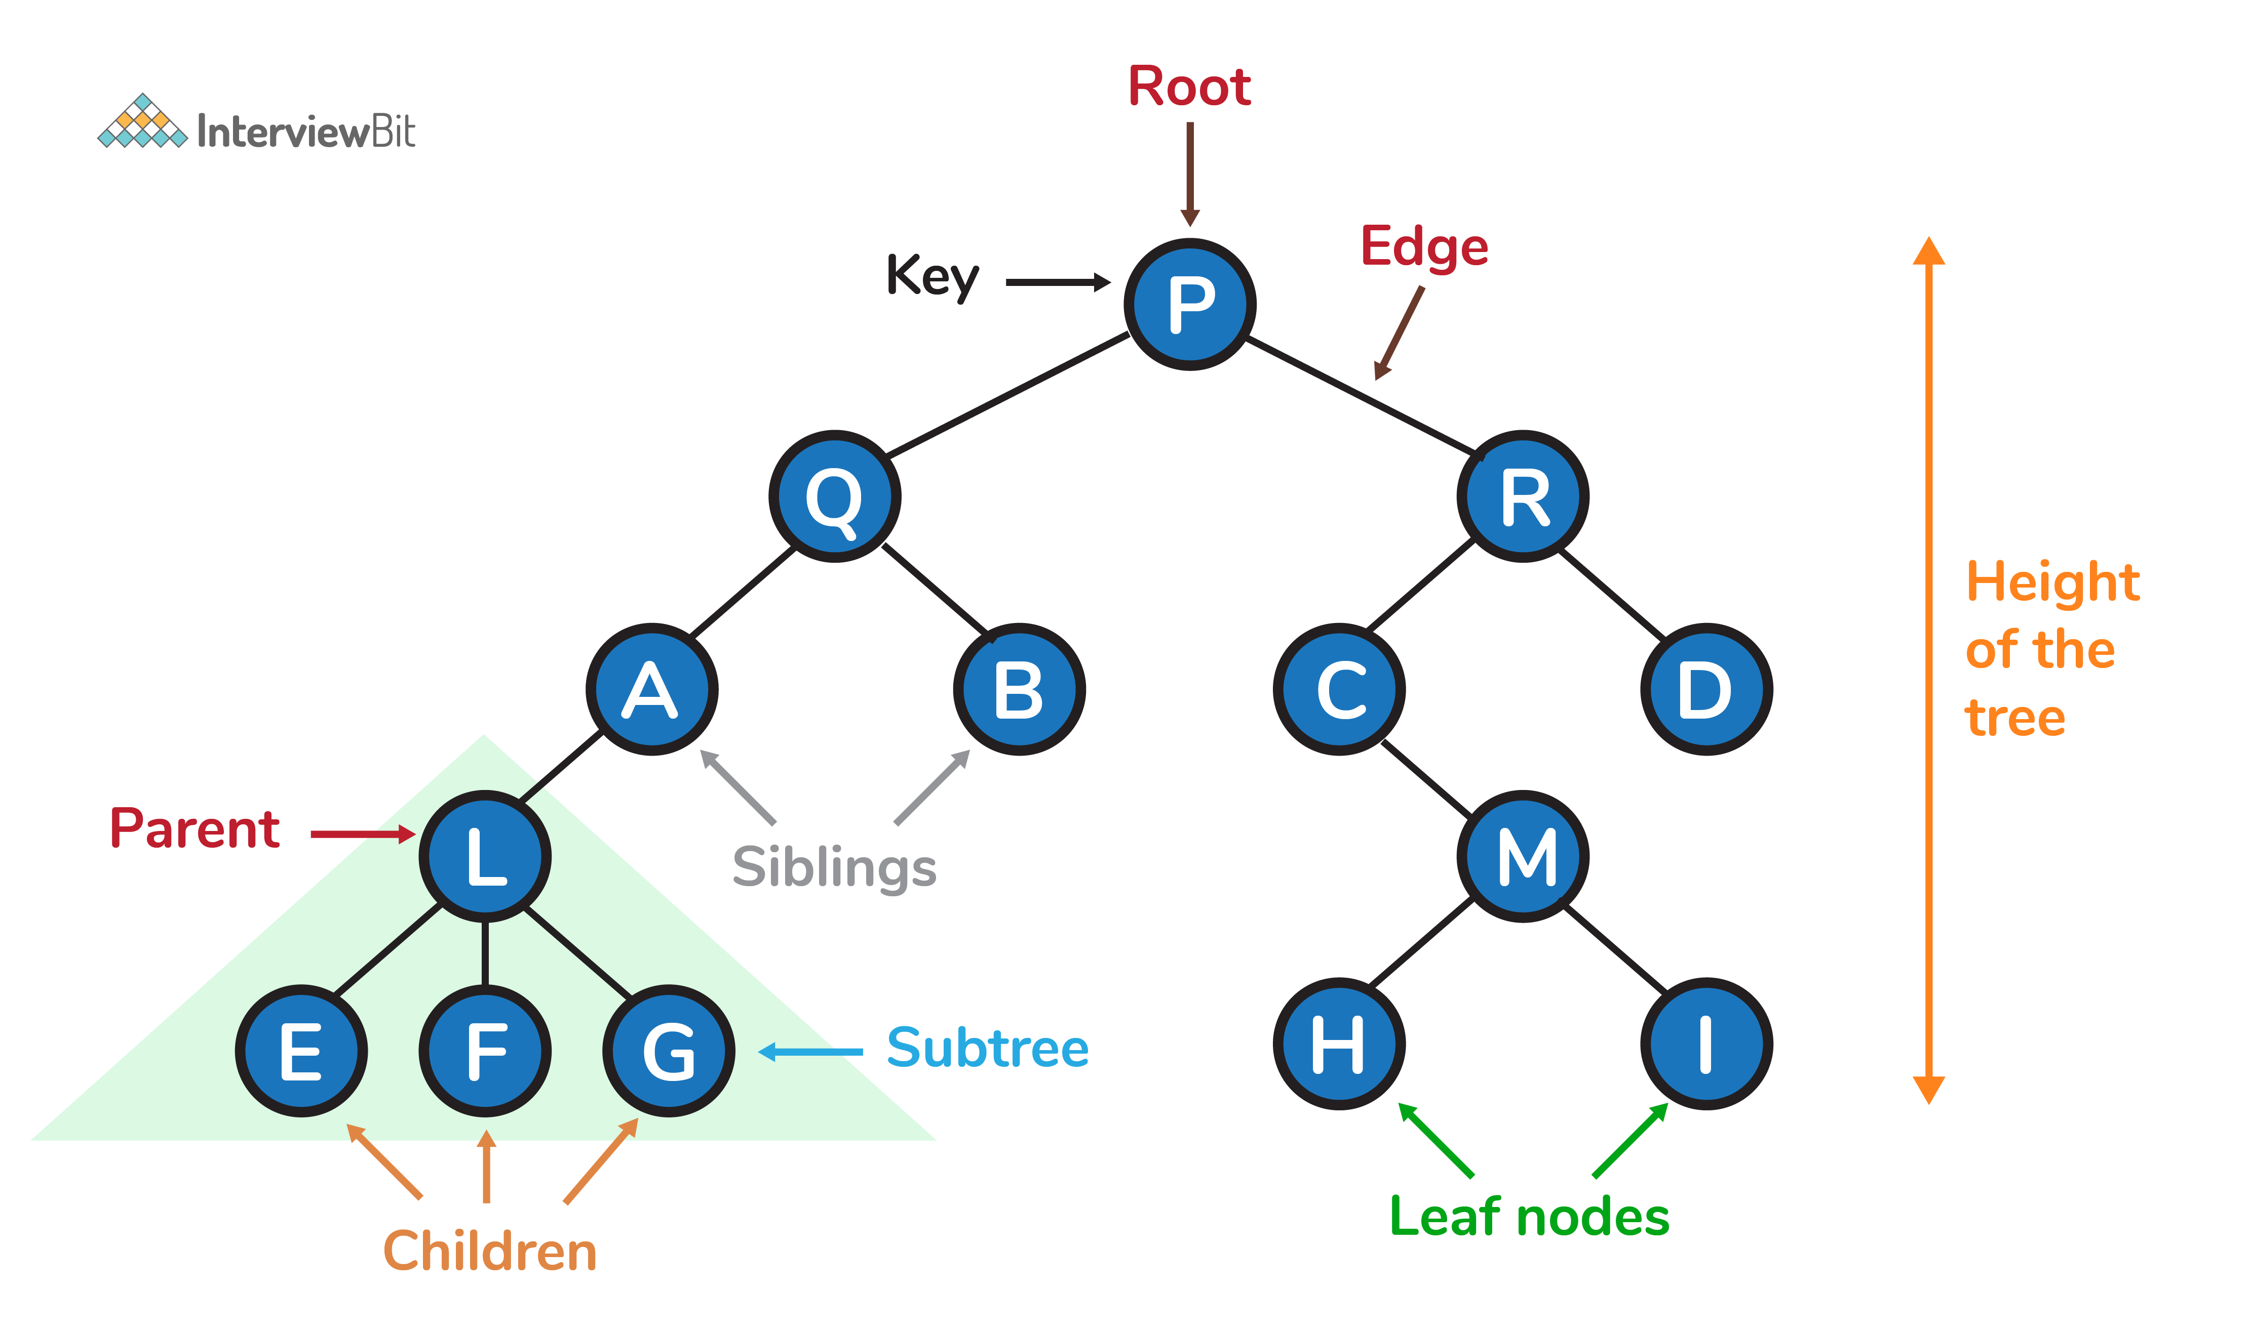
RQ2: What data is needed in the
document representation formats?
Base Documents
Tree hierarchy structure
Labelled document entity
identifiers

Slide 39
APPROACH - RQ3:
How does a consolidation engine based on the results of RQ1 and RQ2 perform?
Kickoff Recap
  Motivation
  Research Gap
  Research Questions
Approach & Results
  Data Set Description
  RQ1: Functionality Requirements
  RQ2: Data Requirements
  RQ3: Reference Implementation Performance
Recap

Slide 40
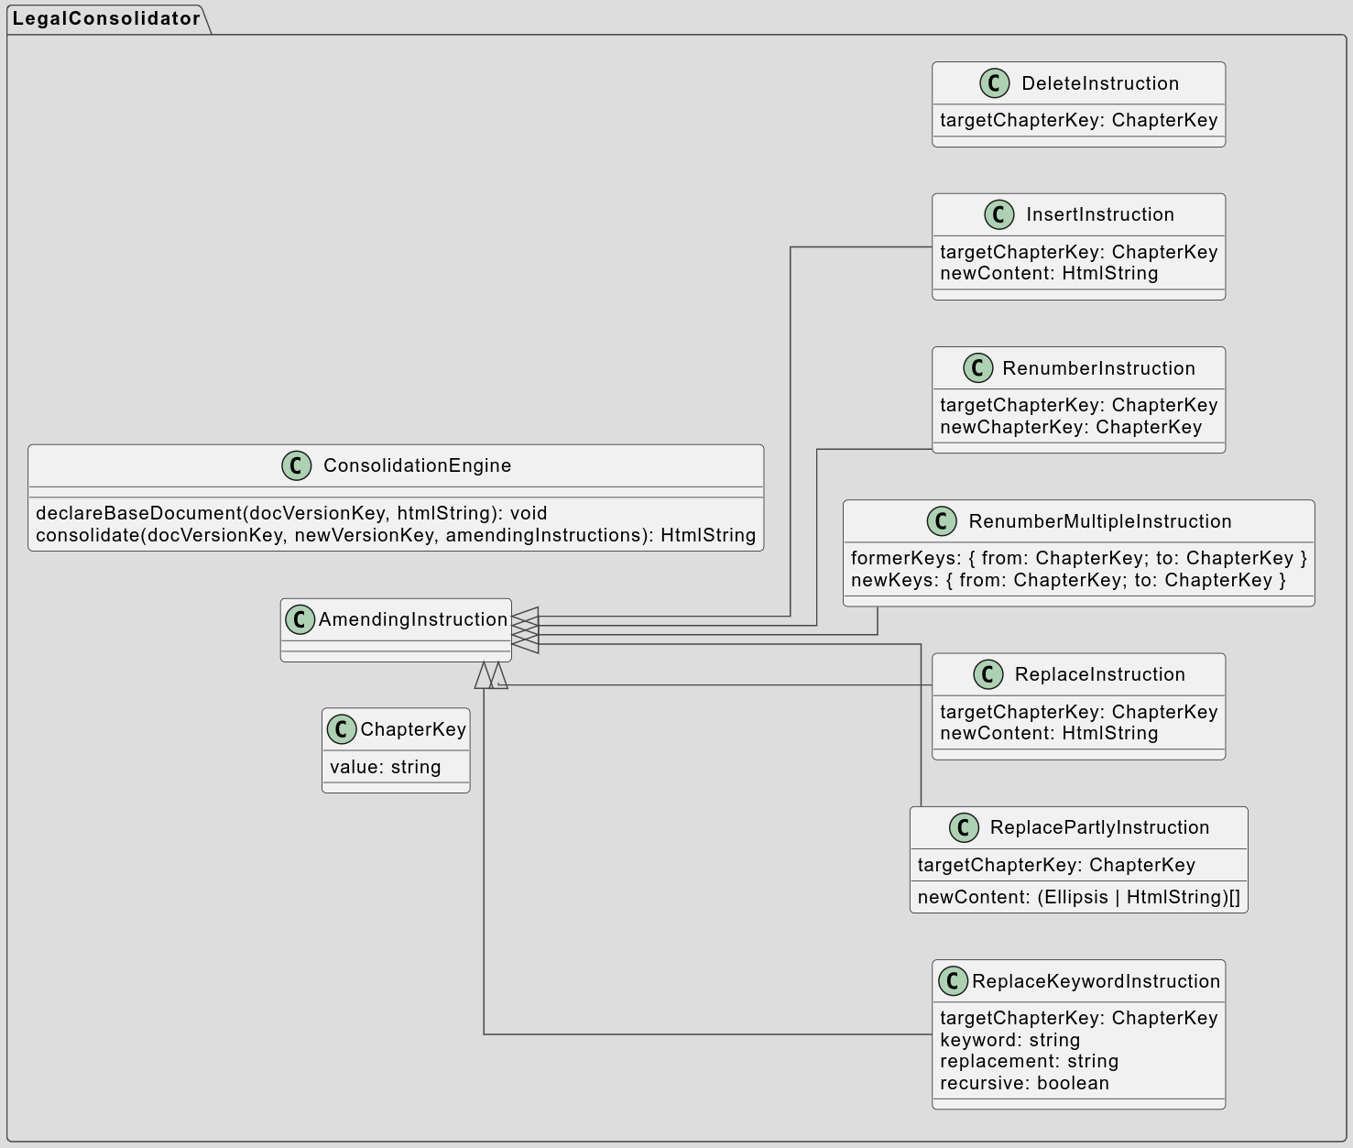


Reference Implementation

Slide 41
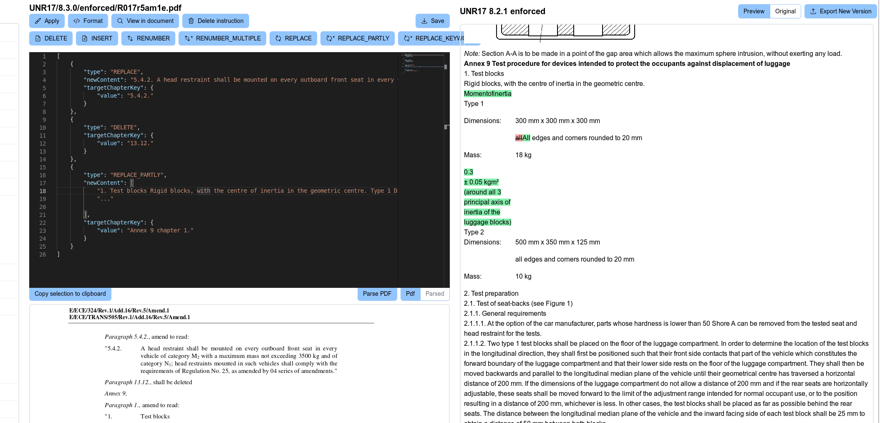
Reference Implementation

Slide 42

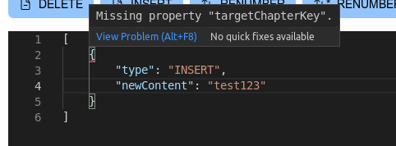
Reference Implementation
Autocomplete
Static code analysis

Slide 43
Experiment Design
Amending
Documents*
Base Document
Representations
*human-readable
machine-readable
Amending Document Representations
Manually parse with UI
machine-readable
Manually
Consolidated
Documents
Automatically
Consolidated
Documents
compare
Consolidation Engine
machine-readable
machine-readable

Slide 44
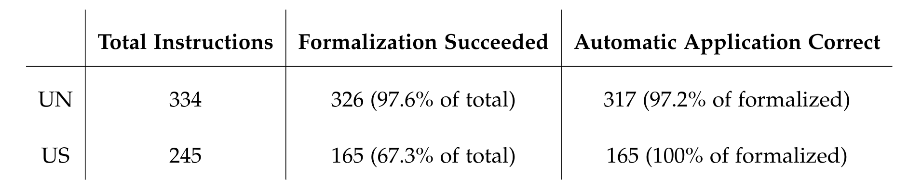
Results Overview

Slide 45
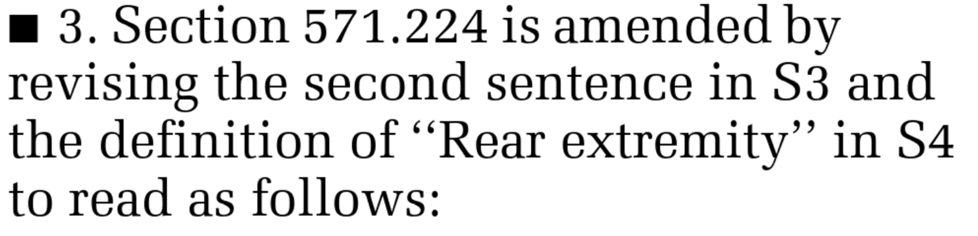
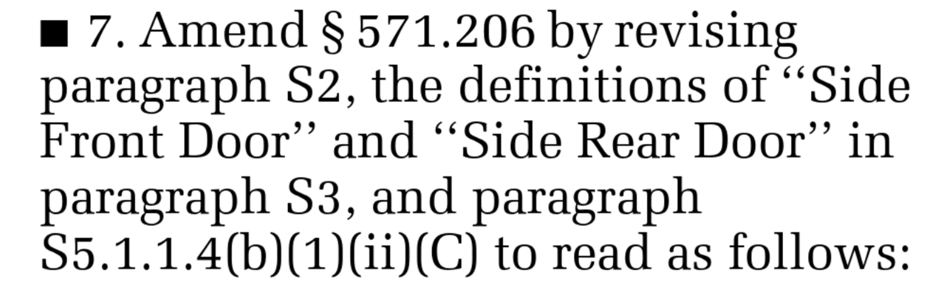
Results Overview
Total Modificatory Provisions
334x
Formalization Format not Expressive Enough
1x
One-off operation:
Sentence Targetting
Out-of-scope issues
19x
Targetting Pictures, Tables, Footnotes, Picture Descriptions
Data Set Problems
79x
Insufficient Labelling of sub-chapters
Successfully parsed
165x
Successfully applied
165x

Slide 46
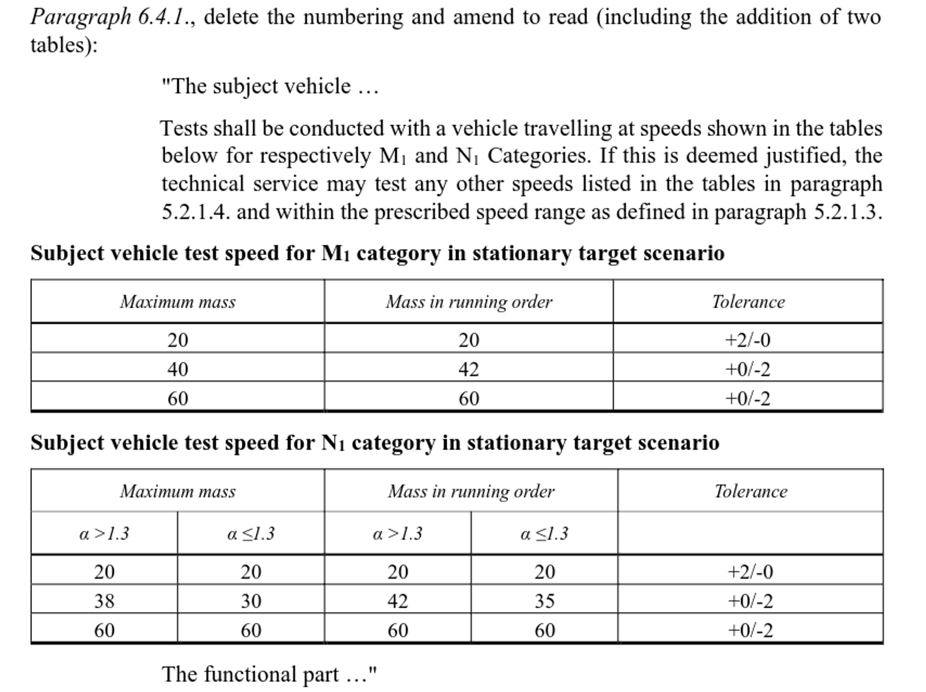
Results Overview
Total Modificatory Provisions
334x
Formalization Format not Expressive Enough
1x
One-off operation:
„Remove Numbering“
Out-of-scope issues
7x
Targetting Pictures, Tables, Footnotes, Picture Descriptions
Successfully parsed
326x
Inflected Keyword Replacement
1x
Failed Ellipsis Replacement
5x
Human Error by Regulatory Body
3x
Successfully applied
317x

Slide 47
RECAP
Kickoff Recap
  Motivation
  Research Gap
  Research Questions
Approach & Results
  Data Set Description
  RQ1: Functionality Requirements
  RQ2: Data Requirements
  RQ3: Reference Implementation Performance
Recap

Slide 48
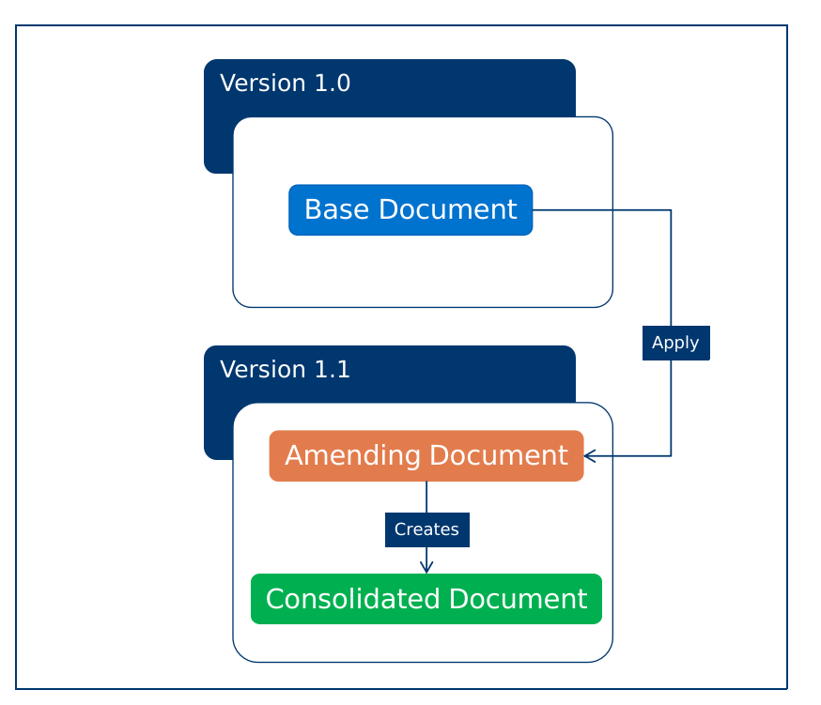
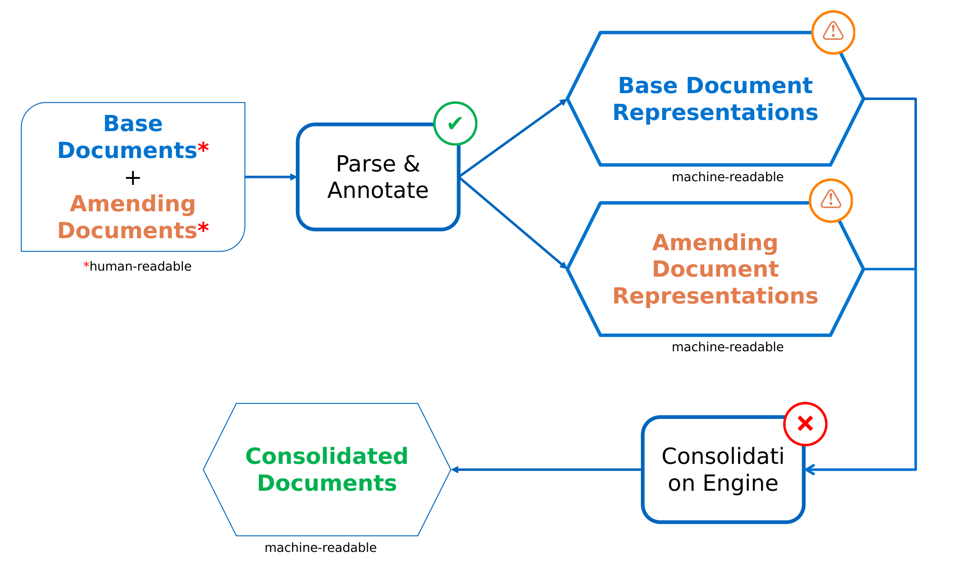
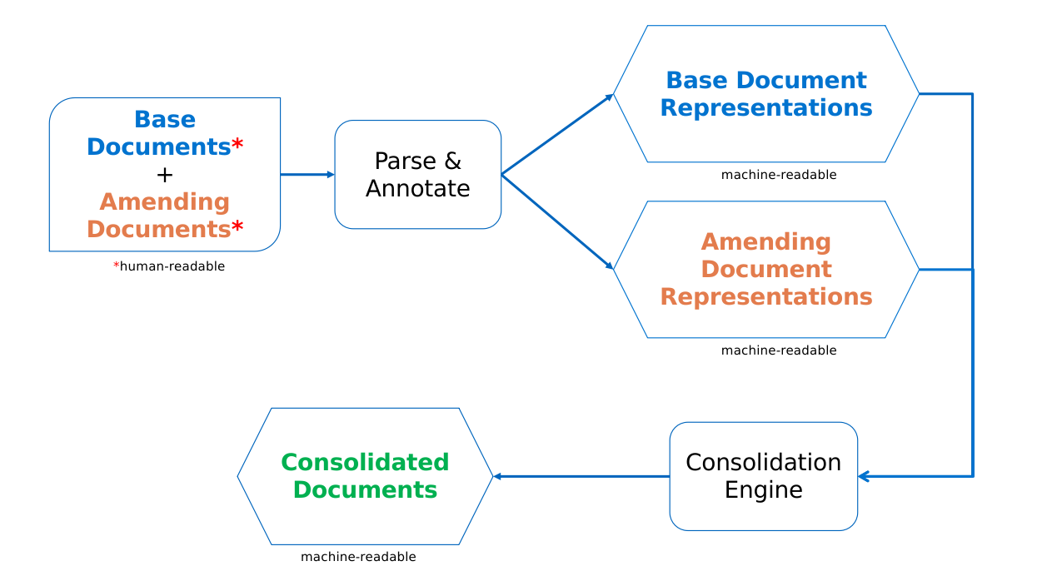
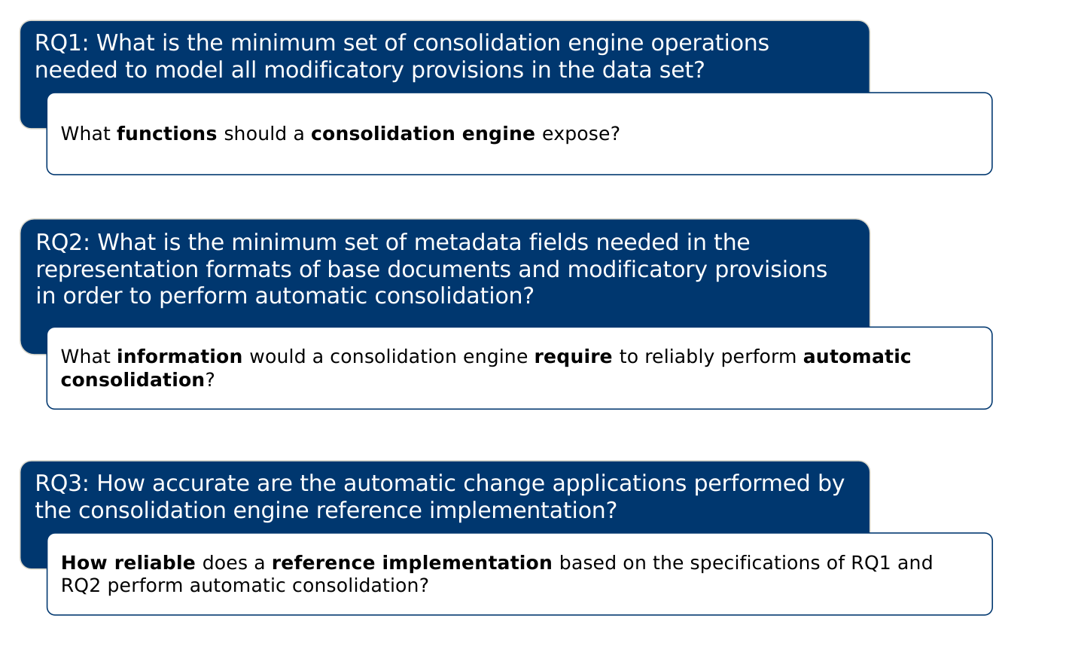
Recap

Slide 49
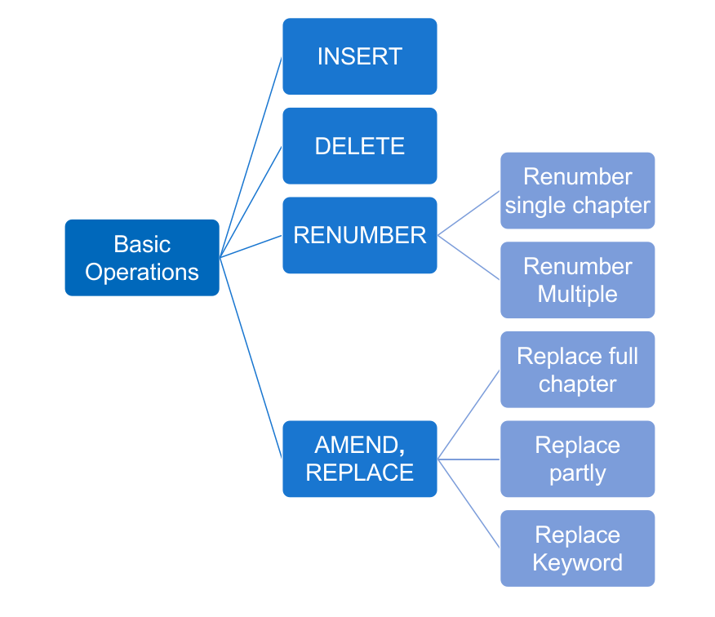
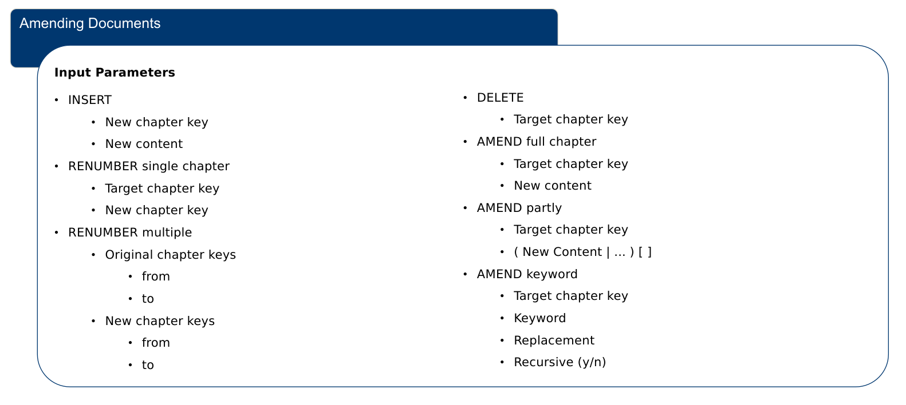
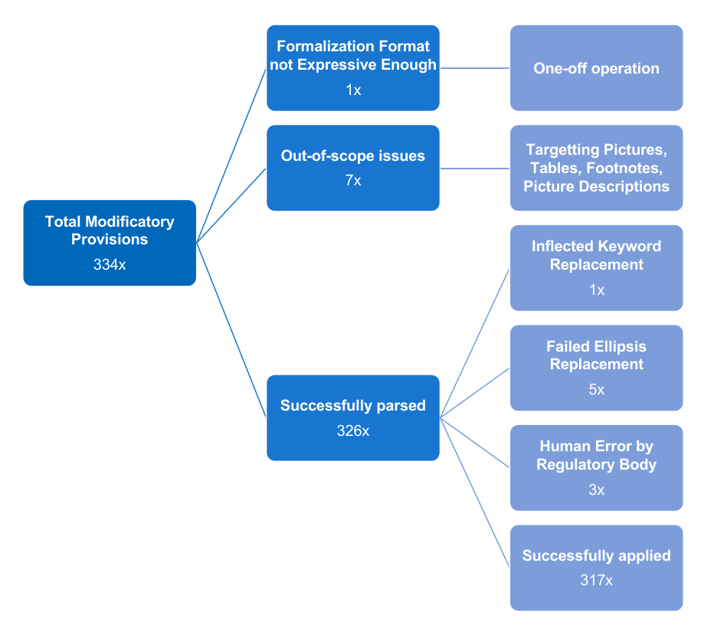
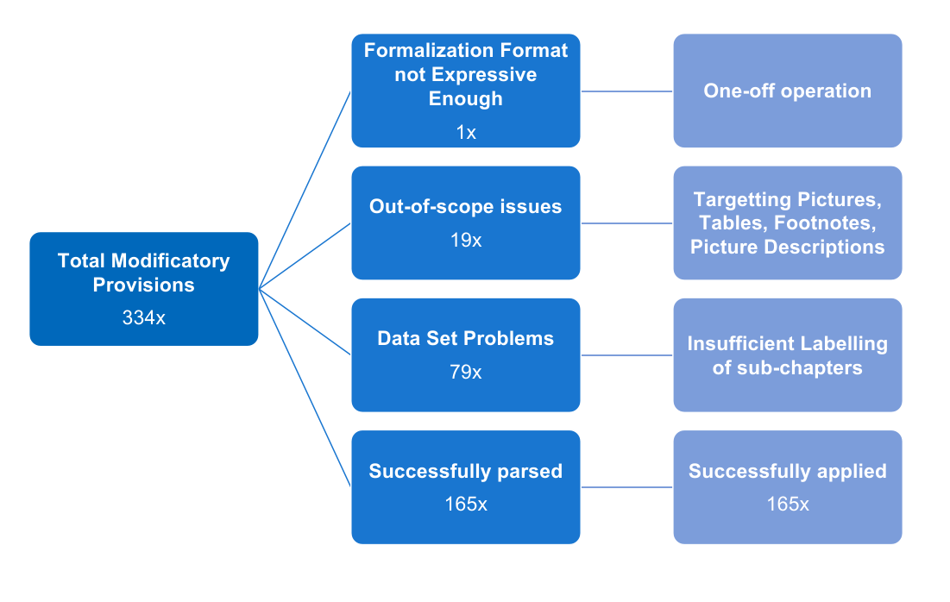
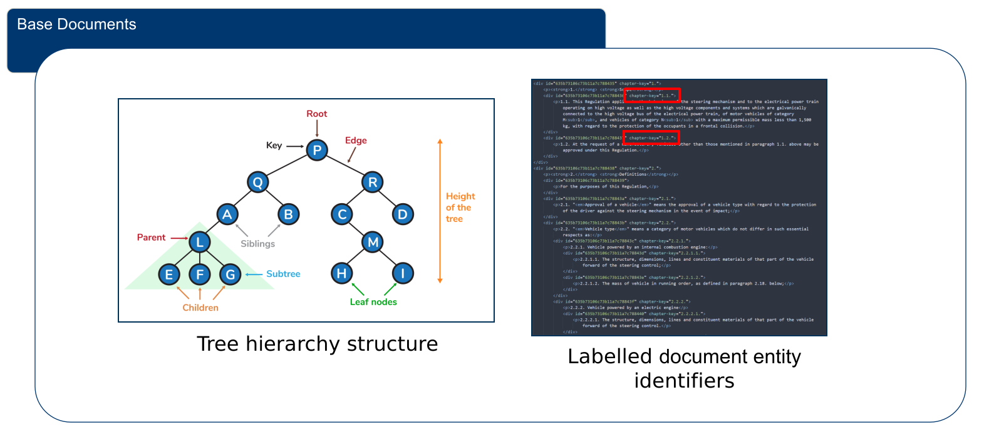
Recap

Slide 50
Prof. Dr.
Florian Matthes
17132
matthes@in.tum.de

Slide 51
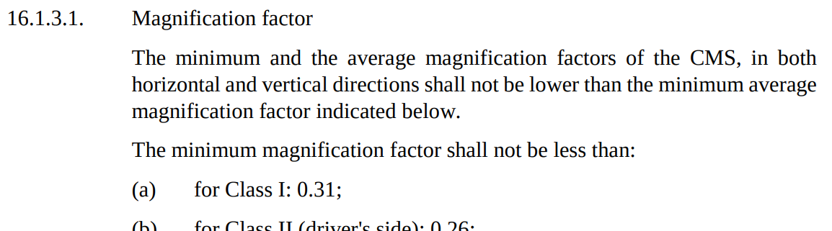
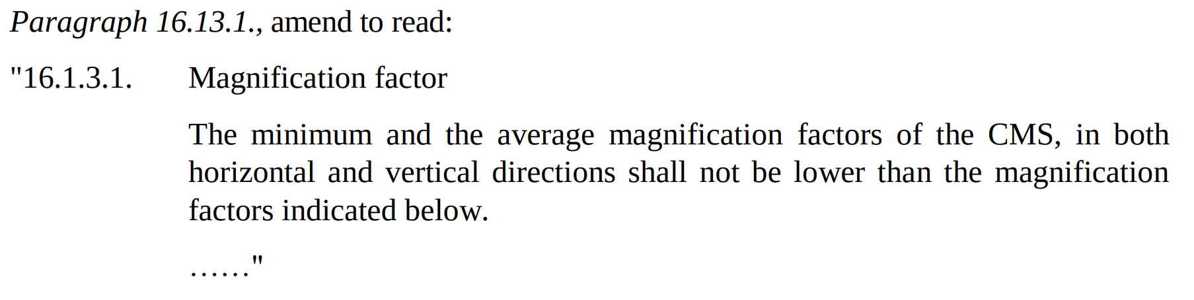
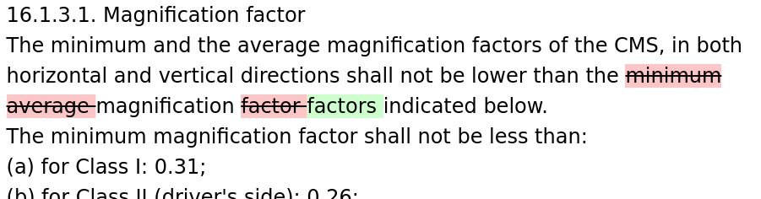
Additional Functions:
Amend Partly
Original Text
Modificatory
Provision
Intended
Outcome

Slide 52
Additional Functions:
Replace Keyword
Examples:

Slide 53
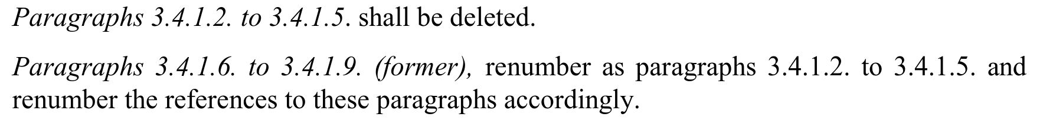
Additional Functions:
Renumber Multiple
Modificatory
Provision
1.
  1.1. ❌
  1.2.
  1.3.
2.
...
1.
  1.2. ⚠️
  1.3. ⚠
2.
...
1.
  1.1.
  1.2.
2.
...
Step-by-step
Explanation
Delete
Renumber
Multiple

Slide 54
One-off Operation:
Remove Numbering

Slide 55
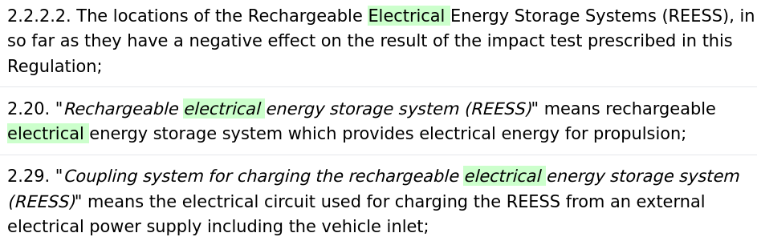
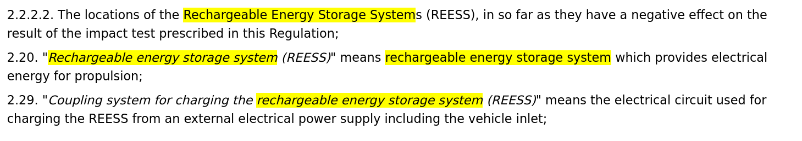
Noteworthy Findings:
Keyword Inflection

Slide 56
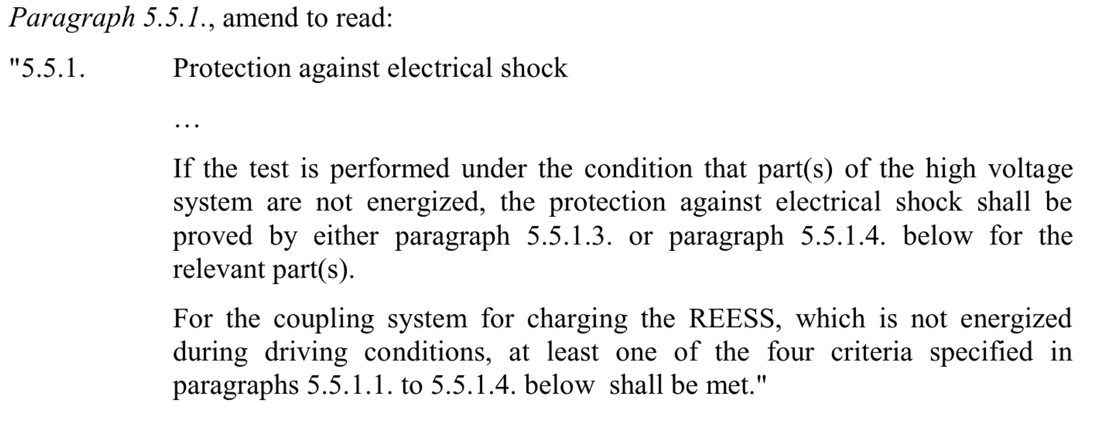
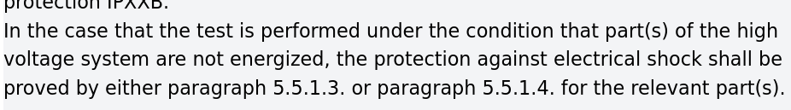
Noteworthy Findings:
Failed Ellipsis Replacement

Slide 57
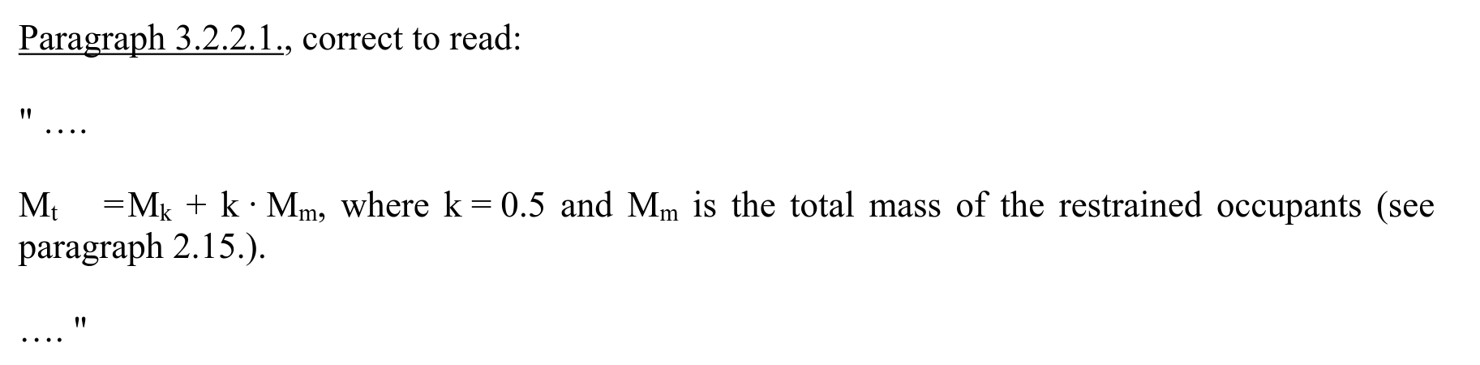
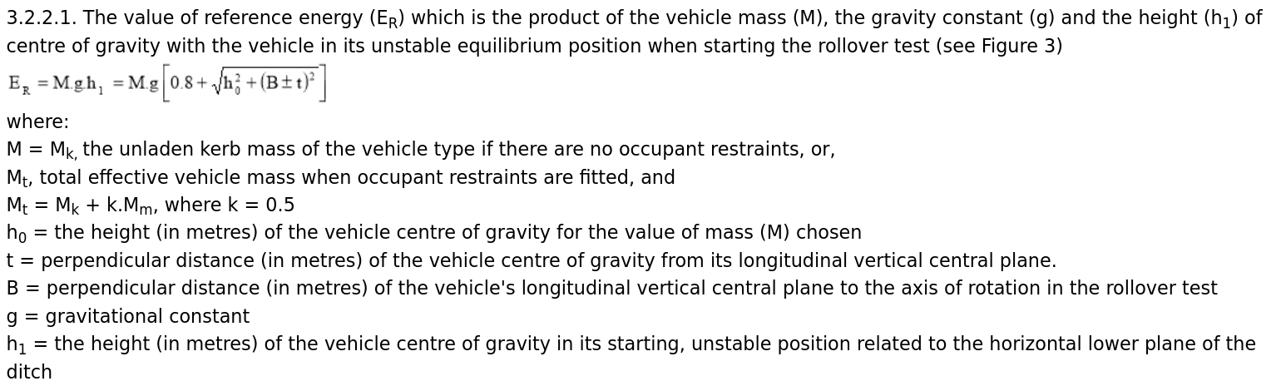
Noteworthy Findings:
Failed Ellipsis Replacement II

Slide 58
Noteworthy Findings:
One-off Operations

Slide 59
Gliederung
- Recap of kickoff
- Motivation
- Research Gap
- Research Questions
- Approach & Outcomes RQ1
- Approach & Outcomes RQ2
- Approach & Outcomes RQ3
1. Motivation
2. Automatic Consolidation
2.1. Research Questions
2.2. Existing Solutions
2.3. Thesis Contribution
3. Timeline
4. Recap & Questions

