Slide 1
Evaluating the adoption of the Government as a Platform Analysis Method by practitioners
Master-Thesis Kickoff
Efstratios Pahis, 21.11.2022

Slide 2
Overview
Agenda
Motivation
Complication
Resolution
Methodology
First Results
Timeline

Slide 3














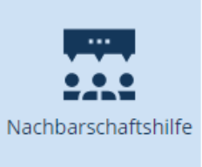

What is Government as a Platform (GaaP)?
Core Idea is the vision of a Government being organized & operated following a platform model

Slide 4






Motivation: Why Government as a Platform (GaaP)?
Silo-Oriented Architecture: Business Registration
Platform-Oriented Architecture: Business Registration
Federal Platform
Tax Office
Trade Office
Tax Office
Trade Office
Platformization
Auth
Auth
Pay, Komm
Auth
Pay, Komm
Where and how to start?
Pay
Komm
Apply for company Tax ID
Apply for company license
Register company
Processes are intertwined
Highly Coupled Architecture
Common Functionality implemented twice
One Processes leads to Goal
Loose Coupled Architecture
Share common Resources

Slide 5
Motivation: Why Government as a Platform (GaaP)?
Silo-Oriented Architecture: Business Registration
Platform-Oriented Architecture: Business Registration
Federal Platform
Tax Office
Trade Office
Tax Office
Trade Office
Platformization
Auth
Auth
Pay, Komm
Auth
Pay, Komm
Government as a Platform Analysis Method (GaaPAM)
Pay
Dimension | Decompose |  | Recompose
 | 1. Status Quo | 2. Infrastructure decomposition | 3. Platform interpretation | 4. Assessment
Platform elements | identify the major components of the infrastructure | classify the components by importance to the infrastructure core use cases | map the components to platform core, boundary resources and ecosystem | infer recommendation for the improvement of the platform
Platform roles | identify the major actors of the infrastructure | classify the scenarios by infrastructure Services | map the actors to the roles of platform owner, complementor, user | infer recommendation for the improvement of the platform
Platform openness | identify the major usage scenarios of the infrastructure | classify the actors by their role | map the infrastructure services to openness participation and co-creation | infer recommendation for the improvement of the platform
Platform management | identify the activities of the infrastructure owner(s) | classify the activities by stakeholder | map the activities into facilitation, tool provision and asset management | infer recommendation for the improvement of the platform
Komm
Apply for company Tax ID
Apply for company license
Register company
Processes are intertwined
Highly Coupled Architecture
Common Functionality implemented twice
One Processes leads to Goal
Loose Coupled Architecture
Share common Resources
Kuhn et al. 2022

Slide 6
Motivation: The Government as a Platform Analysis Method (GaaPAM)
The GaaP Analysis Method (GaaPAM) (Kuhn et. al, 2022)
Dimension | Step 1 | Step 2 | Step 3 | Step 4
Platform Infrastructure | 1. Status quo | 2. Deconstruction | 3. Reconstruction | 4. Evaluation
Platform Principles | 1. Status quo | 2. Deconstruction | 3. Reconstruction | 4. Evaluation
Platform Management | 1. Status quo | 2. Deconstruction | 3. Reconstruction | 4. Evaluation
Information about the current infrastructure
Assessment of the platformization progress & gap identification

Slide 7

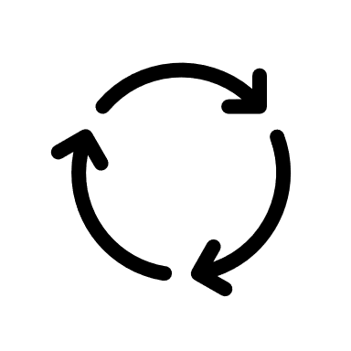
The evaluation of GaaPAM
GaaPAM is not yet evaluated extensively in Practice
It might need a further iteration
Task of my Master-Thesis:
The Evaluation of the Government as a Platform Analysis Method

Slide 8
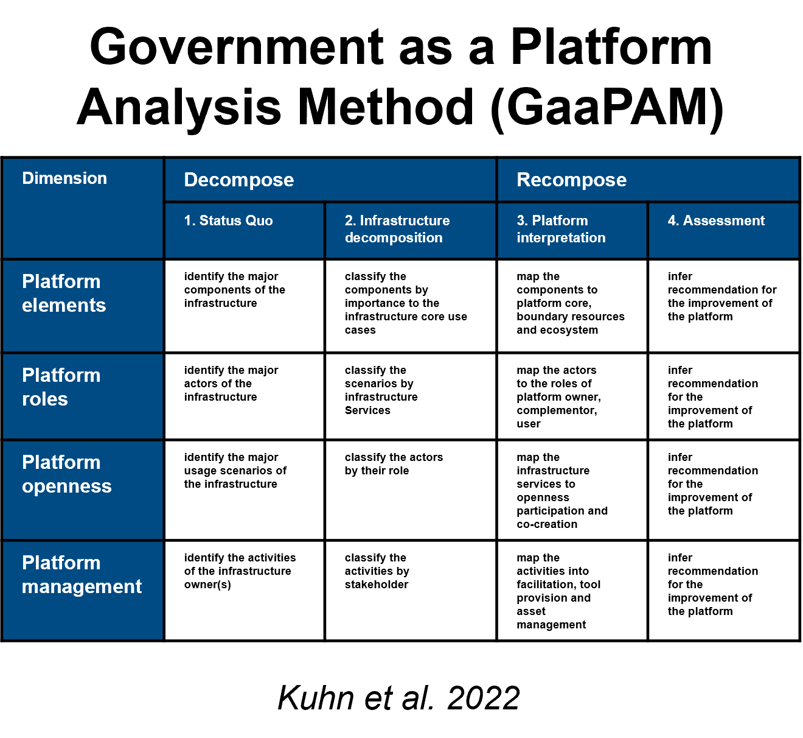
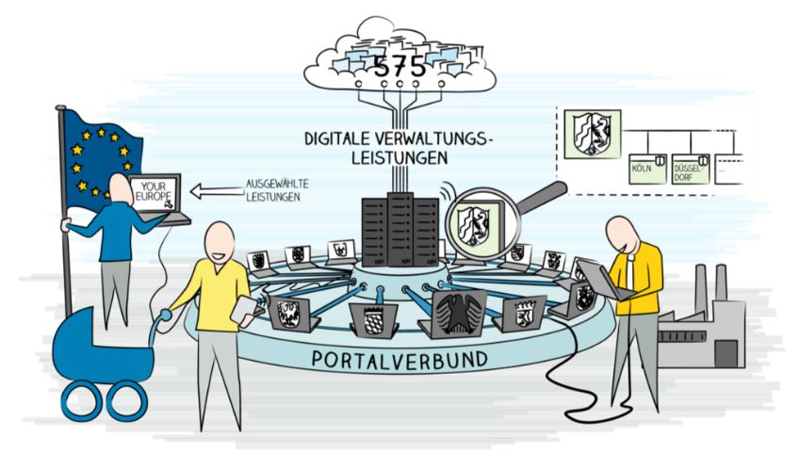

Complication: How to evaluate the impact on the real-world platform system of GaaPAM?
Impact
GaaPAM
*
Real World Platform System
Challenge:
Difficult to measure effective adoption of GaaPAM on actual infrastructure
*Bundesministerium des Innern und für Heimat: OZG-Leitfaden (2022)

Slide 9

Resolution: Measuring the impact of GaaPAM through suitable proxy
Impact
GaaPAM
*
Resolution:
Measuring effective adoption of GaaPAM through impact on Practitioners
Real World Platform System
GaaPAM adopted by Practitioners
Hypothesis: Practitioners have impact on real infrastructure
Practitioners
(IT-Strategist; Enterprise Architects)
*Bundesministerium des Innern und für Heimat: OZG-Leitfaden (2022)

Slide 10


Resolution: Development of Evaluation Concept – Data Collection
Data Collection: Participants as a proxy
Pre Assessment
Post Assessment
Application of GaaPAM
in 3-5 workshops
Interviews & Questionnaires with participants
Interviews & Questionnaires with participants
Observations & Transcriptions
during Workshops of participants
Research Goal:
Evaluation concept assessing the effectiveness of the adoption of GaaPAM by practitioners

Slide 11


Methodology & Expected Results: How to achieve this?
DSR Approach: Build & Evaluate
RQ 1
RQ 2
RQ 3
What are criteria for the evaluation of GaaPAM?
How can the effective adoption of GaaPAM by practitioners be evaluated?
How can the
Evaluation Concept be applied in practice?
Methodology
Methodology
Methodology
Literature Review on Design Science Research & GaaP
Iterative Design based on literature and criteria
Application of Evaluation Concept in GaaPAM workshops
Artifact
Artifact
Artifact
Criteria regarding Evaluation Concept for GaaPAM
Evaluation Concept for
GaaPAM measuring impact
GaaPAM Evaluation
Results

Slide 12
First Results: Evaluation Concept
Pre-Assessment and Post-Assessment Evaluation to measure effective adoption of GaaPAM
Pre Assessment
Post Assessment
Application of GaaPAM

Slide 13


First Results: As of today
Literature Review in 2 core Topics
GaaP: Systematic Literature-Review
DSR Evaluation: Literature-Review
Search Query: „Government as a Platform“ in Abstract OR Keyword
35 Papers
28 relevant
Context for Evaluation
Search for Related Work
New Perspective on GaaP
Starting Point: relevant & most cited Papers
Back & Forward Citation Search
26 relevant papers identified
Basis for Evaluation Concept
Search for Related Work

Slide 14

Timeline
Literature Review
Writing Thesis
Development, Application & Evaluation of Evaluation Concept
Preparation for session with Prof. Matthes
Submission
Go from Prof. Matthes
Workshop
Workshop
Workshop
MA Registration
Workshop
Workshop
Transcription and analysis of data
September
October
November
December
January
February
March

Slide 15
References
Hevner, Alan & R, Alan & March, Salvatore & T, Salvatore & Park, & Park, Jinsoo & Ram, & Sudha,. (2004). Design Science in Information Systems Research. Management Information Systems Quarterly. 28. 75
Kuhn, Peter (2022). Towards “government as a platform”: An analysis framework for public sector infrastructure. FORTHCOMING
Styrin, E., Mossberger, K., & Zhulin, A. (2022). Government as a platform: Intergovernmental participation for public services in the Russian Federation. Government Information Quarterly, 39(1), 101627
Cordella, A., & Paletti, A. (2019). Government as a platform, orchestration, and public value creation: The Italian case. Government Information Quarterly, 36(4), 101409.
Janssen, M., & Estevez, E. (2013). Lean government and platform-based governance—Doing more with less. Government Information Quarterly, 30, S1-S8.
O'Reilly, T. (2011). Government as a Platform. Innovations: Technology, Governance, Globalization, 6(1), 13-40.
Venable, J., Pries-Heje, J. & Baskerville, R. FEDS. (2016): a Framework for Evaluation in Design Science Research. Eur J Inf Syst 25, 77–89. https://doi.org/10.1057/ejis.2014.36
Venable, John, Pries-Heje, Jan & Baskerville, Richard. (2012). A Comprehensive Framework for Evaluation in Design Science Research. LNCS. 7286. 423-438.
Larsen, K.R. et al. (2020). Validity in Design Science Research. In: Hofmann, S., Müller, O., Rossi, M. (eds) Designing for Digital Transformation. Co-Creating Services with Citizens and Industry. DESRIST 2020. Lecture Notes in Computer Science(), vol 12388. Springer, Cham.
Deng, Qi & Ji, Shaobo. (2018). A Review of Design Science Research in Information Systems: Concept, Process, Outcome, and Evaluation. Pacific Asia Journal of the Association for Information Systems. 10. 1-36. 10.17705/1PAIS.10101.

Slide 16
B.Sc.
Efstratios Pahis
Masterand
17132
matthes@in.tum.de

Slide 17





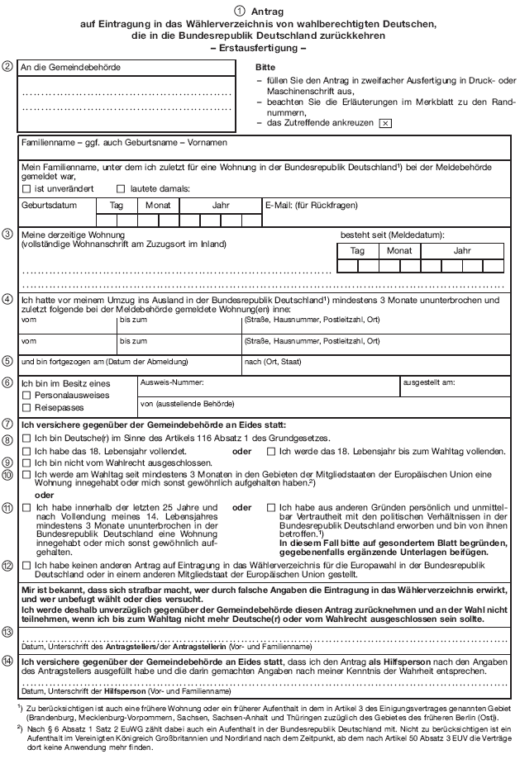

Motivation: Why Government as a Platform (GaaP)?
Silo-Oriented Architecture in public sector
Platform-Oriented Architecture in public sector
Führungszeugnis
Passamt
Petition
XY
3rd Party App: Public Leisure
Facilities Locator
DMV
Justice Department
Platformization
Where and how to start?
Boundary
API
Governance
Documentation
Core
API
Authen-tication
Citizen
DB
Open Data API
Periphery / Ecosystem
„Vending Machine Feeling“

Slide 18
Motivation: Why Government as a Platform (GaaP)?
Silo-Oriented Architecture in public sector
Platform-Oriented Architecture in public sector
Führungszeugnis
Passamt
Petition
XY
3rd Party App: Public Leisure
Facilities Locator
DMV
Justice Department
Platformization
Government as a Platform Analysis Method (GaaPAM)
Boundary
API
Dimension | Decompose |  | Recompose
 | 1. Status Quo | 2. Infrastructure decomposition | 3. Platform interpretation | 4. Assessment
Platform elements | identify the major components of the infrastructure | classify the components by importance to the infrastructure core use cases | map the components to platform core, boundary resources and ecosystem | infer recommendation for the improvement of the platform
Platform roles | identify the major actors of the infrastructure | classify the scenarios by infrastructure Services | map the actors to the roles of platform owner, complementor, user | infer recommendation for the improvement of the platform
Platform openness | identify the major usage scenarios of the infrastructure | classify the actors by their role | map the infrastructure services to openness participation and co-creation | infer recommendation for the improvement of the platform
Platform management | identify the activities of the infrastructure owner(s) | classify the activities by stakeholder | map the activities into facilitation, tool provision and asset management | infer recommendation for the improvement of the platform
Governance
Documentation
Core
API
Authen-tication
User
DB
Open Data API
Periphery / Ecosystem
Kuhn et al. 2022

Slide 19
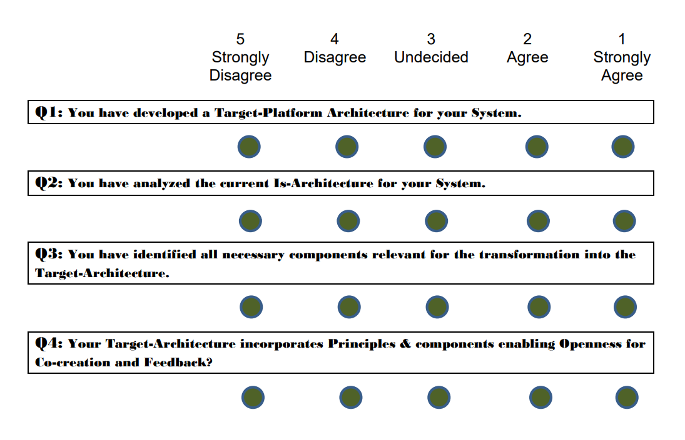
Resolution
Blueprint for Evaluation Criteria/Requirements generation following DSR
Evaluation Concept (Example)
What can I evaluate?
How can I evaluate?
Ex-Ante Evaluation
Post-Ante
Evaluation
Find evaluation proxy
Find evaluation method
Identified proxy
Identified method
Assess practical feasibility
Assess practical feasibility
feasible
feasible
Assess relevance
Assess relevance
relevance given
relevance given
Assess context specific boundaries
Assess context specific boundaries
context boundaries acceptable
context boundaries acceptable
Selected proxy
Selected method

Slide 20

Motivation: Why Government as a Platform Analysis Method (GaaPAM)?
Application of GaaPAM
Is -Architecture
Platform-Oriented Architecture
Das ist gut gemeint, macht es aber komplzierter. Nimmt lieber Folie 5 und dann die Folie die ich dir an die Email anhänge
API
API
1.1 Identify & 1.2 Classify
2.1 Map & 2.2 Infer
1. Decompose Is-Architecture
2. Recompose into Platform-Architecture

Slide 21
Expected Results: Evaluation Concept
A concrete Evaluation Concept designed for methods as DSR artifact outcomes applicable and instantiated to GaaPAM
3 principal Artifacts
Evaluation Concept aiming for validity applicable to GaaPAM
GaaPAM Evaluation regarding its validity
Blueprint of Evaluation Concept as theoretical contribution to DSR

Slide 22
Resolution: Development of an adequate Evaluation Methodology to capture the impact of the GaaP-Method on the infrastructure platfomization process
To develop this evaluation methodology, one must distill and clarify the core goal of the GaaP method
Goal 1
And is generally applicable and not bound to a specific socio, cultural, political, managerial or organizational context
Goal 4
Facilitate and enable the development of platform infrastructures utilizing the GaaP concept by providing a starting point through analyzing the existent infrastructure regarding its platform character
(semi-) Implicitly this further means
(Implicit)
Goal 2
(Implicit) Goal 3
The GaaP-method must also act as a continuous mental framework fostering platforming thinking and application of the GaaP concept
The GaaP-method must also foster the understanding of the GaaP concept and its implications on infrastructure and design

Slide 23
Resolution (2): Implications for the Development of such Evaluation Methodology
Core Question: How to evaluate & measure the main goal -The enabling and facilitation of existing infrastructure transformation towards a platform
The Development & Application of a (general) Evaluation Methodology that can capture and measure the core goal(s) of the GaaP Method and be used to assess its effectiveness across several contexts.
Goal 1
(Implicit)
Goal 2
(Implicit) Goal 3
Goal 4
My aim:

Slide 24

Complication: Generally, DSR lacks a set of concrete methodologies & concepts for the evaluation of such research
Example from Empirical Research
Example from DSR
B
U
I
L
D
Artifact Generation: Construct, Model, Method, Instatiation
framework
approach
algorithm
mechanism
RQ: Difference in two samples
process
E
V
A
L
U
A
T
E
Match Patterns
e.g.
Method * Analytical
Method * Testing
Method * Observational
FEDS
different evaluation strategies based on context,
e.g., Human Risk & Effectiveness → start artificial, formative move quickly to naturalisitc
Categories
effectiveness, user – friendliness, Internal consistency, etc.
Hypothesis
Evaluation alpha/beta error
Two-Paired t-Test

Slide 25
Expected results
An evaluation concept applicable to the evaluation of the GaaPAF developed by utilizing the DSR methodology focusing on validity and reliability
Evaluation Outcome of GaaPAF in 3rd Iteration regarding its validity
Possibly a first part of toolset for evaluating DSR
Possible Blueprint
Possible Blueprint Instatiation/Example
Strategy Blueprint: FEDS & Selection Framework
Human Risk & Effectiveness
Technical Risk & Efficacy
Quick & Simple
Purely Technical
Context Blueprint:
{Build Outcome} on {Evaluation Environment}
Framework Artifact on Human Subjects
Context 2
Context 3
Pre- and Post- Evaluation Framework with use case
Pre- and Post- Evaluation Framework with questionaire
Evaluation Concept 3
Set of Evaluation Tools/concepts
Metadata
Rounds: x
Participants: x
Metadata
Questionaire-type: x
Evaluation-Method: x

Slide 26
Resolution: Concrete evaluation concept for assessing validity of GaaPAF in a reliable manner
Without an explicit toolset of accepted and tested methods to evaluate Artifacts, how shall we achieve real:
Validity
Reliability
Credibility
My Research Goal
Building upon existing DSR Evaluation Theory and Frameworks
A concrete Concept designed for methods as artifact outcomes applicable and instantiated to GaaPAF
First step to a DSR Evaluation Methodology Catalogue/Toolset

Slide 27
Methodology: How to build such concept that can evaluate GaaPAF: enabling the transformation of existing infrastructure towards a platform
DSR Approach: Build & Evaluate
Literature Review (Build)
Existent Literature about Design Science Evaluation Methodology
Compilation of the current state of DSR Evaluation Research to build upon
Existent Literature from IS applying DSR generating Methods as Artefacts
Compilation of already applied evaluation methods in DSR to abstract and develop a common concept
Existent Literature about GaaP & GaaPAF
Overview of the GaaP & GaaPAF Research Conversation as it will serve as the Instantiation
(Possibly transfer from Behavioral Science and other fields of science)
Interviews with experts/participants (Evaluate)
Collection of primary data through interviews/questionnaire about the Evaluation Concept itself
Pre- and/or Post-Evaluation of Evaluation Concept to optimize the concept
Instantiation of Evaluation Concept (Evaluate)
Application of Evaluation Concept in the Context of the GaaPAF
Evaluation of the GaaPAF core objective mitigating alpha and beta-error

Slide 28
Use the sebis visual language (shapes, fonts, colors, sizes “Schnellformatvorlagen”)
Default
Line Style
Default Rectangle
Default
Rounded R.
Text
Default
Text
Text
User
Store
Information
Arrow
Cloud
Process
Box
Explanation
Fast Form 1
Fast Form 2
Fast Form 3
Fast Form 4
Fast Form 5
Fast Form 6
Fast Form 6
Fast Form 1
Fast Form 2
Fast Form 3
Fast Form 4
Fast Form 5
Fast Form 6
Fast Form 6

