Slide 1
Evaluating the adoption of the Government as a Platform Analysis Method by practitioners
Master-Thesis Final Presentation
Efstratios Pahis, 24.04.2023

Slide 2
Overview
Agenda
Motivation
Research Overview
Results
Lessons Learnt
Conclusion

Slide 3
Government as a Platform (GaaP)
Learn from the private sector:
What can we learn from successful platforms like Facebook, Airbnb, and AWS and transfer to the public sector?
Envision the government’s digital infrastructures as an open platform
Different actors contribute collaboratively to create public services
By using shared resources, standardization, common rules, competition, etc.

Slide 4






Government as a Platform
Platform-Oriented Architecture:
Silo-Oriented Architecture:
Federal Platform
Platformization
Auth
Auth
Pay
Auth
Pay
Where and how to start?
Pay
Comm
Processes are intertwined
Highly Coupled Architecture
Common Functionality implemented twice
One Process leads to Goal
Loose Coupled Architecture
Share common Resources

Slide 5
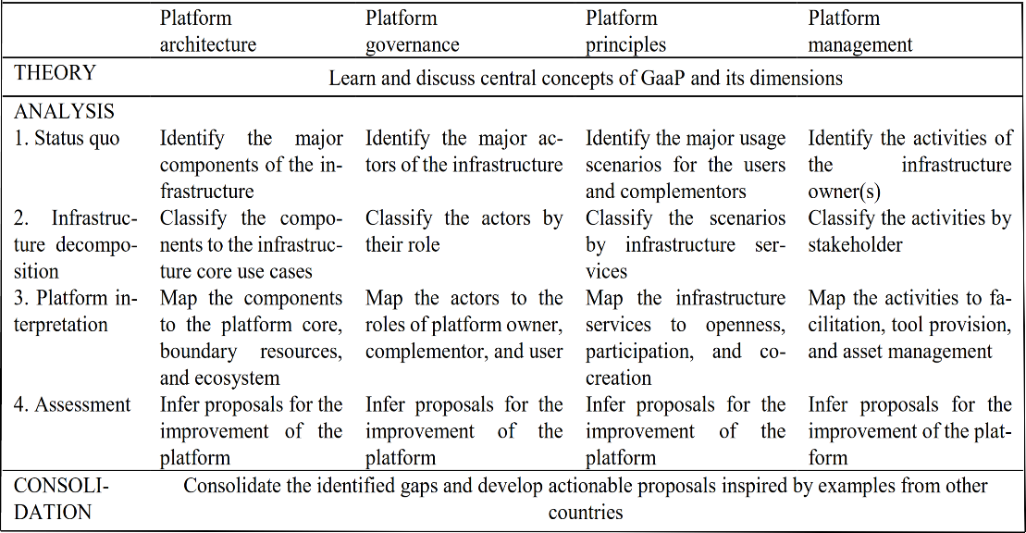
The Government as a Platform Infrastructure Analysis Method (GaaPIAM)
1. Identify gaps in infrastructure
2. Develop actionable proposals for improving infrastructure
3. Better comprehend platforms and GaaP
Application of GaaPIAM
by Kuhn et al., 2023
Information about the
current infrastructure

Slide 6

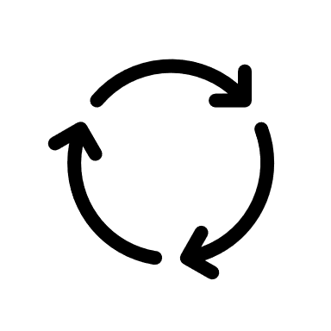
Research Goal: The evaluation of GaaPIAM
GaaPIAM so far has been evaluated once with the focus on identifying strengths and weaknesses
The actual utility: “Does it serve its prime purpose well” is yet subject to further evaluation
The task of my Master Thesis:
The Evaluation of the Government as a Platform Infrastructure Analysis Method

Slide 7
Research Overview
RQ1: What are criteria for the evaluation of GaaPIAM?
RQ2: How can the GaaPIAM be evaluated?
RQ3: How can the Evaluation Concept be applied in practice?
Based on DSR Evaluation and GaaP literature and iterative development of evaluation criteria
Based on DSR Evaluation literature, the evaluation criteria, and iterative development of evaluation methodologies
Evaluation of the Application of GaaPIAM with 2 German agencies using the evaluation concept
Set of 9 Evaluation Criteria
Evaluation Concept based on 9 Evaluation Criteria
GaaPIAM Evaluation Results

Slide 8

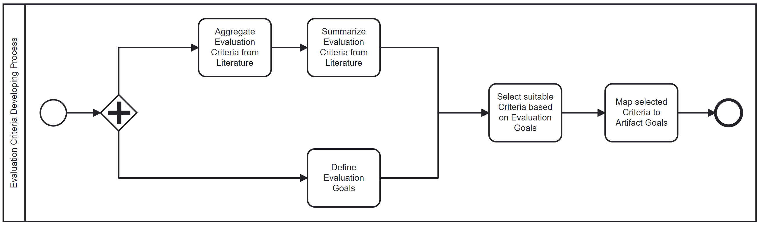
Evaluation Criteria Development Process
RQ1: What are criteria for the evaluation of GaaPIAM?

Slide 9
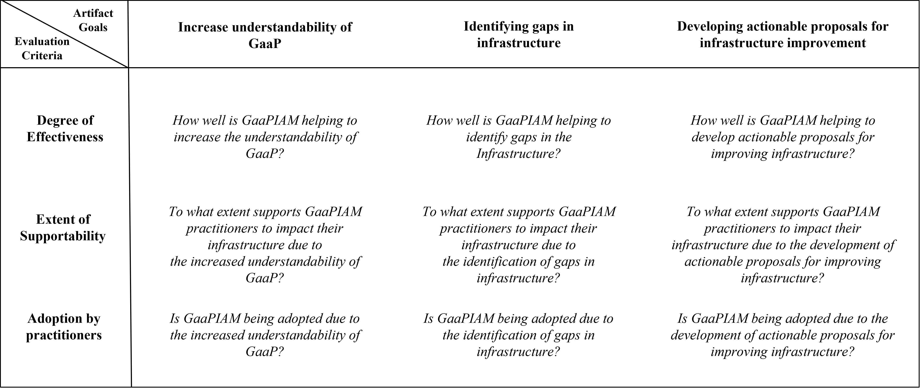
Final Evaluation Criteria – Mapping to Artifact goals
RQ1: What are criteria for the evaluation of GaaPIAM?

Slide 10
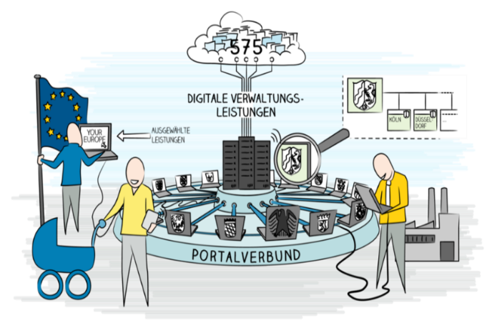

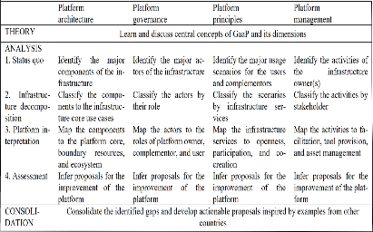

Evaluation Context Analysis
RQ2: How can the GaaPIAM be evaluated?
Kuhn et al., 2023
Impact
Short-Evaluation Period
GaaP Challenges
in Germany
Maximize Evaluation Period
Recommen
dation Willingness
Track impact via GaaP Challenges
Further Context Characteristics
GaaPIAM
*
Resolution:
Using practitioners as proxies to the real infrastructure
Real World Platform System
GaaPIAM utilized by Practitioners
Assumption: Practitioners have impact on real infrastructure
Practitioners
(IT-Strategist; Enterprise Architects)
*Bundesministerium des Innern und für Heimat: OZG-Leitfaden (2022)

Slide 11
Evaluation Concept Configuration in Practice
RQ2: How can the GaaPIAM be evaluated?
Pre-Interview
Assumptions Validation, Current Challenges (Supportability):
Open Questions
Workshop
(Application of GaaPIAM)
All Evaluation Criteria:
Transcriptions
Observations
Survey
Effectiveness & Adoption Criteria:
Likert-Scale
Net Promoter Score
30 m
Post-Interview
Effectiveness & Supportability Criteria:
Open Questions
45 m
3 to 4 weeks
240
m
Same Day
5 m

Slide 12
Example: Effectiveness Related Evaluation Criteria Configuration
RQ2: How can the GaaPIAM be evaluated?
Evaluation Criterion | Mode | Timing | Questions
How well is GaaPIAM helping to increase the understandability of GaaP? | Likert | Survey | The workshop helped me to better understand the Government as a Platform approach.
 | Open Question | Post-Interview | How did the workshop help you to better understand the Government as a Platform approach?
 | Open Question | Post-Interview | Did any aspects of the Government as a Platform approach remain unclear to you?
How well is GaaPIAM helping to identify gaps in the Infrastructure? | Likert | Survey | The workshop helped me to better identify optimization potentials in my infrastructure.
 | Open Question | Post-Interview | How did the workshop help you to better understand the Government as a Platform approach?
 | Open Question | Post-Interview | Did any aspects of the Government as a Platform approach remain unclear to you?
How well is GaaPIAM helping to develop actionable proposals for improving infrastructure? | Likert | Survey | The workshop helped me to better develop improvements in my infrastructure.
 | Open Question | Post-Interview | What improvements could you develop in your infrastructure?
 | Open Question | Post-Interview | What more improvements did you hope to develop in your infrastructure?

Slide 13
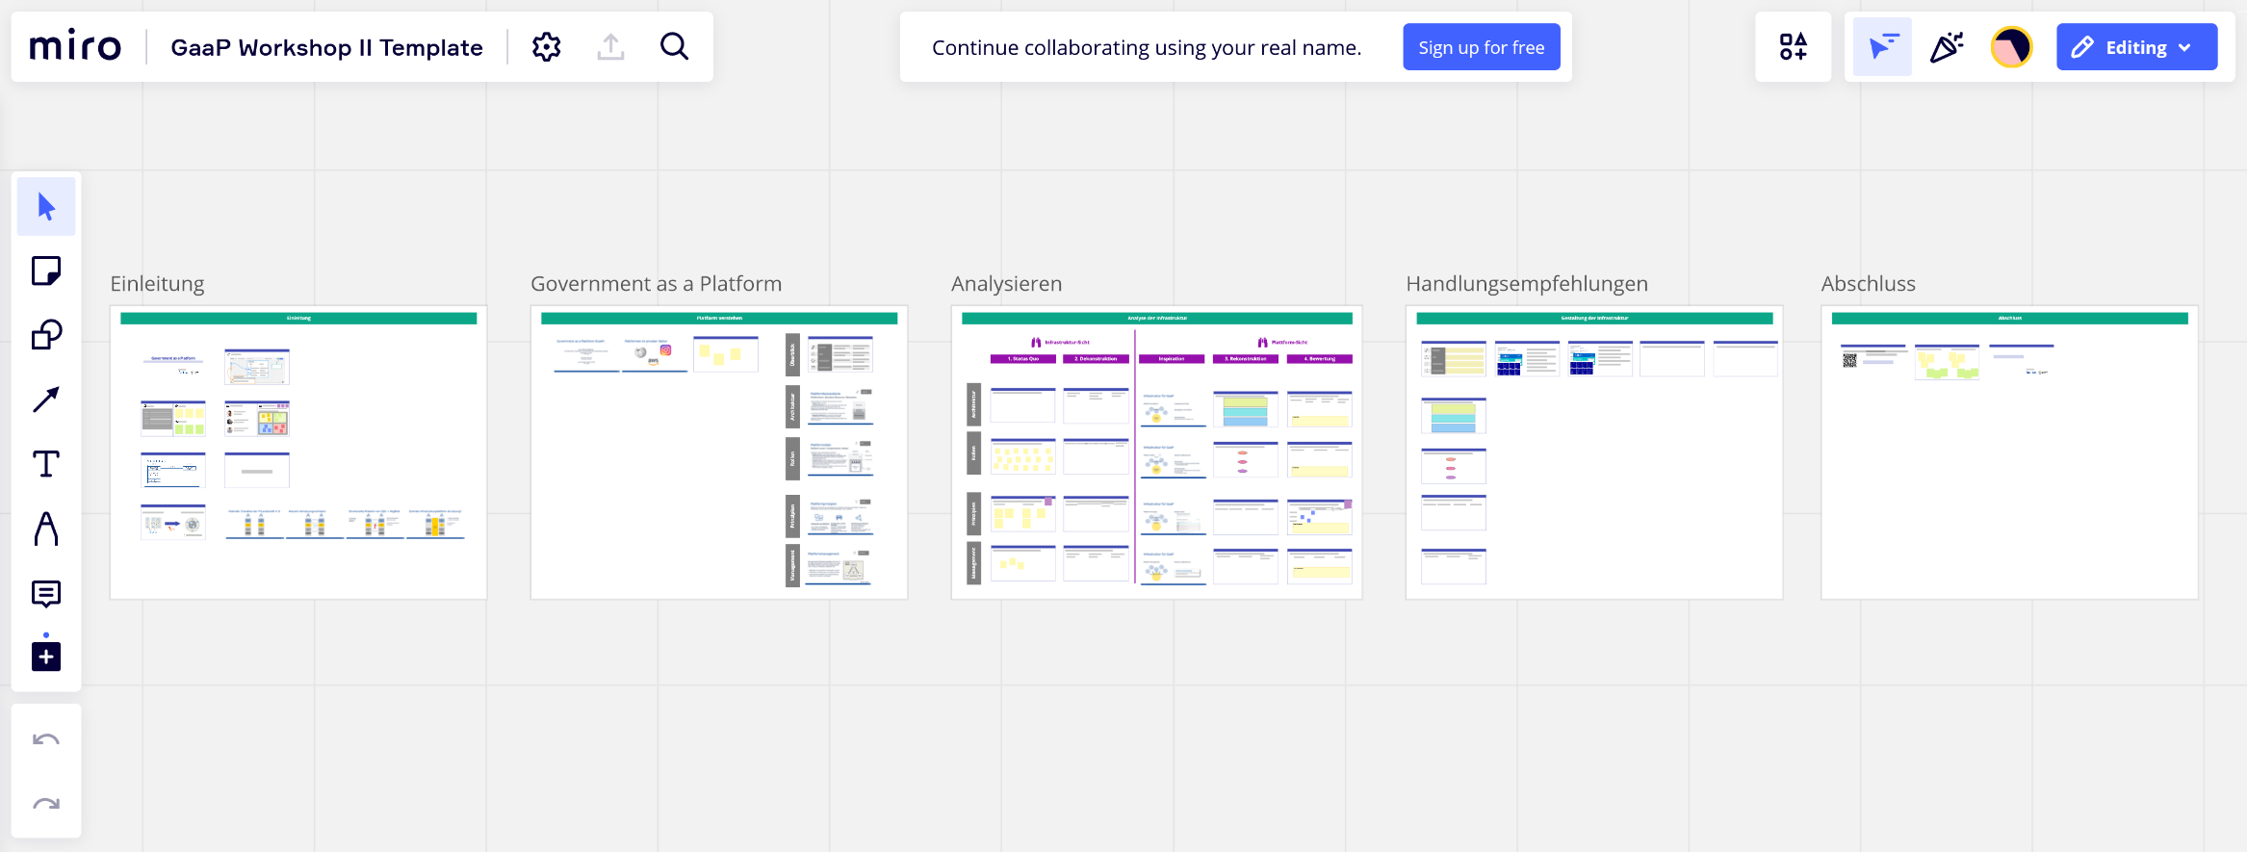
Workshop: Application of GaaPIAM
RQ3: How can the Evaluation Concept be applied in practice?

Slide 14
Collected Data
RQ3: How can the Evaluation Concept be applied in practice?
2 Workshops in total ~ 8h
2 Post-Interview in total ~ 1.5h
2 Pre-Interview in total ~ 1h
Survey data ~ 3 LS and 3 NPS

Slide 15
Evaluation Results
RQ3: How can the Evaluation Concept be applied in practice?
Results
Detailed Results
The evaluation data suggests that GaaPIAM is effective
(regarding the evaluation criteria)
Revised Role Structure for their Infrastructure
Architecture Optimization leveraging Co-creation
Conceptual Vocabulary and Mental Model
The evaluation data suggests that GaaPIAM supports the practitioners
Adjustments of Role structures and Responsibilities
New Architecture Governance encompassing Co-creation principles
Conceptual Vocabulary utilized in Requirements Engineering
The evaluation does not allow for clear, conclusive results regarding the adoption of GaaPIAM
Averaging Net Promoter Score of 11
(from 100)

Slide 16
Lessons Learnt: GaaPIAM
GaaPIAM helps practitioners differently and generates different benefits for practitioners
GaaPIAM helps uncover regulatory barriers hindering platformization
Depending on prior Platform familiarity
Depending on organizational culture
“Existing law shoots us in the knee”
“Already existing legislation is written in such a way that it makes it impossible to implement things like an IT professional”

Slide 17
Lessons Learnt: Evaluation Concept
Using an array of evaluation methodologies adjusted to the criteria is beneficial
Measuring the adoption through the Recommendation Willingness is not suitable in our context
Not one size fits it all approach allows to get more differentiated results for each criterion
Many evaluation angles make evaluation more robust and insightful
Using the adoption as criterion might be beneficial to capture overall utility
However, sample size is the main challenge and is not corroborated if it can replace long-term observation

Slide 18
Conclusion
Summary
GaaPIAM supports the practitioners and performs well in terms of its objectives
The Evaluation Concept was overall suitable and generated plenty of heterogeneous evaluation data
Limitations
Adoption by Practitioners criterion requires more data or a different approach
Generally, more practitioners would have been beneficial in generating more evaluation data
Future Work
GaaPIAM needs more cost-efficient and repeatable ways for its application than a workshop
Legal barriers hindering the improvement of the government’s digital infrastructure must be addressed

Slide 19
References
Hevner, Alan & R, Alan & March, Salvatore & T, Salvatore & Park, & Park, Jinsoo & Ram, & Sudha,. (2004). Design Science in Information Systems Research. Management Information Systems Quarterly. 28. 75
Kuhn, Peter (2022). Towards “government as a platform”: An analysis framework for public sector infrastructure. FORTHCOMING
Styrin, E., Mossberger, K., & Zhulin, A. (2022). Government as a platform: Intergovernmental participation for public services in the Russian Federation. Government Information Quarterly, 39(1), 101627
Cordella, A., & Paletti, A. (2019). Government as a platform, orchestration, and public value creation: The Italian case. Government Information Quarterly, 36(4), 101409.
Janssen, M., & Estevez, E. (2013). Lean government and platform-based governance—Doing more with less. Government Information Quarterly, 30, S1-S8.
O'Reilly, T. (2011). Government as a Platform. Innovations: Technology, Governance, Globalization, 6(1), 13-40.
Venable, J., Pries-Heje, J. & Baskerville, R. FEDS. (2016): a Framework for Evaluation in Design Science Research. Eur J Inf Syst 25, 77–89. https://doi.org/10.1057/ejis.2014.36
Venable, John, Pries-Heje, Jan & Baskerville, Richard. (2012). A Comprehensive Framework for Evaluation in Design Science Research. LNCS. 7286. 423-438.
Larsen, K.R. et al. (2020). Validity in Design Science Research. In: Hofmann, S., Müller, O., Rossi, M. (eds) Designing for Digital Transformation. Co-Creating Services with Citizens and Industry. DESRIST 2020. Lecture Notes in Computer Science(), vol 12388. Springer, Cham.
Deng, Qi & Ji, Shaobo. (2018). A Review of Design Science Research in Information Systems: Concept, Process, Outcome, and Evaluation. Pacific Asia Journal of the Association for Information Systems. 10. 1-36. 10.17705/1PAIS.10101.

Slide 20
B.Sc.
Efstratios Pahis
Masterand
17132
matthes@in.tum.de

Slide 21
Research Overview
RQ1: What are criteria for the evaluation of GaaPIAM?
RQ2: How can the GaaPIAM be evaluated?
RQ3: How can the Evaluation Concept be applied in practice?
DSR Evaluation: Literature-Review
Application of Evaluation Concept in Practice and Evaluation of the GaaPIAM
Starting Point:
4 prominent papers
27
relevant papers
8
papers in RQ1 & RQ2
GaaP: Literature-Review
DB-based Search with GaaP Keyword
35 papers from DB + 4 extra papers
31 relevant papers
Set of 9 Evaluation Criteria
Evaluation Concept based on 9 Evaluation Criteria
GaaPIAM Evaluation Results

Slide 22
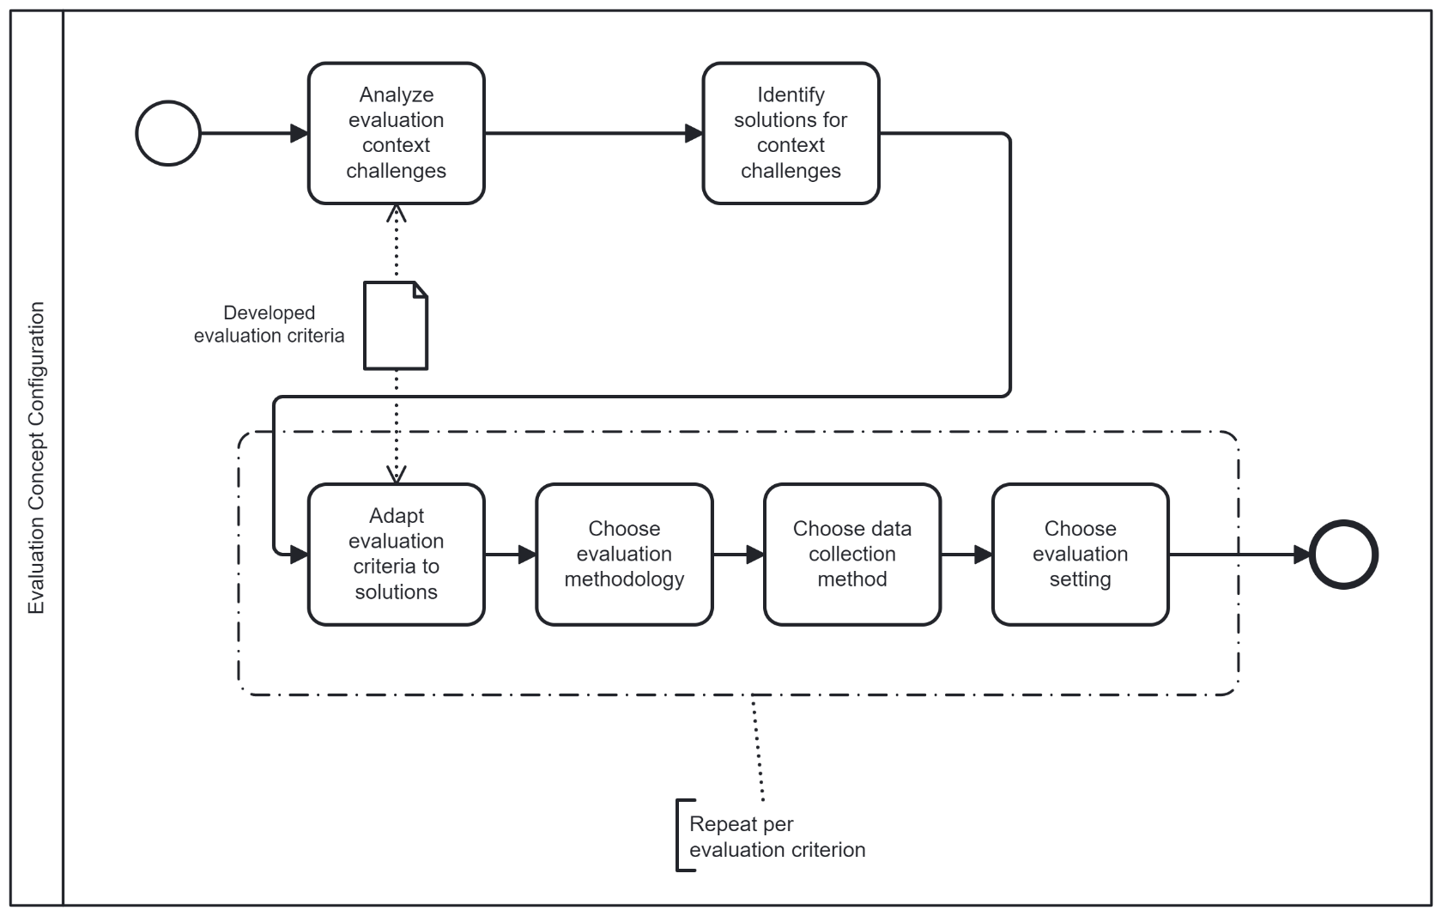
Evaluation Concept Configuration Process
RQ2: How can the GaaPIAM be evaluated?

Slide 23
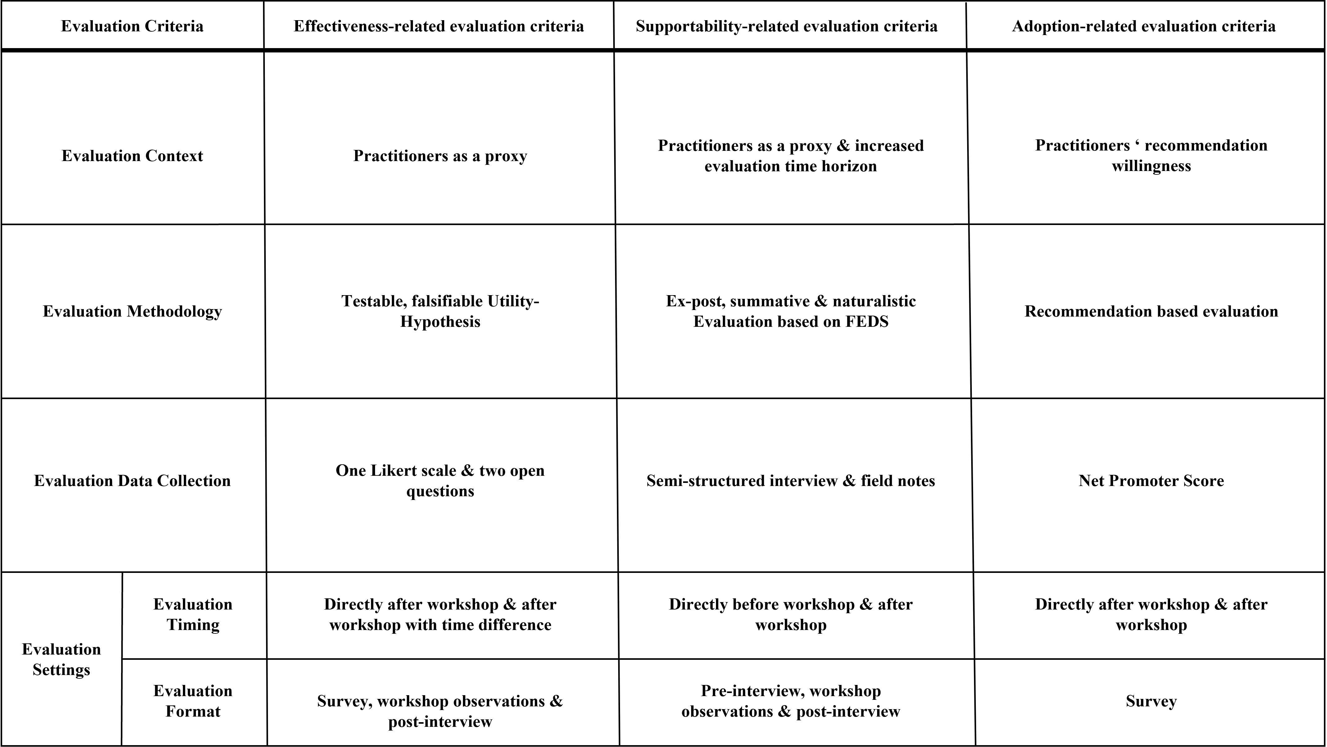
Evaluation Concept Final Configuration
RQ2: How can the GaaPIAM be evaluated?

Slide 24
Evaluation Concept Final Configuration
RQ2: How can the GaaPIAM be evaluated?

Slide 25
Evaluation Goals
RQ1: What are criteria for the evaluation of GaaPIAM?
GaaPIAM so far has been evaluated once with the focus on eradicating toothing problems
Focus on its degree of effectiveness
(How well is it fulfilling its purpose)
Focus on its extent of support to impact infrastructure
Evaluation with a broad scope
12 distinct criteria utilized
Single evaluation event
Focus on its adoption by practitioners
(Will the practitioners use it in the long term)
GaaPIAM evolved

Slide 26


First Results: As of today
Literature Review in 2 core Topics
GaaP: Systematic Literature-Review
DSR Evaluation: Literature-Review
Search Query: „Government as a Platform“ in Abstract OR Keyword
35 Papers
28 relevant
Context for Evaluation
Search for Related Work
New Perspective on GaaP
Starting Point: relevant & most cited papers
Back & Forward Citation Search
26 relevant papers identified
Basis for Evaluation Concept
Search for Related Work

Slide 27





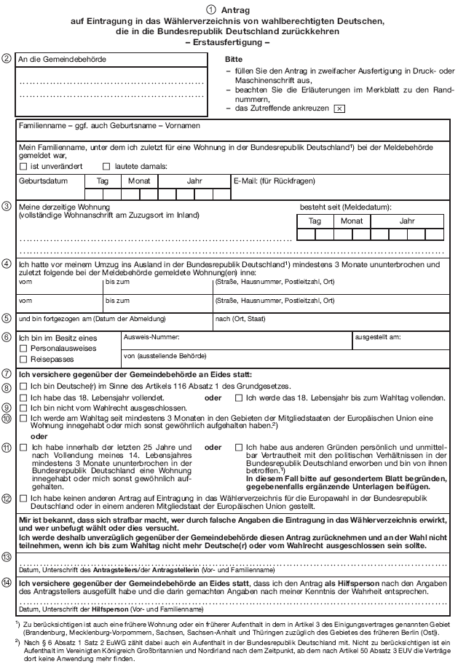

Motivation: Why Government as a Platform (GaaP)?
Silo-Oriented Architecture in public sector
Platform-Oriented Architecture in public sector
Führungszeugnis
Passamt
Petition
XY
3rd Party App: Public Leisure
Facilities Locator
DMV
Justice Department
Platformization
Where and how to start?
Boundary
API
Governance
Documentation
Core
API
Authen-tication
Citizen
DB
Open Data API
Periphery / Ecosystem
„Vending Machine Feeling“

Slide 28
Motivation: Why Government as a Platform (GaaP)?
Silo-Oriented Architecture in public sector
Platform-Oriented Architecture in public sector
Führungszeugnis
Passamt
Petition
XY
3rd Party App: Public Leisure
Facilities Locator
DMV
Justice Department
Platformization
Government as a Platform Analysis Method (GaaPAM)
Boundary
API
Dimension | Decompose |  | Recompose
 | 1. Status Quo | 2. Infrastructure decomposition | 3. Platform interpretation | 4. Assessment
Platform elements | identify the major components of the infrastructure | classify the components by importance to the infrastructure core use cases | map the components to platform core, boundary resources and ecosystem | infer recommendation for the improvement of the platform
Platform roles | identify the major actors of the infrastructure | classify the scenarios by infrastructure Services | map the actors to the roles of platform owner, complementor, user | infer recommendation for the improvement of the platform
Platform openness | identify the major usage scenarios of the infrastructure | classify the actors by their role | map the infrastructure services to openness participation and co-creation | infer recommendation for the improvement of the platform
Platform management | identify the activities of the infrastructure owner(s) | classify the activities by stakeholder | map the activities into facilitation, tool provision and asset management | infer recommendation for the improvement of the platform
Governance
Documentation
Core
API
Authen-tication
User
DB
Open Data API
Periphery / Ecosystem
Kuhn et al. 2022

Slide 29
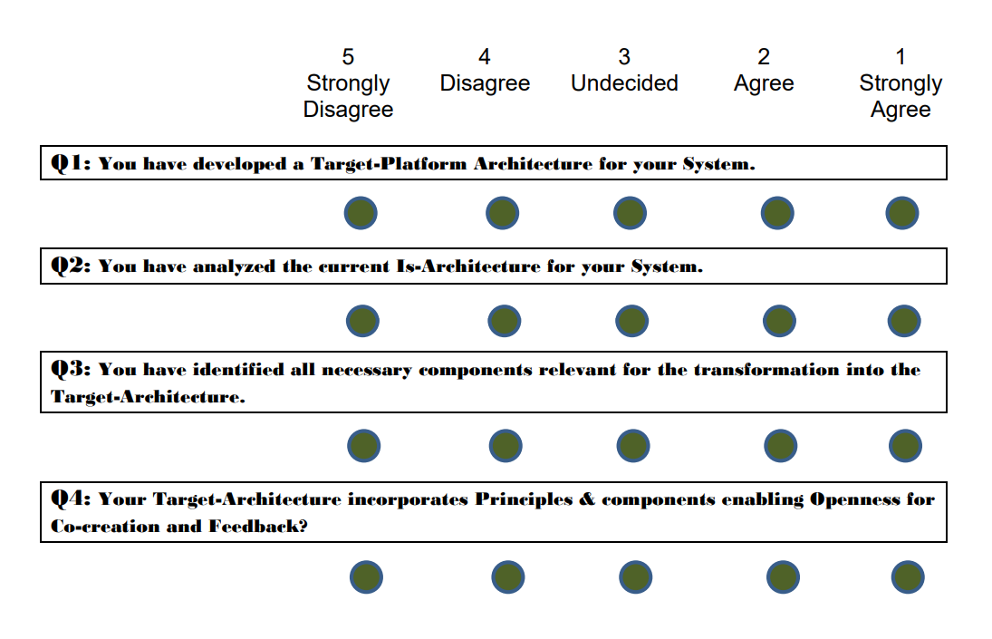

Resolution
Blueprint for Evaluation Criteria/Requirements generation following DSR
Evaluation Concept (Example)
What can I evaluate?
How can I evaluate?
Ex-Ante Evaluation
Post-Ante
Evaluation
Find evaluation proxy
Find evaluation method
Identified proxy
Identified method
Assess practical feasibility
Assess practical feasibility
feasible
feasible
Assess relevance
Assess relevance
relevance given
relevance given
Assess context specific boundaries
Assess context specific boundaries
context boundaries acceptable
context boundaries acceptable
Selected proxy
Selected method

Slide 30

Motivation: Why Government as a Platform Analysis Method (GaaPAM)?
Application of GaaPAM
Is -Architecture
Platform-Oriented Architecture
Das ist gut gemeint, macht es aber komplzierter. Nimmt lieber Folie 5 und dann die Folie die ich dir an die Email anhänge
API
API
1.1 Identify & 1.2 Classify
2.1 Map & 2.2 Infer
1. Decompose Is-Architecture
2. Recompose into Platform-Architecture

Slide 31
Expected Results: Evaluation Concept
A concrete Evaluation Concept designed for methods as DSR artifact outcomes applicable and instantiated to GaaPAM
3 principal Artifacts
Evaluation Concept aiming for validity applicable to GaaPAM
GaaPAM Evaluation regarding its validity
Blueprint of Evaluation Concept as theoretical contribution to DSR

Slide 32
Resolution: Development of an adequate Evaluation Methodology to capture the impact of the GaaP-Method on the infrastructure platfomization process
To develop this evaluation methodology, one must distill and clarify the core goal of the GaaP method
Goal 1
And is generally applicable and not bound to a specific socio, cultural, political, managerial or organizational context
Goal 4
Facilitate and enable the development of platform infrastructures utilizing the GaaP concept by providing a starting point through analyzing the existent infrastructure regarding its platform character
(semi-) Implicitly this further means
(Implicit)
Goal 2
(Implicit) Goal 3
The GaaP-method must also act as a continuous mental framework fostering platforming thinking and application of the GaaP concept
The GaaP-method must also foster the understanding of the GaaP concept and its implications on infrastructure and design

Slide 33
Resolution (2): Implications for the Development of such Evaluation Methodology
Core Question: How to evaluate & measure the main goal -The enabling and facilitation of existing infrastructure transformation towards a platform
The Development & Application of a (general) Evaluation Methodology that can capture and measure the core goal(s) of the GaaP Method and be used to assess its effectiveness across several contexts.
Goal 1
(Implicit)
Goal 2
(Implicit) Goal 3
Goal 4
My aim:

Slide 34


Complication: Generally, DSR lacks a set of concrete methodologies & concepts for the evaluation of such research
Example from Empirical Research
Example from DSR
B
U
I
L
D
Artifact Generation: Construct, Model, Method, Instatiation
framework
approach
algorithm
mechanism
RQ: Difference in two samples
process
E
V
A
L
U
A
T
E
Match Patterns
e.g.
Method * Analytical
Method * Testing
Method * Observational
FEDS
different evaluation strategies based on context,
e.g., Human Risk & Effectiveness → start artificial, formative move quickly to naturalisitc
Categories
effectiveness, user – friendliness, Internal consistency, etc.
Hypothesis
Evaluation alpha/beta error
Two-Paired t-Test

Slide 35
Expected results
An evaluation concept applicable to the evaluation of the GaaPAF developed by utilizing the DSR methodology focusing on validity and reliability
Evaluation Outcome of GaaPAF in 3rd Iteration regarding its validity
Possibly a first part of toolset for evaluating DSR
Possible Blueprint
Possible Blueprint Instatiation/Example
Strategy Blueprint: FEDS & Selection Framework
Human Risk & Effectiveness
Technical Risk & Efficacy
Quick & Simple
Purely Technical
Context Blueprint:
{Build Outcome} on {Evaluation Environment}
Framework Artifact on Human Subjects
Context 2
Context 3
Pre- and Post- Evaluation Framework with use case
Pre- and Post- Evaluation Framework with questionaire
Evaluation Concept 3
Set of Evaluation Tools/concepts
Metadata
Rounds: x
Participants: x
Metadata
Questionaire-type: x
Evaluation-Method: x

Slide 36
Resolution: Concrete evaluation concept for assessing validity of GaaPAF in a reliable manner
Without an explicit toolset of accepted and tested methods to evaluate Artifacts, how shall we achieve real:
Validity
Reliability
Credibility
My Research Goal
Building upon existing DSR Evaluation Theory and Frameworks
A concrete Concept designed for methods as artifact outcomes applicable and instantiated to GaaPAF
First step to a DSR Evaluation Methodology Catalogue/Toolset

Slide 37
Methodology: How to build such concept that can evaluate GaaPAF: enabling the transformation of existing infrastructure towards a platform
DSR Approach: Build & Evaluate
Literature Review (Build)
Existent Literature about Design Science Evaluation Methodology
Compilation of the current state of DSR Evaluation Research to build upon
Existent Literature from IS applying DSR generating Methods as Artefacts
Compilation of already applied evaluation methods in DSR to abstract and develop a common concept
Existent Literature about GaaP & GaaPAF
Overview of the GaaP & GaaPAF Research Conversation as it will serve as the Instantiation
(Possibly transfer from Behavioral Science and other fields of science)
Interviews with experts/participants (Evaluate)
Collection of primary data through interviews/questionnaire about the Evaluation Concept itself
Pre- and/or Post-Evaluation of Evaluation Concept to optimize the concept
Instantiation of Evaluation Concept (Evaluate)
Application of Evaluation Concept in the Context of the GaaPAF
Evaluation of the GaaPAF core objective mitigating alpha and beta-error

Slide 38
Use the sebis visual language (shapes, fonts, colors, sizes “Schnellformatvorlagen”)
Default
Line Style
Default Rectangle
Default
Rounded R.
Text
Default
Text
Text
User
Store
Information
Arrow
Cloud
Process
Box
Explanation
Fast Form 1
Fast Form 2
Fast Form 3
Fast Form 4
Fast Form 5
Fast Form 6
Fast Form 6
Fast Form 1
Fast Form 2
Fast Form 3
Fast Form 4
Fast Form 5
Fast Form 6
Fast Form 6

