Slide 1
An Expert-Defined Rule-Based Approach for Generating Vector Representations to Classify Texts
12.12.22, Master’s Thesis Final Presentation
Andrei Kreinhaus
Notes:
The research was conducted in cooperation with MHP

Slide 2
Outline
Introduction
  Motivation
  Objectives
  Research questions
  Research concept
  General approach
  Data set
  Methodology
  Results
  Classification results (RQ2)
  Identified challenges (RQ1)
  Application of unsupervised learning methods (RQ3)
  Conclusion

Slide 3
Outline
Introduction
  Motivation
  Objectives
  Research questions
  Research concept
  General approach
  Data set
  Methodology
  Results
  Classification results (RQ2)
  Identified challenges (RQ1)
  Application of unsupervised learning methods (RQ3)
  Conclusion

Slide 4

Motivation
Task
Classify customer complaints from the automotive industry regarding vehicle components
About 80% of data in companies are unstructured [1] and often need to be classified. Manual creation of labeled data sets for specific tasks is often used as a solution. However, manual labeling is time-consuming and therefore leads to high labor costs [2].
In the case of multi-class classification, a manually labeled data set cannot be easily adapted to changes in the problem description, e.g., when classes are added, or their meaning is changed. A relabeling of the data set is required in this case [3].
We do not want to derive all available topics from the data set limiting their number to predefined classes.
The given task requires that both vehicle component and the corresponding problem are identified in the same document.
Oftentimes, a document contains multiple classes and their issues that need to be recognized.
[1] Grimes, 2008
[2] Liu et al., 2004
[3] Romera-Parades and Torr, 2015

Slide 5
Outline
Introduction
  Motivation
  Objectives
  Research questions
  Research concept
  General approach
  Data set
  Methodology
  Results
  Classification results (RQ2)
  Identified challenges (RQ1)
  Application of unsupervised learning methods (RQ3)
  Conclusion

Slide 6



Objectives
Suggesting a combination of different NLP techniques and industry expertise
Comparing different
(non-)contextual embedding techniques
Documenting challenges and limitations throughout the classification process
Considering different perspectives such as data, model, expertise, and performance
Assessing if unsupervised learning methods alone can solve the given task
Assessing application of unsupervised learning methods in context of the proposed method
Creating a framework for multi-class classification in predefined classes combining
NLP techniques and domain perspective to reduce manual time and produce training data
Li et al., 2022

Slide 7
Outline
Introduction
  Motivation
  Objectives
  Research questions
  Research concept
  General approach
  Data set
  Methodology
  Results
  Classification results (RQ2)
  Identified challenges (RQ1)
  Application of unsupervised learning methods (RQ3)
  Conclusion

Slide 8
Research Questions
How do these novel methods compare to current methods of unsupervised learning in the context of automotive customer data?
Which NLP methods can be combined with the domain expertise to facilitate the extrapolation from context rules to training data?
What are the challenges faced when trying to create structured data sets from unstructured documents?
1
2
3
Notes:
On that basis we formulate three research questions.
How to combine NLP methods with domain expertise most efficiently
What are the challenges throughout the process
Can unsupervised learning alone solve the underlying task, and if not, can they be in any way useful for this use case

Slide 9
Outline
Introduction
  Motivation
  Objectives
  Research questions
  Research concept
  General approach
  Data set
  Methodology
  Results
  Classification results (RQ2)
  Identified challenges (RQ1)
  Application of unsupervised learning methods (RQ3)
  Conclusion

Slide 10
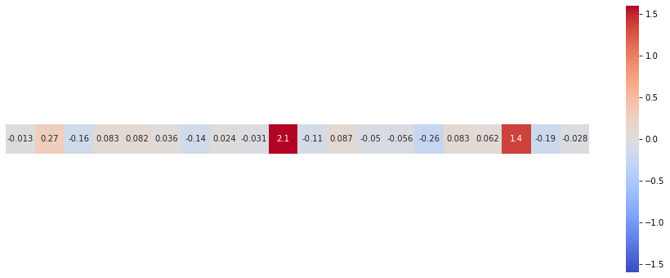
Definitions
Domain Expert
A person with knowledge in a specific area. In our case, all professional employees of the cooperating company.
Context Window
A part of the document of variable length that surrounds a class keyword.
Context Rule
A context window that satisfies task-specific requirements. In our thesis, it must describe a vehicle component and a corresponding issue.
Class Vector
Embedding of the class resulting from aggregating the corresponding context rules.
1
3
4
5
Class Description
A set of specific keywords describing the class.
Class Threshold
A minimum similarity score required for a document sentence required to become part of a particular class.
2
Examples for Evaluation of Context Windows
Yesterday I went home, and my engine stalled on the uphill slope.
This sentence has the word engine inside and could become a context window.
6
The first sentence qualifies as context rule
while the second does not.

Slide 11
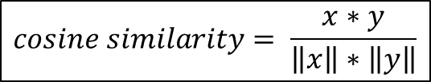
The Proposed Approach is Based on how a Person Classifies Texts [1]
Document
Target Class
Cleaning
Class Description
Sentence-wise representation
Context Windows
Sentence Embedding
Context Rules
Class vector
Sentence Embedding
Class Vector
Similarity
$$cosine similarity= \frac{x∗y}{\left\|x\right\|∗\left\|y\right\|}$$
[1] Haj-Yahia et al., 2019
Notes:
The idea behind the proposed approach is to mimic how easily people can classify documents based on their understanding of the underlying classes because they can associate it with different experience (Haj-Yahia et el.)
The proposed method is inspired by the way a human proceeds in this situation: It draws on textual similarity between the most relevant words in each document and a dictionary of keywords for each category reflecting its semantics and lexical field (Haj-Yahia et el.)

Slide 12
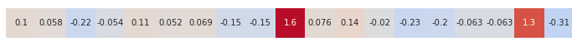


The Proposed Approach with an Example
document_id: 283661
Document
Target Class
“Engine” class
while driving at any speed the engine will stall without a prior warning.
dealer could not duplicate the problem.
Cleaning
Class Description
engine quit while cruising at 50mph
the engine checklight comes on
…
sensor wire broke resulting in motor burning
Sentence-wise representation
Context Windows
Sentence Embedding
Context Rules
Class vector
Sentence Embedding
Class Vector
$$x$$
Similarity
$$y$$
$$cosine similarity= \frac{x∗y}{\left\|x\right\|∗\left\|y\right\|}$$
Haj-Yahia et al., 2019

Slide 13


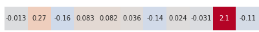
Semantically Similar Concepts of Engine-Related Issues in a 2D Vector Space
Radiator cooling
grinds
Cosine similarity
score of 0.7
ID:14
ID:94
Fire in the
engine
Smoke coming
from the engine
ID:21
ID:11
ID:42
Engine
stall
Engine lost
all power
Generator had
to be replaced
Cosine similarity
score of 0.6
ID:23
ID:18
ID:34
Engine
issue
Engine
failure
Engine service
light was on
ID:83
Rough
idling
Engine
quit
ID:39
Reminder
Alternator
tested as bad
ID:28
ID:31
Ignition
problems
Class Vector
Embedding of the class resulting from aggregating the corresponding context rules.
Class Threshold
A minimum similarity score required for a document sentence required to become part of a particular class.
ID:38
ID:61
Temperature sensor
light comes on
The key would
not turn
ID:71
ID:57
Oil indicator
lamp came on
ID:99
ID:74
Inspired by Schopf et al., 2022

Slide 14
Outline
Introduction
  Motivation
  Objectives
  Research questions
  Research concept
  General approach
  Data set
  Methodology
  Results
  Classification results (RQ2)
  Identified challenges (RQ1)
  Application of unsupervised learning methods (RQ3)
  Conclusion

Slide 15
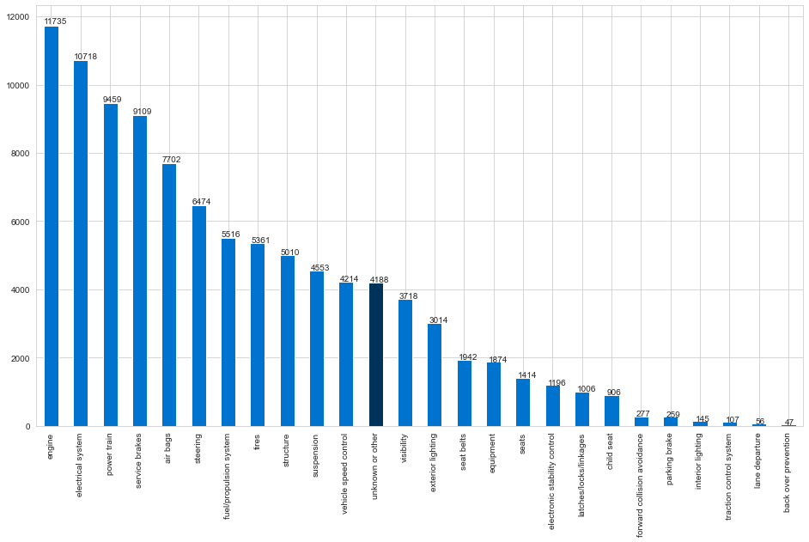
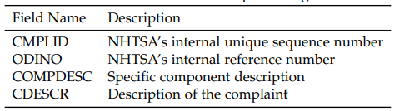
Data set
Anonymized open-source data set of the U.S. Department of Transportation (NHTSA).
Topic: Identification of safety issues and determining if a safety-related defect trend exists.
Over 1.3 Mio unique complaints updated on daily basis.
The data set is highly imbalanced.
A quarter of the complaints have multiple label.
A sample of 100,000 documents is used for classification.
Distribution of documents over 25 classes
A sample of 100,000 document
The component descriptions are selected by individuals submitting complaints and are often chosen arbitrary. For this reason, we cannot use them for validation.
Fields of the data set used for classification

Slide 16
Outline
Introduction
  Motivation
  Objectives
  Research questions
  Research concept
  General approach
  Data set
  Methodology
  Results
  Classification results (RQ2)
  Identified challenges (RQ1)
  Application of unsupervised learning methods (RQ3)
  Conclusion

Slide 17
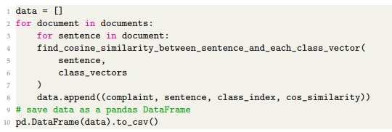
M#: Methodology for Answering the RQ2
Data Preprocessing
Definition and Description of Target Classes
Obtaining Context Rules from Context Windows
Calculating Class Vectors
Classification of Documents
Validation Procedure
Handling NaN values, lower case, noise reduction, removal of special characters.
Evaluation of context windows for the “engine” class
Models: contextual SBERT-based all-MiniLM-L6-v2 and all-distilroberta-v1; non-contextual tok2vec.
Aggregation method: average pooling of embeddings of context rules for each class.
Sentence | Evaluation
vehicle experienced a fire in the engine. | 1
purchased car july '09 with 64000 on engine. | 0
engine coolant and engine light etc came on. | 1
Class descriptions used for classification
These five classes are further used for validation
Compare each sentence of each document to each class vector
Pseudo code for the proposed algorithm
5 classes for validation
3 embedding models
2 thresholds (0.6 and 0.7)
4 validation rounds
3 voters per class
100 sentences per voter
44 participants in total
Majority voting principle
Inter-voter agreement is measured (Fleiss’ Kappa)
Class | Keywords
Airbag | airbag, air bag, knee bolster, inflator
Engine | engine, motor, ignition, generator
Seats | seat, carseat, headrest, cushion
Tires | tire, wheel, tread wear, flat spot
Traction control | traction, stabilitrak, vsc light

Slide 18
M1: Data Preprocessing
Data Preprocessing
Definition and Description of Target Classes
Obtaining Context Rules from Context Windows
Calculating Class Vectors
Classification of Documents
Validation Procedure
Handling NaN values, lower case, noise reduction, removal of special characters.
Evaluation of context windows for the “engine” class
Models: contextual SBERT-based all-MiniLM-L6-v2 and all-distilroberta-v1; non-contextual tok2vec.
Aggregation method: average pooling of embeddings of context rules for each class.
Sentence | Evaluation
vehicle experienced a fire in the engine. | 1
purchased car july '09 with 64000 on engine. | 0
engine coolant and engine light etc came on. | 1
Class descriptions used for classification
These five classes are further used for validation
Compare each sentence of each document to each class vector
Pseudo code for the proposed algorithm
5 classes for validation
3 embedding models
2 thresholds (0.6 and 0.7)
4 validation rounds
3 voters per class
100 sentences per voter
44 participants in total
Majority voting principle
Inter-voter agreement is measured (Fleiss’ Kappa)
Class | Keywords
Airbag | airbag, air bag, knee bolster, inflator
Engine | engine, motor, ignition, generator
Seats | seat, carseat, headrest, cushion
Tires | tire, wheel, tread wear, flat spot
Traction control | traction, stabilitrak, vsc light

Slide 19
M2: Definition and Description of Target Classes
Data Preprocessing
Definition and Description of Target Classes
Obtaining Context Rules from Context Windows
Calculating Class Vectors
Classification of Documents
Validation Procedure
Handling NaN values, lower case, noise reduction, removal of special characters.
Evaluation of context windows for the “engine” class
Models: contextual SBERT-based all-MiniLM-L6-v2 and all-distilroberta-v1; non-contextual tok2vec.
Aggregation method: average pooling of embeddings of context rules for each class.
Sentence | Evaluation
vehicle experienced a fire in the engine. | 1
purchased car july '09 with 64000 on engine. | 0
engine coolant and engine light etc came on. | 1
Class descriptions used for classification
These five classes are further used for validation
Compare each sentence of each document to each class vector
Pseudo code for the proposed algorithm
5 classes for validation
3 embedding models
2 thresholds (0.6 and 0.7)
4 validation rounds
3 voters per class
100 sentences per voter
44 participants in total
Majority voting principle
Inter-voter agreement is measured (Fleiss’ Kappa)
Class | Keywords
Airbag | airbag, air bag, knee bolster, inflator
Engine | engine, motor, ignition, generator
Seats | seat, carseat, headrest, cushion
Tires | tire, wheel, tread wear, flat spot
Traction control | traction, stabilitrak, vsc light

Slide 20
M3: Obtaining Context Rules from Context Windows
Data Preprocessing
Definition and Description of Target Classes
Obtaining Context Rules from Context Windows
Calculating Class Vectors
Classification of Documents
Validation Procedure
Handling NaN values, lower case, noise reduction, removal of special characters.
Evaluation of context windows for the “engine” class
Models: contextual SBERT-based all-MiniLM-L6-v2 and all-distilroberta-v1; non-contextual tok2vec.
Aggregation method: average pooling of embeddings of context rules for each class.
Sentence | Evaluation
vehicle experienced a fire in the engine. | 1
purchased car july '09 with 64000 on engine. | 0
engine coolant and engine light etc came on. | 1
Class descriptions used for classification
These five classes are further used for validation
Compare each sentence of each document to each class vector
Pseudo code for the proposed algorithm
5 classes for validation
3 embedding models
2 thresholds (0.6 and 0.7)
4 validation rounds
3 voters per class
100 sentences per voter
44 participants in total
Majority voting principle
Inter-voter agreement is measured (Fleiss’ Kappa)
Class | Keywords
Airbag | airbag, air bag, knee bolster, inflator
Engine | engine, motor, ignition, generator
Seats | seat, carseat, headrest, cushion
Tires | tire, wheel, tread wear, flat spot
Traction control | traction, stabilitrak, vsc light

Slide 21
M4: Calculating Class Vectors
Data Preprocessing
Definition and Description of Target Classes
Obtaining Context Rules from Context Windows
Calculating Class Vectors
Classification of Documents
Validation Procedure
Handling NaN values, lower case, noise reduction, removal of special characters.
Evaluation of context windows for the “engine” class
Models: contextual SBERT-based all-MiniLM-L6-v2 and all-distilroberta-v1; non-contextual tok2vec.
Aggregation method: average pooling of embeddings of context rules for each class.
Sentence | Evaluation
vehicle experienced a fire in the engine. | 1
purchased car july '09 with 64000 on engine. | 0
engine coolant and engine light etc came on. | 1
Class descriptions used for classification
These five classes are further used for validation
Compare each sentence of each document to each class vector
Pseudo code for the proposed algorithm
5 classes for validation
3 embedding models
2 thresholds (0.6 and 0.7)
4 validation rounds
3 voters per class
100 sentences per voter
44 participants in total
Majority voting principle
Inter-voter agreement is measured (Fleiss’ Kappa)
Class | Keywords
Airbag | airbag, air bag, knee bolster, inflator
Engine | engine, motor, ignition, generator
Seats | seat, carseat, headrest, cushion
Tires | tire, wheel, tread wear, flat spot
Traction control | traction, stabilitrak, vsc light

Slide 22
M5: Classification of Documents
Data Preprocessing
Definition and Description of Target Classes
Obtaining Context Rules from Context Windows
Calculating Class Vectors
Classification of Documents
Validation Procedure
Handling NaN values, lower case, noise reduction, removal of special characters.
Evaluation of context windows for the “engine” class
Models: contextual SBERT-based all-MiniLM-L6-v2 and all-distilroberta-v1; non-contextual tok2vec.
Aggregation method: average pooling of embeddings of context rules for each class.
Sentence | Evaluation
vehicle experienced a fire in the engine. | 1
purchased car july '09 with 64000 on engine. | 0
engine coolant and engine light etc came on. | 1
Class descriptions used for classification
These five classes are further used for validation
Compare each sentence of each document to each class vector
Pseudo code for the proposed algorithm
5 classes for validation
3 embedding models
2 thresholds (0.6 and 0.7)
4 validation rounds
3 voters per class
100 sentences per voter
44 participants in total
Majority voting principle
Inter-voter agreement is measured (Fleiss’ Kappa)
Class | Keywords
Airbag | airbag, air bag, knee bolster, inflator
Engine | engine, motor, ignition, generator
Seats | seat, carseat, headrest, cushion
Tires | tire, wheel, tread wear, flat spot
Traction control | traction, stabilitrak, vsc light

Slide 23
M6: Validation Procedure
Data Preprocessing
Definition and Description of Target Classes
Obtaining Context Rules from Context Windows
Calculating Class Vectors
Classification of Documents
Validation Procedure
Handling NaN values, lower case, noise reduction, removal of special characters.
Evaluation of context windows for the “engine” class
Models: contextual SBERT-based all-MiniLM-L6-v2 and all-distilroberta-v1; non-contextual tok2vec.
Aggregation method: average pooling of embeddings of context rules for each class.
Sentence | Evaluation
vehicle experienced a fire in the engine. | 1
purchased car july '09 with 64000 on engine. | 0
engine coolant and engine light etc came on. | 1
Class descriptions used for classification
These five classes are further used for validation
Compare each sentence of each document to each class vector
Pseudo code for the proposed algorithm
5 classes for validation
3 embedding models
2 thresholds (0.6 and 0.7)
4 validation rounds
3 voters per class
100 sentences per voter
44 participants in total
Majority voting principle
Inter-voter agreement is measured (Fleiss’ Kappa)
Class | Keywords
Airbag | airbag, air bag, knee bolster, inflator
Engine | engine, motor, ignition, generator
Seats | seat, carseat, headrest, cushion
Tires | tire, wheel, tread wear, flat spot
Traction control | traction, stabilitrak, vsc light

Slide 24
Outline
Introduction
  Motivation
  Objectives
  Research questions
  Research concept
  General approach
  Data set
  Methodology
  Results
  Classification results (RQ2)
  Identified challenges (RQ1)
  Application of unsupervised learning methods (RQ3)
  Conclusion

Slide 25
The Number of Identified Documents for each Class Strongly Depends on two Factors: the Embedding Model and the Similarity Score Threshold
Number of documents per target class
Model used: all-MiniLM-L6-v2, sample: 100000 documents
Number of documents per target class
Model used: all-distilroberta-v1, sample: 100000 documents
Notes:
The number of identified document

Slide 26
Contextual Embedding Models Perform Better than the Non-Contextual one
F1-score and inter-voter agreement (Fleiss’ Kappa) for all validation rounds
Sample: 100,000 documents for all but the olive bar, where 75,445 unclassified samples are used
0.83
0.76
0.83
0.79
0.70
0.49
0.21
0.82
0.70
0.38
0.44
0.24
-0.1
0.82
0.63
0.65
0.59
0.08
0.44
0.11
-0.1
#
Fleiss’ Kappa: inter-voter
score of agreement
Notes:
The olive bar
We present the results

Slide 27
Threshold Calibration Helps to Determine an Optimal Number of Documents
Number of classified documents compared to the baseline
Model: all-MiniLM-L6-v2
Number of classified documents compared to the baseline
Model: all-distilroberta-v1
Notes:
We remember that the baseline is only an approximation
But we can obtain the number of document close to the baseline through adjusting the threshold

Slide 28

Threshold Calibration Helps to Determine an Optimal Number of Documents
Number of classified documents compared to the baseline
Model: all-MiniLM-L6-v2
Number of classified documents compared to the baseline
Model: all-distilroberta-v1
The similarity score threshold balances the number of documents and data quality.
Notes:
We remember that the baseline is only an approximation
But we can obtain the number of document close to the baseline through adjusting the threshold

Slide 29
Validation Process in Practice: Adjusting the Similarity Score Threshold
Select a threshold for the similarity score, e.g., 0.6.
Yes
Does extracted validation sample have good metrics?
Is the change of the threshold value by at least 0.01 possible and not repeated?
Yes
No
No
Are you satisfied with the number of documents?
Increase the threshold
Yes
No
Do you believe that the documents cover most cases?
Decrease the threshold
Yes
No
Use the model for unsupervised text classification
Use the data to train a text classifier
Another issue. Change context rules or the class description

Slide 30
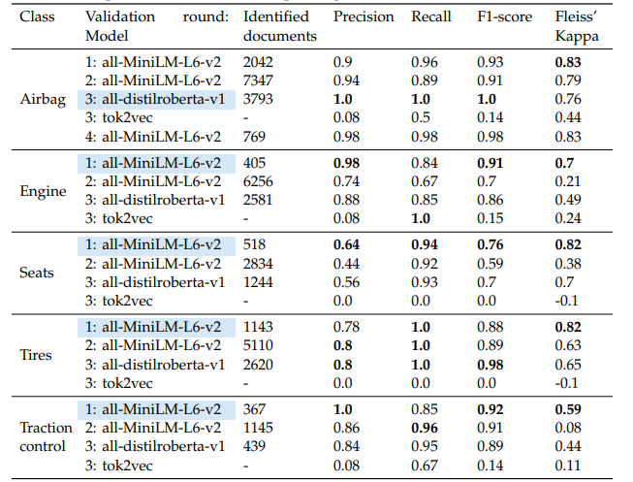
SBERT-Based all-Mini-LM-L6-v2 Performs Best in our Experiments
Results of classification reports for each model and each class
Fleiss’ Kappa indicates the inter-voter agreement
Notes:
Briefly introduce best performing models

Slide 31
Advantages of the Proposed Approach
Required time for obtaining the training data, hours
Number of classified documents for training
Results of the first validation round are used
Class | Manual annotation | Our approach
Airbag | 100 | 2042
Engine | 100 | 405
Seats | 100 | 518
Tires | 100 | 1143
Traction control | 100 | 367
Our approach provides a 79% time savings and produces up to
20 times more training data than manual annotation
79%
Assumptions
Manual annotation (minimum requirements)
Minimum number of annotated documents per class: 100 [1]
Average reading speed: 200 words/min
Average complaint length: 100 words
30 seconds for reading and 30 seconds for multiclass labeling
1 minute per complaint on average is required
2500 minutes in total is over 40 hours.
Our approach (manual effort)
Class descriptions: 5 min * 25 classes = 125 min
Evaluation of context windows 8 min * 25 classes = 200 min
Validation of results: 8 min * 25 classes = 200 min
Less than 9 hours in total
[1] Song and Roth, 2014

Slide 32
Outline
Introduction
  Motivation
  Objectives
  Research questions
  Research concept
  General approach
  Data set
  Methodology
  Results
  Classification results (RQ2)
  Identified challenges (RQ1)
  Application of unsupervised learning methods (RQ3)
  Conclusion

Slide 33
Answering RQ1: Identified challenges (1/3)
Challenges throughout the classification process using the proposed approach
Methodology step | Challenge number | Challenge | Perspective
M1 | C1 | Selecting preprocessing techniques and applying them in a sequence that ensures time efficiency | Data
M1 | C2 | Maintaining readability | Data
M2 | C3 | Choosing the number of target classes | Expert
M2 | C4 | Defining an optimal number of keywords per class | Expert
M2 | C5 | Picking precise keywords for the class descriptions | Expert
M2 | C6 | Creating hierarchical dependencies between classes | Expert
M2 | C7 | Adding new classes or changing the definitions of target classes | Expert
M2 | C8 | Being familiar with the language style and words used in the data set | Expert
M2 | C9 | Using acronyms as keywords | Expert
M3 | C10 | Searching for context windows word-wise if not enough context windows are found | Performance
M3 | C11 | Choosing the length and representation of context windows | Performance
M3 | C12 | Ambiguous meaning of context windows | Model
Notes:
Several sentences (consecutive or not)
The length can be measured in tokens rather than sentences
This step can be eliminated in favor of artificially creating context rules

Slide 34
Answering RQ1: Identified challenges (2/3)
Challenges throughout the classification process using the proposed approach
Methodology step | Challenge number | Challenge | Perspective
M3 | C13 | Determining the optimal number of context rules to describe the class | Model
M3 | C14 | Evaluating the results in terms of the ratio between the words used in a class dictionary and the number of keywords actually used for context rules | Performance
M3 | C15 | Reducing time for a manual evaluation of context windows | Expert
M3 | C16 | Exploring alternative methods for obtaining context rules | Performance
M4 | C17 | Selecting a pre-trained model for obtaining text embeddings | Model
M4 | C18 | Exploring the possibilities of training a tailored model | Model
M4 | C19 | Deciding on the method for calculating the class vectors using context rules | Model
M4 | C20 | High similarities between class vectors | Model
M4 | C21 | Exploring other approaches beyond computing the class vector | Model
M5 | C22 | Selecting the approach to classify documents | Model
M5 | C23 | Using time-saving code writing techniques for the algorithm | Performance
M5 | C24 | Determining a minimum threshold for saving classified documents | Performance
Notes:
Again, several sentences can be used
A sliding window (of fixed or dynamic size) can be utilized
A combination with Question Answering can be considered (first SBERT, then QA)

Slide 35
Answering RQ1: Identified challenges (3/3)
Challenges throughout the classification process using the proposed approach
Methodology step | Challenge number | Challenge | Perspective
M5 | C25 | Adjusting a class threshold for each individual class | Expert
M5 | C26 | Exploring additional features of the data set to enhance the classification | Performance
M5 | C27 | Identifying multiple topics in a document | Model
M6 | C28 | Examining false statements | Expert
M6 | C29 | Establishing the number of statements required for validation | Expert
M6 | C30 | Determining reasonable metrics for the validation sample | Expert
M6 | C31 | Improving the validation procedure | Expert
General | C32 | Exploring portability of results to other tasks | Model
General | C33 | Reducing labor time required for the suggested approach | Expert
General | C34 | Training a text classifier | Model
General | C35 | Improving the model over time | Performance

Slide 36
Answering RQ1: Categorization of Identified Challenges
M1
C1
C2
C17
C18
C19
M2
C20
C21
M3
C3
C4
C5
C22
C23
C24
C6
C7
C8
M4
C25
C26
C27
C9
M5
C28
C30
C29
C31
M6
C10
C11
C12
C13
C14
C15
C32
C33
C34
C16
General
C35
M# - Methodology step
C# - Identified challenge
Data perspective
Model perspective
Expert perspective
Performance perspective
Notes:
Model: what components to use
Performance: what can be improved

Slide 37
Outline
Introduction
  Motivation
  Objectives
  Research questions
  Research concept
  General approach
  Data set
  Methodology
  Results
  Classification results (RQ2)
  Identified challenges (RQ1)
  Application of unsupervised learning methods (RQ3)
  Conclusion

Slide 38
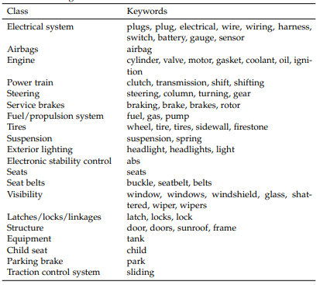
Answering RQ3: Applying Common Unsupervised Learning Methods
Initialization
Topic Modeling: Latent Dirichlet Allocation
Clustering: k-means clustering
25 topics/clusters each
10-15 keywords per topic/cluster
Meaningful keywords for predefined classes
Combined results of topic modeling and clustering
1
2
Can unsupervised learning methods alone classify documents in pre-defined classes?
Can unsupervised learning can be helpful in combination with the proposed approach?
Common unsupervised learning methods cannot be used alone to classify documents into specific predefined classes.
Unsupervised learning methods can (but do not have to) be used for inspiration purposes to support the creation of class descriptions.
Notes:
For 1: the added expertise plays a role

Slide 39
Outline
Introduction
  Motivation
  Objectives
  Research questions
  Research concept
  General approach
  Data set
  Methodology
  Results
  Classification results (RQ2)
  Identified challenges (RQ1)
  Application of unsupervised learning methods (RQ3)
  Conclusion

Slide 40
Conclusion: Answering the Research Questions
RQ1: What are the challenges faced when trying to create structured datasets from unstructured documents?
35 challenges for the proposed approach are identified and categorized
RQ2: Which NLP methods can be combined with the domain expertise to facilitate the extrapolation from context rules to training data?
We created an algorithm combining NLP techniques and domain expertise which reduces manual labor time up to 79% while producing up to 20 times more training data.
RQ3: How do these novel methods compare to current methods of unsupervised learning in the context of automotive customer data?
Unsupervised learning methods alone cannot classify texts in specific classes, but they can be used as inspiration to create class dictionaries.
We believe that further development of the proposed approach can lead to
its use for unsupervised text classification without training of a text classifier
Notes:
The suggested approach can be used to validate the data set.

Slide 41
Andrei Kreinhaus
17132
matthes@in.tum.de

Slide 42
Back-Up

Slide 43
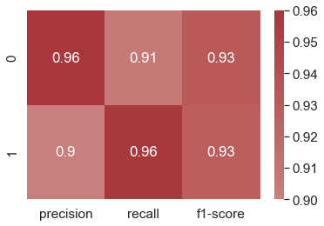
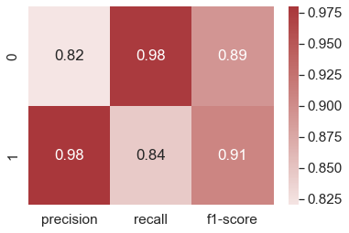
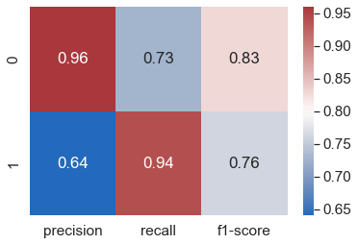
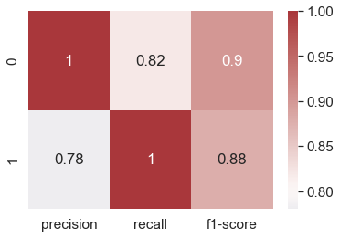
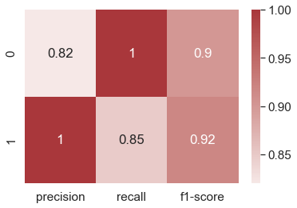
Results of the First Validation Round
Airbag over 0.7
Engine over 0.7
Seats over 0.7
Tires over 0.7
Traction control over 0.7
Fleiss Kappa
Airbag: 0.826
Engine: 0.704
Seats: 0.818
Tires: 0.819
Traction Control: 0.586
Number of samples per class: 100
Validation round: first
Model used: all-MiniLM-L6-v2

Slide 44
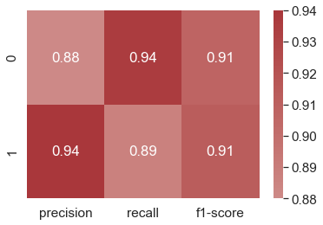
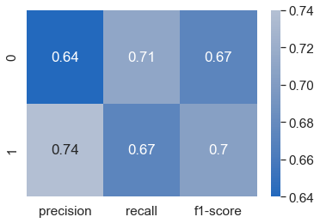
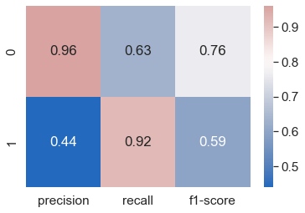
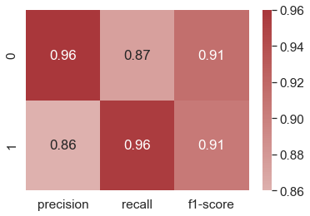
Results of the Second Validation Round
Airbag over 0.6*
Engine over 0.6
Seats over 0.6
Tires over 0.6
Traction control over 0.6*
Fleiss Kappa
Airbag: 0.786
Engine: 0.21
Seats: 0.376
Tires: 0.627
Traction Control: 0.079
Number of samples per class: 100
Validation round: second
Model used: all-MiniLM-L6-v2
*more than 2/3 decisions by majority voting

Slide 45
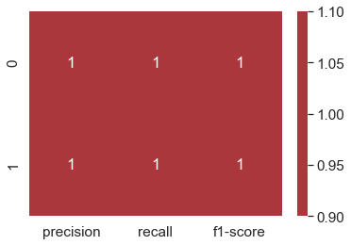
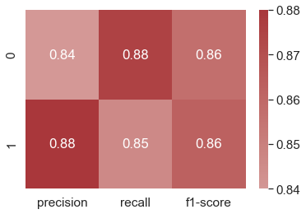
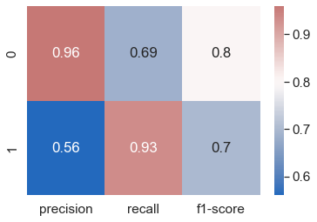
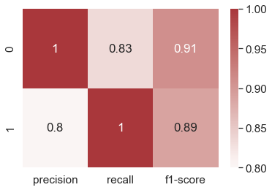
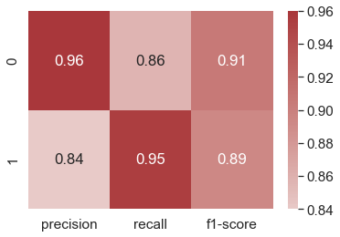
Results of the Third Validation Round (1/2)
Airbag over 0.7
Engine over 0.7
Seats over 0.7
Tires over 0.7
Traction control over 0.7
Fleiss Kappa
Airbag: 0.759
Engine: 0.493
Seats: 0.697
Tires: 0.651
Traction Control: 0.436
Number of samples per class: 50
Validation round: third
Model used: all-distilroberta-v1

Slide 46
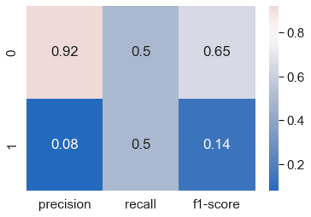
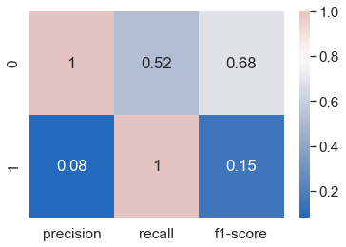
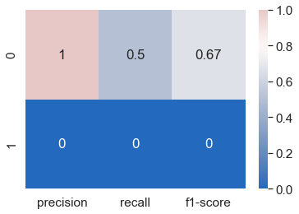
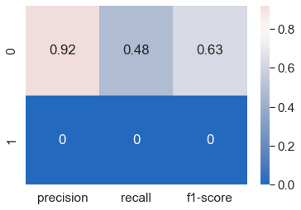
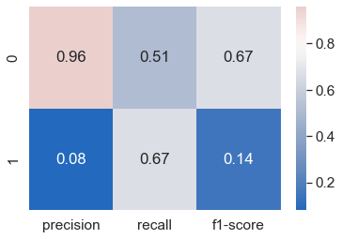
Results of the Third Validation Round (2/2)
Airbag over 0.7
Engine over 0.7
Seats over 0.7
Tires over 0.7
Traction control over 0.7
Fleiss Kappa
Airbag: 0.440
Engine: 0.242
Seats: -0.111
Tires: -0.065
Traction Control: 0.111
Number of samples per class: 50
Validation round: third
Model used: Tok2Vec

Slide 47
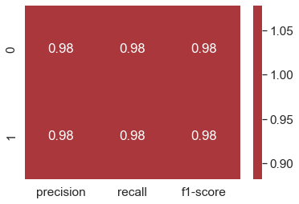
Results of the Fourth Validation Round
Airbag over 0.7
Interpretation of Fleiss’ Kappa [1]
Kappa | Level of agreement
> 0.8 | Almost perfect
> 0.6 | Substantial
> 0.4 | Moderate
> 0.2 | Fair
> 0 | Slight
< 0 | No agreement
Fleiss Kappa
Airbag: 0.825
Number of samples per class: 100
Validation round: fourth
Model used: all-MiniLM-L6-v2
[1] Landis and Koch, 1977

Slide 48
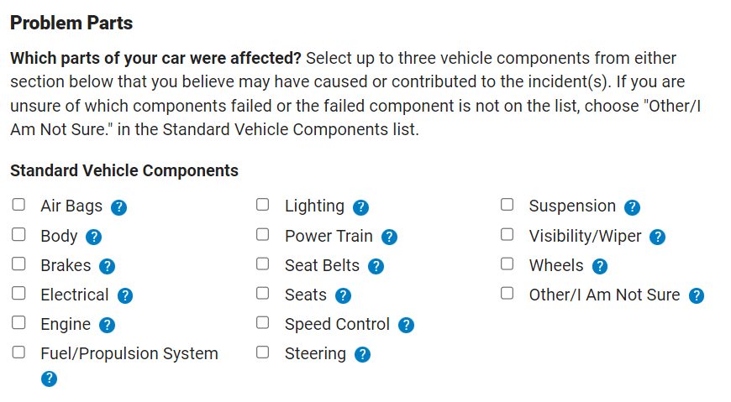
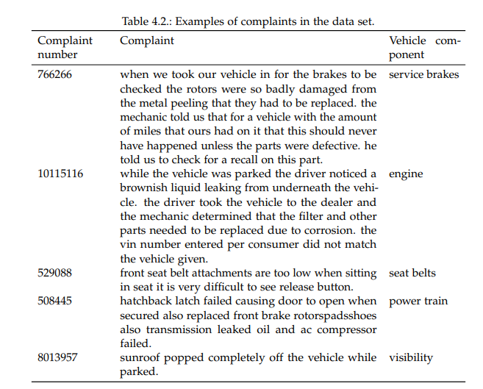
Problems with the Data Set
NHTSA complaint form suggesting selection of affected components
Examples of complaints from the data set
Arbitrary components are highlighted in blue

Slide 49
More Classified Sentences Means More Data for Training of a Text Classifier

Slide 50
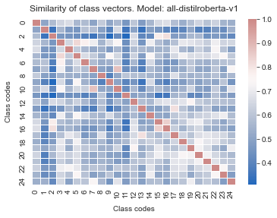
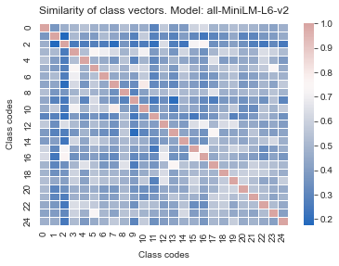
Similarities Between Class Vectors are not Too High

Slide 51
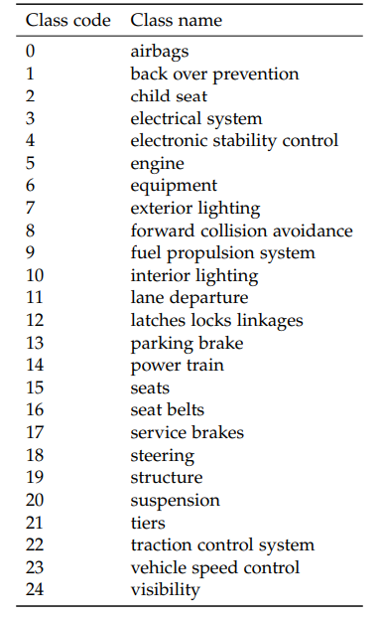
Target Classes Used for the Proposed Approach
Class names with corresponding codes
25 target classes of vehicle components
Represented as a word cloud
Exterior lighting
Electrical system
Electronic stability control
Parking brake
Airbags
Child seat
Interior lighting
Lane departure
Forward collision avoidance
Tires
Structure
Service brakes
Engine
Suspension
Back over prevention
Seats
Seat belts
Visibility
Latches/locks/linkages
Steering
Vehicle speed control
Power train
Traction control system
Equipment
Fuel/propulsion system

