Slide 1
Towards an Online Service to Detect NFT Wash Trading Activities on the Ethereum Blockchain
Baran Kalkavan, 24.10.2022, Final Presentation

Slide 2
Outline
1. Introduction
2. Wash Trade Detection
3. Methodology
4. Results
5. Research Questions

Slide 3
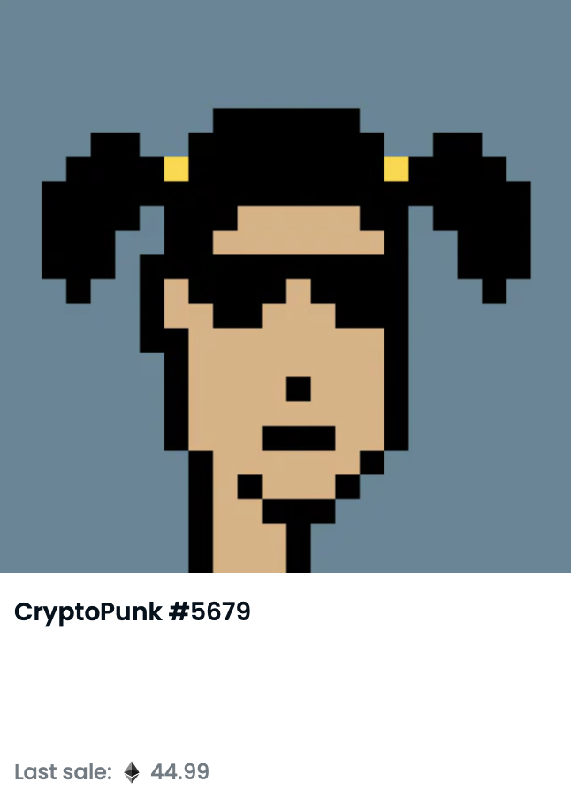
Introduction
NFT
Unique digital assets
References to digital files
Created by smart contracts
ERC721 is the NFT standard of Ethereum
Each NFT has an owner
NFTs can be traded
NFT Marketplace (NFTM)
Digital platforms where NFT collections are listed
An NFT collection has collection_address and NFTs in the collection have token_ids
Most popular NFTM: OpenSea

Slide 4
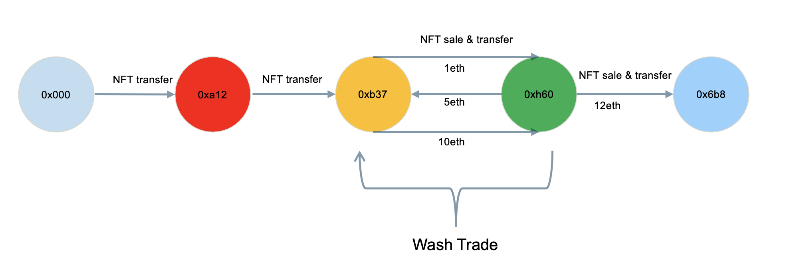
Introduction: NFT Wash Trade
Wash Trading (WT)
A transaction in which the seller is on both sides of the trade to paint a misleading picture of an asset’s value and liquidity¹
Illegal since 1936 in the USA (Commodity Exchange Act)
Increased WT activities in the NFT ecosystem due to lack of regulations
Baran Kalkavan | Towards an Online Service to Detect NFT Wash Trading Activities on the Ethereum Blockchain

Slide 5
Outline
1. Introduction
2. Wash Trade Detection
3. Methodology
4. Results
5. Research Questions

Slide 6
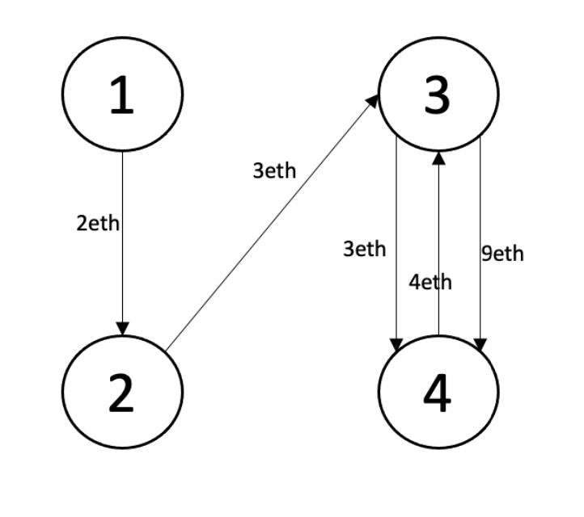
Wash Trade Detection: Trade Graph
Directed, multigraph G_{NFT} = (V,E)
V: user address
E: set of trades
Direction of the edges:
sender –> receiver
Weight of the edges: transaction value in ether (eth)

Slide 7
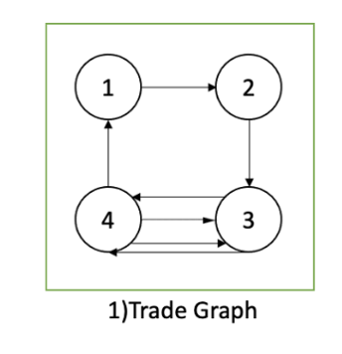
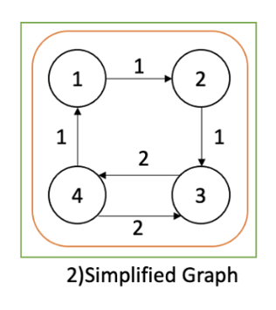
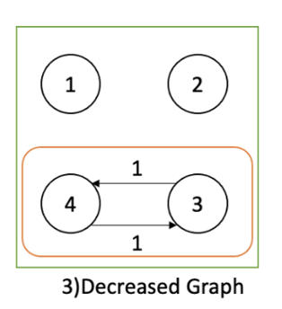
Wash Trade Detection: Detection Algorithm
1.Part: Iterative detection of strongly connected components (SCC) ¹
Trade graph creation
Simplifying the trade graph
SCC detection (a maximal connected sub-graph, which means that every vertex is reachable from every other vertex)
Decreasing the edge weights until there is no more edge left
Applying the algorithm
1 F. Victor and A. M. Weintraud. “Detecting and Quantifying Wash Trading on Decentralized Cryptocurrency Exchanges.” In: (2021).

Slide 8
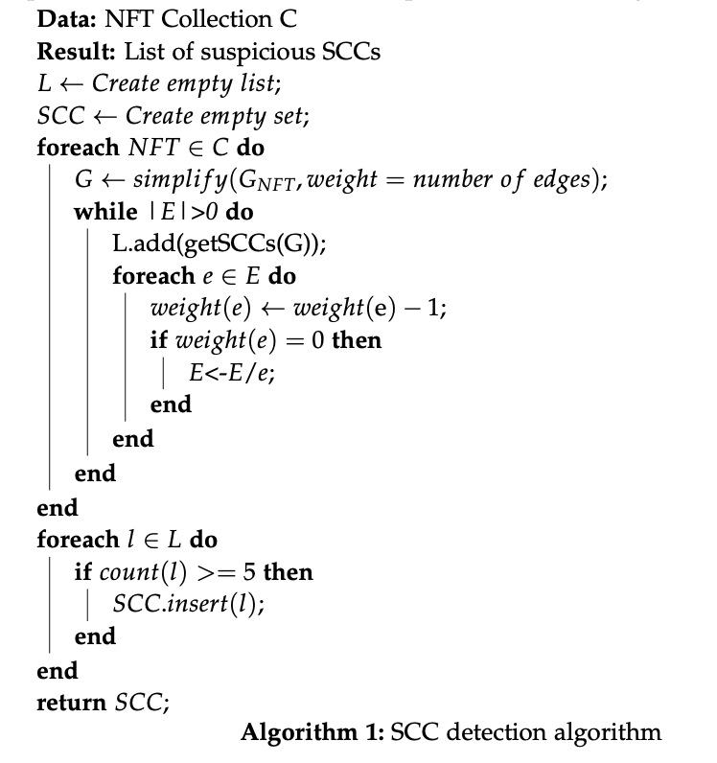
Wash Trade Detection: Detection Algorithm
1.Part: Iterative detection of strongly connected components (SCC)
The mentioned algorithm is applied to each NFT in the collection
SCCs repeated>=5 (empirical threshold) times are marked as suspicious

Slide 9
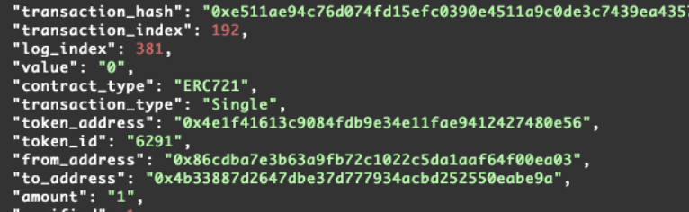
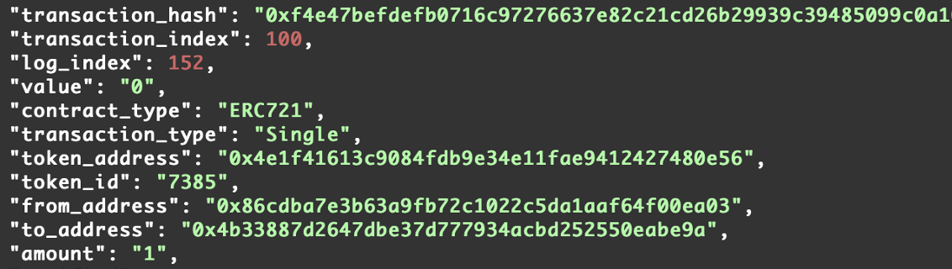
Wash Trade Detection: Detection Algorithm
2.Part: Iteratively weakly connected components (WCC) detection
Some wash traders prevent closed cycles
Transfers are transactions with value 0
Unconditional asset transfer
WCC: of a directed graph is a sub-graph where all nodes are reachable from every other node irrespective of the direction of the edges.
WCCs repeated>=2 (empirical threshold) times are marked as suspicious

Slide 10
Wash Trade Detection: Detection Algorithm
3.Part: Identifying the suspicious trades and addresses
SCCs repeated >=5 (empirical threshold)
WCCs repeated >=2
Addresses in the suspicious SCC V WCC are possible wash traders
Transactions, which’s to_ and from_addresses are in the same suspicious SCC V WCC, are considered as wash trade
Example:
Suspicious SCCs={0xa4Bc, 0xd34c}, {0xh6k8, 0x7kn9}
Transaction between 0xa4Bc → 0xd34c Washtrade
Transaction between 0xa4Bc → 0xh6k8 Not Washtrade

Slide 11
Outline
1. Introduction
2. Wash Trade Detection
3. Methodology
4. Results
5. Research Questions

Slide 12
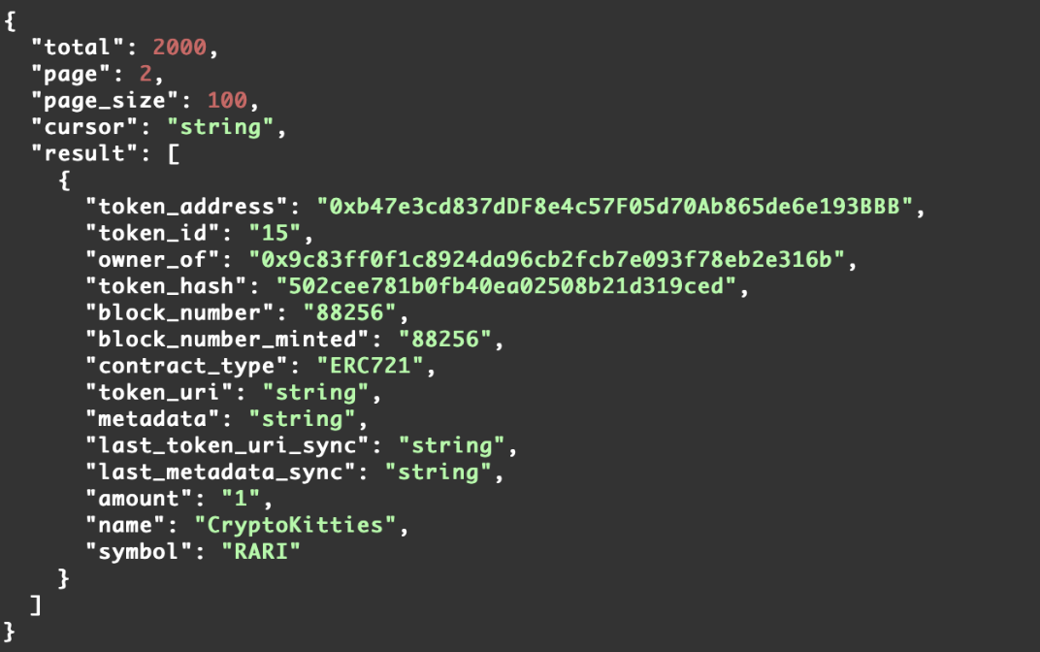
Methodology: Input Data
Moralis
Web3 developing platform
APIs, SDKs, and data
"/nft/address"
Gets the NFTs of a collection.
Aim: get list of token_ID’s
Compulsory input field: collection_address
"nft/address/token_id/transfers/"
Gets the transactions of an NFT given a collection address and token ID.
Output fields: from_address, to_address, value, transaction_hash, and block_timestamp
Example result of "/nft/address"

Slide 13
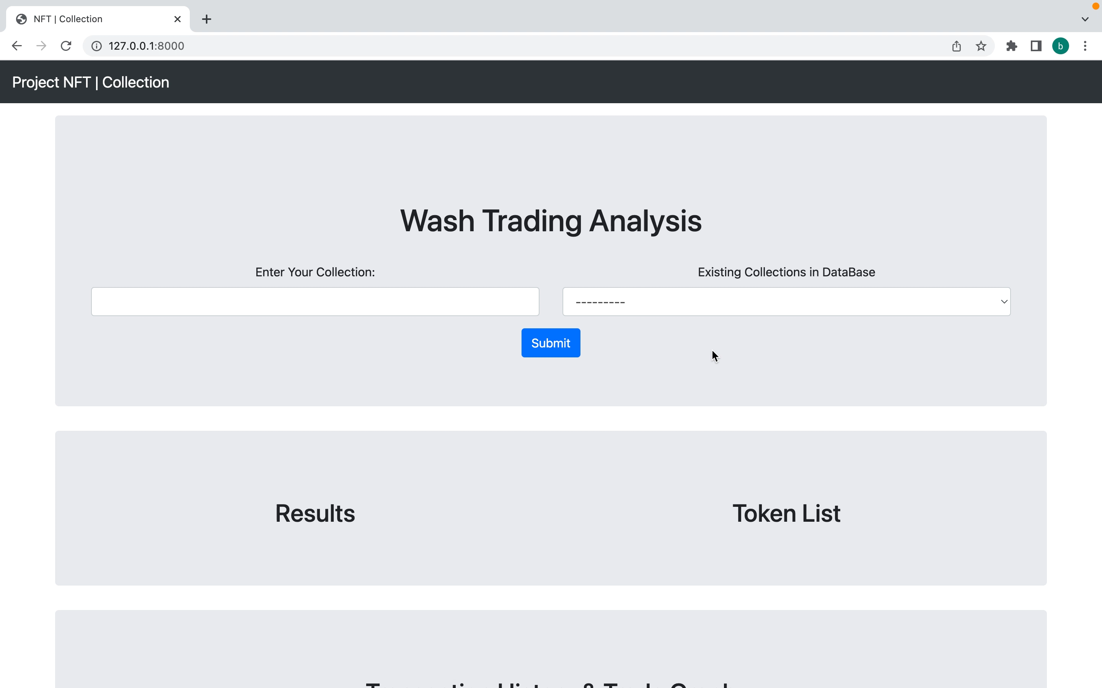

Slide 14
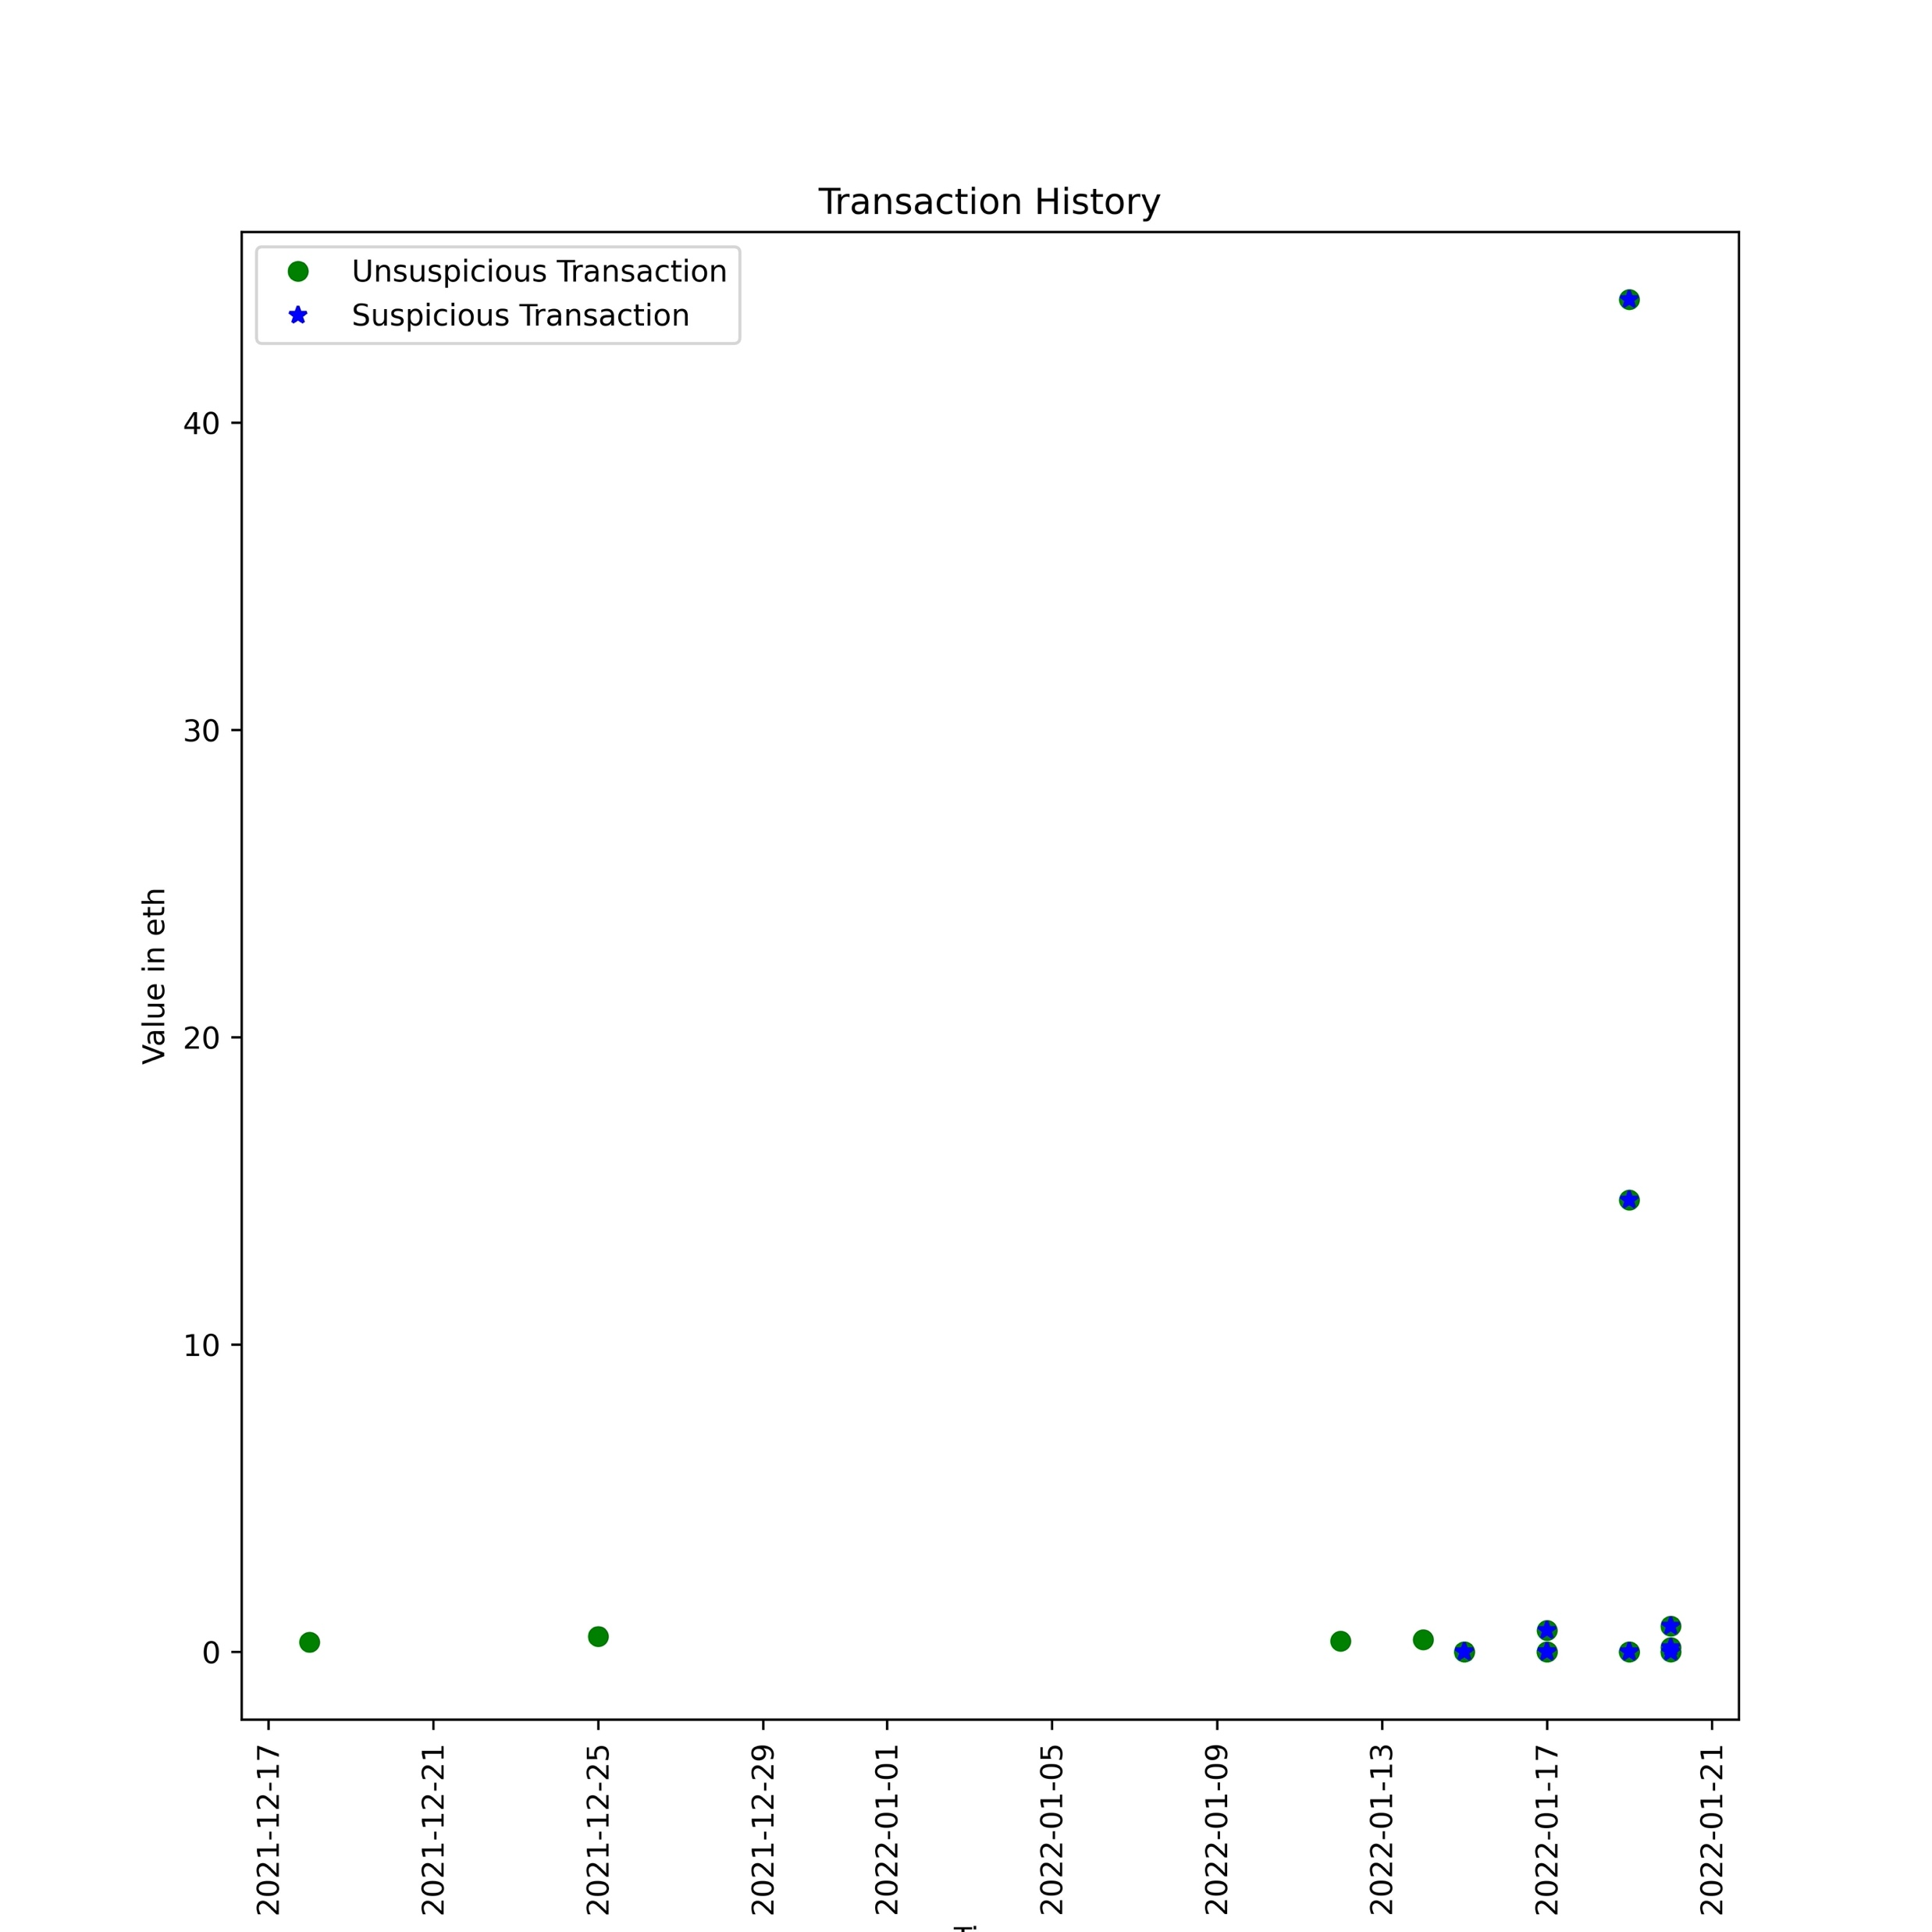
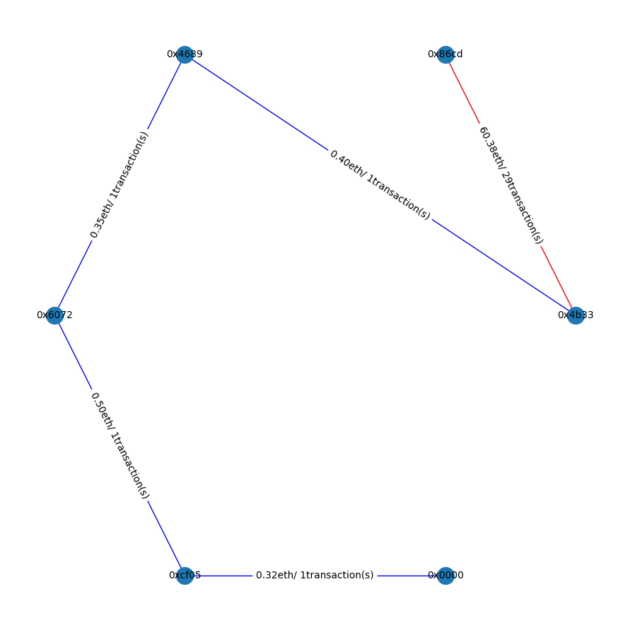
Methodology: Web App
Trade Graph
Transaction History Graph

Slide 15
Outline
1. Introduction
2. Wash Trade Detection
3. Methodology
4. Results
5. Research Questions

Slide 16



Results
According to the existing literature most of the WT activities happen on LooksRare
The most popular NFTM with the largest trading volume is OpenSea
Few reports also mention that Rarible has wash trading problem
Selection Criteria
Top 5 collections from these 3 NFTMs
Ethereum Blockchain
Max 20k item

Slide 17
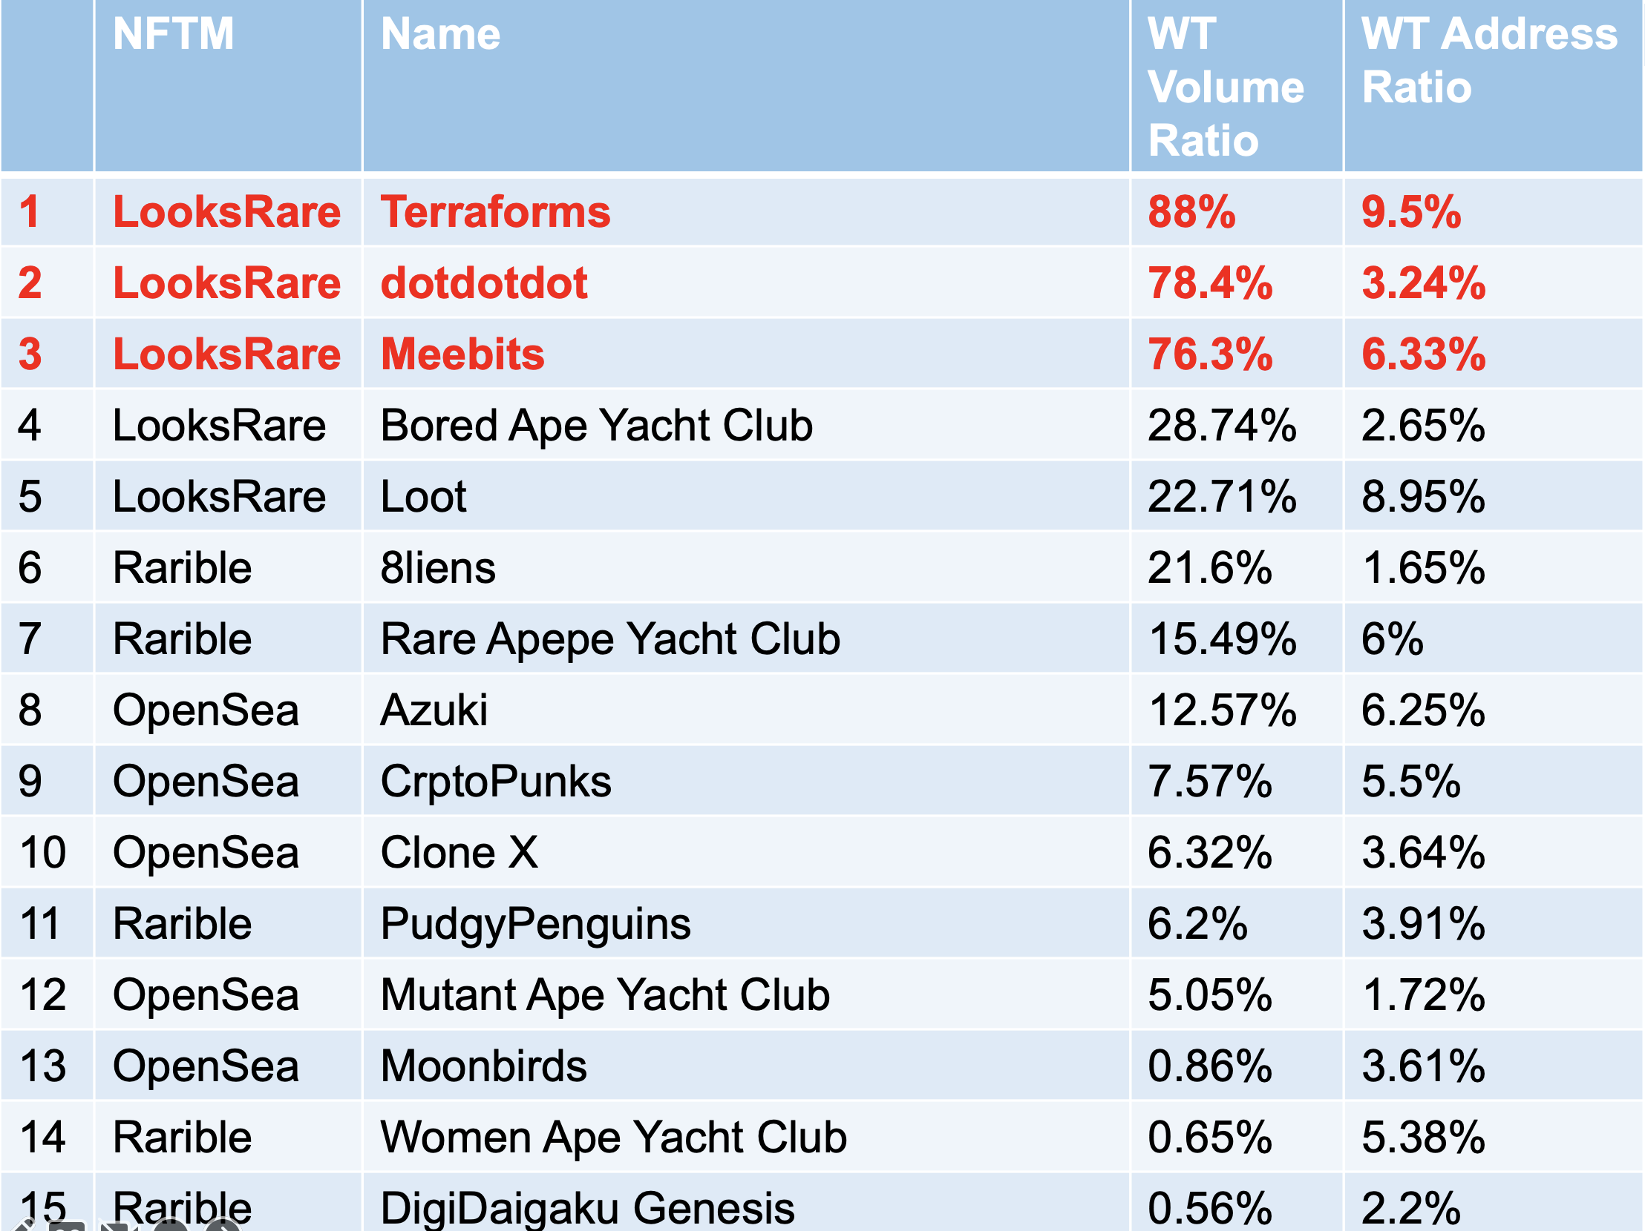
Results

Slide 18
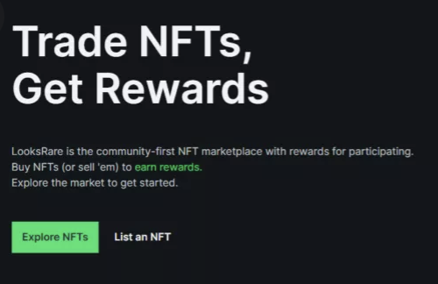
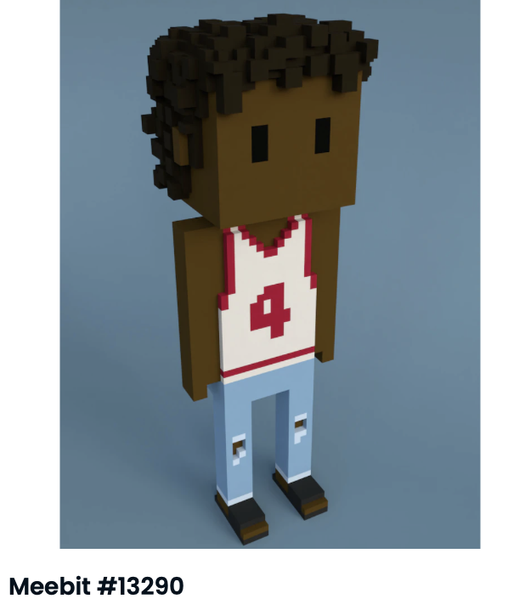
Results: Performance
CoinTelegraph¹, CryptoSlam²
LooksRare: rewards its users with Looks coins when they trade an NFT
Both the buyer and seller of an NFT earns Looks -> increased wash trading activities
No-royalty collections: where the secondary sale fee is zero.
Meebits, Terraforms, Loot…..
75% of Meebits’ total trading volume is fake
Our findings
Increased wash trading activities in the collections from LooksRare
Especially in “no-royalty” collections
76.3% of Meebits’ trading volume is wash trading
1 https://cointelegraph.com/news/clever-nft-traders-exploit-crypto-s-unregulated-landscape-by-wash-trading-on-looksrare
Baran Kalkavan | Towards an Online Service to Detect NFT Wash Trading Activities on the Ethereum Blockchain

Slide 19
Outline
1. Introduction
2. Wash Trade Detection
3. Methodology
4. Results
5. Research Questions

Slide 20
Research Questions
RQ1: Which research has been conducted so far on detecting wash trading on NFT marketplaces?
Limited number of academical papers
RQ2: What insights can an online service provide regarding an NFT collection?
Detection of suspicious addresses and trades
Calculation of total volumes and their ratios
Creating trade-, transaction history graphs
RQ3:What are the most common wash trading patterns?
Average number of addresses in an SCC/WCC is 2,2
All of them focuses on detecting SCCs/ closed cycles
Suspicious WCCs/SCCs are repeated in average 10 times
A single address is mostly part of 1 suspicious SCC/WCC

Slide 21
Research Questions
RQ4: Can wash trading be detected by an online service efficiently?
Existing collections in our database less than 5s
RQ5: Can wash trading activity be avoided/regulated by marketplaces?
Some marketplaces threatining users to ban from the marketplace
Large-sized collections more than 1h to fetch data, less than 30s to analyze
Some marketplaces reward it’s users, when they trade an NFT on their platform
Small-sized collections in less than 10min

Slide 22
Baran Kalkavan
17132
baran.kalkavan@tum.de

Slide 23
Appendix
X-axis: the NFT collections
Y-axis: average number of addresses in an SCC/WCC
Between 2.04-2.65: WT mainly occurs between the same pair of addresses
Controlling min. amount saves time and effort

Slide 24
Appendix
X-axis: the NFT collections
Y-axis: frequency of addresses
Results range between 1.08 - 1.47 : an address is mostly part of one suspicious SCC/WCC
No positive relationship between the ratio of suspicious trades and the frequency of addresses.!

Slide 25
Appendix
X-axis: the NFT collections
Y-axis: frequency of suspicious SCCs/WCCs
Terraforms: the highest average frequency (21.53)
Collections from LooksRare have higher average frequency

