Slide 1
Evaluating Approaches to Overcome the Input Size Limitations of Transformer-Based Language Models on Patent Documents
Jan Robin Geibel, Master Thesis Kick-Off Presentation

Slide 2
Outline
Motivation
  Encoding textual data
  Problem: Models cannot process long sequences
  Methods to encode long sequences
Research Interest
Approach
  Methodology
  Evaluation criteria
  Timeline

Slide 3
Motivation | Encoding textual data
Textual data needs to be represented numerically in order to serve as input for downstream machine learning tasks
The objective is to find a representation that retains as much of the information codified in the text as possible
Some
text
of
interest
[0.3312, 0.1234, …]
[0.9899, 0.5464, …]
[0.4432, 0.3939, …]
[0.1139, 0.7343, …]
Some
classification

Slide 4


Motivation | Encoding textual data
State of the art: large language models pretrained trained on vast amounts of data
‘I bought a baseball bat.’
‘I saw a bat.’
BERT
BERT
Contextual Word
Embeddings:
Context dependent
encodings
of words
[ 0.12324
0.142335
0.935344
0.424535
…. ]
[ 0.4596
0.562335
0.11484
0.288999
…. ]
Images: Flavicon.com

Slide 5
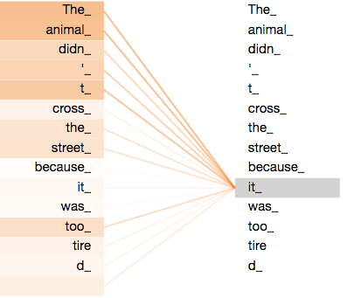
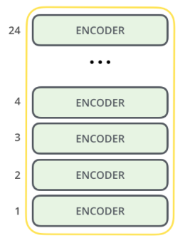
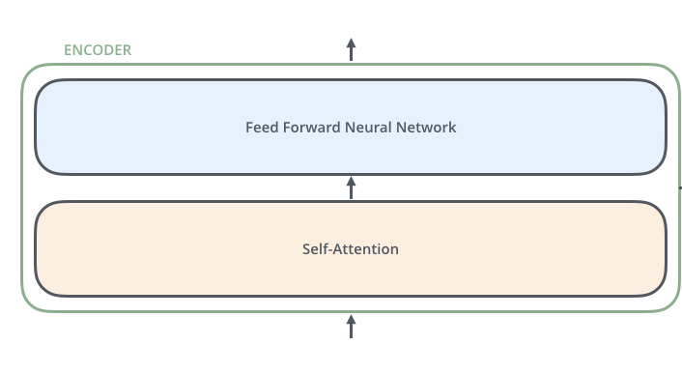
Motivation | Encoding textual data
Pretrained language models rely on Transformer architecture
Self-attention: How do words relate to each other and what is the relevant context?
BERT_{Large}
Encoder
Self-Attention
Images: Jalammar blog (http://jalammar.github.io/illustrated-transformer/)

Slide 6
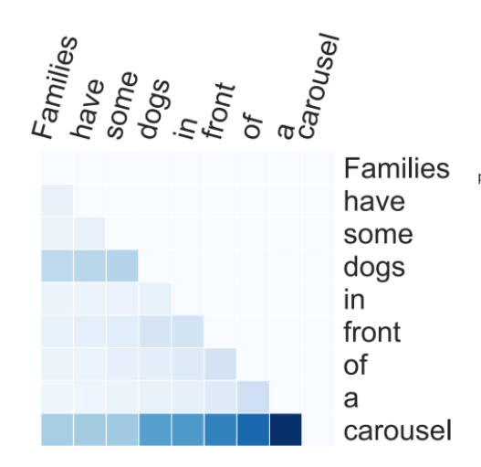
Motivation | Models cannot process long sequences
Full self-attention has quadratic complexity w.r.t. sequence length
Each word is ‘related’ to every word in the sequence
The sequence length is thus limited to, e.g., 512 tokens
Patents, for instance, can significantly exceed the maximum length
Image: Varano, C.: Interpreting Self-Attention Weights

Slide 7
Motivation | Methods to encode long sequences
Approach 1: How can existing language models be used on long sequences?
Limit number of attention operations
But which tokens to attend to?
Slide language model over the sequence
[CLS] … … some token … … some long text … … some token … … [SEP]
Include randomly chosen and artificially introduced tokens

Slide 8
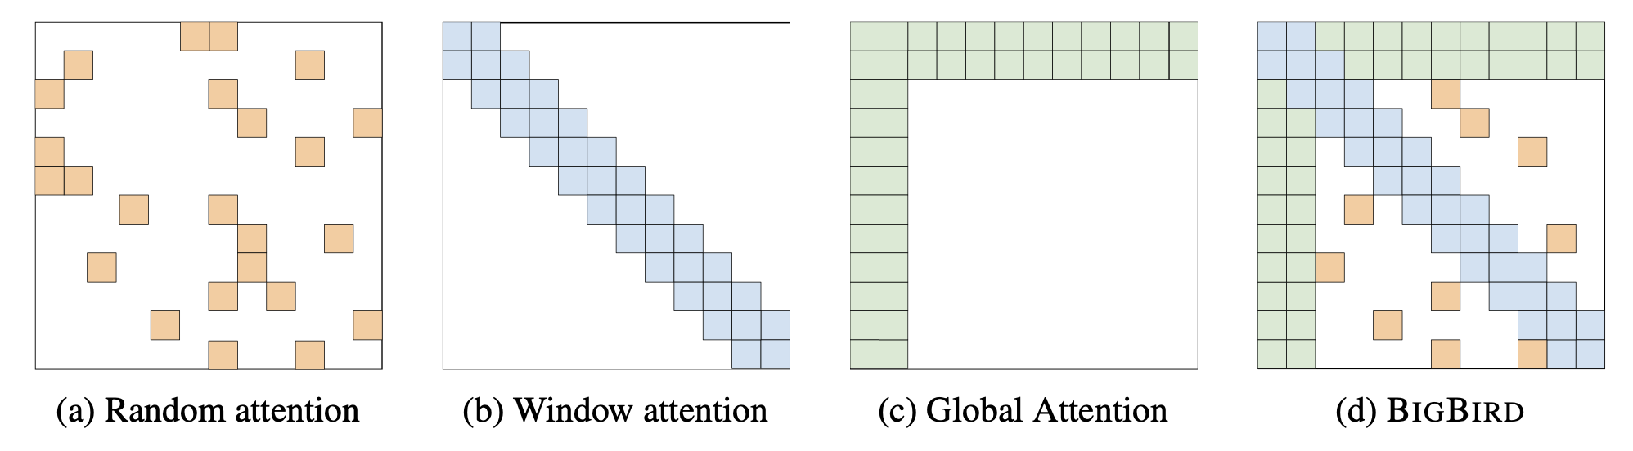
Motivation | Methods to encode long sequences
Example of BigBird – Limiting the number of attention operations:
  Random Attention: set of random tokens
  Window Attention: set of local neighboring tokens
  Global Attention: all parts of the sequence
Zaheer, M., et al. :Big Bird: Transformers for Longer Sequences

Slide 9
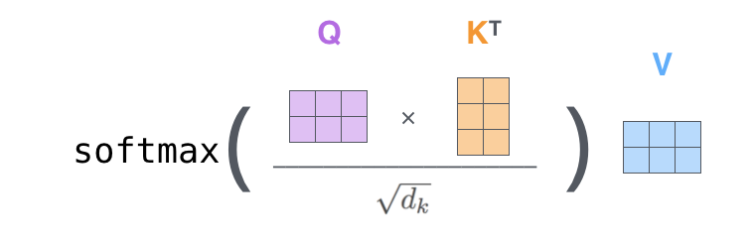
Motivation | Methods to encode long sequences
Approach 2: How can the attention mechanism itself be adapted?
Develop attention mechanism with linear complexity
Usually by approximating full self-attention
The Attention Mechanism:
A key vector for each token
A query vector for each token
The result is an l x l Matrix
Images: Jalammar blog (http://jalammar.github.io/illustrated-transformer/)

Slide 10

Motivation | Methods to encode long sequences
Example of Performer – Rethinking the attention mechanism:
Leaving normalization aside for a moment
Multiplying keys and values first would significantly reduce dimensionality
What about the softmax function?
l x d
d x l
l x d
d x d
l x d
Choromanski, Krzysztof, et al.: Rethinking attention with performers
Images: Jalammar blog (http://jalammar.github.io/illustrated-transformer/)

Slide 11
Motivation | Methods to encode long sequences
Example of Performer – Rethinking the attention mechanism:
Leaving normalization aside for a moment
Multiplying keys and values first would significantly reduce dimensionality
What about the softmax function?
A
=
Choromanski, Krzysztof, et al.: Rethinking attention with performers
Images: Jalammar blog (http://jalammar.github.io/illustrated-transformer/)

Slide 12

Motivation | Methods to encode long sequences
Example of Performer – Rethinking the attention mechanism:
Key idea is to decompose the softmax
Use a kernel function to approximate the result
A
$$𝔼$$
=
‘
‘
l x l
l x r
r x l
Choromanski, Krzysztof, et al.: Rethinking attention with performers
Images: Jalammar blog (http://jalammar.github.io/illustrated-transformer/)

Slide 13
Research Interest | Encoding patent applications
Which methods and models to encode long text sequences are most suited for downstream machine learning tasks?
Which classification model is most appropriate for patent subject matter classification?
How does adapting a model’s attention mechanism to accommodate longer sequences effect performance on downstream machine learning tasks?
1
2
3

Slide 14
Approach | The data
The BigPatent corpus:
1.3 million U.S. patent documents
Description of patented invention
Patent summarization
Classified according to subject matter
Sharma, E., Chen, L., and Lu, W.: BIGPATENT: A Large-Scale Dataset for Abstractive and Coherent Summarization

Slide 15
Approach | Methodology
1
2
BigPatent
(subsample)
E.g., BigBird
numeric representation
Feed Forward NN
Full-text patent description
Encoding mechanism
[0.3312, 0.1234, …]
[0.9899, 0.5464, …]
[0.4432, 0.3939, …]
[0.1139, 0.7343, …]
Convolutional NN
Subject Matter Classification
…
Exploring various architectures

Slide 16
Approach | Methodology
3
Same model architecture
Longformer 1
attention window size:128
BigPatent
Longformer 2
attention window size: 256
Classification task
Longformer 3
attention window size: 512

Slide 17
Approach | Evaluation criteria
Quantitative encoding evaluation:
  Perplexity
Quantitative classification assessment:
  Accuracy
  Recall
  Precision
  F1-score
  Confusion matrix

Slide 18
Approach | Timeline
Begin of
project
Submission
April
May
June
July
August
September
Literature review
Implementation of encoding mechanisms
Implementation of classification task
Experiments and result analysis
Full-text documentation of project
Notes:
Implementation of classification task

Slide 19
Appendix | ML in the domain of patent applications
Processing of patent applications offers various possibilities for automation
Classification of applications according to their subject matter
European Patent Office (EPO)
Incoming Patent Application
Chemistry, Metallurgy
Electricity
…
Who processes incoming applications is determined according to subject matter
Group 1
Group 2
Group 3

Slide 20
Appendix | ML in the domain of patent applications
Processing of patent applications offers various possibilities for automation
Prior art search
🔎 Search for patents relevant for
determination of patentability
Incoming Patent Application
Granted Patents
Granted patents related to claims of application

Slide 21
Prof. Dr.
Florian Matthes
17132
matthes@in.tum.de

