Slide 1
Evaluating Approaches to Overcome the Input Size Limitations of Transformer-Based Language Models on Patent Documents
Jan Robin Geibel, Master Thesis Final Presentation

Slide 2
Outline
Motivation
Background
Corpora
Experiments
Conclusion
Future Work

Slide 3
Motivation | Encoding textual data
Textual data needs to be represented numerically in order to serve as input for downstream machine learning tasks
The objective is to find a representation that retains as much of the information codified in the text as possible
State of the art: Transformer-based language models
Some
text
of
interest
[0.3312, 0.1234, …]
[0.9899, 0.5464, …]
[0.4432, 0.3939, …]
[0.1139, 0.7343, …]
Some
classification

Slide 4
Motivation | Why is attention so great?
1. Able to capture long-range dependencies:
Attention is great because… . The Mechanism therefore…
2. Enables pretraining:
Process tokens in parallel
Pretraining with vast amounts of data
State of the art results on downstream tasks
Attention

Slide 5
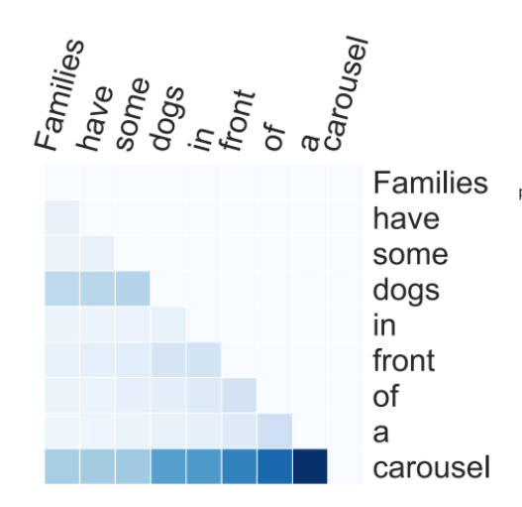
Motivation | Models cannot process long sequences
Full self-attention has quadratic complexity w.r.t. sequence length
Each word is ‘related’ to every word in the sequence
The sequence length is thus limited to, e.g., 512 tokens
Image: Varano, C.: Interpreting Self-Attention Weights

Slide 6
Background | Methods to encode long sequences
Approach 1: How can existing language models be used on long sequences?
Limit number of attention operations
But which tokens to attend to?
Slide language model over the sequence
[CLS] … … some token … … some long text … … some token … … [SEP]

Slide 7
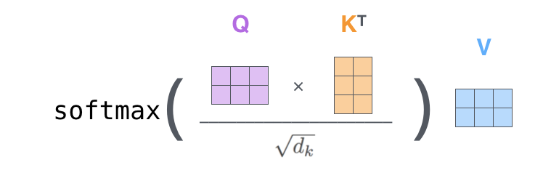
Background | Methods to encode long sequences
Approach 2: How can the attention mechanism itself be adapted?
Reformulate attention mechanism
Usually by approximating full self-attention
The Attention Mechanism:
A key vector for each token
A query vector for each token
The result is an l x l Matrix
Images: Jalammar blog (http://jalammar.github.io/illustrated-transformer/)

Slide 8
Background | Models used in experiments
Transformer variant | Max. input length of available pretrained model | Attention mechanism
BigBird | 4,096 | Sliding window using roBERTa and random tokens
Longformer | 4,096 | Sliding window (with gaps) using roBERTa
Longformer-Encoder-Decoder | 16,384 | Sliding window (with gaps) using BART
Performer | -/- | Reformulate attention with kernel function
Reformer | 524,288 | Dynamically determine which tokens to attend to
Linformer | -/- | Approx. attention matrix with smaller one

Slide 9
Background | Models used in experiments
Transformer variant | Max. input length of available pretrained model | Attention mechanism
BigBird | 4,096 | Sliding window using roBERTa and random tokens
Longformer | 4,096 | Sliding window (with gaps) using roBERTa
Longformer-Encoder-Decoder | 16,384 | Sliding window (with gaps) using BART
Performer | -/- | Reformulate attention with kernel function
Reformer | 524,288 | Dynamically determine which tokens to attend to
Linformer | -/- | Approx. attention matrix with smaller one
Approach 1
Approach 2

Slide 10
Corpora | BigPatent corpus
1.3 million U.S. patent documents
Classified according to subject matter (9 classes – multi-class problem)
3 balanced sample corpora drawn from BigPatent
Sample | Training | Validation | Test
Small (S) | 1,250 | 54 | 81
Medium (M) | 12,150 | 540 | 810
Large (L) | 36,000 | 1,800 | 2,700
Sharma, E., Chen, L., and Lu, W.: BIGPATENT: A Large-Scale Dataset for Abstractive and Coherent Summarization

Slide 11
Experiments | Research Interest
Which models to encode long text sequences are most suited for downstream tasks?
How does adapting a model’s attention mechanism effect performance on downstream tasks?
Which classification model is most appropriate for patent subject matter classification?

Slide 12
Question 1
Which methods and models to encode long text sequences are most suited for downstream machine learning tasks?

Slide 13
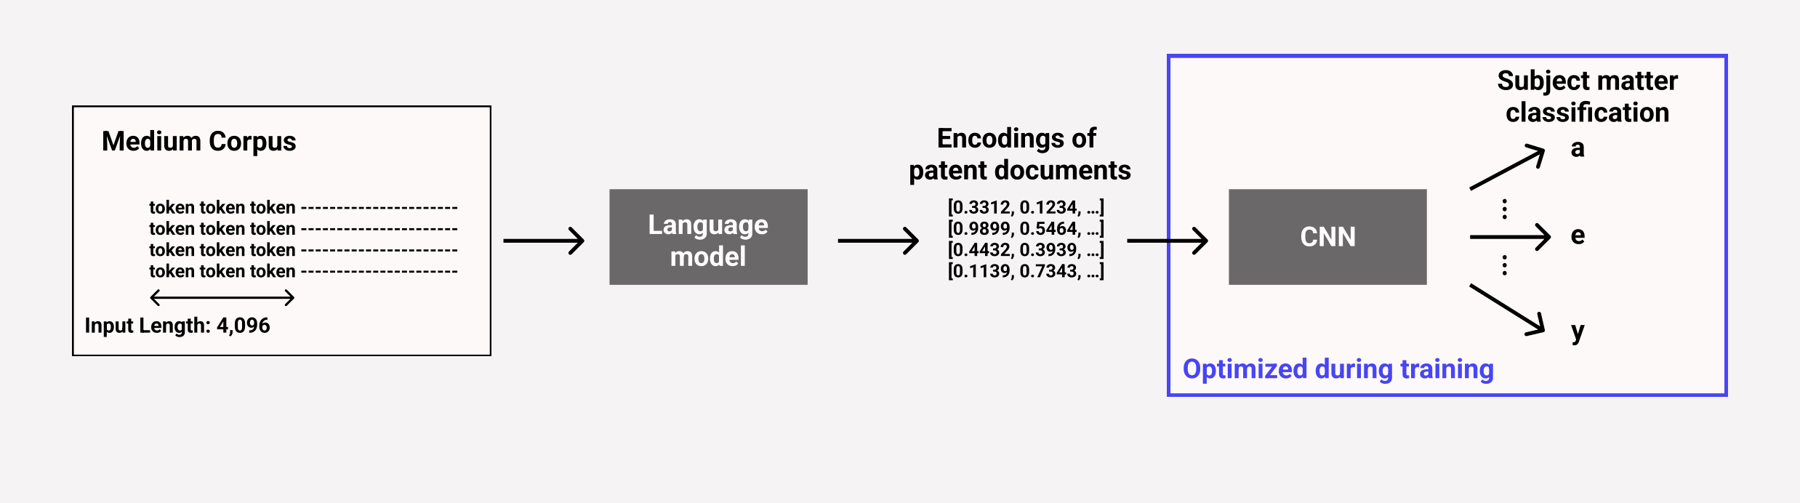
Question 1 – Experiment 1 | Methodology
Investigating the amount of information retained in the models’ embeddings

Slide 14
Question 1 – Experiment 1 | Results
roBERTa and BART competitive or outperform counterparts despite lower training accuracy
Longformer fits training set perfectly, but low performance
→ Strong trade-off: fitting to training set vs. performance on unseen data
Language Model | Input Length | Training Accuracy (%) | Test Accuracy (%)
roBERTa-base | 512 | 79.69 | 50.86
BART-base | 1,024 | 60.26 | 58.40
BigBird-base | 4,096 | 81.41 | 53.58
Longformer-base | 4,096 | 99.98 | 48.02
LED-base | 4,096 | 75.47 | 53.70
Reformer-1 | 4,096 | 95.80 | 26.30

Slide 15
Question 1 – Experiment 1 | Results
Of the efficient Transformers, BigBird and LED models perform best
Language Model | Input Length | Training Accuracy (%) | Test Accuracy (%)
roBERTa-base | 512 | 79.69 | 50.86
BART-base | 1,024 | 60.26 | 58.40
BigBird-base | 4,096 | 81.41 | 53.58
Longformer-base | 4,096 | 99.98 | 48.02
LED-base | 4,096 | 75.47 | 53.70
Reformer-1 | 4,096 | 95.8 | 26.30

Slide 16
Question 1 – Experiment 1 | Results
Low performance of Reformer model due to little pretraining
Language Model | Input Length | Training Accuracy (%) | Test Accuracy (%)
roBERTa-base | 512 | 79.69 | 50.86
BART-base | 1,024 | 60.26 | 58.40
BigBird-base | 4,096 | 81.41 | 53.58
Longformer-base | 4,096 | 99.98 | 48.02
LED-base | 4,096 | 75.47 | 53.70
Reformer-1 | 4,096 | 95.80 | 26.30

Slide 17
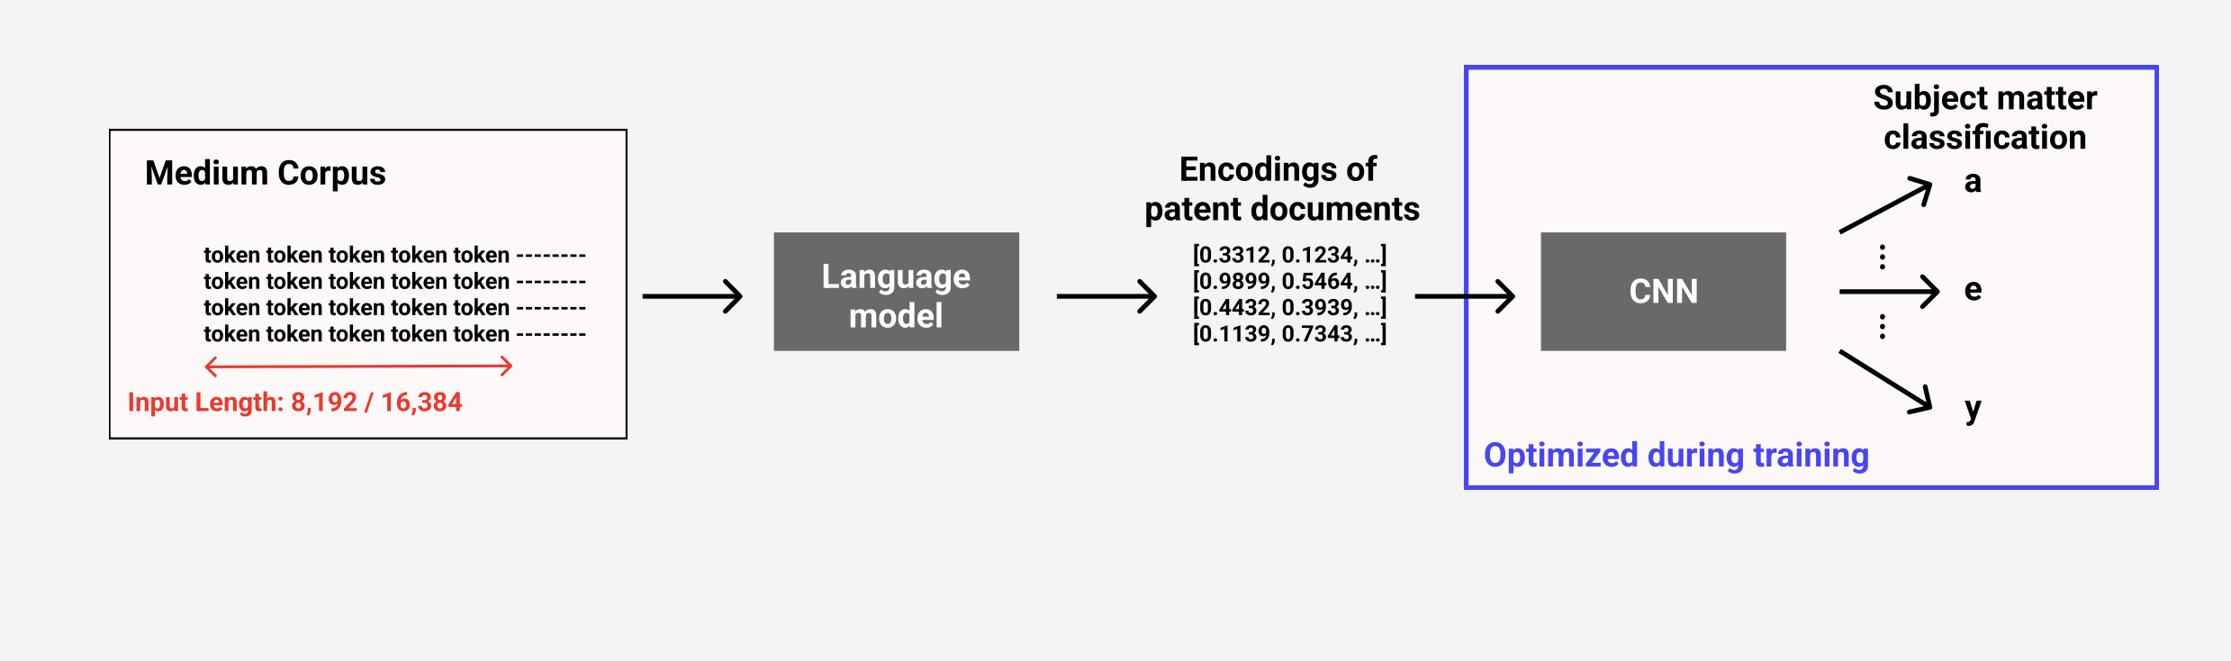
Question 1 – Experiment 2 | Methodology
Investigating the effects of increasing the input sequence length

Slide 18
Question 1 – Experiment 2 | Results
Increasing input length to 8k improves performance, might be due less overfitting
8k length performs better than 16k
→ Increasing sequence length does not monotonically increase performance
Language Model | Input Length | Training Accuracy (%) | Test Accuracy (%)
LED-base | 4,096 | 75.47 | 53.70
LED-base | 8,192 | 72.15 | 55.31
LED-base | 16,384 | 75.17 | 54.32
Reformer-1 | 4,096 | 95.80 | 26.30
Reformer-1 | 8,192 | 97.50 | 27.65
Reformer-1 | 16,384 | 96.16 | 28.02

Slide 19
Question 1 – Experiment 2 | Results
Increasing sequence length marginally increases performance
Language Model | Input Length | Training Accuracy (%) | Test Accuracy (%)
LED-base | 4,096 | 75.47 | 53.70
LED-base | 8,192 | 72.15 | 55.31
LED-base | 16,384 | 75.17 | 54.32
Reformer-1 | 4,096 | 95.80 | 26.30
Reformer-1 | 8,192 | 97.50 | 27.65
Reformer-1 | 16,384 | 96.16 | 28.02

Slide 20
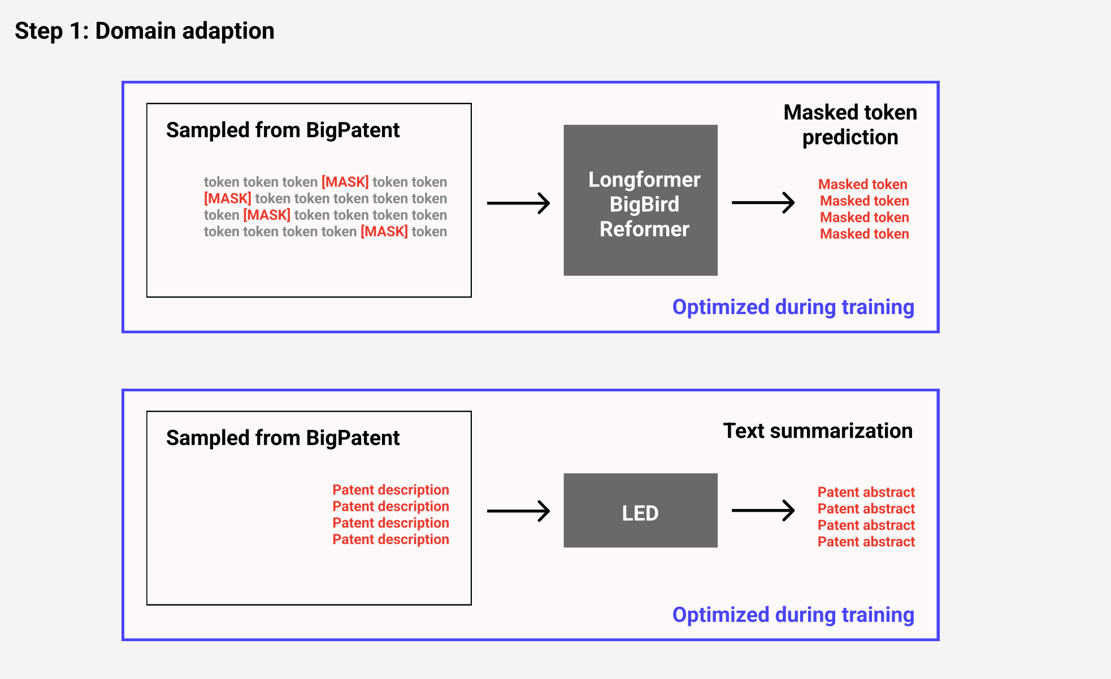
Question 1 – Experiment 3 | Methodology
Models were mostly pretrained on Wikipedia/news articles etc.
Patent data is vastly different

Slide 21
Question 1 – Experiment 3 | Methodology
Pretrained available Reformer model has
small architecture
only been trained on Fyodor Dostoevsky’s novel Crime and Punishment
→ Extend architecture and further pretrain model on other data sources

Slide 22
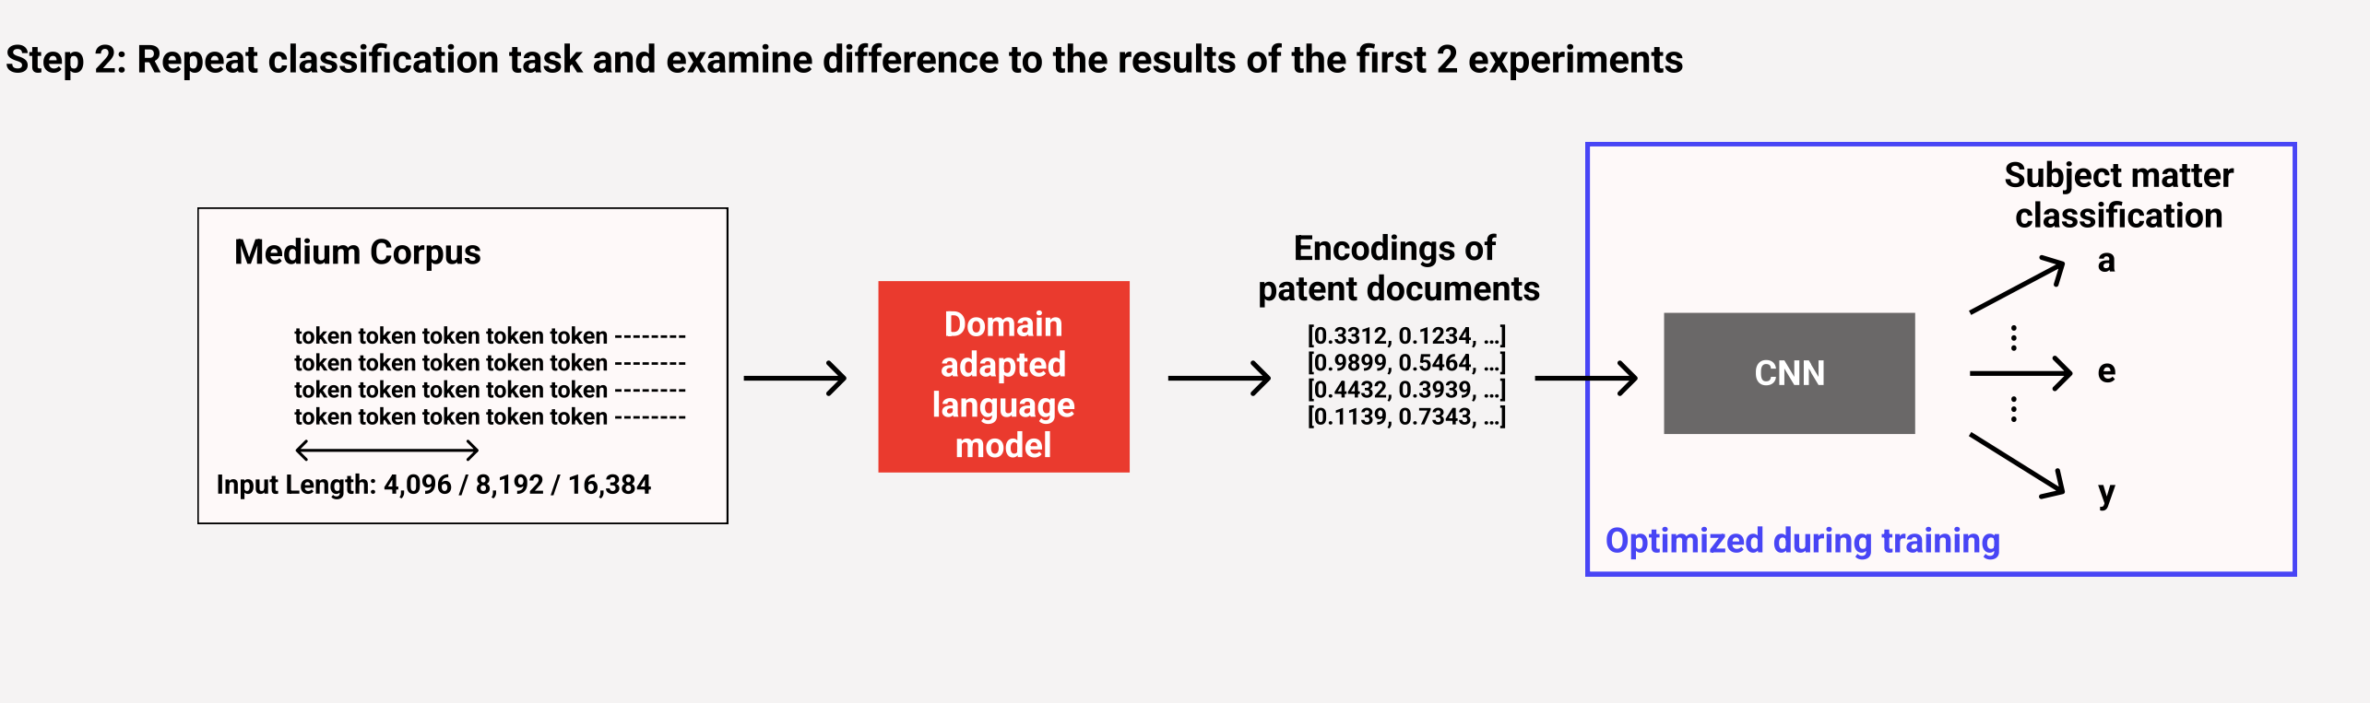
Question 1 – Experiment 3 | Methodology
Examining whether domain adaption improves the models’ embeddings

Slide 23
Question 1 – Experiment 3 | Results
Domain Adapting increases Longformer’s performance by 6.55 points
→ Less overfitting
Language Model | Input Length | Training Accuracy (%) | Test Accuracy (%)
BigBird-base (da) | 4,096 | 84.88 | 53.20
Longformer-base (da) | 4,096 | 99.97 | 54.57
LED-base (da) | 8,192 | 76.07 | 56.42
LED-base (da) | 16,384 | 93.18 | 54.18
Reformer-2 | 4,096 | 97.28 | 27.78
Reformer-3 | 4,096 | 97.81 | 27.41
Reformer-4 | 4,096 | 11.63 | 11.60
Reformer-5 | 4,096 | 11.47 | 10.49

Slide 24
Question 1 – Experiment 3 | Results
8k sequence length: better training and test accuracy
16k sequence length: substantially better better training and no real effect on test performance
Language Model | Input Length | Training Accuracy (%) | Test Accuracy (%)
BigBird-base (da) | 4,096 | 84.88 | 53.20
Longformer-base (da) | 4,096 | 99.97 | 54.57
LED-base (da) | 8,192 | 76.07 | 56.42
LED-base (da) | 16,384 | 93.18 | 54.18
Reformer-2 | 4,096 | 97.28 | 27.78
Reformer-3 | 4,096 | 97.81 | 27.41
Reformer-4 | 4,096 | 11.63 | 11.60
Reformer-5 | 4,096 | 11.47 | 10.49

Slide 25
Question 1 – Experiment 3 | Results
Further pretraining Reformer only marginally improves performance
Reformer models with extended architecture fail to learn the task
Language Model | Input Length | Training Accuracy (%) | Test Accuracy (%)
BigBird-base (da) | 4,096 | 84.88 | 53.20
Longformer-base (da) | 4,096 | 99.97 | 54.57
LED-base (da) | 8,192 | 76.07 | 56.42
LED-base (da) | 16,384 | 93.18 | 54.18
Reformer-2 | 4,096 | 97.28 | 27.78
Reformer-3 | 4,096 | 97.81 | 27.41
Reformer-4 | 4,096 | 11.63 | 11.60
Reformer-5 | 4,096 | 11.47 | 10.49

Slide 26
Question 2
How does adapting a model’s attention mechanism to accommodate longer sequences effect performance on downstream machine learning tasks?

Slide 27
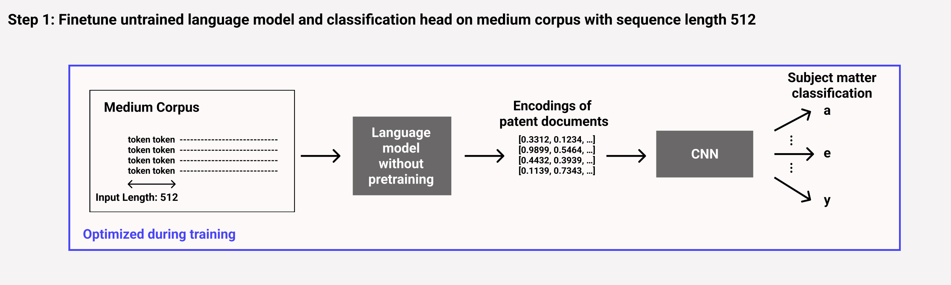
Question 2 – Experiment 1 | Methodology
Investigating the various attention mechanisms’ ability to absorb information during training on a downstream task

Slide 28
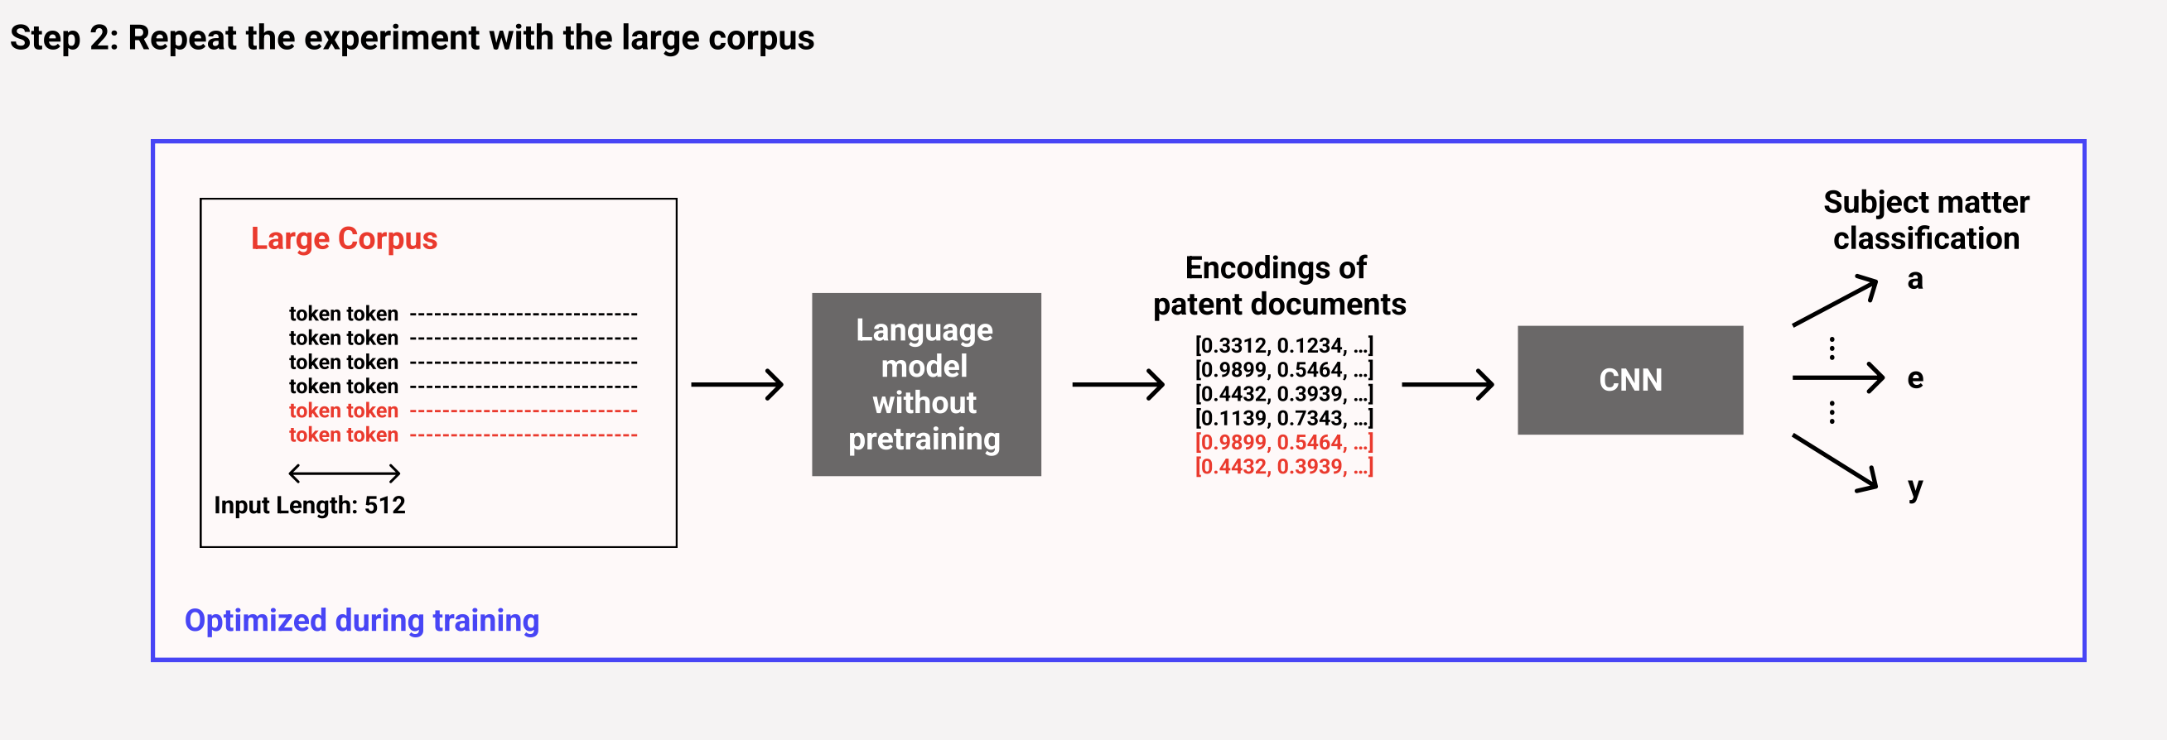
Question 2 – Experiment 1 | Methodology
Investigating the various attention mechanisms’ ability to absorb information during training on a downstream task

Slide 29
Question 2 – Experiment 1 | Results
Apart from Longformer, all efficient Transformers outperform roBERTa
Performance gap between roBERTa and other models is less severe when more data is used

Slide 30
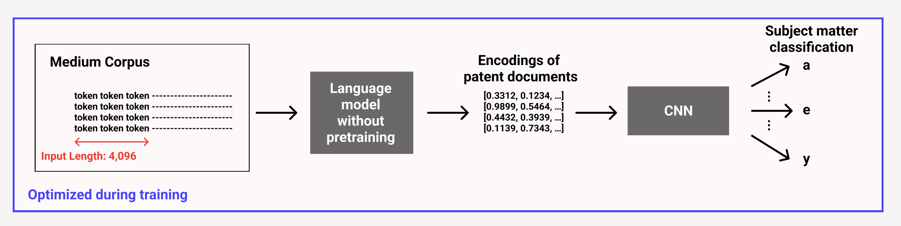
Question 2 – Experiment 2 | Methodology
Examining how the ability to absorb information changes when the input sequence length is increased

Slide 31
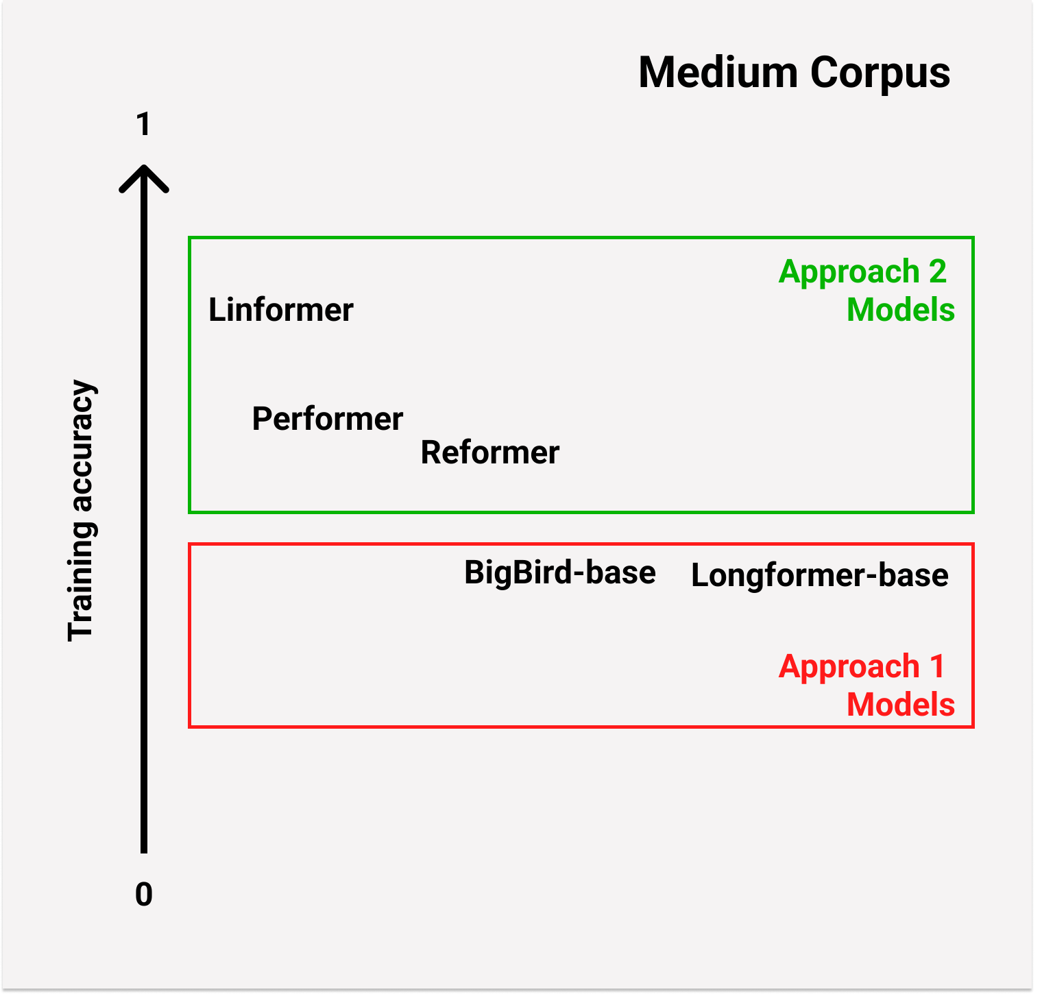
Question 2 – Experiment 2 | Results
Models that approx. attention learn task much faster than sliding window ones
Might be more suitable for tasks with less data

Slide 32
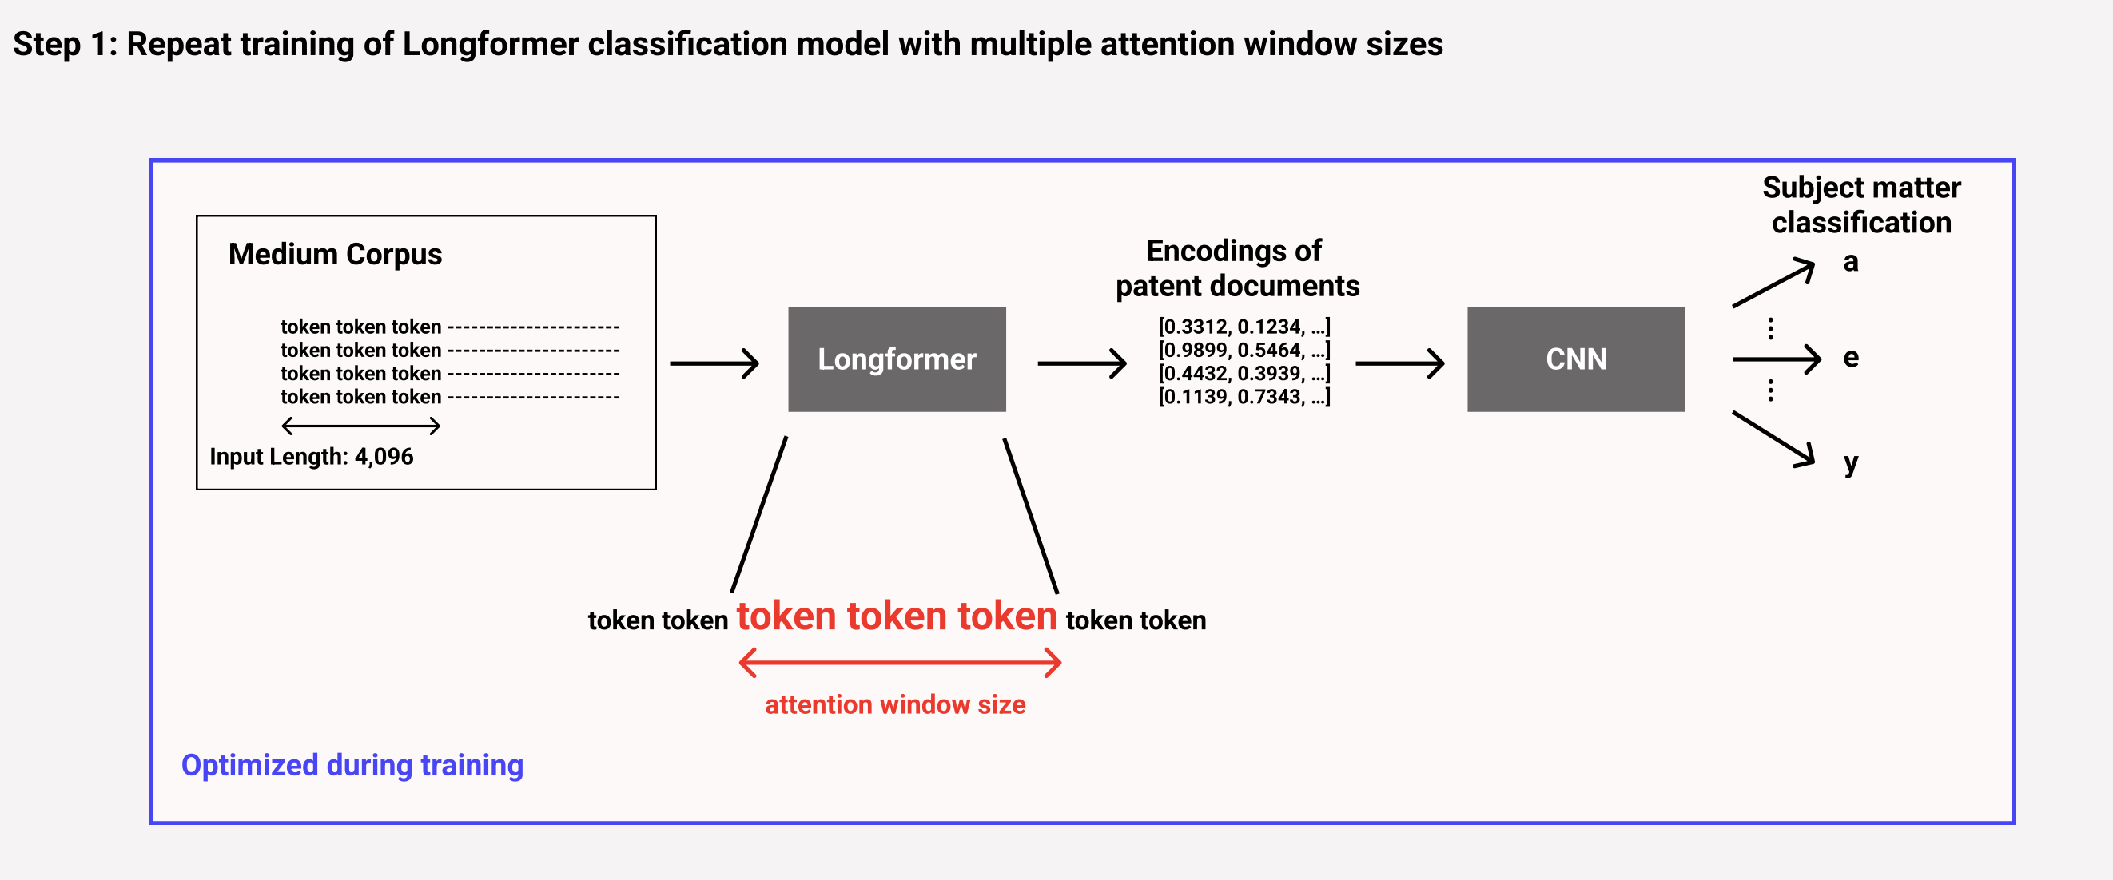
Question 2 – Experiment 3 | Methodology
Examining the impact of the configuration of BigBird’s and Longformer’s attention mechanism on downstream performance

Slide 33
Question 2 – Experiment 3 | Results
Decreasing attention window size only marginally impacts performance
Performance does not decrease monotonically
Window Size | Test Accuracy (%)
512 (default) | 66.17
384 | 64.44
256 | 66.05
192 | 64.44
128 | 61.60
64 | 61.85
32 | 58.89
→ Potential for changing configurations to save memory/time without performance impact

Slide 34
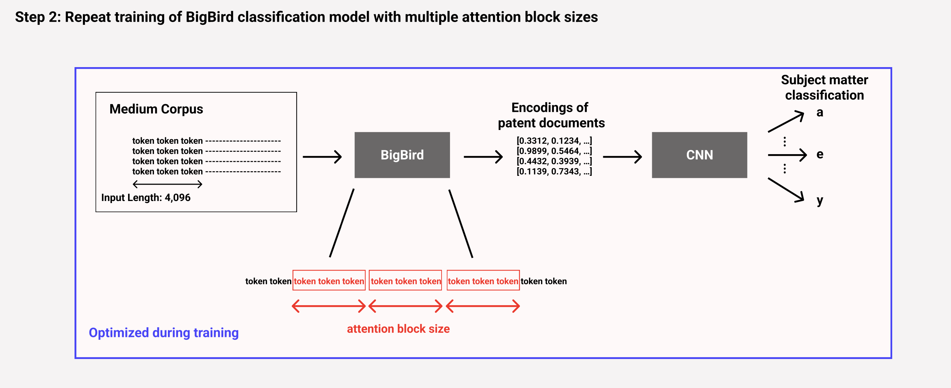
Question 2 – Experiment 3 | Methodology
Examining the impact of the configuration of BigBird’s and Longformer’s attention mechanism on downstream performance

Slide 35
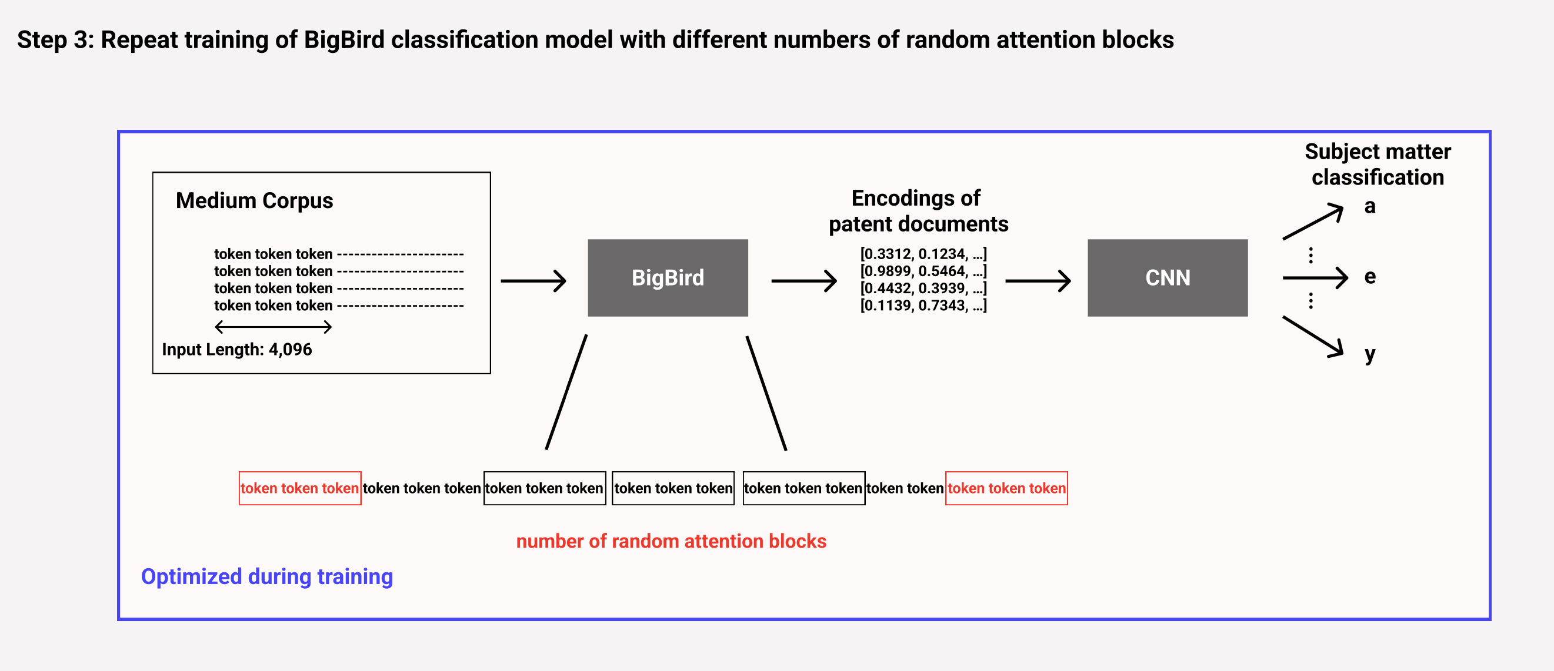
Question 2 – Experiment 3 | Methodology
Examining the impact of the configuration of BigBird’s and Longformer’s attention mechanism on downstream performance

Slide 36
Question 2 – Experiment 3 | Results
Changing attention block size only marginally impacts performance
Changing number of random blocks only marginally impacts performance
Attention Block Size | Test Accuracy (%)
128 | 66.91
64 (default) | 65.80
32 | 65.68
# Random Blocks | Test Accuracy (%)
5 | 68.52
3 (default) | 65.80
1 | 65.80
→ Potential for changing configurations to save memory/time without performance impact

Slide 37
Question 3
Which classification model is most appropriate for patent subject matter classification?

Slide 38
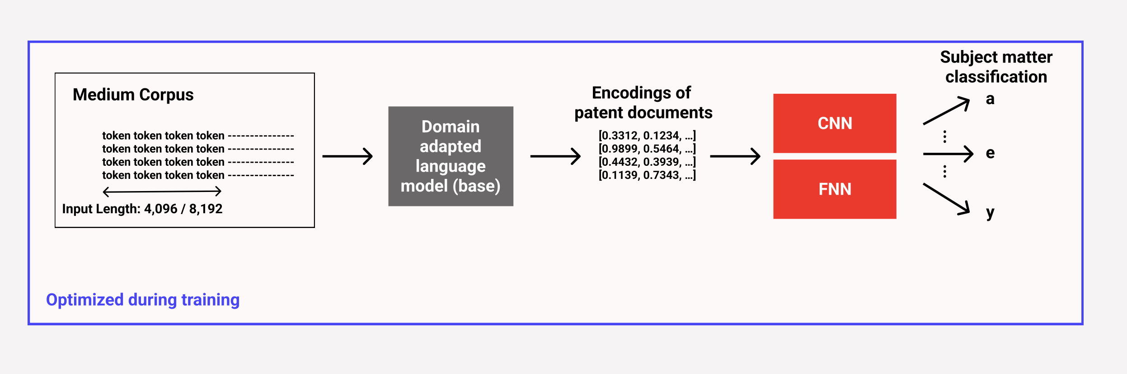
Question 3 – Experiment 1 | Methodology
Testing various classification heads and hyperparameters

Slide 39
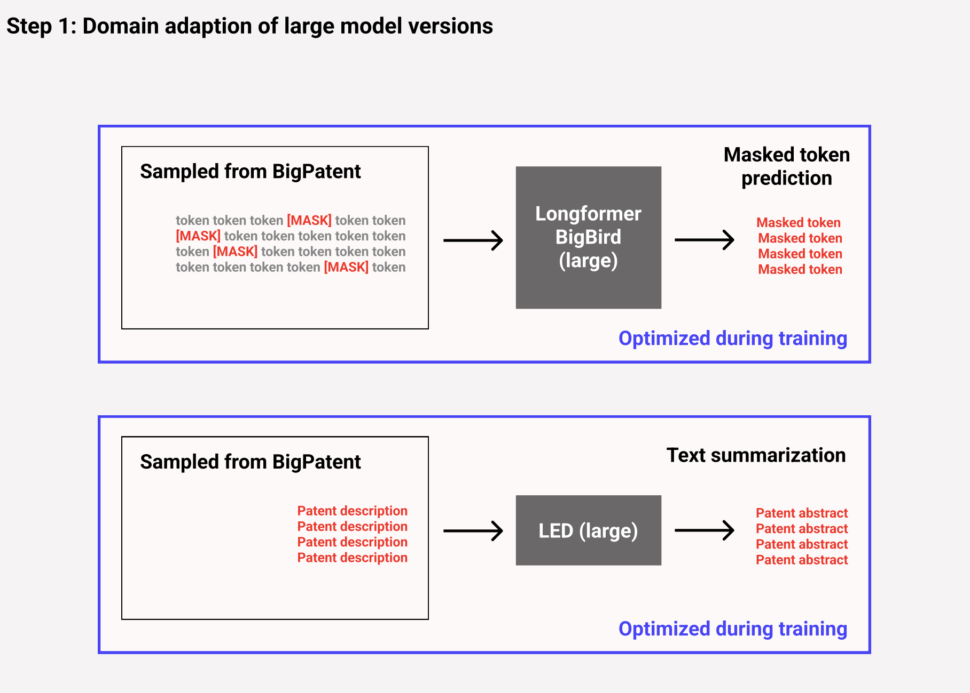
Question 3 – Experiment 2 | Methodology

Slide 40
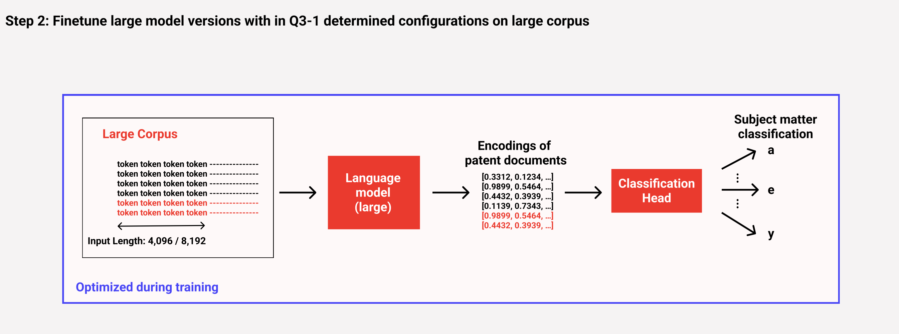
Question 3 – Experiment 2 | Methodology
Optimizing performance on the test set of the large corpus

Slide 41
Question 3 – Experiment 2 | Results
LED-large model leads to OUT OF MEMORY error even on 80GB GPUs
Language Model | Input Length | Test Accuracy (%)
Longformer-large (da) | 4,096 | 70.41
LED-base (da) | 8,192 | 70.07
LED-large (da) | 4,096 | OOM
LED-large (da) | 8,192 | OOM
BigBird-large (da) | 4,096 | 71.02
Reformer-5 | 16,384 | 40.00

Slide 42
Question 3 – Experiment 2 | Results
LED-base, Longformer-large, BigBird-large deliver comparable results
Language Model | Input Length | Test Accuracy (%)
Longformer-large (da) | 4,096 | 70.41
LED-base (da) | 8,192 | 70.07
LED-large (da) | 4,096 | OOM
LED-large (da) | 8,192 | OOM
BigBird-large (da) | 4,096 | 71.02
Reformer-5 | 16,384 | 40.00

Slide 43
Conclusion | Q1
Ability to process longer sequences increases training accuracy
In this case: Models overfit
Domain adaption can mitigate adverse effects of overfitting

Slide 44
Conclusion | Q2
Approach 2 models learn faster during training than original Transformer
Approach 2 models learn faster during training than approach 1 models
They might be better suited for tasks with little data
Changing configuration of BigBird/Longformer can save memory and time with little impact on performance

Slide 45
Conclusion | Q3
Models still need vast amounts of resources
No model significantly exceeds 70% accuracy on patent subject classification

Slide 46
Future Work
Comparison on downstream tasks becomes easier as more pretrained models are available (e.g., backwards compatibility of Performer)
Experiments with other corpora and other tasks
All models follow premise that full self-attention is best for sequential data
Will there be completely new approach?

Slide 47
Prof. Dr.
Florian Matthes
17132
matthes@in.tum.de

Slide 48
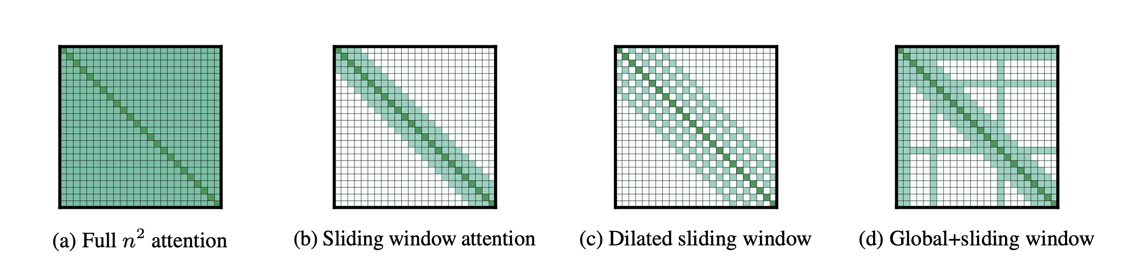
Appendix | Longformer
Window Attention: set of local neighboring tokens
Dilated Window Attention: window attention with gaps
Global Attention: all parts of the sequence
→ Trained from roBERTa checkpoint
Zaheer, M., et al. :Big Bird: Transformers for Longer Sequences

Slide 49
Appendix | Longformer Encoder-Decoder
Longformer’s attention mechanism
Sequence-to-sequence model
Only the LED’s encoder is used during this project
→ Trained from BART checkpoint
Zaheer, M., et al. :Big Bird: Transformers for Longer Sequences

Slide 50
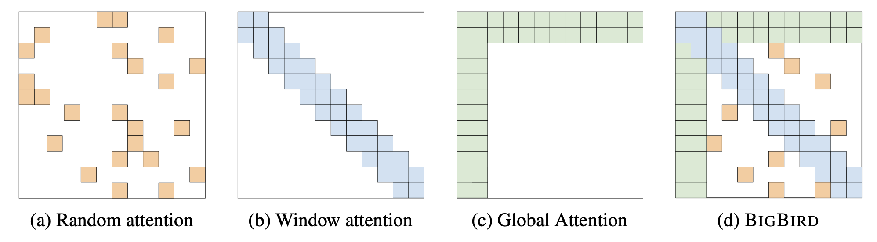
Appendix | BigBird
Random Attention: set of random tokens
Window Attention: set of local neighboring tokens
Global Attention: all parts of the sequence
→ Trained from roBERTa checkpoint
Zaheer, M., et al. :Big Bird: Transformers for Longer Sequences

Slide 51

Appendix | Performer
Leaving normalization aside for a moment
Multiplying keys and values first would significantly reduce dimensionality
What about the softmax function?
l x d
d x l
l x d
d x d
l x d
Choromanski, Krzysztof, et al.: Rethinking attention with performers
Images: Jalammar blog (http://jalammar.github.io/illustrated-transformer/)

Slide 52
Appendix | Performer
Leaving normalization aside for a moment
Multiplying keys and values first would significantly reduce dimensionality
What about the softmax function?
A
=
Choromanski, Krzysztof, et al.: Rethinking attention with performers
Images: Jalammar blog (http://jalammar.github.io/illustrated-transformer/)

Slide 53

Appendix | Performer
Key idea is to decompose the softmax
Use a kernel function to approximate the result
A
$$𝔼$$
=
‘
‘
l x l
l x r
r x l
Choromanski, Krzysztof, et al.: Rethinking attention with performers
Images: Jalammar blog (http://jalammar.github.io/illustrated-transformer/)

Slide 54
Appendix | Linformer
Main assumption: Attention matrix is low-rank
Smaller matrix can retain most of the information
Keys and value matrices are projected into lower dimensions
Resulting approx. attention matrix (A’) is smaller
(A’) requires less memory
Wang, Li, et al.: Linformer: Self-attention with linear complexity.

Slide 55
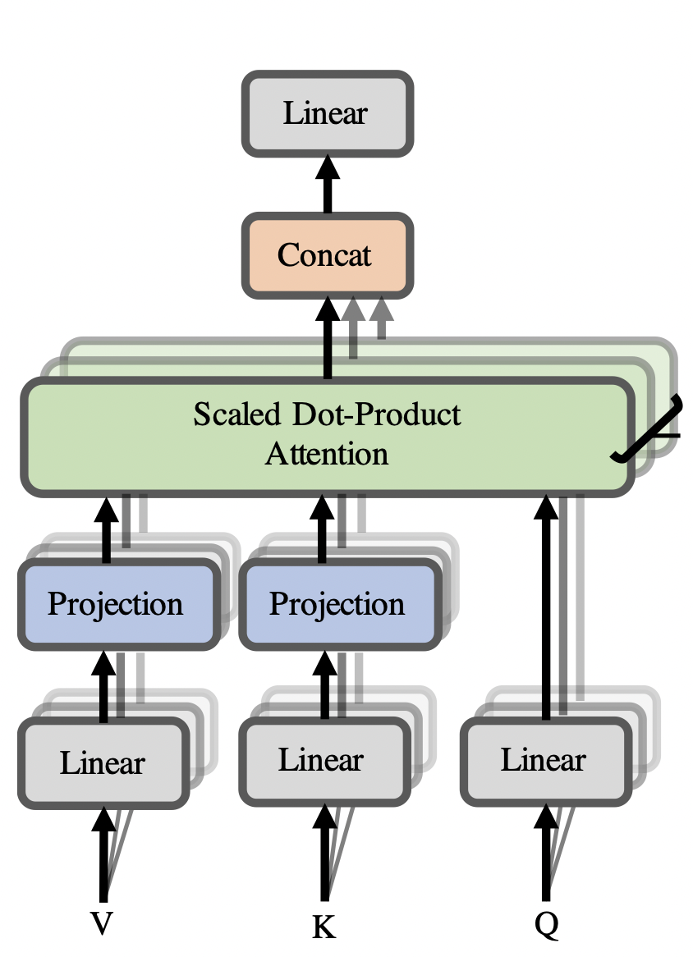
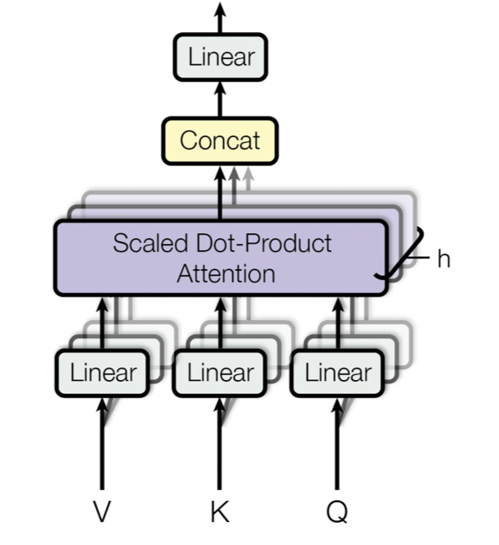
Appendix | Linformer
Choromanski, Krzysztof, et al.: Rethinking attention with performers
Images: Jalammar blog (http://jalammar.github.io/illustrated-transformer/)

Slide 56
Appendix | Reformer
Reminder: Attention Mechanism
Wang, Li, et al.: Linformer: Self-attention with linear complexity.

Slide 57
Appendix | Reformer
Small values are close to 0
Only large values of QK^{T} really matter
Enough to compute QK^{T} for most similar vectors
Softmax
Kitaev, Kaiser, et al.: Reformer: The efficient transformer.

Slide 58
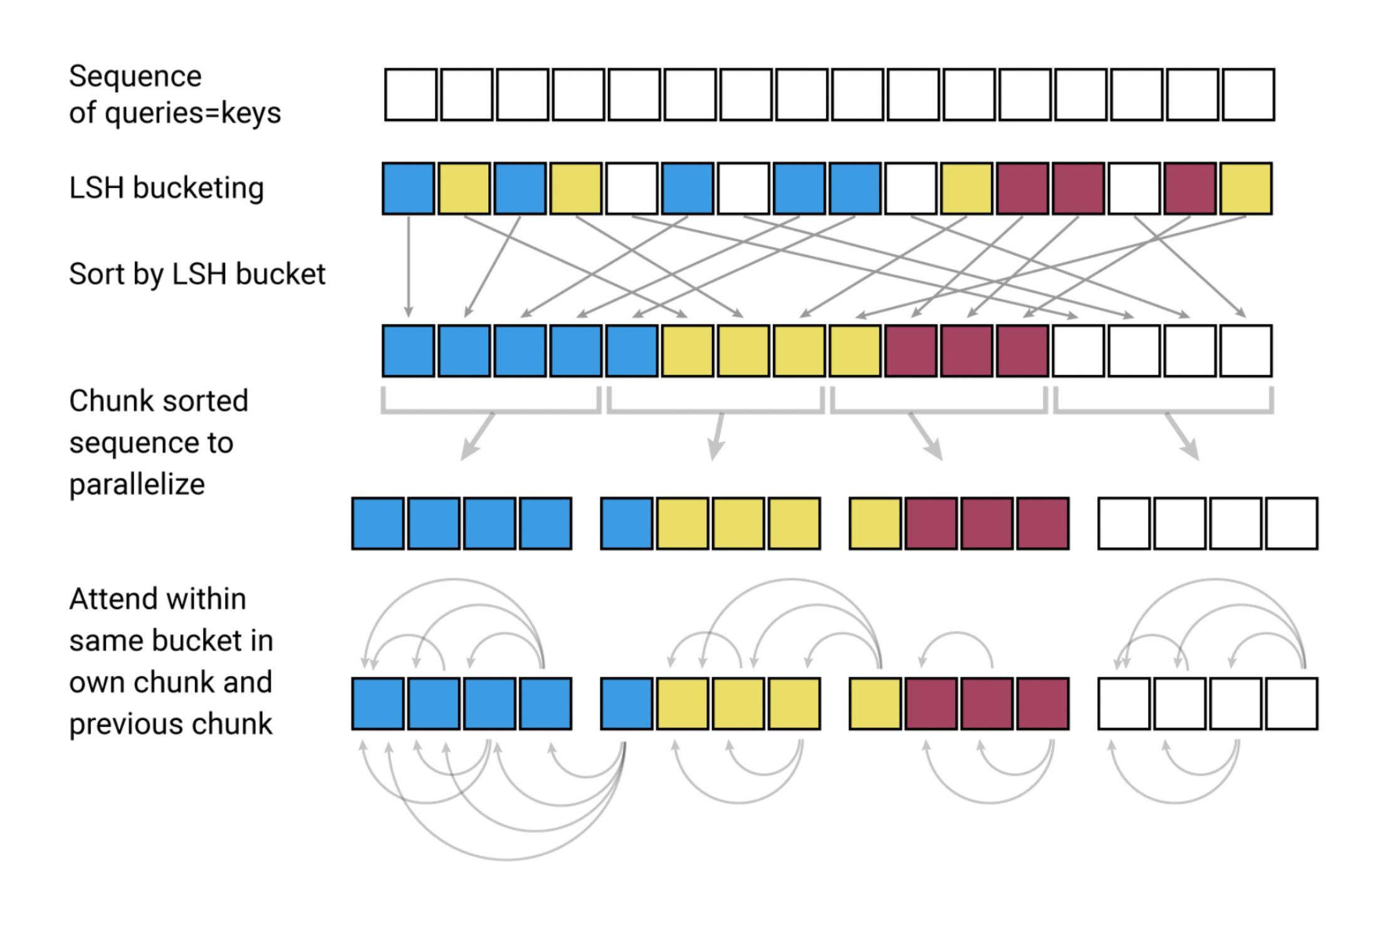
Appendix | Reformer
Kitaev, Kaiser, et al.: Reformer: The efficient transformer.

Slide 59
Appendix | Reformer Models
Reformer Model | # Hidden Layers | # Attention Heads | FNN Size | Vocab Size | Pretraining
Reformer-1 | 6 | 2 | 512 | 320 | Crime and Punishment
Reformer-2 | 6 | 2 | 512 | 320 | Crime and Punishment, 60k patents
Reformer-3 | 6 | 2 | 512 | 320 | Crime and Punishment, 60k patents, 100k scientific papers, 50k Wikipedia articles
Reformer-4 | 12 | 12 | 1,024 | 52k | Crime and Punishment, 60k patents
Reformer-5 | 12 | 12 | 1,024 | 52k | Crime and Punishment, 60k patents, 100k scientific papers, 50k Wikipedia articles

Slide 60
Appendix | Question 2 - Experiment 1 - Results
Language Model | Training Accuracy (%) | Test Accuracy (%)
roBERTa-base | 33.84 | 26.42
Longformer-base | 15.10 | 16.17
BigBird-base | 40.38 | 37.53
Performer | 35.07 | 32.84
Linformer | 78.69 | 36.05
Reformer | 57.33 | 47.41

Slide 61
Appendix | Question 2 - Experiment 1 - Results
Language Model | Training Accuracy (%) | Test Accuracy (%)
roBERTa-base | 46.80 | 42.96
Longformer-base | 33.55 | 31.11
BigBird-base | 45.93 | 44.59
Performer | 54.41 | 47.85
Linformer | 66.93 | 50.52
Reformer | 58.48 | 50.67

Slide 62
Appendix | Question 2 - Experiment 2 - Results
Language Model | Training Accuracy (%) | Test Accuracy (%)
Longformer-base | 39.35 | 30.37
BigBird-base | 40.72 | 38.89
Performer | 63.98 | 42.72
Linformer | 79.28 | 37.04
Reformer | 58.48 | 47.90

