Slide 1
Evaluating the Usability of Acadela: a Domain Specific Language for Defining Clinical Pathways in Integrated Care Platforms
Felix Eckert, 09.08.2021

Slide 2





Outline
Problem
Solution
User Test
Evaluation
Future Work

Slide 3



Clinical Pathways
Standardization of treatment process
Cluster patients
Suggest procedure
Make treatment fast & efficient
Notes:
Clinical Pathways:
Introduced 1980s
Used to standardize treatment process
Define suggestions for medical staff to follow
Cluster patients by age and/or health condition
Limit pre-identified variation in patient outcome
Fast and Efficient
Efficient: Cost and accuracy
Problem: modeling tools are complicated

Slide 4


Adaptive Clinical Pathways
Doctor 1
Nurse 1
Roles: Surgeon
Roles: Nurse
Stage 2
Task 1
Task 2
Stage 1
Task 3
Stage X
…
Task 1
…
Task 1
Task 2
Task 2
Task 3
Task1.x = True
Stage 3
Task 3
…
…
Task 1
Task 2
Human Task
Automated Task
Dual Task
Task 3
…
Notes:
Solution Adaptive Clinical Pathways:
Abstract clinical pathways
Recurring elements can be seen
Tasks
Human
Automated
Dual
Stages
Responsibilities:
Who is allowed or must execute which task
Can be assigned individually or over roles

Slide 5
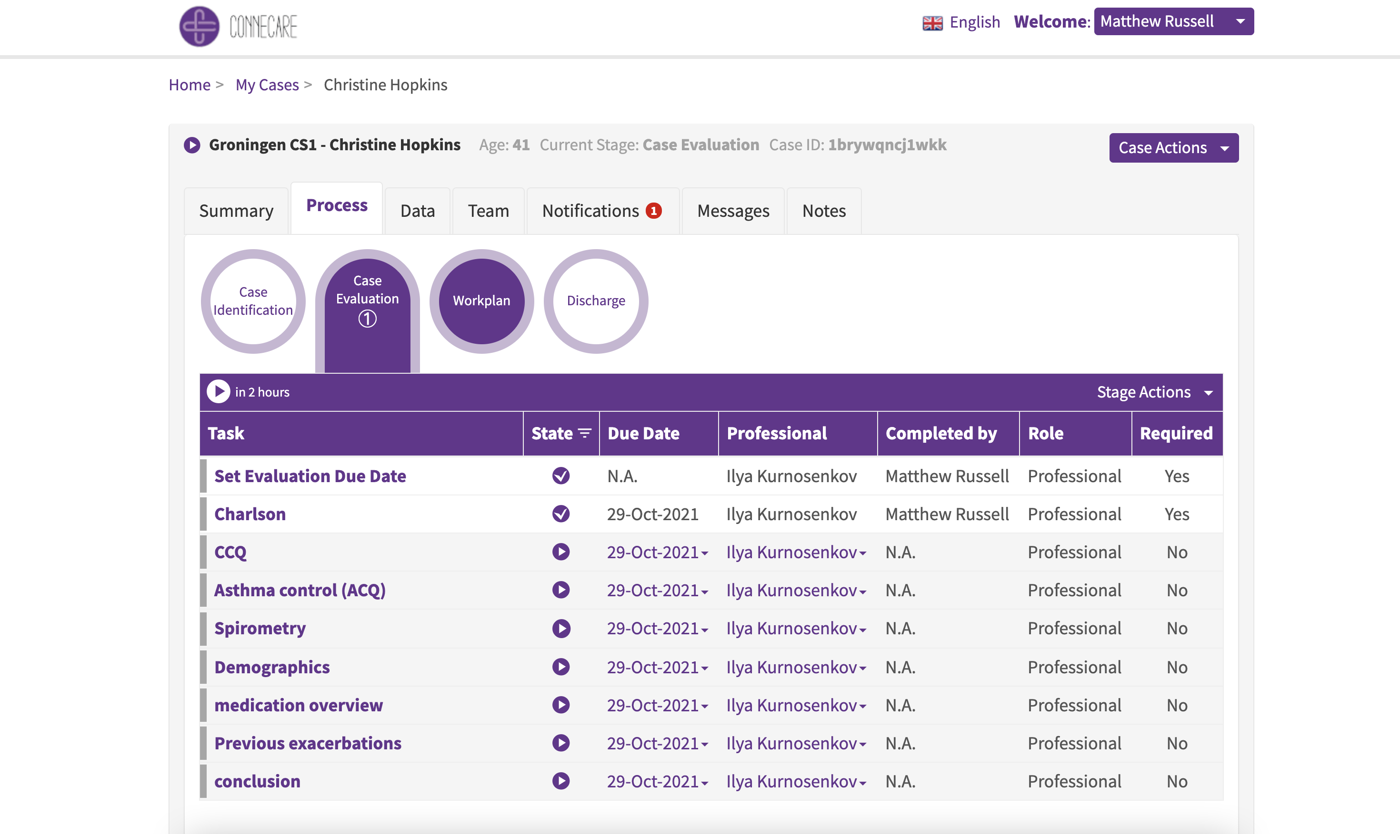
Smart Adaptive Case Management (SACM)
Notes:
One implementation: Smart Adaptive Case Management (SACM): - Goal:
- Orchestration of all relevant stakeholders indepeendent of their association
- Preserving the hierarchy of access and editing rights
- Customizable solution -> solve different needs from hospitals, treatments & patients
- Result: enable patient centric treatment
Seen in example:
Stages (Circle) (Completed or locked white, unlocked purple)
Tasks (List)
Responsibilities (Columns)
Model for treatment is given in XML
Problem: Complexity of model

Slide 6
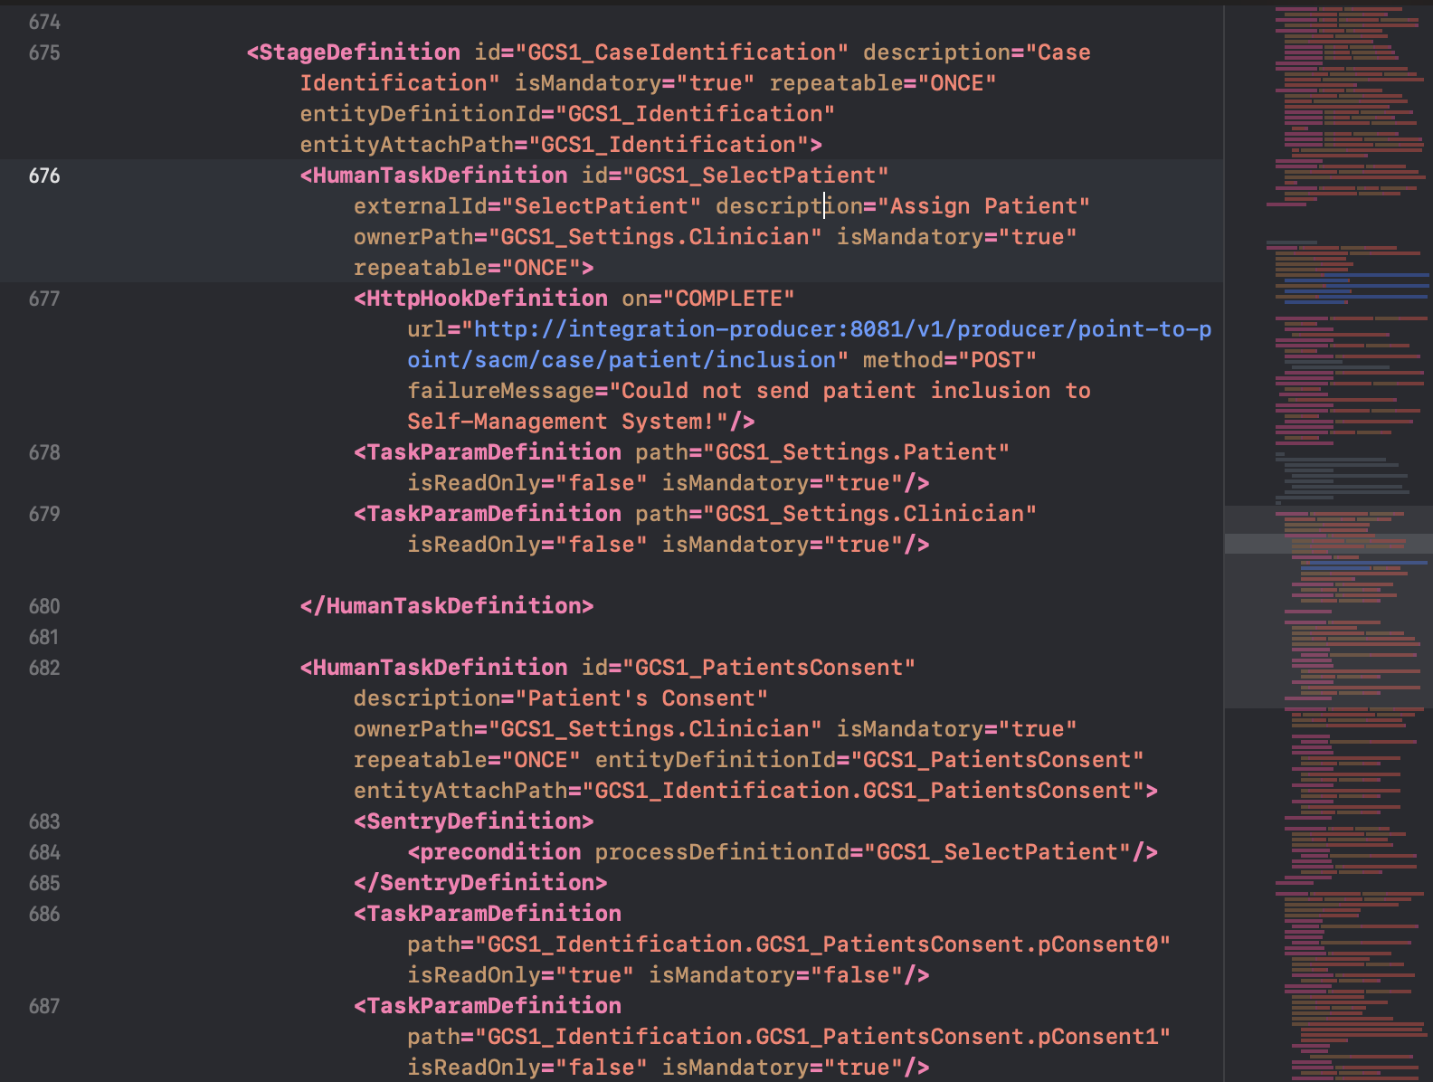
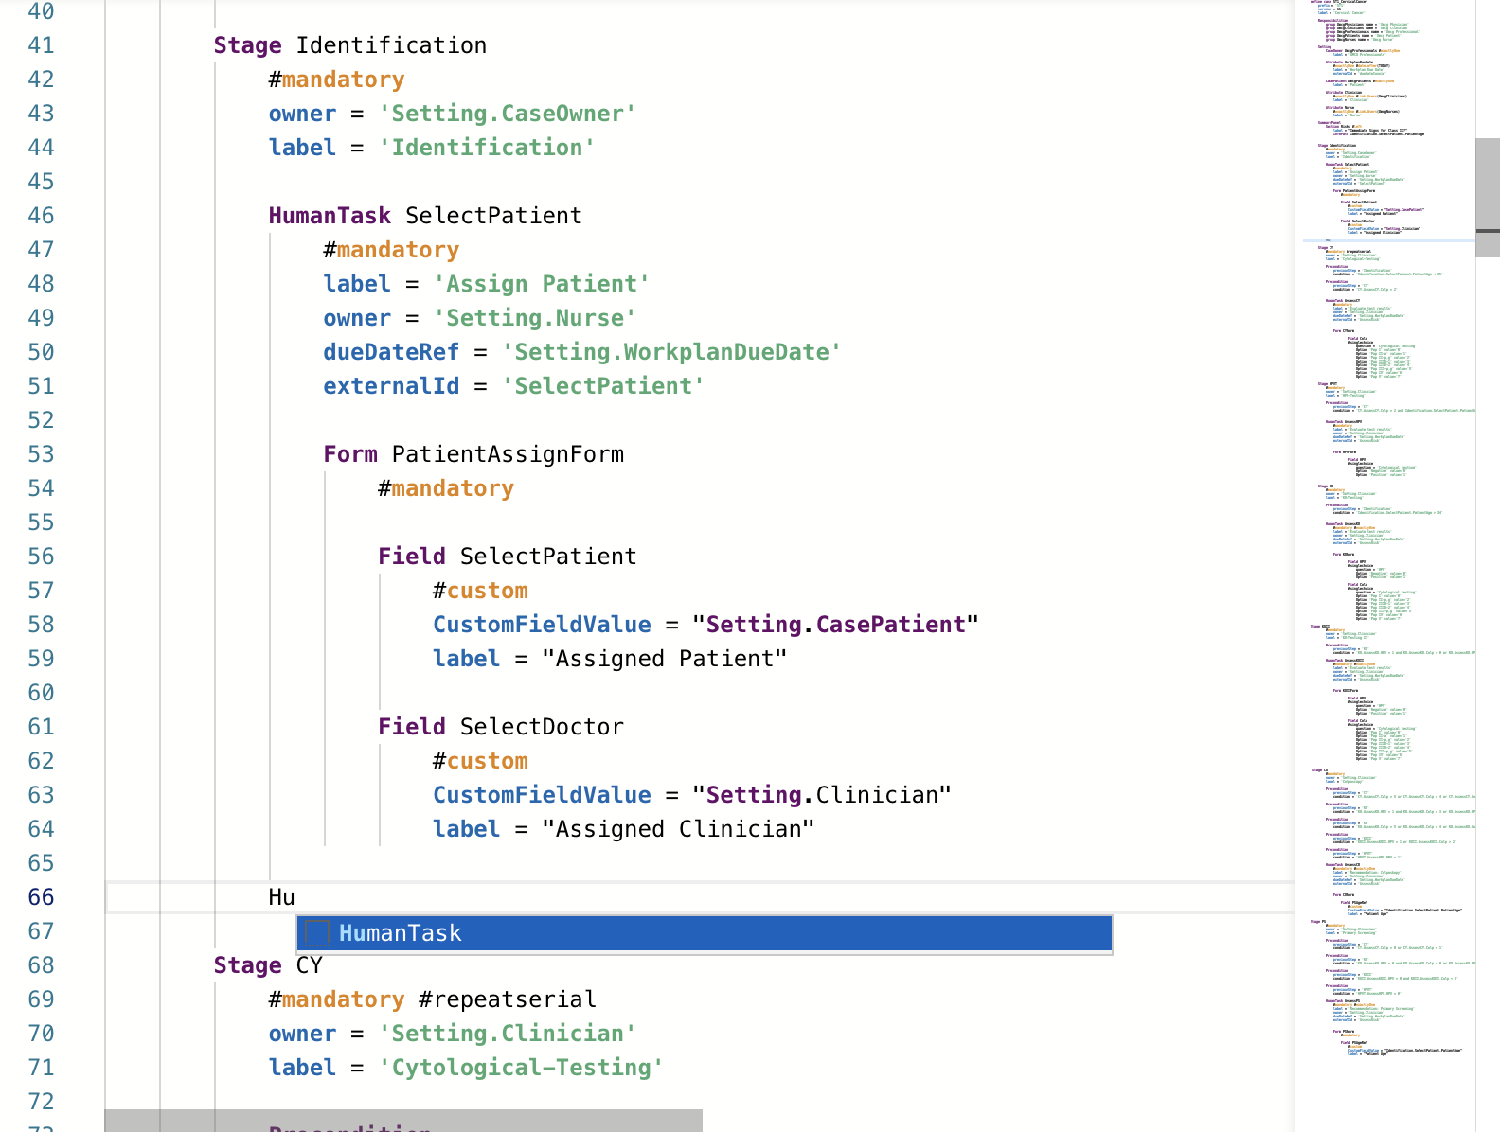



Domain Specific Language (DSL)
Patient selection described in XML
Patient selection described in Acadela
Simplifications:
Reduce document size
Simplify grammar
IDE support
Notes:
Both describe patient selection
Main advantages:
Reduction of document size
Acadela based on TextX not XML:
No closing tags
XML always key value assignments -> acadela single attributes possible
Shorten key words, e.g. StageDefinition -> Stage
Removal of redundancy: SACM: data schema and visualization definition -> combined
Import of elements, additionally enablesr reuse of elements
Simplify grammar
Reduction of size -> more readable
Syntactic freedom (whitespace, capitalization, quotationmarks, no delimiter, no order of elements) -> more accessible
Default values -> faster development of commonly used scenarios, no limitation as can be overwritten
Proper IDE support
Code highlighting (Grammar terms, attributes, state, strings)
Auto-complete -> create blueprints
Possibility for auto prettifying code with indents

Slide 7
Conditional unlocking of stages
Definition of Field “VisibleBurns“
Stage Evaluation
HumanTask EvaluateRisk
Form RisksForm
Field VisibleBurns
#singlechoice
question = 'Visible burns‘
Option 'No' value=‚0‘
Option 'Yes' value='1'
Evaluation
EvaluateRisk
EvaluateRisk: Visible burns = 1
Conditional unlocking of Stage “Diagnosis“
Diagnosis
…
Stage Diagnosis
Precondition
previousStep = 'Evaluation‘
condition = 'Evaluation.EvaluateRisk.VisibleBurns =1'
Notes:
Demonstrate how simple DSL is: example conditional unlocking of stage
- One of most important features for doctors
- Few lines of code allow to create input mask for doctors to give measured information
- Few more lines allow to conditionnaly trigger stage unlock depending on value

Slide 8
User Test
Pre-evaluation
Focus: Who should create models?
Task: Doctors use DSL to create simple clinical pathway
Stage 1
Stage 2
Main user test
Focus: Can DSL create accurate models of clinical pathways from different medical fields?
Task: Doctors evaluate pre-created models of their respective field
Notes:
What we wanted to find out:
Who should create models?
Can DSL create accurate models of clinical pathways from different medical fields
Two stage user tests:
Stage 1:
Introduce 3 doctors to DSL
Use easily understandable pathway: Obesity
Stages: Admit patient, measure BMI, Evaluation, Discharge
Go through the model
Let them create model
Stage 2:
We model pathways from their domain
Show for evaluation
Do interview with scale and open end questions

Slide 9





Participants
Dermatologist
Surgeon
Gynecologist
Physiotherapist
Psychotherapists
Psychotherapists
3 years experience
Stage 1
3 years experience
Stage 1 & 2
31 years experience
Stage 1 & 2
4 years experience
Stage 2
3 years experience
Stage 2
5 years experience
Stage 2

Slide 10
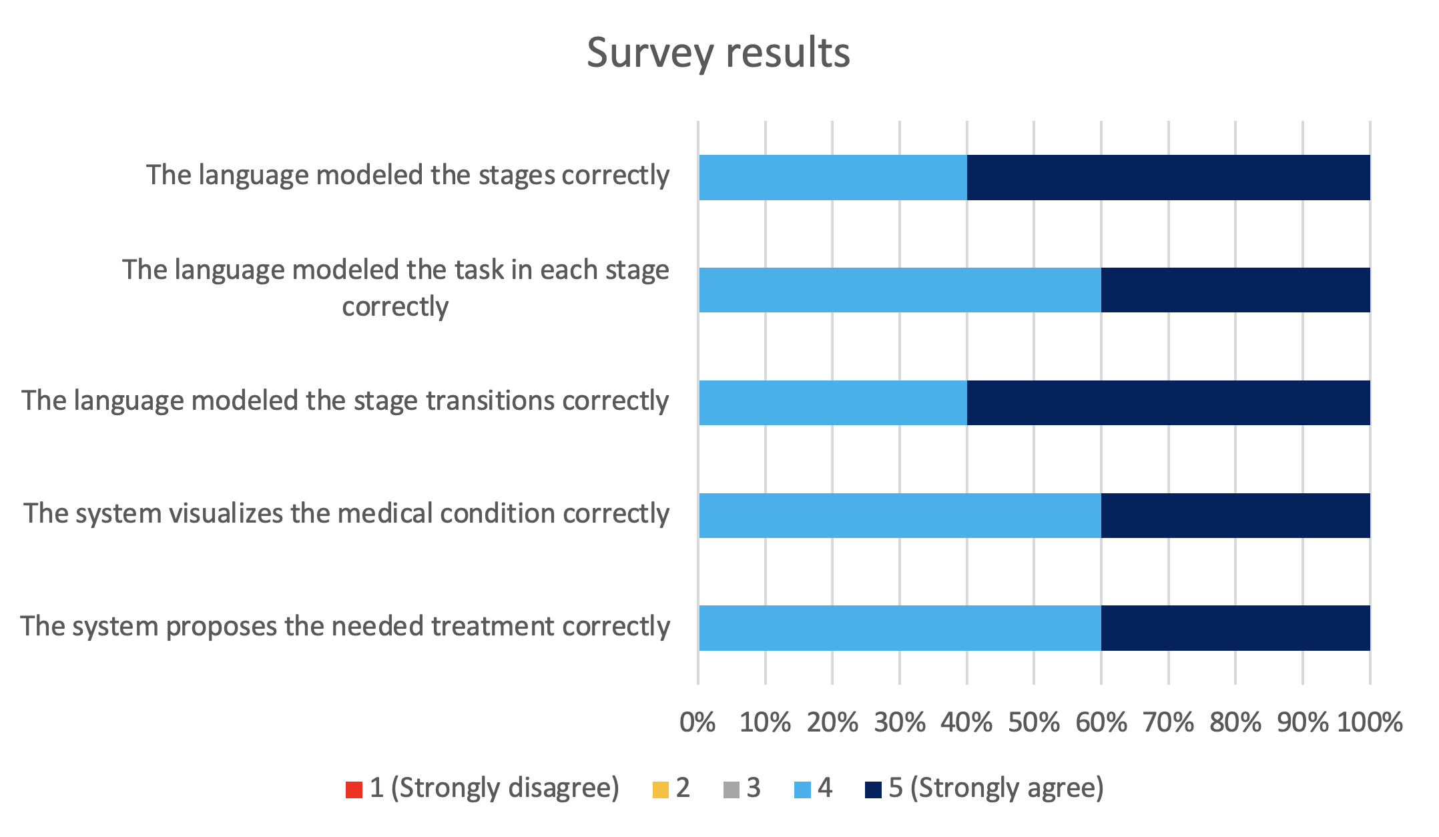
Evaluation
General outcome:
Interested in using DSL for smaller changes
See value in application for daily routines
Well perceived
DSL capable of portraying most pathways accurately

Slide 11
Limitations
Limitations of SACM
No preconditions for tasks
Condition from recurring task not possible
No pure text-based advice
Accessing variables from other stages
Accessing constants
No definition of request handler when contacted from external systems

Slide 12
Future Work
Further develop SACM
Use Acadela with other base system
More user tests
Cover more medical fields e.g. cardiology
Additionally explore traditional eastern medicine

Slide 13
Prof. Dr.
Florian Matthes
17132
matthes@in.tum.de

Slide 14
Group
Definition of Groups
Responsibilities
group UmcgPhysicians name = 'Umcg Physician'
group UmcgClinicians name = 'Umcg Clinician'
group UmcgProfessionals name = 'Umcg Professional'
group UmcgPatients name = 'Umcg Patient'
group UmcgNurses name = 'Umcg Nurse'
Conditional unlocking of Stage “Diagnosis“
Setting
CaseOwner UmcgProfessionals #exactlyOne
label = 'UMCG Professionals'

