Slide 1
Automatic English Text Simplification for Statutes
Akshaya Muralidharan, 17.05.2021, Master Thesis Kickoff presentation

Slide 2
Outline
Motivation
Research questions
Methodology
Current progress
Timeline

Slide 3
Motivation
Low written language comprehension (76% of the non-native-English speakers, 37 percent of the native-English-speakers) [1]
Inability to comprehend legal language
Simplified text improves readability of laws [2]
Makes legal information more accessible

Slide 4
Outline
Motivation
Research questions
  Characteristics of simple legal text
  Text simplification methods
Methodology
Current progress
Timeline

Slide 5
Research questions
How do we characterize easy and difficult legal text?
How can we find and automatically align easy legal text with laws in their original form to create a parallel aligned corpus?
How can we use this corpus to understand the features of easy and hard to read legal text?
How do the state-of-the-art simplification models perform on legal data?

Slide 6
Outline
Motivation
Dataset collection
Research questions
Methodology
  Corpus creation
  Derive characteristics of simple legal text
  Evaluation of simplification methods
Current progress
Timeline

Slide 7
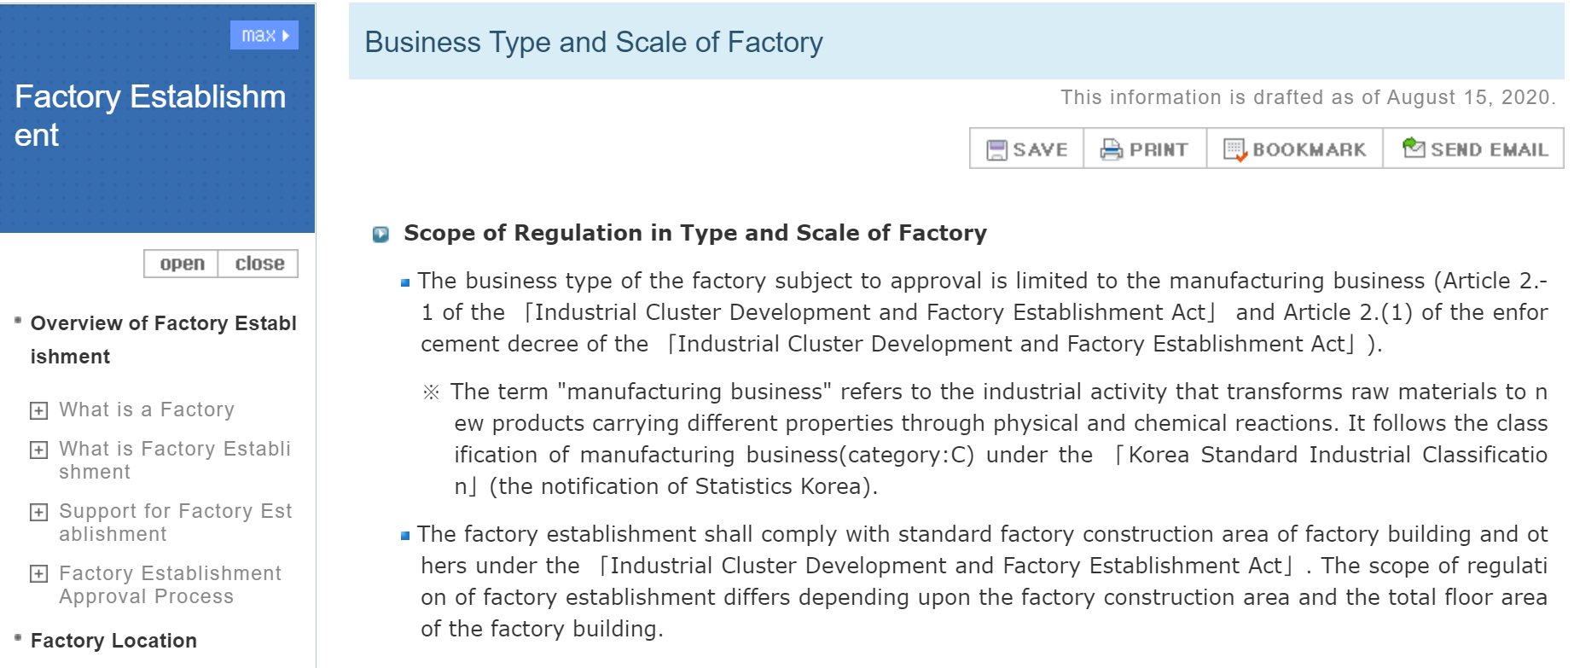
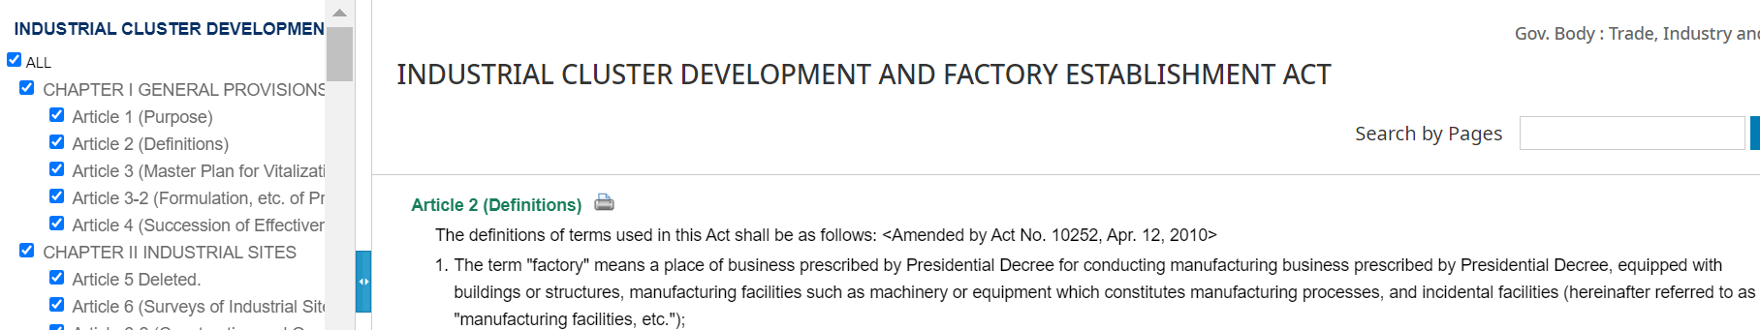
Corpus creation
  EasyLaw (South Korea)
Find
Find easily readable legal text and standard legal counterpart
Scrape and store
Scrape and store text in appropriate data structure
Align
Align easily readable text with standard legal text
Article alignment
CATS model [3]
Neural CRF Model [4]
Evaluate
Manually evaluate corpus by examining random samples
  E-Law South Korea

Slide 8
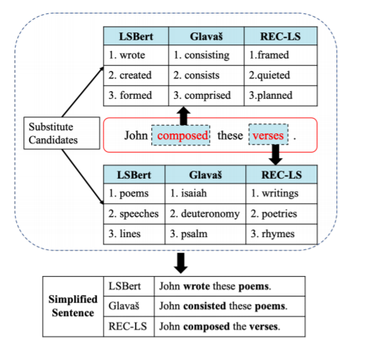
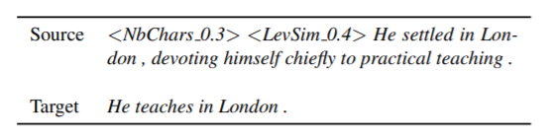
Evaluate text simplification models using corpus
  Lexical simplification model
    LS-BERT [5]
  Sentence simplification model
      ACCESS [6]

Slide 9
Derive characteristics of easy text from corpus
Measure and compare structuring statistics
Measure and compare grammar frequencies
Measure and compare readability scores
Measure and compare count statistics

Slide 10
Outline
Motivation
Dataset collection
Research questions
Methodology
Current progress
Timeline

Slide 11
Literature Survey
Readability metrics
Grade-based metrics
Direct measurements
Feature based metrics
Count based statistics
Text alignment techniques
State of the art text simplification techniques

Slide 12
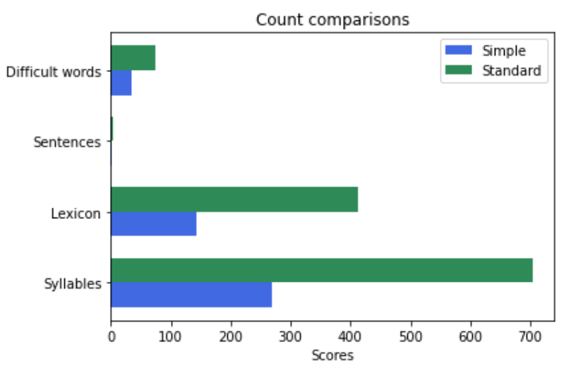
Measuring readability of sample text

Slide 13
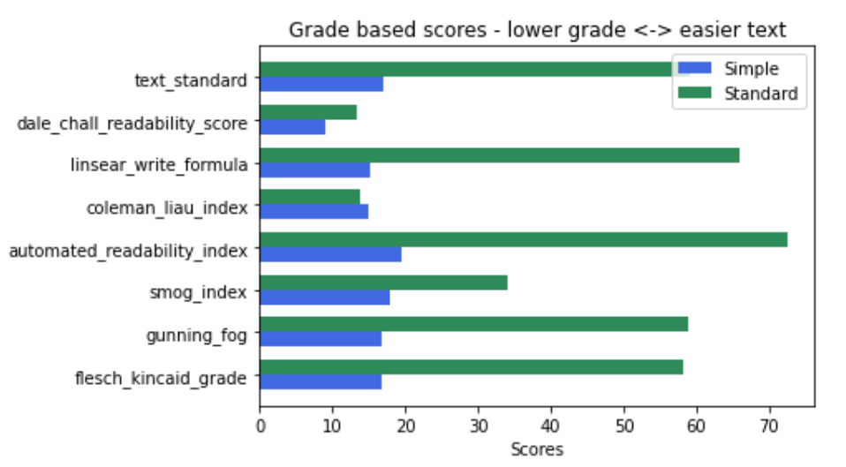
Measuring readability of sample text

Slide 14
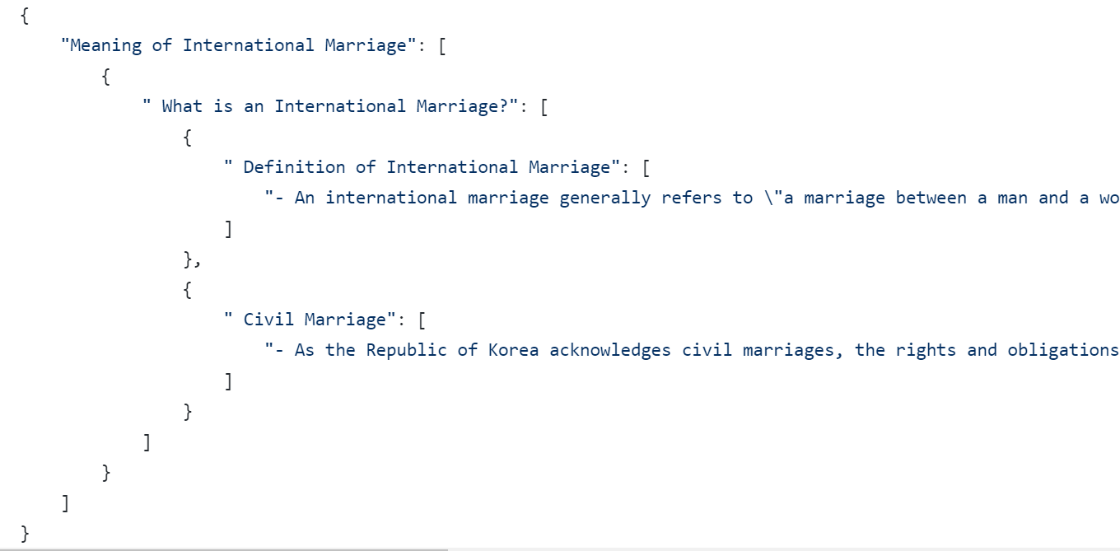
Scraping easy-to-read text
Source: easylaw.go.kr
Scraped using BeautifulSoup
Translated styles into a nested json
Data contains around ~15k sentences
Next step: Scrape standard text from elaw.klri.re.kr

Slide 15
Outline
Motivation
Dataset collection
Research questions
Methodology
Current progress
Timeline

Slide 16
Timeline
2021
Apr
May
Jun
Jul
Aug
Sep
Oct
2021
Today
Master's Thesis
Apr 15 - Oct 15
Literature Survey
Apr 16 - May 17
Scrape and store data
May 1 - Jun 14
Text alignment
Jun 14 - Jul 12
Characterize text readability features
Jul 12 - Aug 16
Evaluating SOTA models on the dataset
Aug 16 - Sep 13
Write-up & final presentation
Jun 21 - Oct 15

Slide 17
Thank you!
Questions?

Slide 18
References
[1] Jin, Y., & Kling, J. (2009). Overcoming the language barrier: The literacy of non-native-English-speaking adults. US Department of Labor, Employment and Training Administration.
[2] Iram Rubab, Mamona Yasmin Khan, and Tahira Asgher. Transformationof legal texts into simplified accounts to make the justice accessible.
[3] Štajner, S., Franco-Salvador, M., Rosso, P., & Ponzetto, S. P. (2018, May). Cats: A tool for customized alignment of text simplification corpora. In Proceedings of the Eleventh International Conference on Language Resources and Evaluation (LREC 2018).
[4] Jiang, C., Maddela, M., Lan, W., Zhong, Y., & Xu, W. (2020). Neural CRF Model for Sentence Alignment in Text Simplification.
[5] Qiang, Jipeng et al. “LSBert: A Simple Framework for Lexical Simplification.”
[6] L. Martin, B. Sagot, E. De la Clergerie, A. Bordes, Controllable Sentence Simplification

