Slide 1
Web-based Breathing Exercise System for Assisting the Treatment of Chronic Obstructive Pulmonary Disease (COPD)
Elçin Can Çavuşoğlu, 22.02.2021, Munich

Slide 2





Outline
Motivation
Prototype
Research Goals
Expected Outcome
Timeline
Notes:
Motivation, Prototype, Research Goals, Expected Outcome, Timeline

Slide 3
Outline
Motivation
Prototype
Research Goals
Expected Outcome
Timeline
Notes:
Motivation, Prototype, Research Goals, Expected Outcome, Timeline

Slide 4
Motivation
Chronic Obstructive Pulmonary Disease (COPD)
Global Leading Causes of Death*
1- Ischaemic heart disease
2- Stroke
3- COPD
65 Million
3 Million
People suffer from moderate or severe COPD
People die each year
FIRS. (2017). The Global Impact of Respiratory Disease - Second Edition
*WHO. (2019)
Notes:
3rd disease: order the first and the second
COPD in bold
https://www.who.int/news-room/fact-sheets/detail/the-top-10-causes-of-death#:~:text=The%20top%20global%20causes%20of,birth%20asphyxia%20and%20birth%20trauma%2C
Motivation
COPD below motivation

Slide 5
Motivation
Chronic Obstructive Pulmonary Disease
Shortness of breath
Sputum (phlegm) production
Coughing
Wheezing
Recurrent respiratory infection
Muscle weakness
Reduced exercise performance and physical inactivity in daily life
Notes:
Put physical body exercises and breathing exercises to here under the respiratory physiotherapy

Slide 6


Motivation
Chronic Obstructive Pulmonary Disease
Respiratory Physiotherapy
Shortness of breath
Sputum (phlegm) production
Coughing
Wheezing
Recurrent respiratory infection
Muscle weakness
Reduced exercise performance and physical inactivity in daily life
Physical Body Exercises
Breathing Exercises
Notes:
Put physical body exercises and breathing exercises to here under the respiratory physiotherapy
Both done in clinics weekly sessions, breathing at home
Add clinic and home icons to the boxes

Slide 7

Motivation
Respiratory Physiotherapy - Breathing Exercises Benefits
Strengthen the inspiratory muscles
Reduce shortness of breath
Improve quality of life
https://www.webmd.com/

Slide 8


Motivation
Respiratory Physiotherapy - Problems
Lack of a guidance mechanism
Lack of supervision over the patient
Notes:
Benefits of breathing exercises
Put the image of a breathing exercise to this slide
Helps the patients to strengthen the lung muscles (inspiratory muscles) and then they can breath normally
Problems of this treatment in a new slide
Another slide (between problem and prototype slides): Explain how to correctly do a breathing exercise (ex: belly expands on inhaling etc)

Slide 9
Outline
Motivation
Prototype
Research Goals
Expected Outcome
Timeline
Notes:
Motivation, Prototype, Research Goals, Expected Outcome, Timeline

Slide 10
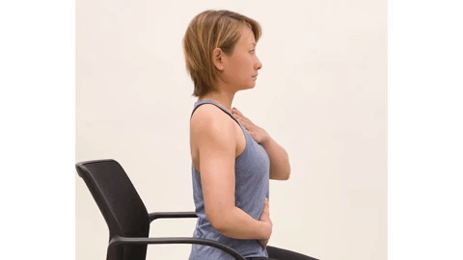
Prototype
Respiratory Physiotherapy - Breathing Exercises Metrics
Sit in upright position and lean back towards the chair
Inhale: belly needs to expand
Exhale: belly needs to shrink and ribs appear
Shoulders should not move too much
https://www.hopkinsmedicine.org/
Notes:
Deep breathing
Diaphragmatic breathing
Pursued lip breathing
Coordinated breathing
Huff cough

Slide 11
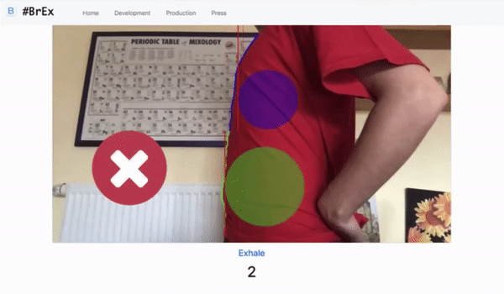
Prototype
Patient User Interface
Notes:
The requirements of the breathing exercise:
Sitting upright
The shoulders shouldn’t move too much
Expansion of the belly according to the inhale & exhale instructions
Explain green and purple circles, explain the lines

Slide 12
Prototype
Physiotherapist User Interface
Remote Patient Monitoring Dashboard
List of patients
Patient exercise performance details
How often they did it
How accurate they performed
What went wrong
Notes:
The requirements of the breathing exercise:
Sitting upright
The shoulders shouldn’t move too much
Expansion of the belly according to the inhale & exhale instructions
Explain green and purple circles, explain the lines

Slide 13
Outline
Motivation
Prototype
Research Goals
Expected Outcome
Timeline
Notes:
Motivation, Prototype, Research Goals, Expected Outcome, Timeline

Slide 14
Research Goals - Hypothesis
An accurate and highly usable assistive breathing exercise system increases the efficiency and satisfaction of the COPD treatment both for physiotherapists and their patients.

Slide 15
Research Goals - Research Questions
What are the relevant and measurable metrics of an effective breathing exercise for the treatment of COPD?
Method: Interview with physiotherapists
How can an algorithm be developed from the relevant metrics to accurately evaluate the breathing exercise?
From the perspective of physiotherapists, how does this approach improve the efficiency of the COPD treatment?
How usable is this approach in the treatment of COPD from the perspectives of patients and physiotherapists?
Notes:
Each of the question, explain why I have this question. (When talking about one, gray out the other ones)
How I plan to answer each of these. Ex: Interview with physiotherapists and medical sources

Slide 16
Research Goals - Research Questions
What are the relevant and measurable metrics of an effective breathing exercise for the treatment of COPD?
How can an algorithm be developed from the relevant metrics to accurately evaluate the breathing exercise?
Method: Iterative development; interview with physiotherapist and pilot-testing
From the perspective of physiotherapists, how does this approach improve the efficiency of the COPD treatment?
How usable is this approach in the treatment of COPD from the perspectives of patients and physiotherapists?

Slide 17
Research Goals - Research Questions
What are the relevant and measurable metrics of an effective breathing exercise for the treatment of COPD?
How can an algorithm be developed from the relevant metrics to accurately evaluate the breathing exercise?
From the perspective of physiotherapists, how does this approach improve the efficiency of the COPD treatment?
Method: Conduct user study on physiotherapists
How usable is this approach in the treatment of COPD from the perspectives of patients and physiotherapists?

Slide 18
Research Goals - Research Questions
What are the relevant and measurable metrics of an effective breathing exercise for the treatment of COPD?
How can an algorithm be developed from the relevant metrics to accurately evaluate the breathing exercise?
From the perspective of physiotherapists, how does this approach improve the efficiency of the COPD treatment?
How usable is this approach in the treatment of COPD from the perspectives of patients and physiotherapists?
Method: User study

Slide 19
Outline
Motivation
Prototype
Research Goals
Expected Outcome
Timeline
Notes:
Motivation, Prototype, Research Goals, Expected Outcome, Timeline

Slide 20
Expected Outcome - Prototype
Patient User Interface
Frontend
User starts the exercise
Camera is activated
Send image frames to backend
Display real time feedback
Display exercise results
NO
Backend
Breathing Exercise Validation Algorithm
YES
Exercise finished?

Slide 21
Expected Outcome - Prototype
Patient User Interface
Frontend
User starts the exercise
Camera is activated
Send image frames to backend
Display real time feedback
Display exercise results
NO
Backend
Breathing Exercise Validation Algorithm
YES
Exercise finished?

Slide 22
Expected Outcome - Prototype
Patient User Interface
Frontend
User starts the exercise
Camera is activated
Send image frames to backend
Display real time feedback
Display exercise results
NO
Backend
Breathing Exercise Validation Algorithm
YES
Exercise finished?

Slide 23
Expected Outcome - Prototype
Patient User Interface
Frontend
User starts the exercise
Camera is activated
Send image frames to backend
Display real time feedback
Display exercise results
NO
Backend
Breathing Exercise Validation Algorithm
YES
Exercise finished?

Slide 24
Expected Outcome - Prototype
Patient User Interface
Frontend
User starts the exercise
Camera is activated
Send image frames to backend
Display real time feedback
Display exercise results
NO
Backend
Breathing Exercise Validation Algorithm
YES
Exercise finished?

Slide 25
Expected Outcome - Prototype
Patient User Interface
Frontend
User starts the exercise
Camera is activated
Send image frames to backend
Display real time feedback
Display exercise results
NO
Backend
Breathing Exercise Validation Algorithm
YES
Exercise finished?

Slide 26
Expected Outcome - Prototype
Patient User Interface
Frontend
User starts the exercise
Camera is activated
Send image frames to backend
Display real time feedback
Display exercise results
NO
Backend
Breathing Exercise Validation Algorithm
YES
Exercise finished?

Slide 27
Expected Outcome - Prototype
Patient User Interface
Frontend
User starts the exercise
Camera is activated
Send image frames to backend
Display real time feedback
Display exercise results
NO
Backend
Breathing Exercise Validation Algorithm
YES
Exercise finished?

Slide 28
Expected Outcome - Prototype
Patient User Interface
Frontend
User starts the exercise
Camera is activated
Send image frames to backend
Display real time feedback
Display exercise results
NO
Backend
Breathing Exercise Validation Algorithm
YES
Exercise finished?

Slide 29
Expected Outcome - Prototype
Patient User Interface
Frontend
User starts the exercise
Camera is activated
Send image frames to backend
Display real time feedback
Display exercise results
NO
Backend
Breathing Exercise Validation Algorithm
YES
Exercise finished?
Evaluation of the prototype: Accuracy and Usability
Notes:
(In the end I want to develop a user friendly and efficient system and I will evaluate this)(In the end I want to develop a user friendly and efficient system and I will evaluate this)

Slide 30
Expected Outcome - Prototype
Physiotherapist User Interface
Frontend
User logs in
Display list of patients
User clicks on patient
Display patient exercise performance details

Slide 31
Expected Outcome - Prototype
Physiotherapist User Interface
Frontend
User logs in
Display list of patients
User clicks on patient
Display patient exercise performance details

Slide 32
Expected Outcome - Prototype
Physiotherapist User Interface
Frontend
User logs in
Display list of patients
User clicks on patient
Display patient exercise performance details

Slide 33
Expected Outcome - Prototype
Physiotherapist User Interface
Frontend
User logs in
Display list of patients
User clicks on patient
Display patient exercise performance details

Slide 34
Expected Outcome - Prototype
Physiotherapist User Interface
Frontend
User logs in
Display list of patients
User clicks on patient
Display patient exercise performance details

Slide 35
Expected Outcome - Prototype
Physiotherapist User Interface
Frontend
User logs in
Display list of patients
User clicks on patient
Display patient exercise performance details
Evaluation of the prototype: Efficiency and Usability

Slide 36


Evaluation
Quality & Performance
Usability
Physiotherapists (Germany & Turkey)
5 COPD patients
Notes:
Tell us what you want to look for: accuracy of algorithm, efficiency of application, usability: user experience, satisfaction, user friendliness

Slide 37
Evaluation
Usability
Accuracy: On-site testing
Efficiency: User study
Quality & Performance
Notes:
Efficiency: more patients can be monitored at the same time. More exercises can be done at the same time. Does this exercise increase the frequency of the exercises? User study to evaluate.

Slide 38
Evaluation
Quality & Performance
User experience
User satisfaction
User friendliness
System
Usability
Usability
Scale
Notes:
Tell us what you want to look for: accuracy of algorithm, efficiency of application, usability: user experience, satisfaction, user friendliness
Easy to use?
Easy to learn?
Evaluate the score to determine the usabili

Slide 39
Outline
Motivation
Prototype
Research Goals
Expected Outcome
Timeline
Notes:
Motivation, Prototype, Research Goals, Expected Outcome, Timeline

Slide 40
Timeline
Collecting requirements
Development of the web application
Development of breathing exercise validation algorithm
Evaluation
Analysis
Thesis
February
March
April
May
June
July
Notes:
Make a GANTT chart
Thesis is done simultaneously with others
Development:
Algorithm: development of the detection algorithm
Detection of correct breathing exercise
Extracting data out of it
Development of the web application
Put the backup slide of new prototype

Slide 41
M.Sc. Informatics
Elçin Can Çavuşoğlu
17132
elcin.cavusoglu@tum.de

Slide 42
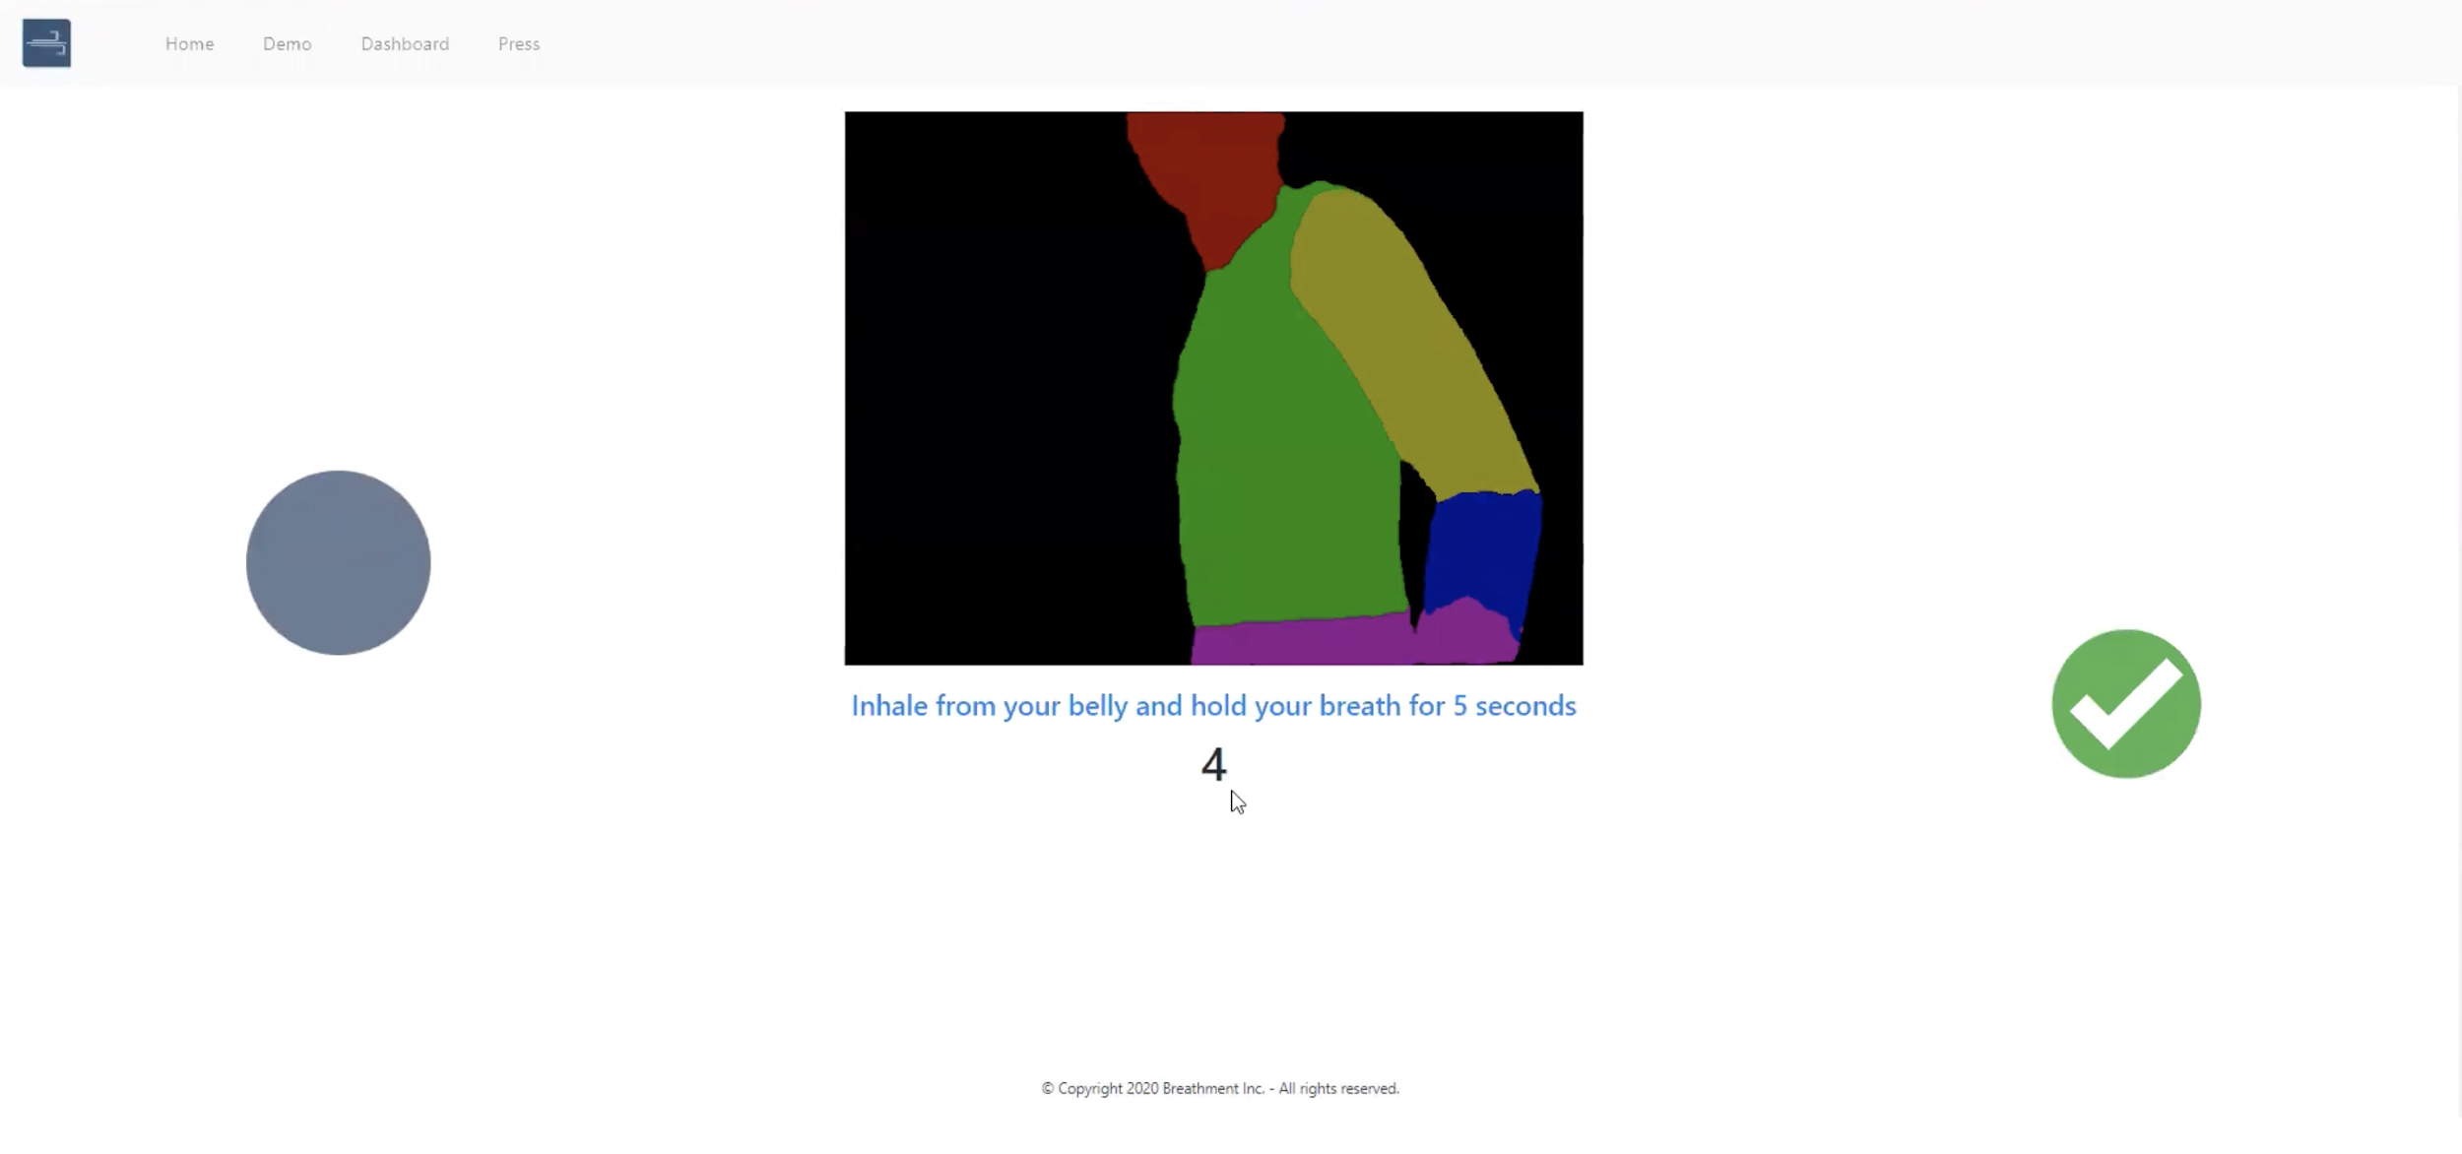
Backup
Notes:
Motivation, Prototype, Research Goals, Expected Outcome, Timeline

