Slide 1
Privacy-Preserving Natural Language Processing: A Systematic Mapping Study
Felix Jedrzejewski, 26.07.2021, Master Thesis Final Presentation

Slide 2
Outline
Background
Motivation
Research Questions
Methodology
Key Findings
Conclusion, Limitations and Future Work
Notes:
Warum Privacy wichtig ist? Vll kürzer
GDPR ist klar, was das ist. Ist bekannt

Slide 3
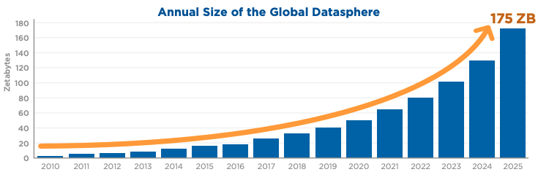
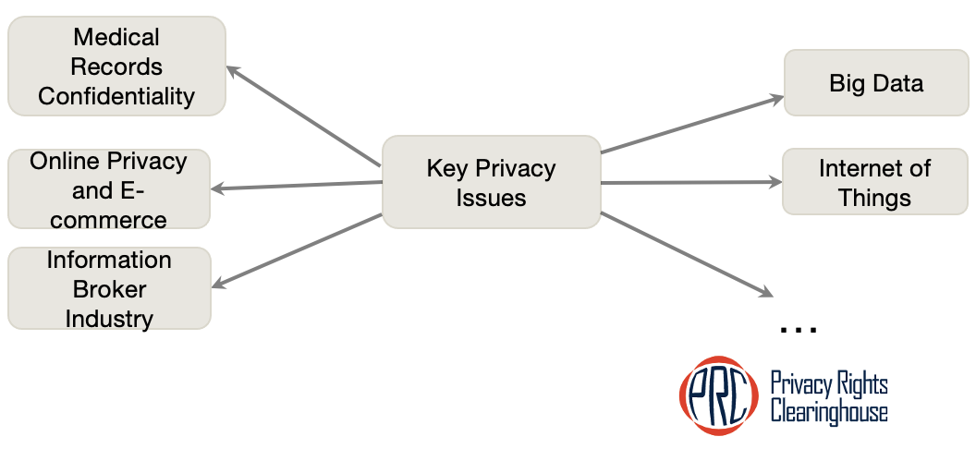
Background
Introduction of GDPR
Fees for privacy related violations (20 mio or 4 % of annual income)¹
Increase of 40 % of GDPR penalties within a year (Jan 2020 - Jan 2021)²
Increased Data Usage
High Diversity of Privacy Issues
¹For more information about GDPR fines, visit https://gdpr.eu/fines/
²For more information about GDPR statistics, visit https://www.tessian.com/blog/biggest-gdpr-fines-2020/
[Ryd18] Rydning, David Reinsel–John Gantz–John: "The digitization of the world from edge to core." Framingham: International Data Corporation (2018).
For more information, visit Privacy Today: A Review of Current Issues
Picture from privacyrights.org
Notes:
Warum Privacy wichtig ist? Vll kürzer
GDPR ist klar, was das ist. Ist bekannt

Slide 4
Background
Introduction of GDPR
Fees for privacy related violations (20 mio or 4 % of annual income)¹
Increase of 40 % of GDPR penalties within a year (Jan 2020 - Jan 2021)²
Increased Data Usage
High Diversity of Privacy Issues
Regulations
¹For more information about GDPR fines, visit https://gdpr.eu/fines/
²For more information about GDPR statistics, visit https://www.tessian.com/blog/biggest-gdpr-fines-2020/
[Ryd18] Rydning, David Reinsel–John Gantz–John: "The digitization of the world from edge to core." Framingham: International Data Corporation (2018).
For more information, visit Privacy Today: A Review of Current Issues
Picture from privacyrights.org
Notes:
Warum Privacy wichtig ist? Vll kürzer
GDPR ist klar, was das ist. Ist bekannt

Slide 5
Background
Introduction of GDPR
Fees for privacy related violations (20 mio or 4 % of annual income)¹
Increase of 40 % of GDPR penalties within a year (Jan 2020 - Jan 2021)²
Increased Data Usage
High Diversity of Privacy Issues
Regulations
Volume
¹For more information about GDPR fines, visit https://gdpr.eu/fines/
²For more information about GDPR statistics, visit https://www.tessian.com/blog/biggest-gdpr-fines-2020/
[Ryd18] Rydning, David Reinsel–John Gantz–John: "The digitization of the world from edge to core." Framingham: International Data Corporation (2018).
For more information, visit Privacy Today: A Review of Current Issues
Picture from privacyrights.org
Notes:
Warum Privacy wichtig ist? Vll kürzer
GDPR ist klar, was das ist. Ist bekannt

Slide 6
Background
Introduction of GDPR
Fees for privacy related violations (20 mio or 4 % of annual income)¹
Increase of 40 % of GDPR penalties within a year (Jan 2020 - Jan 2021)²
Increased Data Usage
High Diversity of Privacy Issues
Regulations
Volume
Diversity
¹For more information about GDPR fines, visit https://gdpr.eu/fines/
²For more information about GDPR statistics, visit https://www.tessian.com/blog/biggest-gdpr-fines-2020/
[Ryd18] Rydning, David Reinsel–John Gantz–John: "The digitization of the world from edge to core." Framingham: International Data Corporation (2018).
For more information, visit Privacy Today: A Review of Current Issues
Picture from privacyrights.org
Notes:
Warum Privacy wichtig ist? Vll kürzer
GDPR ist klar, was das ist. Ist bekannt

Slide 7
Motivation
Complexity
Diversity
Regulations
Volume

Slide 8
Motivation
Natural Language Processing
Neural Networks
Word Embeddings
Statistical Language Models
Complexity
Diversity
Regulations
Volume

Slide 9
Motivation
Natural Language Processing
Neural Networks
Exploitability of Word Embeddings
Statistical Language Models
Complexity
Diversity
Regulations
Volume

Slide 10
Motivation
Natural Language Processing
Memorizability Neural Networks
Exploitability of Word Embeddings
Statistical Language Models
Complexity
Diversity
Regulations
Volume

Slide 11
Motivation
Natural Language Processing
Memorizability Neural Networks
Exploitability of Word Embeddings
Exploitability of Statistical Language Models
Complexity
Diversity
Regulations
Volume

Slide 12
Motivation
Vulnerabilities within Natural Language Processing
Memorizability Neural Networks
Exploitability of Word Embeddings
Exploitability of Statistical Language Models
Complexity
Diversity
Regulations
Volume

Slide 13
Motivation
Vulnerabilities within Natural Language Processing
Memorizability Neural Networks
Exploitability of Word Embeddings
Exploitability of Statistical Language Models
Complexity
Diversity
Regulations
Volume
Privacy-Preserving Natural Language Processing

Slide 14
Research Questions
  RQ1: What privacy-related challenges exist in the area of Natural Language Processing (NLP)?
  RQ2: What approaches are used to preserve privacy in and with NLP tasks and how can they be classified?
  RQ3: What are the current research gaps and possible future research directions in the area of privacy-preserving NLP?
Notes:
Fehlt: erwähne, dass es eine mapping studie ist, die auf existierender literatur basiert.

Slide 15
Recap: Methodology – Systematic Mapping Study
Planning Phase
Selecting Search Terms
Search Execution
Filtering out Duplicates
Classification Phase
Keywording of Abstracts and Titles
Selecting Electronic Data Sources
Applying Inclusion and Exclusion Criteria
Data Extraction and Systematic Mapping
Paper Validation
Multiple Classification Re-Evaluation Rounds
Assigning Papers to Schemes
Mapping Schemes among eachother
Figure inspired by [Pe08] Petersen, K., Feldt, R., Mujtaba, S., & Mattsson, M. (2008, June). Systematic mapping studies in software engineering. In 12th International Conference on Evaluation and Assessment in Software Engineering (EASE) 12 (pp. 1-10).
Notes:
Search query through data bases.

Slide 16
Recap: Methodology – Systematic Mapping Study
All Papers
~ 6000
Filtered Papers
~ 4400
Included
Papers
~ 400
NLP as Privacy Enabler ~ 300
NLP as Privacy Threat ~ 100
Figure taken from [Pe08] Petersen, K., Feldt, R., Mujtaba, S., & Mattsson, M. (2008, June). Systematic mapping studies in software engineering. In 12th International Conference on Evaluation and Assessment in Software Engineering (EASE) 12 (pp. 1-10).
Notes:
Search query through data bases.

Slide 17
Methodology – Systematic Mapping Study – Classification Scheme
Classification Scheme
NLP as a Privacy Enabler
NLP as a Privacy Threat
Top Category Level
Notes:
Search query through data bases.

Slide 18
Methodology – Systematic Mapping Study – Classification Scheme
Classification Scheme
NLP as a Privacy Enabler
NLP as a Privacy Threat
Top Category Level
Notes:
Search query through data bases.

Slide 19
Methodology – Systematic Mapping Study – Classification Scheme
NLP as
Privacy Enabler
Use Case
Privacy Issue
Privacy Solution
Domain
NLP Method Type
Applied NLP Concept
Notes:
Search query through data bases.

Slide 20
Methodology – Systematic Mapping Study – Classification Scheme
Classification Scheme
NLP as a Privacy Enabler
NLP as a Privacy Threat
Top Category Level
Notes:
Search query through data bases.

Slide 21
Methodology – Systematic Mapping Study – Classification Scheme
NLP as
Privacy Threat
Use Case
Privacy Issue
PET
Domain
Data Type
Notes:
Search query through data bases.

Slide 22
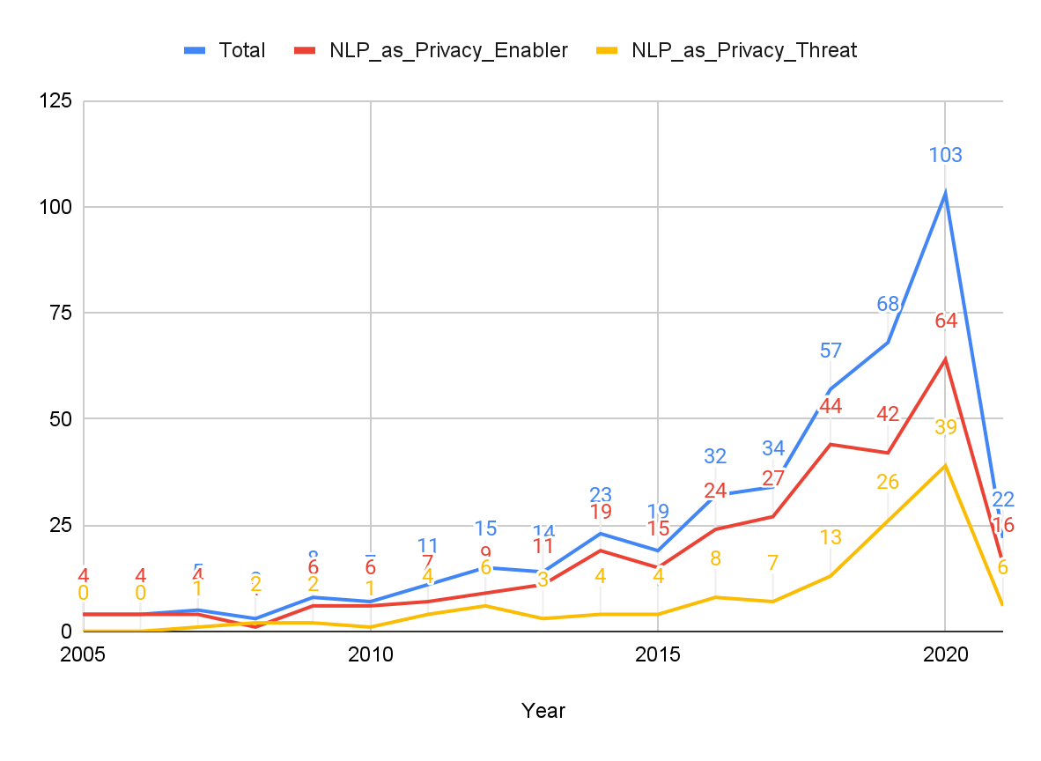
Key Findings - Relevance of the Topic and its Sub-Streams
Notes:
Beschreibe das diagramm, das die zahlen kommulative sind.
Erkläre, warum es in 2021 wieder fällt.

Slide 23
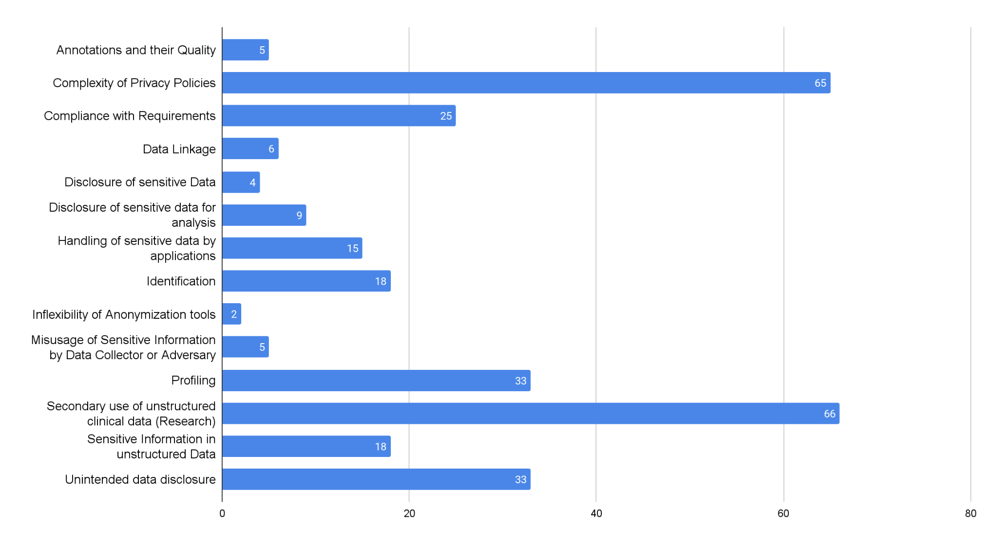
Key Findings - RQ1 - NLP as Privacy Enabler - Privacy Issues
Notes:
@Emai lan Jorge, liste mit 66 paper mit dem tag “secondary use of clinical unstructured data”

Slide 24
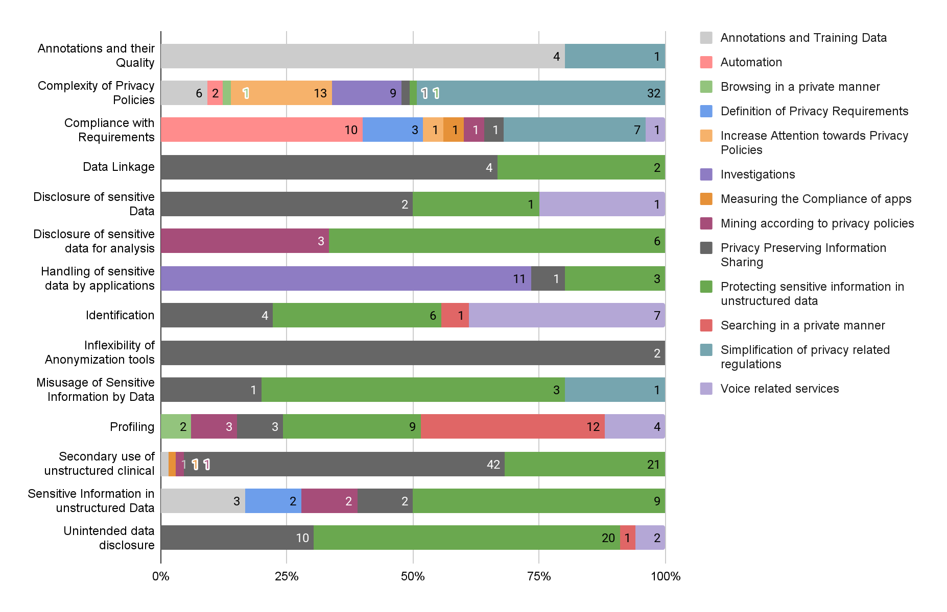
Key Findings - RQ1 - NLP as Privacy Enabler - Use Cases → Privacy Issues
Notes:
Search query through data bases.

Slide 25
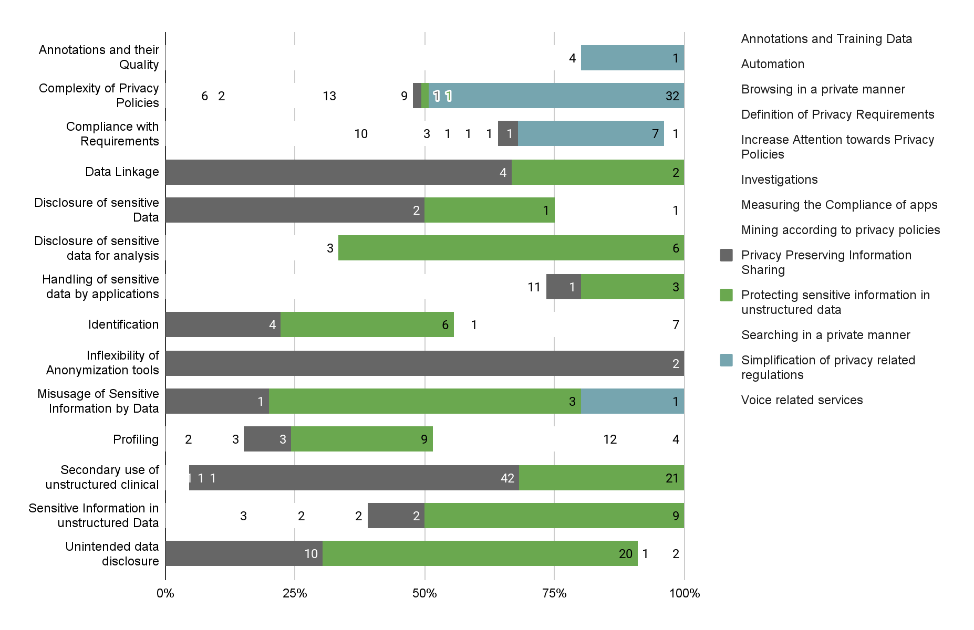
Key Findings - RQ1 - NLP as Privacy Enabler - Use Cases → Privacy Issues
Notes:
Search query through data bases.

Slide 26
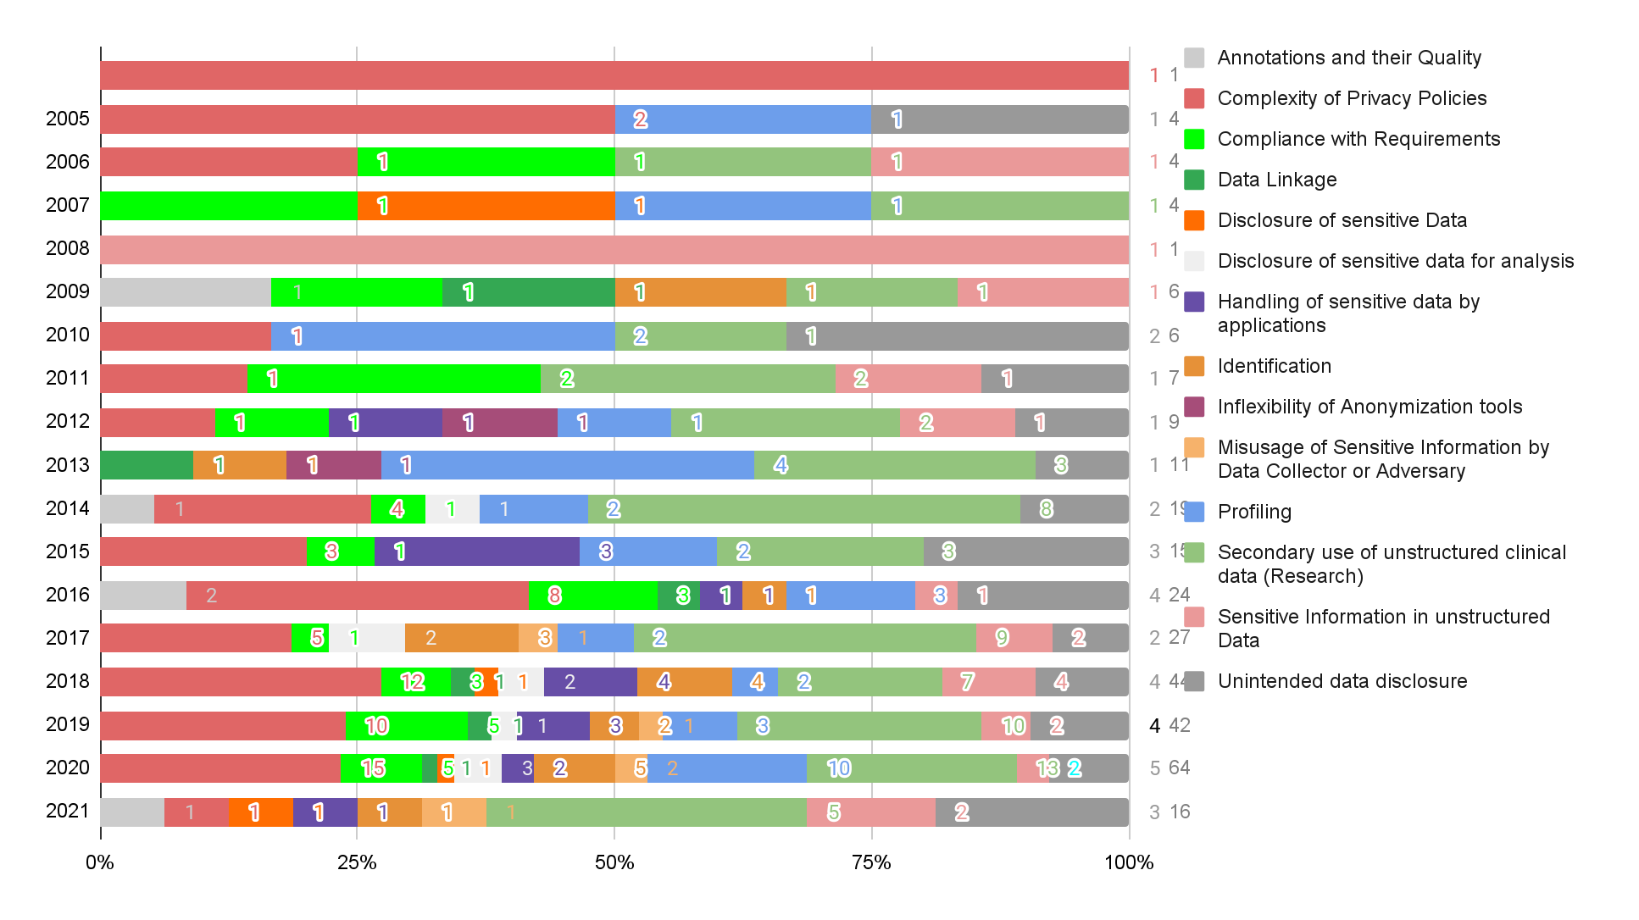
Key Findings - RQ1 - NLP as Privacy Enabler - Privacy Issue Development
1
1
1
4
1
4
1
4
1
1
1
6
2
6
1
7
1
9
1
11
2
19
3
15
4
24
2
27
4
44
4
42
5
64
3
16
Notes:
Search query through data bases.

Slide 27
Key Findings - RQ1 - NLP as Privacy Enabler - Privacy Issue Development
1
1
1
4
1
4
1
4
1
1
1
6
2
6
1
7
1
9
1
11
2
19
3
15
4
24
2
27
4
44
4
42
5
64
3
16
Notes:
Search query through data bases.

Slide 28
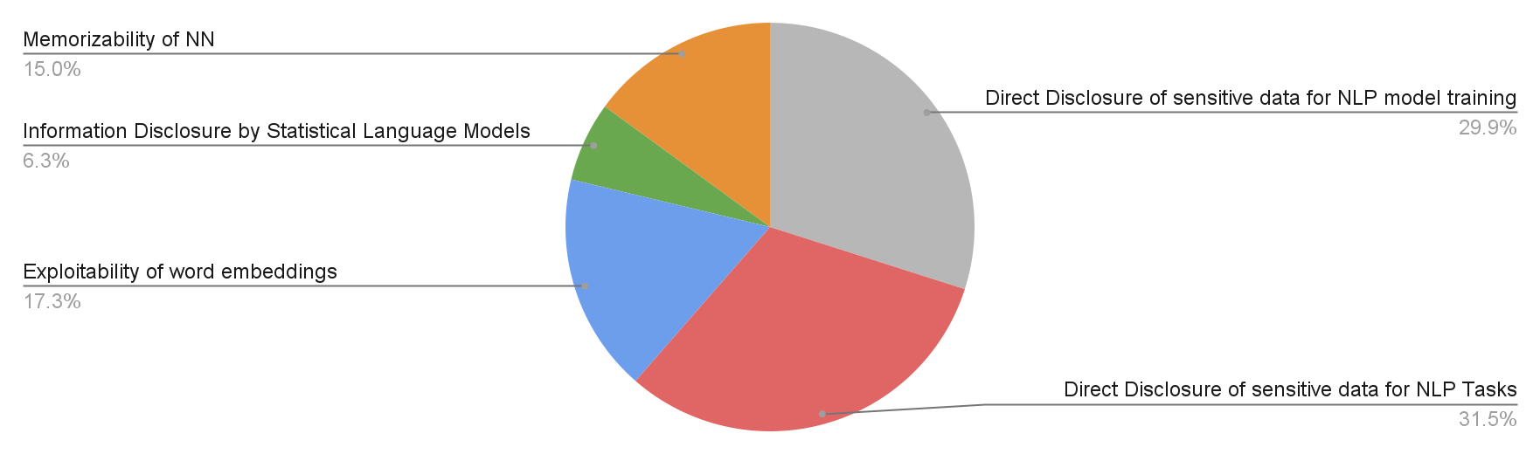
Key Findings - RQ1 - NLP as Privacy Threat – Mapping Result
Notes:
Search query through data bases.

Slide 29
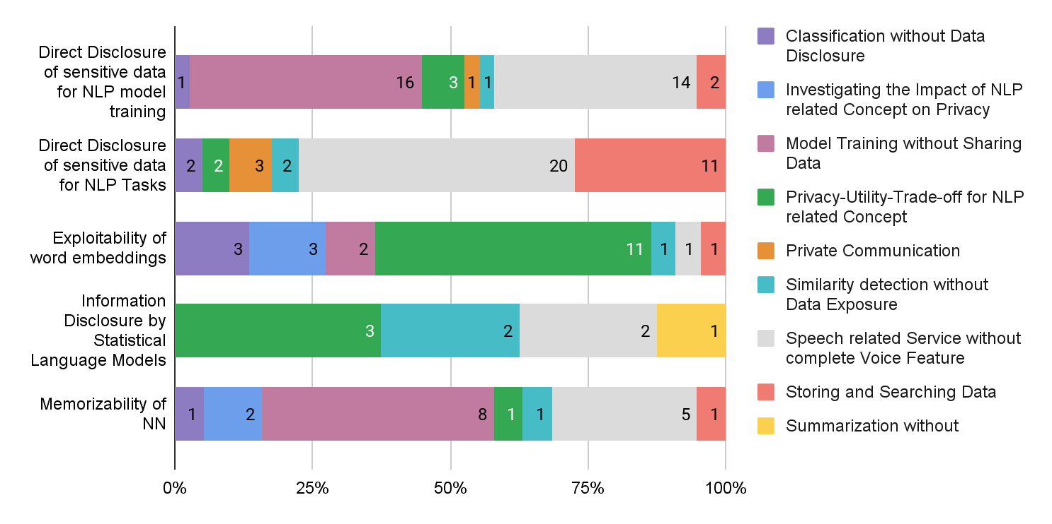
Key Findings - RQ1 - NLP as Privacy Threat - Use Cases → Privacy Issues
Notes:
Search query through data bases.

Slide 30
Key Findings - RQ1 - Result Summary
NLP as a Privacy Enabler:
  Most frequently addressed Privacy Issues:
    Complexity of Privacy Policies
    Secondary use of clinical unstructured data
    Profiling
    Unintended data disclosure
  Most affected use case categories:
    Privacy Preserving information sharing
    Protection of sensitive information in unstructured data sets
    Simplification of privacy related regulations
  Increased diversity and amount of publications between 2016 and 2020
Notes:
Search query through data bases.

Slide 31
Key Findings - RQ1 - Result Summary
NLP as a Privacy Threat:
  Most frequently addressed Privacy Issues:
    Disclosure of sensitive information for NLP tasks
    Disclosure of sensitive information for NLP Model training
    Exploitability of word embeddings
  Voice based services and the sharing of data for model training mostly affected by direct data disclosure
Notes:
Search query through data bases.

Slide 32
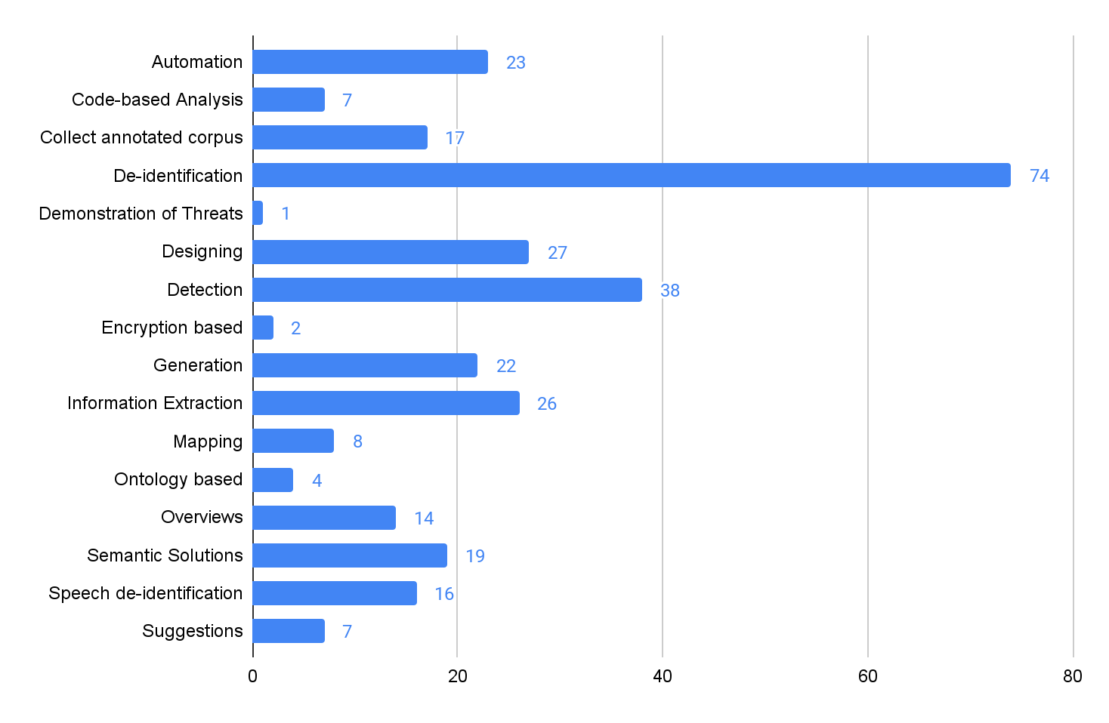
Key Findings - RQ2 - NLP as Privacy Enabler – Mapping Results
Notes:
Mehr erklären, inhaltlich mit beispielen für die drei meisten publikationen.

Slide 33
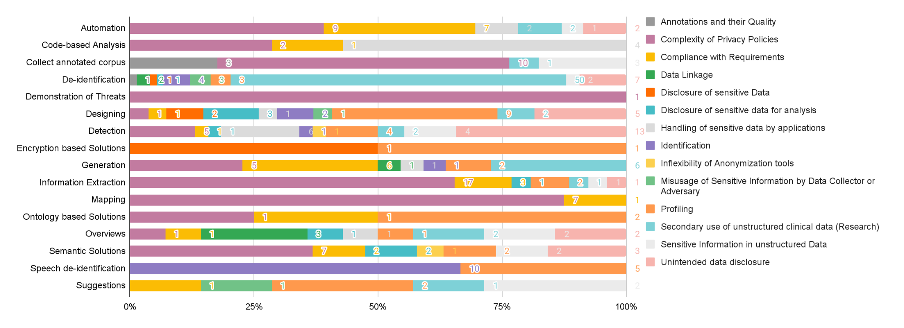
Key Findings - RQ2 - NLP as Privacy Enabler – Privacy Issues → Solutions

Slide 34
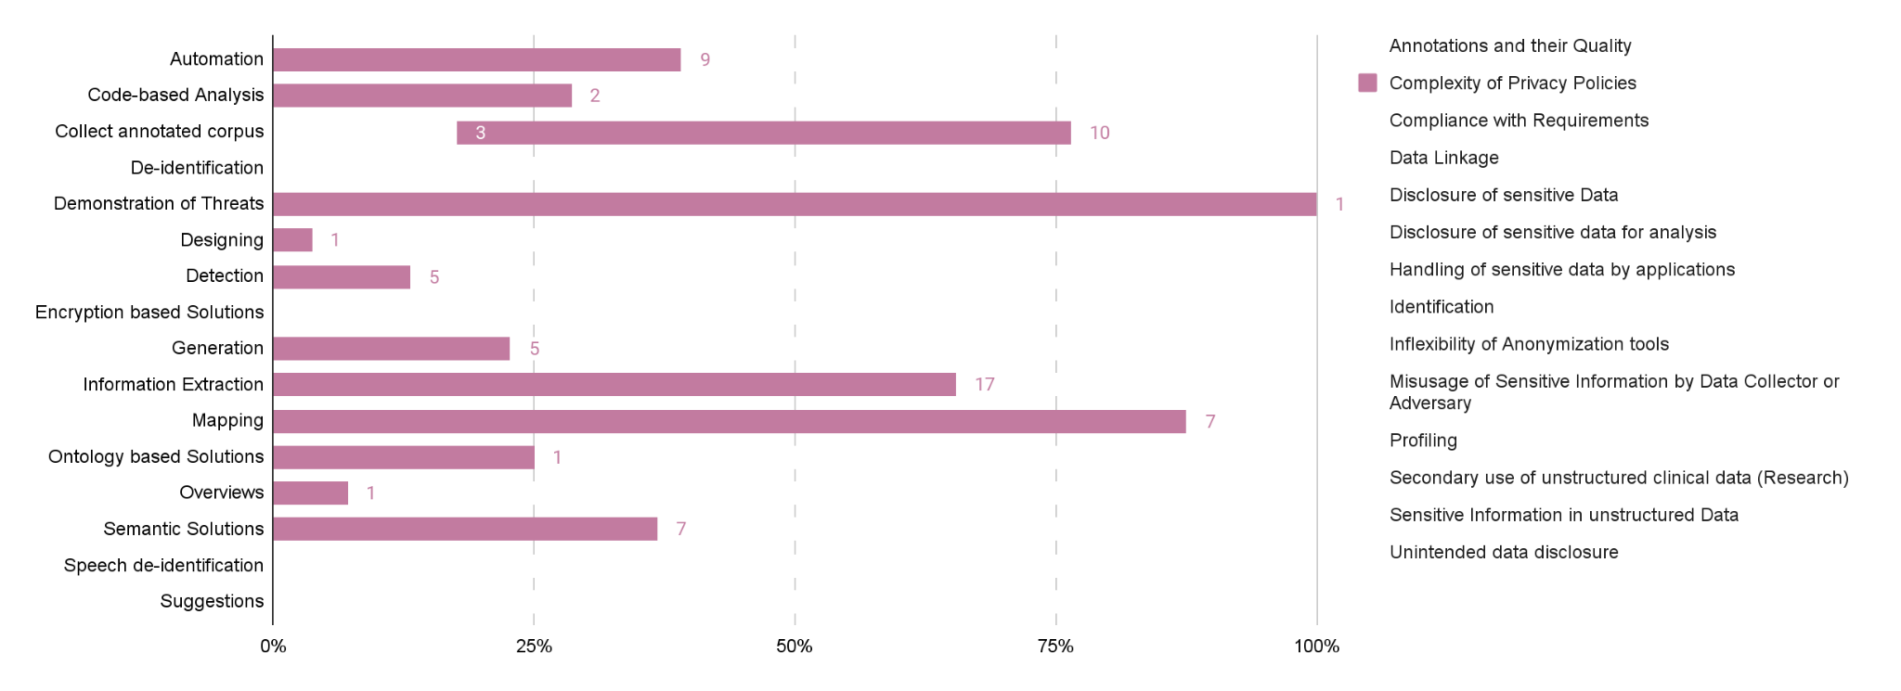
Key Findings - RQ2 - NLP as Privacy Enabler – Privacy Issues → Solutions

Slide 35
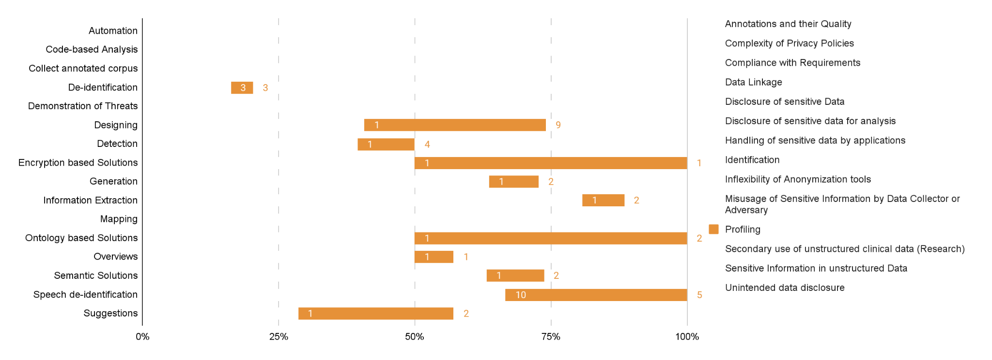
Key Findings - RQ2 - NLP as Privacy Enabler – Privacy Issues → Solutions

Slide 36
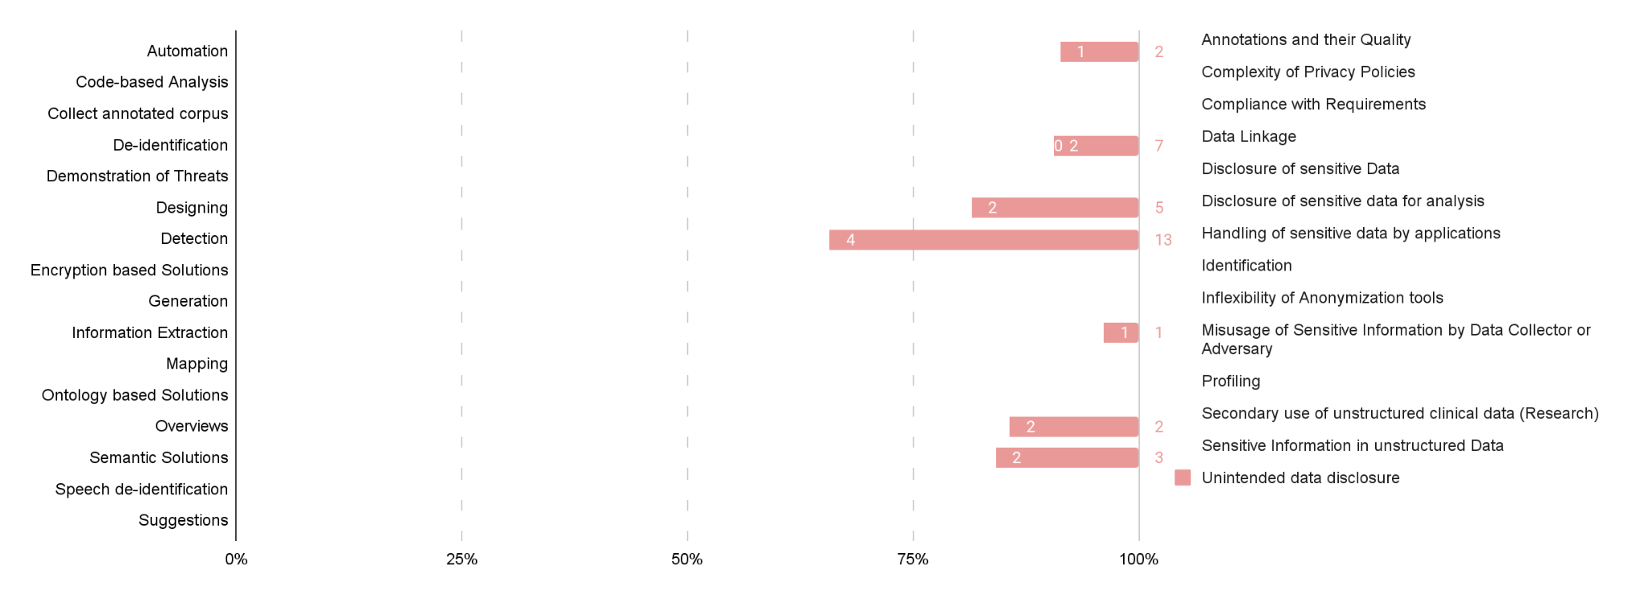
Key Findings - RQ2 - NLP as Privacy Enabler – Privacy Issues → Solutions

Slide 37
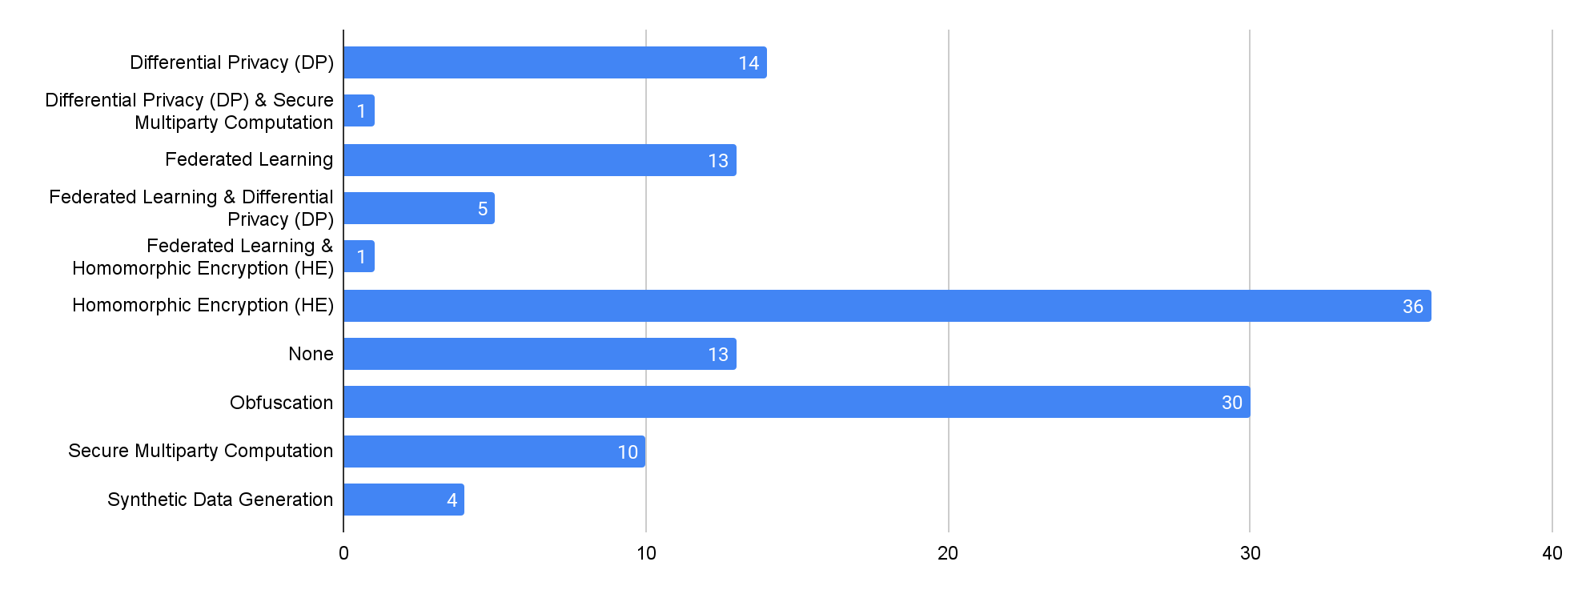
Key Findings - RQ2 - NLP as Privacy Threat – Mapping Results
Notes:
Search query through data bases.

Slide 38
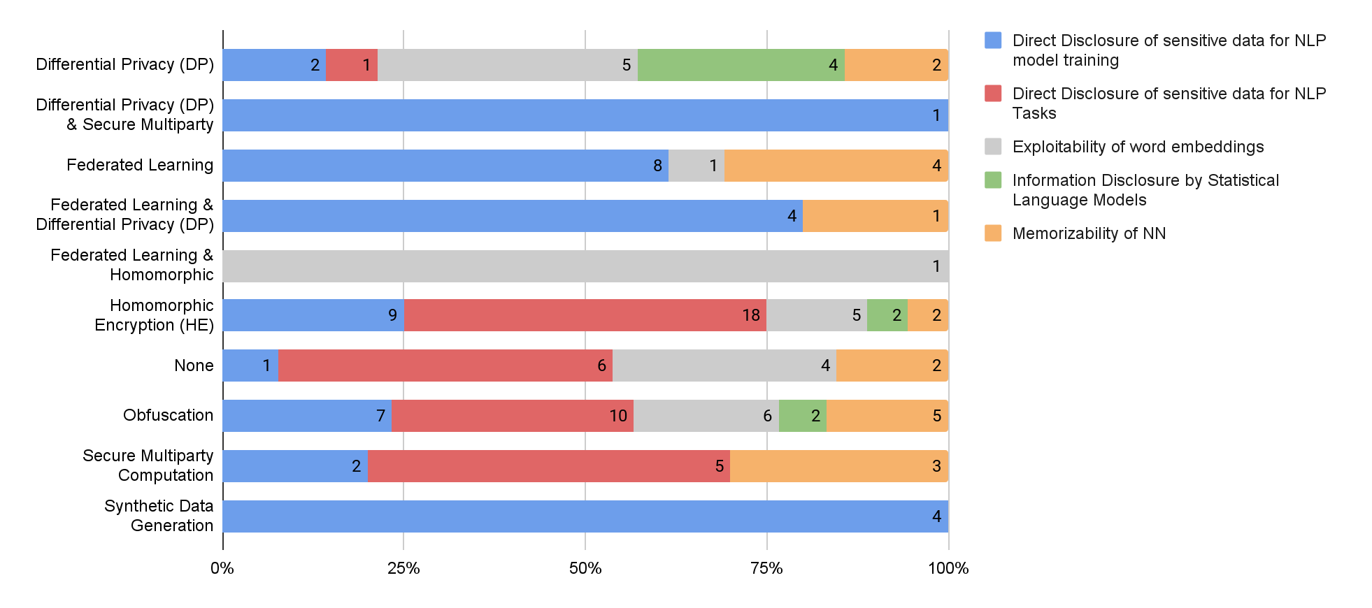
Key Findings - RQ2 - NLP as Privacy Threat – Privacy Threats → PET
Notes:
Search query through data bases.

Slide 39
Key Findings - RQ2 - NLP as Privacy Threat – Privacy Threats → PET
Notes:
Search query through data bases.

Slide 40
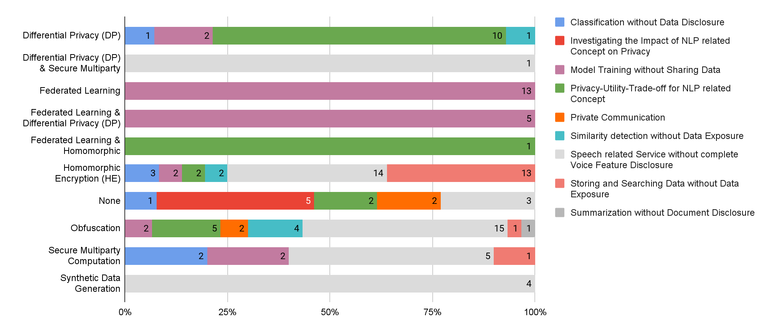
Key Findings - RQ2 - NLP as Privacy Threat – Use Case → PET

Slide 41
Key Findings - RQ2 - NLP as Privacy Threat – Use Case → PET

Slide 42
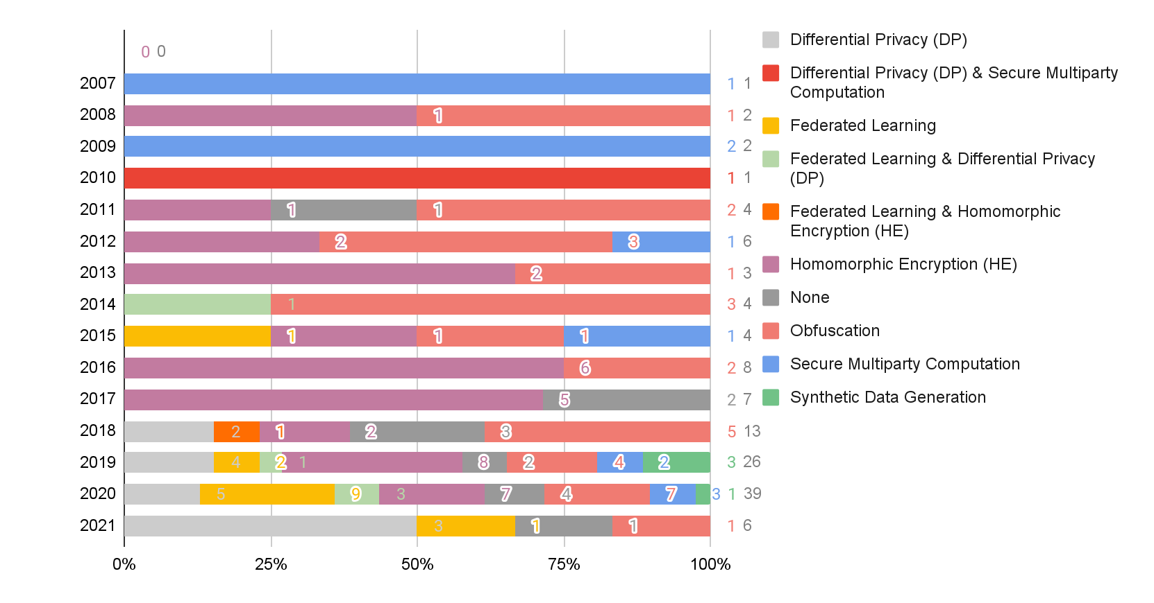
Key Findings - RQ2 - NLP as Privacy Threat – Development
1
1
2
1
2
1
1
3
1
2
2
5
3
3
1
1

Slide 43
Key Findings - RQ2 - NLP as Privacy Threat – Development
5
3
3
1

Slide 44
Key Findings - RQ2 - Result Summary
NLP as a Privacy Enabler:
  Most frequently applied Privacy Issue Solution:
    De-identification
    Detection
  High diversity of solution approaches towards complexity of privacy policies
  De-identification addressing most of the identified privacy issues
  All solution approaches involve neural networks, still the focus is statistical
  High focus on semantic and morphological level

Slide 45
Key Findings - RQ2 - Result Summary
NLP as a Privacy Threat:
  Most frequently applied PETs:
    Homomorphic Encryption
    Obfuscation
    Differential Privacy
  Differential Privacy, Homomorphic Encryption and Obfuscation applied on all discovered privacy issue categories → Universality
  Increased diversity and amount of publications between 2018 and 2020

Slide 46
Key Findings - RQ3 - NLP as Privacy Enabler
Applied NLP Method type mostly based on Statistical Approaches
→ NN Approaches requiring less training data¹ but still achieving a reasonable model performance OR focusing more on synthetic data generation
High Diversity of terms for unstructured clinical data
→ Universal catalogue in order to avoid repetitive research
Pinpoint the privacy issues addressed by future papers to evaluate papers easier
→ an example classification of privacy threats given by Boukharrou²
¹[Fey19] Feyisetan, Oluwaseyi, et al. "Privacy-preserving active learning on sensitive data for user intent classification.
²[Bouk20] Boukharrou, Radja, Ahmed-Chawki Chaouche, and Khaoula Mahdjar: Toward a Privacy Guard for Cloud-Based Home Assistants and IoT Devices.
Notes:
address correctly, pinpoint the privacy issues addressed by future papers to evaluate papers easier
In zukunft wäre es gut, wenn paper genau die privacy issues adressieren, die sie lösen

Slide 47
Key Findings - RQ3 - NLP as Privacy Threat
Thorough addressing of privacy consequences within papers
→ Illustrating potential scenarios for better comprehension
Intensifying the inclusion of PP NLP in daily life (e.g. business)
→ Move PP NLP out of the lab

Slide 48
Conclusion, Limitations and Future Work
Conclusion
Collected relevant papers for the research field PP NLP from selected electronic data sources
Classified privacy related challenges, their solutions and use case categories they appear in for NLP as a Privacy Enabler and Privacy Threat
Limitations
Around 10 percent out of the filtered papers were considered within the mapping study
Lack of a few important papers (Published after the study)
Future Work
Survey on which tools are applied for particular privacy related challenges and their solutions
Create a graphical overview indicating the maturity of solutions for privacy related issues
Mapped the discovered classifications among each other to identify patterns
Notes:
Sei auf frage gefasst bzgl. der maturity!

Slide 49
    Thanks for your attention!

Slide 50
    Backup Slides

Slide 51
Recap: Methodology – Systematic Mapping Study - Search Terms
Natural Language Understanding
Natural Language Generation
Text
Automatic Summarization
Machine Translation
Privacy Guaranteeing
Word Embeddings
Question Answering
Private
Privacy Preserving
Natural Language Processing
NLP
Privacy Enhancing
Speech Recognition
Text-to-Speech
Speech
Speech Segmentation
Notes:
Search query through data bases.

Slide 52
Current Results – Inclusion / Exclusion Criteria
Inclusion | Exclusion
The appearance of terms closely related to privacy preservation and NLP in the title or the abstract | Lack of privacy in the title or abstract
Privacy and Natural Language Processing or related terms appear in the keyword section | Lack of Natural Language Processing or its sub-domains in the title or abstract
Generation of speech or text synthetically | Conference or workshop summary, content list, chapter overview, books or patents
Processing of any privacy regulating document | Restricted access to the content
 | Any topics related to steganography
 | Insecure access to the paper
 | Processing of Privacy Policies with crowdsourcing
 | Papers not written in English

Slide 53
Methodology – Systematic Mapping Study – Classification Scheme
Use Case
Annotations and Training Data
Automation
Browsing in a private manner
Definition of Privacy Requirements
Simplification of privacy related regulations
Investigations
Measuring the Compliance of apps
Mining according to privacy policies
Increase Attention towards Privacy Policies
Privacy Preserving Information Sharing
Protecting sensitive information in unstructured data
Searching in a private manner
Voice related services
Notes:
Kann man das zusammen legen mit der statistik?

Slide 54
Methodology – Systematic Mapping Study – Classification Scheme
Privacy Issue
Annotations and their Quality
Complexity of Privacy Policies
Compliance with Requirements
Data Linkage
Disclosure of sensitive Data
Disclosure of sensitive data for analysis
Handling of sensitive data by applications
Identification
Inflexibility of Anonymization tools
Misusage of Sensitive Information by Data Collector or Adversary
Profiling
Secondary use of unstructured clinical data (Research)
Sensitive Information in unstructured Data
Unintended data disclosure
Notes:
Kann man das zusammen legen mit der statistik?

Slide 55
Methodology – Systematic Mapping Study – Classification Scheme
Privacy Solution
Automation
Code-based Analysis
Collect annotated corpus
De-identification
Demonstration of Threats
Designing
Detection
Encryption based Solutions
Generation
Information Extraction
Mapping
Ontology based Solutions
Overviews
Semantic Solutions
Speech de-identification
Suggestions
Notes:
Kann man das zusammen legen mit der statistik?

Slide 56
Methodology – Systematic Mapping Study – Classification Scheme
Use Case
Classification without Data Disclosure
Investigating the Impact of NLP related Concept on Privacy
Model Training without Sharing Data
Privacy-Utility-Trade-off for NLP related Concept
Private Communication
Similarity detection without Data Exposure
Speech related Service without complete Voice Feature Disclosure
Storing and Searching Data without Data Exposure
Summarization without Document Disclosure
Notes:
Kann man das zusammen legen mit der statistik?

Slide 57
Methodology – Systematic Mapping Study – Classification Scheme
Privacy Issues
Direct Disclosure of sensitive data for NLP model training
Direct Disclosure of sensitive data for NLP Tasks
Exploitability of word embeddings
Information Disclosure by Statistical Language Models
Memorizability of NN
Notes:
Kann man das zusammen legen mit der statistik?

Slide 58
Methodology – Systematic Mapping Study – Classification Scheme
PET
Differential Privacy (DP)
Federated Learning (FL)
Homomorphic Encryption (HE)
Obfuscation
Secure Multiparty Computation
Synthetic Data Generation
None
Notes:
Kann man das zusammen legen mit der statistik?

Slide 59
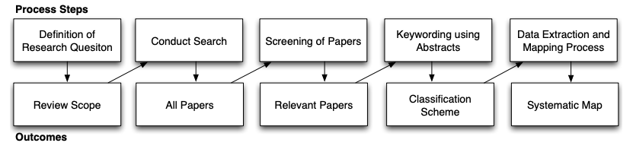
Methodology – Systematic Mapping Study - Results
Figure taken from [Pe08] Petersen, K., Feldt, R., Mujtaba, S., & Mattsson, M. (2008, June). Systematic mapping studies in software engineering. In 12th International Conference on Evaluation and Assessment in Software Engineering (EASE) 12 (pp. 1-10).
Notes:
Search query through data bases.

Slide 60
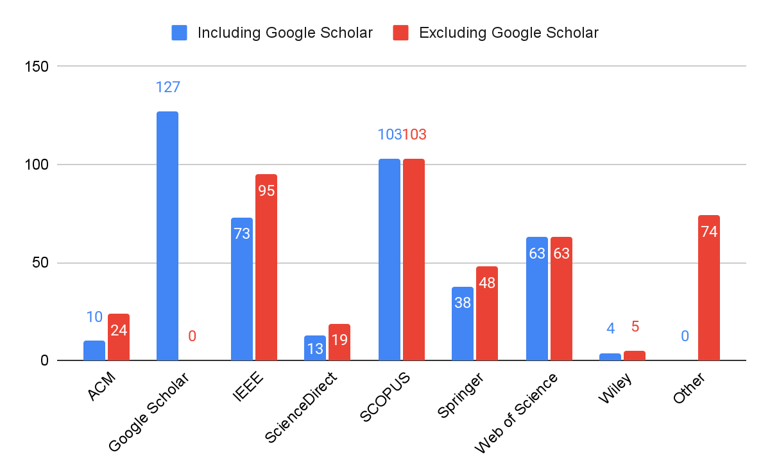
Key Findings – Electronic Data Source Contributions
Notes:
Search query through data bases.

Slide 61
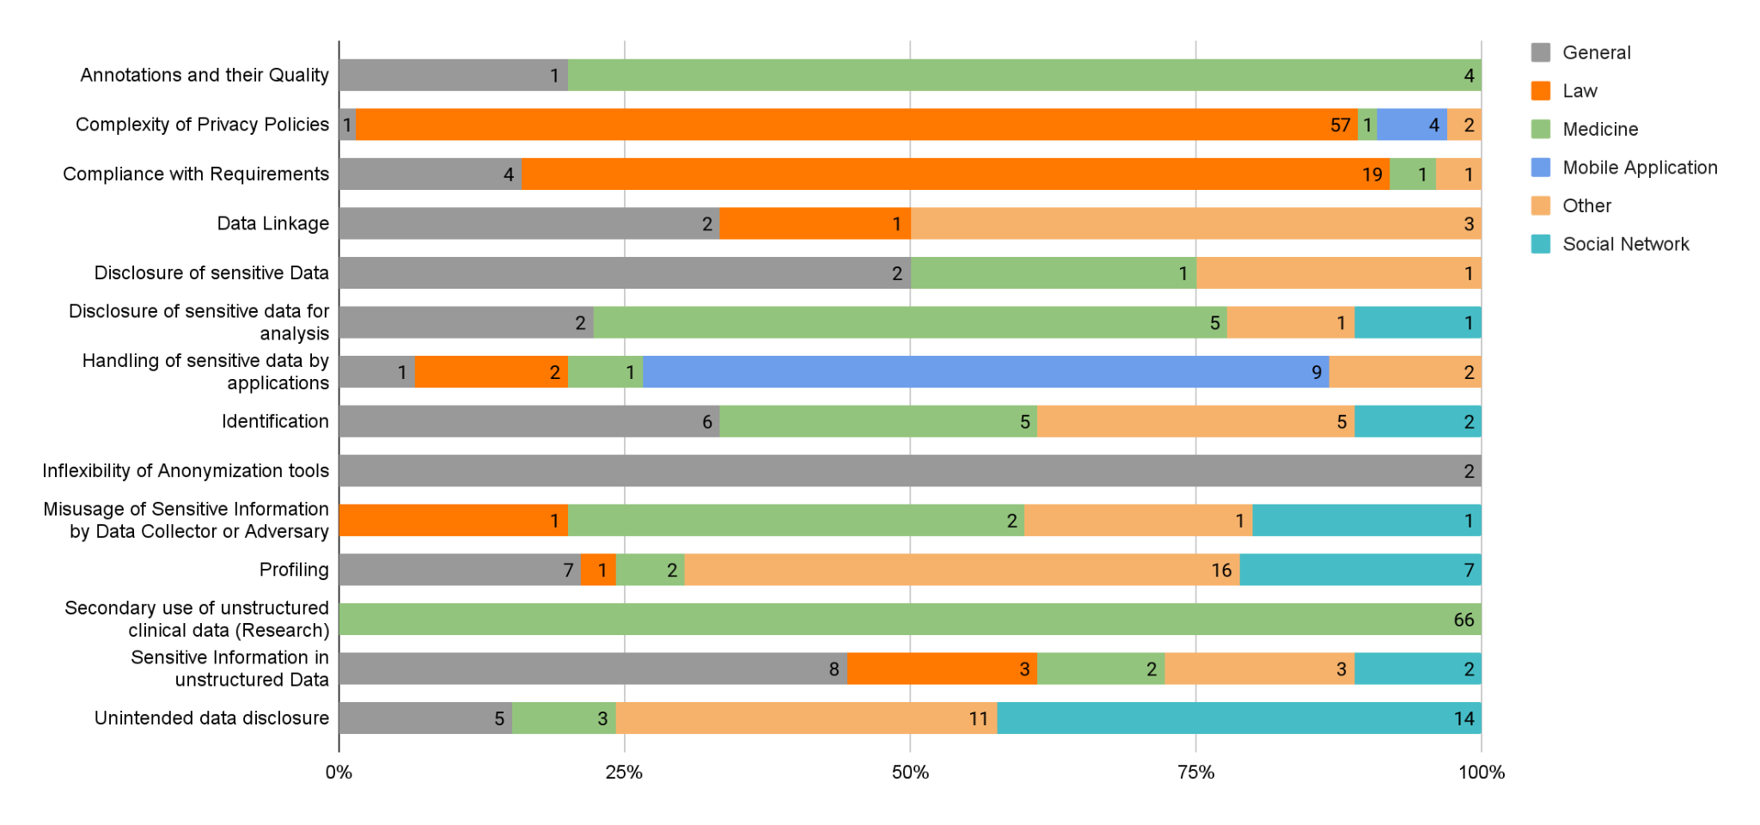
Key Findings - RQ1 - NLP as Privacy Enabler
Notes:
Search query through data bases.

Slide 62
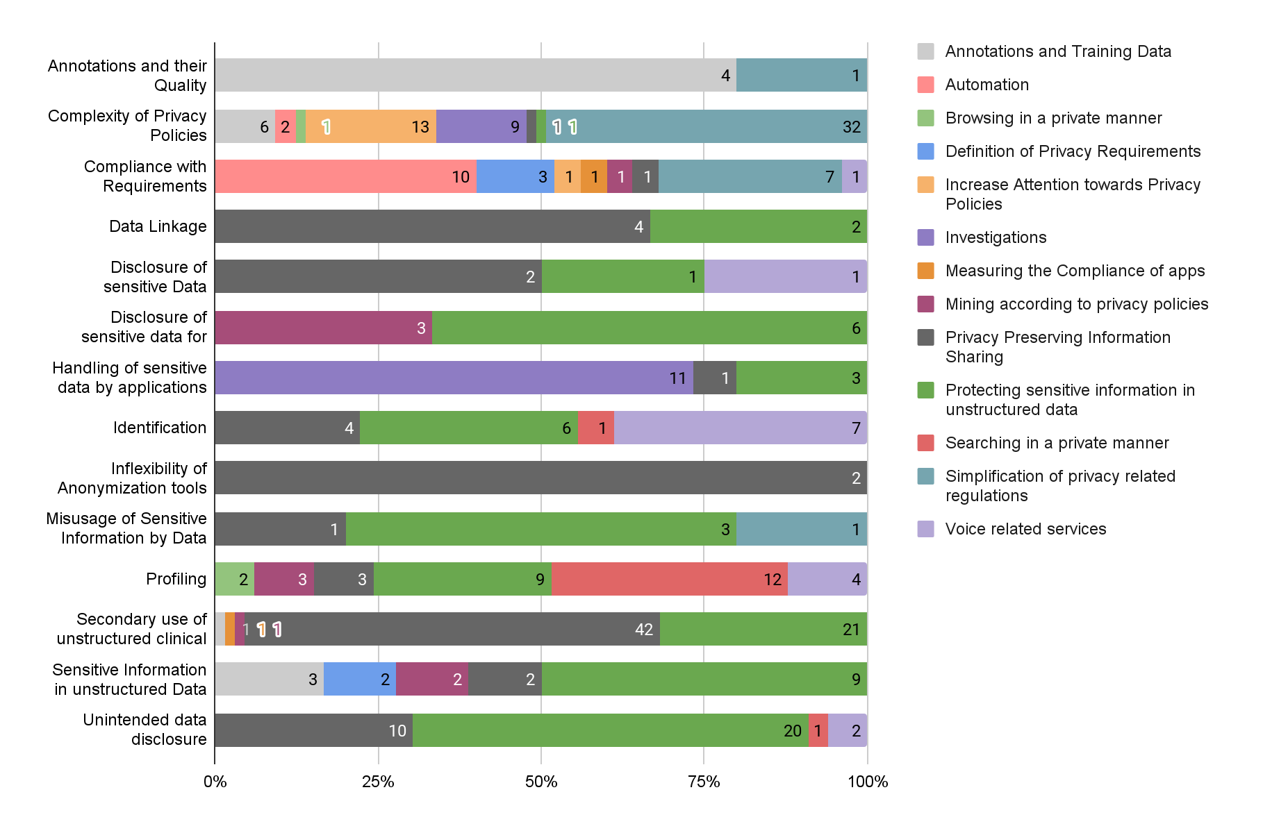
Key Findings - RQ1 - NLP as Privacy Enabler - Mapping Use Cases on Privacy Issues
Notes:
Search query through data bases.

Slide 63
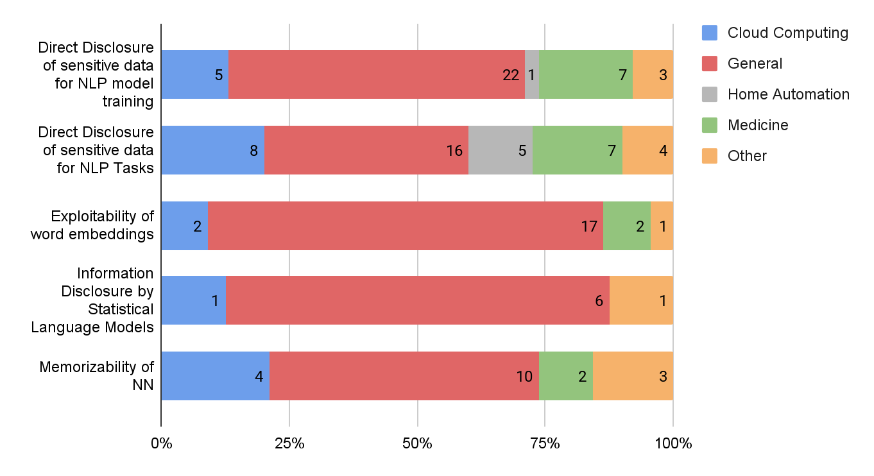
Key Findings - RQ1 - NLP as Privacy Threat
Notes:
Search query through data bases.

Slide 64
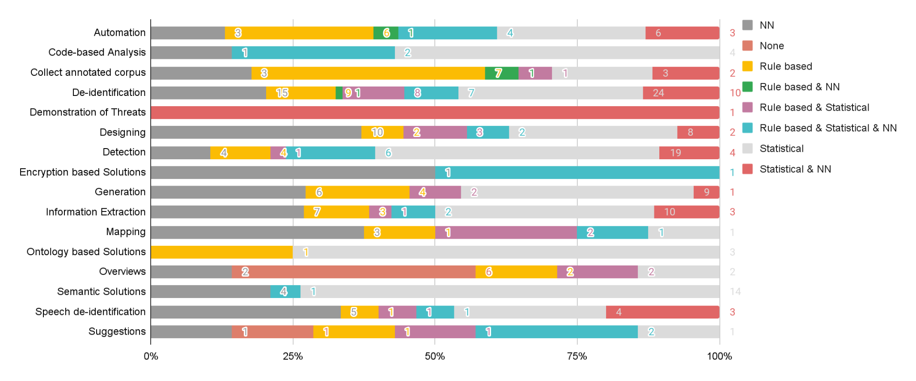
Key Findings - RQ2 - NLP as Privacy Enabler
Notes:
Grafik schöner darstellen!

Slide 65
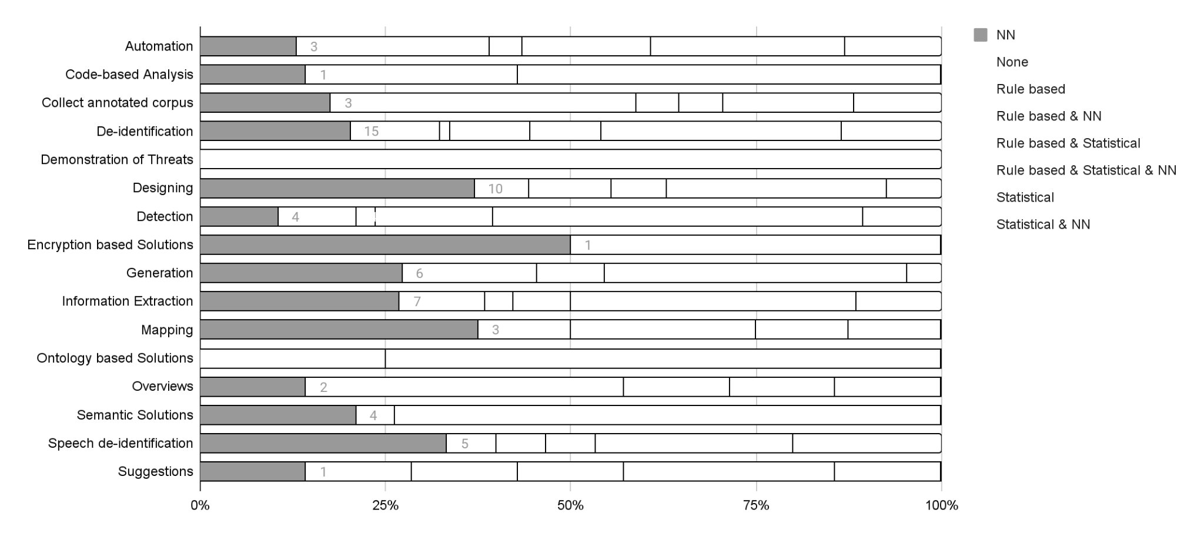
Key Findings - RQ2 - NLP as Privacy Enabler
Notes:
Grafik schöner darstellen!

Slide 66
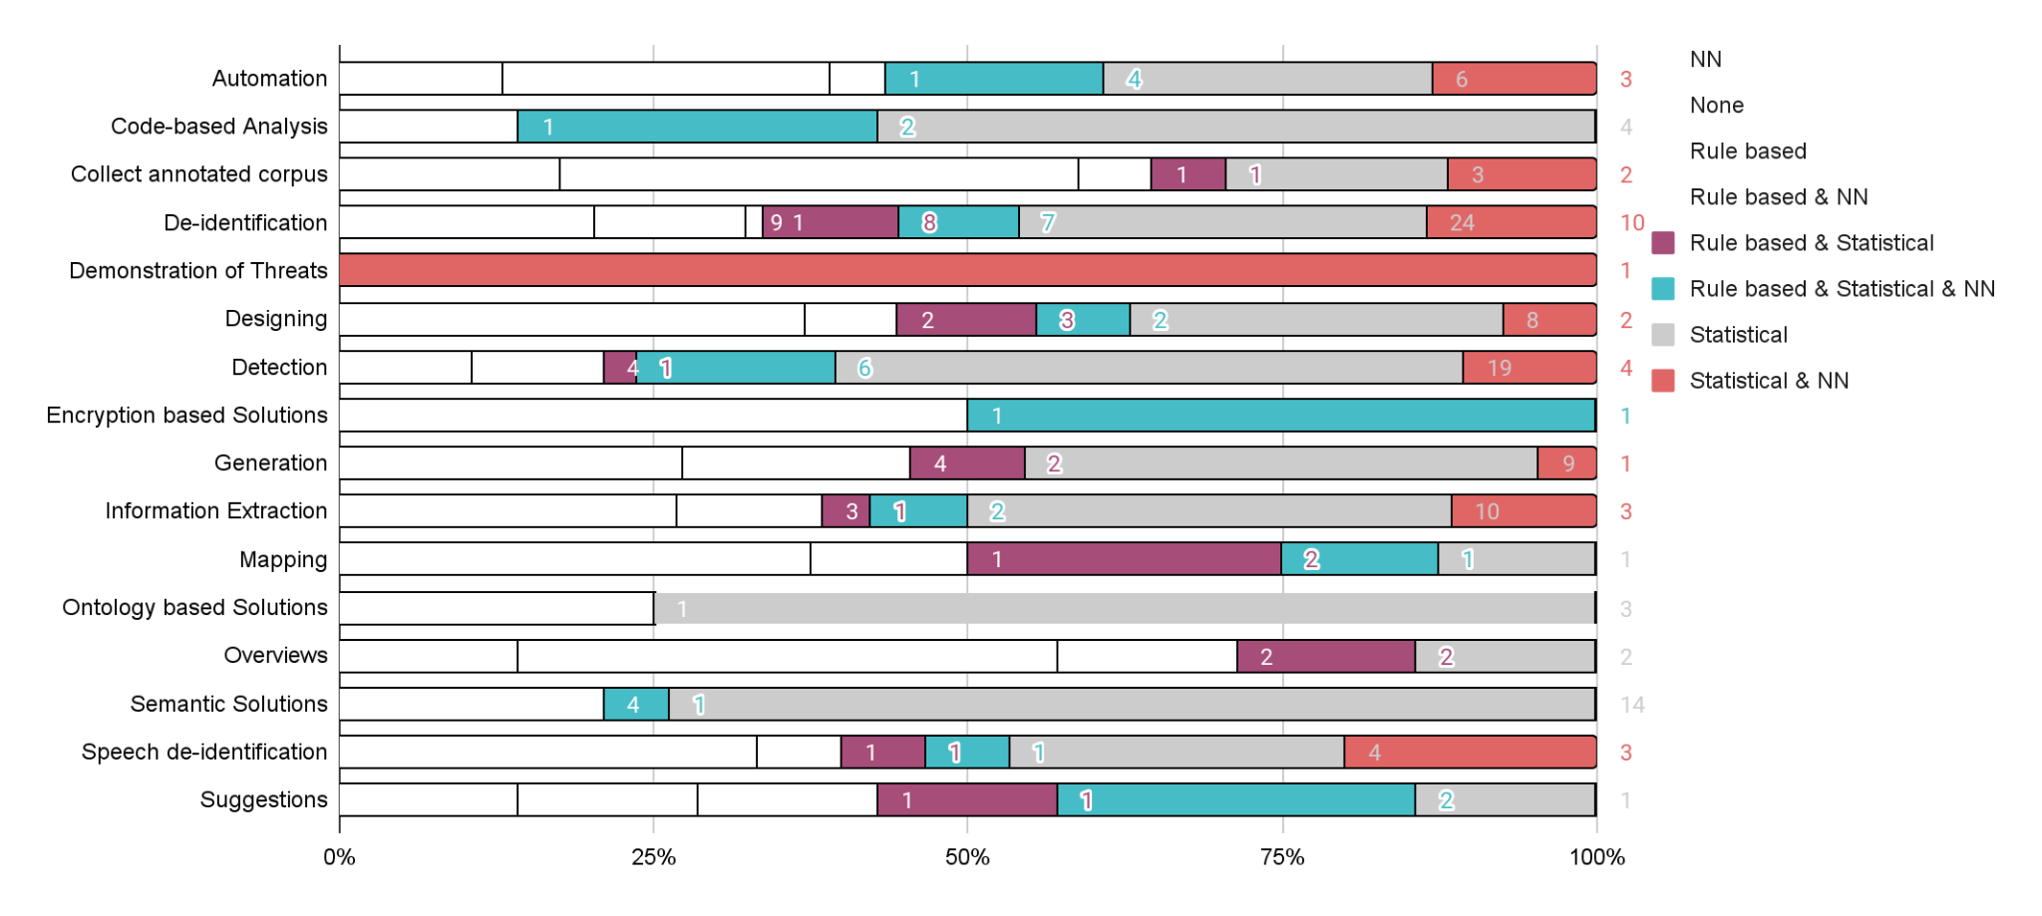
Key Findings - RQ2 - NLP as Privacy Enabler
Notes:
Grafik schöner darstellen!

Slide 67
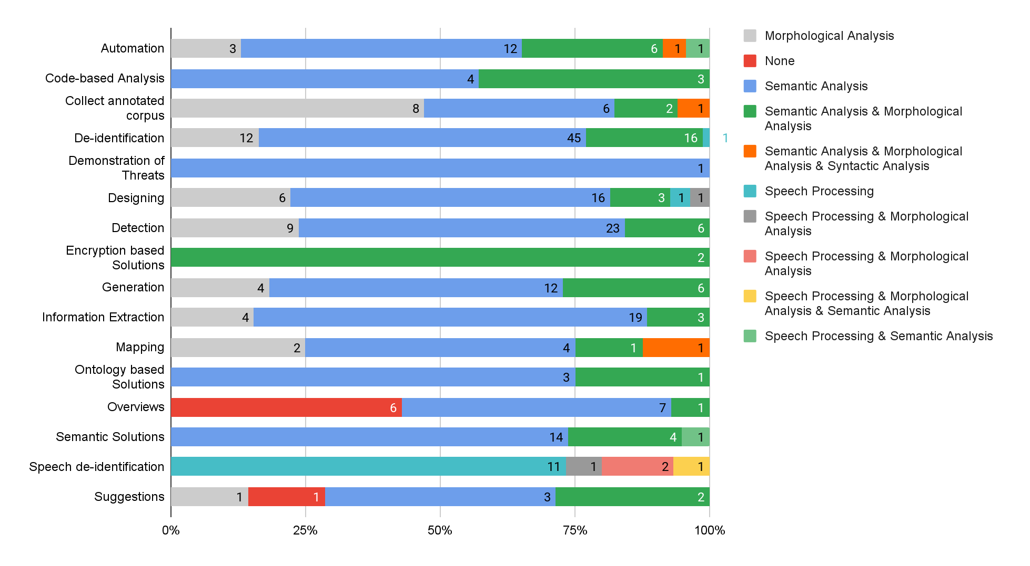
Key Findings - RQ2 - NLP as Privacy Enabler
Notes:
Search query through data bases.

Slide 68
Quality of Papers
Implying that the quality of papers is given by the consultation of electronic data sources incorporating high quality standards
Selection of electronic data sources according to Chen¹:
  IEEE Xplore (IEEE)
  ACM Digital Library (ACM)
  EI Compendex & Inspec (EI)
  ISI Web of Science (WoS)
  CiteSeer (CS)
  Google Scholar (GS)
  ScienceDirect (SD)
  SpringerLink (SL)
  Wiley InterScience (WIS)
  SCOPUS (SCOPUS)
  Kluwer Online (KO)
¹[Che10] Chen, Lianipng, Muhammad Ali Babar, and He Zhang: "Towards an evidence-based understanding of electronic data sources."
Notes:
Sei auf frage gefasst bzgl. der maturity!

Slide 69
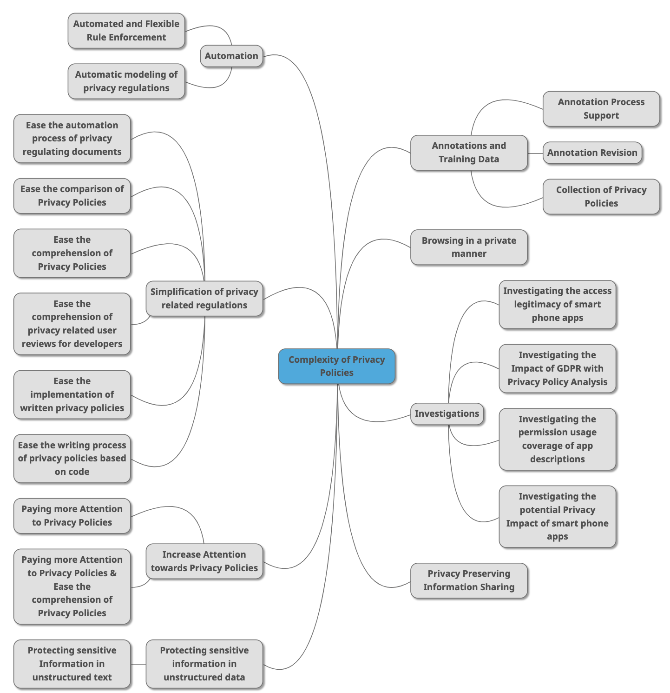

Slide 70
Use the sebis visual language
(shapes, fonts, colors, sizes)
Default
Line Style
Default Rectangle
Default
Rounded R.
Text
Default
Text
User
Store
Information
Arrow
Cloud
Process
Box
Explanation
Fast
Form 1
Fast
Form 2
Fast
Form 3
Fast
Form 4
Fast
Form 5
Fast
Form 6
Fast
Form 6
Fast
Form 1
Fast
Form 2
Fast
Form 3
Fast
Form 4
Fast
Form 5
Fast
Form 6
Fast
Form 6

