Slide 1
Supporting Nonexperts in Choosing Appropriate Privacy-Enhancing Technologies
Mohammad Faisal Bin Ahmed, 15/03/2021, Kick-off Presentation

Slide 2
Outline
Motivation
Background
Potential Scenario
Privacy-enhancing technologies
Methodology
Research Questions
Expected Outcome
Current Progress
Literature searching and classification
Classification automated
Findings and future work
Initial findings
Next steps and timeline

Slide 3




Why privacy enhancing is important
Ever-increasing demand for ensuring privacy
More data getting collected and analyzed
Government regulations
Creating business value while maintaining privacy.
Notes:
Privacy in general
Ever increasing amount of data, collected, analysed
Create business value, facilitate research
GDPR regulations
Need pet that allows to derive value without compromise
This is why pet is important.

Slide 4








Different Privacy-Enhancing Technology
Federated Learning
Differential Privacy
Homomorphic encryption
Zero-knowledge proof
Secure multi-party computation
Pseudonymization
Obfuscation
Random data generation

Slide 5



Motivation
So many privacy-enhancing technologies…
Easy to get overwhelmed when choosing
A guideline to solve this dilemma

Slide 6
Potential scenario
Felix is a tech lead at a VoD start-up in Munich. He wants some analytics to improve their performance, but he can’t send the data to a third-party analytics firm without ensuring proper privacy preserving first. The data they collect includes name, age, UUID, watch history, device info, and payment info. What type of privacy-enhancing technology should Felix use to ensure the privacy of the data subjects is not violated during the analysis?
Concerns: user privacy, potentially malicious analytics firm, data breach during transit or rest, GDPR violation.
Solution 1: spending countless hours to research all the different privacy-enhancing technologies and their pros and cons.
Solution 2: using this systematic research as a guidebook and answering a few question to get a suitable privacy-enhancing technology for his scenario. In this case Homomorphic Encryption!

Slide 7
Research Questions
What are the state-of-the-art privacy-enhancing technology and their distinct characteristics?
1
What are the different scenarios where privacy enhancement is required and their
corresponding basic requirements?
2
How to guide the decision-making process to allow diverse stakeholders make informed
decisions about the use of an appropriate privacy-enhancing technology?
3

Slide 8
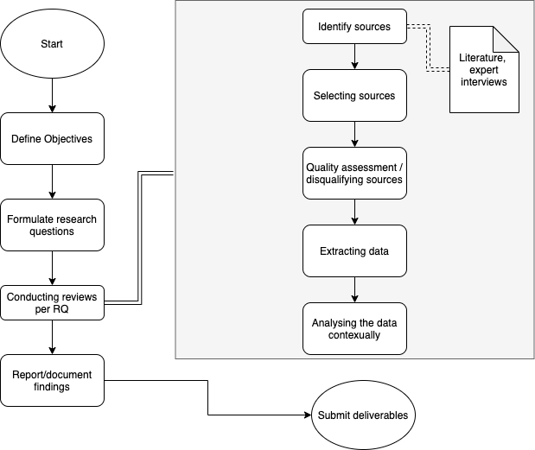
Methodology/Protocol

Slide 9
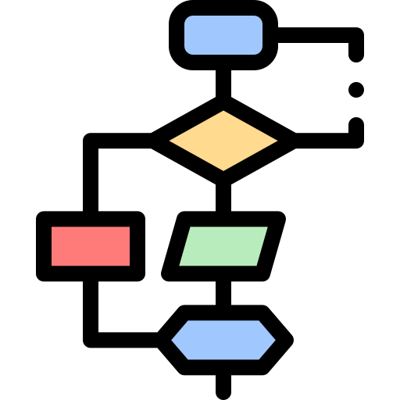

Expected Outcomes
A Decision making system
A web app
implementation

Slide 10
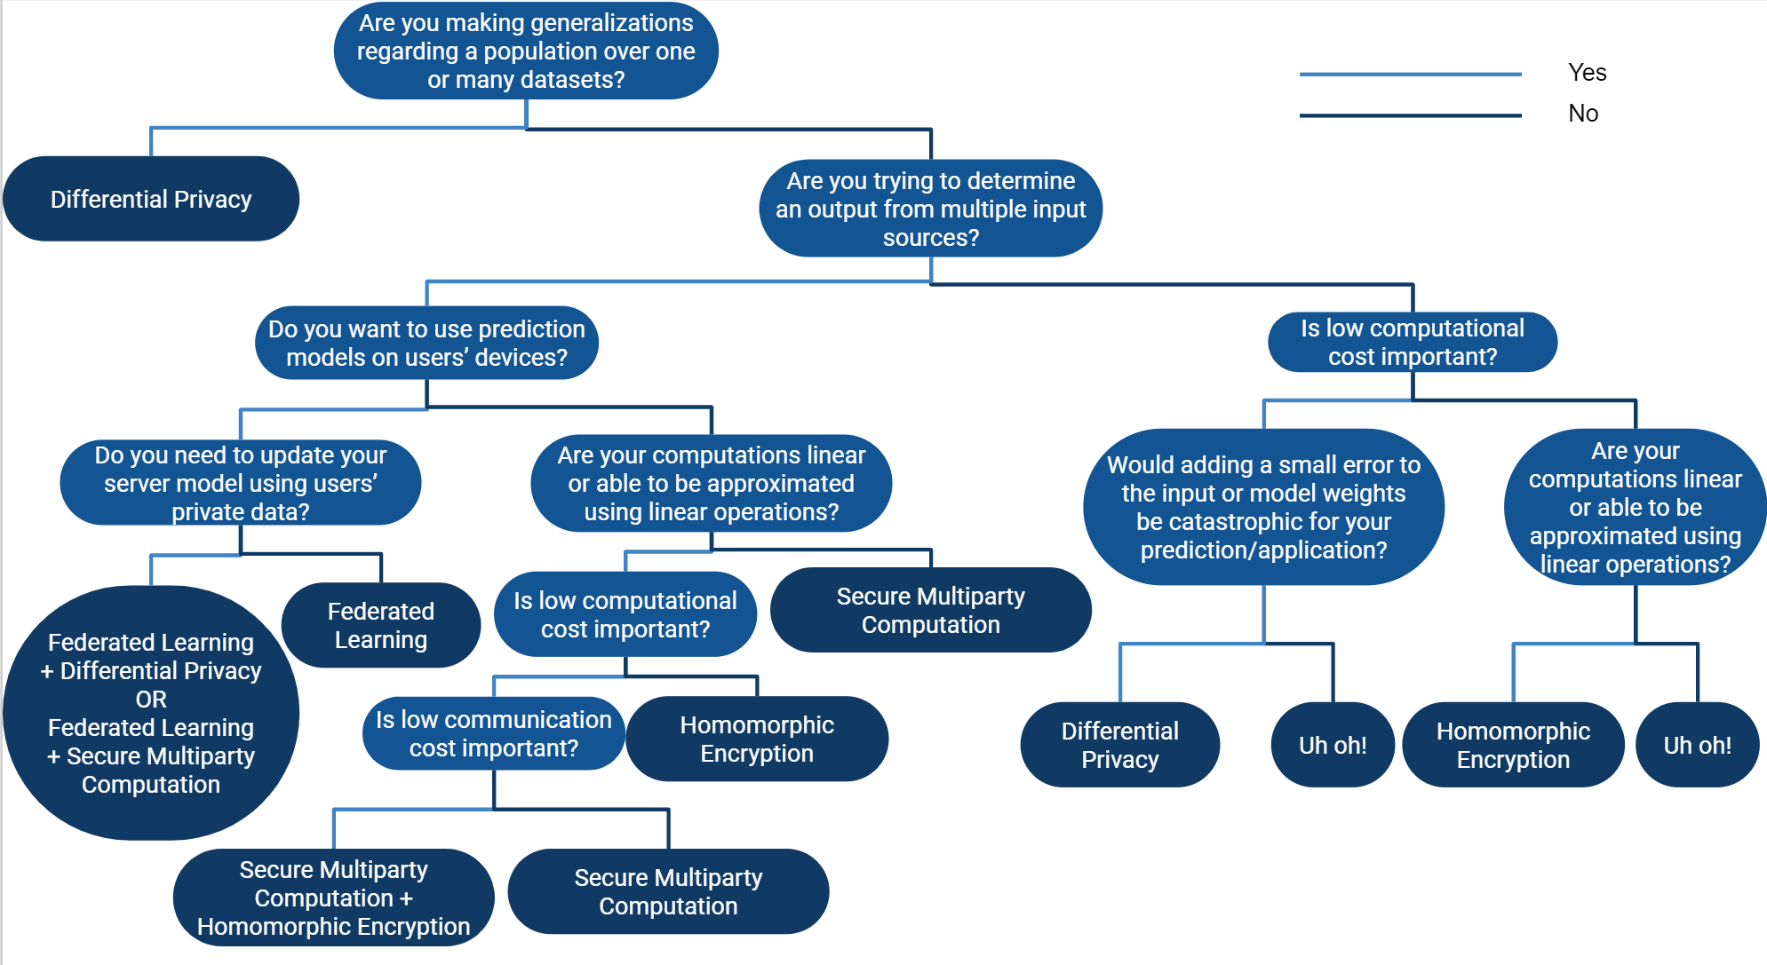
Inspirational decision tree
Image courtesy of Patricia Thaine

Slide 11
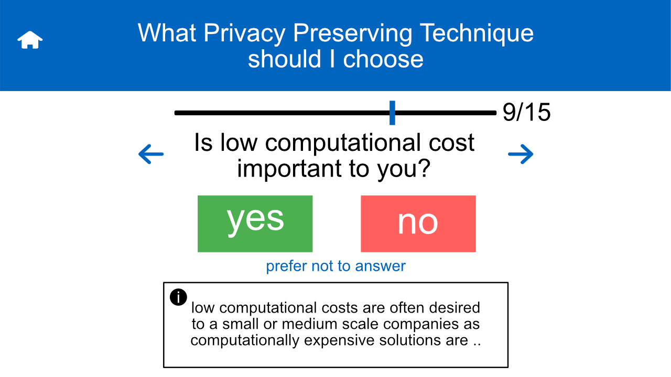
Mockups

Slide 12
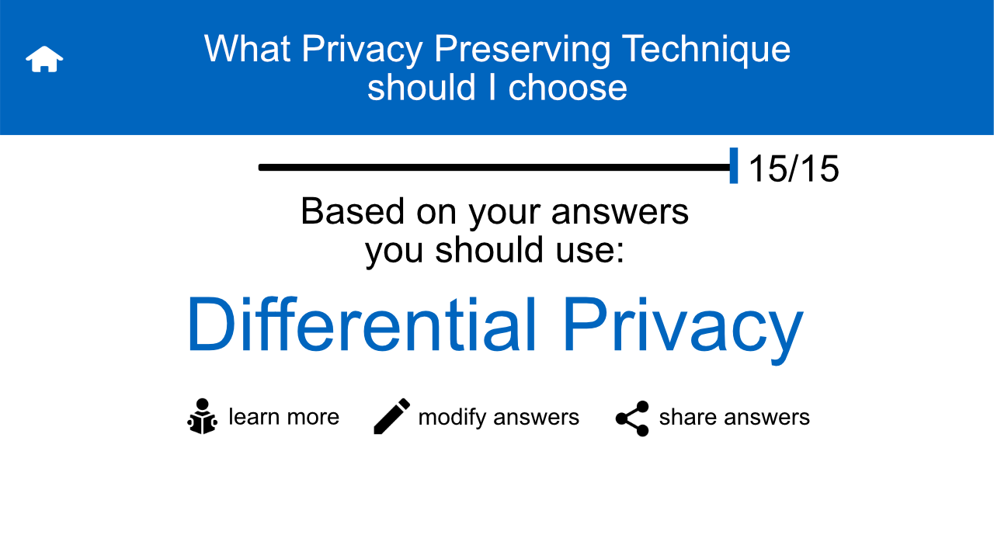
Mockups

Slide 13
Current Progress

Slide 14
Literature searching & classification 1
Identify initial literatures
Searching generic keywords like: "privacy", "privacy preserving", & "privacy enhancing"
Extracting relevant Keywords
Using SketchEngine to identify search keywords (top 30)
Excluding keywords specific to a particular PET
(12 final search queries)
Conducting Secondary search
Exclusion criteria: papers older than 15 years old.
Removing duplicates
(3176 total papers)
Filtering
Initially manual filtering
Automatic filtering based on keyword matching
Final List of papers
466 papers after initial results
664 papers after manually adding new keywords
807 papers

Slide 15
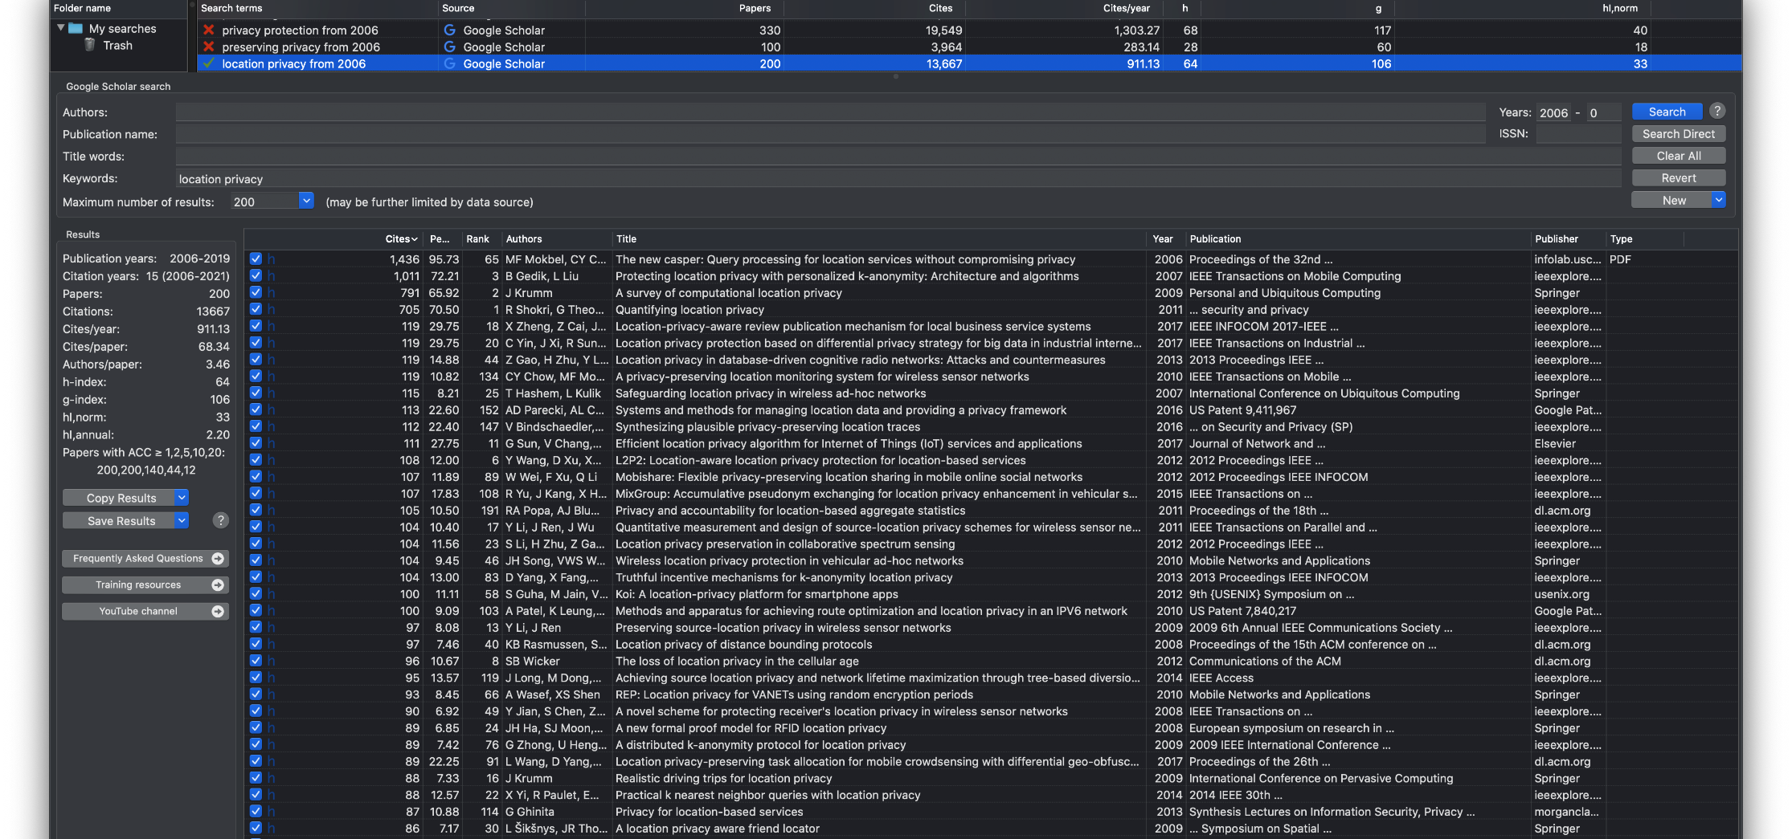
Tools for searching: Publish or Perish
A literature searching tool.
Sources include Google Scholar and CrossRef.
Results can be exported to CSV or JSON.

Slide 16
Literature searching & classification 2
Identify initial literatures
Searching generic keywords like: "privacy", "privacy preserving", & "privacy enhancing"
Extracting relevant Keywords
Using SketchEngine to identify search keywords
Conducting Secondary search
Exclusion criteria: papers older than 15 years old.
Removing duplicates
(3176 total papers)
Filtering
Initially manual filtering
Automatic filtering based on keyword matching
Final List of papers
466 papers after initial results
664 papers after manually adding new keywords
Excluding keywords specific to a particular PET
Top 30 keywords extracted
12 final search queries

Slide 17
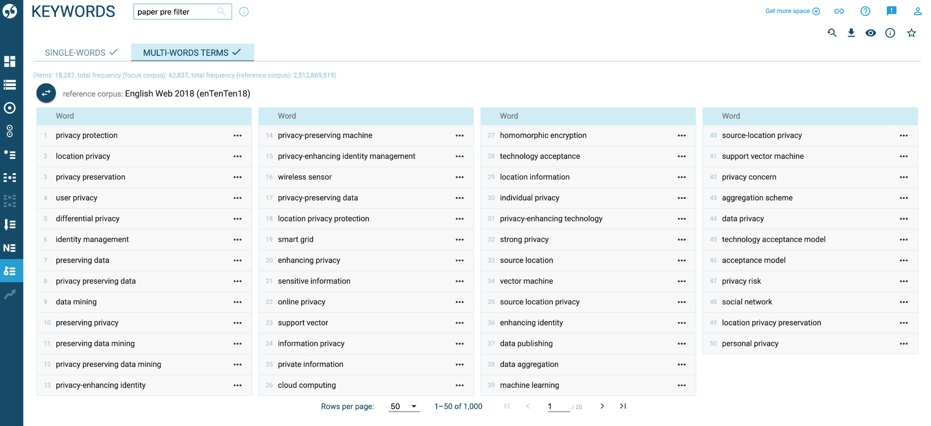
SketchEngine
A text analysis tool
Uses ML to generate corpuses from lists of texts
‘Keywords’ corpus is used to extract terminologies in this research

Slide 18
Literature searching & classification 3
Identify initial literatures
Searching generic keywords like: "privacy", "privacy preserving", & "privacy enhancing"
Extracting relevant Keywords
Using SketchEngine to identify search keywords
Conducting Secondary search
Exclusion criteria: papers older than 15 years old.
Removing duplicates
Filtering
Initially manual filtering
Automatic filtering based on keyword matching
Final List of papers
466 papers after initial results
664 papers after manually adding new keywords
Excluding keywords specific to a particular PET
3582 total papers after removing duplicates

Slide 19
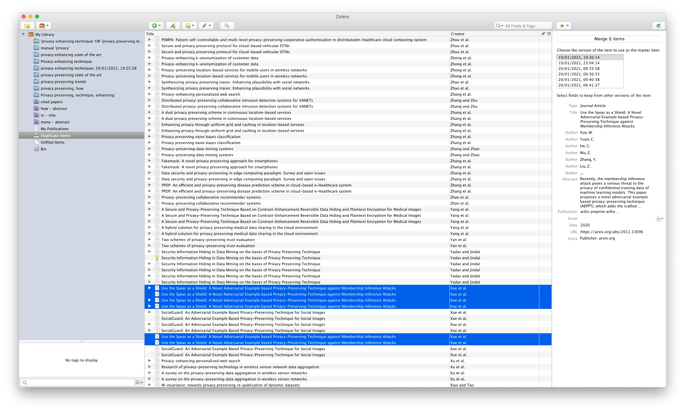
Literature management: Zotero and Excel
Zotero is used for record keeping
Can also be used to merge papers and remove duplicates

Slide 20
Literature searching & classification 4
Identify initial literatures
Searching generic keywords like: "privacy", "privacy preserving", & "privacy enhancing"
Extracting relevant Keywords
Using SketchEngine to identify search keywords from titles and abstracts
Conducting Secondary search
Exclusion criteria: papers older than 15 years old.
Removing duplicates
Classification
Initially manual classification
Automatic classification based on keyword matching
Final List of papers
466 papers after initial results
664 papers after manually adding new keywords
Excluding keywords specific to a particular PET
3176 total papers after initial manual classification
Notes:
At this point I realized this is going to take me a lot of time to filter, also errors

Slide 21
Classification Automated 1
1. Extracting keywords with SketchEngine
2. Create List of Words (PET)
3. Assign Keyword(s) to each paper
Match a paper's title and abstract with the List of Words.
Identify PET keywords (including different grammatical variants)
Using titles and abstracts
4. Manual Keyword searching
5. Repeat steps 2-4 until all papers are scanned
Search unassigned papers manually to extract new PET keywords
Assign PET keywords if matched
“Anonymization”
“Randomization”
“K-anonymity”
Manually searching through 2000 single & multiword keywords
“Obfuscation”
“Zero knowledge”
…

Slide 22
Classification Automated 2
1. Extracting keywords with SketchEngine
2. Create List of Words (PET)
3. Assign Keyword(s) to each paper
Match a paper's title and abstract with the List of Words.
Identify PET keywords (including different grammatical variants)
Using titles and abstracts
4. Manual Keyword searching
5. Repeat steps 2-4 until all papers are scanned
Search unassigned papers manually to extract new PET keywords
Assign PET keywords if matched
“Anonymization”
“Randomization”
“K-anonymity”
Manually searching through 2000 single & multiword keywords
“Obfuscation”
“Zero knowledge”
…

Slide 23
Classification Automated 3
1. Extracting keywords with SketchEngine
2. Create List of Words (PET)
3. Assign Keyword(s) to each paper
Match a paper's title and abstract with the List of Words.
Identify PET keywords (including different grammatical variants)
Using titles and abstracts
4. Manual Keyword searching
5. Repeat steps 2-4 until all papers are scanned
Search unassigned papers manually to extract new PET keywords
Assign PET keywords if matched
“Anonymization”
“Randomization”
“K-anonymity”
Manually searching through 2000 single & multiword keywords
“Obfuscation”
“Zero knowledge”
…

Slide 24
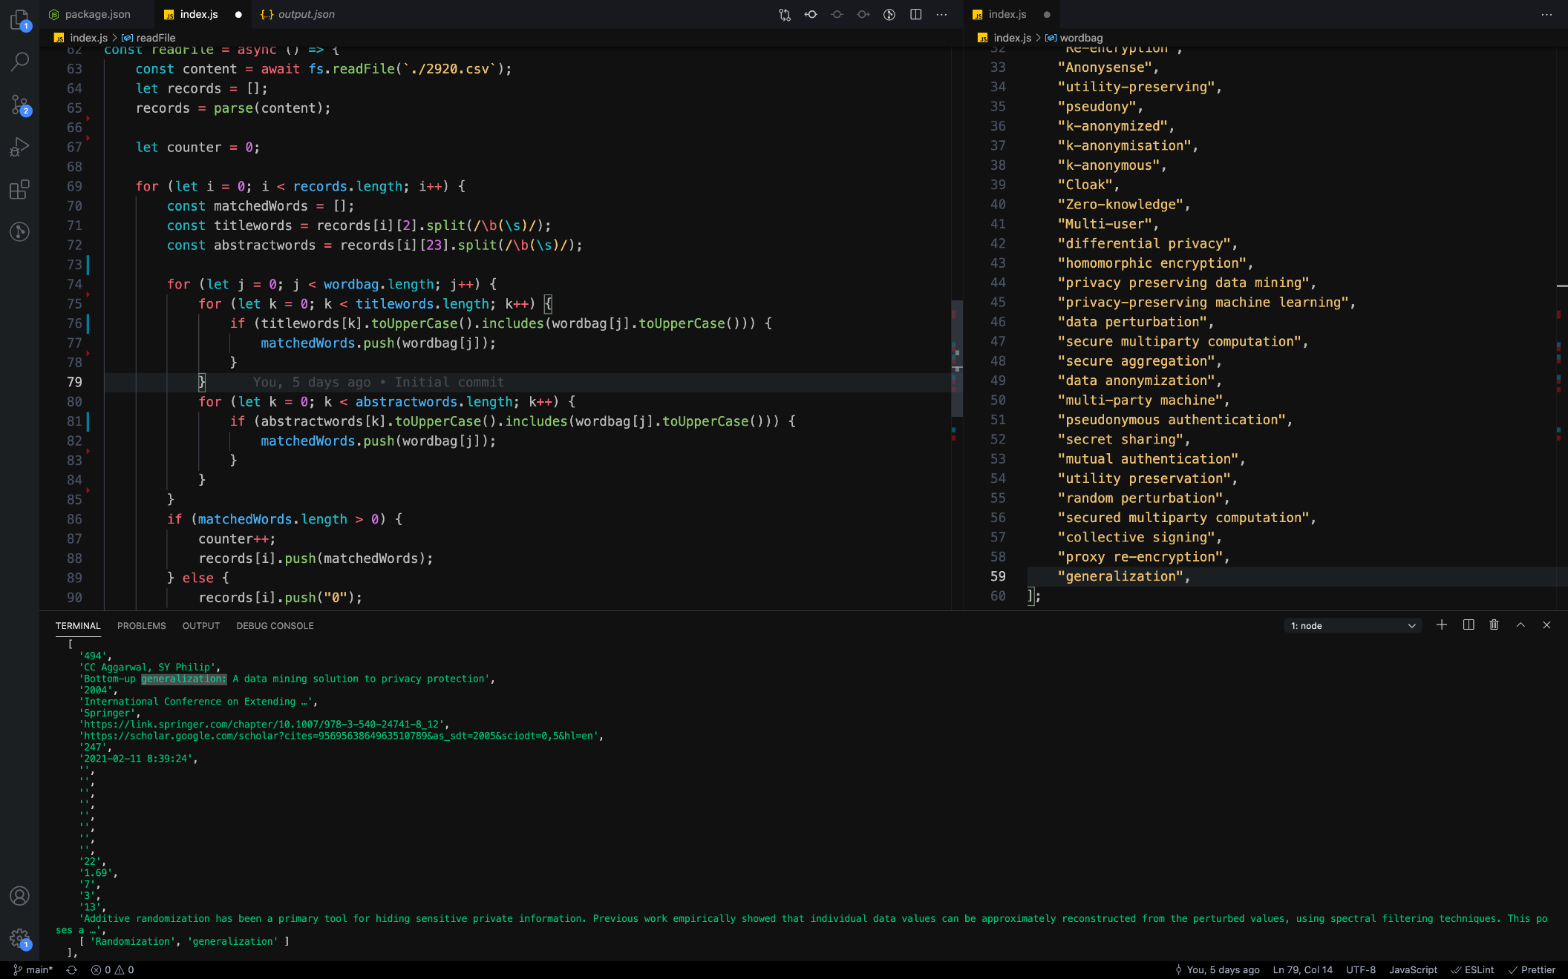
Assigning keywords
Parses and creates CSV files
Uses character matching to assign new keywords

Slide 25
Classification Automated 4
1. Extracting keywords with SketchEngine
2. Create List of Words (PET)
3. Assign Keyword(s) to each paper
Match a paper's title and abstract with the List of Words.
Identify PET keywords (including different grammatical variants)
Using titles and abstracts
4. Manual Keyword searching
5. Repeat steps 2-4 until all papers are scanned
Search unassigned papers manually to extract new PET keywords
Assign PET keywords if matched
“Anonymization”
“Randomization”
“K-anonymity”
Manually searching through 2000 single & multiword keywords
“Obfuscation”
“Zero knowledge”
…

Slide 26
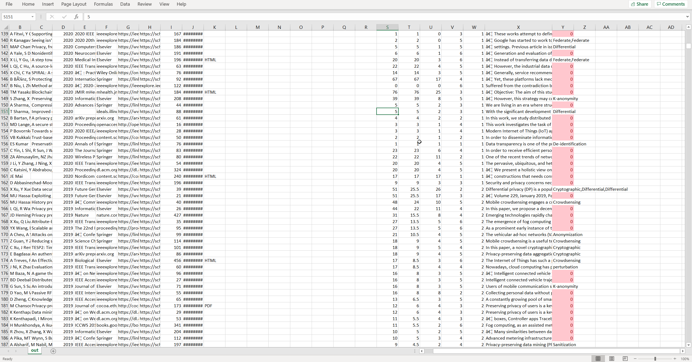
Manually finding keywords

Slide 27
Classification Automated 5
1. Extracting keywords with SketchEngine
2. Create List of Words (PET)
3. Assign Keyword(s) to each paper
Match a paper's title and abstract with the List of Words.
Identify PET keywords (including different grammatical variants)
Using titles and abstracts
4. Manual Keyword searching
5. Repeat steps 2-4 until all papers are scanned
Search unassigned papers manually to extract new PET keywords
Assign PET keywords if matched
“Anonymization”
“Randomization”
“K-anonymity”
Manually searching through 2000 single & multiword keywords
“Obfuscation”
“Zero knowledge”
…

Slide 28
Literature searching & classification 5
Identify initial literatures
Searching generic keywords like: "privacy", "privacy preserving", & "privacy enhancing"
Extracting relevant Keywords
Using SketchEngine to identify search keywords (top 30)
Conducting Secondary search
Exclusion criteria: papers older than 15 years old.
Classification
Excluding keywords specific to a particular PET
Final List of papers
Initially manual classification
Automatic classification based on keyword matching
(12 final search queries)
(3176 total papers)
420 papers after initial results
623 papers after manual adjustments
Removing duplicates

Slide 29
Initial Findings 1
Privacy enhancing technology identified: 16
Differential “privacy” is the most commonly-found privacy enhancing technology. This is possibly due to a bias as the initial search term “privacy” is contained in it.

Slide 30
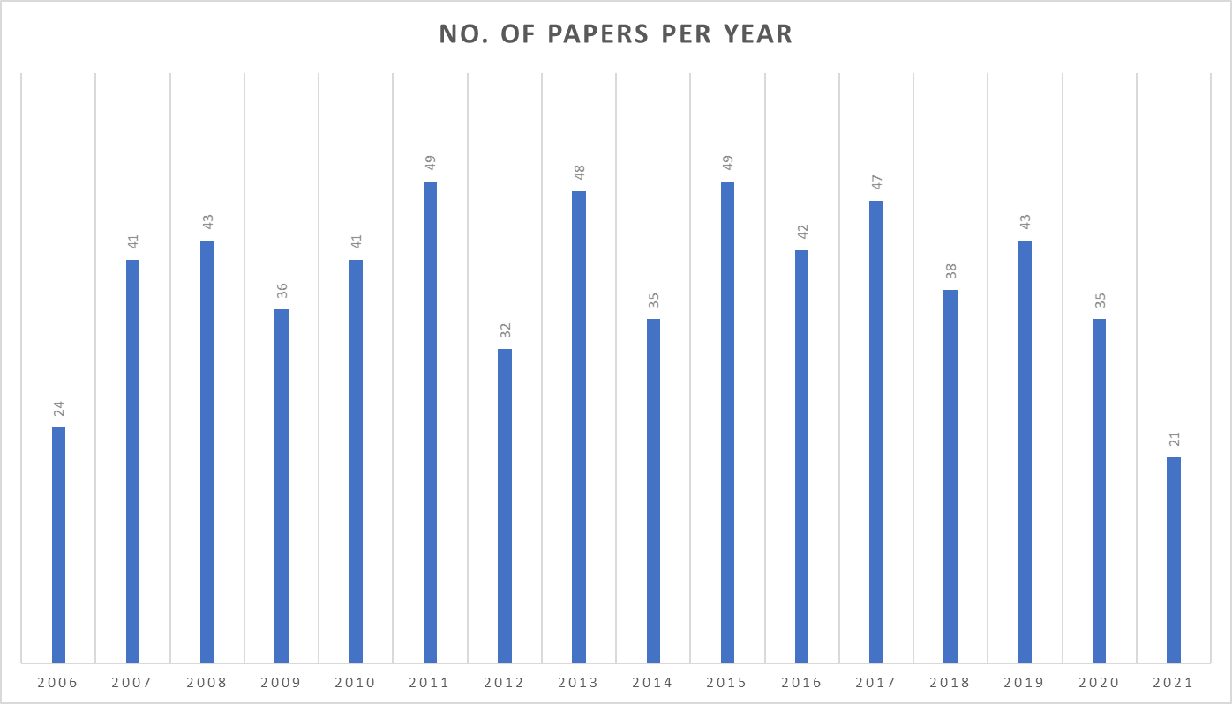
Initial Findings 2
Notes:
No trends due to tool fetching most cited ones first

Slide 31
Lessons learned
Manually searching/filtering through thousands of literature is time consuming, prone to human errors and bias.
PET related keywords sometimes result in papers from Mathematics and Medical backgrounds.
While creating the List of words, one must include all the grammatical variants for the keywords for optimal results.
Some search terms provide more results than other: ‘privacy technique’ has less results compared to ‘privacy technology’
‘Privacy enhancing’ is more dominantly used in academia than ‘Privacy preserving’ although they both are used interchangeably
Many PETs are subset of a larger PET.
Many novel PETs don’t mention their names in the title/abstract of the paper; they mostly just go by the attack they protect against i.e., “a privacy enhancing technique for k-means clustering in data mining”

Slide 32
Next Steps
Finding distinct characteristics of different technologies
Identify in which context a specific technology is preferred and why
Mapping scenarios with PETs
Implement the web app
Writing the thesis.

Slide 33
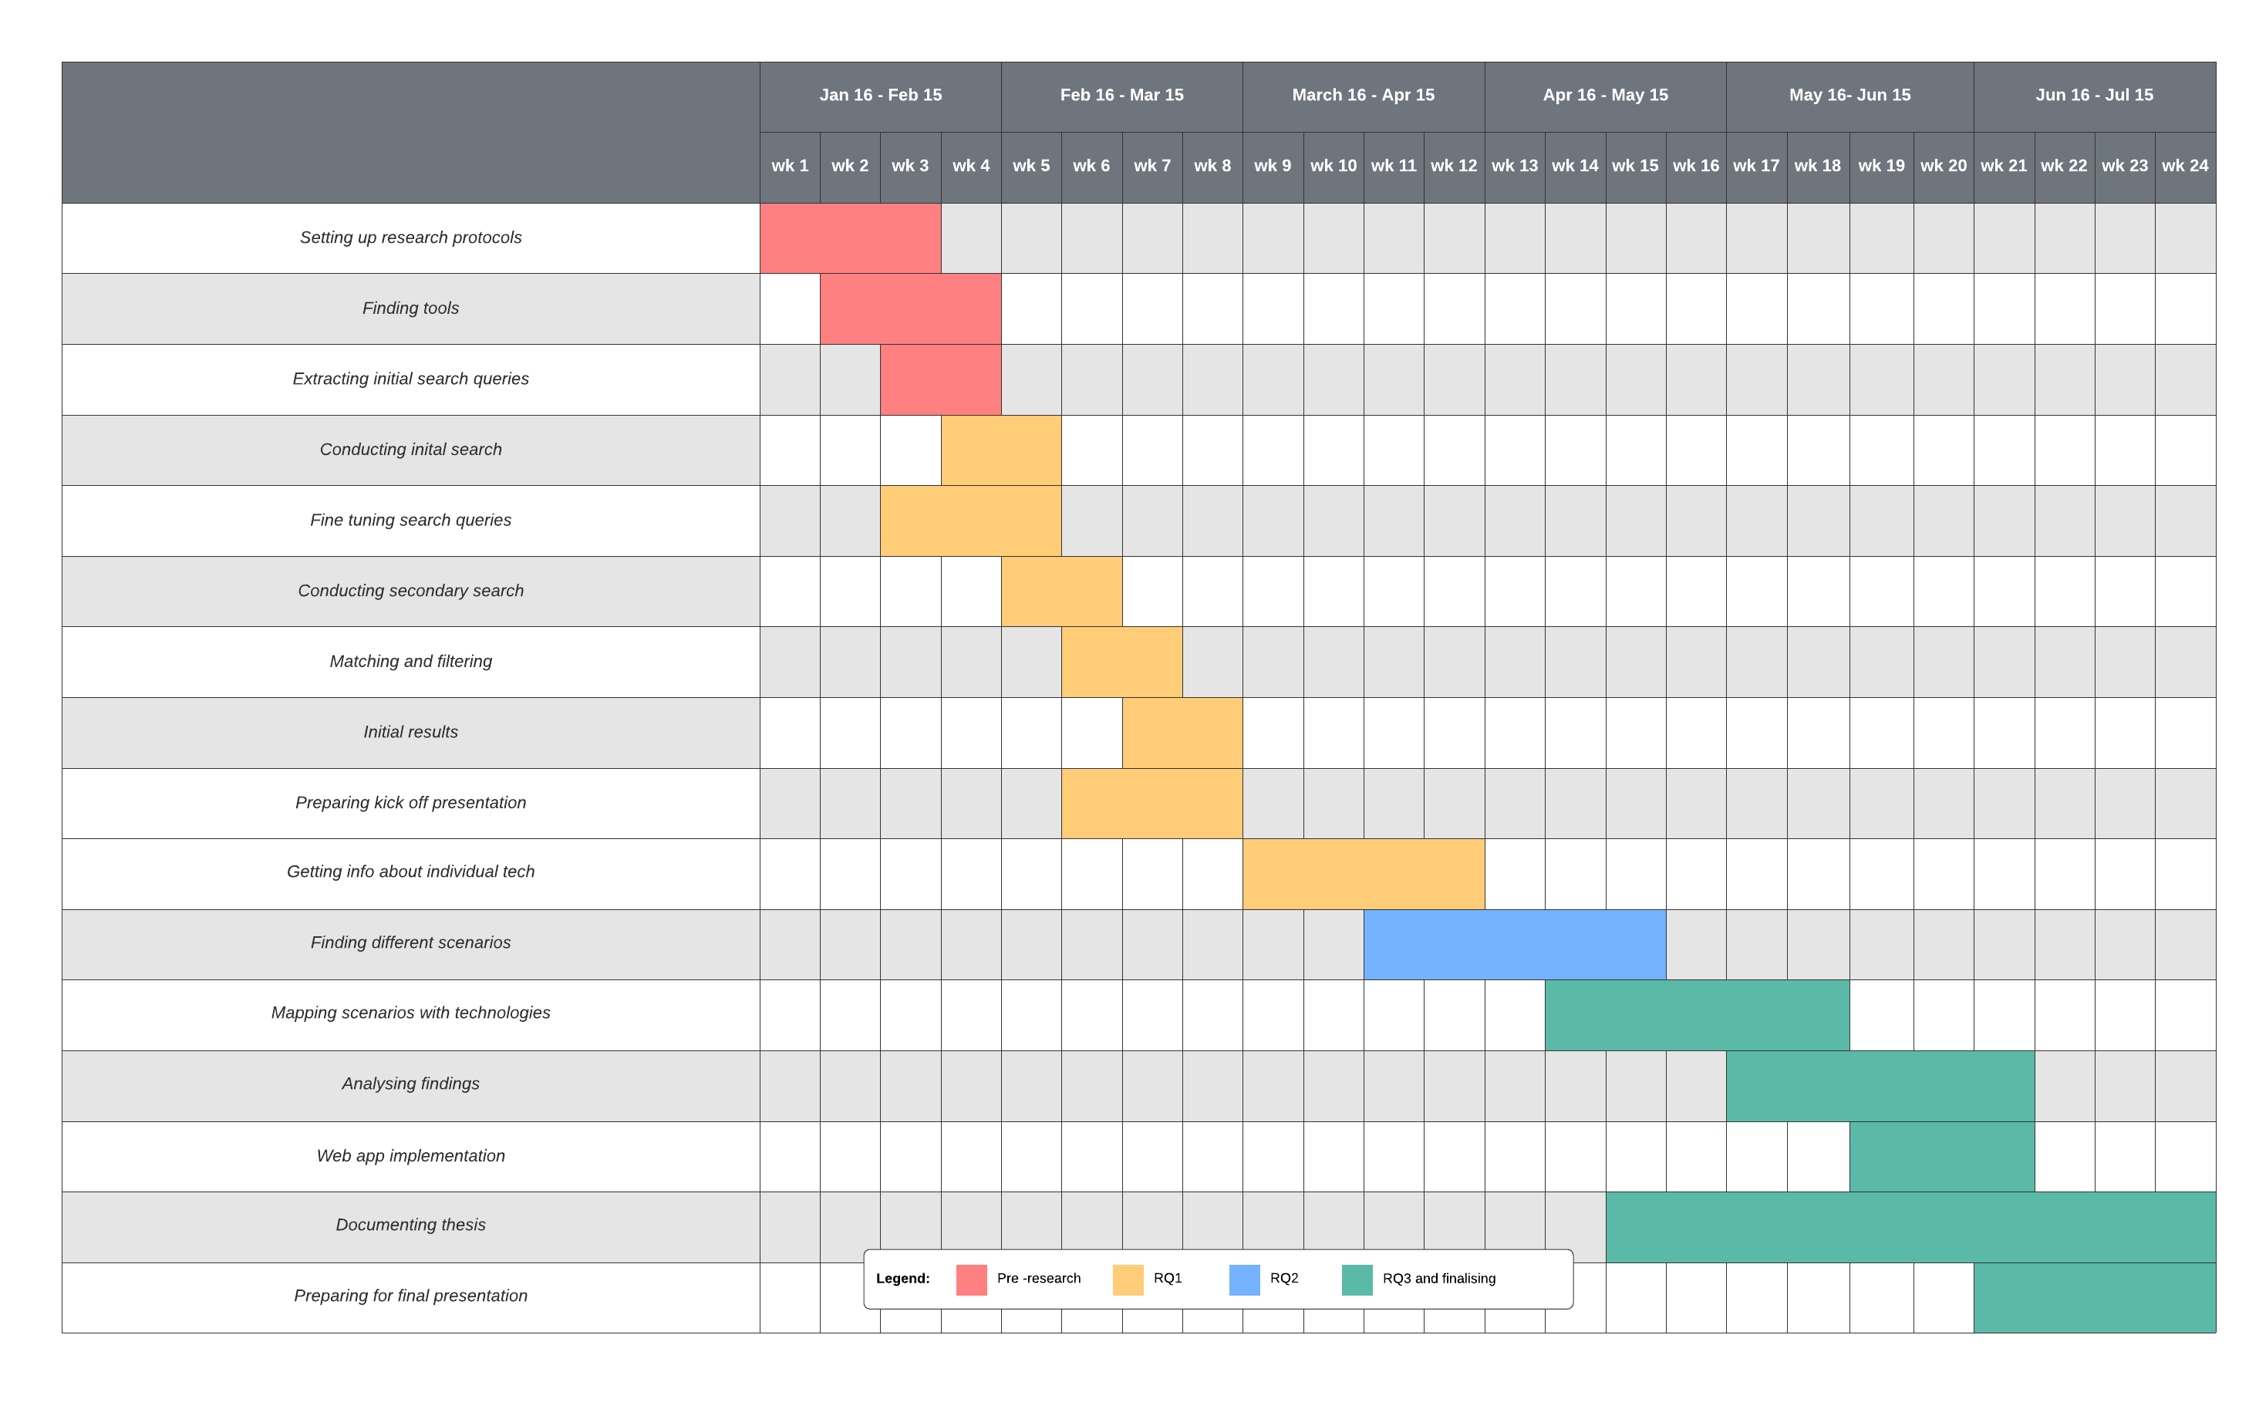
Timeline

Slide 34
Faisal Ahmed
17132
Faisal.ahmed@tum.de

