Slide 1
Goals and KPIs in Large-Scale Agile Development: A Systematic Literature Review and Development of a Goal-Driven KPI Catalog
Nadine Teiber, 02.11.20, Kick-Off Presentation

Slide 2
Outline
Motivation
Research Questions
Research Methodology
Current State
Timeline

Slide 3
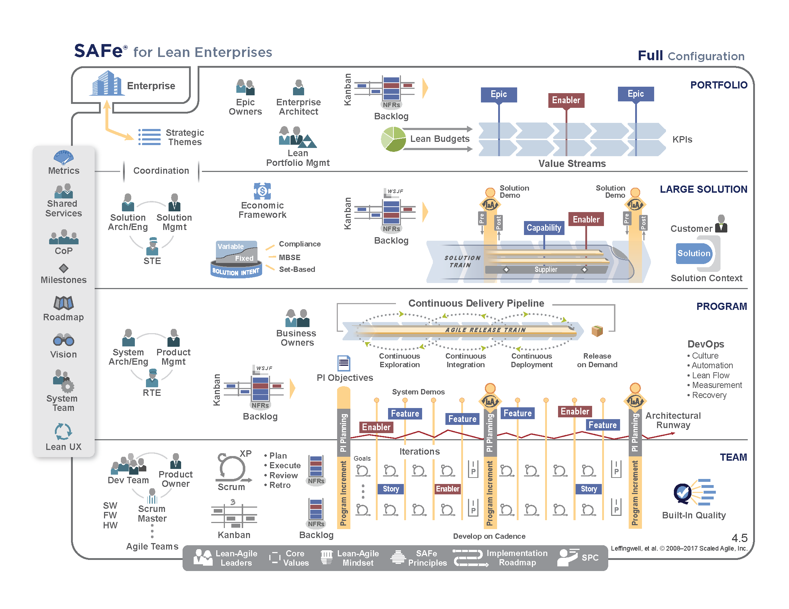
Motivation - Large-Scale Agile Software Development
Agile development was originally designed for use in small, single team projects
Adopting agile in large-scale agile development is challenging
Source: K. Dikert et al. (2016), B. Boehm, R. Turner (2005), https://www.scaledagileframework.com/
Notes:
Individuals and interactions over processes and tools
Responding to change over following a plan Working software over comprehensive documentation Customer collaboration over contract negotiation
need for additional coordination, inter-team coordination
interfacing with other organizational units, such as human resources, marketing and sales, and product management

Slide 4
Motivation - KPIs
Individual Goals
Team Goals
KPIs
Business Goals
Software metrics have been studied for decades and several literature reviews have been published
Need for metrics to monitor progress and support transparency for agile software development
So far only few studies on KPIs in large-scale agile development
So far, no structured goal-driven collection of KPIs in large-scale agile software development
Source: R. Kurnia et al (2018), T. Dingsøyr, N. B. Moe (2014), Ö. Uludag et al. (2020)
Notes:
Agile management goals: starting with your agile goals identify relevant KPIs
KPI template: adapt the selected KPIs on your enterprise context using a structured template
Information model: determine which information is needed for the calculation of the selected KPIs
Agile layers: determine which elements of your agile software development project are covered by the selected KPIs
Sprint and Project Planning, Sprint and
Project Progress Tracking, Understanding and Improving Quality,
Fixing Software Process Problems, and Motivating People.

Slide 5
Research Questions
RQ1: Which goals and KPIs related to large-scale agile software development can be found in the scientific literature?
RQ2: How can the identified goals and KPIs related to large-scale agile software development be documented in a structured way?

Slide 6
Methodology – Design Science Research
Identify Problem and Motivate
Presented on previous slides
Define objectives of a solution
Develop a goal-driven KPI catalog
Design & Development
Scientific Literature Review
Design KPI catalog
Demonstration
Demonstration of the use of the artefact by showing it to an industry partner
Evaluation
Assess the KPI catalog by performing an interview with an industry partner
Communication
Results published in my Master‘s thesis and possibly on a conference
Source: Pfeffers et al. (2007), B. A. Kitchenham, S. Charters (2007)

Slide 7
Current State – Related Work
Literature reviews of metrics for agile software development:
S. L. Ramírez-Mora and H. Oktaba: “Productivity in Agile Software Development: A Systematic Mapping Study”
R. Kurnia et al.: "Software Metrics Classification for Agile Scrum Process: A Literature Review“
E. Kupiainen et al.: “Using metrics in Agile and Lean Software Development – A systematic literature review of industrial studies”

Slide 8
Current State – Scientific Literature Review
Phase 1 of Scientific Literature Review finished:
Search strategy defined
Preliminary search done:
71 sources identified
14 sources about metrics in large-scale agile software development
57 about metrics in agile software development or undefined project size
Main Search

Slide 9
Timeline
2020
Sep
Oct
Nov
Dec
2021
Feb
Mar
2021
Today
Study search
Study selection
Data extraction
KPI catalog development
KPI catalog evaluation
Writing

Slide 10
References
B. Boehm, R. Turner (2005) Management challenges to implementing agile processes in traditional development organizations
B. A. Kitchenham, S. Charters (2007) Guidelines for performing systematic literature reviews in software engineering
I. Monahov (2014) Integrated Software Support for Quantitative Models in the Domain of Enterprise Architecture Management
K. Dikert et al. (2016) Challenges and success factors for large-scale agile transformations: A systematic literature review
Peffers, K.; Tuunanen, T.; Rothenberger, M. A.; Chatterjee, S.: A design science research methodology for information systems research. Journal of management information systems. 24(3):45–77. 2007.
T. Dingsøyr, N. B. Moe (2014) Towards Principles of Large-Scale Agile Development
Ö. Uludag et al. (2020) Revealing the State-of-the-Art of Large-Scale Agile Development: A Systematic Mapping Study
021120 Nadine Teiber, Master‘s Thesis – Kick-Off Presentation

Slide 11
B.Sc.
Nadine Teiber
17132
matthes@in.tum.de

