Slide 1
Goals and KPIs in Large-Scale Agile Development: A Systematic Literature Review
Nadine Teiber, 10.05.21, Final Presentation

Slide 2
Outline
1
Motivation
2
Research methodology
3
Results
4
Key Findings & Outlook

Slide 3



Motivation - Large-Scale Agile Software Development
Agile development was originally designed for use in small, single team projects [1]
The adoption of agile software development in large organizations has increased over the last years [2]
Adopting agile in large-scale context is challenging due to:
inter-team coordination
coordination between organizational units [3]
Notes:
Individuals and interactions over processes and tools
Responding to change over following a plan Working software over comprehensive documentation Customer collaboration over contract negotiation
need for additional coordination, inter-team coordination
interfacing with other organizational units, such as human resources, marketing and sales, and product management

Slide 4
Motivation - KPIs
Rules
Objective
Entities
Attributes
In agile software development metrics are useful for:
Sprint and project planning
Sprint and project progress tracking
Understanding and improving quality
Fixing software process problems
Motivating people [5]
In large-scale agile development, metrics at program and portfolio level are usefuf for portfolio management [6]
No notable research stream and overview of metrics in large-scale agile software development [7]
Source: [4]
Notes:
Measurement is the process of assigning values to attributes or entities according to predefined rules
In order for metrics to be useful, they must be linked to predefined goals.

Slide 5
Research Questions
RQ1
Which goals and metrics related to large-scale agile software development can be found in the scientific literature?
RQ2
What are challenges of using and implementing metrics in large-scale agile software development?
RQ3
What are success factors of using and implementing metrics in large-scale agile software development?

Slide 6
Outline
1
Motivation
2
2
Research Methodology
3
Results
4
Key Findings & Outlook

Slide 7
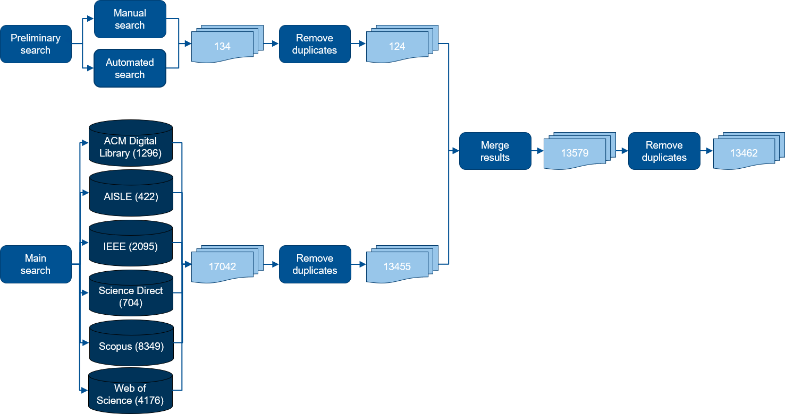
Methodology
Source: [7], [8]

Slide 8
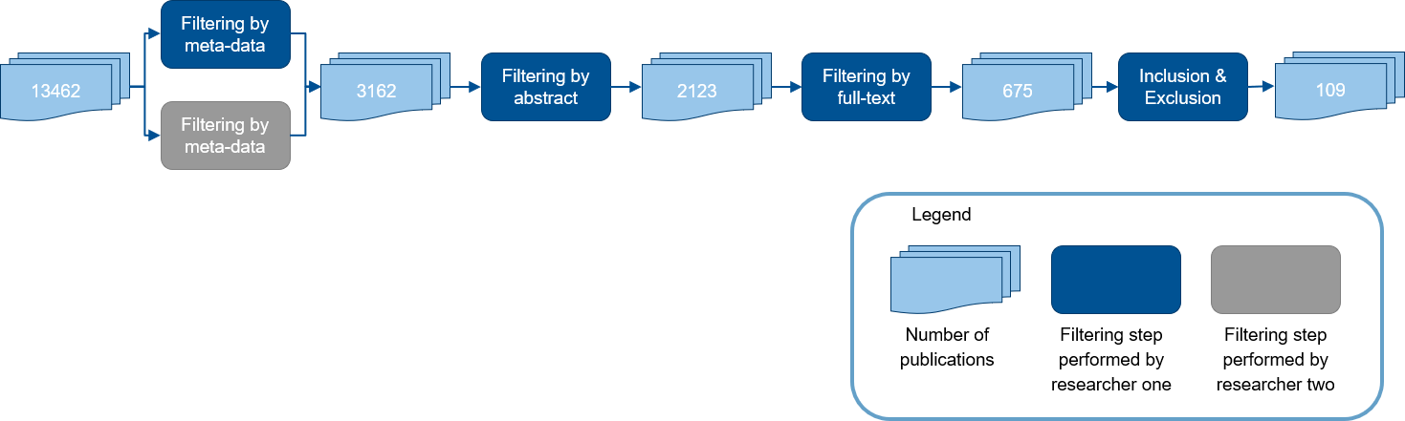
Filtering process
Facet | Inclusion criteria | Exclusion criteria
Metrics and goals in ASD | Papers that present metrics and goals in an agile software development | Studies that are related to agile manufacturing are excluded.
Industrial context | Publications that present the use of metrics in an industrial context | Publications where metrics are proposed by research
Metric information | Papers that provide data about metric usage and additional information regarding metrics | Papers that only mention metrics but do not provide any additional information about their usage, challenges, or success factors
Language | Studies written in English language are included | Studies not written in English
Publication type | Experience reports, conference publications, journal publications, and early access articles | Papers that are published in the form of abstracts, book chapters, book and conference reviews, grey literature, magazines, newsletter, short communications, talks, technical reports, and tutorials.
Publication date | Publications published between February 2001 and January 2021 | Publications outside of this time span
Access | Papers that could be accessed in full text by the rights of TUM | Papers that could not be accessed in full text by the rights of TUM
Quality | Publications with correct grammar and vocabulary. | Publications that have serious issues with grammar and vocabulary.
Source: [7], [8]

Slide 9
Outline
1
Motivation
2
2
Research methodology
3
Results
4
Key Findings & Outlook

Slide 10
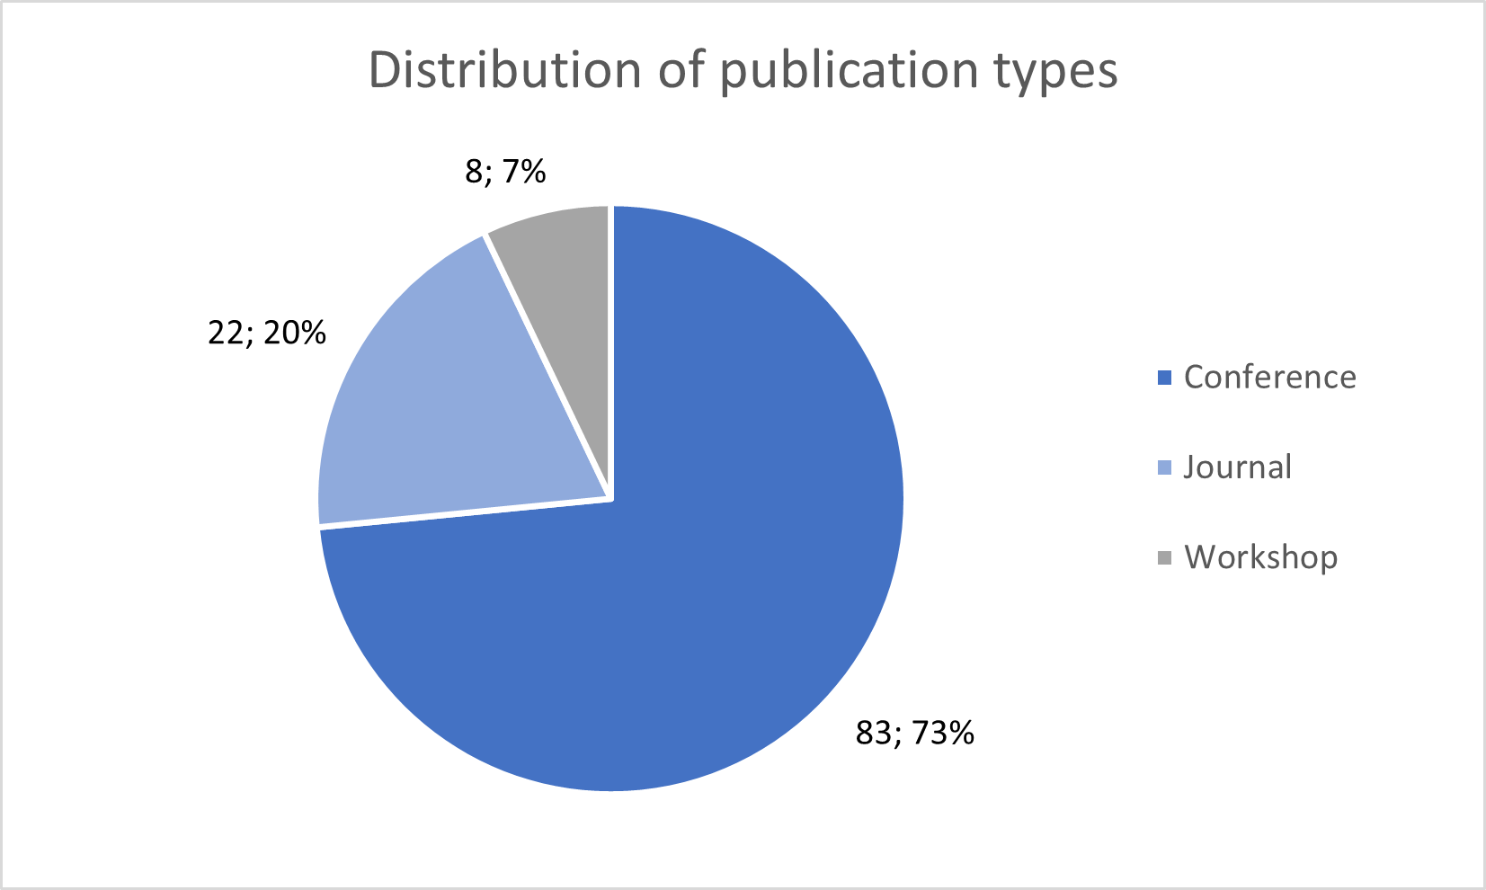
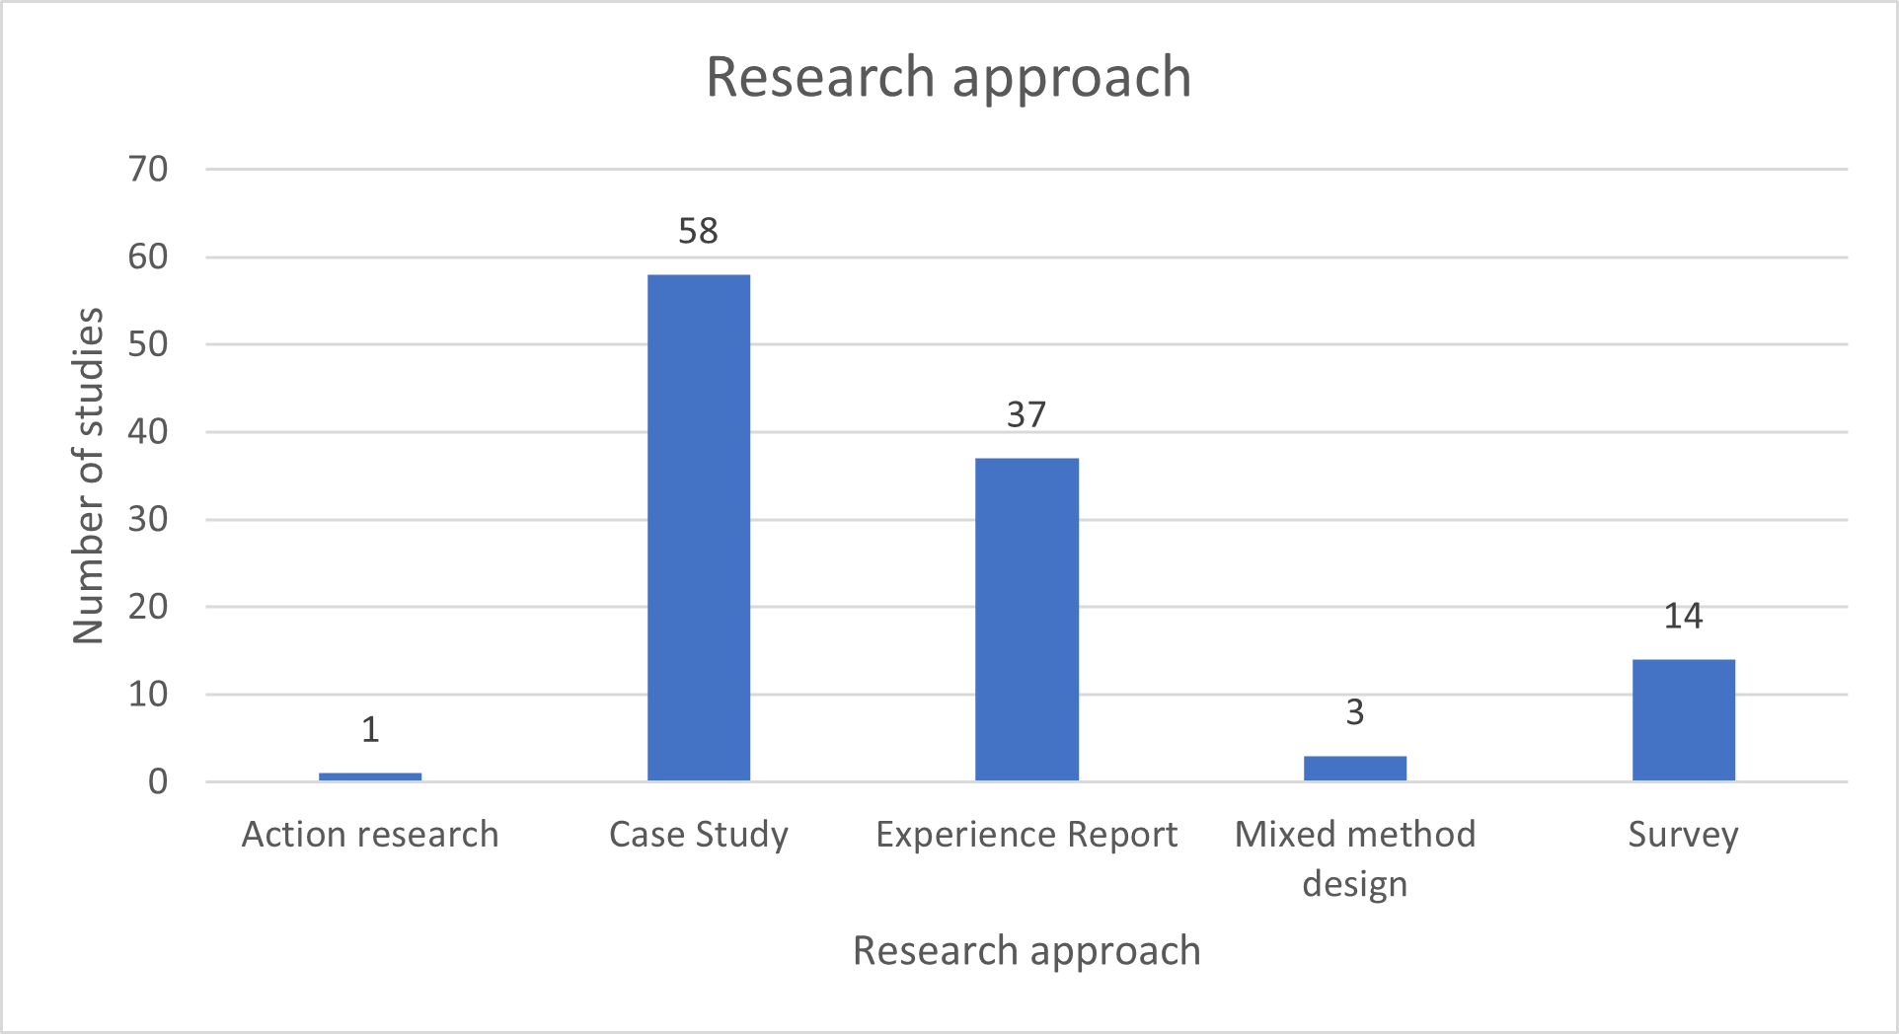
Results – Distribution of publications

Slide 11
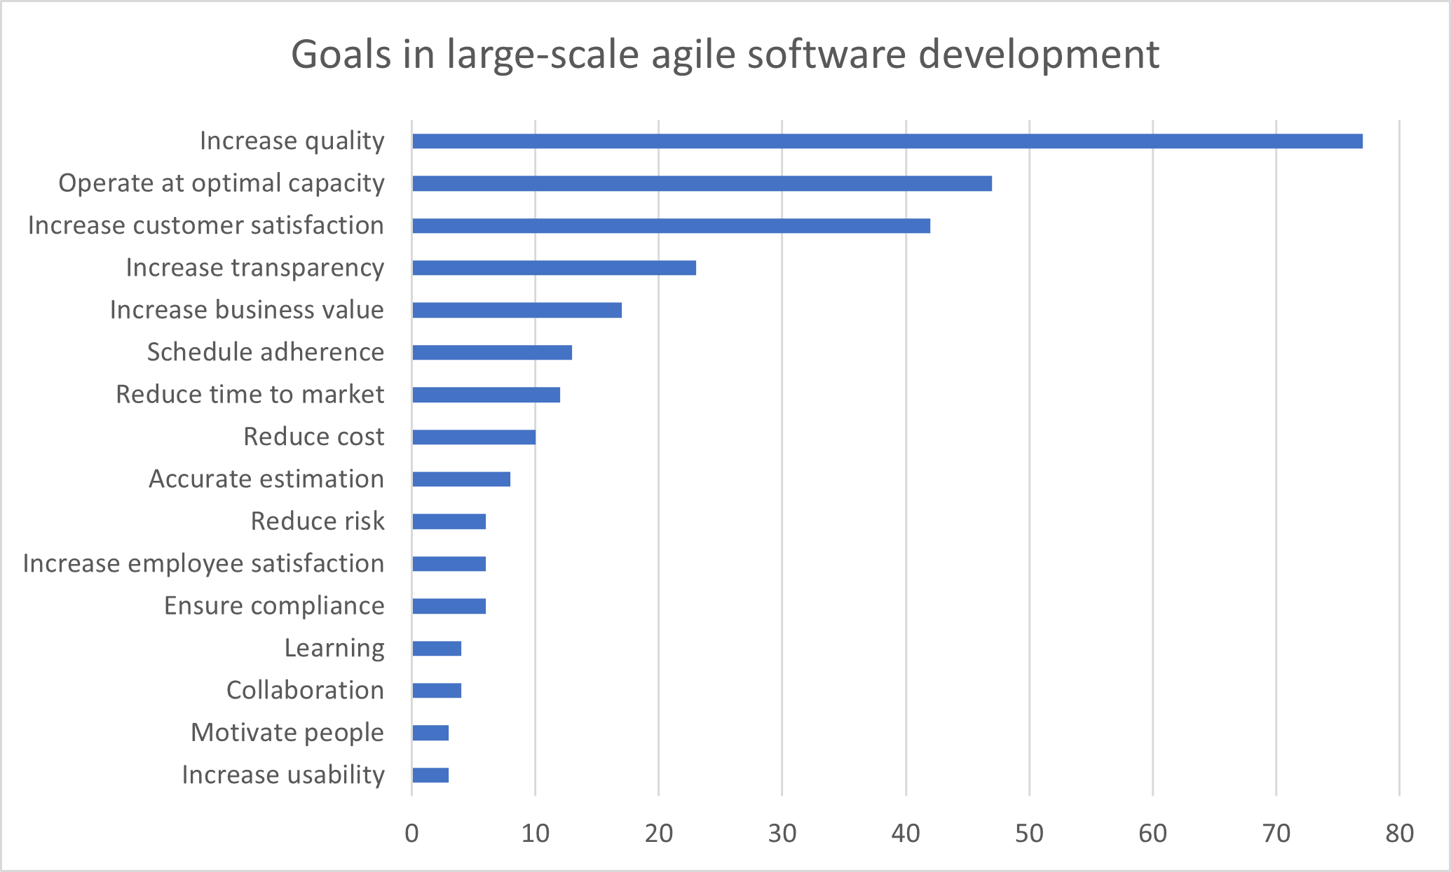

RQ1: What are goals and metrics in large-scale agile software development?

Slide 12
RQ1: What are goals and metrics in large-scale agile software development?
Entities | Attributes
 | Internal 55% |  | External 45%
Product 20% | Code: | complexity (23), lines of code (17), technical debt (8) | Code: | maintenance effort (1), code reliability(1)
 | Product: |  | Product: | Net Promoter Score (11), customer satisfaction (9)
Process 69% | Testing: | number of defects (54), number of tests (19), defect density (12) | Testing: | deferred defects (12), number of defects found by customer (4)
 | Implementation: | number of completed tasks (12), number of closed defects (12), churn (5) | Implementation: | velocity (43), time to fix defects (21)
Resources 11% | Personnel | available capacity (9), team satisfaction (6), contribution chart (2) | Personnel | individual effectiveness (3), top contributors bases on LOC (1), actual hours on ideal capacity (1)
 | Economic | cost (6), results past period (2) | Economic | return on investment (10), business value delivered (7)
Source: [4]
Notes:
Processes are collections of software-related activities
Products are any artifacts, deliverables or doducments that result from a process activity.
Resources are entities that are required by a process activity
Internal attributes: can be measured purely in terms of looking at the entity itself. E.g. number of lines of Code
External attributes can be measured only in terms of how the product relates to the environment. E.g. code maintainability. Productivity is always considered as an external measure because it is a combination of process and product measures.

Slide 13




RQ1: What are goals and metrics in large-scale agile software development?
1%
Enterprise level:
Enterprise Story Points (1), Velocity (1), Operations velocity (1), cycle time (1), build status monitor (1), efficiency regarding cost (1)
3%
Portfolio level:
Return on investment (ROI) (4), Net Promoter Score (NPS) (3), application downtime (2), customer satisfaction (2), Customer Experience Index(1), velocity (1)
26%
Program level:
Defect count (15), # of tests (8), code coverage (8), estimation accuracy (7), lines of code (LOC) (5) # of closed defects (5)
69%
Team level:
Velocity (41), defect count (38), estimation accuracy (21), complexity(21), code coverage (19)
1%
Individual level:
Available capacity (3), individual effort remaining (1), individual effectiveness (1), developer reputation (1), time to fix defects (1),

Slide 14
RQ2: What are challenges of using and implementing metrics in large-scale agile software development?
28%
Data collection
23%
Metrics are difficult to implement
10%
Comparison in multi-team settings
10%
Hierarchical boundaries of measurement
10%
Misinterpretation of metrics
18%
No shared understanding
Notes:
Data collection: data availabilita, time and effort needed for data collection
Metrics difficult to implement: difficulty of deriving actionable inputs, misalignment between metrics and objectives, some aspects are hard to measure

Slide 15
RQ3: What are success factors of using and implementing metrics in large-scale agile software development?
18%
Make metrics accessible to everyone
16%
Use tools
10%
Ensure trust and cooperation of teams
10%
Iterative operationalization of metrics
10%
Use metrics over all organizational levels
8%
Align metrics to objectives and processes
8%
Involve team and stakeholders
7%
Keep it simple

Slide 16
Outline
1
Motivation
2
2
Research methodology
3
Results
4
Key Findings & Outlook

Slide 17
Key findings & Outlook
Key findings
There is an increasing attention of metrics in large-scale agile software development.
The research area of metrics in large-scale agile software development lacks maturity.
Most measures have been conducted on team and program level. Not much enterprise and portfolio measures have been mentioned.
The five most frequently mentioned challenges were data availability (12%), time and effort needed for data collection (12%), coordination challenges in multi-team settings (10%), fragmented collection and storage of data at different organizational levels (8%), and difficulty of deriving actionable inputs (7%)
The most common mentioned success factors are automated data collection (16%), making metrics visible to everyone (11%), and introducing metrics in an iterative fashion (7%).
Outlook
Further research regarding goals and metrics in large-scale agile software development, especially at portfolio and enterprise level is needed.
Find solutions to the identified challenges by building tools and collections of metrics to counter the identified challenges.

Slide 18
References
[1] Boehm, B., & Turner, R. (2005). Management challenges to implementing agile processes in traditional development organizations. IEEE software, 22(5), 30-39.
[2] VersionOne Inc. 10th annual state of agile report. 2016. URL: http://www.agile247.pl/wp-content/uploads/2016/04/VersionOne-10th-Annual-State-of-Agile-Report.pdf (visited on 05/05/2021).
[3] K. Dikert et al. (2016) Challenges and success factors for large-scale agile transformations: A systematic literature review
[4] N. Fenton and J. Bieman.Software metrics: a rigorous and practical approach. CRC press, 2014
[5] E. Kupiainen, M. V. Mäntylä, and J. Itkonen. “Using metrics in Agile and LeanSoftware Development–A systematic literature review of industrial studies”. In:Information and Software Technology62 (2015), pp. 143–163.
[6] Müller, R., Martinsuo, M., Blomquist, T.: Project portfolio control and portfolio management performance in different contexts. Proj. Manag. J. 39(3), 28–42 (2008)
[7] Ö. Uludag et al. (2020) Revealing the State-of-the-Art of Large-Scale Agile Development: A Systematic Mapping Study
[8] H. Zhang, M. A. Babar, and P. Tell. “Identifying relevant studies in software engi-neering”. In:Information and Software Technology53.6 (2011), pp. 625–637.
[9] B. A. Kitchenham, S. Charters (2007) Guidelines for performing systematic literature reviews in software engineering
021120 Nadine Teiber, Master‘s Thesis – Kick-Off Presentation

Slide 19
B.Sc.
Nadine Teiber
17132
matthes@in.tum.de

