Slide 1
Identifying and Assessing the Effects of Domain Level Technical Debts in Practice
Joonas Palm, 16.11.2020, Master’s Thesis Kick-off

Slide 2
Outline
Motivation
Research Questions
Research Methodology
Current State
Roadmap

Slide 3
Motivation
Why technical debt (TD)?
Def.: “the gap between the current state of a software system and some hypothesized “ideal” state in which the system is optimally successful in a particular environment.” [7]
Notes:
Domain level TD belongs to the family of TD.
TD coined by Ward Cunningham in 1992.
Defined as: “the gap between the current state of a software system and some hypothesized “ideal” state in which the system is optimally successful in a particular environment.”

Slide 4

Motivation
~23%[4]
Notes:
2018 Besker et al. found that developers on average waste nearly a quarter of their development time on TD.
Mostly spent on testing, analysis and refactoring.

Slide 5
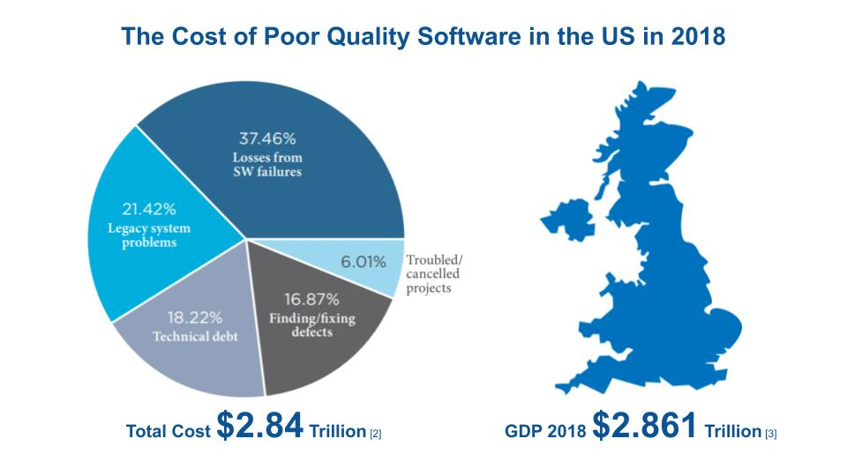
Motivation
Notes:
CISQ report.
Consortium for Information & Software Quality.

Slide 6
Motivation
What is domain level TD?
Def.: “Domain level technical debt (TD) is the misrepresentation of the application domain by an actual system.” [1]
Notes:
TD typically categorized based on artifacts or abstraction level.
2019 two experts and researchers from QAware published a paper on domain debt.
There is something still there, causing pain, that has not been described by research so far.
Identified a research gap in the ontology.
In their paper try to describe it and provide a primary definition.
Definition not clear yet. I will try to elicit further characteristics and describe it.

Slide 7
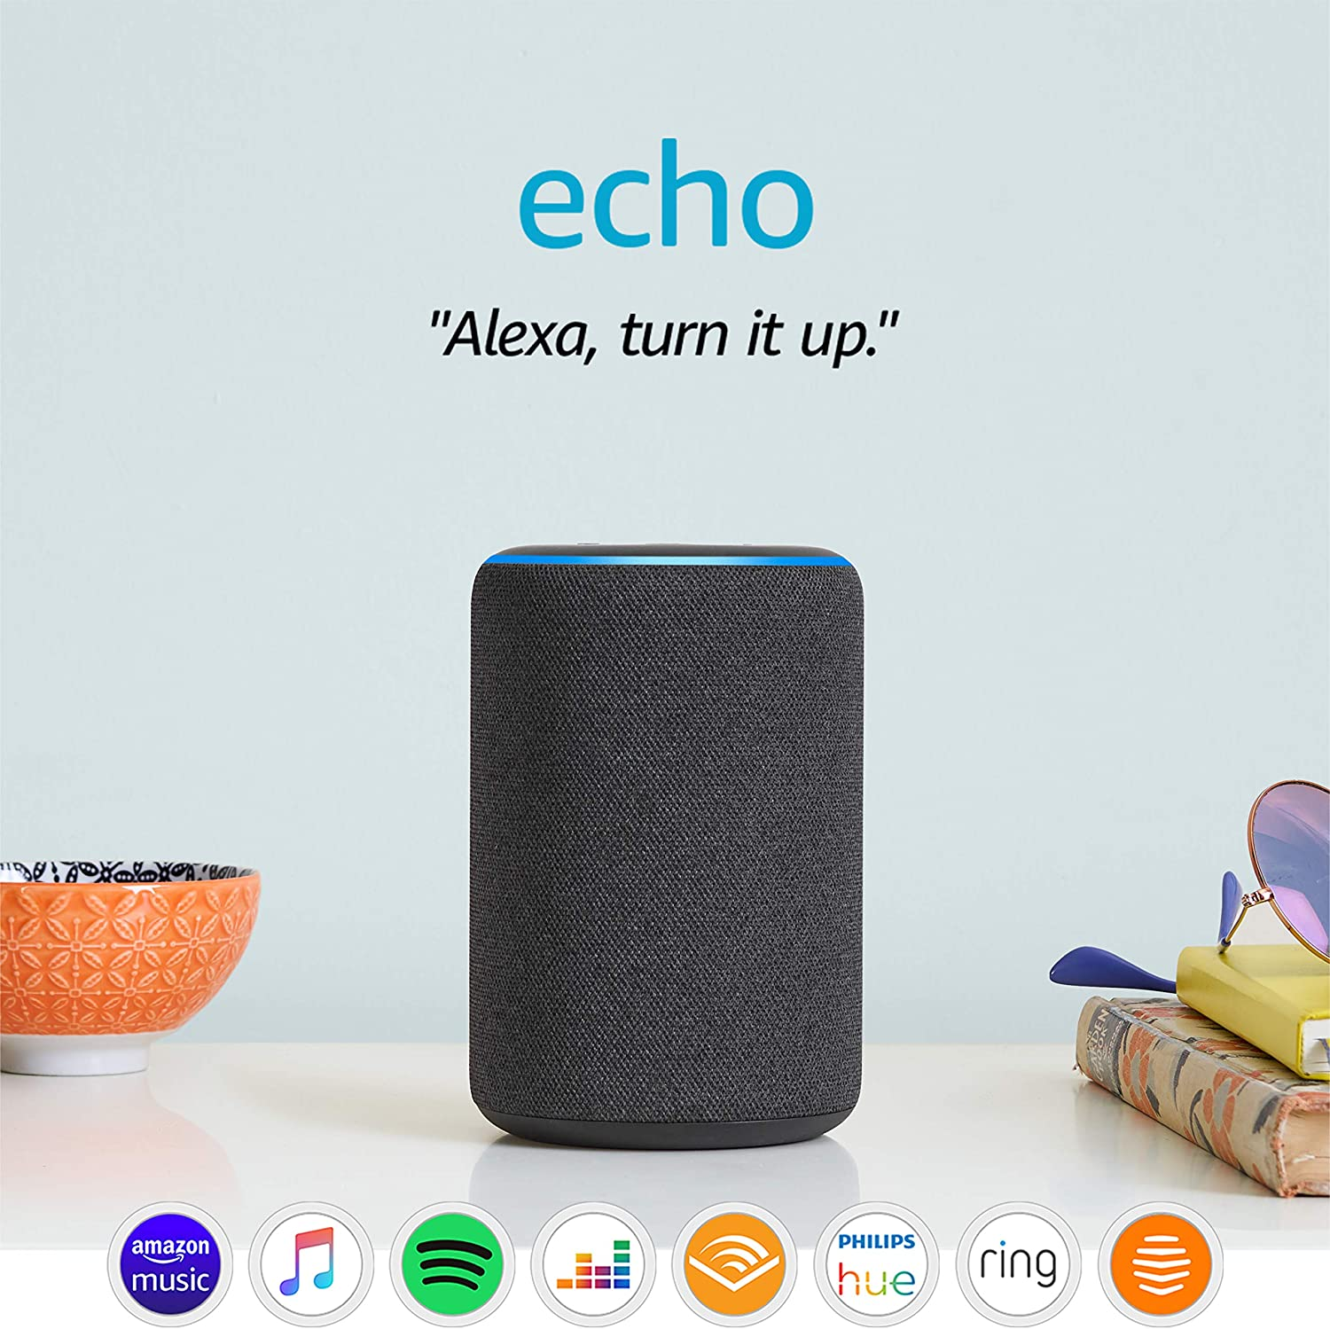
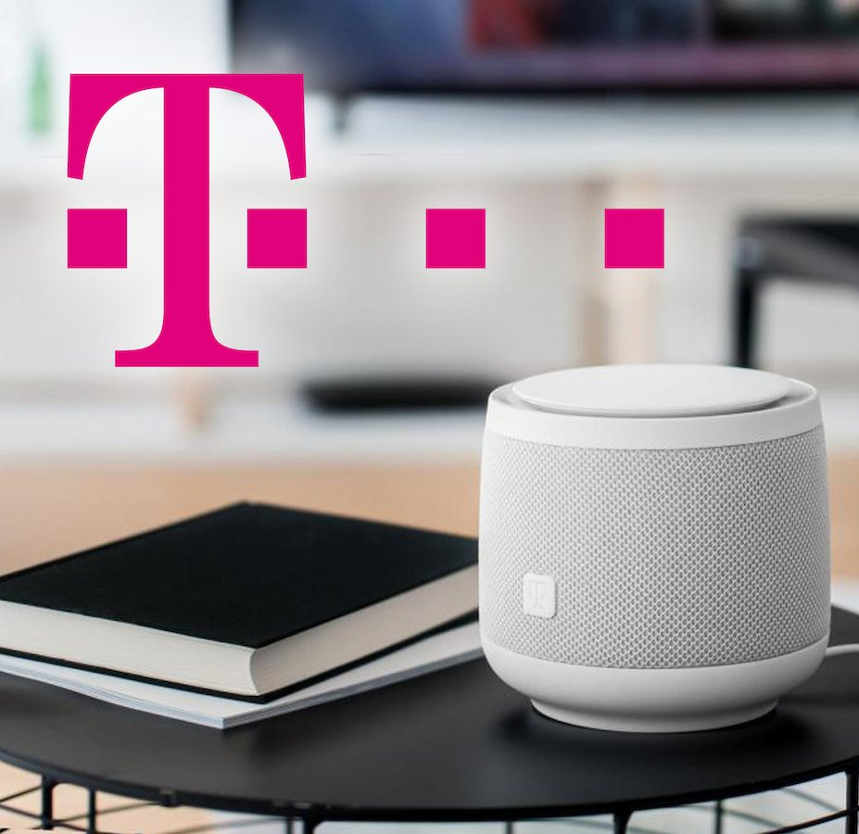
Motivation
[Source: https://tinyurl.com/yxo2tr8e]
[Source: https://tinyurl.com/y3uhkhb6]
2014
2018
Notes:
Echo released in 2014 and Magenta in 2018.

Slide 8



Motivation
[Source: https://tinyurl.com/yxo2tr8e]
[Source: https://tinyurl.com/y3uhkhb6]
2014
2018
Notes:
GDPR came into effect in 2018.
Both products need to take care of GDPR compliance.
Amazon claims to be compliant, but some issues came up…

Slide 9
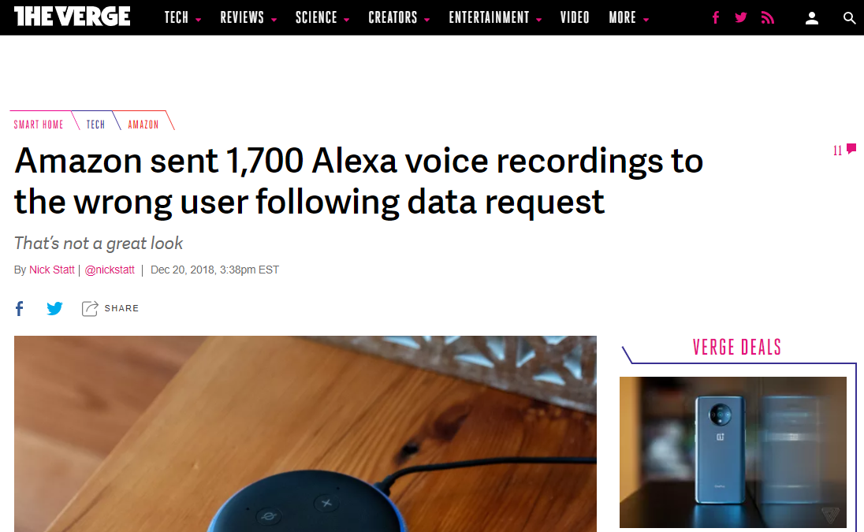
Motivation
[Source: https://tinyurl.com/y8tpyrx7]
Notes:
2018

Slide 10
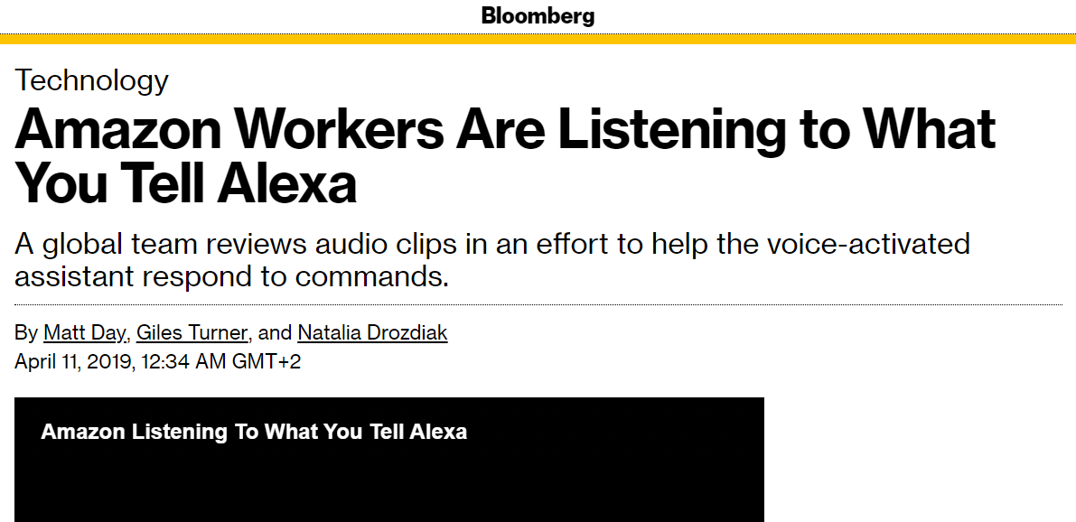
Motivation
[Source: https://tinyurl.com/y3hsxhuz]
Notes:
2019
Created turbulence. Users concerned.

Slide 11
Motivation
[Source: https://tinyurl.com/yxo2tr8e]
[Source: https://tinyurl.com/y3uhkhb6]
2014
2018
Notes:
Echo: (+) more advanced, (+) faster time-to-market, (-) privacy issues.
Magenta: (+) a strong focus on privacy and GDPR compliance.

Slide 12
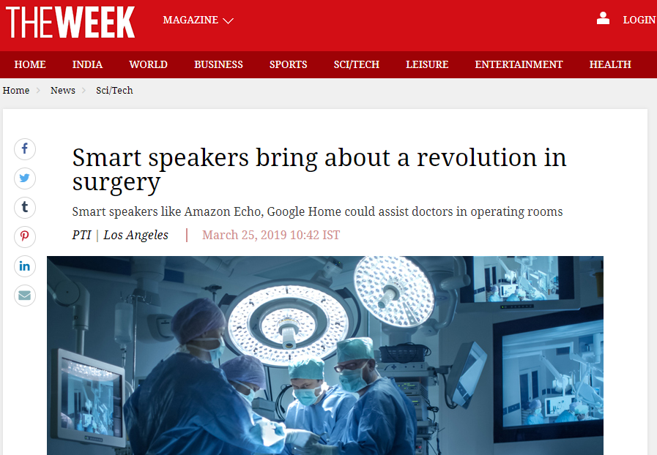
Motivation
[Source: https://tinyurl.com/y6nyy88p]
Notes:
In a privacy and security critical application Magenta might be preferred.
Amazon’s Echo would be failing to fulfill a use case from its domain.
Echo might fulfill all high software quality standards.
Echo has misrepresented the application domain.
Typical TD makes development slower. Here other stakeholders pay the price.
These characteristics distinguish domain debt from other types of TD.

Slide 13
Research Questions
What are the characteristics of domain level TD in practice?
RQ01
Can domain level TD be measured, and if so, how?
RQ02
What are the proportions of different levels of TD in terms of number and size of issues, economic and technological impact?
RQ03
Notes:
RQ01 is based on the case studies.
RQ02 is based on RQ01. Of the identified characteristics which of them could potentially be measured.
RQ03 is based on the whole list of TD items.

Slide 14




Research Methodology
Collecting and assessing lists of items of TD from candidate projects
Identifying the economic and technological impact of different levels of TD
Identifying characteristics of domain level TD in practice
Checklist for eliciting and assessing domain level TD
Evaluation & Interviews
Literature & Evaluation
Case Studies & Interviews
Expert Interviews
Overarching approach: case study research [6]
Notes:
Overarching approach - Case Study Research.

Slide 15

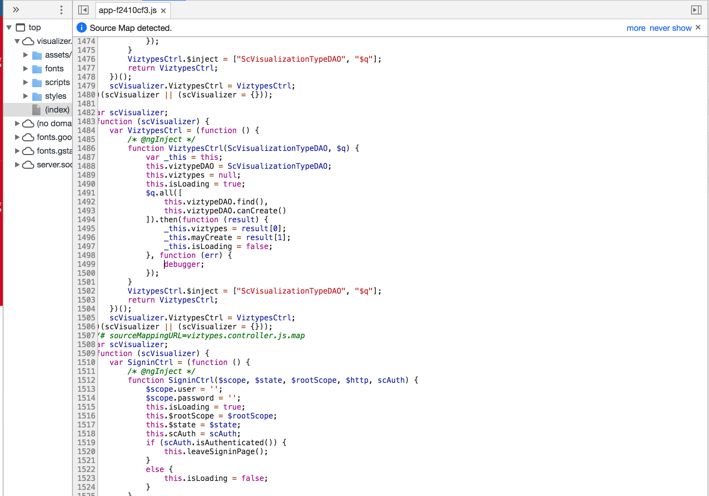
Research Methodology
Our Industrial Partner
www.qaware.de
QAware GmbH
Aschauer Straße 32
81549 München, Germany

Slide 16
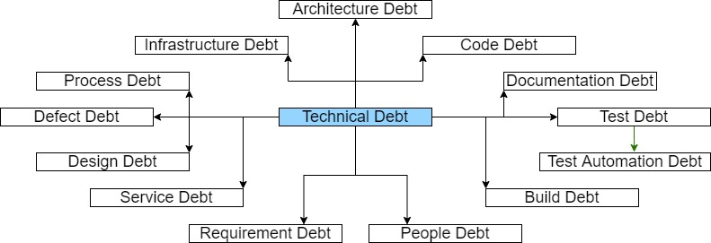
Current State
Data collection:
Received list of TD
First expert interviews scheduled
Literature review close to completion:
[5]

Slide 17




Roadmap
OCT
NOV
DEC
JAN
FEB
MAR
APR
Collect lists of TD in given projects
Collect and describe domain debt items (iteration)
Sanitize list into publishable list of issues
Abstract debt assessment into a check list
Validate results with domain experts
Reviewing literature
Writing master’s thesis
Official start
15th October 2020
Official end
15th April 2021
Notes:
1) Collect lists of items of TD in the given candidate projects.
2) Collect information on domain debt items and describe them in a detailed, yet confidentiality-preserving way (case studies).
3) Sanitize the existing assessments of the projects to create a publishable list of issues.
4) Abstract the existing review procedure into a generally applicable procedure for domain debt assessment, e.g. as a check list.
5) Conduct interviews with a small number of senior experts at QAware to validate the results achieved.

Slide 18
References
Harald Störrle, Marcus Ciolkowski. “Stepping Away from the Lamppost: Domain-Level Technical Debt.” 45th Euromicro Conference on Software Engineering and Advanced Applications (SEAA). IEEE, 2019.
Herb Krasner. “The Cost of Poor Quality Software in the US: A 2018 Report” Consortium for IT Software Quality (CISQ), 2018.
The World Bank, United Kingdom. Available at: https://data.worldbank.org/country/GB . Accessed: 21.10.2020.
Terese Besker, Antonio Martini, Jan Bosch. “Technical Debt Cripples Software Developer Productivity.” International Conference on Technical Debt. ACM/IEEE, 2018.
Nicolli S. R. Alves, Leilane F. Ribeiro, Vivyane Caires, Thiago S. Mendes, Rodrigo O. Spínola. “Towards an Ontology of Terms on Technical Debt.” 6th IEEE International Workshop on Managing Technical Debt. IEEE, 2014.
Per Runeson, Martin Höst, Austen Rainer, Björn Regnell. “Case Study Research in Software Engineering.” John Wiley & Sons, Inc., Publication, 2012.
Nanette Brown, Yuanfang Cai, Yuepu Guo et al. “Managing Technical Debt in Software-Reliant Systems.” ACM, 2010.

Slide 19
B.Sc.
Joonas Palm
joonas.palm@tum.de
17132

