Slide 1
Identifying and Assessing the Effects of Domain Level Technical Debts in Practice
Joonas Palm, 22.03.2021, Final Presentation Master’s Thesis

Slide 2
Outline
Motivation
Research Methodology
Domain Level Technical Debt in Practice (RQ1)
Identifying Domain Level Technical Debt (RQ2)
Impacts of Different Types of Technical Debt (RQ3)
Limitations
Conclusion and Future Work

Slide 3

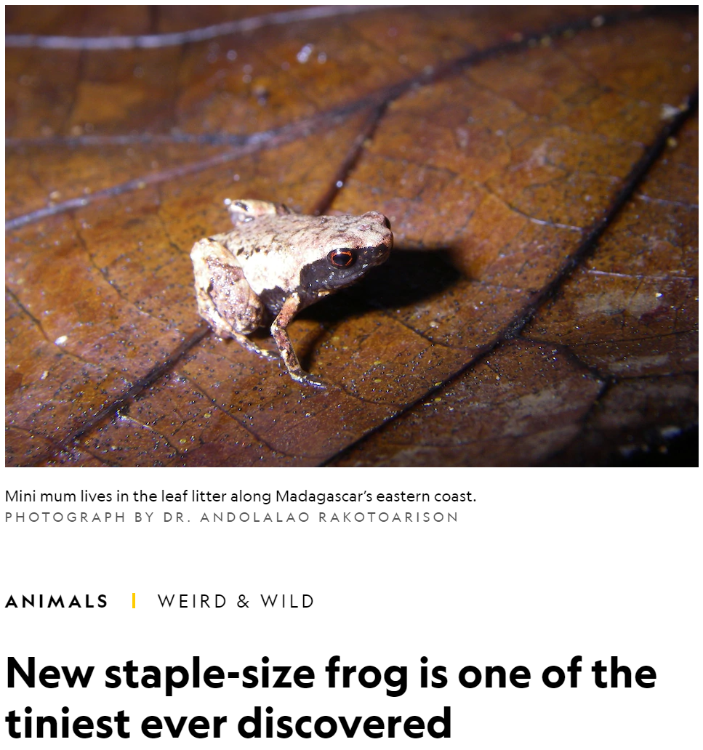
Motivation
Source: National Geographic. Available at: https://www.nationalgeographic.com/animals/article/smallest-frog-species-discovered-mini-mum. Accessed: 15.03.2021.
Notes:
Start with small parallel from biology.
In 2019 among 71 other species, the tiny frog Mini Mum was discovered on Madagascar.
Shows how much there still is to be discovered about our planet Earth.
The same with my thesis, I was working on discovering new phenomenon's in the world of software. And especially the world of Technical Debt.

Slide 4
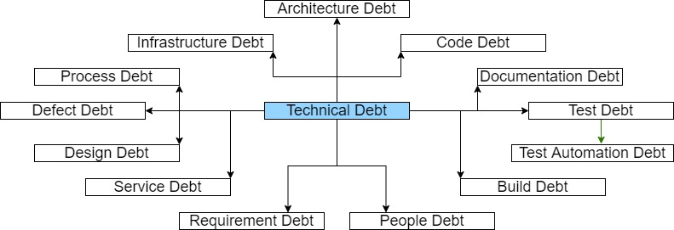
Motivation
~78%
Source: Nicolli S. R. Alves, Leilane F. Ribeiro, Vivyane Caires, Thiago S. Mendes, Rodrigo O. Spínola. “Towards an Ontology of Terms on Technical Debt.” 6th IEEE International Workshop on Managing Technical Debt. IEEE, 2014.
Source: Nicolli S.R. Alves, Thiago S. Mendes, Manoel G. de Mendonça, Rodrigo O. Spínola, Forrest Shull, Carolyn Seaman. “Identification and Management of Technical Debt: A Systematic Mapping Study.” Elsevier, 2015.
Notes:
We can visualize the world of TD as an ontology.
TD coined by Ward Cunningham in 1992.
Defined as: “the gap between the current state of a software system and some hypothesized “ideal” state in which the system is optimally successful in a particular environment.”
Many papers since 1992 have been trying to map the ontology of TD. The different species.
However, around 78% of the research concentrates on TD at the lower implementation level.
A lot less research has gone into higher level types of TD. My goal to address this gap.

Slide 5
Motivation
Domain level TD
Def.: “Domain level technical debt (TD) is the misrepresentation of the application domain by an actual system.”
Source: National Geographic. Available at: https://www.nationalgeographic.com/animals/article/smallest-frog-species-discovered-mini-mum. Accessed: 15.03.2021.
Source: Harald Störrle, Marcus Ciolkowski. “Stepping Away from the Lamppost: Domain-Level Technical Debt.” 45th Euromicro Conference on Software Engineering and Advanced Applications (SEAA). IEEE, 2019
Notes:
2019 two experts and researchers from QAware published a paper on domain debt.
There is something still there, causing pain, that has not been described by research so far.
Identified a research gap in the ontology.
In their paper try to describe it and provide a primary definition.
Definition not clear yet. My goal was to elicit further characteristics and describe it.

Slide 6
Research Methodology
What are the characteristics of domain level TD in practice?
Characteristics include effects, causes and indicators.
RQ01
Can domain level TD be measured, and if so, how?
By measuring we mean the detection of domain level TD.
RQ02
What are the proportions of different levels of TD in terms of number and size of issues, economic and technological impact?
RQ03
Comparing domain level TD to other levels of TD.
Notes:
RQ02 - By measured we mean the detection of domain debt in a system.

Slide 7




Research Methodology
Collecting and assessing a list of items of TD from a candidate project
Identifying characteristics of domain level TD in practice
(RQ1)
Checklist for eliciting and assessing domain level TD
(RQ2)
Identifying the economic and technological impact of different levels of TD (RQ3)
Conducting case studies on domain level TD
Interviews & Evaluation
Interviews & Questionnaires
Case Studies & Literature
Expert Validation
Evaluation
Overarching approach: Case Study Research
Source: Per Runeson, Martin Höst, Austen Rainer, Björn Regnell. “Case Study Research in Software Engineering.” John Wiley & Sons, Inc., Publication, 2012.
Notes:
Overarching approach - Case Study Research.
1. The list was supplemented with expert interviews and data collected from issue tracking software.
2. From the list and some other projects selected instances of TD that have links to domain level TD. Conducted comprehensive Case Studies on these instances.
3. Based on the case studies, identified characteristics.
4. Based on the characteristics identified. Checklist validated by several experts.
5. Based on the overall list of TD items.

Slide 8

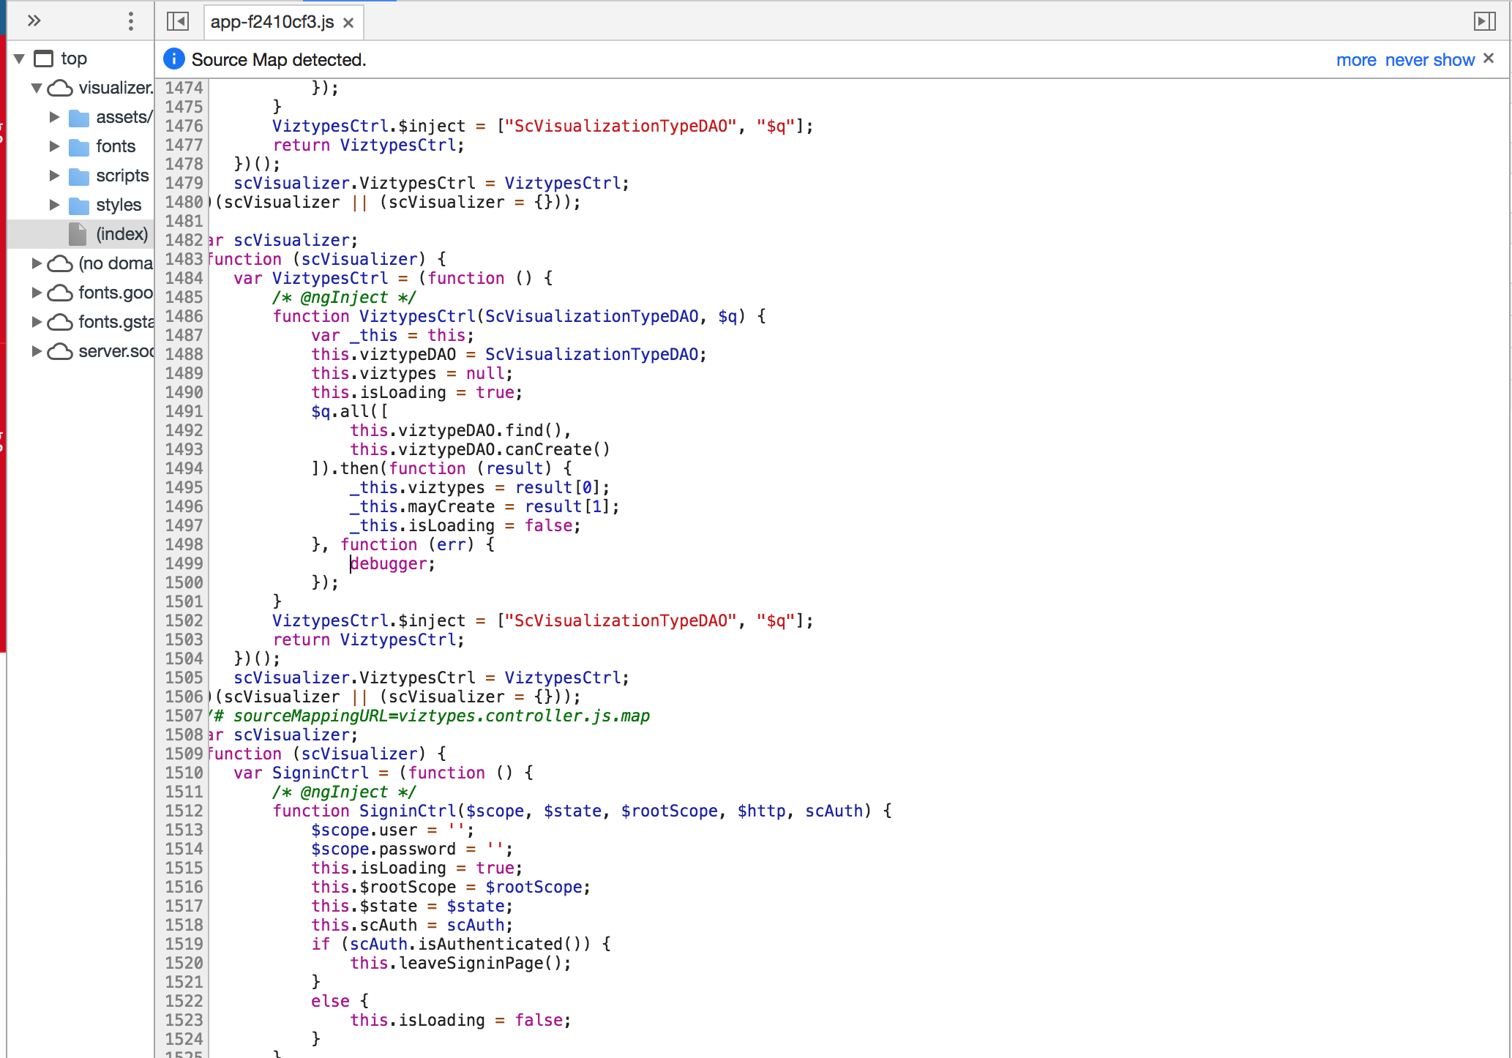
Research Methodology
Our Industrial Partner
www.qaware.de
QAware GmbH
Aschauer Straße 32
81549 München, Germany

Slide 9
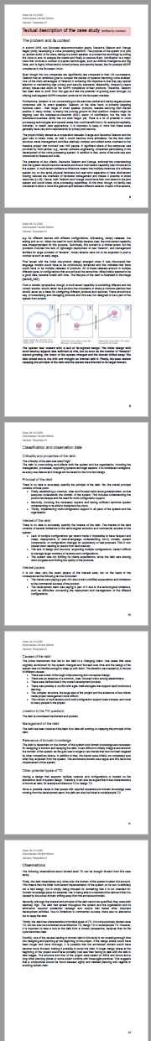
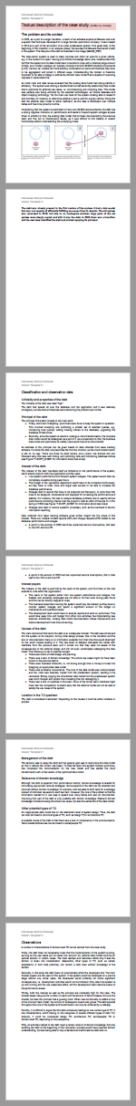
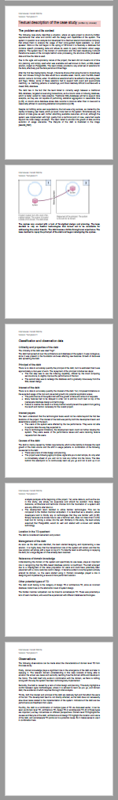
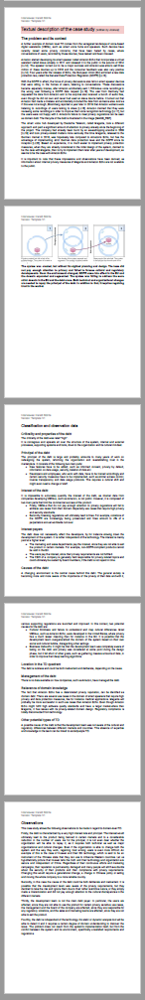
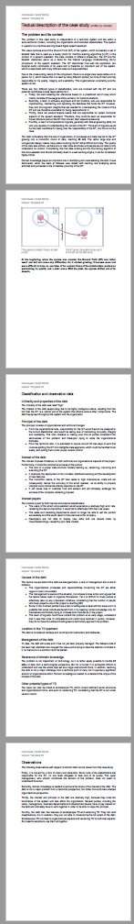
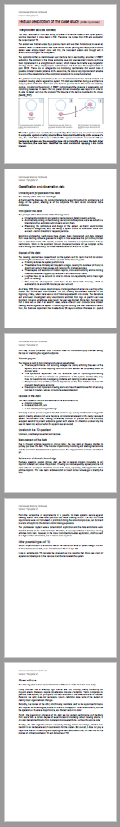
Domain Level Technical Debt in Practice (RQ1)
CS1
Multi-tenancy
CS2
Database Problem
CS3
Interactive Filtering
CS4
GDPR
CS5
Ground Truth
CS6
Crawler Attacks
Six case studies on domain level TD with two senior software consultants.
Notes:
RQ1: identifying characteristics of domain level TD in practice.
In total we conducted 6 domain debt case studies with 2 senior software consultants at QAware.
All of them are revolving around items of TD that have a correlation with domain level TD.
The items of TD were selected from different projects and systems.
Goal: write them down, analyze them and compare them to each-other.

Slide 10
Domain Level Technical Debt in Practice (RQ1)
CS1
Multi-tenancy
CS2
Database Problem
CS3
Interactive Filtering
CS4
GDPR
CS5
Ground Truth
CS6
Crawler Attacks
Six case studies on domain level TD with two senior software consultants.
Notes:
As an example we will take a closer look at CS1.

Slide 11

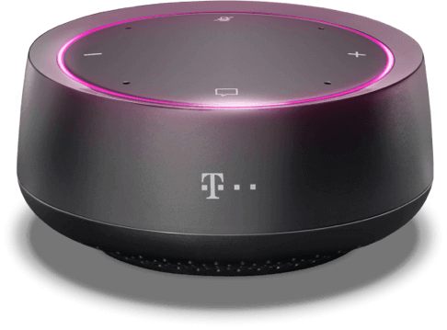

Domain Level Technical Debt in Practice (RQ1)
Notes:
First CS revolving around a smart voice assistant.
In 2015 Deutsche Telekom and Orange started jointly developing a voice processing platform.
Cooperation to share costs.
Goal: GDPR-compliant voice processing tech for the B2B sector.

Slide 12


Domain Level Technical Debt in Practice (RQ1)
Shared Voice Processing Application
Telekom DB
Orange DB
Notes:
Due to the two client structure, a multi-tenancy architecture was implemented.
A multi-tenant software architecture means that multiple instances of a software system run on the same physical hardware but need strict separation of data.
Both had a tenant, sharing the voice processing capabilities.
However, it turned out that more fine-grained product variants were needed.

Slide 13


Domain Level Technical Debt in Practice (RQ1)
Test
Release X
Release Y
Release Z
Shared Voice Processing Application
Test DB
Release X DB
Telekom DB
Orange DB
Release Y DB
Release Z DB
Notes:
Language models would have to be continuously enhanced. This indicates the need for multiple releases of products.
Additionally, different devices for testing, canary releases, configurations etc. were needed.
The multi-tenancy support was misused to support new use cases from the domain.
This worked to a limited extent.
From a domain perspective a product-line or a common platform would be needed.
A way for instantiating and managing the variants was needed.
Interest: slow deployments, difficult management, client expectations unfulfilled.
Interest payers: clients, dev team.

Slide 14
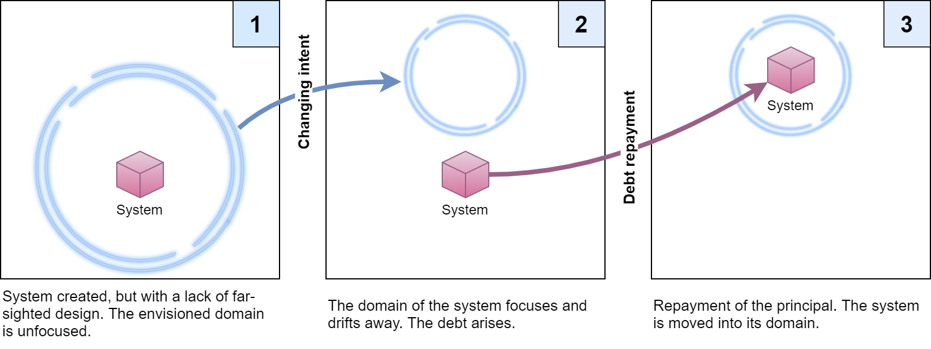
Domain Level Technical Debt in Practice (RQ1)
Notes:
Causes: lack of planning, no shared common focused vision, agility, complex project structure.
Envisioned domain was too vague, clients not sure what they want.
Domain debt is that people did not understand that those were not tenants that they were developing, but product variants. Initially valid decisions became invalid with time. Not detectable directly from code.
Domain knowledge needed to design a solution. Use cases from domain not fulfilled.
Principal: requires more than system redesign, establish vision, involve experts, implement multi-configuration support.

Slide 15
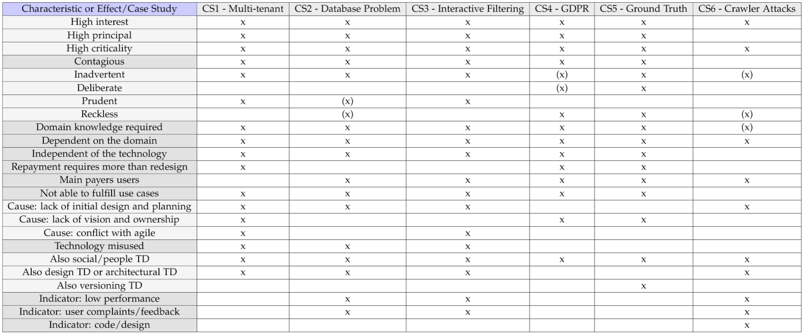
Domain Level Technical Debt in Practice (RQ1)
1. Relatively expensive: high interest, high principal, high criticality.
2. Repayment requires more than changing the system: cultural and organizational changes.
3. Requires domain knowledge for identification and management.
4. Independency from technology. Not caused by the technology.
5. Users and business departments are main interest payers.
Case Studies
CS1 … CS6
analyzed and compared to each-other.
…
Notes:
In total 19 characteristics. Taking a look at the first 5.
Expensive: high interest, principal and criticality.
Repayment: cultural and organizational changes.
Domain knowledge: needed for identification and management.
Independency: debt not caused by the tech, but the mismatch between the tech and the domain.
Users often payers: usability issues, use cases not fulfilled.

Slide 16
Identifying Domain Level Technical Debt (RQ2)
Total weight: 153
Threshold: 50
Threshold and weights specified through experiments with TD items.
Structured into four categories:
1st Order: part of the definition of domain level TD.
2nd Order: describe the core nature of domain level TD.
3rd Order: common for domain level TD, not so common for others.
4th Order: common for domain level TD, common for others.
Questions and wording validated by 8 senior software engineers.
Notes:
Based on characteristics, developed a checklist for identifying domain debt.
Goal: if you have an item of TD, you can take the checklist, go through the questions and understand if it belongs to domain debt.
Diagram: Structured the list into 4 categories with different weights. A total of 20 questions.
Threshold: experimented with examples to get a working system.
First Order: very closely linked to domain debt. Part of its definition.
Second Order: describe core nature of domain debt. Significantly distinguishes domain debt from other types.
Third Order: common for domain debt, not so common for other types.
Fourth Order: common for domain debt and common for other types.

Slide 17
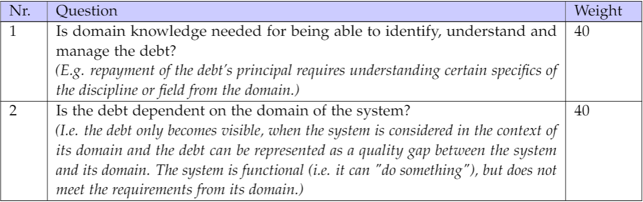
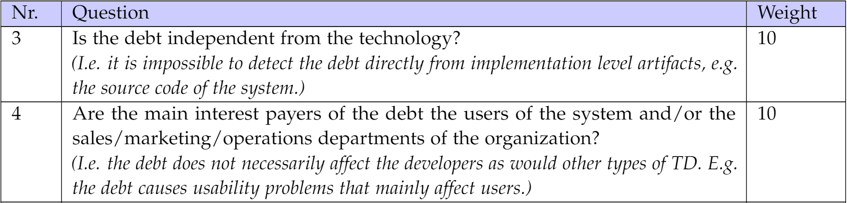
Identifying Domain Level Technical Debt (RQ2)
Examples of questions:
1st Order
2nd Order
…

Slide 18
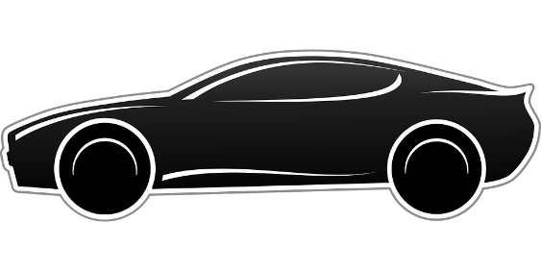

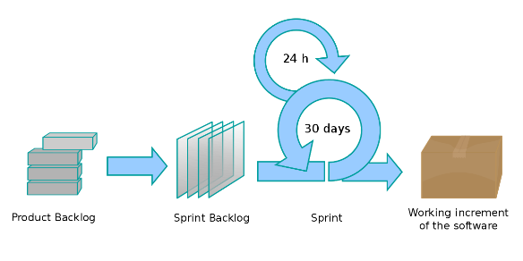
Impacts of Different Types of Technical Debt (RQ3)
The Candidate Project
Large German automotive company
Team 10 developers
> 50.000 users worldwide
Agile
Since 2015
Transition in 2020
Notes:
RQ3: impacts of different levels of TD.
Research and repair system. Research and order parts for various vehicles. Users mainly car dealerships.
2020 the system transitioned from another company to QAware.
Mainly during this transition the previously presented list was created.

Slide 19
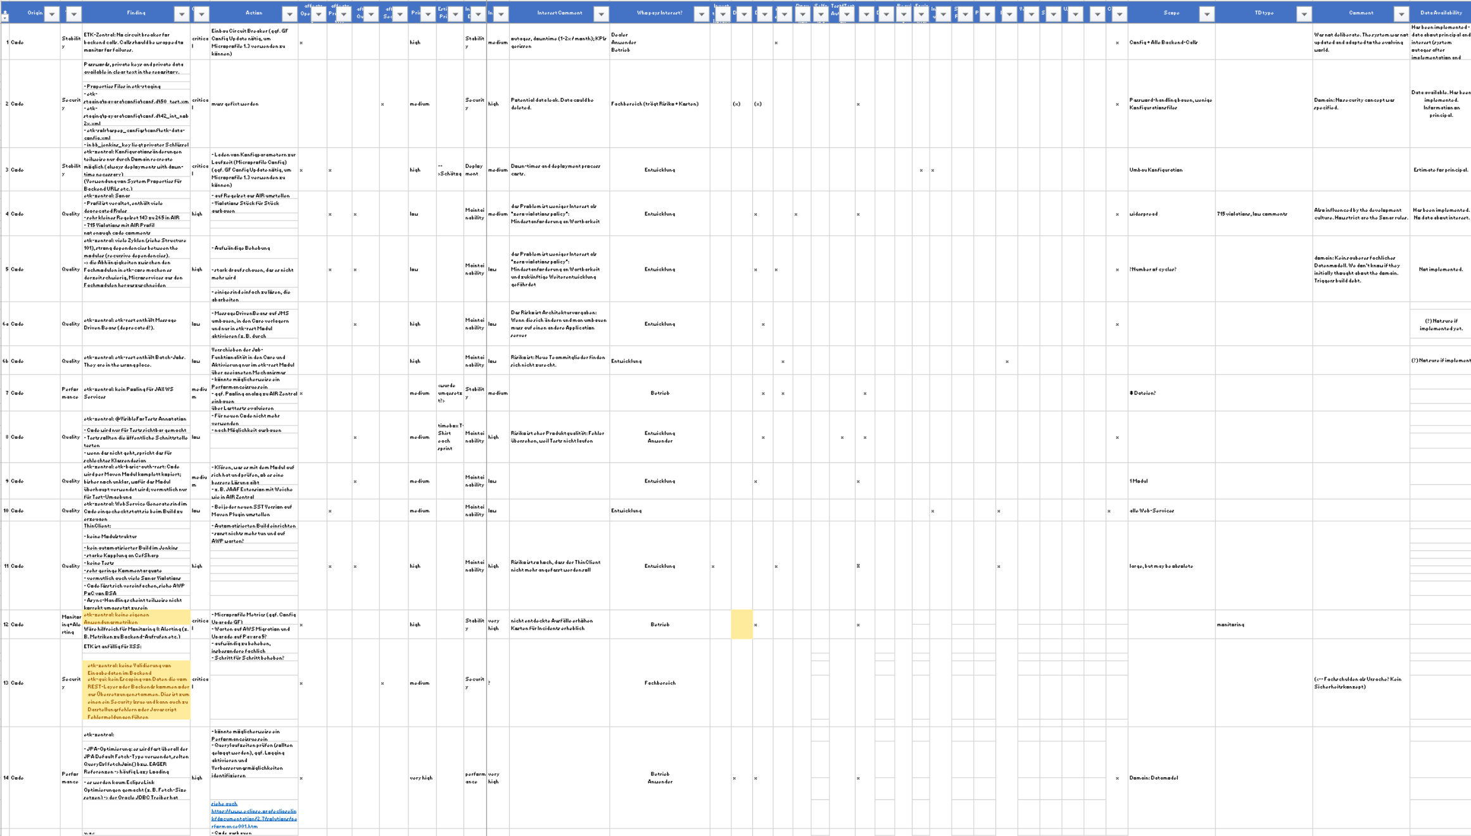
Impacts of Different Types of Technical Debt (RQ3)
List of TD items
Contains 87 entries
Systematically compiled within 2 months by 4 senior software architects.
Contains information about:
Interest
Principal
Effects
Interest Payers
Criticality
Categorization based on the TD ontology
Notes:
Based on the overall list of TD. Had to be sanitized to remove confidential info.
A total of 87 items.
Systematically compiled within 2 months by 4 senior software architects.
All available software artifacts taken into account.
The list has high quality and level of detail, as forms a basis for responsibility when taking over the project.
Limitation: the list is not complete. Does not contain all smaller issues.
Data about interest, principal, effects, interest payers, criticality. Economic and technological impact.
Categorization based on the ontology identified from previous literature. Domain debt added.

Slide 20
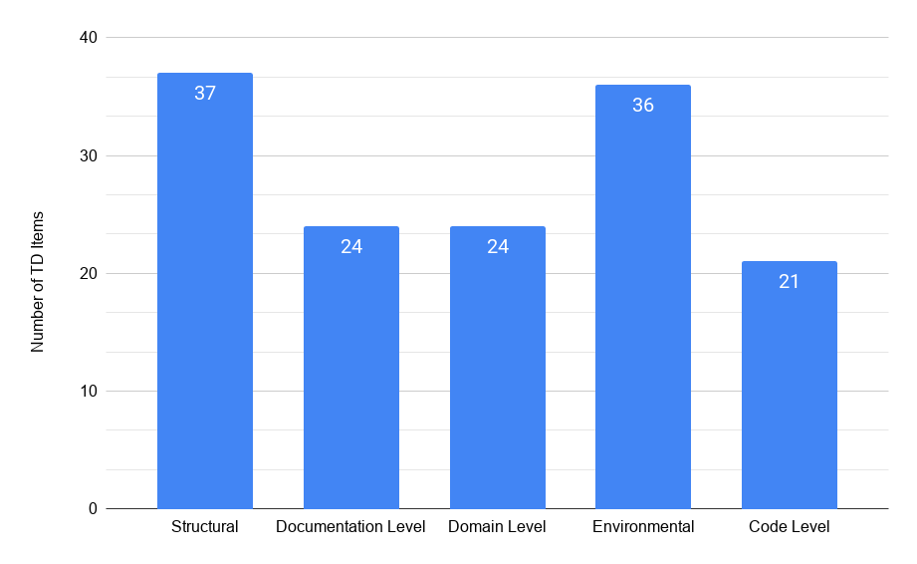
Impacts of Different Types of Technical Debt (RQ3)
Proportions
Notes:
Proportions of different types of TD.
Fine-grained TD types had to be grouped into more abstract levels, due to small sample sizes and uneven distribution.
Most dealing with structural and environmental issues.
Less with code level issues.
Limitation: possibly smaller issues not on the list or grouped into other items. List not complete.

Slide 21
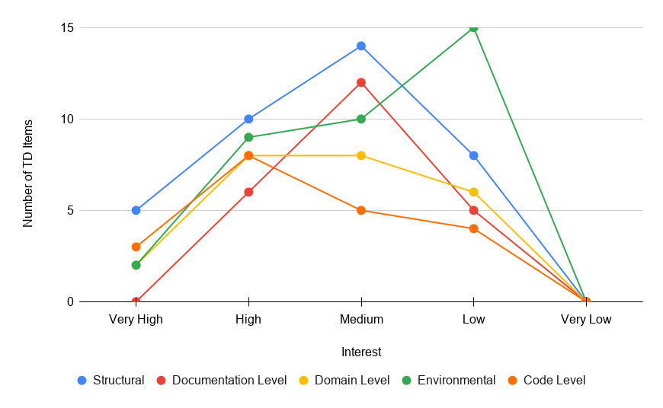
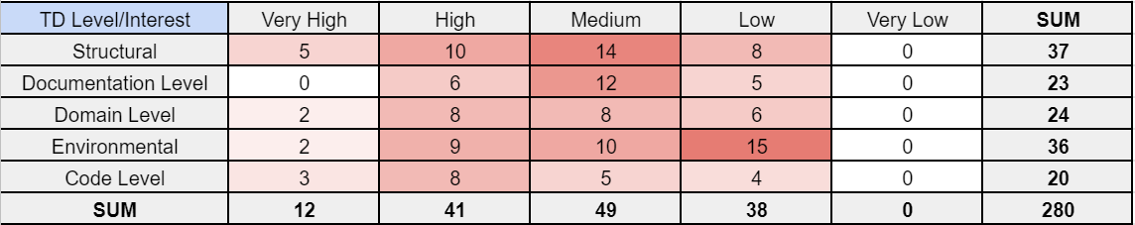
Impacts of Different Types of Technical Debt (RQ3)
Cost of the Interest
Not statistically significant
Notes:
The interest of the different levels.
For costs wasn’t able to prove that there is any statistical significance. Sample sizes small and were a vague estimate from “Very High” to “Very Low”.
Not backed up by enough data from issue tracking software.
Contingency table with observed frequencies and the resulting graph.
Most follow a similar pattern and have a peak at “medium”.
Environmental often a “low” interest rate.
Code level often a “high” interest rate.

Slide 22
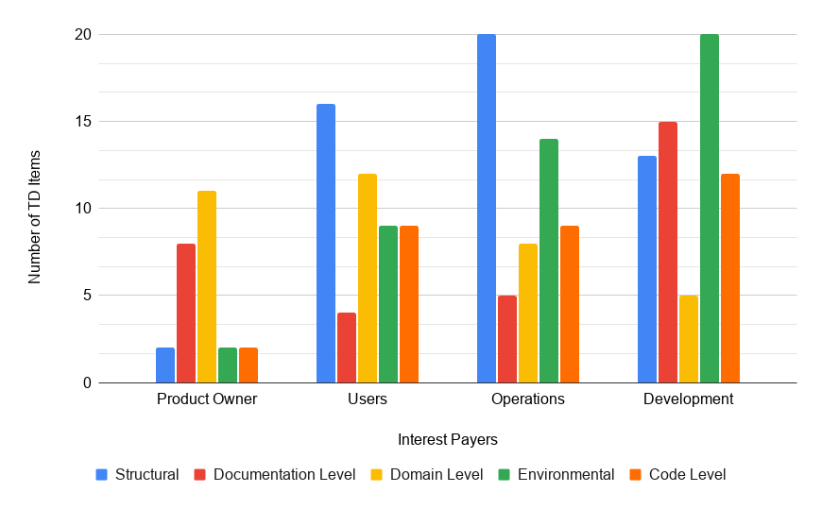
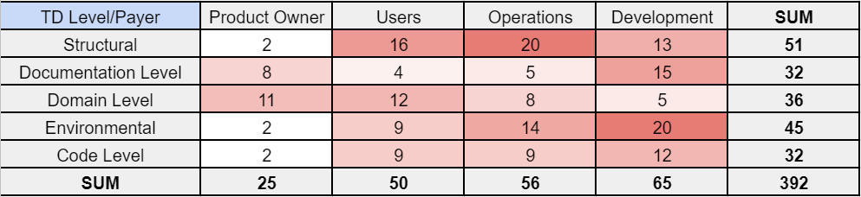
Impacts of Different Types of Technical Debt (RQ3)
Interest Payers
Statistically significant
Notes:
The interest payers of different levels.
Statistical significance proved. Dependency between payer and TD level.
Contingency table with observed frequencies and the resulting graph.
Domain debt mainly “users” and “product owners”. Confirms previous characteristics.
Code level debt mainly “developers”.
Documentation often “product owners” and “developers”.
Structural debt often “operations department”.
Environmental debt often “developers” and “operations department”.

Slide 23
Limitations
Reliability
Case studies rely on subjective opinions, but interviewees were both experienced senior software consultants.
The list of TD items relies on subjective opinions, but compiled by 4 senior software architects. Later validated and complemented with data from issue tracking software.
Checklist based on qualitative studies, but validated by senior software engineers, familiar with the concept of TD.
Generalizability
Data collected from a single company. Cultural and organizational biases.
The list of TD items collected from one project.
Notes:
First, it was a qualitative study.
Both software consultants are well acquainted with the subject of this thesis and have previously studied the concept of domain level TD.
Research does not take into account international specificities and the results may not be applicable to other organizations and countries.
Possible that due to the specifics of the project, the results of the study cannot be generalized to other projects.

Slide 24
Conclusion and Future Work
Conclusion
A new more high level type of TD was mapped and analyzed.
Characteristics and effects of domain level TD in practice were listed.
A checklist for identifying and measuring domain level TD was proposed.
Different levels of TD were assessed in a project from practice.
Future Work
A more comprehensive and large-scale study about domain level TD.
The domain debt checklist needs further work:
Validation in practice
Extensions
Validation and adjustment of the weighting system
More research on higher levels of TD.
Notes:
Future Work:
Not only one company, but many.
Checklist validation in multiple projects and companies.

Slide 25

Thank You!
Questions / Feedback

Slide 26
B.Sc.
Joonas Palm
joonas.palm@tum.de
17132

Slide 27
Domain Level Technical Debt in Practice (RQ1)

Slide 28
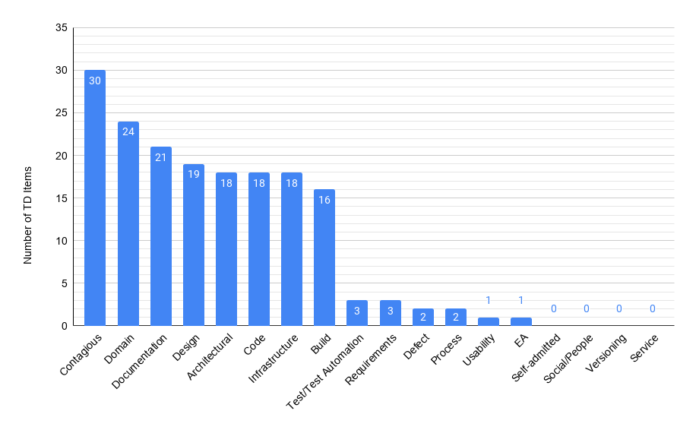
Impacts of Different Types of Technical Debt (RQ3)
Notes:
Proportions of different types of TD.
Most items were in the categories from “contagious” to “build” debt.

Slide 29
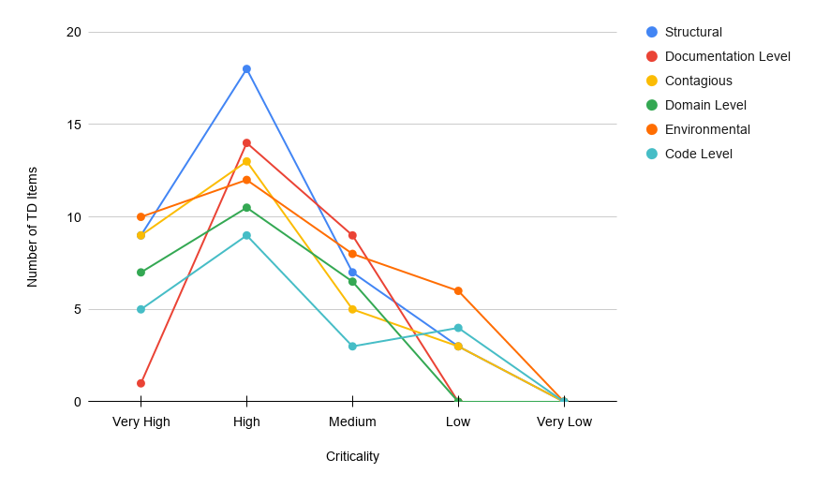
Impacts of Different Types of Technical Debt (RQ3)

Slide 30
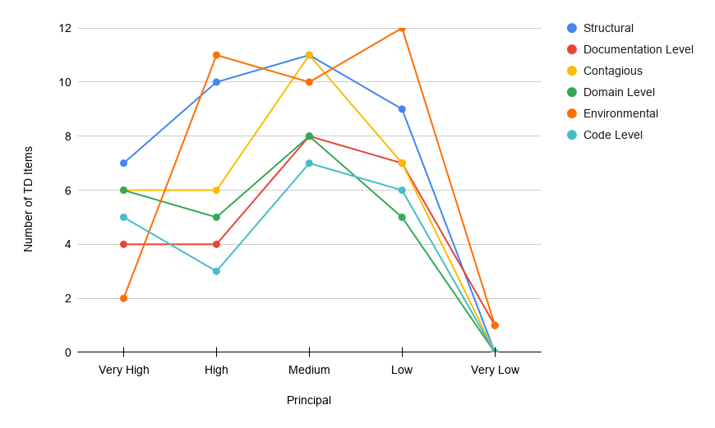
Impacts of Different Types of Technical Debt (RQ3)

Slide 31
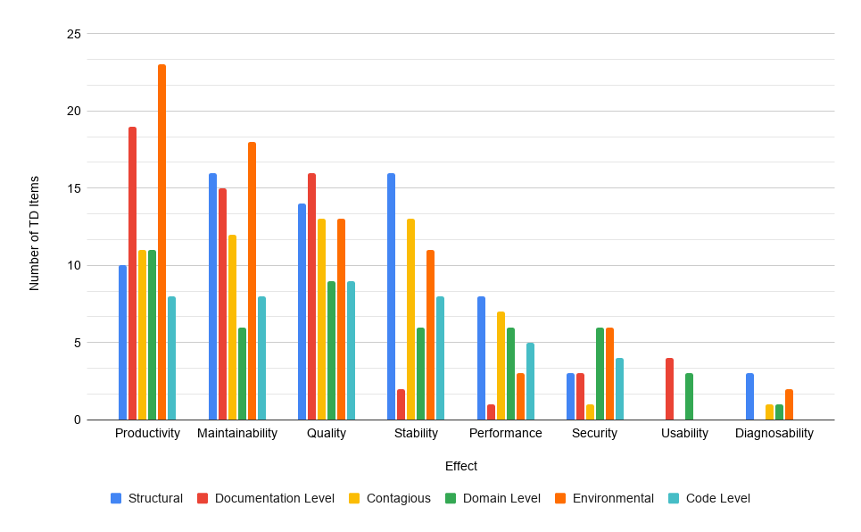
Impacts of Different Types of Technical Debt (RQ3)

Slide 32
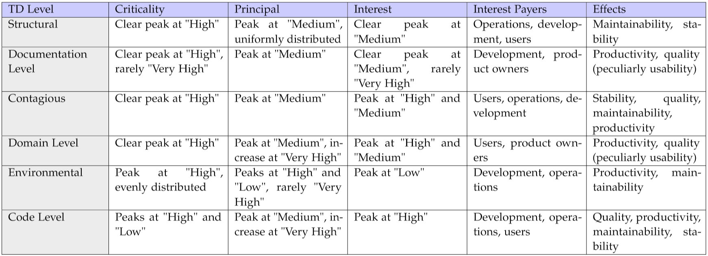
Impacts of Different Types of Technical Debt (RQ3)

