Slide 1

“Implementation of K-Anonymity for the Use Case of Automotive Industry in Big Data Context.”
Sharada Sowmya, 26.10.2020 – Master Thesis Kick-off Presentation

Slide 2
Outline
1)Motivation and Problem Statement
2)Proposal
3)Research questions and Approach
4) Current Results
Existing techniques of k-anonymity Methods
Use Case - Deep Dive
Software architecture diagram - First version
5) Timeline and Next Steps

Slide 3
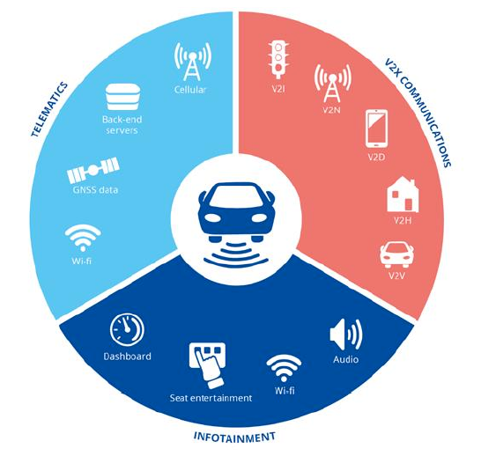
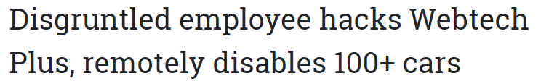



Motivation and Problem Statement
Connected Car is a vehicle that is equipped with Internet access which enables the vehicle to share the internet connection with other devices.
According to recent survey, these connected Cars generate upto 25GB of data per hour.
Collected data includes driver and passenger data, driving behavior, biometric, health, location and communication data.
Analytical functions on behavioral car datasets to provide improved personalized driving experience pose privacy threats.
Aggregated data sets can be used to achieve general product improvements as well.
Notes:
https://www.upstream.auto/blog/infographic-top-real-world-threats-facing-connected-cars-fleets/
https://edps.europa.eu/data-protection/our-work/publications/techdispatch/techdispatch-3-connected-cars_en

Slide 4

Proposal - De-Identification methods and k-anonymity
How is this helpful?
allows data to be used without the possibility of sensitive data being identified.
with minimal or no information loss, analytics performed on the dataset returns valid outcomes.

Slide 5





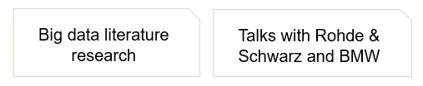



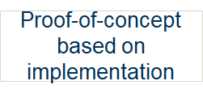
Research Questions and Approach
Notes:
what are the requirements for k-anonimity for big data implementation
How can k-anonymity be implemented for big data?
How does the solution architecture for k-anonimity look like?
How can k-anonymity be implemented for big data?
How can a k-anonymity implementation for big data look like?
How can we design a k-anonymity implementation for big data?
Overall goal: Design of a k-anonymity implementation for big data

Slide 6




Existing techniques of k-anonymity Methods for De-identification of data sets
Transforming k-anonymization problem to k-member clustering problem.
Distance and cost functions are custom specified.
Uses multidimensional recoding model for k-anonymity.
Uses greedy approximation algorithm for quality metrics.
Produces full-domain generalizations of the data model.
Key ideas used are bottom-up aggregation along generalization dimensions.
Key concepts used are full domain global recoding, hierarchical generalisation and minimal suppression.
Uses greedy algorithm to search the domain generalisation hierarchy.
Notes:
Technique to be chosen depends on data model also.
https://academic.oup.com/jamia/article/16/5/670/804120#100523873

Slide 7


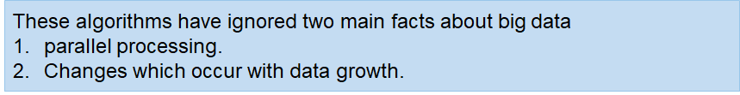
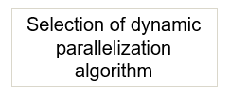
Requirements for big data k-anonymity
breaks down data while walking through the taxonomy tree from the top towards the bottom.
starts from the topmost domain values in attribute tree, specialization is performed until k-anonymity is violated.
generalizes the data from the bottom of the taxonomy tree towards its top.
the attributes are suppressed or generalized until each row is identical with at least k-1 other rows.
Two-phase TDS approach can be used.
Approaches like Parallel BUG and Hybrid BUG.
Exploration of approaches combining both is a good option as well.

Slide 8


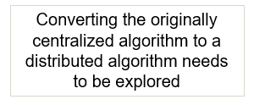
Requirements for big data k-anonymity
VS
can be viewed ‘integrate-then-generalize’.
Generalization is performed on integrated data set post any write or update.
Usefulness of data is guaranteed for analytical purpose.
On big data sets, this approach could lead to space and time complexities.
can be viewed as ‘generalize-then-integrate’.
Generalization is performed on horizontally partitioned dataset.
Two challenges in this approach -
Data utility of anonymous integrated data set should be good.
Prevention of data leak in the final anonymous integrated table.
Notes:
Technique to be chosen depends on data model also.
https://academic.oup.com/jamia/article/16/5/670/804120#100523873

Slide 9


ARX - Data Anonymization Tool
Scalable upto 50 dimensions.
Support to multiple privacy models like k-anonymity, t-closeness, l-diversity, δ-Disclosure privacy.
Provision to decide data utility measure.
Uses combination of Mondrian and Incognito algorithms in a top-down specialization manner.
Proven and widely used solution for data anonymization using k-anonymity.
The solution can be further extended to other privacy models.
No support for anonymization of location data.
Since the tool uses centralized approach, issues exist with space and time complexities.

Slide 10
Use Case
Connected Cars generate data. This data can be useage-based data such as mileage or event based data such as automatic service call.
Having consent of the car owner, this data can be made accessible for corporate third parties.
Two interesting use cases for third parties were found post interviews conducted at BMW.
Use case | Focus | Threat | Attributes used from dataset
Advertisement | Smart placement of billboards based on drivers driving patterns like frequent traversed location and more stoppage time. | The most traversed path is extracted from dataset without revealing location or identity of car/driver. | car_id, isc_timestamp, gps_lat, gps_long, car_type, car_model
Smart charging stations | Smart placement of charging stations based on drivers driving patterns like the most frequent places where the car is likely to run out of charge. | The optimal location of the smart charging station is derived without revealing the location or identity of the car/driver. | car_id, isc_timestamp, gps_lat, gps_long, charging_method, smart_charging_status, remaining_charging_time, fuel_percentage
Notes:
Smart home/smart charging stations based on charging data
Workshops can deliver individual or customer specific maintenance service based on service related data

Slide 11
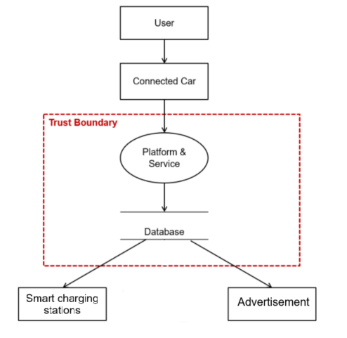
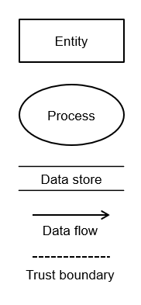
Data-flow diagram(DFD) of the connected car use case
Notes:
May be add attribute type here ??

Slide 12
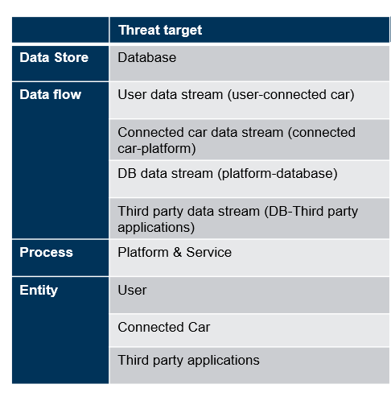
Privacy threat modelling of the DFD - LINDDUN methodology
Notes:
May be add attribute type here ??

Slide 13
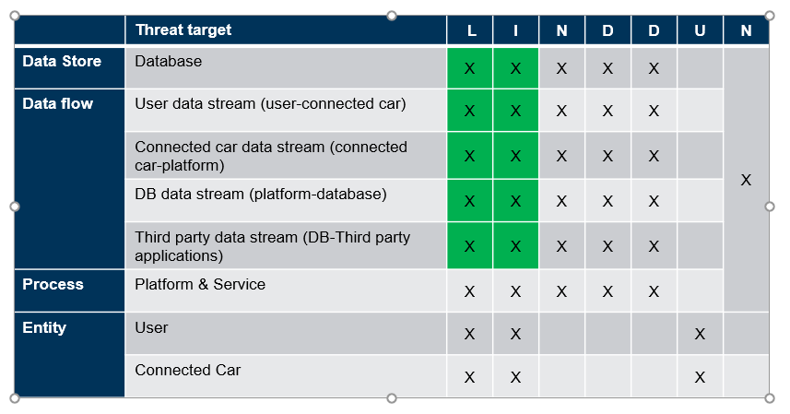



Privacy threat modelling of the DFD
Linkability
Identifiability
Non-repudiation
Detectability
Information Disclosure
Content Unawareness
Non-compliance
Privacy threat mitigation through de-identification is possible.
Privacy threat mitigation through de-identification is not possible.
Notes:
May be add attribute type here ??

Slide 14
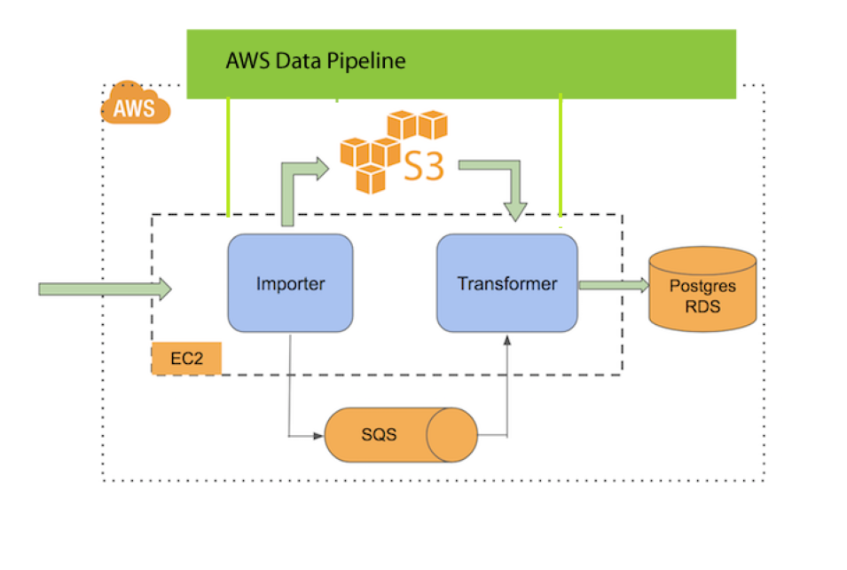
Software architecture diagram - First version
Framework for a distributed privacy model pipeline.
Step 1: Data Importer is an EC2 instance which will fetch the data from an external API.
Step 2: Data is backed up into S3.
Step 3: Data Importer will send a message to queue on SQS once data backup is complete.
Step 4: Data Transformer is an EC2/EMR instance which listens to the queue and starts de-identification process.
Step 5: De-identification process includes partitioning of the dataset and applying de-identification methods in a distributed manner
using AWS Data pipeline.
Step:6: Storing anonymized data into Postgres database is the last stage of the data pipeline.
Notes:
May be add attribute type here ??

Slide 15
Test dataset for applying de-identification methods
Attribute Name | Attribute value | Attribute unit | Attribute type(in postgres)
car_id | 80248072 | NaN | INT
car_model | X1 | NaN | CHAR
charging_method | AC_TYPE1PLUG | NaN | VARCHAR
charging_status | CHARGING_ACTIVE | NaN | CHAR
smart_charging_status | RENEWABLE_OPTIMIZED | NaN | CHAR
remaining_charging_time | 1300 | min | INT
fuel_percentage | 72.5 | NaN | FLOAT
mileage | 224000 | km | INT
isc_timestamp | 02.06.201908:30:00UTC | NaN | TIMESTAMP
gps_lat | 43.257 | WGS84 | FLOAT/GEOGRAPHY
gps_long | 110.234 | WGS84 | FLOAT/GEOGRAPHY
temperature_external | 16 | degreescelsius | INT
Notes:
May be add attribute type here ??

Slide 16
Next steps
Literature review
Distributed pipeline for big data architecture.
Design System Architecture
Setup interviews with BMW and Rohde and Schwarz to design the system architecture.
Evaluate the technology stack feasible with design architecture.
Get access to all platforms required to implement the finalized system architecture.
POC implementation and Evaluation
Evaluated the privacy based on existing approaches.
Identify ways to measure utility of data.
Notes:
May be add attribute type here ??

Slide 17
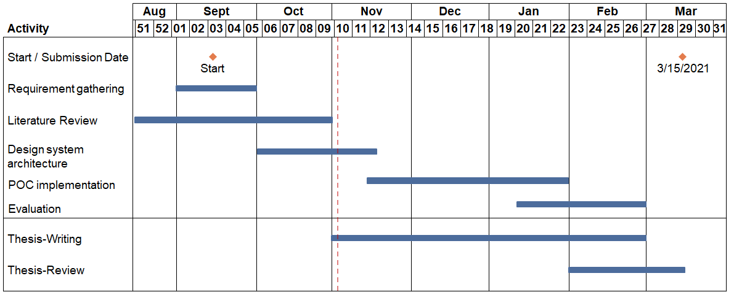
Timeline

Slide 18
Sharada Sowmya
17132
matthes@in.tum.de

