Slide 1
Supporting diverse stakeholders to make informed decisions about the use of differential privacy with a web-based e-learning application
Marcus Land, 10.08.2020, Master Thesis: Initial Presentation

Slide 2
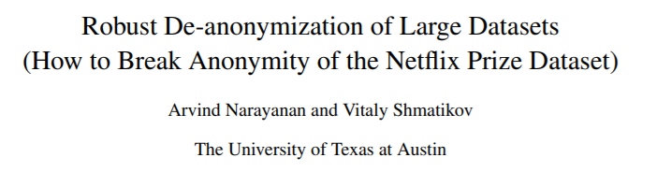

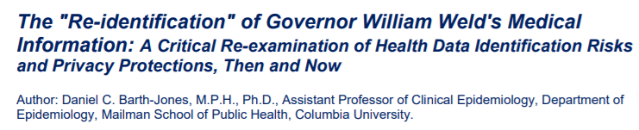
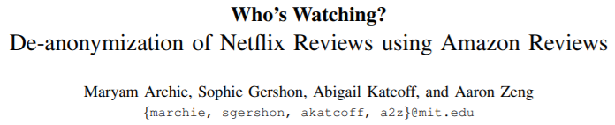
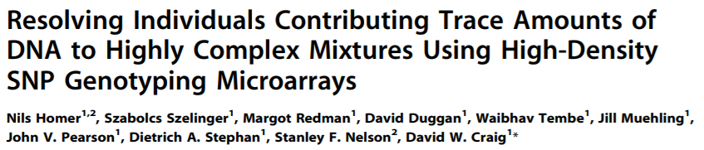
Motivation: The Threat of De-Anonymization

Slide 3
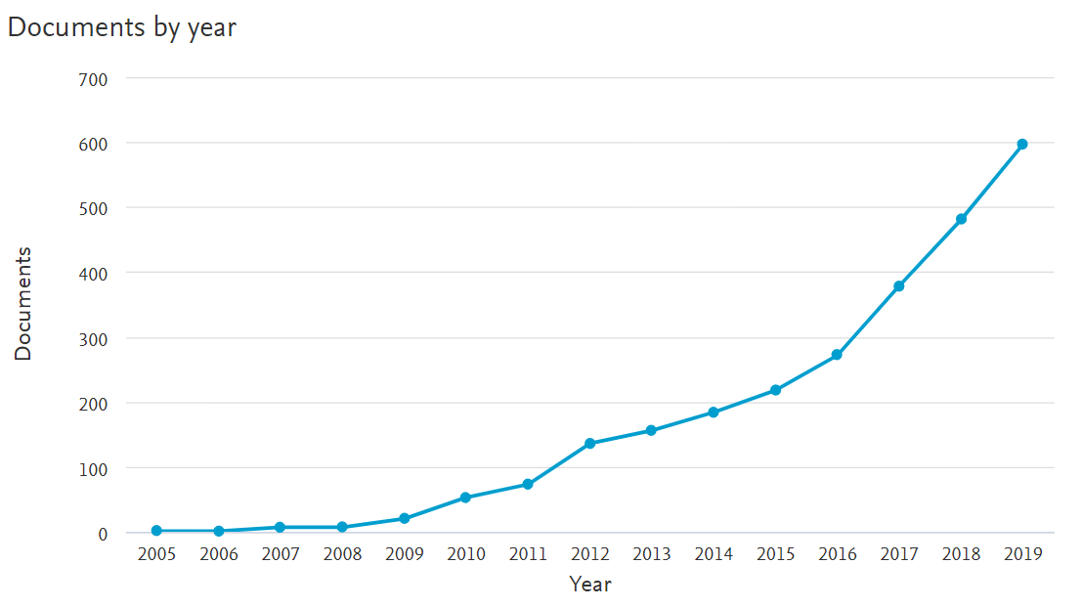
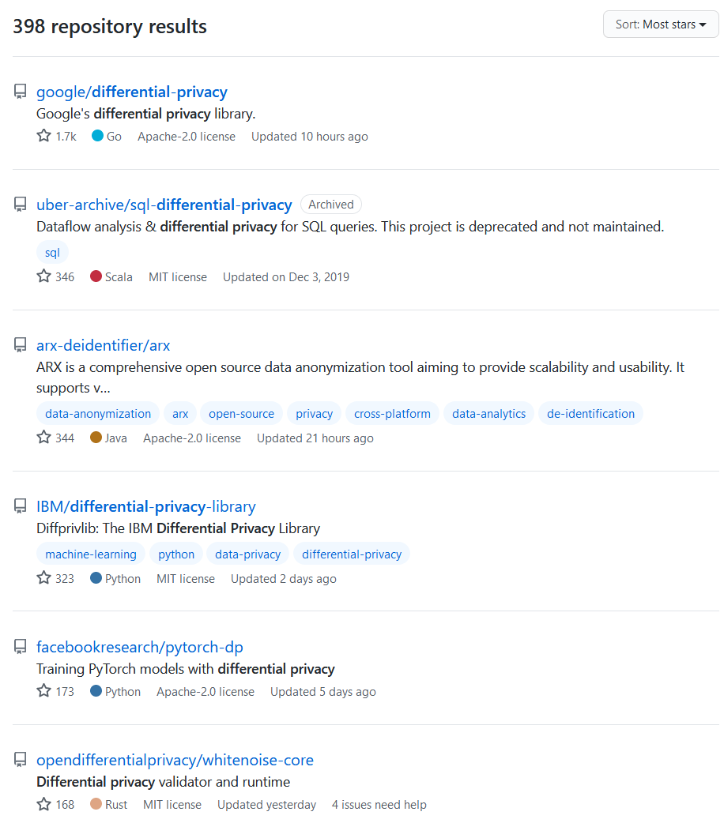

Motivation: Differential Privacy - A Trending Topic
*
* According to Scopus, using the search term “differentia* priva*” in title, keywords & abstract

Slide 4

Differential Privacy: Definition
“It (Differential Privacy) ensures, that any sequence of outputs […] is ‘essentially’
equally likely to occur, independent of the presence or absence of any individual” ^{[1]}
X
Process
Output + Noise
Equally
likely *
Process
Output + Noise
*
$$For two neigbhoring databases X and X^{′}: \frac{1}{e^{ε}}≤\frac{P(Response=r|X)}{P(Response=r|X′)}≤e^{ε}$$
Variance $=2∗{(\frac{sensitivity}{ε})}^{2}$

Slide 5



Differential Privacy: Advantages
Privacy loss can be quantified
Privacy Budget ɛ
No need for attack modelling
Assumes omnipotent adversary
Can be adapted
to many use cases
Versatile

Slide 6
Differential Privacy: Challenges
Privacy loss can be quantified
Privacy Budget ɛ
Limited amount of utility
No need for attack modelling
Assumes omnipotent adversary
Ignores context
Can be adapted
to many use cases
Versatile
Complex

Slide 7
Research Questions
What are potentials and limitations of differential privacy?
Methods: Literature Research & Interviews
How to guide decision-making throughout the application of differential privacy?
Methods: Literature Research & Interviews
How can e-learning be used to teach differential privacy to various roles within a company?
Deliverable: Slide deck containing the condensed information
Deliverable: Guidelines to decide if one should use differential privacy and how to do so
Deliverable: Web-based e-learning application
Identifying benefits, drawbacks and use cases of differential privacy as well as potential alternatives
When and how to use differential privacy. Common pitfalls and best practices.
Agile Development
REACT Frontend + Python Backend (Flask)
Methods: Literature Research, Implementation & Evaluation

Slide 8
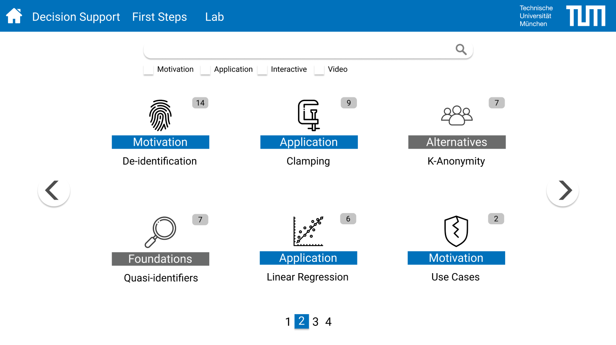

Slide 9
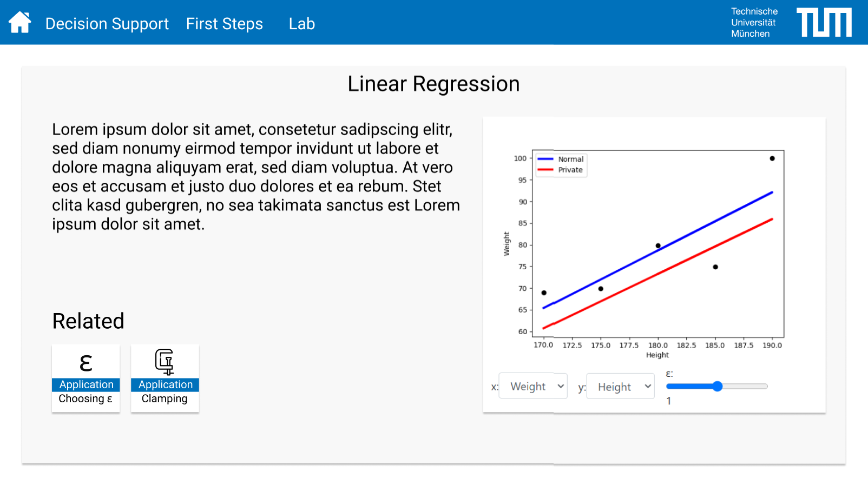

Slide 10
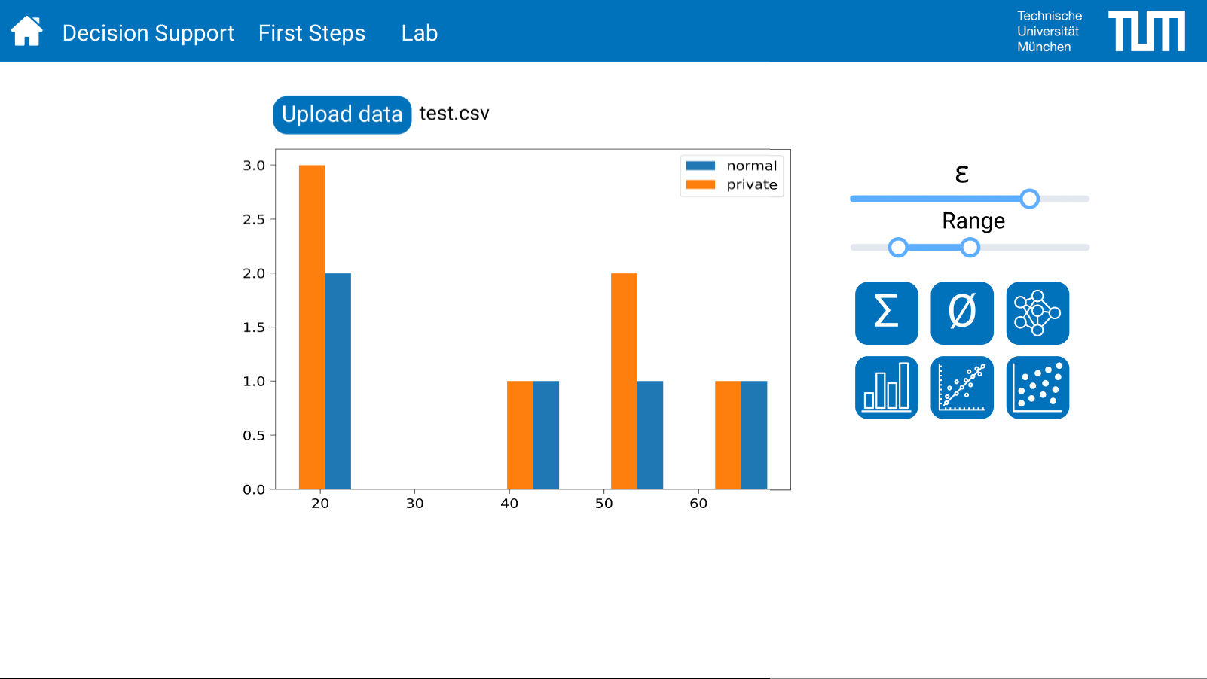

Slide 11
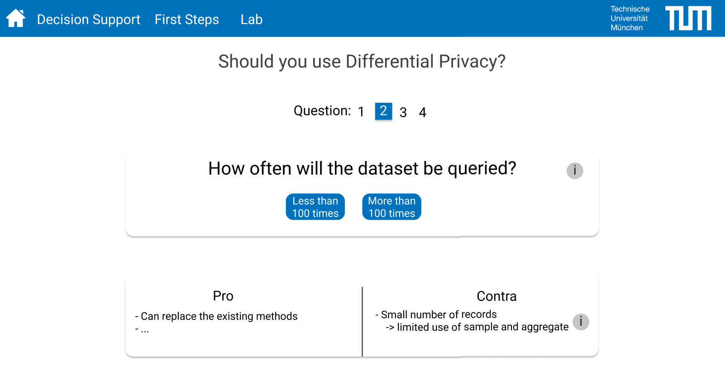

Slide 12
Research Approach: Requirements
Relevant
Useful for practitioners
Grey Literature
Unbiased
Topic selection is transparent and objective
Comprehensive
No important topic is left out
Systematic Approach
Extendible
Creating the learning content is repeatable

Slide 13
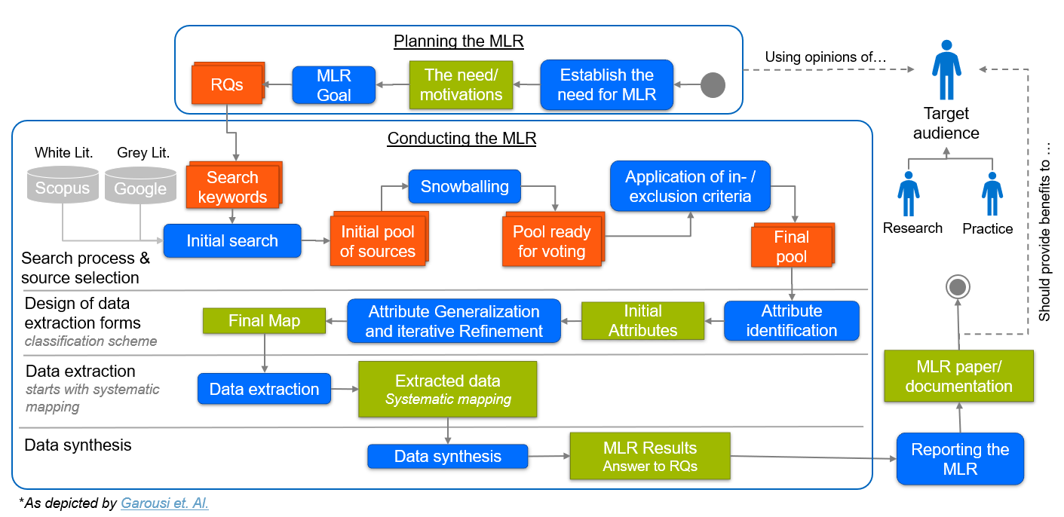
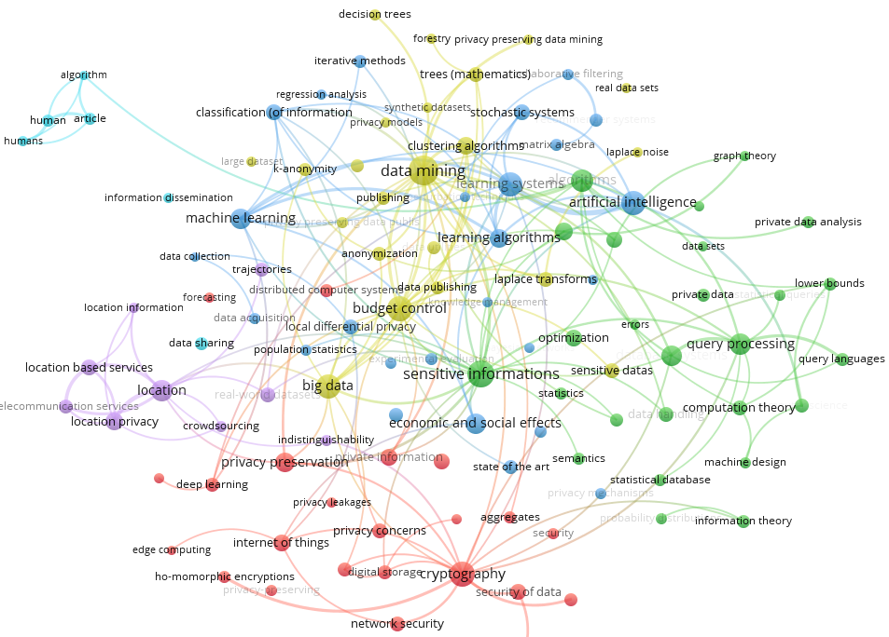
Research Approach: Design Science ^{[2][3]}
Environment
Knowledge Basis
Semi-structured Interviews
Rele-
vance
Problem identification & motivation
Rigor
Multivocal Literature Review ^{[4]}
Topic Selection
Define the objectives for a solution
Business needs
Applicable knowledge
Guidelines
Design and development
Learning content
Decision guidelines
Web application
Science
Mapping
Evaluation
Demonstration
When to use differential privacy
How to use differential privacy
Motivation
Application
Evaluation
Use cases
Risks
Alternatives
Core Concepts
Common fallacies
Variations
Communication
Limitations
Existing tools
Best practices
Benefits

Slide 14

Timeline – What has been done so far
15.6
15.6
Thesis Registration
Submission
Literature Research
Pilot searches
Choose research method
Plan MLR
Conduct MLR
Science mapping
Pilot
interviews
Feedback
Interviews
Evaluation
List of contacts
Questionnaire
Design
Implementation
Prototype
Evaluate existing offers
List of Requirements
User stories

Slide 15
Sources
Dwork, C., & Roth, A. (2014). The Algorithmic Foundations of Differential Privacy.
Accessed at https://www.cis.upenn.edu/~aaroth/Papers/privacybook.pdf
Hevner et. al. (2004). Design Science in Information Systems Research. Management Information Systems Quarterly. Accessed at https://wise.vub.ac.be/sites/default/files/thesis_info/design_science.pdf
Peffers, Ken & Tuunanen, Tuure & Rothenberger, Marcus & Chatterjee, S.. (2007). A design science research methodology for information systems research. Journal of Management Information Systems. Accessed at http://citeseerx.ist.psu.edu/viewdoc/download?doi=10.1.1.535.7773&rep=rep1&type=pdf
Garousi et. al. (2018). Guidelines for including grey literature and conducting multivocal literature reviews in software engineering. Information and Software Technology.
Accessed at https://arxiv.org/ftp/arxiv/papers/1707/1707.02553.pdf
* All online sources have been accessed at the 08.08.2020

