Slide 1
Supporting diverse stakeholders to make informed decisions about the use of differential privacy with a web-based e-learning application
Marcus Land, 01.03, Master Thesis, Final Presentation

Slide 2
Outline
Introduction and problem statement
Research approach
Contribution
Evaluation
Conclusion

Slide 3



Introduction
Preventing unauthorized data access
Security measures
Security is about confidentiality, integrity and availability of data
e.g., access control, encryption, network security, firewalls
Safely releasing or analyzing sensitive data
Privacy measures
Privacy is about preventing unwanted disclosure
e.g., consent, de-identification, query auditing, output perturbation
Provable privacy guarantees
Differential privacy
$$e^{ε}$$
Differential privacy is the only approach that provides strong formal privacy guarantees ^{1,2} Whereas other privacy-preserving methods such as k-anonymity are vulnerable to various attacks ³

Slide 4
Definition of Differential Privacy
“It (Differential Privacy) ensures, that any sequence of outputs […] is ‘essentially’
equally likely to occur, independent of the presence or absence of any individual” ⁴
X
Process
Output + Noise
Equally
likely
Process
Output + Noise

Slide 5

The Practitioner's View
Should I use differential privacy
How can I use differential privacy?
What is differential privacy?
?

Slide 6



Research Questions
What are the benefits and challenges of using differential privacy?
Literature review, Interviews
What are the most important topics practitioners should know about?
Literature review, Interviews
How can these topics be conveyed?
Learning Nuggets

Slide 7
Outline
Introduction and problem statement
Research approach
Contribution
Evaluation
Conclusion

Slide 8
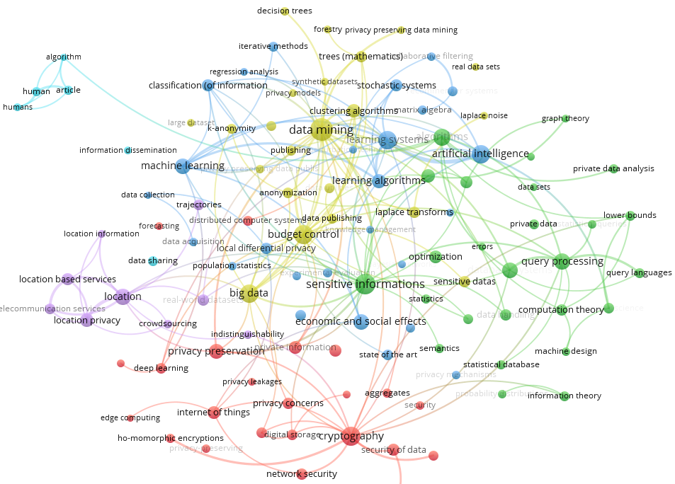

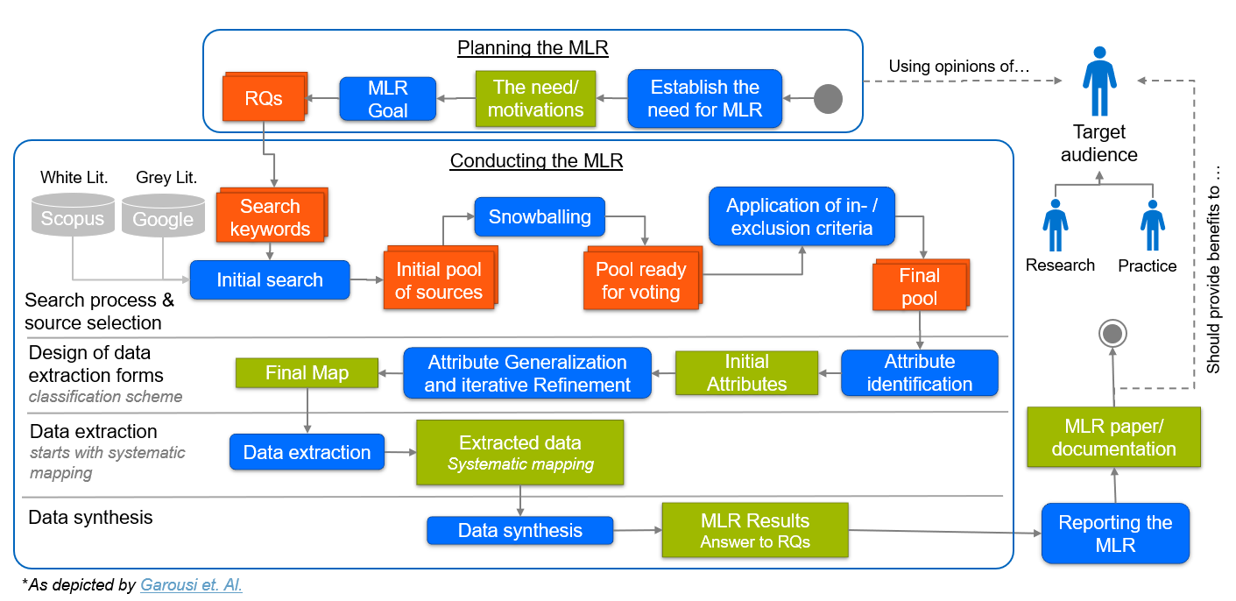

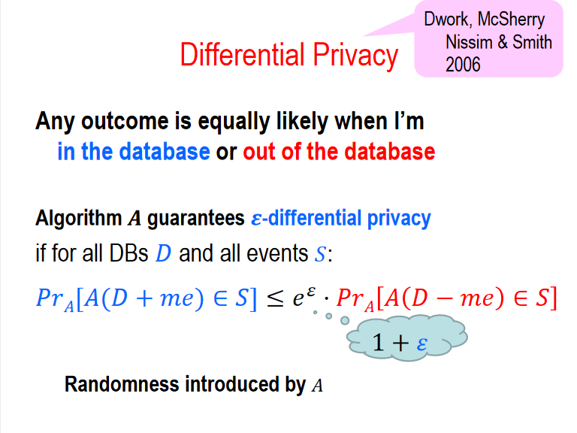
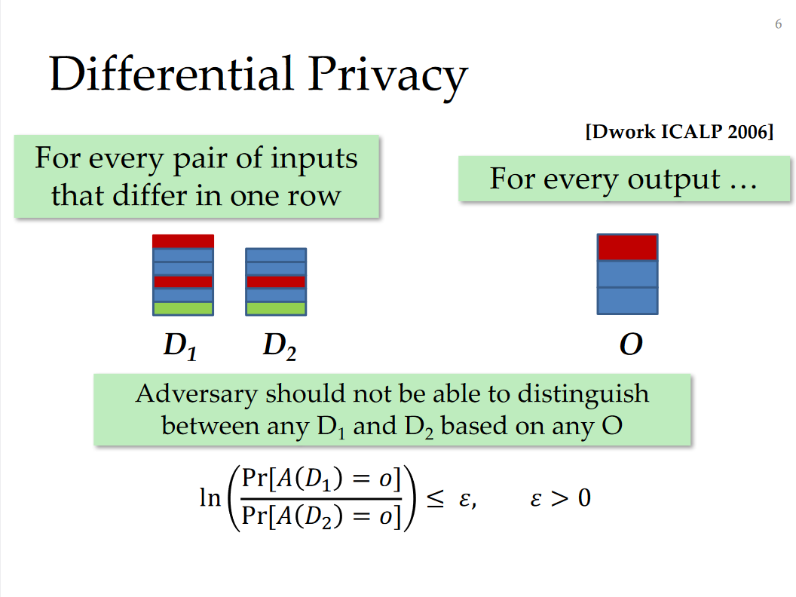
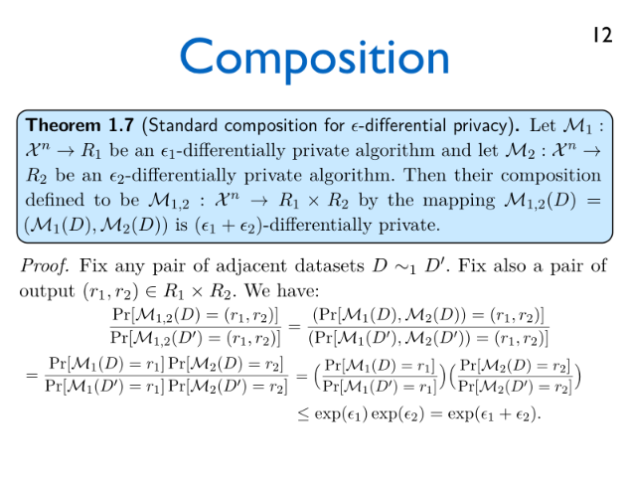
Research Approach
Environment
Knowledge Basis
Semi-structured Interviews ⁵
Rele-
vance
Problem identification & motivation
Rigor
Science
Mapping
Define the objectives for a solution
Overview of important research areas
Business needs
Applicable knowledge
5 experts
Design and development
Learning nuggets
Multivocal Literature Review
40 pages of transcripts
Demonstration
Scientific literature
Blogs
Whitepapers
Lectures
Git repositories
Evaluation
Communication
Adapted from Peffers et. al.⁶

Slide 9






The Interviews – Details
Diverse set of experts from vastly different companies
What motivated you to use differential privacy?
What are the benefits of using differential privacy?
What challenges did you face and how did you overcome them?
What tools and sources did you rely on when working with differential privacy?
How mature is differential privacy, in your opinion?
What topics should we cover in our learning content?
Their use cases ranged from simple statistics to data mining, machine learning and synthetic data
The interviews were scheduled for one hour
The questionnaire was adapted to the interviewee and sent to them in advance
The 6 key questions addressed in the interviews
Notes:
The use cases of them and their clients ranged from financial services to the automotive sector, healthcare, the public sector, telecommunication, location data, and machine learning in general

Slide 10
Outline
Introduction and problem statement
Research approach
Contribution
Evaluation
Conclusion

Slide 11

What Are the Benefits and Challenges of Using Differential Privacy?
Strong Privacy Guarantees
Low Utility
Versatility
Complexity
Framework to Discuss Privacy
Requires Change
Performance
Maturity
Notes:
Additional benefits
Parameterizable (Provides a parameter to trade off between privacy and utility)
Programmable (Composition, build more complex structures out of DP building blogs)
Transparency (Allows for transparency, guarantee does not rely on the secrecy of implementation details)
Quantifiability (Can quantify privacy risk)
Availability (Can make data more/faster available, accessible)

Slide 12
How Can These Challenges Be Addressed?
Low Utility
Put noise into perspective
Develop techniques to reduce noise
Complexity
Better references and tools
Requires Change
Performance
Mostly an issue of time
Maturity

Slide 13
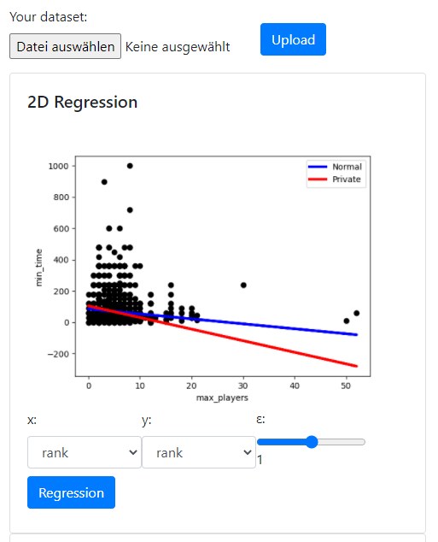
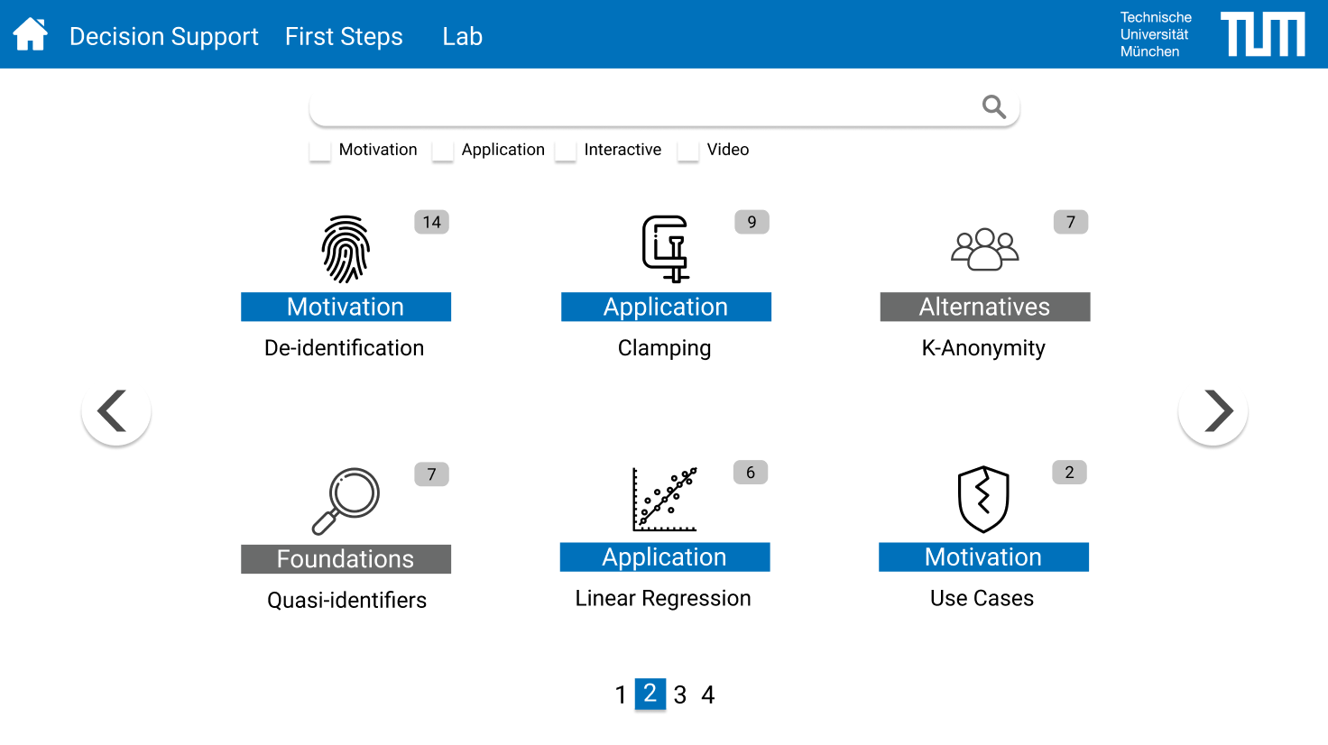
Learning Platform
We conceptualized a learning platform and developed a small prototype. The platform was later implemented by a group of students in a practical course
Mock-Up of the learning platform
Prototype of a “DP-Lab”

Slide 14

Example Learning Nugget – Introduction
Prerequisites
Necessary: the definition of differential privacy, the Laplace mechanism
Beneficial: the randomized response algorithm
Introduction
The Laplace mechanism can only be used for queries that are robust to perturbation and relatively insensitive to changes in the data of a single individual. It is not suitable for optimization problems or when dealing with non-numeric values
In this unit, you will learn how differential privacy can be achieved in these settings, using the exponential mechanism
We will cover the motivation, the formal definition, the proof and the accuracy of this mechanism
Learning Objectives
You can explain the exponential mechanism and why it is ε-differentially private
You can identify cases in which the exponential mechanism should be used
You can apply the exponential mechanism to a simple case
You can determine the accuracy of the exponential mechanism
You can model other differentially private mechanisms using the exponential mechanism

Slide 15
Example Learning Nugget – Content
In 2007 Frank McSherry and Kunal Talwar explored how differential privacy extends beyond disclosure limitation and can also give broad game theoretic guarantees¹
Intuitively, if the result of an analysis remains the same, regardless of an individual contributing their data or not, there is no incentive for individuals to misreport their data to influence the result in their favor
As the guarantee of differential privacy extends to groups as well, it is also resistant to collusion
However, when dealing with optimization problems, even adding a small amount of noise to the result could render it completely useless
Example
Consider a digital goods auction. A company has an unlimited supply of a certain item, such as a digital movie, and would like to determine the optimal price to sell it at
They survey 100 potential customers on how much they would be willing to pay for it (from 0 to 5$). But they want to conduct this analysis in a differentially private manner to preserve the privacy of the respondents and to discourage strategic lying
According to their findings, 75 of the respondents would pay at most 1$, whereas the remaining 25 would pay up to 4$ for the movie
Thus, the optimal price would either be 1$ or 4$ as both yield a revenue of 100$. But adding noise to this result could drastically lower the revenue. With a price of 4,01$ not a single movie would be sold, whereas a price of 1,01$ only yields a revenue of 25,25$

Slide 16
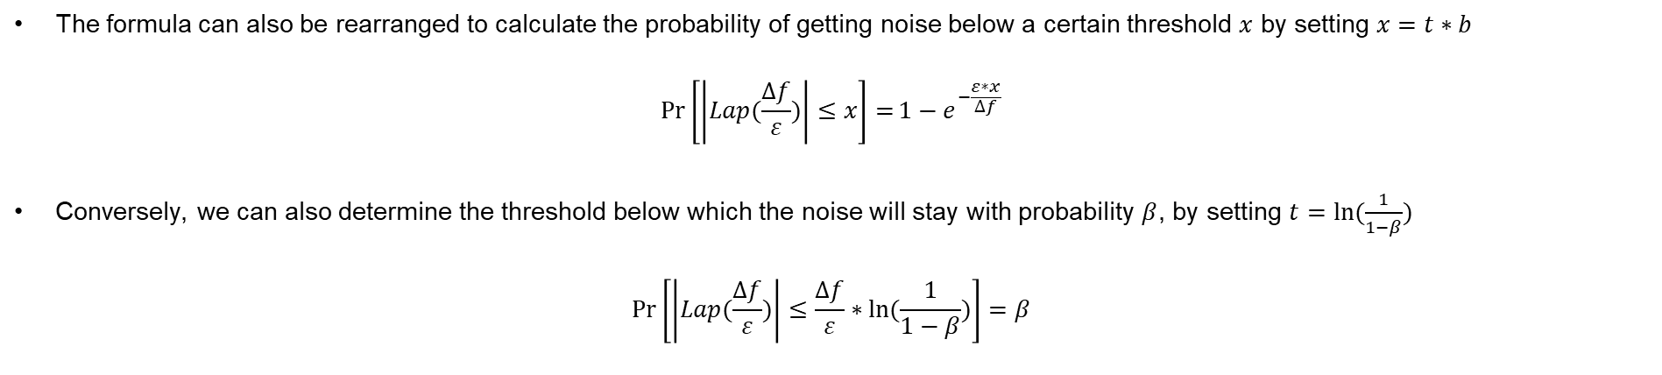
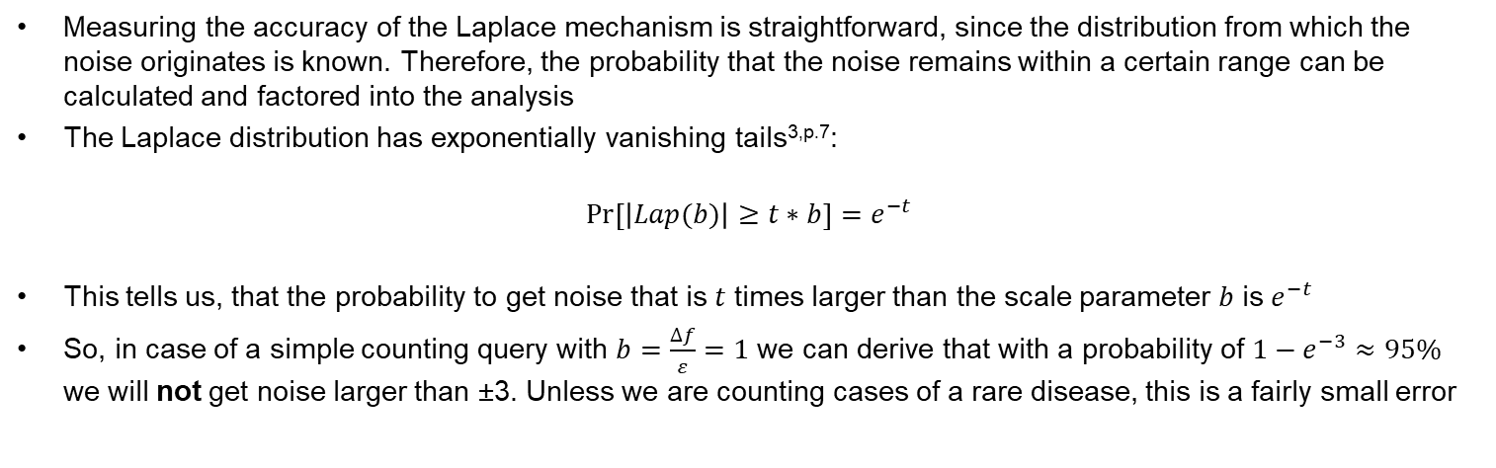
Example Learning Nugget – Interactive Elements
Measuring the accuracy of the Laplace mechanism is straightforward, since the distribution from which the noise originates is known. Therefore, the probability that the noise remains within a certain range can be calculated and factored into the analysis
The Laplace distribution has exponentially vanishing tails^{3,p.7}:
$$\operatorname{Pr}\left[\left|Lap(b)\right|≥t∗b\right]=e^{−t}$$
This tells us, that the probability to get noise that is $t$ times larger than the scale parameter $b$ is $e^{−t}$
So, in case of a simple counting query with $b=\frac{∆f}{ε}=1$ we can derive that with a probability of ${1−e}^{−3}≈95\%$ we will not get noise larger than ±3. Unless we are counting cases of a rare disease, this is a fairly small error
The formula can also be rearranged to calculate the probability of getting noise below a certain threshold $x$ by setting $x=t∗b$
$$\operatorname{Pr}\left[\left|Lap(\frac{∆f}{ε})\right|≤x\right]={1−e}^{−\frac{ε∗x}{∆f}}$$
Conversely, we can also determine the threshold below which the noise will stay with probability $β$, by setting $t=ln⁡(\frac{1}{1−β})$
$$\operatorname{Pr}\left[\left|Lap(\frac{∆f}{ε})\right|≤\frac{∆f}{ε}∗ln⁡(\frac{1}{1−β})\right]=β$$

Slide 17
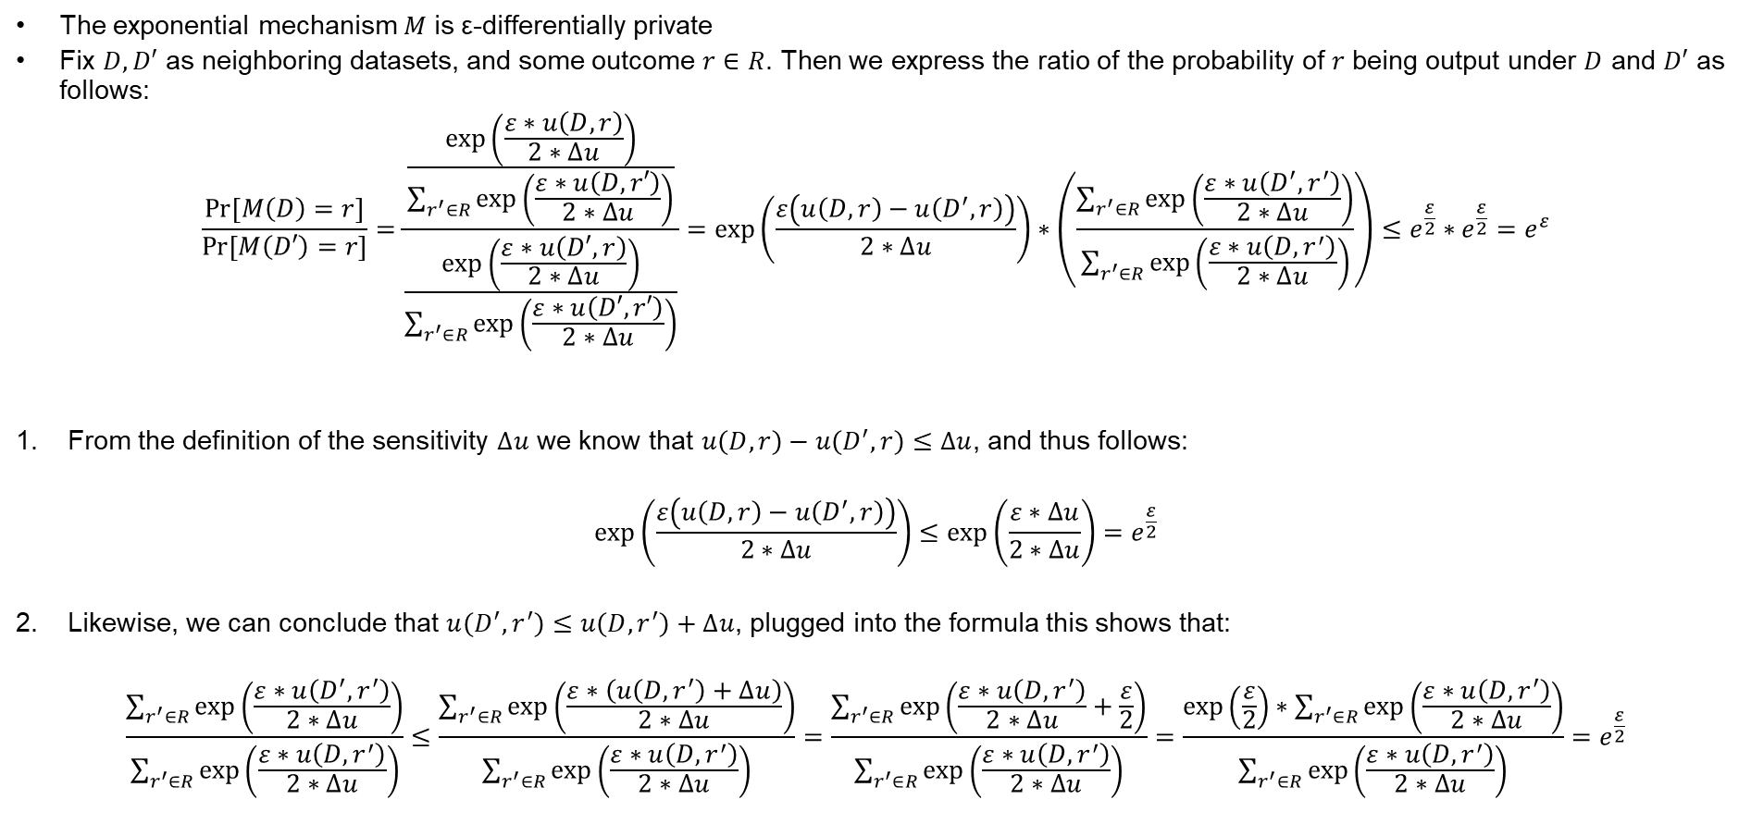

Example Learning Nugget – Proof
The exponential mechanism $M$ is ε-differentially private
Fix $D,D′$ as neighboring datasets, and some outcome $r∈R$. Then we express the ratio of the probability of $r$ being output under $D$ and $D′$ as follows:
$$\frac{Pr⁡[M\left(D\right)=r]}{Pr⁡[M\left(D′\right)=r]}=\frac{\frac{\exp\left(\frac{ε∗u\left(D,r\right)}{2∗∆u}\right)}{\sum_{r^{′}∈R}{\exp\left(\frac{ε∗u\left(D,r′\right)}{2∗∆u}\right)}}}{\frac{\exp\left(\frac{ε∗u\left(D′,r\right)}{2∗∆u}\right)}{\sum_{r^{′}∈R}{\exp\left(\frac{ε∗u\left(D′,r′\right)}{2∗∆u}\right)}}}=\exp\left(\frac{ε\left(u\left(D,r\right)−u\left(D^{′},r\right)\right)}{2∗∆u}\right)∗\left(\frac{\sum_{r^{′}∈R}{\exp\left(\frac{ε∗u\left(D^{′},r^{′}\right)}{2∗∆u}\right)}}{\sum_{r^{′}∈R}{\exp\left(\frac{ε∗u\left(D,r^{′}\right)}{2∗∆u}\right)}}\right)≤{e^{\frac{ε}{2}}∗e^{\frac{ε}{2}}=e}^{ε}$$
From the definition of the sensitivity $∆u$ we know that $u\left(D,r\right)−u\left(D^{′},r\right)≤∆u$, and thus follows:
$$exp\left(\frac{ε\left(u\left(D,r\right)−u\left(D^{′},r\right)\right)}{2∗∆u}\right)≤exp\left(\frac{ε∗∆u}{2∗∆u}\right)=e^{\frac{ε}{2}}$$
Likewise, we can conclude that $u\left(D^{′},r^{′}\right)≤u\left(D,r^{′}\right)+∆u$, plugged into the formula this shows that:
$$\frac{\sum_{r^{′}∈R}{\exp\left(\frac{ε∗u\left(D^{′},r^{′}\right)}{2∗∆u}\right)}}{\sum_{r^{′}∈R}{\exp\left(\frac{ε∗u\left(D,r^{′}\right)}{2∗∆u}\right)}}≤\frac{\sum_{r^{′}∈R}{\exp\left(\frac{ε∗\left(u\left(D,r^{′}\right)+∆u\right)}{2∗∆u}\right)}}{\sum_{r^{′}∈R}{\exp\left(\frac{ε∗u\left(D,r^{′}\right)}{2∗∆u}\right)}}=\frac{\sum_{r^{′}∈R}{\exp\left(\frac{ε∗u\left(D,r^{′}\right)}{2∗∆u}+\frac{ε}{2}\right)}}{\sum_{r^{′}∈R}{\exp\left(\frac{ε∗u\left(D,r^{′}\right)}{2∗∆u}\right)}}=\frac{\exp\left(\frac{ε}{2}\right)∗\sum_{r^{′}∈R}{\exp\left(\frac{ε∗u\left(D,r^{′}\right)}{2∗∆u}\right)}}{\sum_{r^{′}∈R}{\exp\left(\frac{ε∗u\left(D,r^{′}\right)}{2∗∆u}\right)}}=e^{\frac{ε}{2}}$$
Both get half of the privacy budget
1: Changes in the utility of $r$
2: Changes in the normalization term

Slide 18
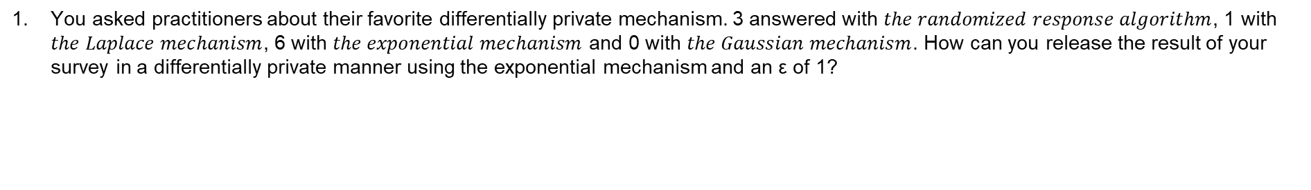
Example Learning Nugget – Exercises
You asked practitioners about their favorite differentially private mechanism. 3 answered with $the randomized response algorithm$, 1 with $the Laplace mechanism$, 6 with $the exponential mechanism$ and 0 with $the Gaussian mechanism$. How can you release the result of your survey in a differentially private manner using the exponential mechanism and an ε of 1?

Slide 19
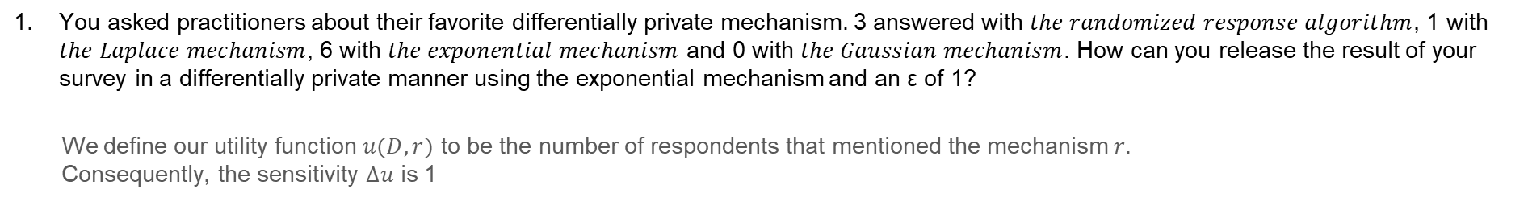
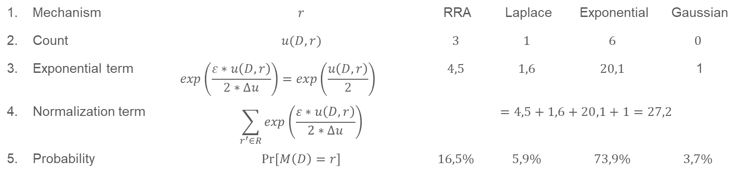
Example Learning Nugget – Exercises
You asked practitioners about their favorite differentially private mechanism. 3 answered with $the randomized response algorithm$, 1 with $the Laplace mechanism$, 6 with $the exponential mechanism$ and 0 with $the Gaussian mechanism$. How can you release the result of your survey in a differentially private manner using the exponential mechanism and an ε of 1?
We define our utility function $u(D,r)$ to be the number of respondents that mentioned the mechanism $r$. Consequently, the sensitivity $∆u$ is 1
Mechanism | $$r$$ | RRA | Laplace | Exponential | Gaussian
Count | $$u(D,r)$$ | $$3$$ | $$1$$ | $$6$$ | $$0$$
Exponential term | $$\exp\left(\frac{ε∗u\left(D,r\right)}{2∗∆u}\right)=\exp\left(\frac{u\left(D,r\right)}{2}\right)$$ | $$4,5$$ | $$1,6$$ | $$20,1$$ | 1
Normalization term | $$\sum_{r^{′}∈R}{\exp\left(\frac{ε∗u\left(D,r\right)}{2∗∆u}\right)}$$ | $$=4,5+1,6+20,1+1=27,2$$
Probability | $$\operatorname{Pr}\left[M\left(D\right)=r\right]$$ | $$16,5\%$$ | $$5,9\%$$ | $$73,9\%$$ | $$3,7\%$$
The most popular answer will be returned with a probability of ~74%. This is pretty good, considering the fact that only 10 people were surveyed. If 100 people would have been surveyed instead, then the most popular answer would have been returned with a probability of 99,99997% (assuming a similar distribution, i.e., $\{RRA:30,Laplace:10,Exponential:60,Gaussian:0\})$

Slide 20
Example Learning Nugget – Exercises
Implement the Laplace mechanism in a programming language of your choice. The function should take as input parameters a query result (single number), epsilon and the sensitivity
We will sketch a solution written in Python. The package NumPy already comes with a built-in functionality to draw random values from the Laplace distribution
import numpy as np def laplace_mechanism(query_result, epsilon, sensitivity): return query_result+np.random.laplace(loc=0, scale=sensitivity/epsilon) print(laplace_mechanism(8,1,1))
Note that, as in cryptography, it is advisable to rely on existing solutions rather than implementing them yourself. The differential privacy guarantee can be undermined if the noise introduced is not truly random.

Slide 21
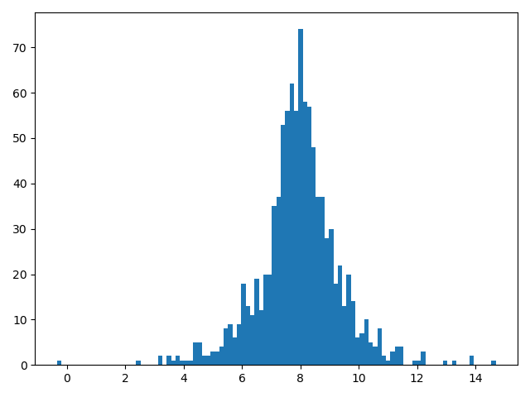
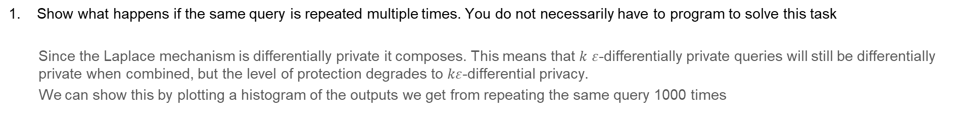
Example Learning Nugget – Exercises
Show what happens if the same query is repeated multiple times. You do not necessarily have to program to solve this task
Since the Laplace mechanism is differentially private it composes. This means that $k$ $ε$-differentially private queries will still be differentially private when combined, but the level of protection degrades to $kε$-differential privacy.
We can show this by plotting a histogram of the outputs we get from repeating the same query 1000 times
import matplotlib.pyplot as plt plt.hist([laplace_mechanism(8,1,1) for x in range(1000)], 100) plt.show()
As you can see, the histogram takes on the form of the Laplace distribution centered at 8. With every query it becomes more likely that this is the true result.
This illustrates the inevitability that too many too accurate query results will eventually break privacy. Differential privacy attempts to postpone this inevitability but cannot change the fact that either the number of queries we can ask, or their usefulness is limited.

Slide 22

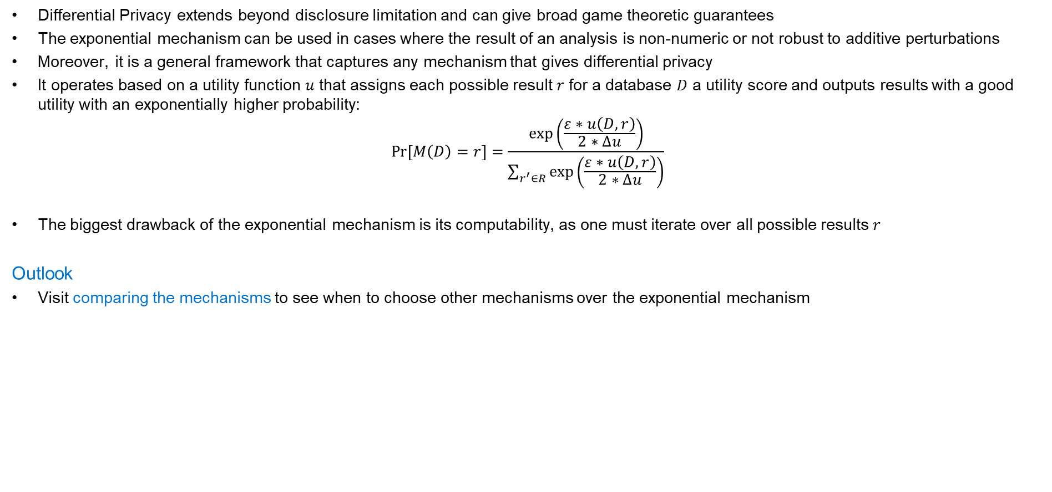
Key Takeaways
Differential Privacy extends beyond disclosure limitation and can give broad game theoretic guarantees
The exponential mechanism can be used in cases where the result of an analysis is non-numeric or not robust to additive perturbations
Moreover, it is a general framework that captures any mechanism that gives differential privacy
It operates based on a utility function $u$ that assigns each possible result $r$ for a database $D$ a utility score and outputs results with a good utility with an exponentially higher probability:
$$\operatorname{Pr}\left[M\left(D\right)=r\right]=\frac{\exp\left(\frac{ε∗u\left(D,r\right)}{2∗∆u}\right)}{\sum_{r^{′}∈R}{\exp\left(\frac{ε∗u\left(D,r\right)}{2∗∆u}\right)}}$$
The biggest drawback of the exponential mechanism is its computability, as one must iterate over all possible results $r$
Outlook
Visit comparing the mechanisms to see when to choose other mechanisms over the exponential mechanism

Slide 23
Example Learning Nugget – Sources
McSherry, F., & Talwar, K. (2007). Mechanism design via differential privacy. Proceedings - Annual IEEE Symposium on Foundations of Computer Science, FOCS. https://doi.org/10.1109/FOCS.2007.4389483
Dwork, C., & Roth, A. (2013). The algorithmic foundations of differential privacy. Foundations and Trends in Theoretical Computer Science. https://doi.org/10.1561/0400000042
Vadhan, S. (2017). The complexity of differential privacy. In Information Security and Cryptography. https://doi.org/10.1007/978-3-319-57048-8_7
Kamath, G. (2020). Lecture 7 - Exponential Mechanism. http://www.gautamkamath.com/CS860notes/lec7.pdf
Roth, A. (2020). Lecture 3. https://www.cis.upenn.edu/~aaroth/courses/slides/Lecture3.pdf
Goldberg, S. (2012). Notes on the Exponential Mechanism. https://cs-web.bu.edu/~goldbe/teaching/HW55812/exponential.pdf
He, X. (2019). Privacy & Fairness in Data Science. https://cs.uwaterloo.ca/~xihe/cs848/slides/02-module1-DP-basics.pdf

Slide 24
Outline
Introduction and problem statement
Research approach
Contribution
Evaluation
Conclusion

Slide 25





Evaluation – General Information
Informal think-aloud sessions with students and a review by other DP researchers preceded the formal evaluation
17 participants
7 Learning nuggets were evaluated
27
The survey contained 27 questions
7
The questions were based on LORI ⁷ and Blooms Taxonomy ⁸
5 nuggets were completed on average
5

Slide 26
Evaluation Results – Usability and Content

Slide 27
Evaluation Results – Learning Effect

Slide 28
Evaluation Results - Summary
Scope
Too narrow
Too broad
Complexity
Blog post
Scientific paper
It took 21 min on average to complete a learning nugget

Slide 29
Outline
Introduction and problem statement
Research approach
Contribution
Evaluation
Conclusion

Slide 30



Conclusion
Differential privacy is a promising approach. However, it is still at an early stage and will probably take more than 5 years until it is widely used
To accelerate this process, we need more resources to help practitioners decide whether they should use it and that ease their transition
Our Learning Nuggets proved to be a valuable contribution to this effort and a solid foundation for future refinements and enhancements

Slide 31

Future Work
Learning Content
Investigate legal aspects
Cover other privacy-preserving methods
Split up existing learning nuggets
Learning Platform
Extend existing interactive elements
Collaborative features
Recommendation algorithm
User analytics
Advanced e-learning features (e.g., gamification, videos)
Evaluation
Evaluate in a larger scale
Conduct case studies

Slide 32
Sources
Wagner, I., & Eckhoff, D. (2018). Technical privacy metrics: A systematic survey. In ACM Computing Surveys. https://doi.org/10.1145/3168389
Wood, A., Altman, M., Bembenek, A., Bun, M., Gaboardi, M., Honaker, J., Nissim, K., O’Brien, D., Steinke, T., & Vadhan, S. (2019). Differential Privacy: A Primer for a Non-Technical Audience. SSRN Electronic Journal. https://doi.org/10.2139/ssrn.3338027
Nissim, K., & Wood, A. (2018). Is privacy privacy? Philosophical Transactions of the Royal Society A: Mathematical, Physical and Engineering Sciences, 376(2128), 1–19. https://doi.org/10.1098/rsta.2017.0358
Dwork, C. (2011). The promise of differential privacy: A tutorial on algorithmic techniques. Proceedings - Annual IEEE Symposium on Foundations of Computer Science, FOCS. https://doi.org/10.1109/FOCS.2011.88
Seaman, C. B. (1999). Qualitative methods in empirical studies of software engineering. IEEE Transactions on Software Engineering. https://doi.org/10.1109/32.799955
Peffers, K., Tuunanen, T., Rothenberger, M. A., & Chatterjee, S. (2007). A design science research methodology for information systems research. Journal of Management Information Systems. https://doi.org/10.2753/MIS0742-1222240302
Leacock, T. L., & Nesbit, J. C. (2007). A framework for evaluating the quality of multimedia learning resources. In Educational Technology and Society. http://www.sfu.ca/~jcnesbit/articles/LeacockNesbit2007.pdf
Krathwohl, D. R. (2002). A Revision Of Bloom’s Taxonomy Of Educational Objectives. Theory into Practice.

Slide 33
Backup Slides

Slide 34
Overview of the Learning Nuggets
Motivation
Definition
Attacks on Privacy
Privacy Pre-serving Methods
K-Anonymity
Privacy Through Perturbation
The Definition of DP
The Adversary’s Perspective
Discussion
Application
The Benefits of DP
The Challenges of DP
Putting Noise Into Perspective
Randomized Response
Laplace Mechanism
Exponential Mechanism
Gaussian Mechanism
Local Differential Privacy
Comparing the Mechanisms
Outlook
The Maturity of DP
The DP Family
DP in Machine Learning
Evaluated
Draft
DP Tools
Real-World Applications
DP Vendors
Unfinished

Slide 35
Outlook – More Areas to Cover
Motivation
Privacy
Security vs privacy
Legal aspects
Privacy over the data lifecycle
Application
Staircase Mechanism
Report Noisy Max
Sparse Vector Technique
Small DB
More complex or niche algorithms
Differentially private versions of median, linear regression etc.
Outlook
The Maturity of DP
The DP Family
DP in Machine Learning
Instead of listing DP tools, vendors or real-world applications, each of them could get explained in more detail in their own learning nugget
DP Tools
Real-World Applications
DP Vendors

Slide 36
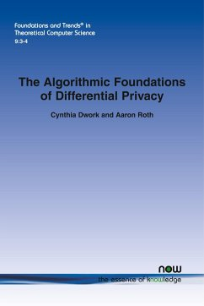
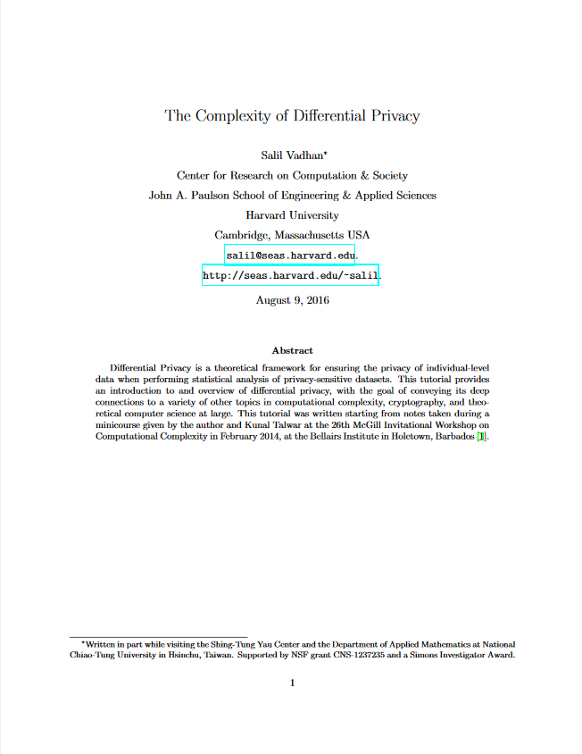
Existing References – Scientific Literature
“The Algorithmic Foundations of Differential Privacy”
Cynthia Dwork and Aaron Roth, 2014, 281 pages
“This work is meant as a thorough introduction to the problems and techniques of differential privacy, but is not intended to be an exhaustive survey — there is by now a vast amount of work in differential privacy, and we can cover only a small portion of it.”
A comprehensive overview including all the important basics
Since it is already 7 years old it lacks information about current developments, i.e., tools, vendors and real-world applications
“The Complexity of Differential Privacy”
Salil Vadhan, 2016, 95 pages
“This tutorial provides an introduction to and overview of differential privacy, with the goal of conveying its deep connections to a variety of other topics in computational complexity, cryptography, and theoretical computer science at large.”
Together with “the algorithmic foundations of differential privacy” it is among the recommended literature of most lectures

Slide 37
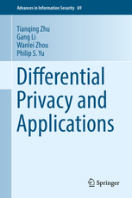
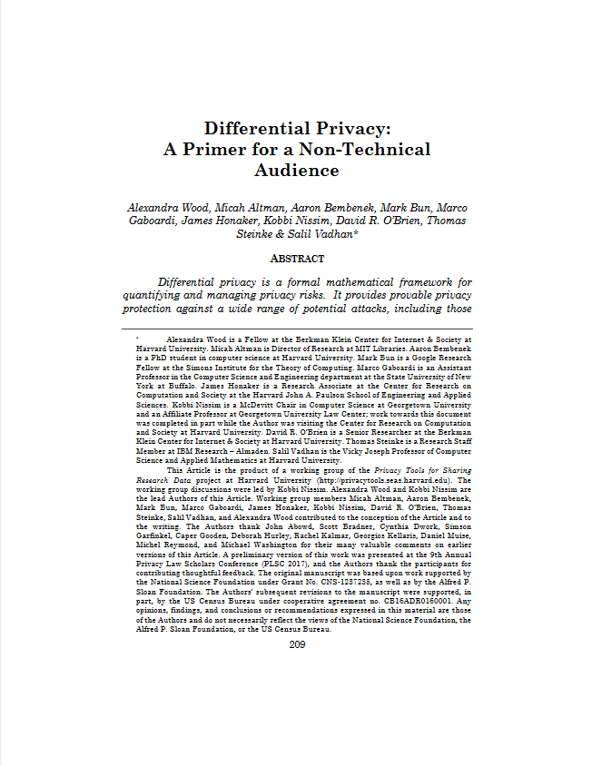
Existing References – Scientific Literature
“Differential Privacy and Applications”
Zhu et. al., 2017, 243 pages
“This book intends to enable readers […] to study up-to-date concepts, methods, algorithms, and analytic skills for building modern privacy-preserving applications through differential privacy.”
Covers advanced topics, can be considered a successor to the learning nuggets
“Differential Privacy: A Primer for a Non-Technical Audience”
Wood et. al., 2019, 68 pages
“It can help guide practitioners as they make decisions regarding whether to use differential privacy and, if so, what types of promises they should make to data subjects about the guarantees differential privacy provides.”
Does not include (complex) formulas and algorithms
Practitioners reading it will not be able to apply differential privacy

Slide 38
Existing References – Example Lectures
Differential Privacy: What, Why and When, Moni Naor, 2018
Differential Privacy, Marco Gaboardi, 2017
Building Privacy-Aware Database Systems, Xi He, 2021
Existing lecture slides are quite abstract and hard to understand on their own. Only few provide recordings or lecture notes

Slide 39


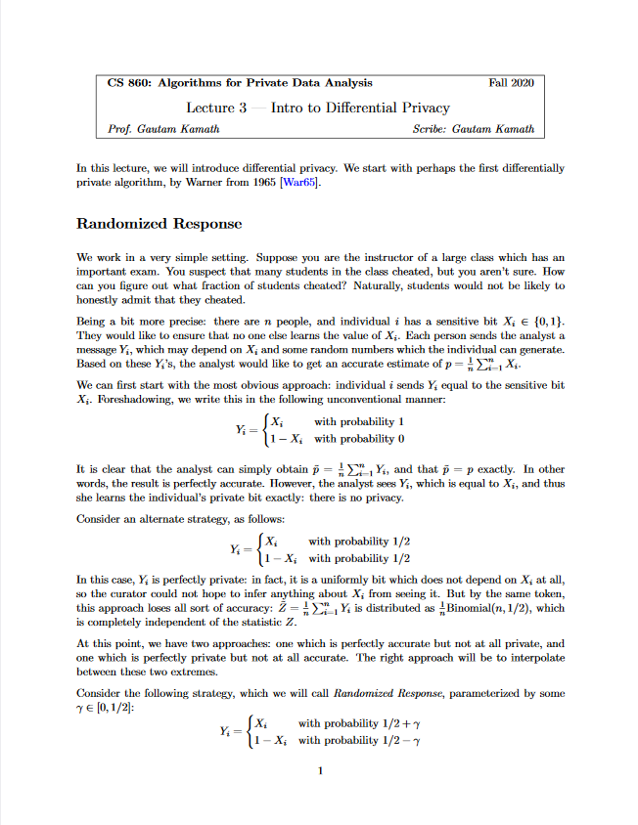
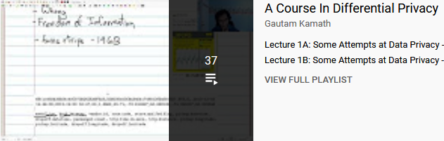
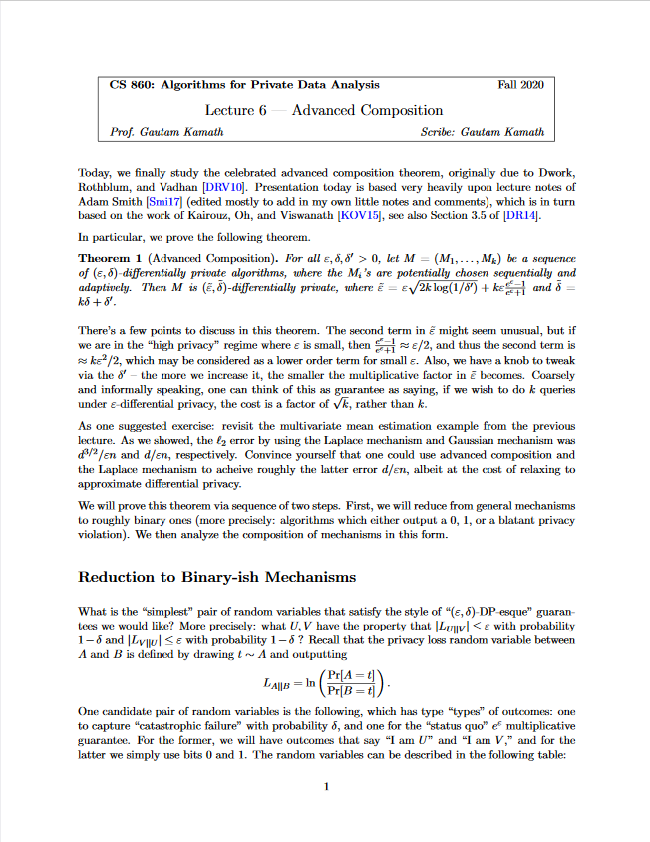


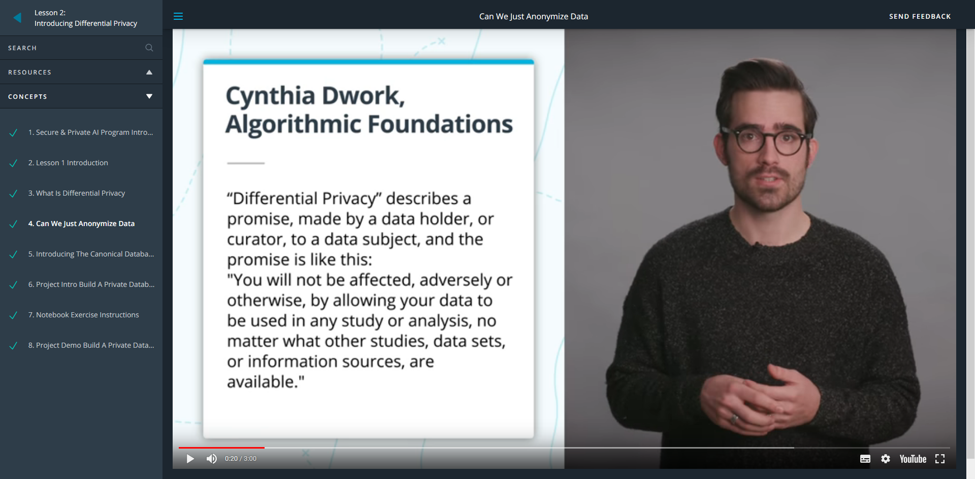
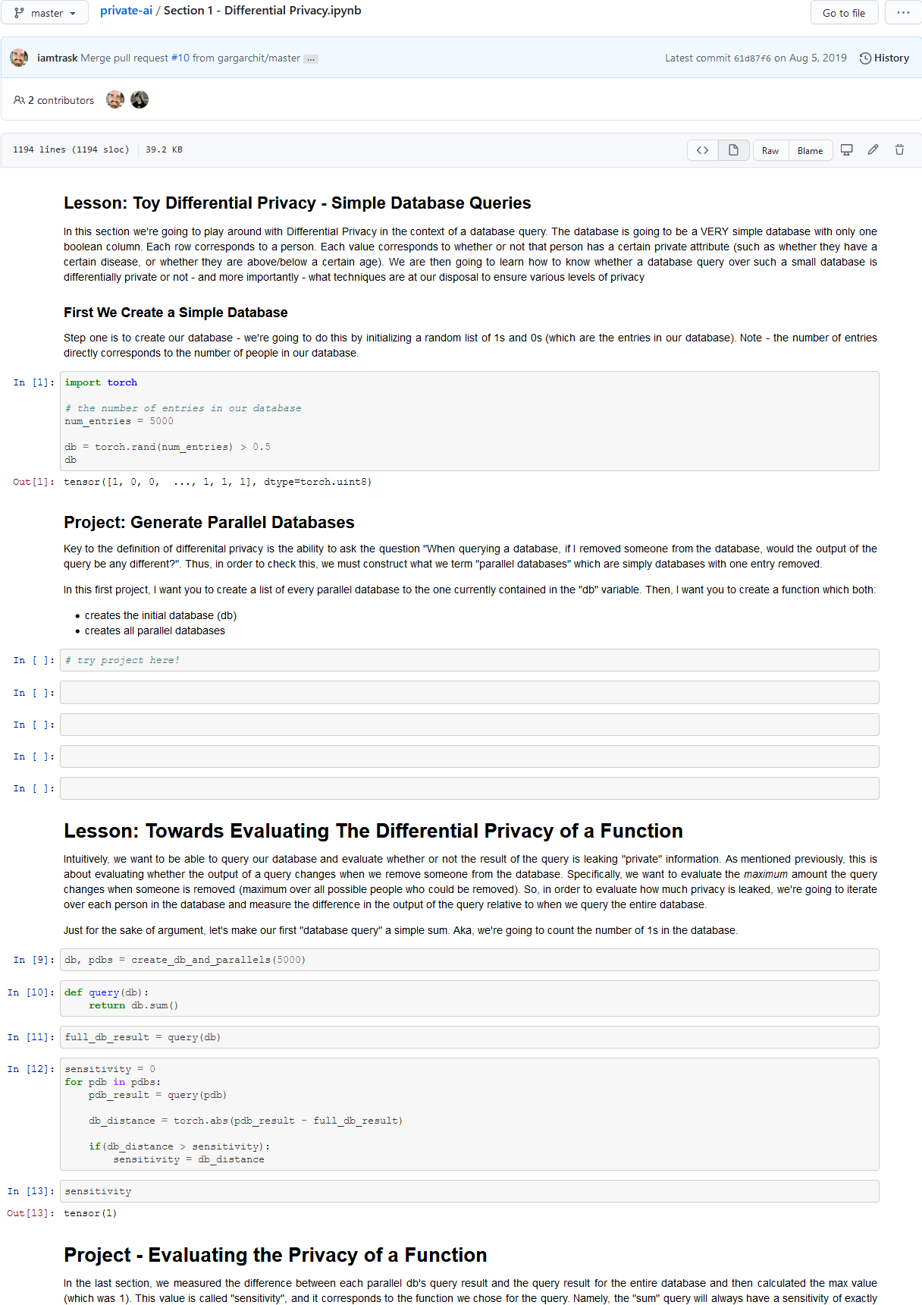

Existing References – Lecture Recordings and Video Courses
Cynthia Dwork, 2012
Provide detailed lecture notes as well
Gautam Kamath, 2020
Additionally, provide Jupyter notebooks with exercises
Andrew Trask, 2019

Slide 40

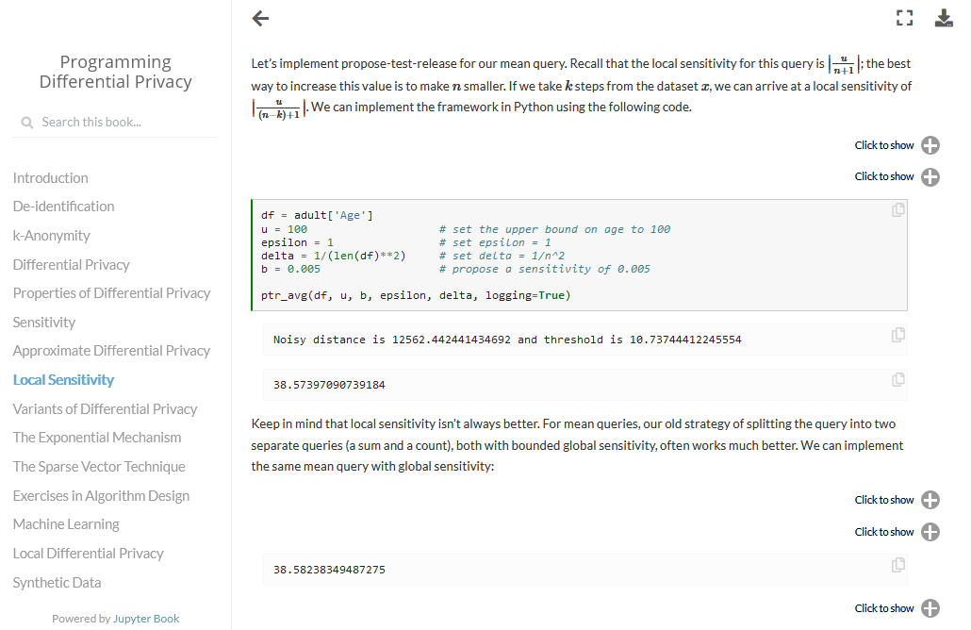
Existing References – Lecture Textbooks
Lecture from fall 2020 by Joseph P. Near, an assistant professor at the University of Vermont and affiliated with Uber
He provided the textbook for his lecture in the form of a Jupyter notebook, containing learning objectives and code examples

Slide 41
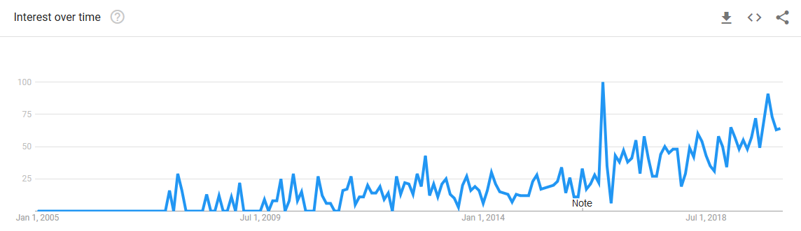
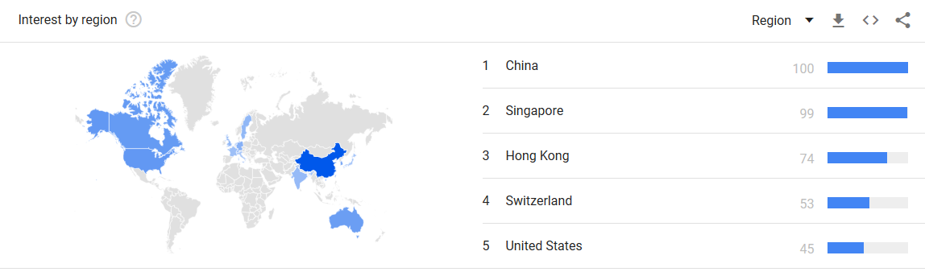
Rising Interest in Differential Privacy – Google Analytics

Slide 42
Rising Interest in Differential Privacy

Slide 43
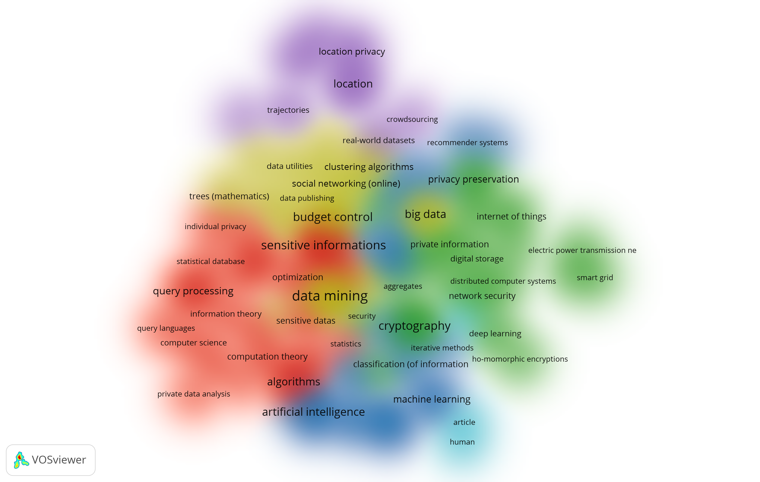
Analysis of the Differential Privacy Research Field
Resulting output of most important topics (data-processing with custom python scripts, visualized with VOSViewer):
Keywords with more than 40 occurrences out of 2793 publications
Location data
Foundations
Distributed systems
Machine Learning
Healthcare

Slide 44
What Are the Benefits and Challenges of Using Differential Privacy?
Strong Privacy Guarantees
Versatility
Framework to Discuss Privacy
Performance
Provides a formal guarantee that can be mathematically proven and holds under any circumstances
DP is a definition that has to be fulfilled instead of a method that is applied and thus can be adapted to many use cases
DP allows for transparency, offers a parameter to trade off privacy with utility, can quantify privacy risk and is programmable. Hence, it provides the perfect framework to reason about privacy
Adding a random number to a query result is trivial. However, more advanced applications like the exponential mechanism or machine learning can become computationally expensive
Low Utility
Complexity
Requires Change
Maturity
Introducing noise leads to less accurate results
DP is difficult to understand, explain and implement
Analysts have to change the way they work with data
Although there are many resources available, there a
still only few real-world applications and for a company it can be hard to find appropriate personnel

Slide 45
Differential Privacy – Variants and Extensions – Taxonomy
“An attacker with perfect background knowledge (B) and unbounded computation power (C) is unable (R) to distinguish (F) anything about an individual (N), uniformly across users (V) even in the worst-case scenario (Q)”
Dimension | Description | Typical Motivations
Quantification of Privacy Loss | How is the privacy loss quantified across outputs? | Averaging risk, obtaining better composition properties
Neighborhood Definition | Which properties are protected from the attacker? | Protecting specific values or multiple individuals
Variation of Privacy Loss | Can the privacy loss vary across inputs? | Modeling users with different privacy requirements
Background Knowledge | How much prior knowledge does the attacker have? | Using mechanisms that add less or no noise to data
Formalism Change | Which formalism is used to describe the attacker’s knowledge gain? | Exploring other intuitive notions of privacy
Relativization of Knowledge Gain | What is the knowledge gain relative to? | Guaranteeing privacy for correlated data
Computational Power | How much computational power can the attacker use? | Combining cryptography techniques with differential privacy
Desfontaines, D., & Pejó, B. (2020). SoK: Differential privacies. Proceedings on Privacy Enhancing Technologies. https://doi.org/10.2478/popets-2020-0028

Slide 46

Quantifying Privacy Risk
The privacy loss parameter ε bounds the amount of information that is leaked through a differentially private data release
Conversely, we can take on the perspective of an adversary, to examine how much information can be gained from this release in the worst case, i.e., if every record in the database is known, except for the target X
This is done by determining by how much the adversary's initial belief whether X is in the database changes after seeing the release
This change is bounded by: $\frac{Initial belief}{e^{ε}+\left(1−e^{ε}\right)∗Initial belief}≤Updated belief≤\frac{e^{ε}∗Initial belief}{1+\left(e^{ε}−1\right)∗Initial belief}$

Slide 47
Additional Evaluation Results

Slide 48
Additional Evaluation Results

Slide 49
Evaluation Results – Learning Effect

