Slide 1
Analysis and Implementation of Verifiable Computation Techniques for Energy Blockchain Applications
Bernd Steinkopf - Dec. 14th, 2020

Slide 2
Contents
Motivation
Research Questions
Methodology
Results, Part 1 – Literature Analysis
Results, Part 2 – Prototype Implementation
Conclusion

Slide 3
Contents
Motivation
Research Questions
Methodology
Results, Part 1 – Literature Analysis
Results, Part 2 – Prototype Implementation
Conclusion

Slide 4
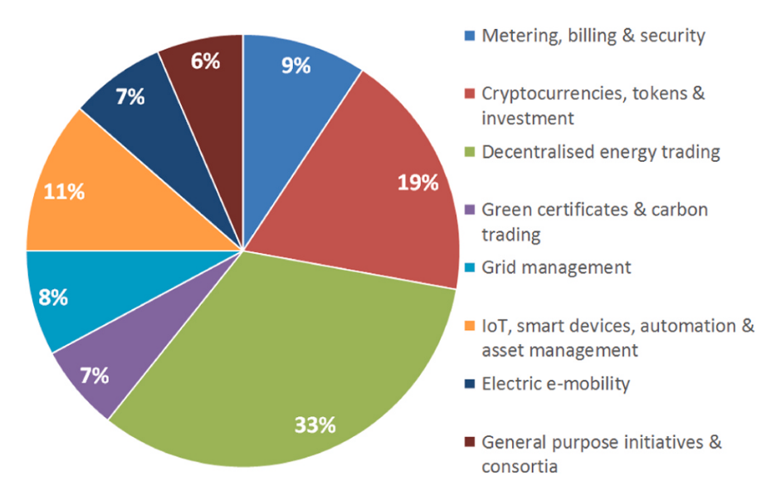
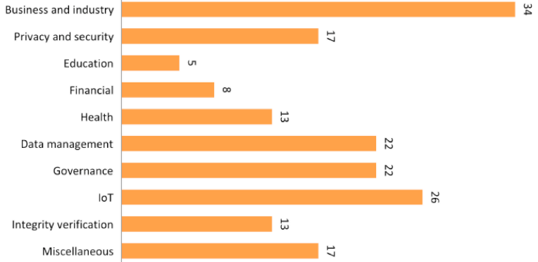
Smart Contracts in the Real World
Rise of Smart Contracts,…
… especially in the Energy Industry.
Number of Blockchain Studies by Industry (2017)
Casino, F., Dasaklis, T. K., & Patsakis, C. (2019).
A systematic literature review of blockchain-based applications:
Current status, classification and open issues.
Telematics and Informatics, 36(November 2018), 55–81. https://doi.org/10.1016/j.tele.2018.11.006
Blockchain Use Cases in the Energy Industry
Andoni, M., Robu, V., Flynn, D., Abram, S., Geach, D.,
Jenkins, D., McCallum, P., & Peacock, A. (2019).
Blockchain technology in the energy sector: A systematic review of challenges and opportunities. In Renewable and Sustainable Energy Reviews (Vol. 100, pp. 143–174). https://doi.org/10.1016/j.rser.2018.10.014

Slide 5
Remaining Issues
Smart contracts are slow
  Many energy industry use cases rely on expensive computational work
What is preventing a more widespread adoption?
We aim to fix this with privacy-preserving verifiable computation
Smart contracts are public
  Energy-industrial use cases deal with highly sensitive user data
  (e.g. location, payments, etc.)
Notes:
verifiable computation:
a way to off-chain expensive and sensitive work
while maintaining security guarantees of the blockchain

Slide 6
Contents
Motivation
Research Questions
Methodology
Results, Part 1 – Literature Analysis
Results, Part 2 – Prototype Implementation
Conclusion

Slide 7
Change of Thesis Focus
Blockchain-based Decentralized Optimization
for Energy Industry Applications
first draft
project-driven
optimizations only
privacy as afterthought
Analysis and Implementation of Verifiable Computation Techniques
for Energy Blockchain Applications
throughout writing
research-driven
all computations
privacy first
Notes:
blockchain-based …
driven by ongoing projects at industry partner
focused only on optimization use cases
not really focused on privacy
analysis and impl …
idea driven by current research
works for all computations
privacy as a first concern

Slide 8








Research Questions
What are the requirements and challenges of common blockchain applications in the energy industry?
What are the requirements and challenges of common optimization problems in the Energy Industry?
How can the use of verifiable computing increase the security and reliability of energy-related blockchain applications?
How can the use of blockchain technology increase the security and reliability of energy economic processes?
How do different blockchain-based verifiable computing techniques compare in terms of performance, security and usability?
How do different blockchain-based optimization techniques compare in terms of performance, reliability and protection of private data?
Which measures are required to prototypically implement a functioning infrastructure for solving blockchain-aided optimizations?
Which measures are required to prototypically implement a functioning infrastructure for solving blockchain-aided verifiable computations?

Slide 9
Contents
Motivation
Research Questions
Methodology
Results, Part 1 – Literature Analysis
Results, Part 2 – Prototype Implementation
Conclusion

Slide 10
Methodology
#4
Goals
Theory
Implementation
/2
#1
#3
Artifacts
Use Case Requirements
Technology Comparison
Software Framework
Performance Evaluation
Tasks
Literature Analysis – Blockchain in the Energy Industry
Literature Analysis – Verifiable Computing
Use Case Model
Development Environment
Algorithmic Implementation
Framework
Test Run
RQ#1
What are the requirements and challenges of
common blockchain applications in the energy industry?
RQ#2
How can the use of verifiable computing increase
the security and reliability of energy-related blockchain applications?
RQ#3
How do different blockchain-based verifiable computing techniques compare
in terms of performance, security and usability?
RQ#4
Which measures are required to prototypically implement
a functioning infrastructure for solving blockchain-aided verifiable computations?
Notes:
conducting literature analysis on current state of bc in ei
incidentally answered, because we now know about requirements
can also be answered by literature analysis but for vc
little more work, deals with implementation
first software framework to run vc
test framework performance to gauge usefulness
because we already looked at use cases, we can cross first two rq’s of our list

Slide 11
Contents
Motivation
Research Questions
Methodology
Results, Part 1 – Literature Analysis
Results, Part 2 – Prototype Implementation
Conclusion

Slide 12






Taxonomy of Verifiable Computing Techniques
Blockchain-based Verifiable Computing
Trusted Oracles
Zero-Knowledge Proofs
Multi-Party Computation
Incentive-compatible
Off-Chaining
Preprocessing zkSNARKs
Linear
Secret-Sharing
Trusted Execution Environments
Transparent zkSNARKs
others
Notes:
Trusted Oracles: added trust mechanism
IOC: monetary rewards for correct computations
TEEs: special hardware
ZKPs: mathematical proofs
Preprocessing: require key exchange between participants
Transparent: require no key exchange
MPC: jointly execute secret computation
LSS: polynomial interpolation
other forms exist but not for blockchain

Slide 13
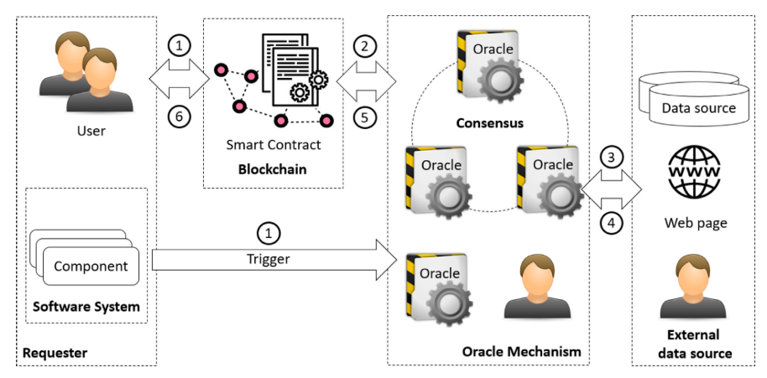

Trusted Oracles
Incentive-compatible Off-Chaining
Process
Pros
mature technology
transparent aggregation
native execution performance
Cons
Generalized IOC Architecture
Lo, S. K., Xu, X., Staples, M., & Yao, L. (2020).
Reliability analysis for blockchain oracles.
Computers and Electrical Engineering, 83, 106582. https://doi.org/10.1016/j.compeleceng.2020.106582
slow aggregation
no cryptographic guarantees
execute computation
on multiple nodes
collect and merge individual results
reward correct results
punish incorrect results
requires honest majority
Notes:
correctness of results depends on aggregation function

Slide 14
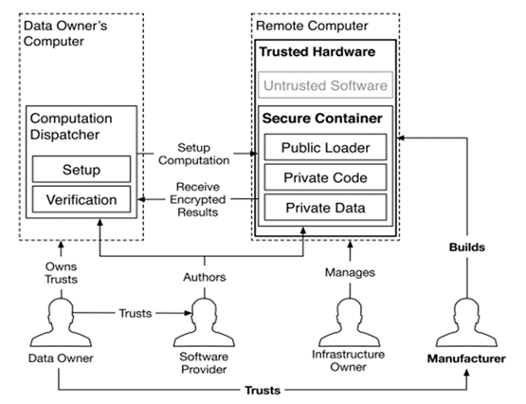
Trusted Oracles
Trusted Execution Environments
Process
Pros
broad availability
near-native execution performance
encryption of private data
Cons
TEE Memory Layout (Intel SGX)
Costan, V., & Devadas, S. (2016).
Intel SGX Explained.
IACR Cryptology EPrint Archive, 1–118.
https://doi.org/10.1159/000088809
vendor as trusted third party
no access to hardware (e.g. network)
install cryptographic coprocessors on CPU
create secure environment at runtime
certify
program integrity
after completion
known side-channel attacks

Slide 15
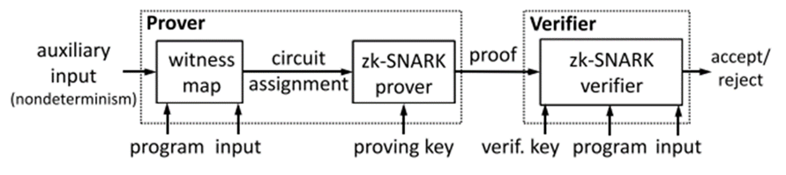
Zero-Knowledge Proofs
Preprocessing zkSNARKs
Process
Pros
cryptographically secure
fully transparent
fast verification
Cons
Generalized Preprocessing zkSNARK Workflow
Ben-sasson, E., Chiesa, A., Tromer, E., & Virza, M. (2013).
Succinct Non-Interactive Arguments for a von Neumann Architecture.
USENIX Security, 1–35.
http://dblp.uni-trier.de/db/conf/uss/uss2014.html#Ben-SassonCTV14
limited execution environment
expensive proof generation
receive program f
and input x
calculate y = f(x)
and generate proof
receive y
and verify proof
requires trusted setup

Slide 16
Zero-Knowledge Proofs
Transparent zkSNARKs
Process
Pros
auxiliary input can be generated without use of
Common Reference String
no trusted setup
same security as preprocessing variant
similar verification speeds
Cons
Generalized Preprocessing zkSNARK Workflow
Ben-sasson, E., Chiesa, A., Tromer, E., & Virza, M. (2013).
Succinct Non-Interactive Arguments for a von Neumann Architecture.
USENIX Security, 1–35.
http://dblp.uni-trier.de/db/conf/uss/uss2014.html#Ben-SassonCTV14
immature technology
proof generation even more expensive
receive program f
and input x
calculate y = f(x)
and generate proof
receive y
and verify proof
massive proof sizes

Slide 17
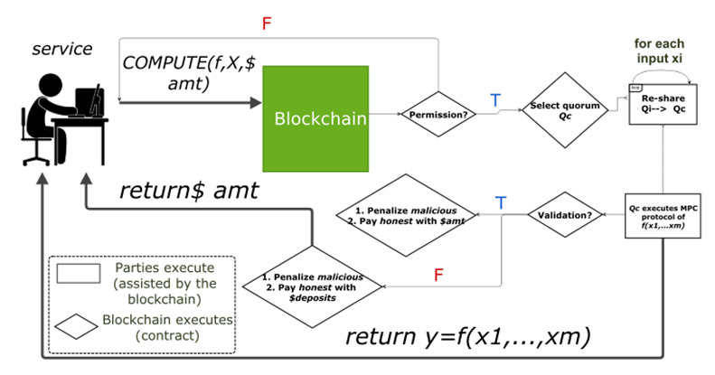
Multi-Party Computation
Linear Secret-Sharing
Process
Pros
cryptographically secure
fully transparent
fully trustless
Cons
LSS-based Platform Architecture (Enigma)
Zyskind, G., Nathan, O., & Pentland, A. (2015).
Enigma: Decentralized Computation Platform with Guaranteed Privacy.
New Solutions for Cybersecurity, 1–14.
https://doi.org/10.7551/mitpress/11636.003.0018
immature technology
limited execution environment
divide secret input
and randomly distribute shares
execute computation locally on share
reassemble shares
to receive result
poor execution performance

Slide 18


Evaluation Framework
Security
  Integrity: can correct execution of computations be guaranteed?
  Transparency: is the process traceable for outside observers?
  Confidentiality: is user data kept secret?
  Privacy: are the identities of the users protected?
Performance
  Transaction Speed: how fast can a single computation be executed?
  Memory Consumption: is the limited space of blockchains a constraining factor?
Practicality
  Maturity: is the technology in a practice-ready state?
  Usability: how accessible is the system for users and developers?
  Extensibility: how easy is it to add new functionality?
Notes:
each subcategory awarded five grades
grades based on qualitative comparison based on literature

Slide 19
Results
Transaction Speed
Memory Consumption
Confidentiality
Transparency
Extensibility
Integrity
Privacy
Maturity
Usability
Incentive-Compatible Off-Chaining
Trusted Execution Environments
Preprocessing zkSNARKs
Transparent zkSNARKs
Multi-Party Computation
Notes:
see clear lines
security/practicality tradeoff

Slide 20
Methodology - Revisited
#4
Goals
Theory
Implementation
/2
#1
#3
Artifacts
Use Case Requirements
Technology Comparison
Software Framework
Performance Evaluation
Tasks
Literature Analysis – Blockchain in the Energy Industry
Literature Analysis – Verifiable Computing
Use Case Model
Development Environment
Algorithmic Implementation
Framework
Test Run
RQ#1
What are the requirements and challenges of
common blockchain applications in the energy industry?
RQ#2
How can the use of verifiable computing increase
the security and reliability of energy-related blockchain applications?
RQ#3
How do different blockchain-based verifiable computing techniques compare
in terms of performance, security and usability?
RQ#4
Which measures are required to prototypically implement
a functioning infrastructure for solving blockchain-aided verifiable computations?

Slide 21
Contents
Motivation
Research Questions
Methodology
Results, Part 1 – Literature Analysis
Results, Part 2 – Prototype Implementation
Conclusion
Notes:
solver for linear optimizations
based on a preprocessing zksnark

Slide 22
Choice of Use Case
Why did we choose an optimization problem for our implementation?
Alskaif
Decentralized Optimal Power Flow in Distribution Networks Using Blockchain
Eric Munsing
Blockchains for decentralized optimization of energy resources in microgrid networks
Raymond H. Byrne
Energy Management and Optimization Methods for Grid Energy Storage Systems
T. Baroche
Prosumer Markets: A Unified Formulation
Xiaolong Jin
Local flexibility markets: Literature review on concepts, models and clearing methods
Alexander Bogensperger
Updating renewable energy certificate markets via integration of smart meter data, improved time resolution and spatial optimization
Blockchain Use Cases in the Energy Industry
Andoni, M., Robu, V., Flynn, D., Abram, S., Geach, D.,
Jenkins, D., McCallum, P., & Peacock, A. (2019).
Blockchain technology in the energy sector: A systematic review of challenges and opportunities. In Renewable and Sustainable Energy Reviews (Vol. 100, pp. 143–174). https://doi.org/10.1016/j.rser.2018.10.014
Notes:
optimization remains most common problem by far
can be seen by original thesis topic

Slide 23
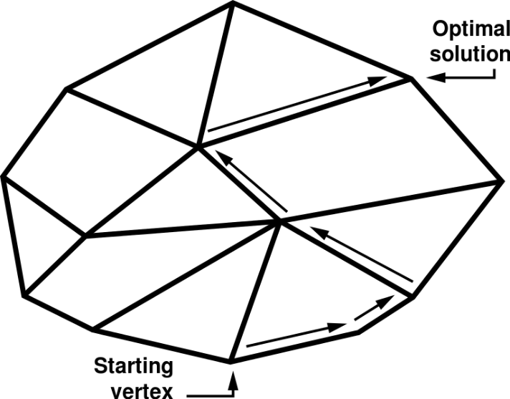
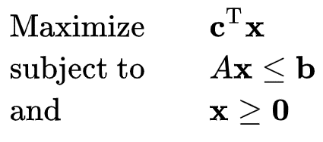
Detour: Foundations of Mathematical Optimization
Linear Programming
The Simplex Algorithm
Canonical Form of Linear Program
https://en.wikipedia.org/wiki/Linear_programming
Illustration of Simplex Algorithm’s Geometric Principles
https://upload.wikimedia.org/wikipedia/commons/thumb/e/ef/Simplex-description-en.svg/767px-Simplex-description-en.svg.png
most common form of optimization
origins in operations research
can be solved quite efficiently on conventional hardware
based on geometry
invented by George Dantzig in 1947
still in use today due to good average-case performance
Notes:
linear programming used by all studies
maximize subject to inequality constraints

Slide 24
Choice of Technology
Why did we choose a preprocessing zkSNARK for our implementation?
trusted setup not a problem for energy applications
Integrity
Confidentiality
good security guarantees
Transparency
Privacy
decent performance (in theory)
Memory Consumption
Transaction Speed
Maturity
very active development
Usability
Extensibility

Slide 25





The ZoKrates Platform
  compiles
  DSL code
  into
  arithmetic circuit
  calculates result
  by executing
  the program
  performs
  trusted setup
  to share CRS
  derives
  zero-knowledge proof
  from witness
  generates verification
  smart contract
Compiler
Witness Calculator
Setup Tool
Prover
Contract Generator
Notes:
integrated development environment for zkSNARKs

Slide 26
Results – Performance Measurements
Notes:
measurement parameters were variables and conditions of problem

Slide 27
Results – Sensitivity Analysis
with respect to number of variables:
with respect to number of conditions:

Slide 28
Methodology - Revisited
#4
Goals
Theory
Implementation
/2
#1
#3
Artifacts
Use Case Requirements
Technology Comparison
Software Framework
Performance Evaluation
Tasks
Literature Analysis – Blockchain in the Energy Industry
Literature Analysis – Verifiable Computing
Use Case Model
Development Environment
Algorithmic Implementation
Framework
Test Run
RQ#1
What are the requirements and challenges of
common blockchain applications in the energy industry?
RQ#2
How can the use of verifiable computing increase
the security and reliability of energy-related blockchain applications?
RQ#3
How do different blockchain-based verifiable computing techniques compare
in terms of performance, security and usability?
RQ#4
Which measures are required to prototypically implement
a functioning infrastructure for solving blockchain-aided verifiable computations?

Slide 29
Contents
Motivation
Research Questions
Methodology
Results, Part 1 – Literature Analysis
Results, Part 2 – Prototype Implementation
Conclusion

Slide 30
Limitations
Performance
Security
compilation does not scale well
trusted setup remains major vulnerability
unsuitable for many conventional algorithms
new attack vectors might be discovered in the future
possible solution: new primitives with better performance (e.g. MiMC instead of SHA-2)
possible solution: move to setup-less technology
Notes:
theory is sound
works for basic examples

Slide 31
Outlook
transparent zkSNARKs
  eliminate the need for a trusted setup
  are not yet in a usable state
linear secret-sharing
  stronger security guarantees that have been shown to work in practice
  no active development community
fully homomorphic encryption
  strong push recently due to applications in machine learning
  might still take a long time to mature
Notes:
actively developed and might become more viable in the future
competing technologies exist

Slide 32
Bernd Steinkopf
17132
matthes@in.tum.de

