Slide 1
Privacy preservation in data markets for IoT devices: A systematic review
Bachelor’s Thesis – KickOff

Slide 2
Outline
Research background
Research questions
Methodology
Current research stage

Slide 3
Research background
Data marketplaces
Third-party, cloud-based software platform providing internet access
to a disparate set of external data sources for use in IT systems. They act as market enablers and must insure [1]:
Interoperability
Security
Legal compliance
Privacy

Slide 4
Research background
Data marketplaces
There is not yet a consensus on the concept of privacy in extant literature.
It can be described from different perspectives (as a set of activities, as a function, etc.)
For us: Set of rules that apply for online scenarios [2].
Privacy

Slide 5
Research background
Data marketplaces
Interconnected IoT devices generate a huge amount of data
→ Corresponding data marketplaces have emerged in order to exploit the analytic potential these devices create.
Privacy
IoT
devices

Slide 6
Research background
Privacy
Data markets
We have found various studies that presented analysis, challenges as well as solutions described from different perspectives (legal, econmical, technical, etc.).
We did not find a comprehensive review on the state of the art for this intersection.
Our focus lays on a technical perspective
(see research questions)
IoT Devices

Slide 7

Research questions
We defined four research questions:
What are the research topics that have been addressed in the intersection of privacy preservation and data markets for IoT devices?
Which privacy preservation techniques have been used to enable data markets for IoT devices?
What are the current research gaps and problems with applying privacy preservation in data markets for IoT devices?
What are the future research directions of the application of privacy preserving techniques on data markets for IoT devices?

Slide 8
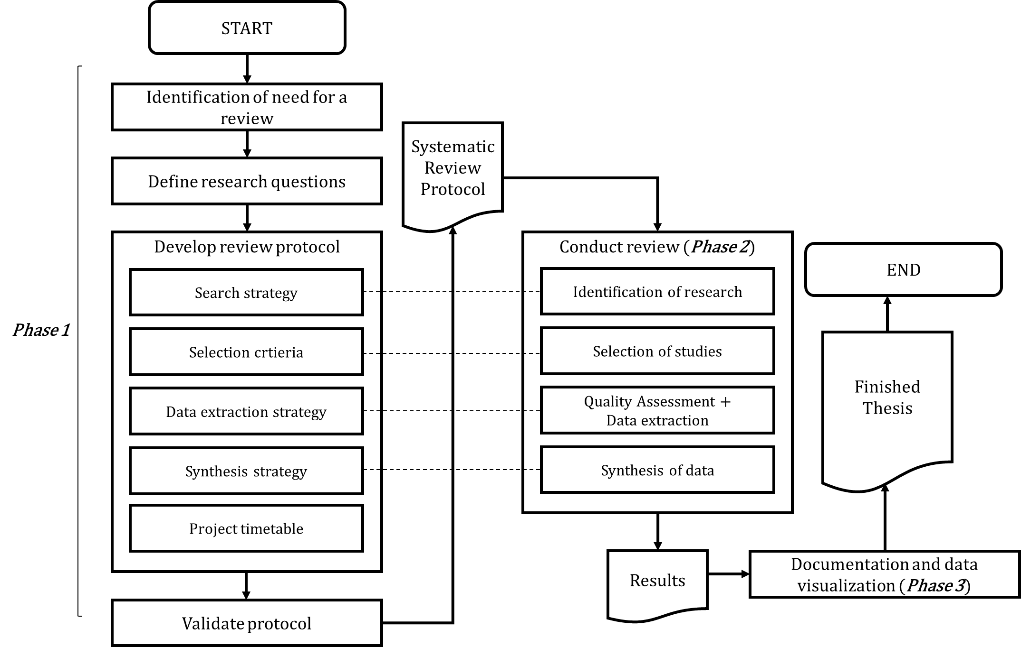
Methodology
Mainly based on [3] and [4]

Slide 9
Current research stage

Slide 10
References
[1] IDC. European Data Market Europe ' s Data Marketplaces - Current Status and Future Perspectives. (June 2016), 2016.
[2] Herman Tavani. Philosophical theories of privacy: implications for an adequate
online privacy policy. 2007.
[3] Pascal Philipp. Investigating the Current State of Research in Large-Scale
Agile Software Development: A Systematic Mapping Study, 2019.
[4] B. A. Kitchenham and D. Budgen, Evidence-based software engineering and systematic reviews. Chapman and Hall/CRC, 2016.
[5] M. Fruhwirth, M. Rachinger, and E. Prlja, “Discovering Business Models of Data Marketplaces,” Proc. 53rd Hawaii Int. Conf. Syst. Sci., pp. 5738–5747, 2020, doi: 10.24251/hicss.2020.704.
[6] D. Solove, “A taxonomy of privacy,” Law Rev., no. 477, pp. 477–560, 2006.
[7] C. Perera, R. Ranjan, and L. Wang, “End-to-end privacy for open big data markets,” IEEE Cloud Comput., vol. 2, no. 4, pp. 44–53, 2015, doi: 10.1109/MCC.2015.78.

Slide 11
Appendix: More on data marketplaces
4 main categories [1]:
Information providers focused on selling their own data to 3d parties, but also providing value added services on top of that content (like Experian)
Big data players or business enterprise software companies who have bought specialized data companies and incorporated them in their service offerings;
Global IT/OTT players providing cloud computing tools and services which can be combined with datasets;
Data portals providing access to open data sets and public sector information with a non-profit business
More on the current situation /
research [5]:
Data marketplaces are still evolving, and a dominant business model of data marketplaces is yet to emerge.
A further perspective that differentiates data markets and research direction:
Whether data marketplaces stored their data in a centralized or decentralized manner (e.g., using a blockchain) → anonymity and encryption as key aspects.

Slide 12
Appendix: More on privacy
Privacy definitions:
The perception of privacy is personal
and it appeals to people's fears and anxieties [6] → Reason for definition problems.
Another problem: The dynamic and always-evolutionary nature of Information
Technology → it creates new gaps and privacy-violation scenarios which would
have been unthinkable in previous times
(Other) Perspectives for definition:
Set of activities that violate a person‘s privacy.
Set of Principles that protect privacy.
Antoher interesting definition, a set of goals [7]:
Unlinkability
Transparency for all stakeholders.
Intervenability for data owners.

Slide 13
Appendix: More on IoT devices
Definition of IoT devices:
System of interrelated computing devices provided with unique identifiers (UIDs) and the ability to transfer data over a network without requiring human-to-human or human-to-computer interaction.
How much data is created by IoT devices?
According to the reports from Cisco, the total number of connected devices becomes 28.5 billion by 2021, and the total amount of data created by these devices will reach 847 ZB per year by 2021 [8].

Slide 14
Appendix: More on related work
Perspective | Study
Behavioral | Sarah Spiekermann, Alessandro Acquisti, Rainer Bohme, and Kai Lung Hui. The challenges of personal data markets and privacy. Electronic Markets, 25(2):161-167, 2015.
Methodical / Mathematical | Chaoyue Niu, Zhenzhe Zheng, Fan Wu, Xiaofeng Gao, and Guihai Chen. Achieving Data Truthfulness and Privacy Preservation in Data Markets. IEEE Transactions on Knowledge and Data Engineering, 31(1):105{119, 2019.
Logical / Technical | Mate Horvath and Levente Buttyan. Problem Domain Analysis of IoT- Driven Secure Data Markets, volume 821. 2018.
Economical | Wolfgang Kerber. Digital markets, data and privacy: Competition law, consumr law and data protection. MAGKS Joint Discussion Paper Series in Economics, 14-2016, 2016.
Mathematical | H. Oh, S. Park, G. M. Lee, H. Heo, and J. K. Choi, “Personal Data Trading Scheme for Data Brokers in IoT Data Marketplaces,” IEEE Access, vol. 7, pp. 40120–40132, 2019, doi: 10.1109/ACCESS.2019.2904248.

Slide 15
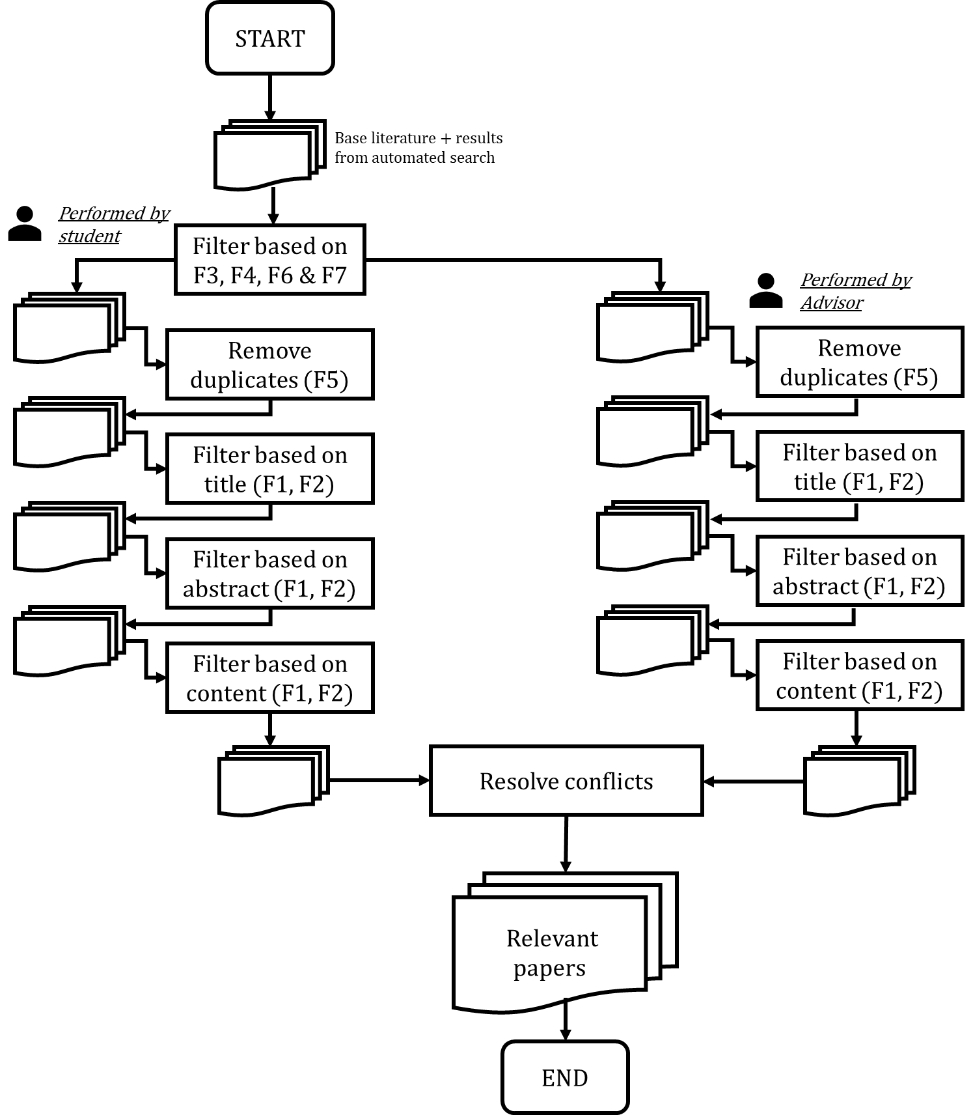
Appendix: More on Methodology (1)

Slide 16
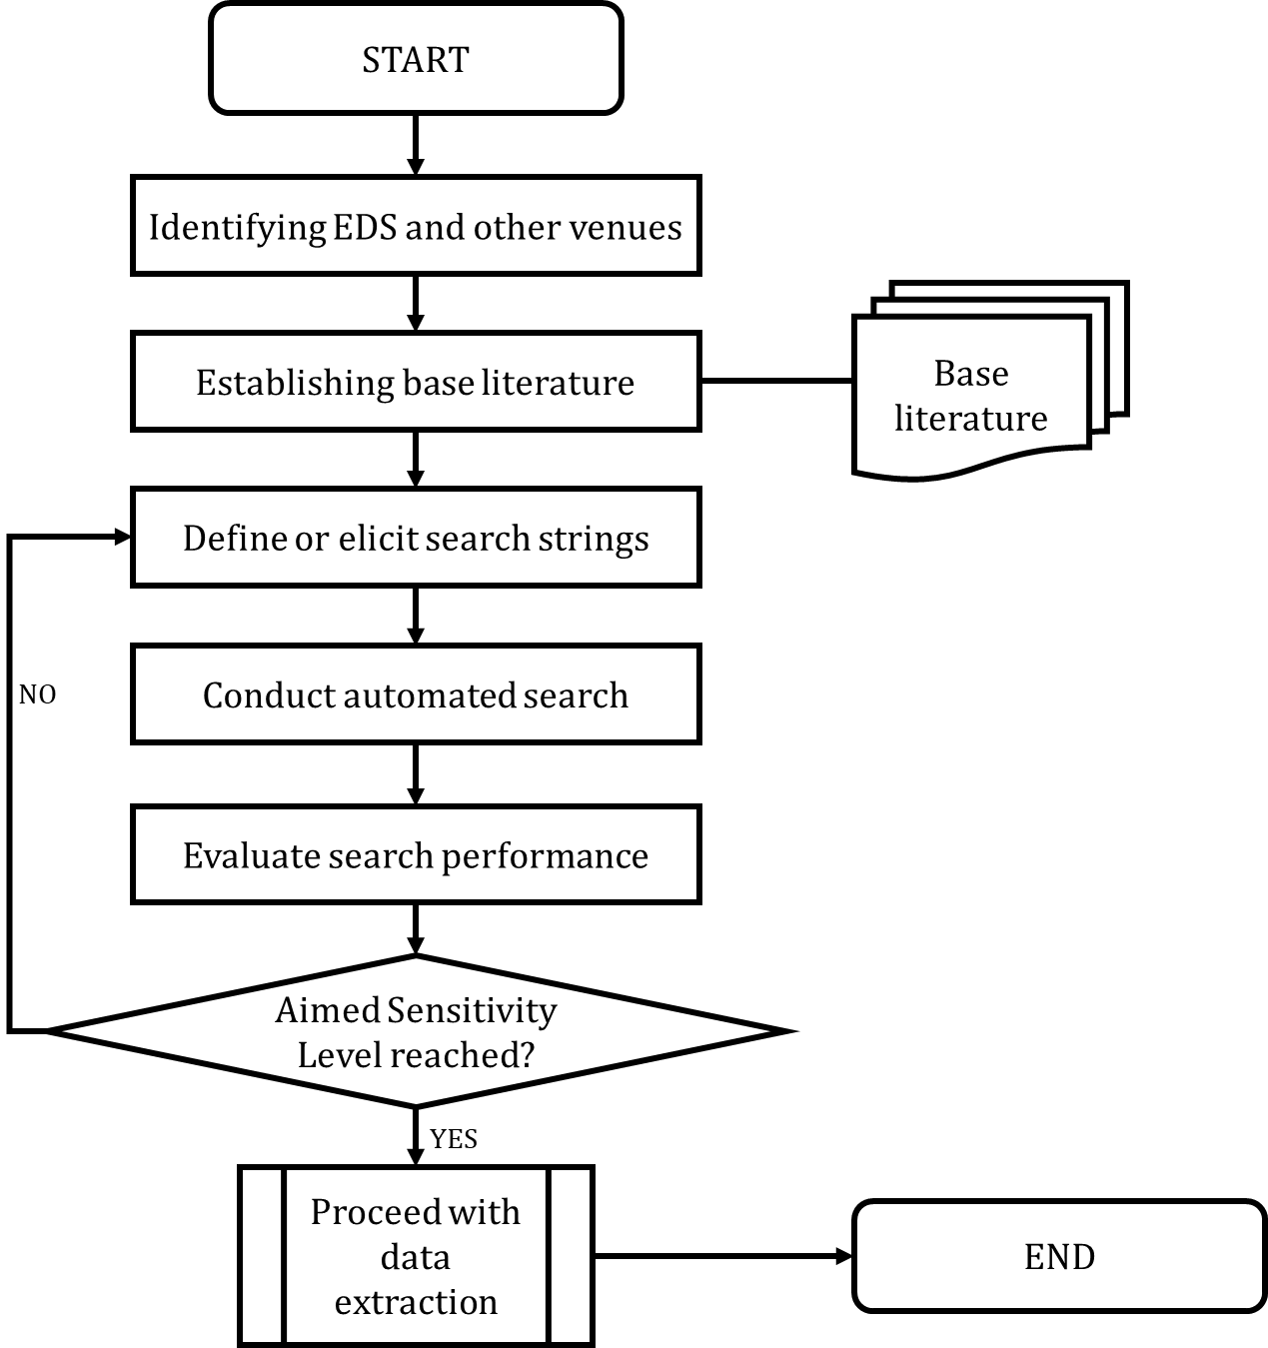
Appendix: More on Methodology (2)

