Slide 1
Privacy Preservation in Data Markets for IoT Devices:
A Systematic Literature Review
Bachelor‘s Thesis: Final presentation
Ilias Soto-Alaoui, October 19th 2020

Slide 2
Agenda
1
Introduction and problem statement
2
Research methodology
3
Results
4
Key findings and outlook

Slide 3
Agenda
1
Introduction and problem statement
2
Research methodology
3
Results
4
Key findings and outlook

Slide 4
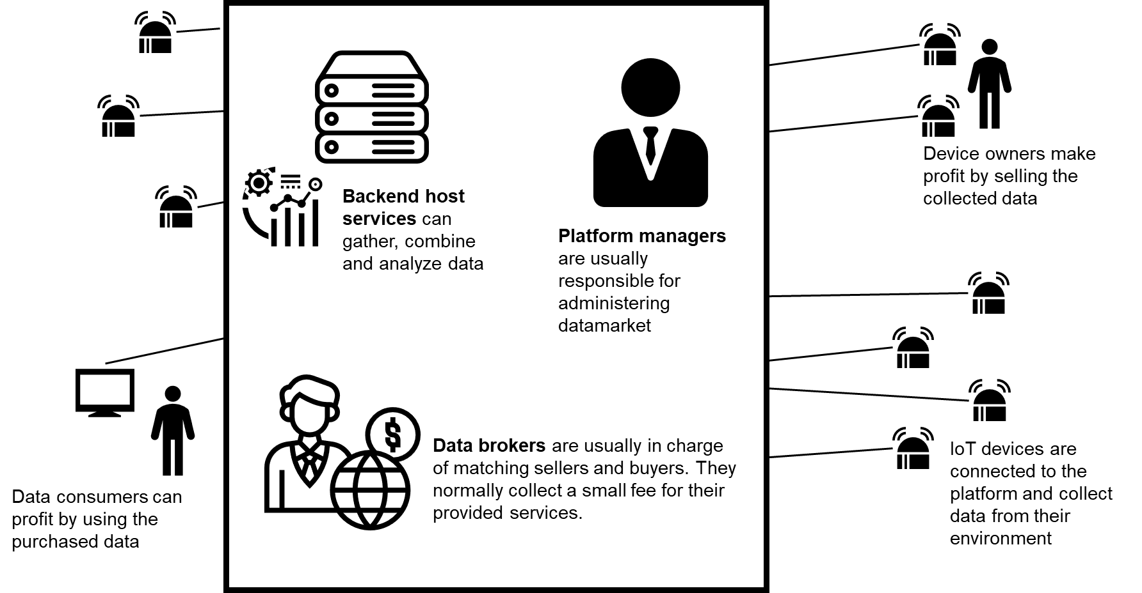
Privacy is one of the requirements in modern data marketplaces
The increasing presence of IoT devices creates opportunities for data owners and consumers who may profit from this data.
There are several types of IoT data markets. We focus on the ones where sellers and buyers are independent parties, and the data can be of any kind.
They also come with a series of requirements such as data correctness, accountability, economic viability and privacy.

Slide 5
Research questions
RQ1
What are the current research gaps and problems in the implementation of
privacy-preserving data markets for IoT devices?
RQ2
What are the research topics that have been addressed in the intersection of
privacy preservation and data markets for IoT devices?
RQ3
Which privacy preservation techniques have been used to enable data markets for
IoT devices and what are their current deployment impediments?
RQ4
What are the future research directions of the application of privacy-preserving
techniques on data markets for IoT devices?
In order to answer these questions, we conducted a Systematic Literature Review (SLR), designed to reduce bias
We also present a meta-data mapping evaluation in order to gain more context

Slide 6
Agenda
1
Introduction and problem statement
2
Research methodology
3
Results
4
Key findings and outlook

Slide 7
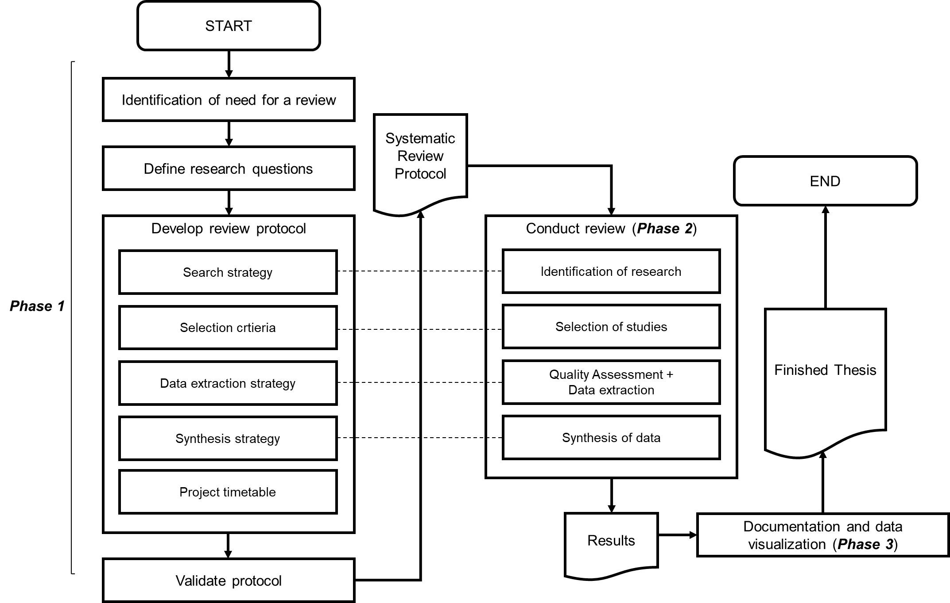
Our methodology consisted of three main phases:
planning, conducting, documenting
Method based on [1]

Slide 8
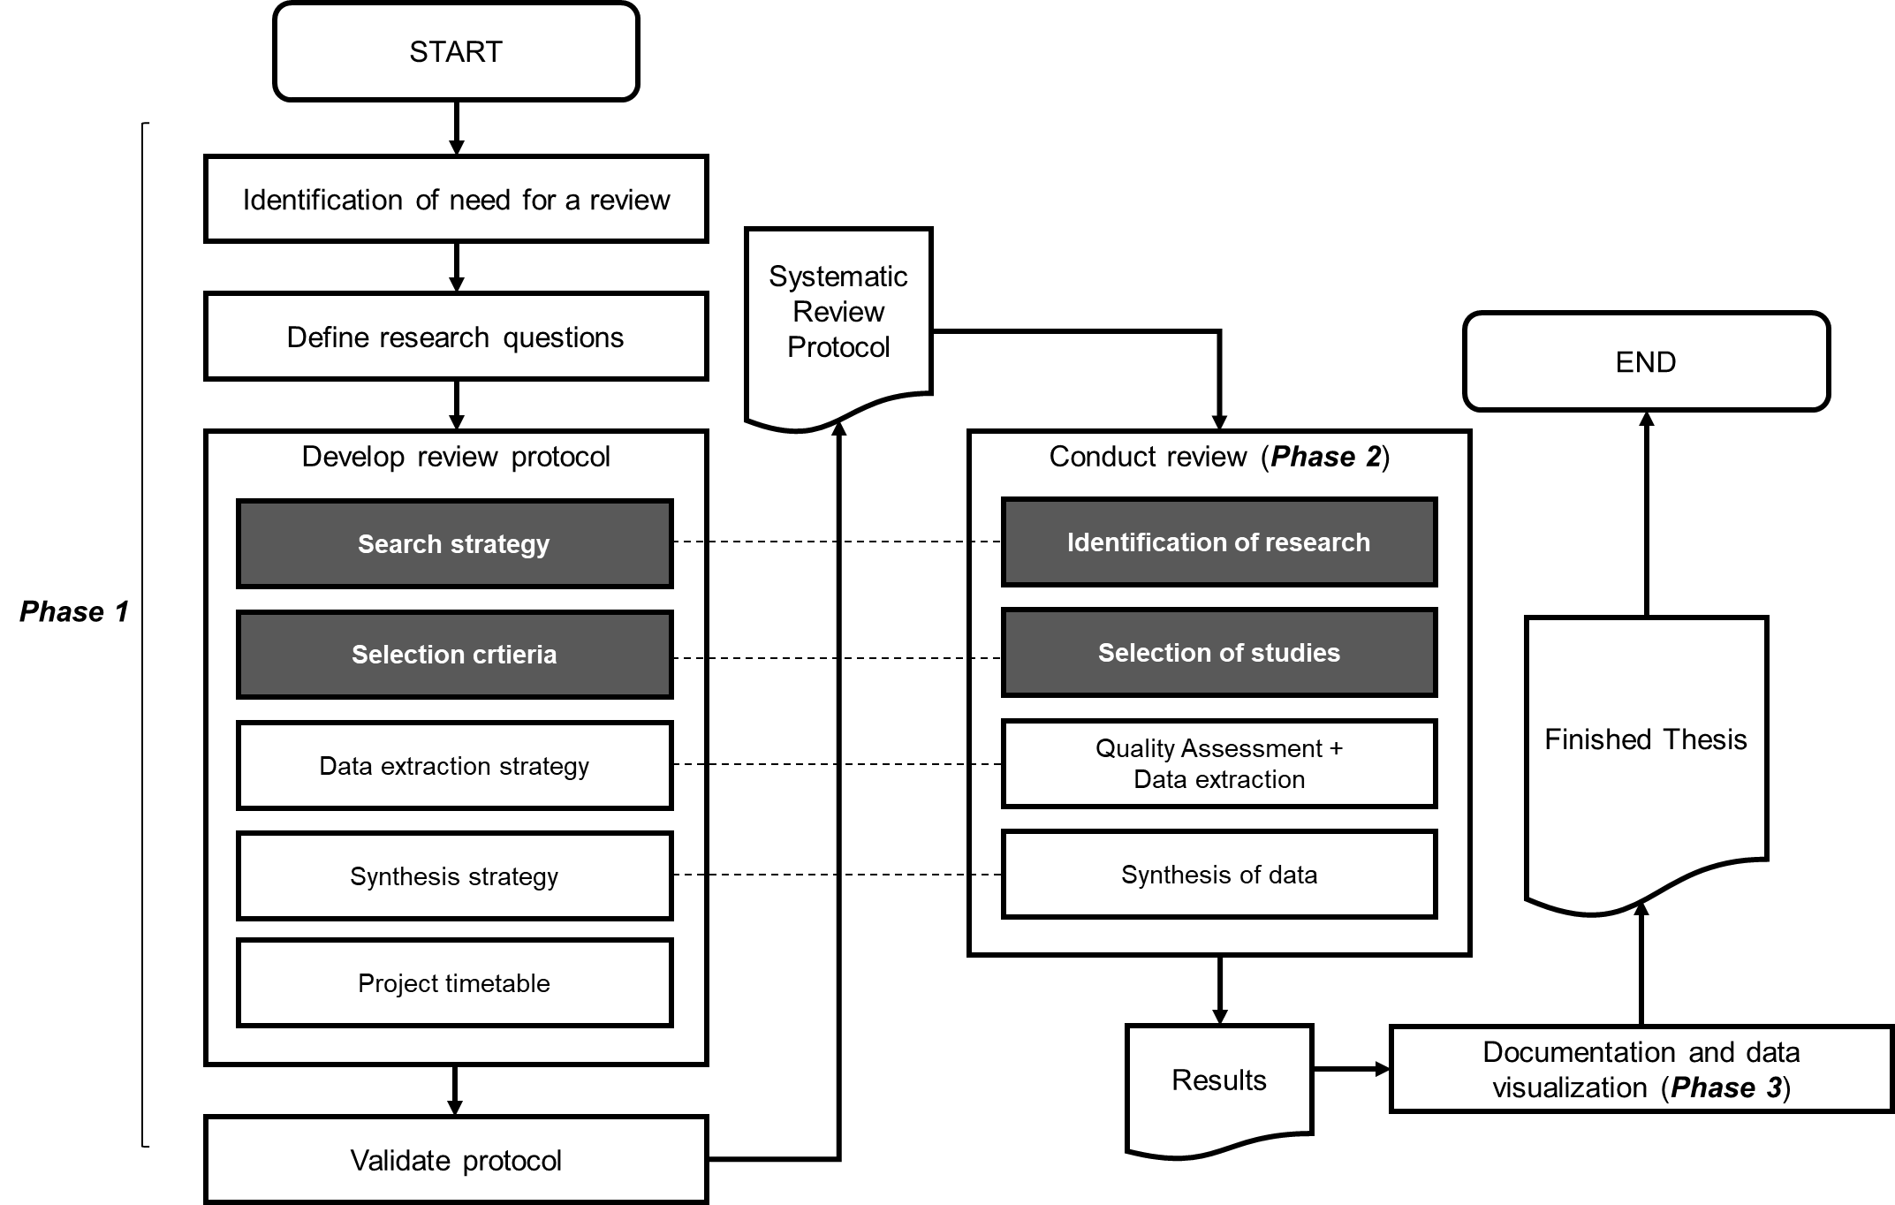
Our methodology consisted of three main phases:
planning, conducting, documenting
Method based on [1]

Slide 9
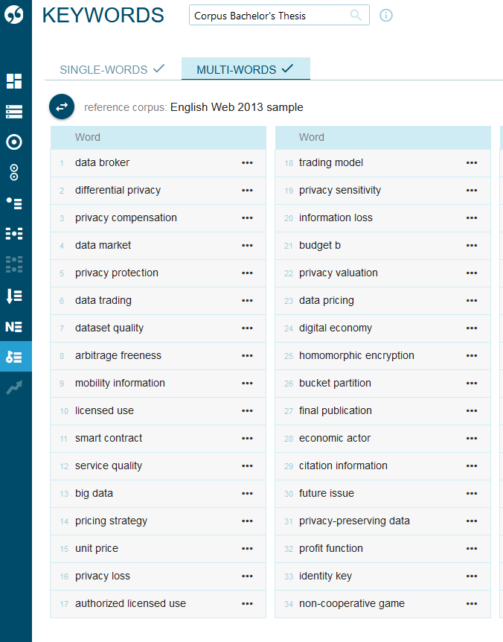
Search strategy and identification of research (2/2)
Initial search string:
Privacy OR private OR encryption OR encrypted OR encrypt OR data protection
AND
Data market OR data marketplace OR data trading OR data broker OR data trader OR data auction
AND
Internet of Things OR Internet of Everything OR IoT OR Sensor OR Connected Devices OR
Networked Devices OR Smart Devices OR Controller OR Edge Computing OR Cloud Infrastructure
OR Machine to Machine OR M2M OR Web-of-Things OR WoT OR Mobility OR Automotive OR
Vehicle OR Car OR Automobile OR Industry 4.0 OR Smart Grids OR V2V OR IIoT OR machine
learning OR mobile OR cyber-physical OR microservice OR microcontroller OR micro-service OR
micro-controller OR blockchain OR neural network OR smart learning OR automated driving OR
autonomous driving OR smart city OR smart factory
Sketch Engine tool

Slide 10
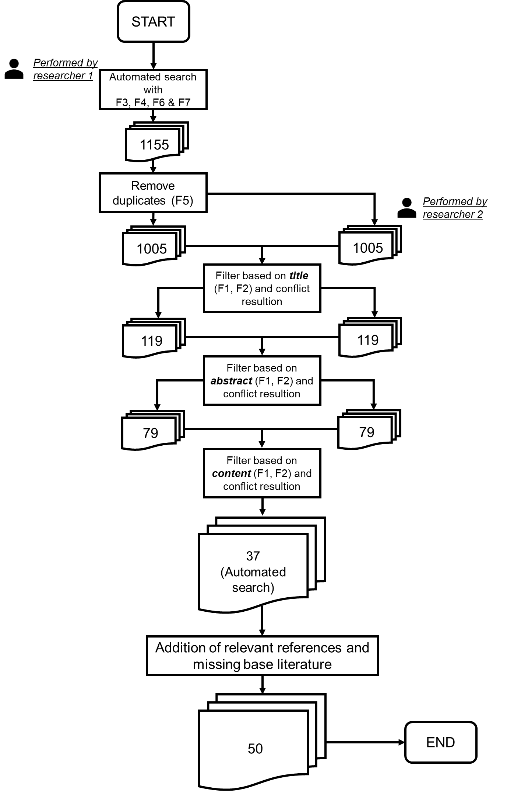
Selection of studies
ID | Facet | Inlcusion criteria | Exclusion criteria
F1 | Coarse focus | The privacy and data market topic must be within the field of computer science and technology | Any other privacy and data market sub-field
F2 | Narrow focus | The paper must explicitly focus on the enablement of privacy (as stated by our selected definitions) within data marketplaces | The paper does not explicitly address this research direction
F3 | Publication channel type | Conference publication OR journal publication (full text) OR workshop publication | The paper is any other type of publication
F4 | Language | English | Non-english
F5 | Duplicates | Publications are unknown to the filtering Process | Publication has been already processed
F6 | Peer-review | The publication has been peerreviewed | The publication is a grey publication
F7 | Full-text access | TUM-Access granted | TUM-Access not granted

Slide 11
Agenda
1
Introduction and problem statement
2
Research methodology
3
Results
4
Key findings and outlook

Slide 12
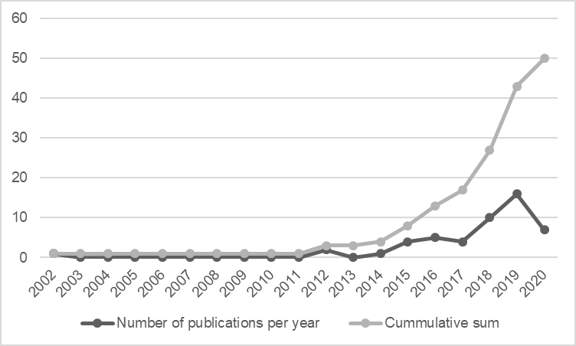
Meta-data mapping: Some resulting graphs
Growing interest in the field over the last years: 66% of the studies were published either in 2018, 2019 or the first four months of 2020

Slide 13
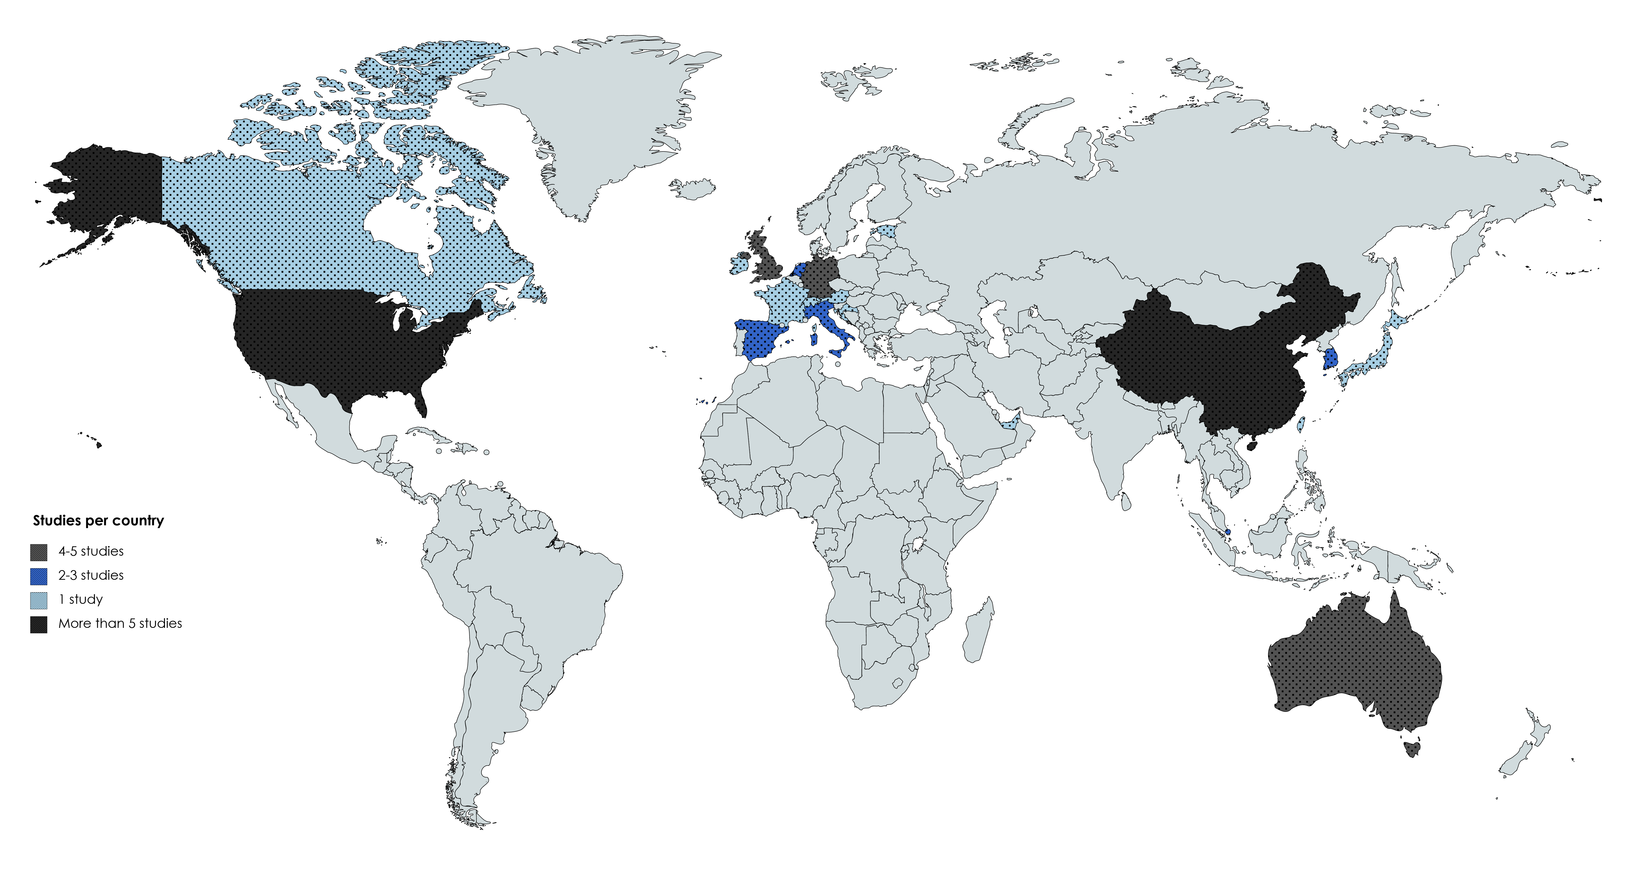
Meta-data mapping: Some resulting graphs
Geographical distribution of studies: China or USA encompassed 78% of the listed contributing countries within the selected studies

Slide 14
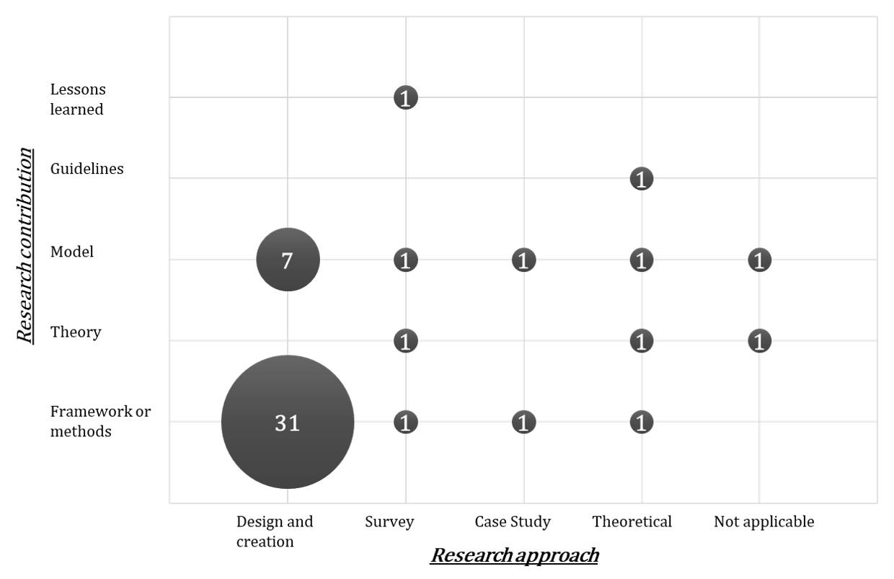
Meta-data mapping: Some resulting graphs
Research approach type and research contribution type: Most of the studies we selected proposed a solution design for a privacy-preserving IoT data marketplace

Slide 15
Results from the Literature Review
RQ1
RQ1: What are the current research gaps and problems in the implementation
of privacy-preserving data markets for IoT devices?
Third-party trust: It is difficult to achieve fairness, security and reliability in data marketplaces without a trusted third-party [2][3].
Truthfulness vs. Privacy preservation: It is difficult to guarantee the truthfulness of both data collection and processing if the data is constrained with privacy requirements [4].
Accountability vs. Privacy preservation: In this case, it is not the content of the data that is questioned, but its origin
Legal challenges
Security challenges: When discussing security, we define it as a measure to provide confidentiality
Costs
Pricing mechanisms
IoT-specific challenges
    3 main challenges:
    Hetereogenity of devices → Design complexity.
    Performance and storage capabilities → Many networkable devices are low in energy and lightweight..
    Lower data quality → due to the unreliability of IoT sensors and the fragility of data transmission links.

Slide 16
Results from the Literature Review
RQ1
RQ1: What are the current research gaps and problems in the implementation
of privacy-preserving data markets for IoT devices?
Third-party trust: It is difficult to achieve fairness, security and reliability in data marketplaces without a trusted third-party [2][3].
Truthfulness vs. Privacy preservation: It is difficult to guarantee the truthfulness of both data collection and processing if the data is constrained with privacy requirements [4].
Accountability vs. Privacy preservation: In this case, it is not the content of the data that is questioned, but its origin
Legal challenges
Security challenges: When discussing security, we define it as a measure to provide confidentiality
Costs
Pricing mechanisms
IoT-specific challenges
    3 main challenges:
    Hetereogenity of devices → Design complexity.
    Performance and storage capabilities → Many networkable devices are low in energy and lightweight..
    Lower data quality → due to the unreliability of IoT sensors and the fragility of data transmission links.

Slide 17
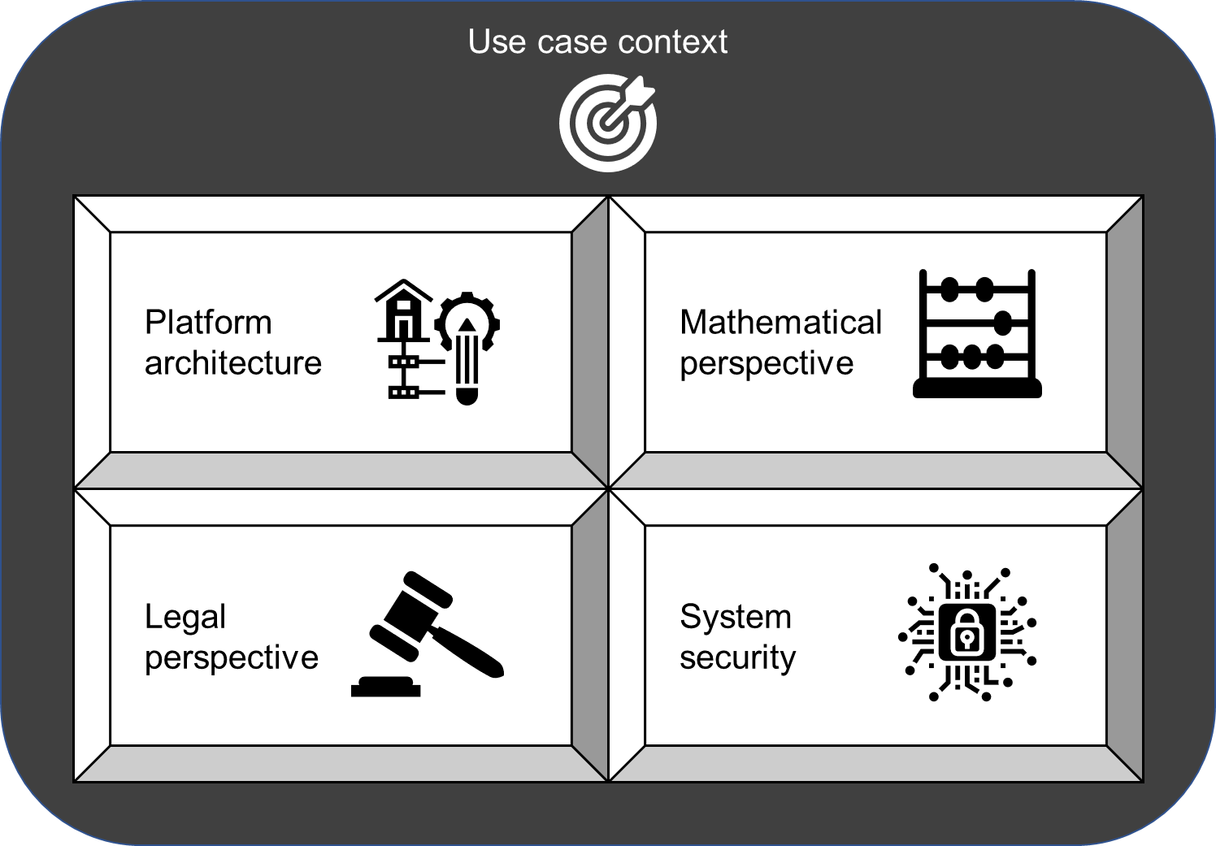
Results from the Literature Review
RQ2
RQ2: What are the research topics that have been addressed in the intersection of
privacy preservation and data markets for IoT devices?
We identified five perspectives for current research topics in the field of IoT data market design and implementation

Slide 18
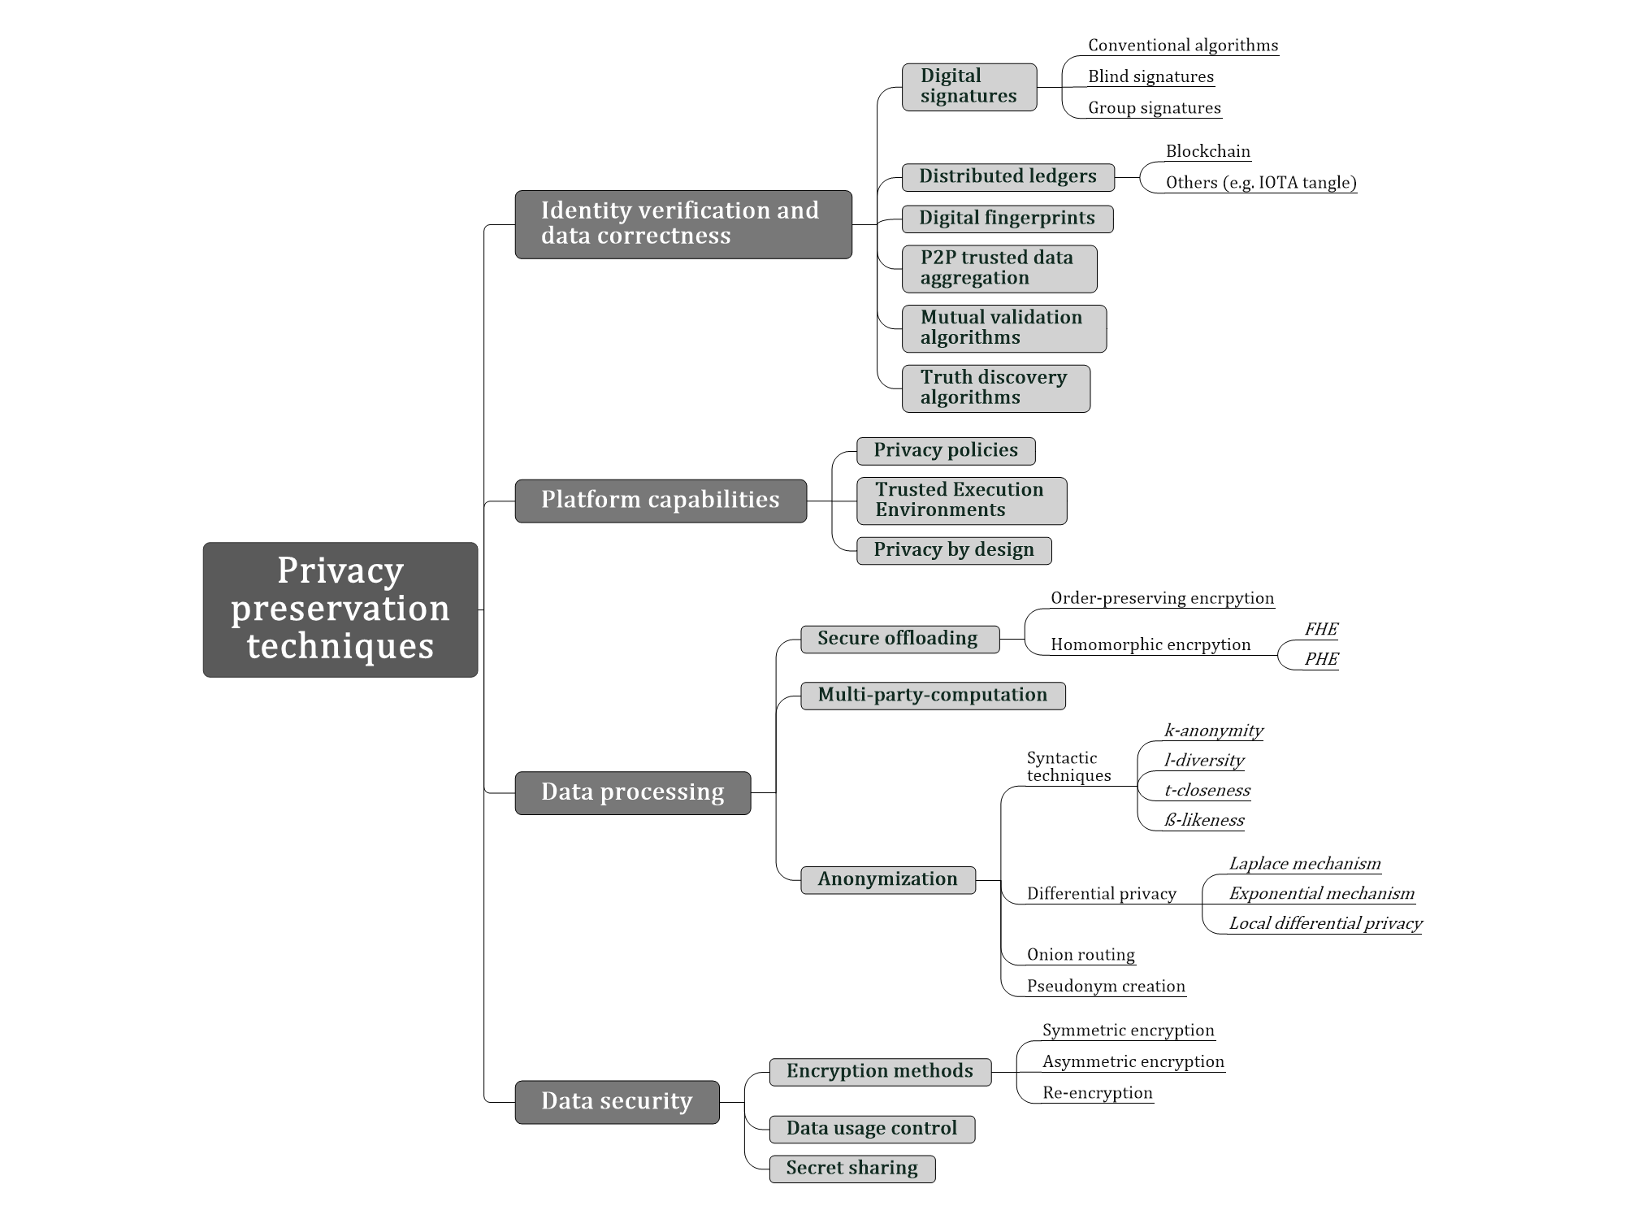
Results from the Literature Review
RQ3
RQ1: Which privacy preservation techniques have been used to enable data markets for
IoT devices and what are their current deployment impediments?

Slide 19

Results from the Literature Review
RQ4
RQ1: What are the future research directions of the application of privacy-preserving
techniques on data markets for IoT devices?
Solving the computational and scalability challenge inherent to IoT devices would tackle many of the problems created by current solutions
Further exploring how other IoT features could enable further techniques that are not possible in other frameworks. For example, using the physical proximity of IoT devices for data correctness verification.
Defining global standards for machine-readible privacy parameters
Further researching adequate legal measures for IoT data markets regarding privacy preservation
The development of effective pricing mechanisms

Slide 20
Agenda
1
Introduction and problem statement
2
Research methodology
3
Results
4
Key findings and outlook

Slide 21

Six key findings represent the most salient characteristics of the field
1
There is an increasing attention of scientists in the research field
2
The privacy requirement for IoT data markets is a requirement that creates several conflicts within data market design
3
Encryption techniques to provide confidentiality must be adjusted to the available capabilities of the devices and to the required privacy level
4
Within data processing stages, homomorphic encryption, k-anonymity and
Differential privacy are the most frequently used techniques
5
Blockchain and digital signatures are the two most frequently mentioned
technologies for supporting accountability and data correctness
6
An efficient way to enable privacy preferences is through the definition of policies

Slide 22
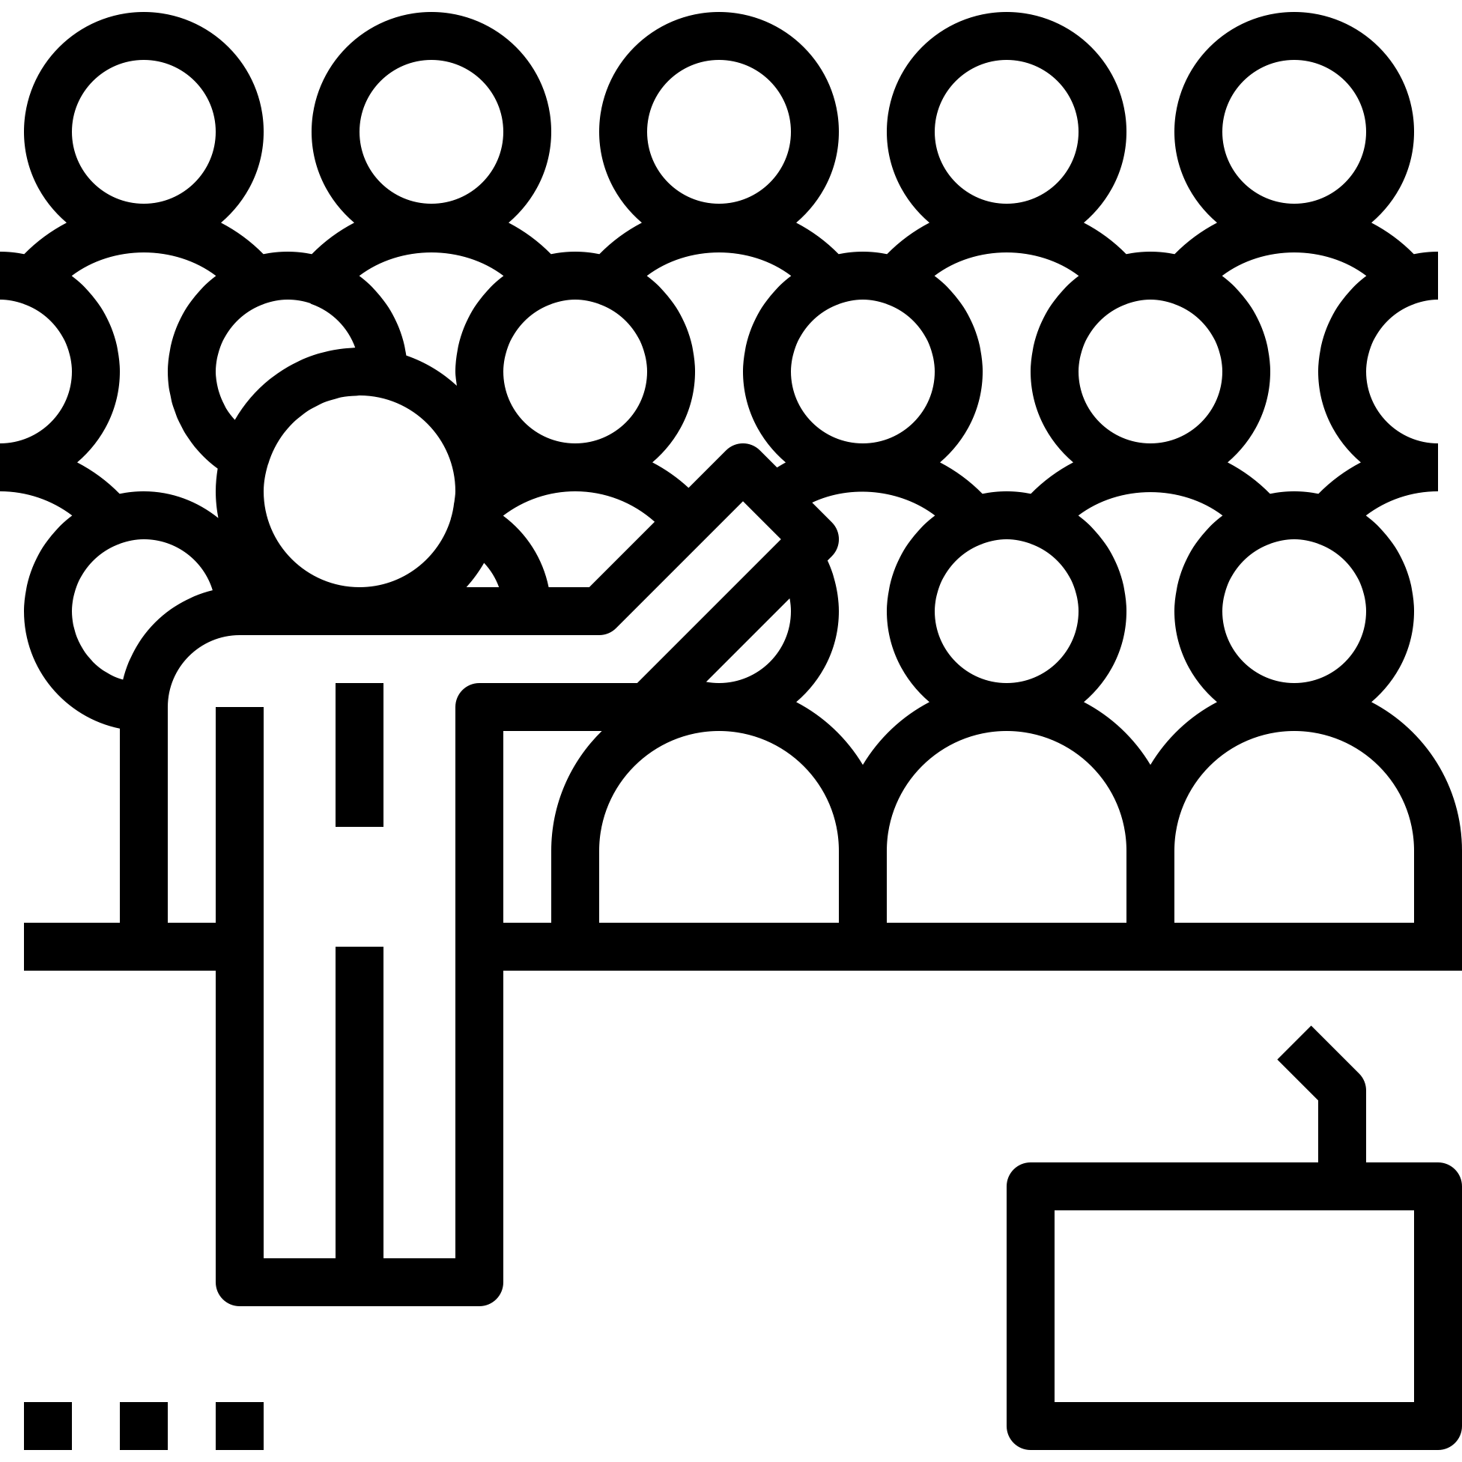
Future work
1
How can the five main research perspectives be unified in order for them to
act as a single thread and not being researched independently?
2
Further measuring the privacy-preserving techniques‘ constraints with
adequate and detailed metrics and map them to the mentioned solutions

Slide 23
References
[1] B. A. Kitchenham and D. Budgen, Evidence-based software engineering and systematic reviews. Chapman and Hall/CRC, 2016.
[2] Z. Guan, X. Shao, and Z. Wan, “Secure, Fair and Efficient Data Trading without Third Party Using Blockchain,” 2018 IEEE Int. Conf. Internet Things IEEE Green Comput. Commun. IEEE Cyber, Phys. Soc. Comput. IEEE Smart Data, pp. 1349–1354, 2018, doi: 10.1109/Cybermatics.
[3] Y. N. Li, X. Feng, J. Xie, H. Feng, Z. Guan, and Q. Wu, “A decentralized and secure blockchain platform for open fair data trading,” Concurr. Comput., vol. 32, no. 7, pp. 1–11, 2019, doi: 10.1002/cpe.5578.
[4] Z. Zheng, W. Mao, F. Wu, and G. Chen, “Challenges and opportunities in IoT data markets,” Soc. 2019 - Proc. 2019 4th Int. Work. Soc. Sens., pp. 1–2, 2019, doi: 10.1145/3313294.3313378.
[5] Mozilla Foundation, “Confidentiality, Integrity, and Availability,” 2019. [Online]. Available: https://developer.mozilla.org/en- US/docs/Archive/Security/Confidentiality,_Integrity,_and_Availability. [Accessed: 01-Oct-2020].
[6] S. De Capitani Di Vimercati, S. Foresti, G. Livraga, and P. Samarati, “Data privacy: Definitions and techniques,” Int. J. Uncertainty, Fuzziness Knowlege-Based Syst., vol. 20, no. 6, pp. 793–817, 2012, doi: 10.1142/S0218488512400247.
[7] S. Spiekermann and A. Novotny, “A vision for global privacy bridges: Technical and legal measures for international data markets,” Comput. Law Secur. Rev., vol. 31, no. 2, pp. 181–200, 2015, doi: 10.1016/j.clsr.2015.01.009.

Slide 24
Ilias Soto-Alaoui
Ilias.soto@tum.de

Slide 25
Backup

Slide 26
IoT data markets – 4 dataflow types (phases)
The interaction phase, where the data subject actively or passively interacts with the smart things in his environment, thereby triggering a service.
A collection phase, where smart things then engage in the collection of information and relay it to the corresponding back-end via the available interconnection networks possibly with the help of intermediate gateways.
The processing phase, where backends analyze the information in order to provide the triggered service.
The presentation phase, where the service is provided to the data subject by the surrounding smart things according to the instructions by the backend.
*Based on [9]

Slide 27
Privacy definition – 3 main goals
The first goal is transparency. Transparency means that all stakeholders must be informed about the data lifecycle and what happens to each data item over time. This goal must be valid for data owners, data buyers and additional entities within the trading process in order to avoid information asymmetries. In practical terms, this means that the data market platforms must inform both sellers and buyers on the data lifecycle for each transaction.
Intervenability, the second goal, means that data owners should be able to intervene at any time during the data lifecycle so that they can withdraw or change their consent at any time.
The third goal is unlinkability, which states that data from multiple sources should not be combined in such a way that together they would violate the other two goals. One important aspect is preventing re-identifiability.
*Based on [10]

Slide 28
Study selection process details
The selected studies were defined in three stages:
  A preliminary research gave us our base literature
  The automated search in 7 Electronic Data Sources (EDS) gave us the main literature
  Further relevant references in the two previous sets encompassed the additional litrature
Base literature
+
Main literature from automated search
+
Additional literature
=
Selected studies

Slide 29
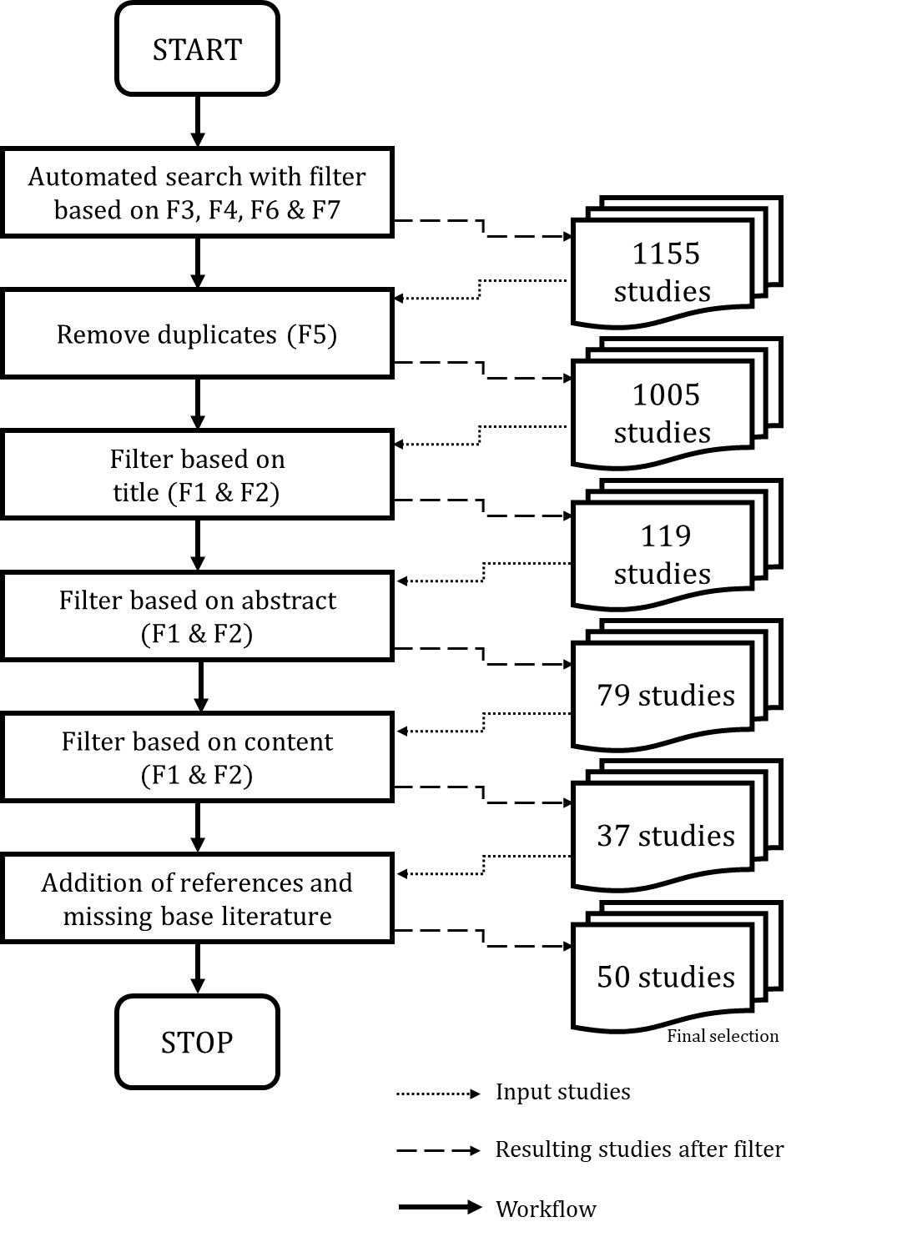
Study selection process details
We defined seven selection criteria for the inlcusion of the studies
The selection was performed by both the student and the advisor
After each filter, arising conflicts were resoluted

Slide 30
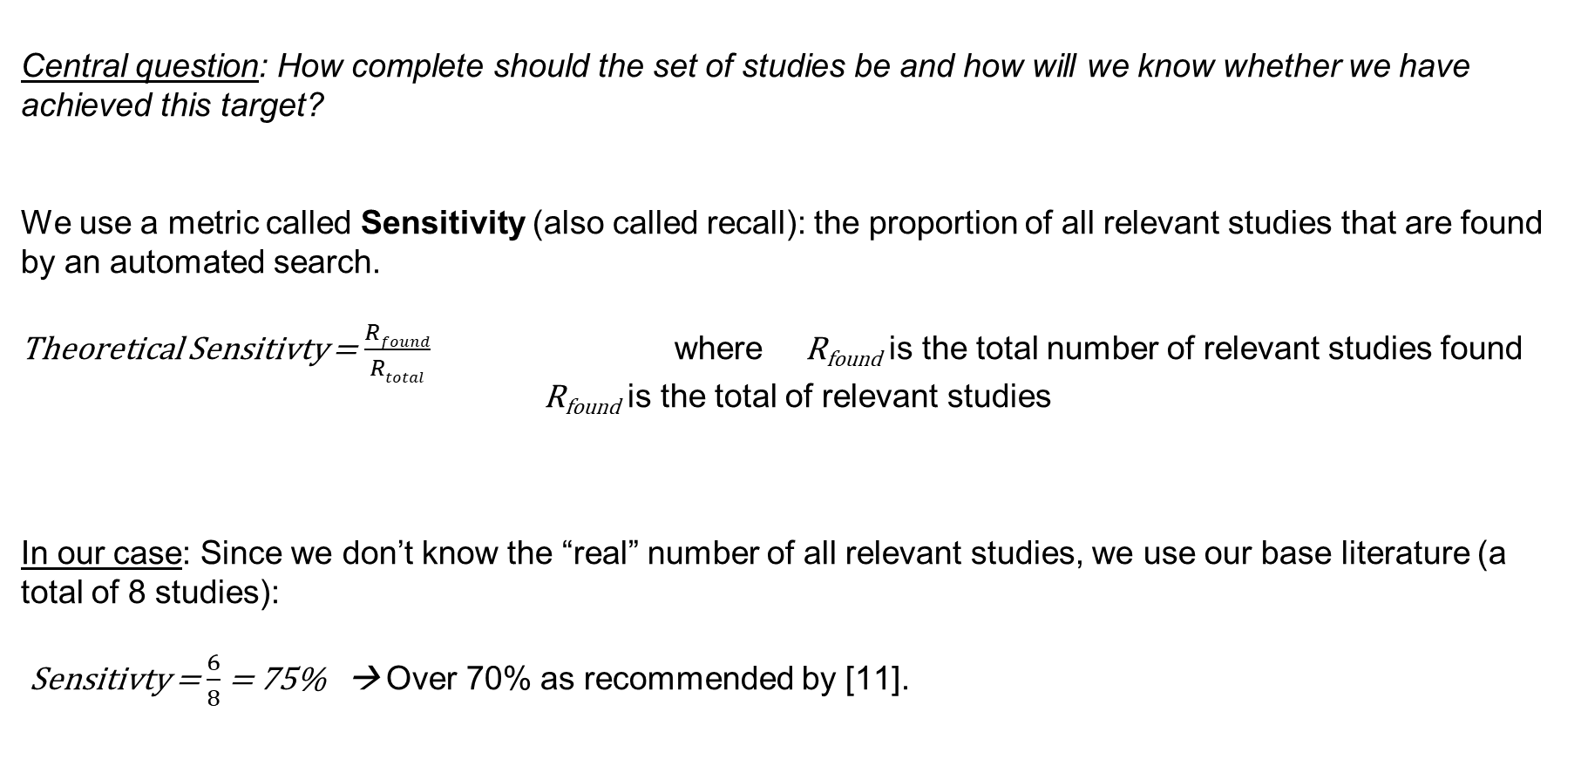
Measuring completeness of automated search
Central question: How complete should the set of studies be and how will we know whether we have achieved this target?
We use a metric called Sensitivity (also called recall): the proportion of all relevant studies that are found by an automated search.
Theoretical Sensitivty = $\frac{Rfound}{Rtotal}$ where R_{found} is the total number of relevant studies found
R_{found} is the total of relevant studies
In our case: Since we don’t know the “real” number of all relevant studies, we use our base literature (a total of 8 studies):
Sensitivty = $\frac{6}{8}$ = 75% → Over 70% as recommended by [11].

Slide 31
Sketch Engine Details
We used an online tool called Sketch Engine to create a corpus of our base literature and analyze its recurring terms in order to create our search string. Within this tool, we used the following functionalities:
The Keywords functionality is used to extract single word and multi-word units which are typical of the corpus. It defines what makes the existing corpus different from other corpora.
The Wordlist function generates frequency lists for all words in the corpus (brute force approach) .Users can specifically look for word types (verbs, nouns, etc.).
The Thesaurus functionality automatically generated list of synonyms or words belonging to the same category (semantic field). The list was produced based on the context in which the words appear in our corporus.
The Word Sketch functionality processes the word’s collocates and other words in its surroundings. It can be used as a one-page summary of the word’s grammatical and collocational behaviour. The results are organized into categories, called grammatical relations, such as words that serve as an object of the verb, words that serve as a subject of the verb, words that modify the word etc.

Slide 32
Selected EDS
EDS | Complete search string used | Query date | # of results
IEEE | YES | 29.04.2020 | 49
ACM | YES | 30.04.2020 | 311
Web Of Science | YES | 01.05.2020 | 40
Science Direct | NO | 01.05.2020 | 143
Springer Link | YES | 01.05.2020 | 69
Wiley Interscience | YES | 02.05.2020 | 225
SCOPUS | YES | 02.05.2020 | 318
TOTAL |  |  | 1155
We identified five perspectives for current research topics in the field of IoT data market design and implementation

Slide 33
Classification of research approaches
Research approach | Description
Survey | If the study collects quantitative and/or qualitative data with the help of a questionnaire or interviews.
Design and creation | The development of a new IT product or artifact, or new model/ method.
Case study | If one of the following conditions is fulfilled: 1) The study states one or more research questions and some of them or all are answered with a case study. 2) The study evaluates a theoretical concept empirically by implementing it in a case study.
Theoretical | If the study is of a theoretical nature but not explicitly describes that a grounded theory approach was used.
Not applicable | Either if study does not define the applied research method or and it cannot be inferred or interpreted from study.
*Classification Based on [8]

Slide 34
Classification of research contributions
Research contribution | Description
Model | Presentation of an observed reality with the help of concepts or related concepts resulting from a conceptualization process.
Theory | Establishing relationships between cause and effect from determined results.
Framework or methods | All Models that relate to the design of software or to the management of development processes.
Lessons learned | List of outcomes, which is analyzed directly from the research results obtained.
Guidelines | A list of advice represents a summary of the research results obtained.
*Classification Based on [8]

Slide 35
Data extraction strategy
Data extraction card for PXXX
Meta-data:
Publication date: Cite count:
Authors: Research institutions:
Source: Research approach:
Our extraction strategy consisted of using data extraction cards for each study
The extraction cards were divided in two parts: study meta-data and content relevant for SLR
This approach enhanced the process of comparing different studies within the data synthesis phase
…
…
Content for SLR:
Tags / Keywords:
Small summary:
Problem statement:
Privacy-preservation techniques:
Challenges:
…

Slide 36
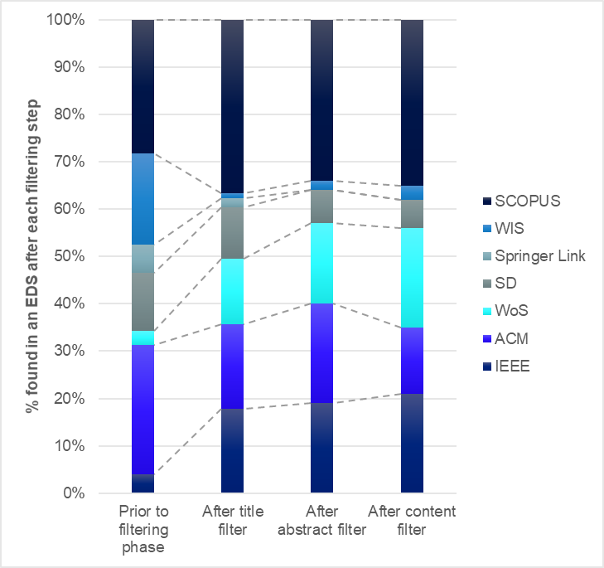
Meta-data mapping – further results

Slide 37
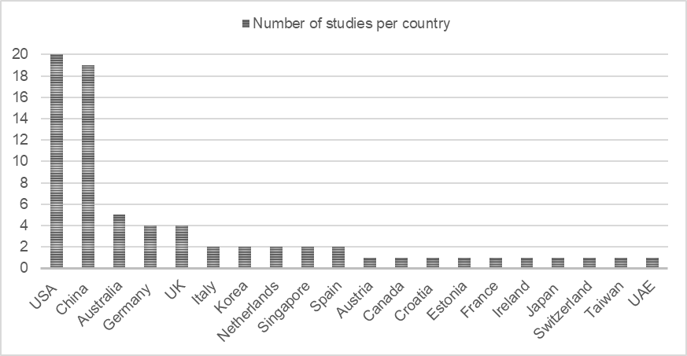
Meta-data mapping – further results
78% of all contributing countries were either the USA or China

Slide 38
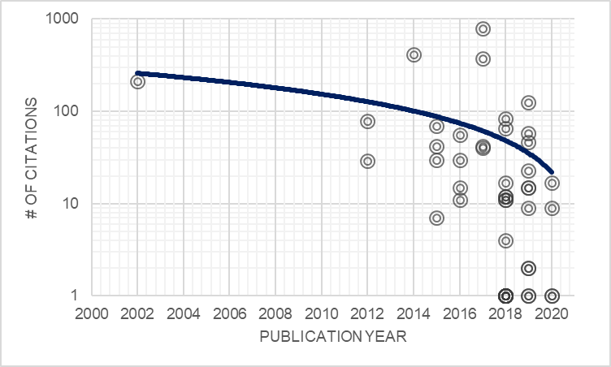
Meta-data mapping – further results

Slide 39
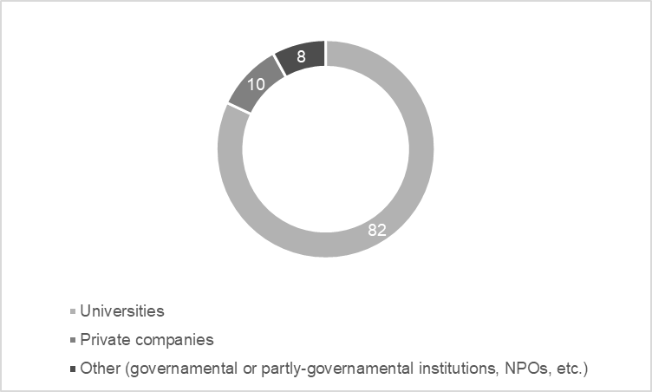
Meta-data mapping – further results
Most of the colleborating research institutions were universities

Slide 40
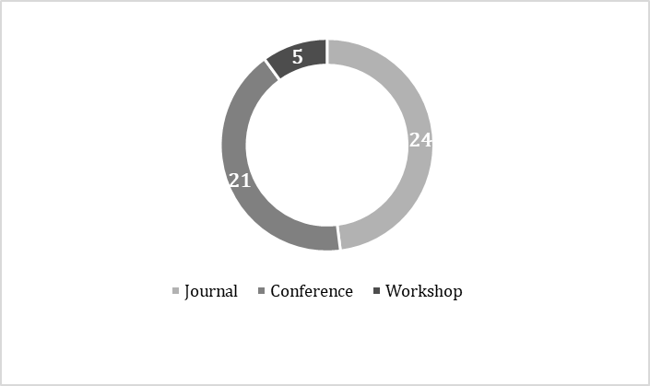
Meta-data mapping – further results
Most of our studies were found either in journals or workshop proceedings

Slide 41
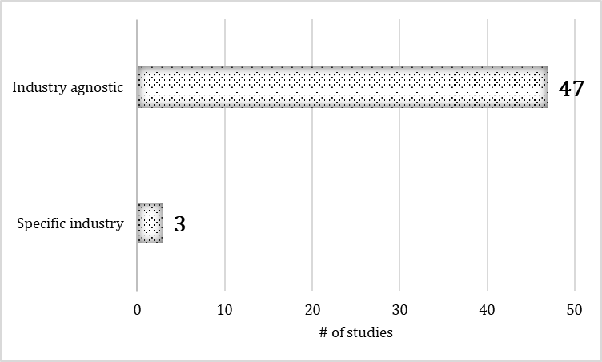
Meta-data mapping – further results
Most of the selected studies were industry agnostic

Slide 42
Data security – possible attacks
The SLR differentiates between „semi-honest“ and „malicious“ attackers.
Besides the general classification, we identify the following attacks specific for IoT scenarios:
  Re-identification (mostly using a combination of datasets)
  Localization and tracking (for Location-Based-Services)
  Profiling (of interests or behaviour)
  Linkage, which means usingseveral datasets in order to gain new inormation about a person / entity
Attack types | Description
Data forwarding | The seller’s raw data is forwarded to an authorized party. This attack is particularly challenging within data markets since the acquired data is very feasible since information can be duplicated with costs almost to zero and quickly lose its value.
DoS attack | An attacker invokes a marketplace functionality (e.g. a smart contract) repeatedly to exhaust the network communication resources in the platform.
Collision | When a malicious actor may be the same person or there is a collision between one or more actors in different roles (e.g. a data broker and a data seller colliding to get a higher selling price).
Information Leakage during running | Occurs only during the execution of data analysis within the data market
Side-channel attack | When an adversary is trying to take advantage of the physical specificities (the implementation) of actual cryptographic /computational systems. .

Slide 43
Multiparty computation
In multiparty computation (MPC), multiple entities can jointly compute a function without revealing individual inputs to each other, i.e. protocols between multiple distrusting stakeholders to either jointly compute a result or to exchange information obliviously.
The main purpose of these protocols is to defend the mechanisms that make sure that parties don’t learn more information than their own when processing data.
Within our SLR, we found 4 studies that implement MPC as part of their solution.
Challenges: high latency and risk of collision of participants
One special and common case of MPC is the two-party computation. Two central concepts of this case are oblivious transfer and the principle of garbled circuits:
  Oblivious Transfer (OT) is a cryptographic primitive which in its simplest flavor (1-out-of-2 OT) a sender has two input messages M0 and M1 and a receiver has a choice bit c. At the end of the protocol, the receiver is supposed to learn the message Mc and nothing else, while the sender is supposed to learn nothing. In other words, a sender doesn’t know which piece of information it has sent to the receiver.
  Garbled circuits are protocols that enable two-party secure computation where the function must be described as a Boolean circuit providing basic logic gates such as AND, XOR and OR. Garbled circuits make use of oblivious transfer protocols to function.

Slide 44
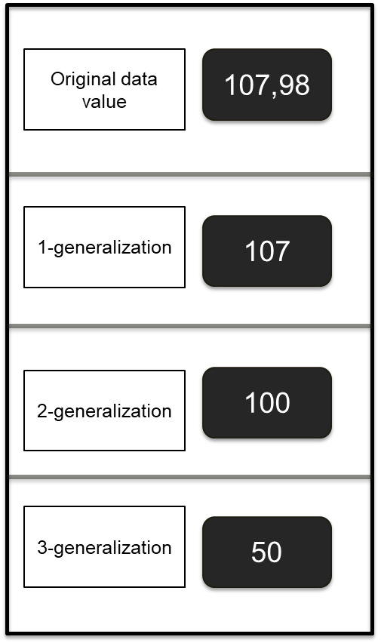
Anonymization – k-anonymity
Anonymization techniques are mainly used to mitigate re-identification attacks.
Anonymization protects the data from any entity that is not the data owner (including the buyer)
Syntactic techniques guarantee data protection while preserving data truthfulness:
  K-anonymity: if the information for each individual contained in the release cannot be distinguished from at least k-1 individuals within the same dataset.
    K-anonymity is normally realized through generalization.
    Challenge: issues if sensitive attributes lack diversity.
  L-diversity: Each equivalence class must have l well represented values.
    Challenge: issues if the adversary knows the frequency for each value.
  T-closeness: Distribution of each set must be close to the distribution of the entire dataset.
    Challenge: worse data quality because of noise induction.
Example: 3 generalization steps

Slide 45
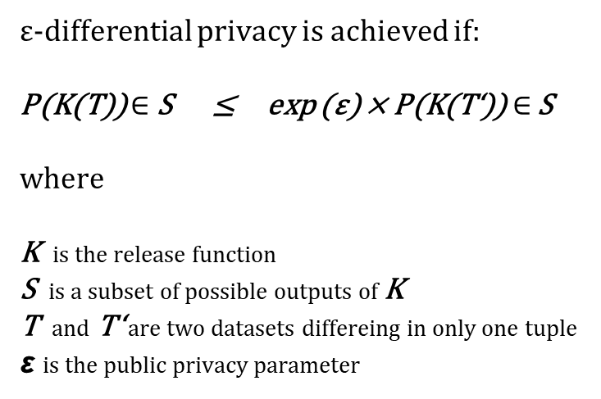
Anonymization – Differential privacy
Semantic techniques such as differential privacy typically add noise to the released data. Noise addition perturbs the original content of the dataset, thus achieving privacy at the price of truthfulness.
13 studies used differential privacy as part of the proposed solution.
The idea behind differential privacy is that if the effect of making an arbitrary single substitution in the database is small enough, the query result cannot be used to infer much about any single individual.
  An algorithm is differentially private if an observer seeing its output cannot tell if a particular individual's information was used in the computation.
The goal is to give each individual roughly the same privacy that would result from having their data removed. That is, the statistical functions run on the database should not overly depend on the data of any one individual.
ε-differential privacy is achieved if:
P(K(T)) $∈$ S ≤ exp (ε) × P(K(T‘))$∈$ S
where
K is the release function
S is a subset of possible outputs of K
T and T‘ are two datasets differeing in only one tuple
ε is the public privacy parameter

Slide 46

Trusted Execution Environments
Trusted execution environments (TEEs) are secure areas of a main processor that guarantee code and data loaded inside to be protected with respect to confidentiality and integrity.
Four of the selected papers use TEEs in order to enhance these characteristics. All of these papers use Software Guard Extensions (SGX), which are security-related instruction codes built into modern Intel CPUs where TEEs can be built.
SGX are able to prove the correct execution of programs (attested execution) by issuing remote attestation, digital signatures and the private hardware key over the program and an execution output.
The regions of memory used for the execution of the code are called enclaves.

Slide 47
Results from the Literature Review
RQ1
RQ1: What are the current research gaps and problems in the implementation
of privacy-preserving data markets for IoT devices?
Challege | Description
Third-party trust | It is difficult to achieve fairness in data marketplaces without a trusted third-party [2]. Besides fairness, many other requirements expected in existing data markets (such as security and reliability) cannot be guaranteed without a mediating third-party [3]. Besides requiring trust, a mediating third-party has other issues, such as costs.
Truthfulness vs. Privacy preservation | It is difficult to guarantee the truthfulness of both data collection and processing if the data is constrained with privacy requirements [4]. If the first challenge presented in this section dealt with trusting a third party with one’s own data, this challenge deals with trusting the data owner or the data processor with their own data.
Accountability vs privacy preservation | Privacy preservation contradicts accountability (data traceability and provenance) as much as it contradicts truthfulness. In this case, it is not the content of the data that is questioned, but its origin. Should one party provide dishonest data, efficient mechanisms must be implemented in data marketplaces in order to hold that party accountable and be able to take countermeasures against that party (e.g. banning that party from further participating in the data trading platform). This requirement violates the privacy need for impeding reidentification.
Legal challenges | 4 main challenges: Firstly, most pieces of legislation center around fuzzy notations of “personal identifiable information” (PII). These notations are quickly deprecated as new IoT technologies unlock and combine new datasets that can enable identification and make the distinction of PII and non-PII almost impossible. Secondly, the timeliness of legislation is a big issue since laws in most countries are passed at a much slower pace than technology advancements are researched. Thirdly, many of the privacy breaches go unnoticed: an impressive “shadow market” for private data. This market’s shadow existence “undermines its long-term viability, making all its players operate at the edge of what is ethically sustainable” [7]. Lastly, the economic aspect of privacy is still favorable of those that disregard privacy legislation.
Security challenges | When discussing security, we define it as a measure to provide confidentiality. Confidentiality refers to protecting information from being accessed by unauthorized parties or in other words, only authorized can gain access to sensitive data [5].
Costs | The achievement of all needed transactions between two parties requires a few “runs” to get in touch with and it may take several negotiations (especially in auction mechanisms) to reach a consensus. Furthermore, if data owners suffer from low sales they may need to invest in additional resources in order to promote their sales [3]. Moreover, the costs of maintaining the trading platform must also be economically viable [6]. Another cost factor is the awareness of individuals.
Pricing mechanisms | The negotiation mechanisms must be taken into account when contemplating the technical implementation and there must be supporting incentives for all parties.
IoT-specific challenges | 3 main challenges: Hetereogenity of devices → Design complexity. Performance and storage capabilities → Many networkable devices are low in energy and lightweight.. Lower data quality → due to the unreliability of IoT sensors and the fragility of data transmission links.

Slide 48
Results from the Literature Review
RQ1
RQ1: What are the current research gaps and problems in the implementation
of privacy-preserving data markets for IoT devices?
Challege | Description
Third-party trust | It is difficult to achieve fairness in data marketplaces without a trusted third-party [2]. Besides fairness, many other requirements expected in existing data markets (such as security and reliability) cannot be guaranteed without a mediating third-party [3]. Besides requiring trust, a mediating third-party has other issues, such as costs.
Truthfulness vs. Privacy preservation | It is difficult to guarantee the truthfulness of both data collection and processing if the data is constrained with privacy requirements [4]. If the first challenge presented in this section dealt with trusting a third party with one’s own data, this challenge deals with trusting the data owner or the data processor with their own data.
Accountability vs privacy preservation | Privacy preservation contradicts accountability (data traceability and provenance) as much as it contradicts truthfulness. In this case, it is not the content of the data that is questioned, but its origin. Should one party provide dishonest data, efficient mechanisms must be implemented in data marketplaces in order to hold that party accountable and be able to take countermeasures against that party (e.g. banning that party from further participating in the data trading platform). This requirement violates the privacy need for impeding reidentification.
Legal challenges | 4 main challenges: Firstly, most pieces of legislation center around fuzzy notations of “personal identifiable information” (PII). These notations are quickly deprecated as new IoT technologies unlock and combine new datasets that can enable identification and make the distinction of PII and non-PII almost impossible. Secondly, the timeliness of legislation is a big issue since laws in most countries are passed at a much slower pace than technology advancements are researched. Thirdly, many of the privacy breaches go unnoticed: an impressive “shadow market” for private data. This market’s shadow existence “undermines its long-term viability, making all its players operate at the edge of what is ethically sustainable” [7]. Lastly, the economic aspect of privacy is still favorable of those that disregard privacy legislation.
Security challenges | When discussing security, we define it as a measure to provide confidentiality. Confidentiality refers to protecting information from being accessed by unauthorized parties or in other words, only authorized can gain access to sensitive data [5].
Costs | The achievement of all needed transactions between two parties requires a few “runs” to get in touch with and it may take several negotiations (especially in auction mechanisms) to reach a consensus. Furthermore, if data owners suffer from low sales they may need to invest in additional resources in order to promote their sales [3]. Moreover, the costs of maintaining the trading platform must also be economically viable [6]. Another cost factor is the awareness of individuals.
Pricing mechanisms | The negotiation mechanisms must be taken into account when contemplating the technical implementation and there must be supporting incentives for all parties.
IoT-specific challenges | 3 main challenges: Hetereogenity of devices → Design complexity. Performance and storage capabilities → Many networkable devices are low in energy and lightweight.. Lower data quality → due to the unreliability of IoT sensors and the fragility of data transmission links.

Slide 49
Further References
[8] P. Philipp, “Investigating the Current State of Research in Large-Scale Agile Software Development: A Systematic Mapping Study.”, Master’s Thesis at TUM, 2019.
[9] J. H. Ziegeldorf, O. G. Morchon, and K. Wehrle, “Privacy in the internet of things: Threats and challenges,” Secur. Commun. Networks, vol. 7, no. 12, pp. 2728–2742, 2014, doi: 10.1002/sec.795.
[10] C. Perera, R. Ranjan, and L. Wang, “End-to-end privacy for open big data markets,” IEEE Cloud Comput., vol. 2, no. 4, pp. 44–53, 2015, doi: 10.1109/MCC.2015.78.
[11] H. Zhang, M. A. Babar, and P. Tell, “Identifying relevant studies in software engineering,” Inf. Softw. Technol., vol. 53, no. 6, pp. 625–637, 2011, doi: 10.1016/j.infsof.2010.12.010.

