Slide 1
Design of a System to Support Open Source Software License Compliance Checking in Large Enterprises
Navina Lang, 7th September 2020, Bachelor Thesis Final Presentation

Slide 2
Outline
Motivation
Research Questions
Data model
Example
Evaluation
Outlook

Slide 3
Motivation
Challenges
Copyleft
An application architect knows about only 10% of the associated software components because of transitive dependencies between components
Components are all under a specific license which are bound by different conditions (e.g. burdens must be fullfilled)
Architects are not educated on legal issues
Lawyers have no know-how about architecture and Open Source Software (OSS) technologies
“Copyleft licenses are conditional licenses. One of the conditions you must satisfy before distributing copylefted software is that any changes you make to that software be likewise released under the copylefted license. A copyleft license ensures that all modified versions of your project remain free in the same way. Such licenses are said to keep code ‘forever free’.”¹
¹Richard Fontana, Bradley M. Kuhn, Eben Moglen, Matthew Norwood, Daniel B. Ravicher, Karen Sandler, James Vasile, Aaron Williamson “A Legal Issues Primer for Open Source and Free Software Projects”

Slide 4
Outline
Motivation
Research Questions
Data model
Example
Evaluation
Outlook

Slide 5
Research Questions
What are the challenges of using OSS in terms of legal compliance?
How can we improve the OSS license compliance legal process?
What are the benefits and limitations of the proposed solution?
Notes:
RQ2: Implementation RQ3: Evaluation

Slide 6
Outline
Motivation
Research Questions
Data model
Example
Evaluation
Outlook

Slide 7
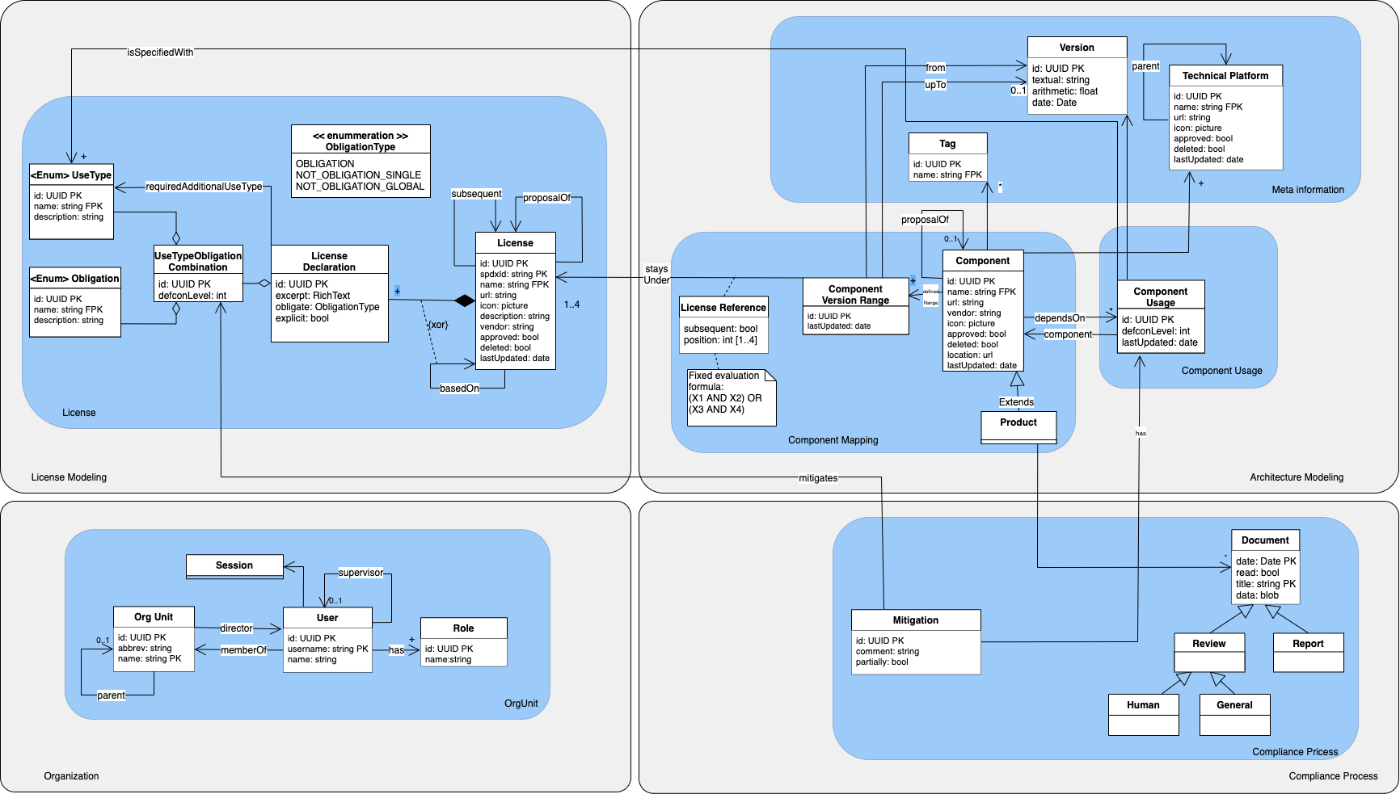

Slide 14
Outline
Motivation
Research Questions
Data model
Example
Evaluation
Outlook

Slide 15
Algorithm
Input
product which includes several component usages (component, version, usage)
Calculation
Basis: values of UseTypeObligationCombination
(X1 AND X2) OR (X3 AND X4)
Return
object which includes
a calculated value between 0 and 6
name, license information, version, use types, transitive dependencies
worst case
best case

Slide 16
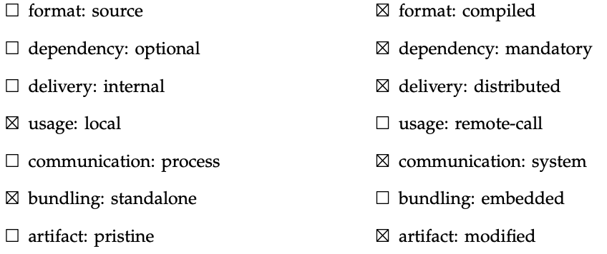
Example: “MyProduct”
Bootstrap Business Test Tree (MIT)¹
Wiremock (Apache-2.0)
jackson-annotations (Apache-2.0)
jackson-databind (Apache-2.0)
slf4j-api (MIT)
Loremipsum (MIT)
junit (EPL-1.0)
hamcrest-core (BSD-3-Clause)
jetty-server (Apache-2.0, EPL-1.0)
jetty-xml (Apache-2.0)
jetty-util-ajax (Apache-2.0)
jetty-slf4j-impl (Apache-2.0)
jetty-test-helper (Apache-2.0)
HSQLDB (HSQLDB License - based on BSD-3-Clause)
junit-jupiter-engine (EPL-1.0)
junit-jupiter-params (EPL-1.0)
jackson-annotations (Apache-2.0)
jackson-databind (Apache-2.0)
jackson-jaxrs-json-provider (Apache-2.0)
jsoup (MIT)
gson (Apache-2.0)
junit (EPL-1.0)
hamcrest-core (BSD-3-Clause)
junit (EPL-1.0)
hamcrest-core (BSD-3-Clause)
jetty-server (Apache-2.0)
jetty-servlet (Apache-2.0)
bootstrap-launcher (MIT)
mockito-core (MIT)
spring-test (Apache-2.0)
Spring Boot Tree (Apache-2.0) ¹
spring-core (Apache-2.0)
spring-icl (Apache-2.0)
spring-context (Apache-2.0)
spring-aop (Apache-2.0)
spring-beans (Apache-2.0)
spring-core (Apache-2.0)
spring-core (Apache-2.0)
spring-beans (Apache-2.0)
spring-core (Apache-2.0)
spring-expression (Apache-2.0)
1 F. Daugan. “Bootstrap Business Test » 2.8.3”. In: (2006-2020). url: https://bit.ly/ 3ha4QXP (visited on 08/18/2020). 2 Pivotal. “Spring Boot » 2.3.3.RELEASE”. In: (2006-2020). url: https://bit.ly/3iQv6XD (visited on 08/18/2020).

Slide 17
Visualization of MyProduct
file:///Users/navinalang/open-source/03-Thesis/02-Minutes/Algorithm/Treemap/index.html

Slide 18
Outline
Motivation
Research Questions
Data model
Example
Evaluation
Outlook

Slide 19
Evaluation: Interviews
Interview 1 | Legal expert of msg Legal Department.
Interview 2 | Project Manager who is currently confronted with license compliance from a customer of a big automotive manufacturer.
Interview 3 | Architect who is currently confronted with license compliance from a customer of a big automotive manufacturer.
Interview 4 | Architect who is currently confronted with license compliance from a customer of a big automotive manufacturer.
Interview 5 | Architect who usually develops individual software for the customer
Interview 6 | Architect who develops both product and individual software.
Interview 7 | Architect who develops individual software for the automotive sector.
Interview 8 | Architect who is also an OSS expert, including knowledge about licenses.

Slide 20
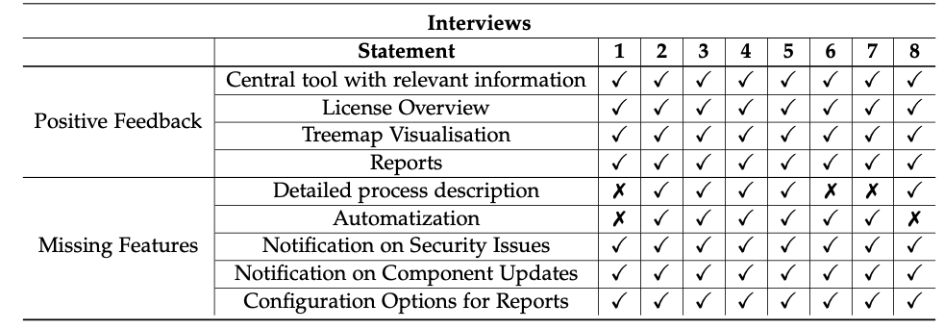
Evaluation: Results

Slide 21
Outline
Motivation
Research Questions
Research Approach
Example Case
Evaluation
Outlook

Slide 22
Outlook
Automatization
Notification on security issues
Notifications on component updates
Recommendations of components based on
security issues
GitHub likes
frequency of use
Metric for strictness of licenses
build-process integration
Common Vulnerabilities and Exposures (CVE)
National Vulnerability Database (NVD)
based on values of UseTypeObligationCombination
third-party tools
maintenance of information

Slide 23
Navina Lang

Slide 24
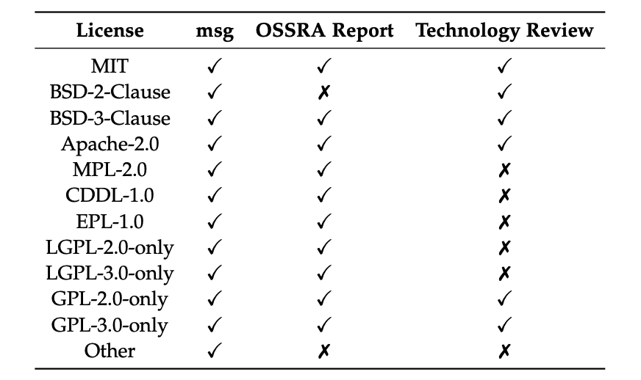
Licenses of license analysis

Slide 25
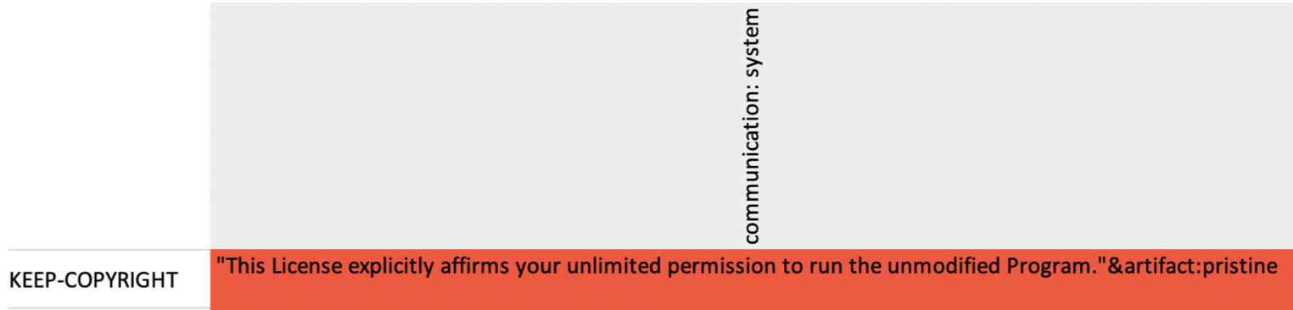
Example of license analysis (Excerpt of GNU Lesser General Public License)
use type
obligation
requiresAdditionalUseType

Slide 26
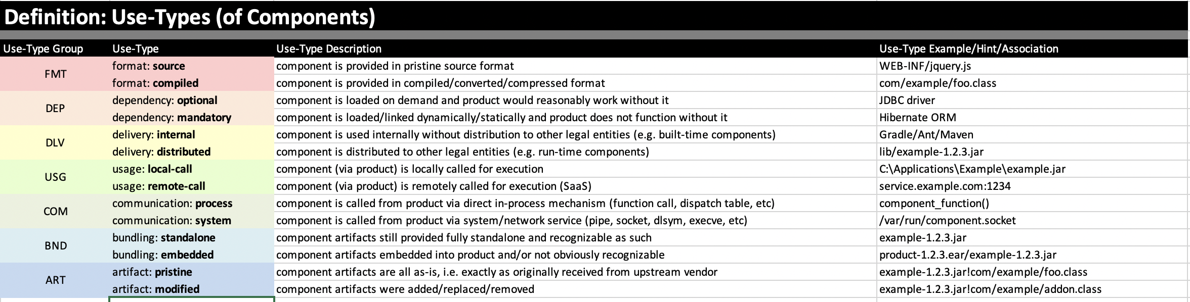
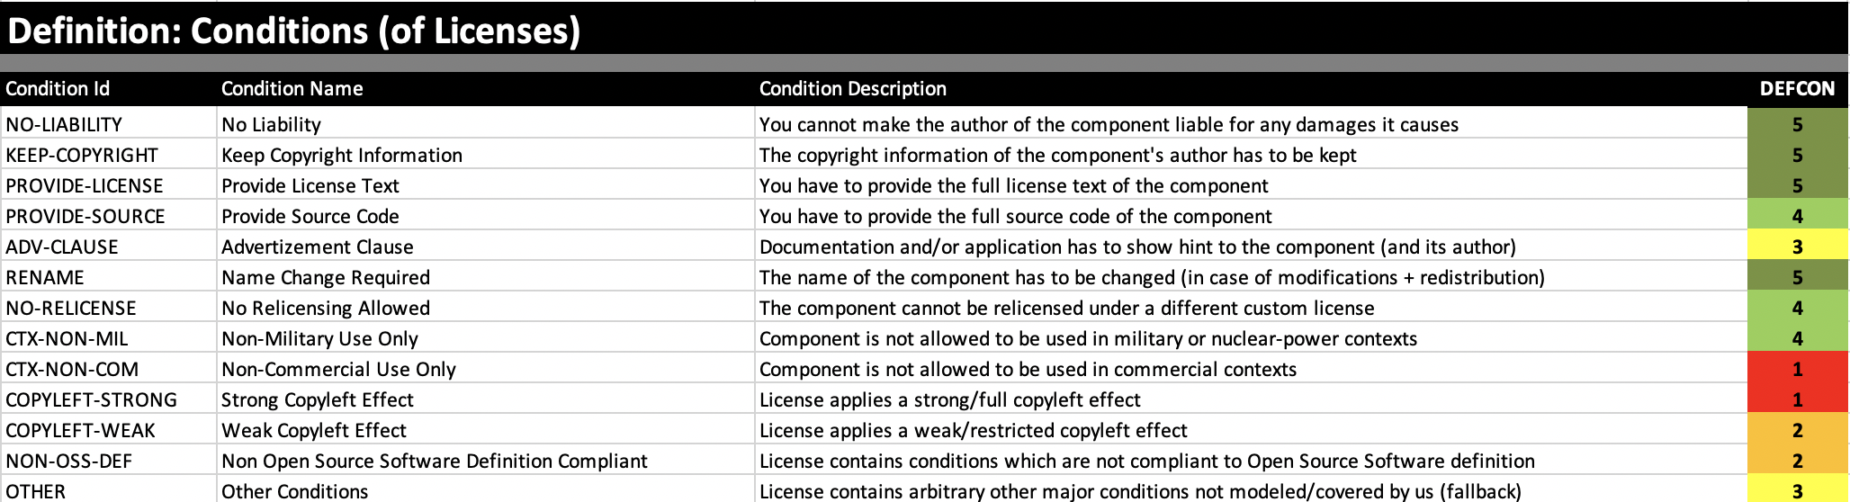
Use Types and Obligations
D. R. S. Engelschall. “ARCHITEKTUR VS. LIZENZRECHT: LIZENZKONFORME VERBAUUNG VON OPEN-SOURCE-SOFTWARE”. In: (2012).

Slide 27
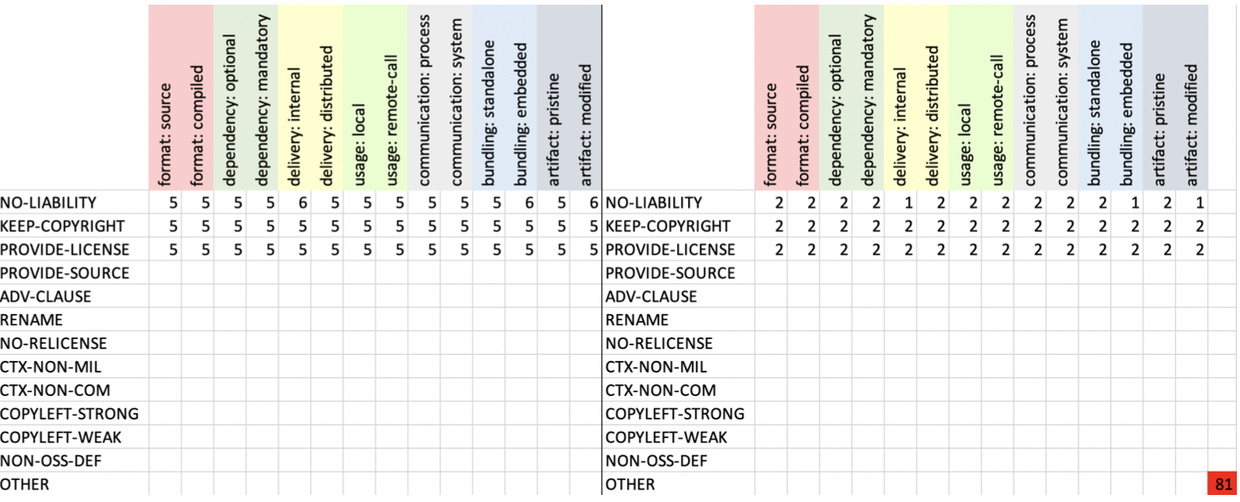
Metric for the MIT License

