Slide 1
“Identification and Evaluation of Concepts for Privacy-enhancing Big Data Analytics Using De-Identification Methods on Wrist-Worn Wearable Data”
Kevin Baumer, 02.03.2020 – Kick-off Master Thesis

Slide 2
Outline
  Motivation & Problem
  Research Questions & Approach
  Current Results
    Definitions
    Research on De-Identification methods
    Use Case
  Timeline & Next Steps

Slide 3
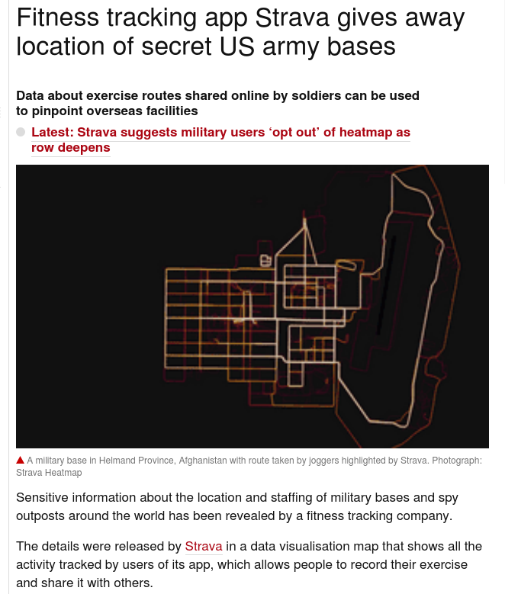




Motivation & Problem Statement
Risks & Problems:
Platform-providers (trustful?)
3rd party providers (usage / sale)
no information about storage, processing of data (despite privacy policy)
→ Disclosure of personal health information
→ Disclosure of your location data
Big Data (Analytics)
Basis for emerging technologies
Enormous growth in data
→ Analytics + Data-driven decision-making
Privacy
Increased privacy awareness
Privacy is valued (67 % → no control)¹
Maturing privacy laws (GDPR, HIPAA, BDSG)
Wrist-worn Wearable Data
Sensitive Health data
Increasing popularity (36% in Germany)²
Lots of data points
E.g. heart rates, blood oxygen saturation, location data
¹ (European Commission, 2018)
² https://de-statista-com.eaccess.ub.tum.de/statistik/daten/studie/1047586/umfrage/anteil-der-smartwatch-nutzer-in-deutschland/

Slide 4
Research Questions / Research Approach
RQ 1
What is the State of the Art of approaches using De-Identification methods for
Privacy-enhancing Big Data Analytics and how can they be distinguished from other approaches?
Extensive Literature Research
Expert interviews
(Data privacy)
Status Quo
RQ 2
What are Requirements and Trends for Privacy-enhancing Big Data Analytics of
wrist-worn Wearable Data in the Cloud (in Germany)?
Extensive Literature Research
Regulations
(GDPR, BDSG, HIPAA)
Expert interviews
Requirements
RQ 3
What are concepts enabling Data Privacy for wrist-worn Wearable Data in the Cloud based on De-Identification Methods?
Evaluation with of Approaches specified Use Case
Results of RQ 1 / RQ 2
Evaluation with Experts
Concepts

Slide 5
Privacy vs. Security – broad definition
“Privacy is the claim of individuals, groups or institutions to determine for themselves when, how, and to what extent information about them is communicated to others” (Westin, 1967)
“Data security means protecting data, such as a database, file, from destructive forces and the unwanted actions of unauthorized users.” (Mukherjee et. al, 2015)
Privacy
Security
Overlap Privacy/Security:
Confidentiality: protect information from unauthorized access and misuse
Integrity: protect information from unauthorized alteration
→ assurance in accuracy and completeness
Availability: protect timely and uninterrupted access to the system
C
I
A

Slide 6
Privacy – in more detail
Attacker- / threat-based approach of Wu (2012) and Solove (2015)
Privacy = combination of a plurality of many distinct (but related) things
Identification / characterization of relevant privacy threats necessary
Imaginary adversary who wants to accomplish a specific goal
“Privacy "[...] is defined not by what it is, but by what it is not - it is the absence of a privacy breach that defines a state of privacy." (Wu, 2012)

Slide 7
Definitions – De-Identification Methods
De-Identification
Anonymization
Pseudonymization
  Similar concepts
  But: no single agreed-upon definition and relation
Approach: (Tomashchuk et. al., 2019)
avoid the terms ‘Anonymization’ and ‘Pseudonymization’
use De-Identification as “a concept of higher level, which covers both anonymization and pseudonymization”
De-Identification method: “method for transforming a dataset with the objective of reducing the extent to which information is able to be associated with individual data principals” (ISO, 2018)
Data subject / principal: “an identifiable natural person” (GDPR)

Slide 8





De-Identification – Extensive Literature Review
Databases:
Search: methods for De-Identification, Anonymization, Pseudonymization
Source | # of methods
Domingo-Ferrer et. al (2019) | 6
Mansfield-Devine (2014) | 6
Nelson (2015) | 14
Tomashchuk (2019) | 7
DP Working Party Art. 29 (2014) | 5
Bourka, Drogkaris (2018) | 5
ISO/IEC 20889 (2018) | 16
Total
38 sources
Comprehensive overviews
7 sources

Slide 9
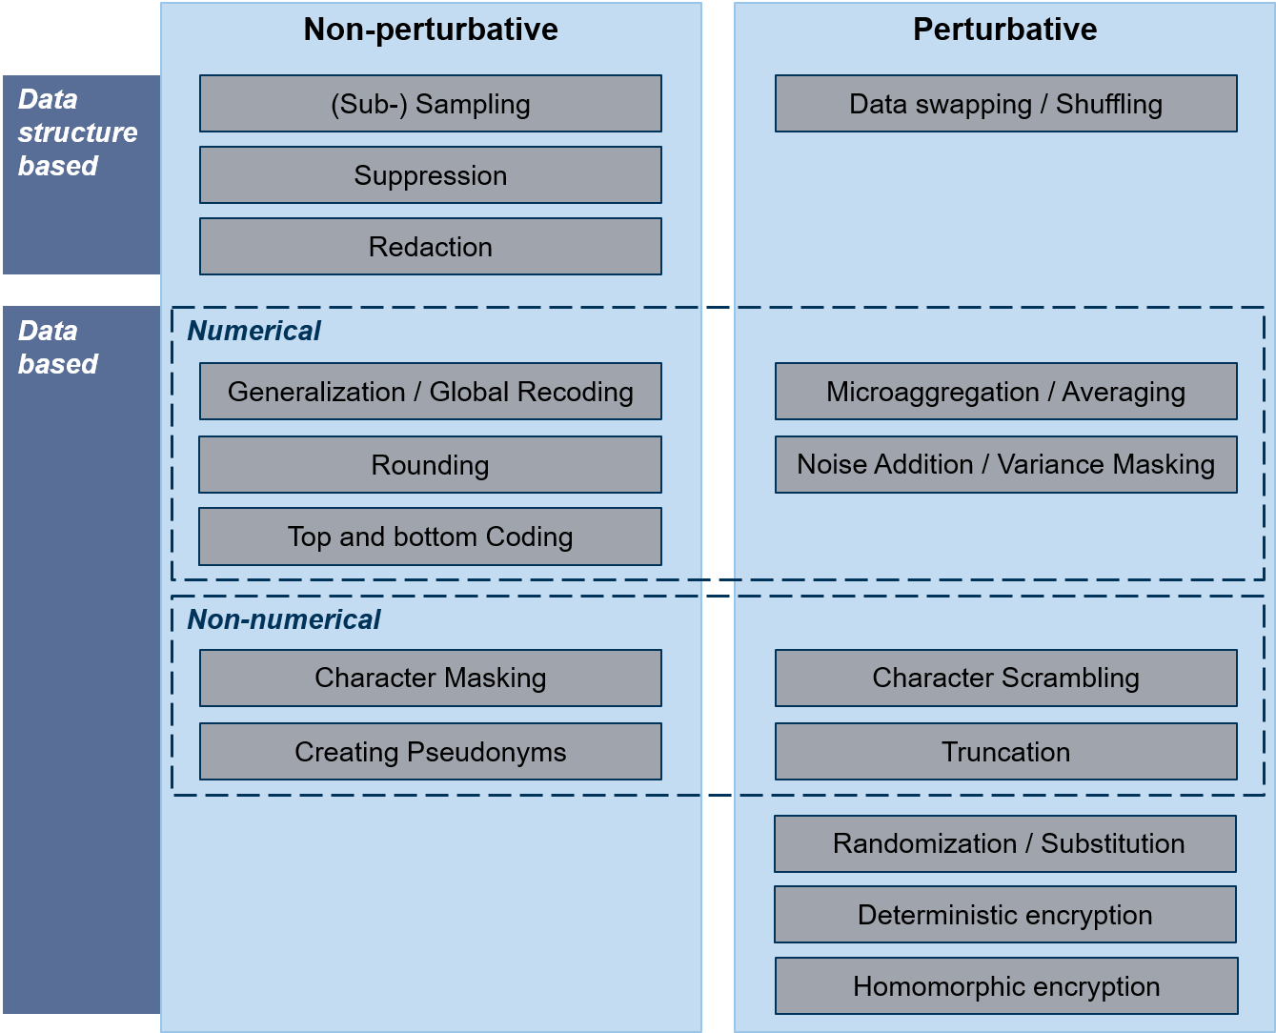
Classification of De-Identification Methods
Non-perturbative
Data stays truthful; Accuracy might be reduced
data truthfulness at the record level
Perturbative
Masked values not truthful in general; statistical properties may be preserved

Slide 10
Data-flow diagram (DFD) of the “wrist-worn wearable” Use Case
User
Wearable
Entity
Trust Boundary
Process
Platform & Service
Data store
Data flow
Provider Database
Trust boundary

Slide 11
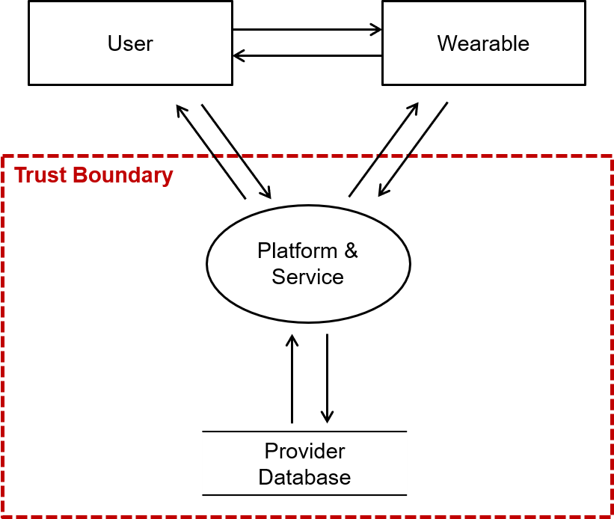
Potential privacy threats mapped to the DFD (LINDDUN methodology)
 | Threat target
Data Store | Provider Database
Data flow | User data stream (user-wearable)
 | Platform data stream (user-platform)
 | Wearable data stream (wearable-platform)
 | DB data stream (platform-DB)
Process | Platform & Service
Entity | User
 | Wearable

Slide 12
Potential privacy threats mapped to the DFD (LINDDUN methodology)
 | Threat target
Data Store | Provider Database
Data flow | User data stream (user-wearable)
 | Platform data stream (user-platform)
 | Wearable data stream (wearable-platform)
 | DB data stream (platform-DB)
Process | Platform & Service
Entity | User
 | Wearable
L | I | N | D | D | U | N
Linkability
Identifiability
Non-repudiation
Detectability
Information Disclosure
Content Unawareness
Policy and consent Non-compliance

Slide 13
Potential privacy threats mapped to the DFD (LINDDUN methodology)
 | Threat target | L | I | N | D | D | U | N
Data Store | Provider Database | X | X | X | X | X |  | X
Data flow | User data stream (user-wearable) | X | X | X | X | X
 | Platform data stream (user-platform) | X | X | X | X | X
 | Wearable data stream (wearable-platform) | X | X | X | X | X
 | DB data stream (platform-DB) | X | X | X | X | X
Process | Platform & Service | X | X | X | X | X
Entity | User | X | X |  |  |  | X
 | Wearable | X | X |  |  |  | X
Linkability
Identifiability
Non-repudiation
Detectability
Information Disclosure
Content Unawareness
Policy and consent Non-compliance

Slide 14
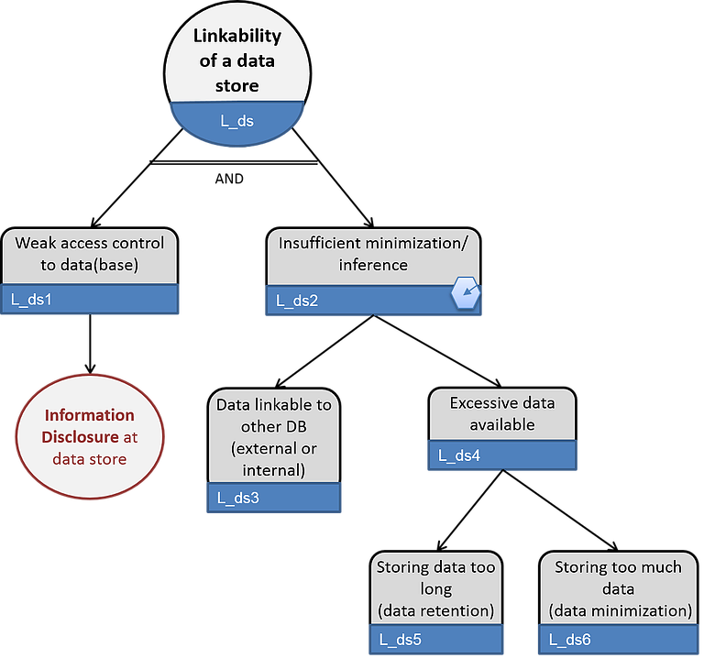
Threat tree (1): Linkability of data store (Provider database)

Slide 15
Potential privacy threats mapped to the DFD (LINDDUN methodology)
 | Threat target | L | I | N | D | D | U | N
Data Store | Provider Database | X | X | X | X | X |  | X
Data flow | User data stream (user-wearable) | X | X | X | X | X
 | Platform data stream (user-platform) | X | X | X | X | X
 | Wearable data stream (wearable-platform) | X | X | X | X | X
 | DB data stream (platform-DB) | X | X | X | X | X
Process | Platform & Service | X | X | X | X | X
Entity | User | X | X |  |  |  | X
 | Wearable | X | X |  |  |  | X
Linkability of two or more items of interest (IOIs, e.g. subjects, messages) allows an attacker to sufficiently distinguish whether these IOTs are related or not within the system
Identifiability of a subject means that the attacker can sufficiently identify the subject associated to an IOI, for instance the sender of a message → Identifiability is a special case of Linkability when a subject and its attributes are involved

Slide 16
Use Case / Dataset of wrist-worn Wearable data (1)
Basis: Complete data export from Garmin, Apple Watch, Fitbit
Benefits: Detailed insights into which wearable information is stored, how it is formatted
Result: Derivation of a generic “wrist-worn wearable data model”
Social Profile Data
Gear Data
User Data
Heart Rate Data
Sleep Movement Data
Activity Data
ECG Data
Step Data
Activity Trackpoint Data
Master Data
Raw Sensor Data

Slide 17
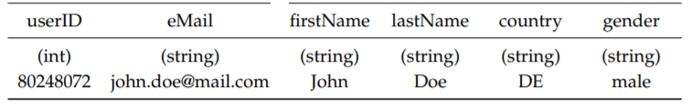
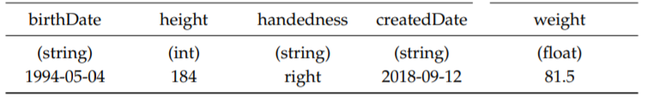
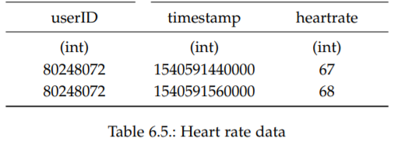
Use Case / Dataset of wrist-worn Wearable data (2)
User Data Table:
Heart Rate Data Table:

Slide 18
Next Steps
Literature Review
→ Direct / quasi identifiers, sensitive attributes
→ Regulations (e.g. HIPAA, GDPR, others)
wrist-worn wearable specific threats
Prepare & Conduct Interviews (Data Privacy Experts)
→ How can identifiable & sensitive information be classified and evaluated?
→ How to evaluate possible risks regarding sensitive data?
→ When can mitigation strategies be rated as sufficient?
Concept Development
Evaluate privacy based on privacy models (k-anonymity, l-diversity)
Identify ways to measure remaining Utility of data

Slide 19
Timeline
Dec
Jan
Feb
Mar
Apr
May
Jun
Jul
Activity
51
52
01
02
03
04
05
06
07
08
09
10
11
12
13
14
15
16
17
18
19
20
21
22
23
24
25
26
27
28
29
30
31
Start / Submission Date
Start
7/15/2020
Use-Case Definition
Literature Review
Interviews
(Prepare + Conduct)
RQ 1 / 2
Concept Development
Thesis-Writing
Thesis-Review

Slide 20
Kevin Baumer
17132
matthes@in.tum.de

